Slide 1

Society of Air Force Pharmacy
Mid-Year Conference
16 -18 June 2025
Hilton Norfolk The Main Norfolk, VA

Slide 2
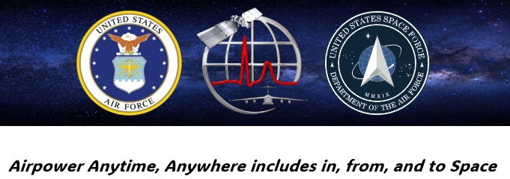
Space Force Medicine 101
Because…
Presented by: Lt Col Kate Heathcote

Slide 3
Disclosure
Katherine J. Heathcote: “Declare(s) no conflicts of interest, real or apparent, and no financial interests in any company, product, or service mentioned in this program, including grants, employment, gifts, stock holdings, and honoraria.”

Slide 4
Learning Objectives
Familiarize medical personnel with the structure of the US Space Force
Introduction of SPAFORGEN and its differences from AFFORGEN
Identify Guardians’ most significant medical needs and challenges
Demonstrate the disconnect between USSF needs and AFMS capability
Consider potential roles for pharmacy in ground- and space-based support for the Aerospace Medicine Enterprise and space domains.

Slide 5
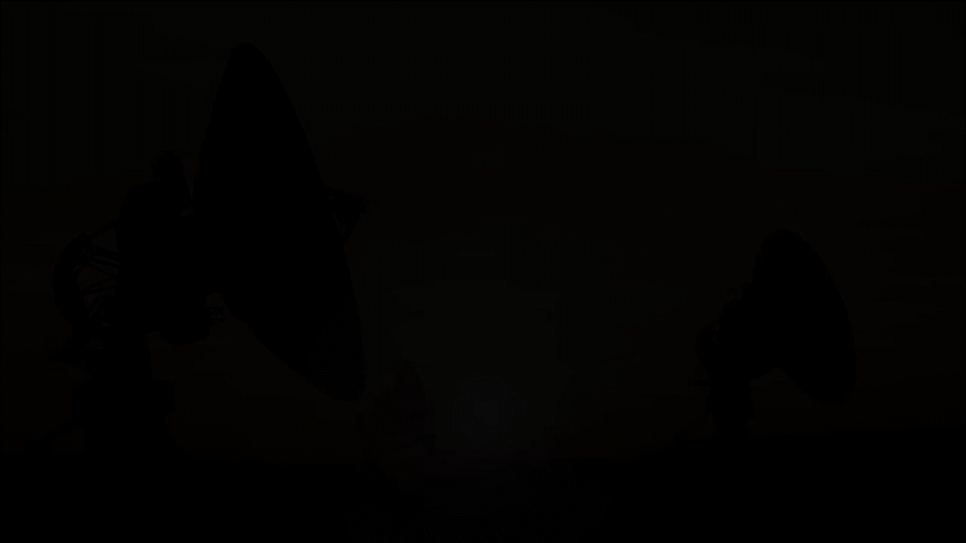
Medical Services are Vital to Space Operations
The AFMS readies the Guardian warfighters who must be
medically ready, reliable, and capable.
-Supporting human space flight, contingencies, and rescue
-Collaborating with industry and academic leaders
-Training the next generation of Aerospace Medicine experts
-Driving research and innovation in Human Performance and Systems Integration

Slide 6
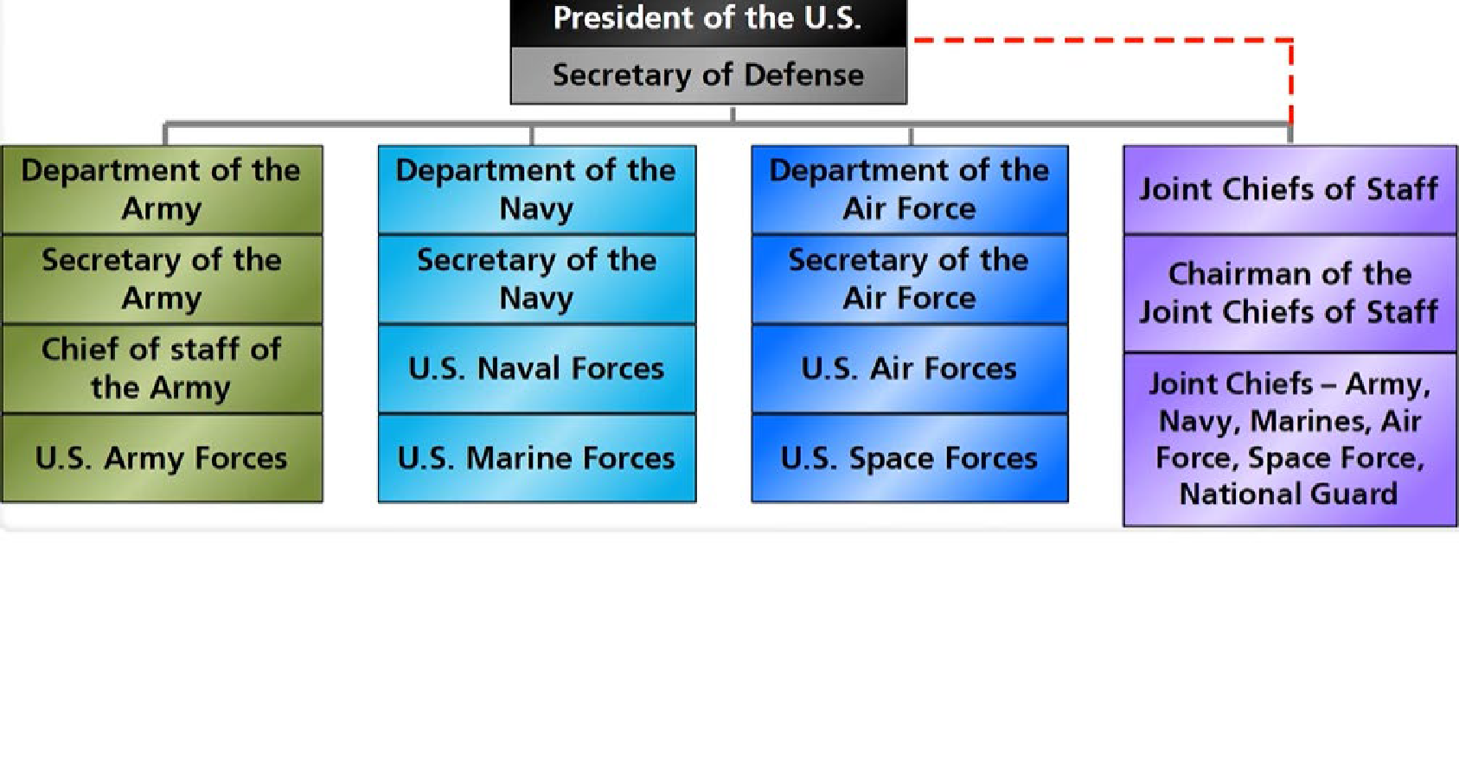


Review: Department of Defense Structure
Unified Combatant Commands
US Africa Command US Central Command
US European Command US Indo-Pacific Command US Northern Command US Southern Command US Cyber Command
US Special Ops Command US Strategic Command
US Transportation Command
Established 20 Dec 2019
Established 19 Aug 2019
and…
US Space Command (USSPACECOM)

Slide 7
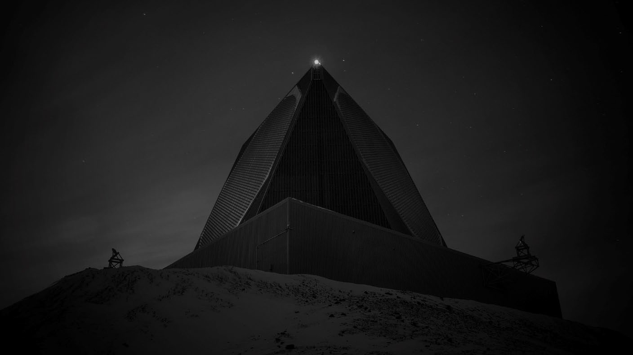












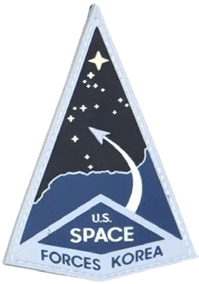

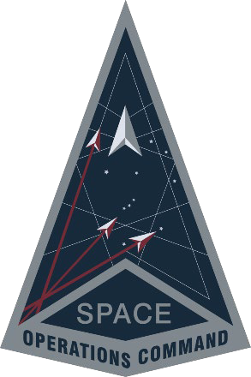













































Space Warfighting Architecture
Secretary of Defense
Secretary of the Air Force
United States Space Command
USASMDC
NavSpace
MARFORSPACE
AFSPACE
Chief of Space Operations
Chief of Staff of the Air Force
Service Components
Field Commands
Joint Functional Component Command for Integrated Missile Defense
Service Component CC &
Combined Joint Space Force Component Commander
16th Air Force
Space Forces -
Space Operations Command
Space Systems Command
Space Training and Readiness Command
Space
COMBAT DEL 5
COMBAT DEL 15
SBD 3 SLD 30 SLD 45
PNT SYD EW SYD
DEL 1
DEL 10 DEL 11 DEL 12 DEL 13
SBD 1
SBD 2
DEL 2
DEL 3
DEL 4
DEL 5* DEL 6 DEL 7 DEL 8
DEL 9 DEL 15* PNT DEL
(Provisional)
Joint Nav Warfare Center
Joint OPIR Center
Missile Warning Center
Combined Space Operations Center
National Space Defense Center
SBD – Space Base Delta DEL – Space Delta
SQ – Squadron DET – Detachment
SLD – Space Launch Delta SYD – System Delta
USASMDC – US Army Space Missiles Defense Command
NavSpace - Navy Space Command MARFORSPACE - Marine Corps Forces Space Command
AFSPACE - Air Forces Space
COMBAT COMBAT COMBAT COMBAT COMBAT COMBAT COMBAT
SQs DETs SQs SQs/DETs SQs/DETs SQs SQs/DETs
COMBAT SQ
PNT – Position Navigation Timing OPIR – Overhead Persistent EW – Electronic Warfare Infrared
*DELs 5 & 15 are presented as Combat DELs 5 & 15 to USSPACECOM/S4S
7

Slide 8
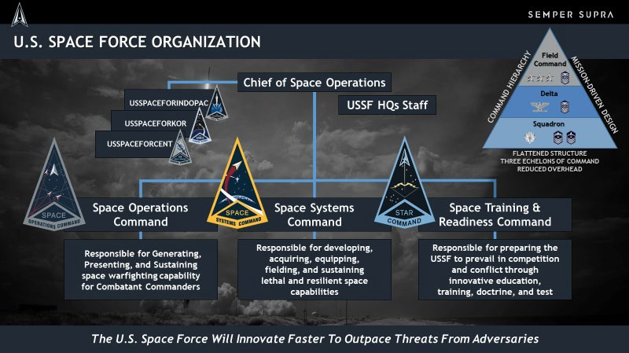
Examples of Space Forces presented as Service Components abroad.

Slide 9






Self-Assessment Question #1
US Space Force is the newest military service branch our country has established. How long has it been since any other service branch was establish? (i.e. What was the age gap between Space Force (the youngest service branch) and its next older sibling (second youngest)?
  72 years
  15 years
  240 years
  53 years

Slide 10
Self-Assessment Question #1
1. US Space Force is the newest military service branch our country has established. How long has it been since any other service branch was establish? (i.e. What was the age gap between Space Force (the youngest service branch) and its next older sibling (second youngest)?
A. 72 years
In 1947 the USAF was the last service branch
B. 15 years
C. 240 years
D. 53 years
established prior to the USSF, in 2019.

Slide 11
Self-Assessment Question #2
1. What symbol can be used to represent this relationship:
USSPACECOM is … to USSF
A. <
B. ≈
C. >
D. ≠
E. ∑

Slide 12
Self-Assessment Question #2
1. What symbol can be used to represent this relationship:
USSPACECOM is … to USSF
A. <
B. ≈
C. >
D. ≠
E. ∑

Slide 13
Self-Assessment Question #3
1. Match the FLDCOM/C-FLDCOM with their appropriate mission:
STARCOM
SSC
SpOC
S4S
Acquisitions & Space Launch Oversight
Represents USSF in Joint Ops & COCOMs
Training, Test, and Wargaming
Force generation & Operational activities

Slide 14
Self-Assessment Question #3
1. Match the FLDCOM/C-FLDCOM with their appropriate mission:
STARCOM
SSC
SpOC
S4S
Acquisitions & Space Launch Oversight
USSF support of Joint Ops & USSPACECOM
Training, Test, and Wargaming
Force generation & Operational activities
Bonus points if you can recall each of their identifiable colors:
STARCOM, SSC, SpOC, S4S

Slide 15
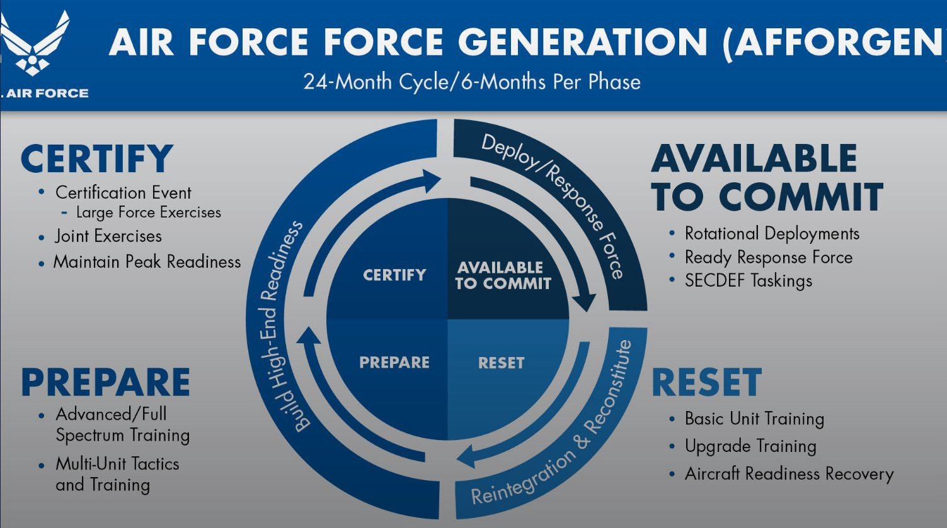

Slide 16
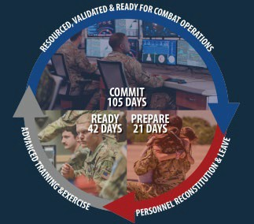

Introduction to the SPAFORGEN model
Space Force Generation model – allows for presentation of forces to combatant commands
Many Space operations (though not all) are conducted while ‘EIP’
SPAFORGEN cycle is 168 days, allowing up to 7 months per year in the ‘Commit’ phase
Voice of Maj Clinton Emry, Branch Chief, SPAFORGEN

Slide 17
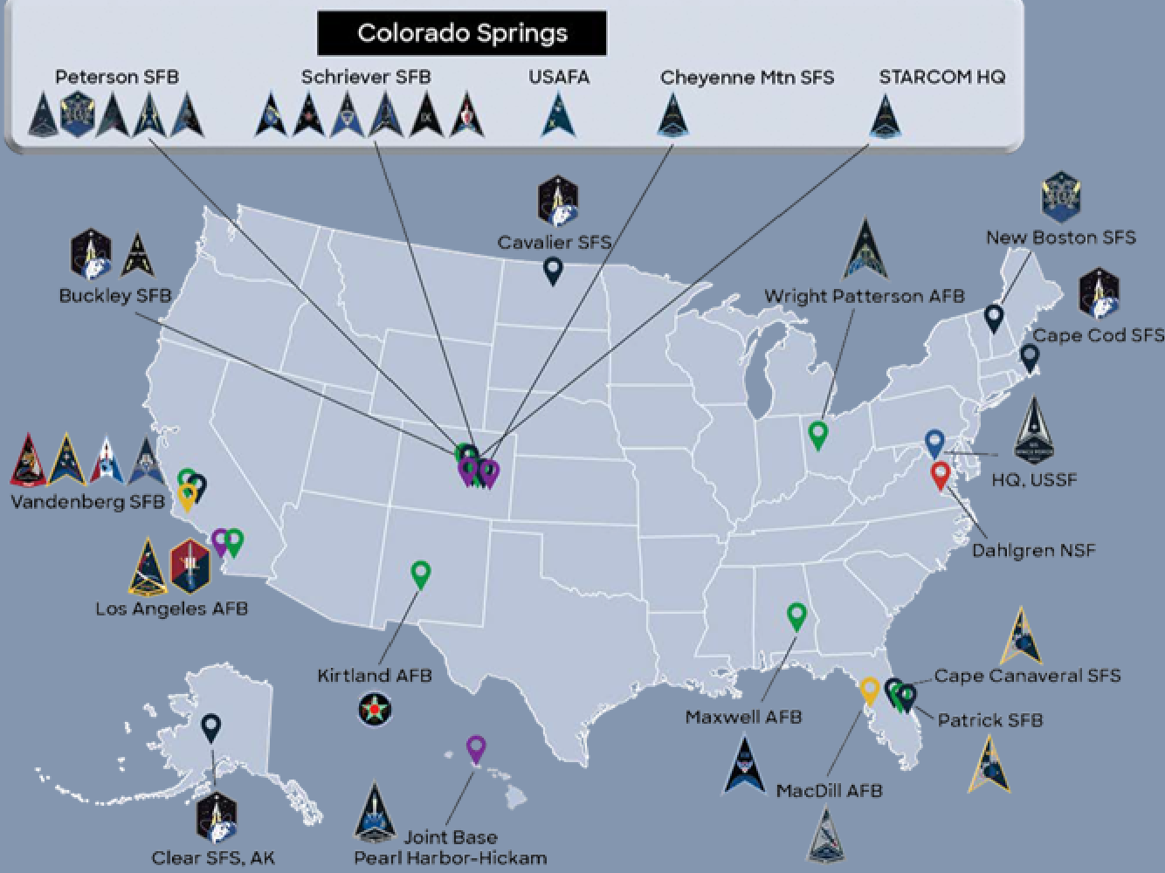
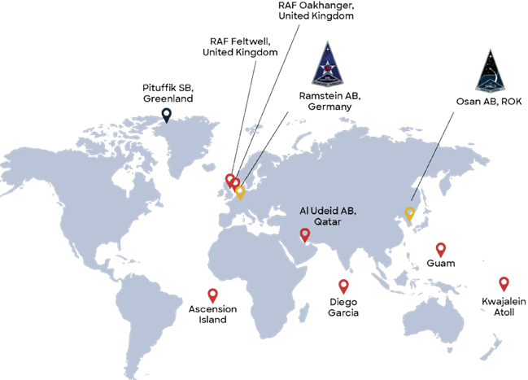
Guardians are Everywhere

Slide 18
Medical challenges identified by USSF
Based on what you’ve heard, can you guess what are the most common medical challenges that Guardians encounter?
As reported by 21 CC’s and 38 SELs from all FLDCOMs:
  67% Timely access to care – Especially while EiP (46%), on shift work (56%), or at remote duty stations (33%)
  20% Sleep disturbances with frequent fatigue and focus/attention challenges
  14% Mental Health concerns
  13% IMR delinquencies
  12% Chronic pain – neck, back, or joint

Slide 19
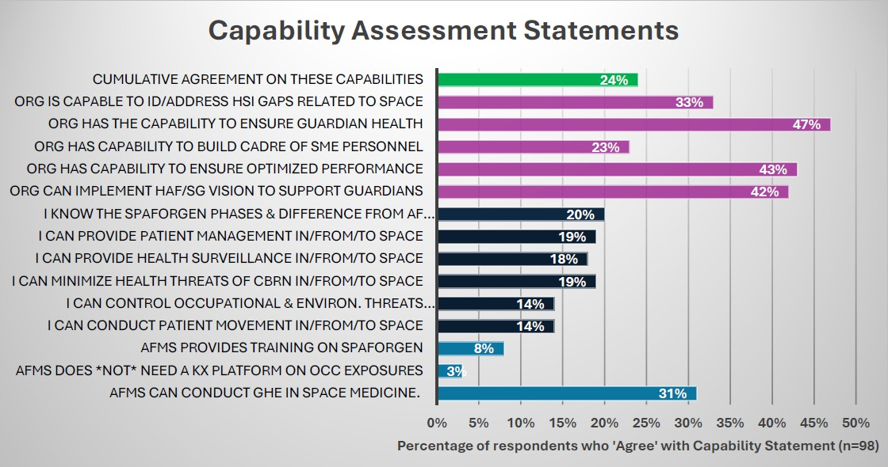
AFMS challenges when supporting USSF

Slide 20
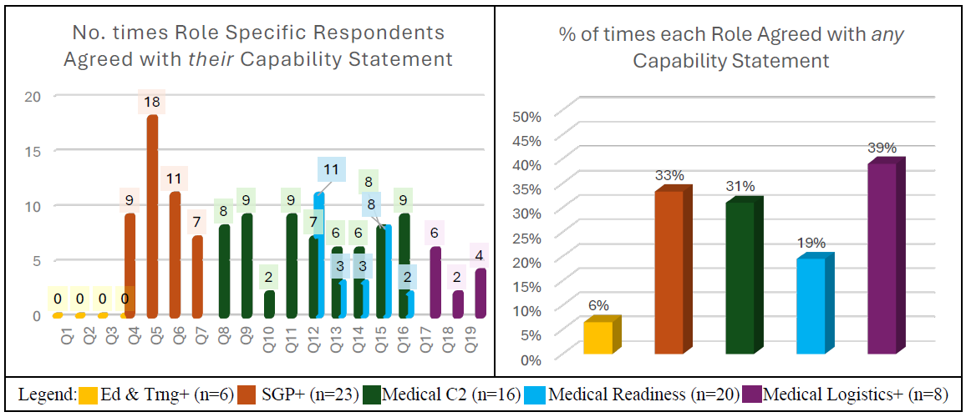
AFMS Challenges when supporting USSF

Slide 21
Countermeasures
Holistic Health Approach (HHA) and Guardian Resilience Teams (GRT)
  HH Integrator, Strength & Conditioning Specialist, Mental Health Provider, Physical Therapist, HH Educator (at GSU locations)
AF/SGSF – Medical Operations for the USSF Directorate
  Policy development
  Occupational Health Analysis
  PRAP-like program establishment
  SME development tracks and SEI opportunities
  Collaboration with partner agencies
AFMEDCOM MRC-B Div Chief, Space Support
Appropriate security clearances for providers

Slide 22
Self-Assessment Question #4
How long is the SPAFORGEN cycle?
  2 years
  24 weeks
  105 days
  6 weeks

Slide 23
Self-Assessment Question #4
How long is the SPAFORGEN cycle?
  2 years
  24 weeks – or 6 months
  105 days
  6 weeks

Slide 24
Self-Assessment Question #5
1. Aside from access to care challenges, what is the top medical condition/concern reported by Guardians?
- Sleep Disturbances

Slide 25
Potential pharmacy roles?
Ground-based considerations:
  Counseling recommendations to minimize sedating or psycho- active medications
  Timely delivery of services
  Space-related incidents during launch or recovery missions
  Provisioning of med kits
  Collaborative research opportunities with NASA
Space-based considerations:
  Increasing diversity and duration of HSF
  Logistical coordination needs for transport and sustained drug stability in space environments
  Familiarity with physiological changes that can occur (in human and microorganisms)
  Treating post-flight side effects and experiences

Slide 26
Self-Assessment Question #6
What is a known physiological change that occurs in micro-gravity environments?
  Fluid redistribution
  Antibiotic resistance
  Motion sickness
  Accelerated bone loss
  All of the above
  None of the above

Slide 27
Self-Assessment Question #6
What is a known physiological change that occurs in micro-gravity environments?
  Fluid redistribution
  Antibiotic resistance
  Motion sickness
  Accelerated bone loss
  All of the above
  None of the above

Slide 28
Self-Assessment Question #7
1. In 2017, how many medications were included in the International Space Station’s formulary?
107

Slide 29
Summary
Our ability to support Guardian is crucial to their readiness and warfighting capability.
Guardians are everywhere, with the smallest service, and a critical 24/7 mission that impacts our entire way of life; from using our credit cards, and processing prescriptions, to supporting COCOM around the world.
Space Force is projected to continue growing and with it more opportunities to support their mission while developing unique clinical expertise.
Anytime, anywhere includes in, from, and to Space!

Slide 30
Questions?
katherine.j.heathcote.mil@health.mil IMA & Special Project Officer Office of the Surgeon General Medical Operations for the USSF

Slide 31
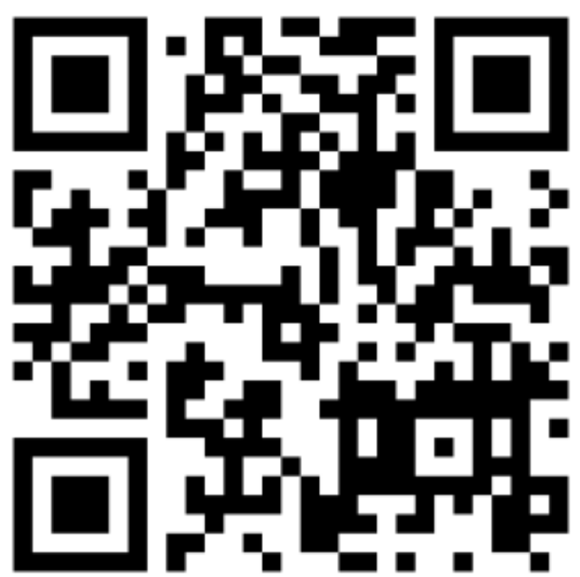
Continuing Education Credit
Deadline to obtain CE 5 Aug 2025

