Slide 1
Sourcing Techniques for Success
Francisco Boral, Lt Col, USAF, BSC
Charles “Josh” Stallings, Lt Col, USAF, BSC

Slide 2
Disclosure
The speakers declare no conflicts of interest, real or apparent, and no financial interests in any company, product, or service mentioned in this program, including grants, employment, gifts, stock holdings, and honoraria.

Slide 3
Learning Objectives
Describe the best practices for sourcing pharmaceuticals
Discuss prime vendor program
Discuss the benefits of career broadening programs
Familiarization with National Contract Compliance, Medical Master Catalog, Prime Vendor Ordering

Slide 4
Self-Assessment Question #1
What organization does CPOC fall under?
  Defense Health Agency
  Defense Logistics Agency
  Department of Health and Human Services
  Department of Veterans Affairs

Slide 5
Self-Assessment Question #2
What is the most accurate source for current on-hand supply of a medication?
  DAPA Manager
  Medical Master Catalog
  Prime Vendor Catalog
  DMLSS

Slide 6
Self-Assessment Question #3
What is the best source for locating alternate NDCs of a product?
  DAPA Manager
  Medical Master Catalog
  Prime Vendor Catalog
  DMLSS

Slide 7
Strategic Relationships
Defense Health Agency (DHA) Pharmacy Operations Division
  DoD P&T Committee, Home Delivery (TMOP), UF BPAs
DoD Pharmacy and Medical Logistics Consultants
  MTFs, Fleet, readiness rqmts, pricing, metrics, credits and data analysis
Department of Veterans Affairs (DVA)
  Joint pharmaceutical national contracts, Federal Supply Schedule
Industry Partners; Manufacturers/suppliers and wholesalers
  Product availability, sales data, gov’t pricing, TAA compliance, shortages
Other Federal Agencies; FDA, DEA, USPHS, CDC
  Drug Shortages, Recalls, Controlled Substances, stockpiles

Slide 8
Customer Pharmacy Operations Center
Drug Shortages
Monthly Sales Reviews
Industry Liaison
Reverse Distribution Guidance
General Logistical Questions
MTF Liaison into DLA Troop Support
Advisor to multiple DHA and Corp Specific working groups
National Strategy Initiatives – Pharm SCRMWG, NATO MPUG

Slide 9
Customer Pharmacy Operations Center
What CPOC is:
What CPOC is not:
Advisors
Contracting (technical review)
Logistical Guidance
Optimizers
Strategic Analytics
Access Granters
Credit Manager
Reverse Distribution
OCONUS controlled substances
Depot/Distributor
B2G/NCCR Police
Clinical Decision Makers
Transporters
Requirement generators

Slide 10
Sourcing
PPV = Pharmaceutical Prime Vendor = Wholesalers
  Provide government contracted drugs directly to Military Treatment Facilities (MTF) and eligible customers based on region
  Primary (PVP) are Cencora, Dakota Drug (Upper Prairie Region), and Cardinal (Navy Fleets)
  Secondary (PV2) is DMS for all regions
NPV = National Prime Vendor
  TRICARE Home Delivery Program
  New NPV is Cencora (Prev. McKesson)
Med/Surg PPV = Medical/Surgical Prime Vendor
  Cardinal
  Owen & Minor
ECAT = Electronic catalog
  An online ordering, distribution, and payment system providing access to laboratory, dental, optical and misc. medical/surgical items not available through PPV or Med/Surg PPV
DVD = Direct Vendor Delivery MILSTRIP = Military Standard Requisitioning and Issue Procedure
  A uniform procedure established by DoD to govern the requisition and issue of material within standardized priorities
Placing an order: PVP -> PV2 then other programs
Note: Government Purchase Credit Card is NOT a DLA source of supply

Slide 11
Primary (PPV1) vs. Secondary (PPV2)
Primary - Current
(Fill or Kill Requirement)
Cencora – MTFs, OCONUS
Cardinal – CONUS Navy Ships
Dakota Drug – Upper Prairie Region
Cencora – Tricare Mail Order Pharmacy
Primary - Upcoming
(Fill or Kill Requirement)
Cencora – MTFs
Cardinal – CONUS and OCONUS Navy Ships (except Hawaii)
Dakota Drug – Upper Prairie Region
Cencora – Tricare Mail Order Pharmacy
  Secondary
  Second option for all regions or users. No Fill or Kill requirement.
  OCONUS – used to order temperature-controlled items and controlled substances
  ALL mixed handling pharmaceuticals going OCONUS must be procured via PV2 (DMS Pharmaceuticals)
  DMS only items (List may change greatly with new generation of contact due to changes to specialty medications)

Slide 12
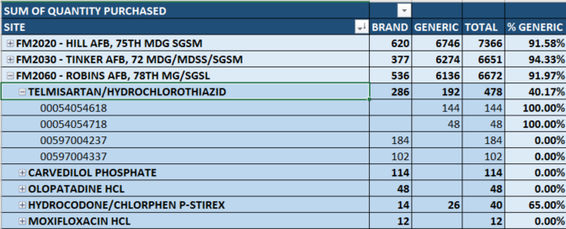
Brand To Generic Report
DHA Goal is 90%

Slide 13
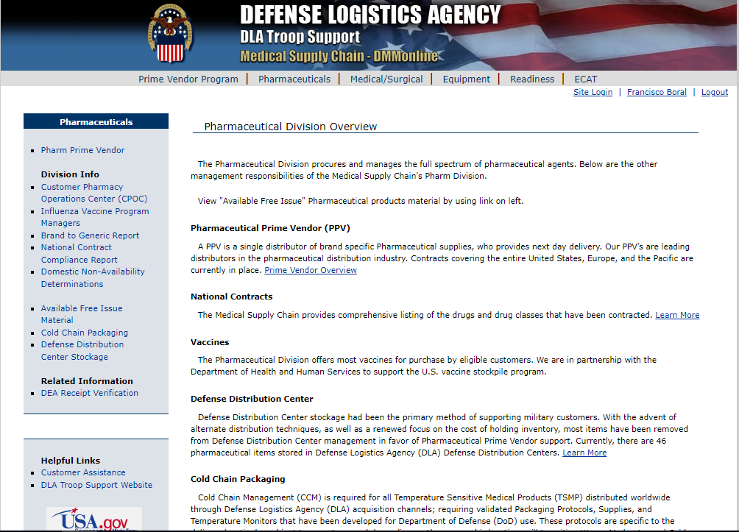
DMM Online
DLA tools that support strategic sourcing
Register via https://www.medical.dla.mil
Pharmaceutical PV Contracts
Business Intelligence Reporting
  National Contracts Compliance Reports
Medical Master Catalog
Vaccines
Cold Chain Packaging
Reverse Distribution

Slide 14
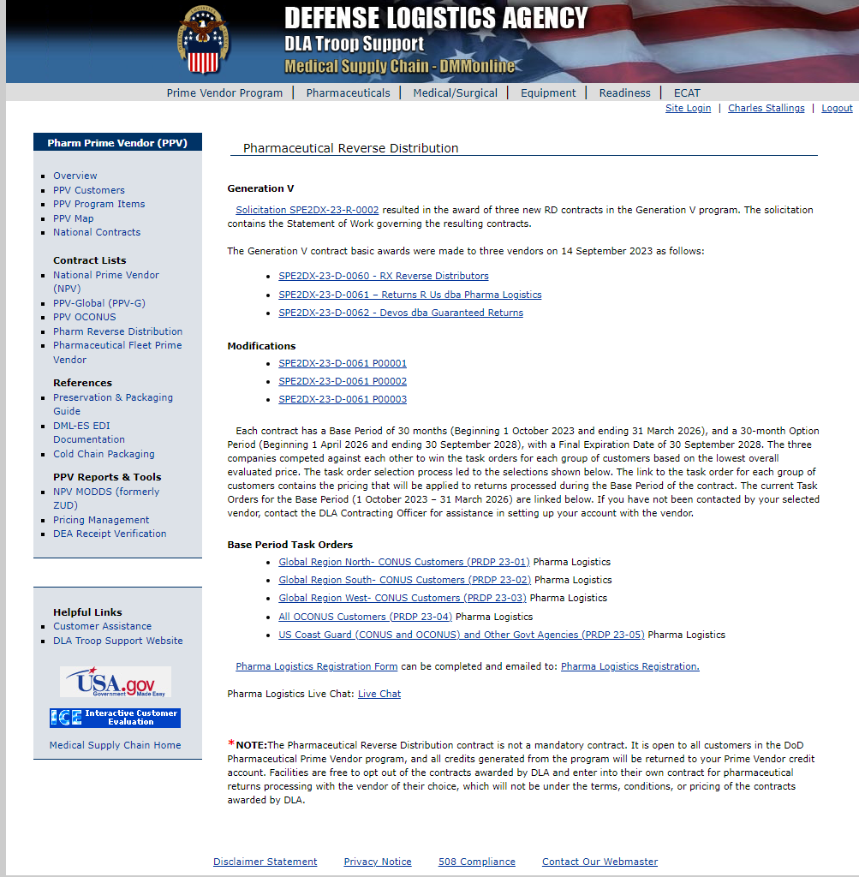
Reverse Distribution
Not:
  a mandatory contract
  a destruction contract
Eligible items
  Purchased through Prime Vendor Program
  Within 120 days of expiration
    No more than 11 months past for CONUS and 9 months past for OCONUS
  In the manufacturers original packaging
  Not an CBRN/BWCW, SLEP, or MEDSURG item
  Not damaged
    Note: Recalls do not supersede these guidelines. Items pulled from your shelves for any reason outside of the 120-day window will either need to be held until the window or disposed of through a destruction/disposal contract.

Slide 15
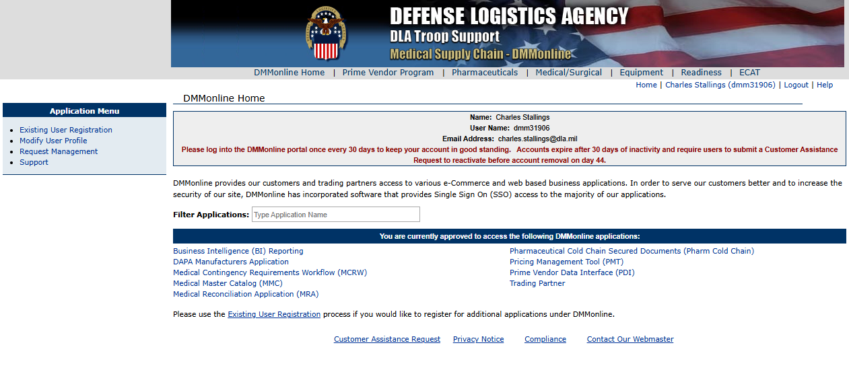
DMM Online
https://www.medical.dla.mil

Slide 16
Terms – Pricing Agreements
National Contract (NC) = Joint National contract (JNC)
  VA or DLA generated
  Open for bid
  Price based on potential supply commitment from vendor
  Clause for reimbursement when items are unavailable (R4 rejections)
Distribution and Pricing Agreement (DAPA)
  DLA generated
  2-week process, gateway agreement
  DoD’s version of FSS
  Example: Bicillin LA
Uniform Formulary Blanket Purchase Agreement (UF BPA)
  DHA generated cost agreement based upon pricing concessions for DoD formulary placement
  Example: Humira

Slide 17
National Contract Compliance Report
Military Medical Treatment Facility Pharmacy Operations - DHA-PI 6025.31 December 20, 2019 , pg 10
(7) MTF Pharmacy Chiefs will ensure compliance with national pharmacy contracts and “Brand to Generic” conversions established by The Defense Logistics Agency in conjunction with the Chief, DHA, POD and the DoD P&T Committee. MTF directors will not permit prescribers or pharmacy industry initiatives to supplant or circumvent contract requirements. Only medications which have been approved by the Food and Drug Administration (FDA) are authorized for use in MTFs except for investigational use.
DHA goal of 90%
Document in P&T off contract purchases
  Not available
  Package size for efficient workflow – critical analysis is allowed

Slide 18
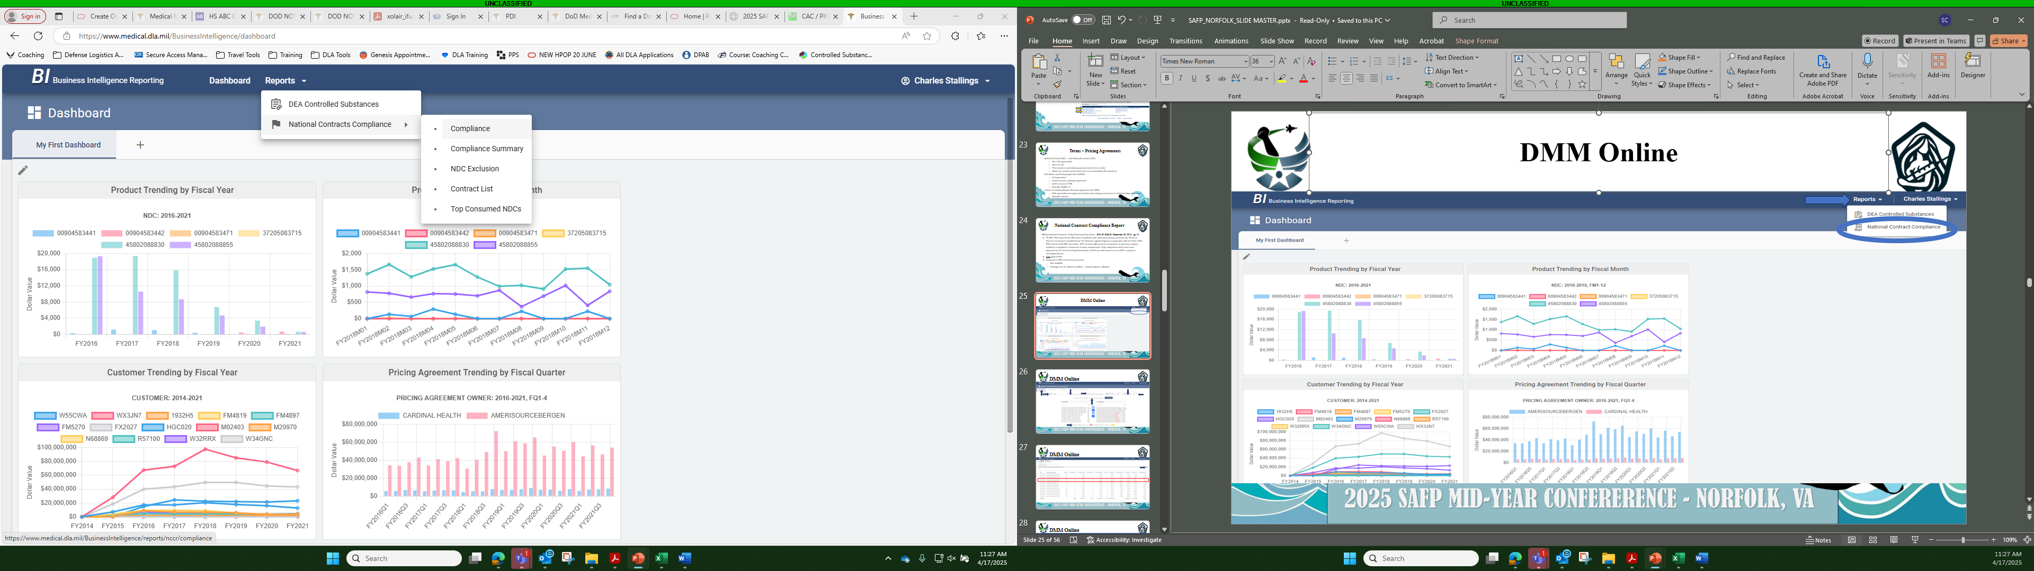
DMM Online

Slide 19
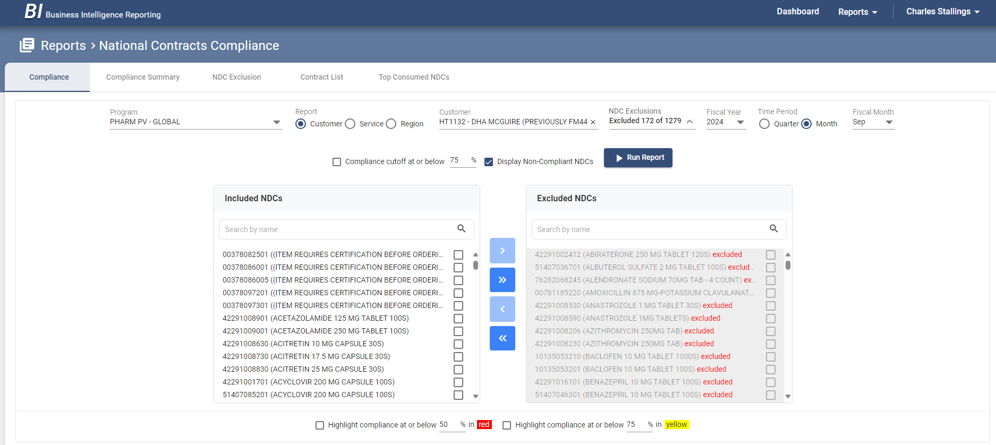
DMM Online

Slide 20
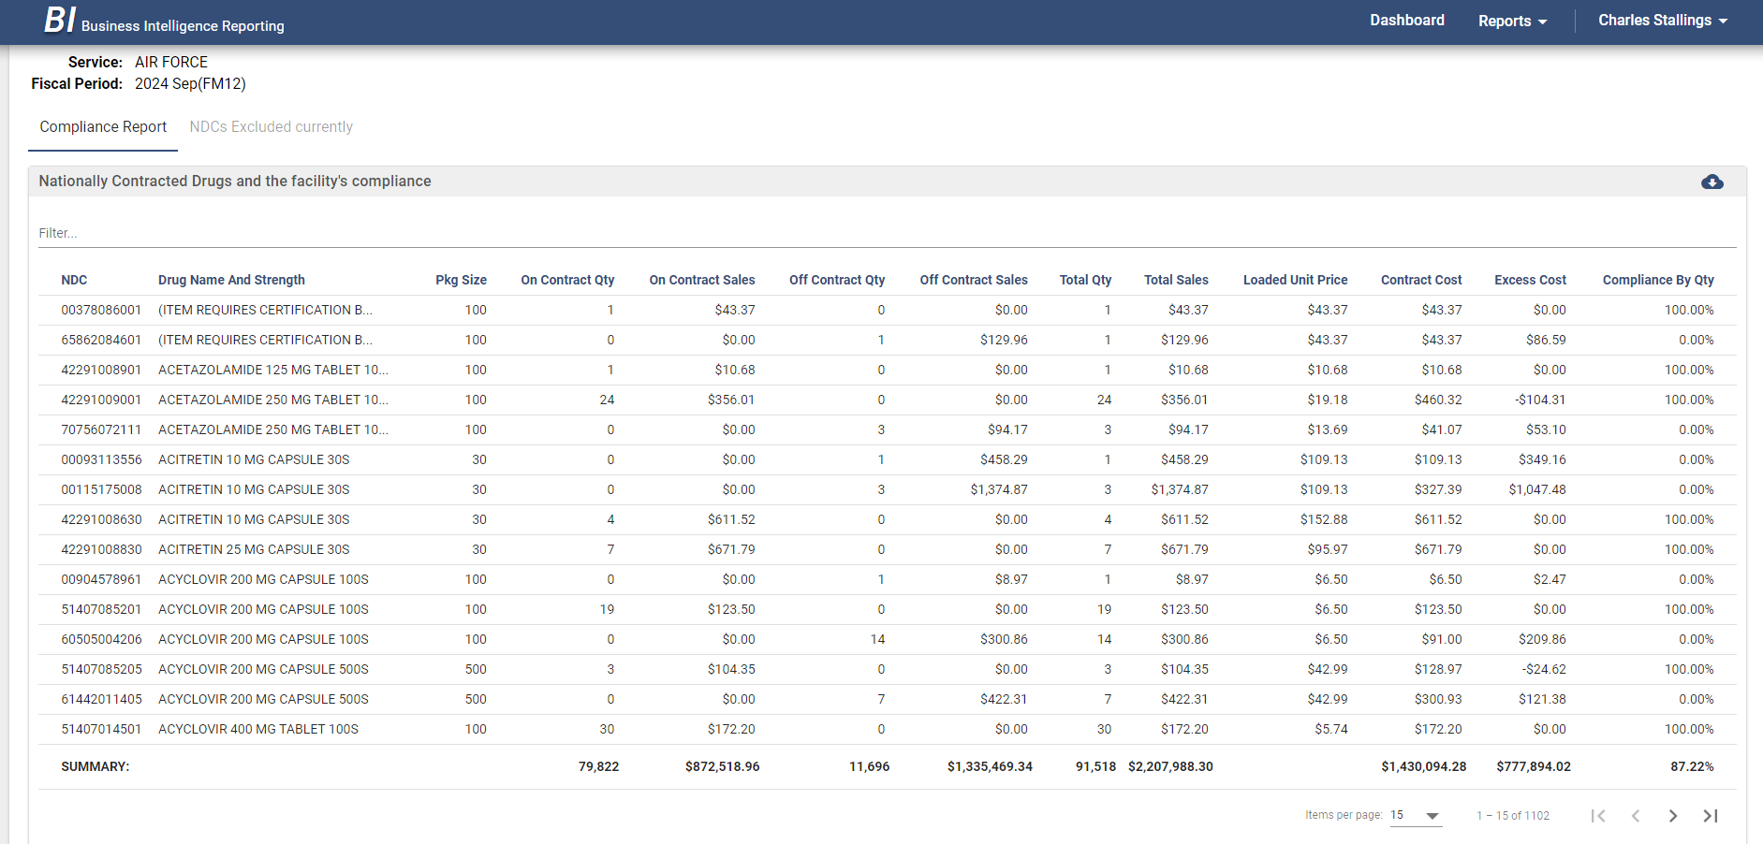
DMM Online

Slide 21
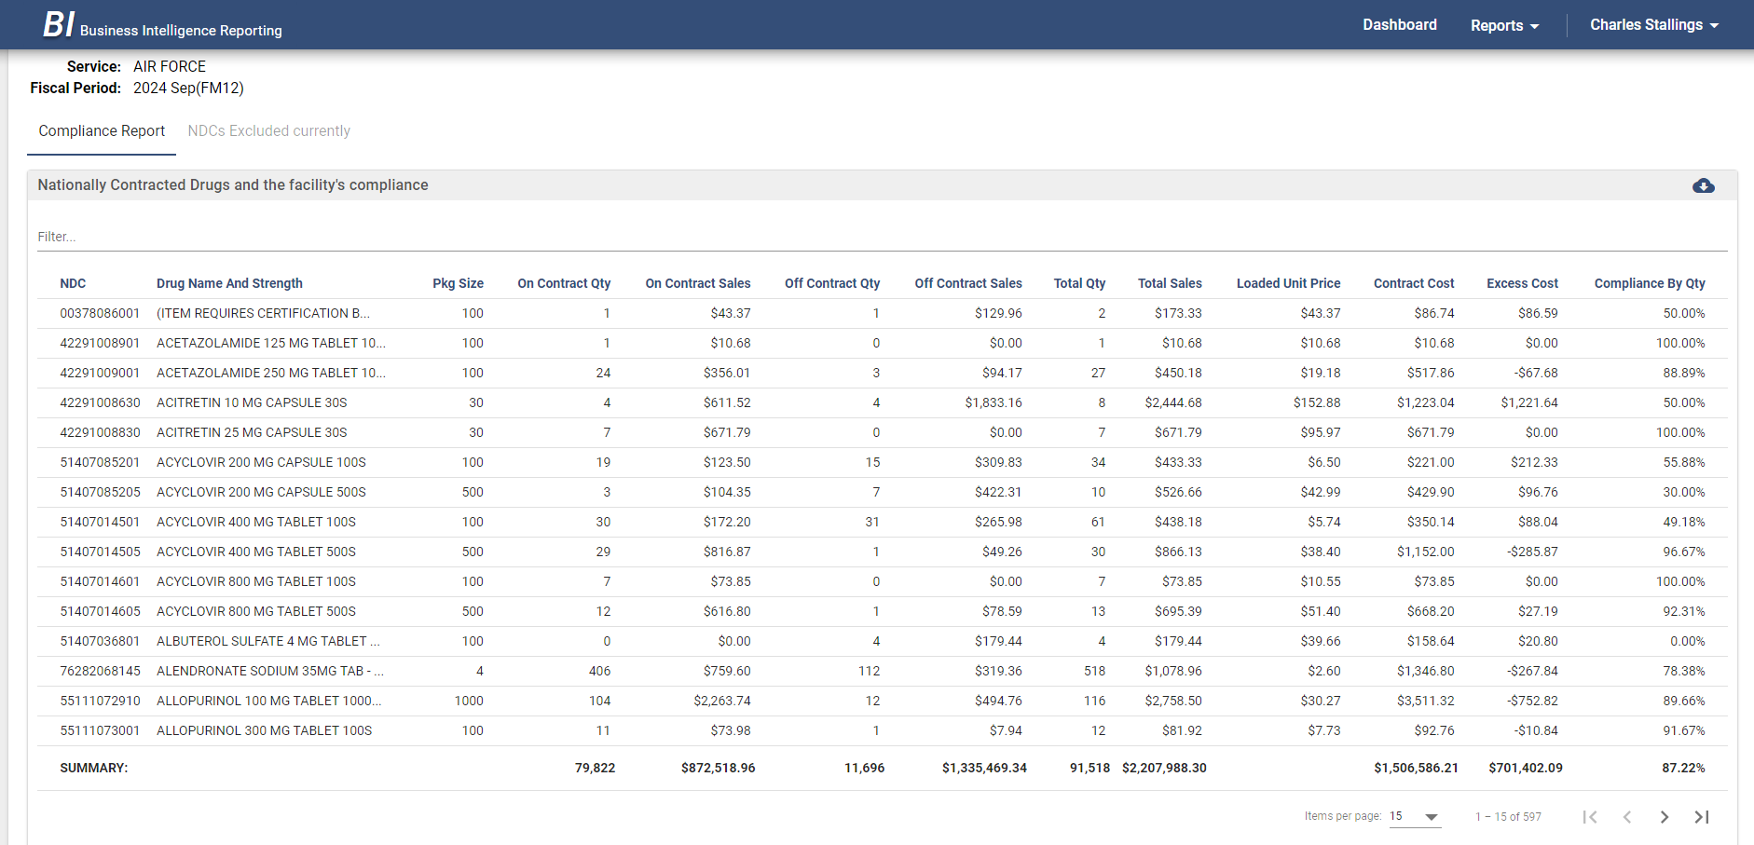
DMM Online

Slide 22
ABC Order – Pricing Agreements
DLA National Contract = Orange Bar
Federal Pricing Agreement (Veterans Affairs (VA) Federal Supply Schedule (FSS), VA Big4, Distribution and Pricing Agreement (DAPA), Blanket Purchase Agreement (BPA)) = Green Bar
Regional DAPA (AWP-15%) = No icon
Click on Icon Legend for specific details

Slide 23
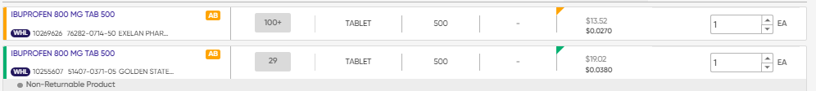
ABC Order – Pricing Agreements

Slide 24
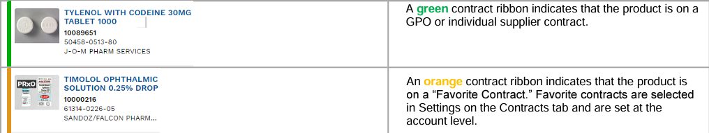
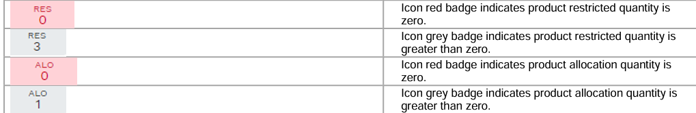
ABC Order – Pricing Agreements
*Non-Stock, Out of Stock etc.

Slide 25
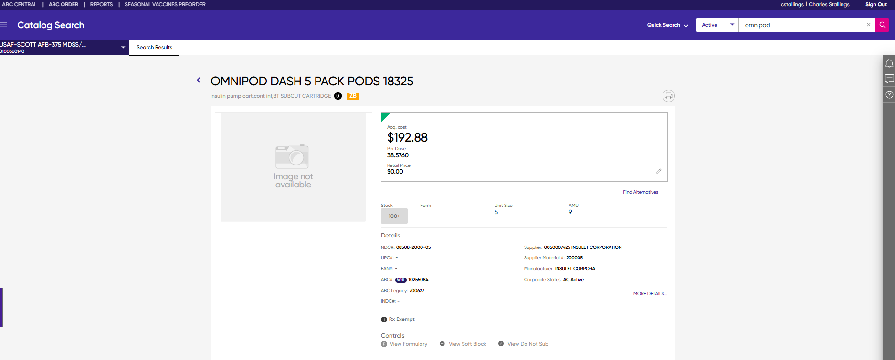
ABC Order

Slide 26
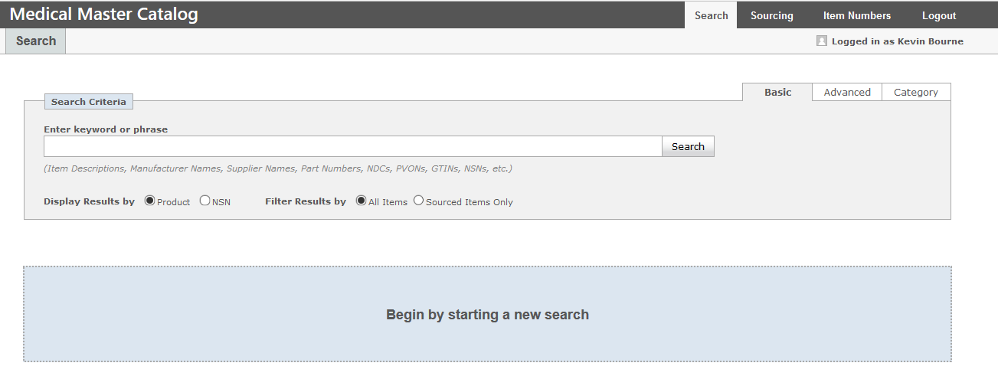
Medical Master Catalog

Slide 27
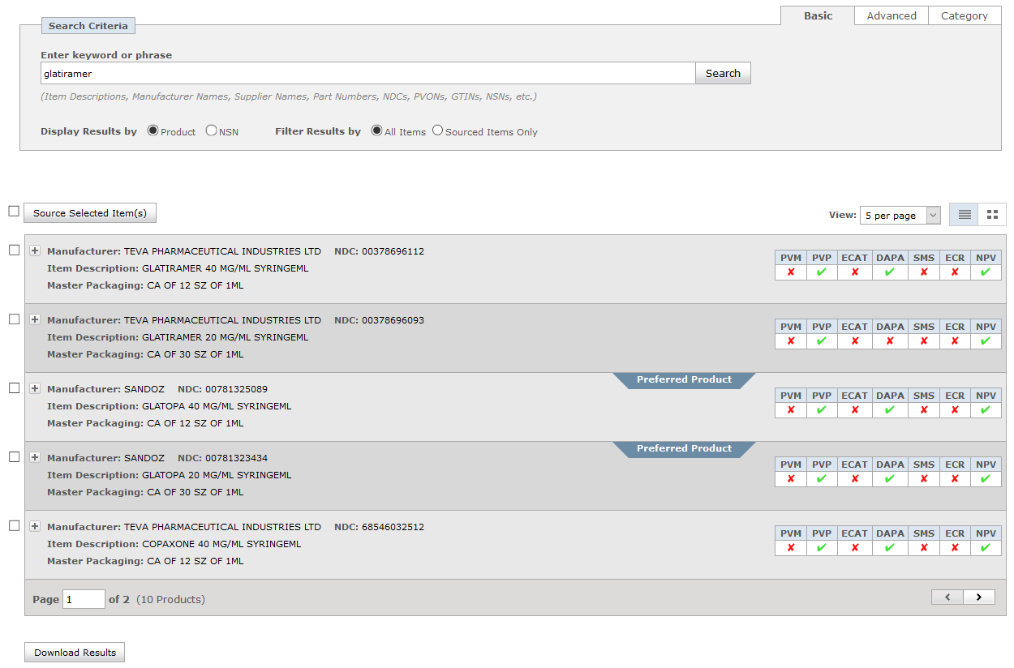
Medical Master Catalog

Slide 28
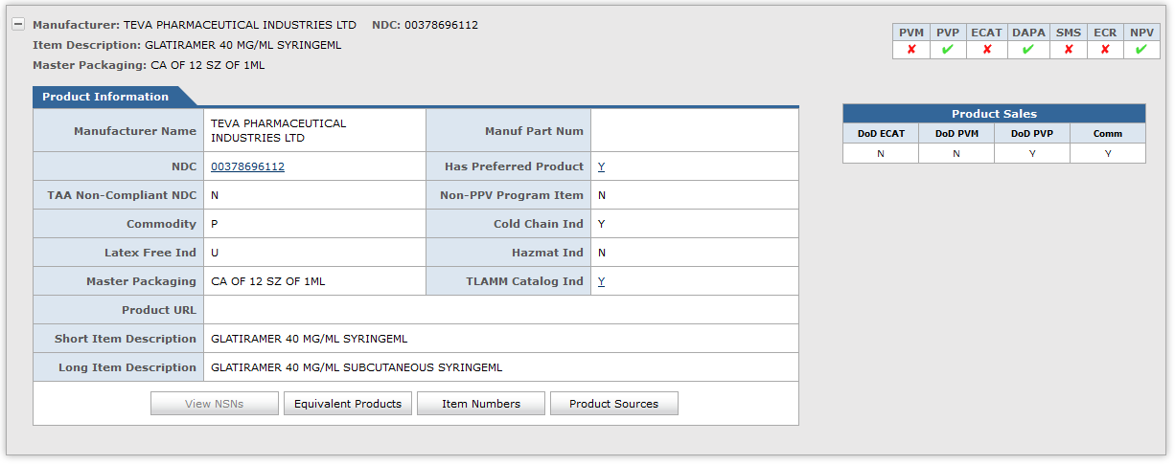
Medical Master Catalog

Slide 29
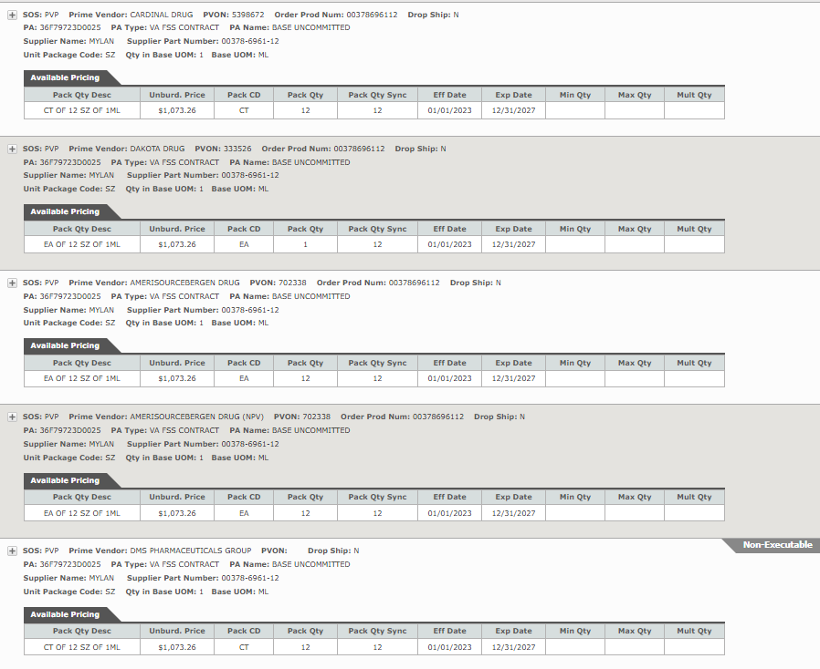
Medical Master Catalog

Slide 30
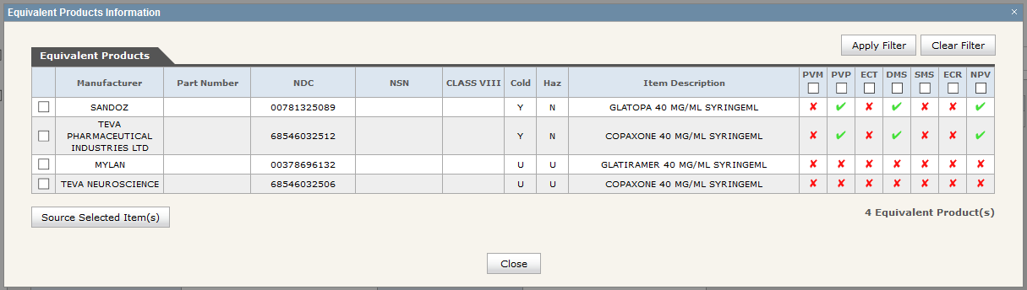
Medical Master Catalog

Slide 31
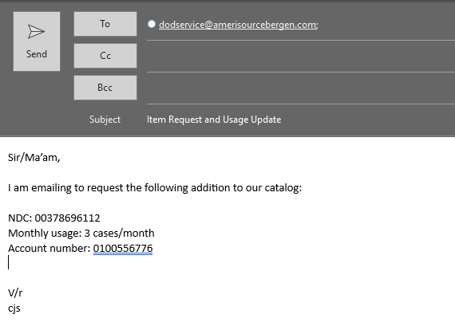
Product Sourcing

Slide 32
COVID Therapeutics
Nirmatrelvir/ritonavir is the only COVID therapeutic managed by CPOC
  Same process until 2028, based on current government contract with Pfizer
  Molnupiravir is available commercially through Cencora
All sites should have the FDA approved nirmatrelvir/ritonavir (commercially available)
  EUA labeled nirmatrelvir/ritonavir are no longer authorized for dispensing
    Discard IAW local procedures (can NOT use Reverse Distributor)
  If you haven’t received nirmatrelvir/ritonavir in 2024, you have EUA nirmatrelvir/ritonavir, contact CPOC to acquire FDA approved nirmatrelvir/ritonavir
Check the HHS and the CPOC news for updates on shelf-life extensions
  No current shelf-life extension in effect for Commercial nirmatrelvir/ritonavir

Slide 33
Holding Orders
Keep non-narcotic orders open for up to 180 days (60 days for narcotics)
  Place only in ordering accounts (non-credit accounts)
  Manual offline holding orders can be placed using non-submit generated 1155
  $25 flat fee using credit account when order is fulfilled
  Holding orders are NDC specific

Slide 34
Manual Orders
For urgent needs, CPOC can assist with coordinating manual orders when DMLSS/TEWLS is down or there is a catalog issue pending long term resolution
  Placed on credit accounts using credit balances
  Coordination between PPV, KOs, CPOC, and the customer
  No fees are applied
  Limited to urgent and emergency requests only
  Send an email to CPOC@dla.mil with justification
Ex. Chartwell Ondansetron tablets

Slide 35
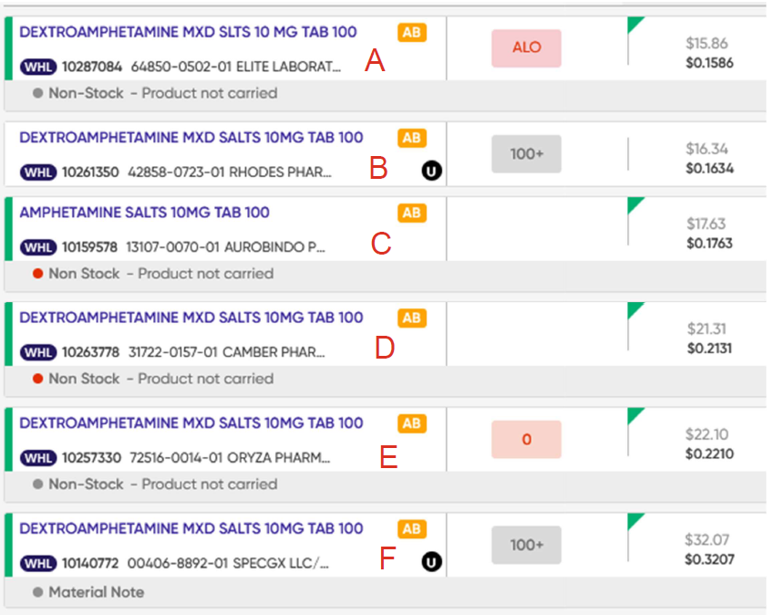
Customer Example
The best priced NDC is “A” but it is marked as non-stock, it does have a pricing agreement. – Currently on allocation.
  Should I request that Amerisource stock the NDC and order a different NDC until it is stocked? Or just move to a different NDC without requesting stock of “A” since it isn’t a National Contract? – You can request Cencora to stock this product at your DC and submit a holding order so that you’re in the queue to receive the item when it becomes available.
Since “A” isn’t available, do I move to “B” because it is the next best price? Or do I consider that “B” doesn’t have a contract (because it doesn’t have the green indicators) and move to the best priced contracted item?
  Are we more concerned with price or contracts? – This item is on a Regional DAPA (AWP-15%) pricing agreement. If you want to order this item it will not count against you in the NCCR.
Is there an order of preference for the green contracted items? FSS, Big 4, DAPA – UF BPA, Big 4, FSS. If the product has an FSS, then there will be no DAPA, unless the manufacturer decides to establish a DAPA pricing agreement that is less costly.
Basically, if I need to order today, should I order “B” (no contract but best price) or “F” (contract but more expensive)?
  Should I send a stock request to Amerisource? DLA can't dictate what you can or can’t order. Ultimately it is up to you to do what is in the best interest of your patients and the MTF.

Slide 36
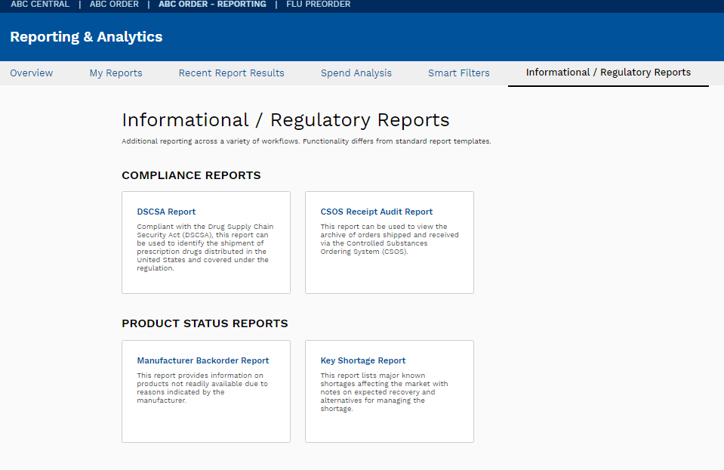
Manufacturer Backorder Reports

Slide 37
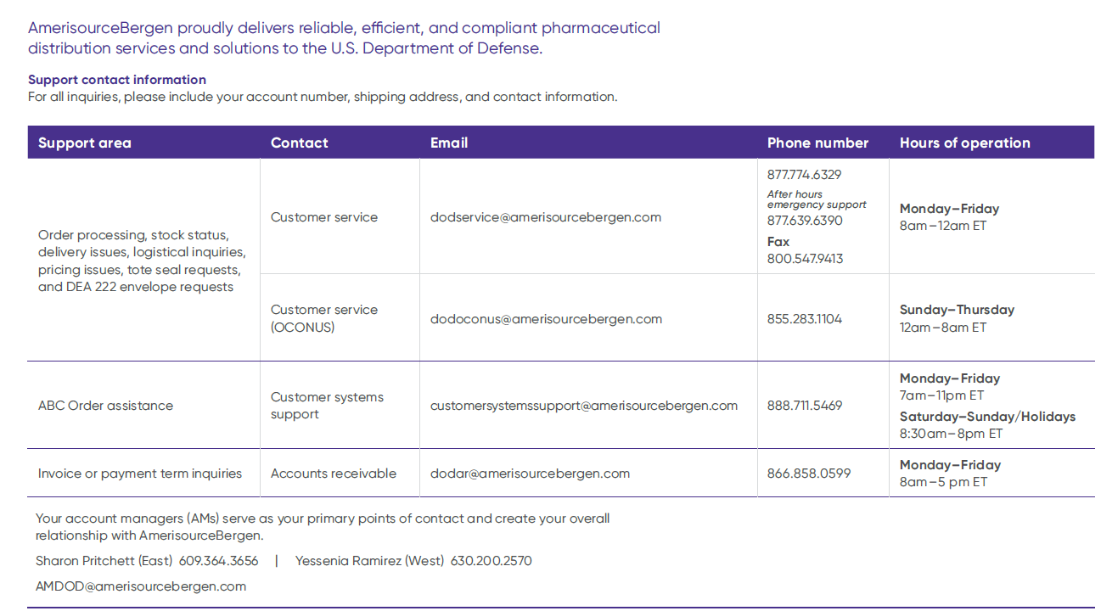
Cencora DoD Support Team Contacts

Slide 38
Self-Assessment Question #1
What organization does CPOC fall under?
  Defense Health Agency
  Defense Logistics Agency
  Department of Health and Human Services
  Department of Veterans Affairs

Slide 39
Self-Assessment Question #2
What is the most accurate source for current on-hand supply of a medication?
  DAPA Manager
  Medical Master Catalog
  Prime Vendor Catalog
  DMLSS

Slide 40
Self-Assessment Question #3
What is the best source for locating alternate NDCs of a product?
  DAPA Manager
  Medical Master Catalog
  Prime Vendor Catalog
  DMLSS

Slide 41

Closing Remarks
Francisco Boral, Lt Col, USAF, BSC – francisco.boral@dla.mil
Charles “Josh” Stallings, Lt Col, USAF, BSC – charles.stallings@dla.mil
Defense Logistics Agency (DLA) Troop Support
Philadelphia, PA
cpoc@dla.mil

Slide 42

Continuing Education Credit
Deadline to obtain CE 5 Aug 2025

