Slide 1
STAT Happens: Handling Pharmacy Trauma Response Like a Pro
Cory Hedin, Lt Col, USAF
Chief, Pharmacy Operations
Nellis AFB, Nevada

Slide 2
Disclosure
Lt Col Cory Hedin declares no conflicts of interest, real or apparent, and no financial interests in any company, product, or service mentioned in this program, including grants, employment, gifts, stock holdings, and honoraria.
All information shared in this presentation is UNCLASSIFIED

Slide 3
Learning Objectives
Describe the need for trauma training in Large-Scale Combat Operations
Review the expanding roles and responsibilities for pharmacists and technicians in trauma response
Identify how trauma response training can be conducted within your pharmacy and with civilian partnerships

Slide 4
Self-Assessment Question #1
Pharmacy involvement in trauma response results in decreased time to administration for which of the following categories:
  Anti-haemorrhagic agents
  Analgesics
  Sedative Agents
  Antibiotics
  All of the Above

Slide 5
Self-Assessment Question #2
Which of the following is NOT a great way to locate a certified trauma center near you?
  https://www.facs.org/hospital-and-facilities/
  Google
  Ask faculty at a school of pharmacy
  Get hurt and see where they take you

Slide 6
Self-Assessment Question #3
Which is not a benefit of pharmacy trauma training?
  Improved readiness focus
  More effective patient care
  Airmen get a day away from crabby patients
  Immense sense of appreciation and value

Slide 7
Overview
Theater Trauma Response
Home-station Trauma Response Training
Civilian Partnership Opportunities
Notes:
DISCLOSURE: All patient-looking photos where patient can be seen/identified were taken during an exercise in Oct 2016 at Bagram and are not actual patients.

Slide 8
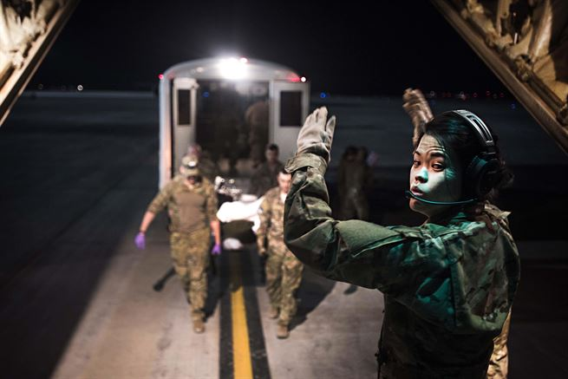
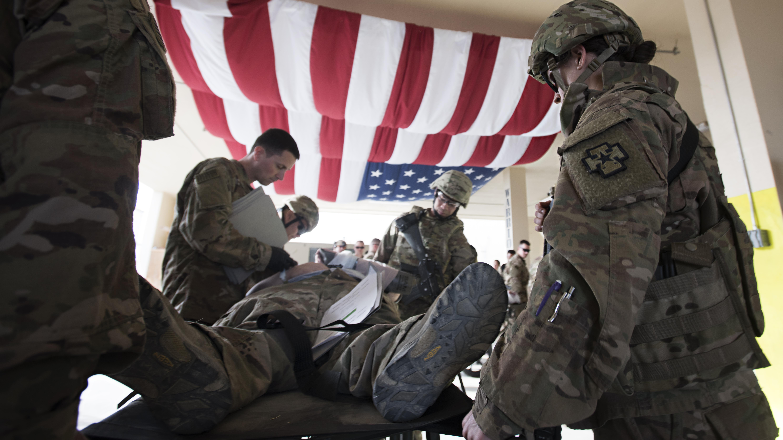
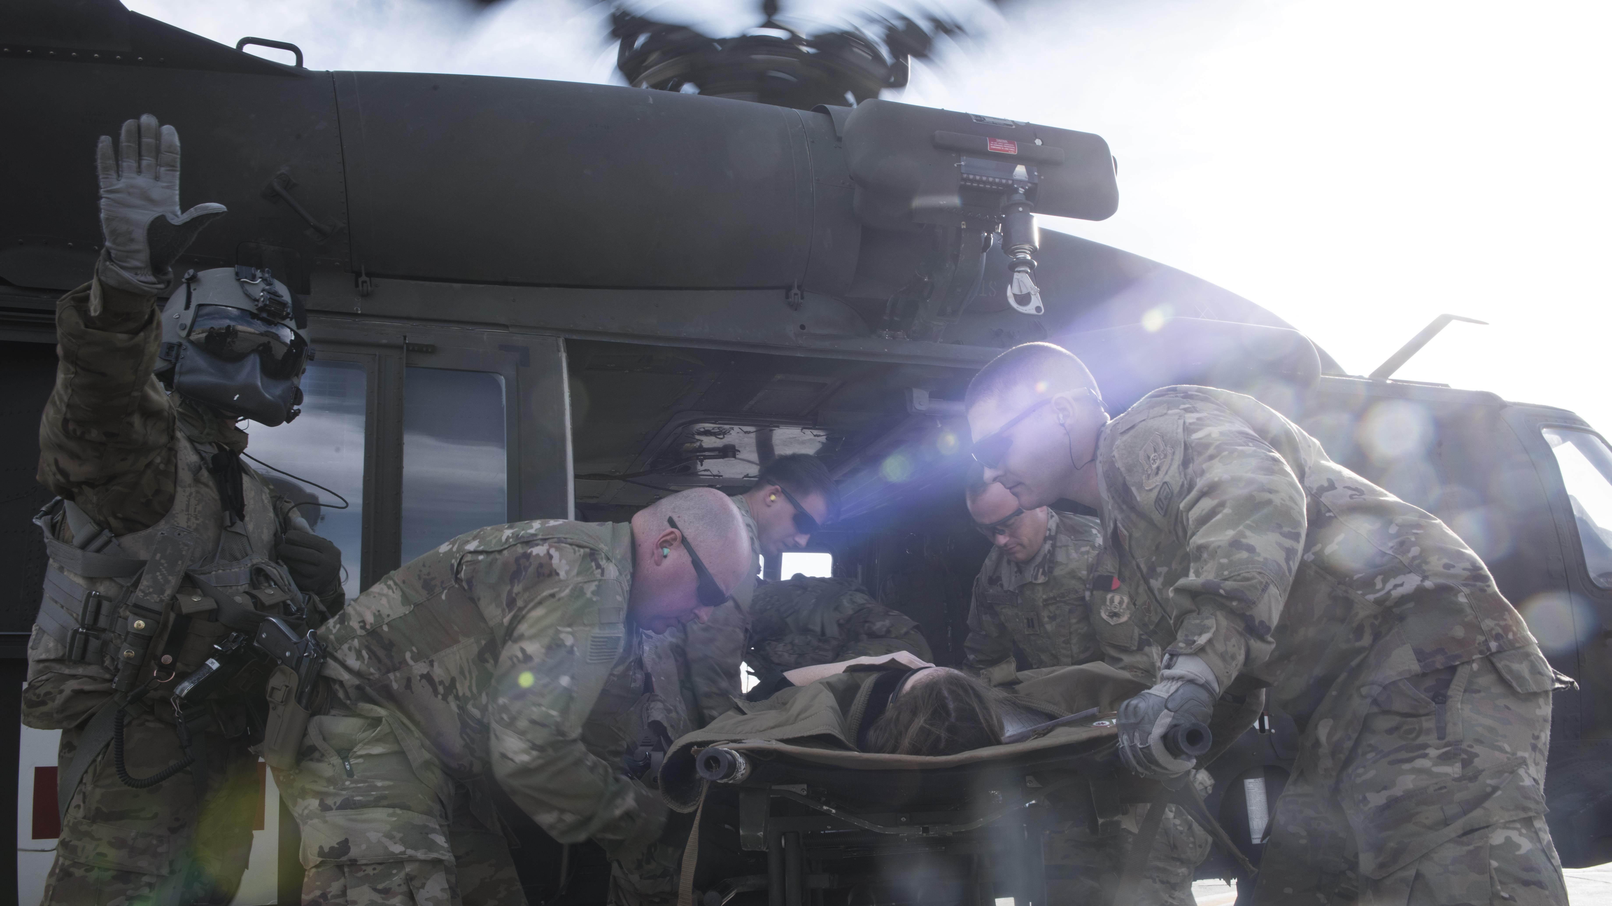
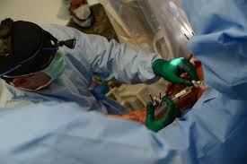
Trauma
Notes:
War is messy and people get hurt. Traumatic injury is an unavoidable part of war.
(U.S. Air Force photo by Staff Sgt. Katherine Spessa) VIRIN: 161029-F-TY749-279.JPG https://www.airforcemedicine.af.mil/News/Art/igphoto/2001661652/
(U.S. Air Force photo by Staff Sgt. Katherine Spessa) VIRIN: 161029-F-TY749-154.JPG https://www.airforcemedicine.af.mil/News/Art/igphoto/2001661650/

Slide 9
Why Trauma Training?
“While the prior two decades of counterinsurgency operations in the Middle East have resulted in critical advances in battlefield medicine with the lowest case fatality rate in history, the US military must prepare for future warfare involving peer or near-peer adversaries equipped with large, modern standing armies. The resulting operational environment, known as large-scale combat operations (LSCOs), will increase the scope of wounded service members to levels not seen since World War II. Lack of reliable air superiority will restrict evacuation and will preclude the ability to provide advanced surgical support within the “golden hour” for many, if not most of those wounded.” ¹
^{- Mason Remondelli, et al}
¹ Remondelli MH, Remick KN, Shackelford SA, Gurney JM, Pamplin JC, Polk TM, Potter BK, Holt DB. Casualty care implications of large-scale combat operations. J Trauma Acute Care Surg. 2023 Aug 1;95(2S Suppl 1):S180-S184. doi: 10.1097/TA.0000000000004063. Epub 2023 May 31. PMID: 37420334; PMCID: PMC10389308.

Slide 10

Large Scale Combat Operations (LSCO)
The Mission Command Training Program (MCTP) regularly runs intricate simulations of battlefield operations
Based on these simulations, during the first 8 days of conflict with China:
  50,000 – 55,000 casualties
    ~30,000 requiring evacuation from theater
    ~10,000 deceased
    ~10,000 injured but able to return to duty
  Roughly equal to total casualties over 20 years in Iraq and Afghanistan
Fandre, Matthew. “Medical Changes Needed for Large-Scale Combat Operations Observations from Mission Command Training Program Warfighter Exercises.” Army University Press, May 2020, www.armyupress.army.mil/Journals/Military-Review/English-Edition-Archives/May-June-2020/Fandre-Medical-Changes/.
Notes:
Image courtesy of: Mastro, O. S. (2023, October 2). The Taiwan temptation: Why Beijing might resort to force. Foreign Affairs. https://www.foreignaffairs.com/articles/china/2021-06-03/china-taiwan-war-temptation

Slide 11
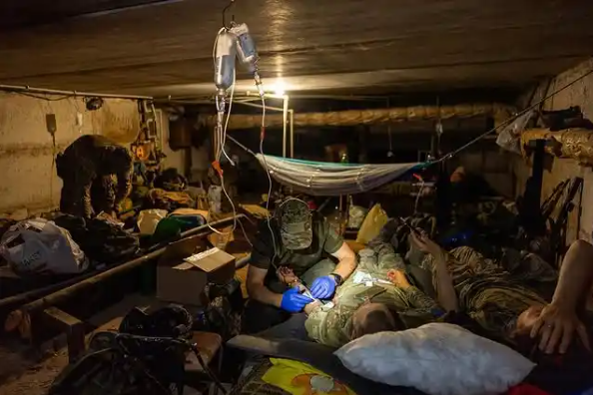
Fast, Furious and Forever (seemingly)
In a LSCO scenario against a peer adversary:
  Air superiority likely non-existent
  Casualties will come rapidly
  In large numbers
  May require prolonged care while awaiting MEDEVAC
Instagram. (n.d.). https://www.instagram.com/mstyslav.chernov/p/CumN5cqMT5o/
Notes:
This photo from Instagram shows Ukrainian medics attempting to treat patients in an improvised bomb shelter

Slide 12
How can we better prepare our airmen?.…
43PX RSV Lesson Plan Trauma and Emergency Response 1a:
“The practice of emergency medicine is at the core of what encompasses a deployed AF pharmacist. The knowledge and skill set that we can bring to an emergency and trauma team is vital to increasing a patient’s survival rate. The better prepared we are for an emergency scenario the more capable we are to handle the complications that may occur.”
Notes:
I would take the word “may” out of that last sentence. Complication DO occur all the time.
With this in mind, I decided to return to Keesler and improve emergency response training for my airmen

Slide 13
Why Pharmacy Involvement?
Pharmacy involvement in Trauma Response has become standard
  Pharmacy involvement at US Trauma Centers increased from 23% in 2007 to 70% in 2017
Pharmacy involvement
  Reduces medication errors in Emergency scenarios
  Reduces time to administration of critical medications
    Anti-haemorrhagic agents
    Analgesics
    Sedative Agents
    Antibiotics
  Demonstrated improvement in patient outcomes
Porter BA, Zaeem M, Hewes PD, Hale LS, Jones CMC, Gestring ML, Acquisto NM. Pharmacist involvement in trauma resuscitation across the United States: A 10-year follow-up survey. Am J Health Syst Pharm. 2019 Aug 1;76(16):1226-1230. doi: 10.1093/ajhp/zxz124. PMID: 31369114.
Currey EM, Falconer N, Isoardi KZ, Barras M. Impact of pharmacists during in-hospital resuscitation or medical emergency response events: A systematic review. Am J Emerg Med. 2024 Jan;75:98-110. doi: 10.1016/j.ajem.2023.10.020. Epub 2023 Oct 22. PMID: 37939522.
Notes:
Medication errors are common in emergency departments (ED). A study of 192 patients in a United States (US) ED found that 59.4% of ED patients had one or more medication error and 37% had one or more medication errors that were not intercepted before administration [4]. The reasons for medication errors are multifactorial. Emergency clinicians work in overcrowded, time-pressured environments in which the risk of medication error is high [5-9]. Overcrowding in EDs has been recognised as a widespread problem in many countries [10-13] and has been shown to increase the risk of medication errors and delays in the administration of time critical medications

Slide 14
Current Training Gap
“The operational realities, the stresses upon the medical system and sustainment units, and the psychological and emotional impact of significant casualties cannot be underestimated and must be prioritized.”
– Col Matthew Fandre, MD, U.S. Army
It’s not easy to perform well during a trauma situation
Exposure and desensitization are a critical 1st step to enabling high-quality pharmacy trauma response
The Problem is……
Fandre, Matthew. “Medical Changes Needed for Large-Scale Combat Operations Observations from Mission Command Training Program Warfighter Exercises.” Army University Press, May 2020, www.armyupress.army.mil/Journals/Military-Review/English-Edition-Archives/May-June-2020/Fandre-Medical-Changes/.
Notes:
Talk about experience with TSgt Cook during first trauma call at Bagram

Slide 15
Home-station Trauma Response Training
Challenge:
  55 / 736 (7.5%) of DHA MTFs¹ provide emergency services
    7 verified² as trauma centers
    1 Lvl 1 (BAMMC)
    2 Lvl 2 (Tripler, LRMC)
    4 Lvl 3 (Camp Lejeune, Fort Liberty, Fort Belvoir, Nellis)
¹ Tricare.mil Find a Doctor tool searching for military hospital or clinic with Emergency Services / https://www.gao.gov/assets/d23105441.pdf
² Verified by the American College of Surgeons
Notes:
Pharmacy trauma response training opportunities at MTFs are limited. A few other MTFs (Madigan, Walter Reed, Carl Darnall) have had trauma center certification in the past but do not currently show up on the ACS site as having current certification.

Slide 16
How to we train for trauma response?
HMMMMMMMMM????????

Slide 17
OMM Partnership: Nellis & UMC Las Vegas
99 MDG Office of Military Medicine (OMM) operates the largest and most integrated military-civilian partnership in the country
Partners with local organizations to enhance military readiness and community needs
  99 MDG airmen embedded at University Medical Center (UMC) Las Vegas
  99 MDG Resident Rotations with UNLV School of Medicine
  99 MDG designated as Level III trauma center – receives trauma patients without military affiliation
    Partnerships with:
      American Medical Response (EMS Ambulance Service)
      AirMed (allowing fixed-wing air ambulances to land at Nellis)
      North Las Vegas Fire Department
      Southern Nevada Health District

Slide 18
Home-station Trauma Response Training
Phase I
  Advanced Life Support mini training
  Basics of Trauma Response Training Day Module
    What is trauma response
    Medications
    What to expect
  Hands on portion
    IV prep refresher
    Aseptic technique

Slide 19
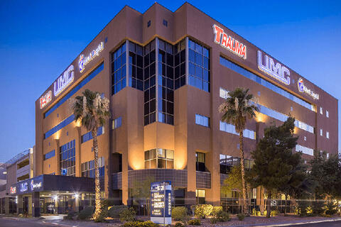
Nellis Pharmacy Trauma Training
University Medical Center (UNLV)
  541 beds
  Affiliated with UNLV Medical School and Roseman University School of Pharmacy
  Level I Trauma Center
  Level III Neonatal ICU
  Verified Burn Center
  Office of Military Medicine
    Partnership with 99th MDG at Nellis AFB

Slide 20
Home-station Trauma Response Training
Phase II - Advanced Experiential Program
  Partnered with University Medical Center Las Vegas (UMCLV)
    43Ps – two-week shadowing in ED/Trauma Bay/ICU
    4Ps – one-week shadowing in ED/Trauma Bay
    Feedback from attendees has been overwhelmingly positive

Slide 21
What if I don’t have an OMM team?
Notes:
My hope is that you have an interest in developing a readiness training program like this at your MTF.

Slide 22

How to set up at your MTF
Locate a trauma center near you
Pharmacist embedded in ED?
Leadership buy-in
Funding for local TDY?
Home station PTSD?

Slide 23
How to find a trauma center
https://www.facs.org/hospital-and-facilities/
  Search by facility type – Trauma Center
  Can Search by State
Google
Civilian or local School of Pharmacy staff
Notes:
Large level 1 is ideal

Slide 24
How to find a trauma center
How to contact Director of Pharmacy
  Google
    “Hedin University Medical Center director of pharmacy”
  Contact us link on website
  Networking
    Schools of Pharmacy
    Contract/GS pharmacists/techs (aka, locals)

Slide 25
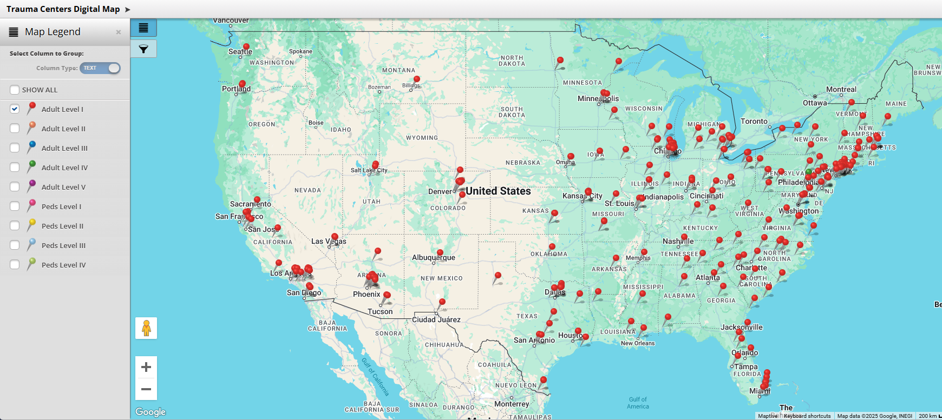
How to find a trauma center
Notes:
Just showing Level 1 Trauma Centers

Slide 26
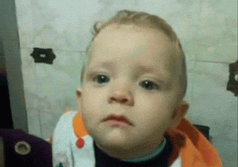
CONUS MTF Proximity to Trauma Centers
  61% of CONUS AF MTFs w/in 67 miles of level 1
    41% w/in 25 miles
  88% of CONUS MTF w/in 67 miles of level 1 or 2
  97% of CONUS MTF w/in 67 miles of level 1, 2, or 3
    Cannon and Laughlin

Slide 27
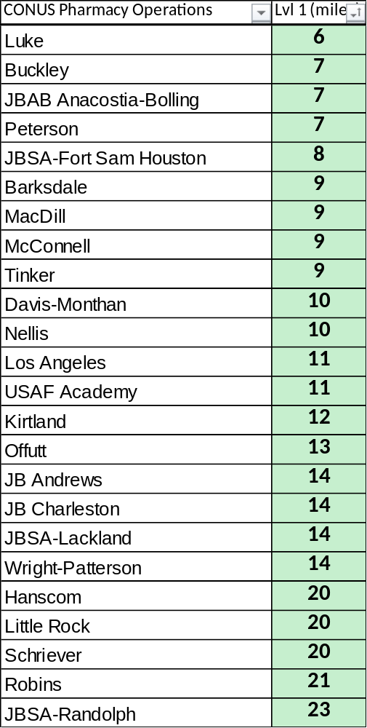
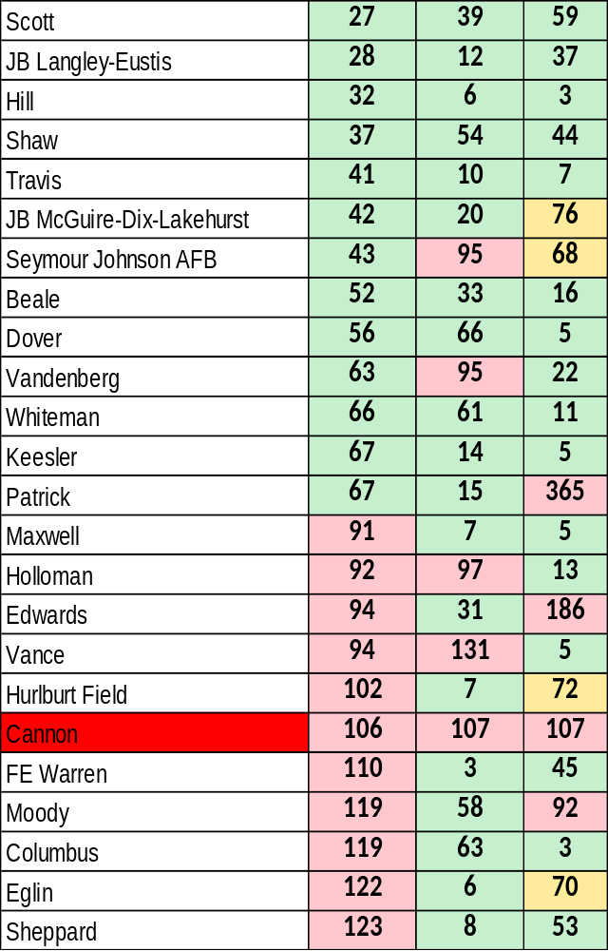
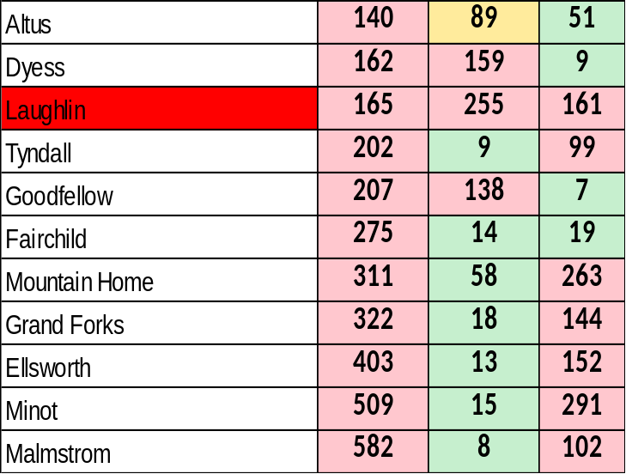

Slide 28
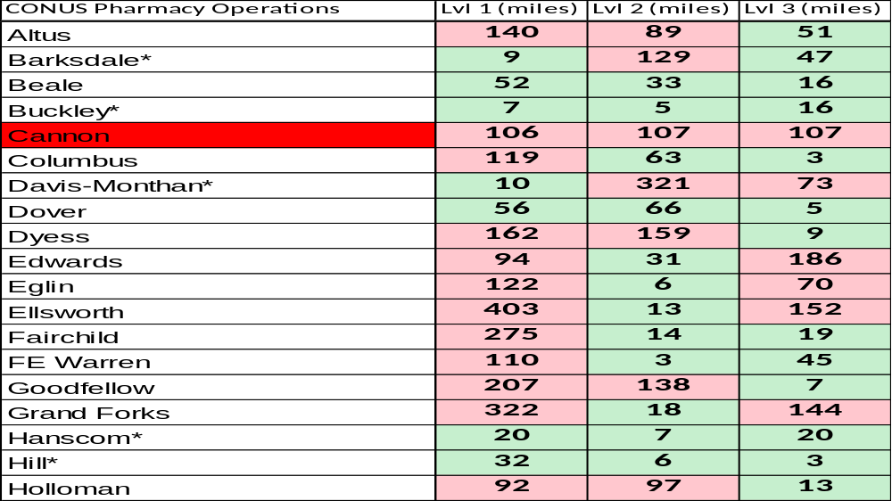

Slide 29
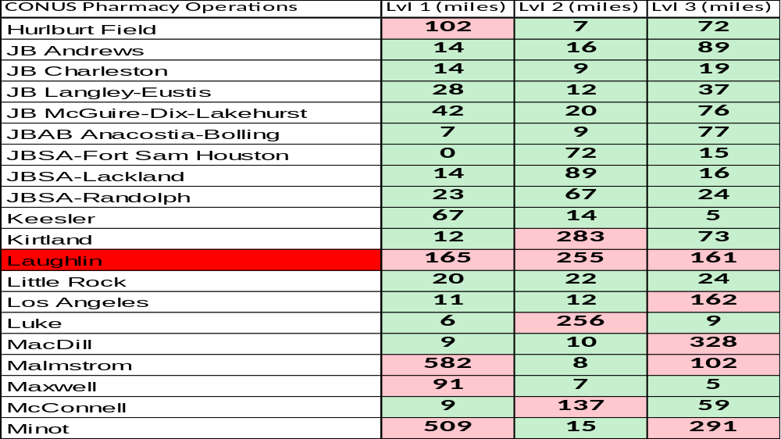

Slide 30
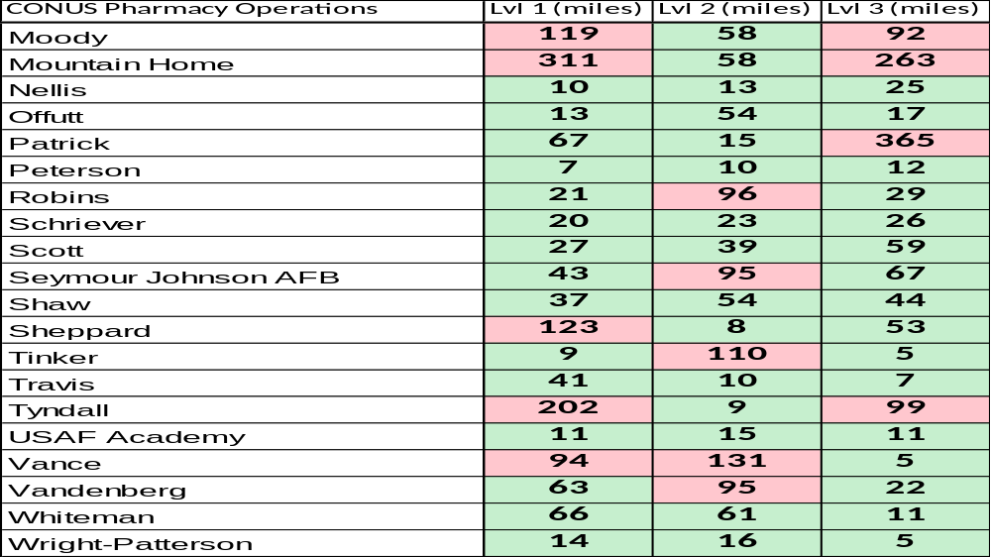

Slide 31
Challenges with Mil-Civ Partnerships
Taxing on Civ staff
  Find a carrot
HR hurdles
  Short duration experiences – is juice worth the squeeze?
  Is a TAA or MOA needed?
Knowledge gaps in trauma/critical care
Notes:
Carrots include: Pride in assisting the military, coining and recognition opportunities, mil-civ blurb on CV, base tours, etc

Slide 32
Pharmacist embedded in ED?
Pharmacist involvement in emergency medicine becoming more prevalent and is becoming a standard practice
What hours do they have pharmacist on shift in ED?
  Nights/Evenings/Weekends is often better
Do they have the bandwidth?
  Are they able to offer “fly on the wall” or teaching rotation?
Notes:
Keesler was fortunate that Dr. Hoh has willing and excited to train AD pharmacy staff.
Could AD pharmacist “volunteer” to function as ED pharmacist at facilities where no ED pharmacist is employed to “sell” pharmacy to hospital/ED/Pharmacy leadership?

Slide 33
Leadership buy-in
Trauma response training lines up with DHA readiness priorities
Airmen will be absent from regular duty
  Ensure that airmen are up to date on:
    Annual trainings
    CDCs and upgrade training
    Fitness
Training can/should be limited to deployable airmen

Slide 34

Funding for local TDY
Local TDY reimburses $0.70/mile for POV
GOV may be an option
  May require special driver permit
  Check with base transportation office
Carpool if sending more than one person
Notes:
Mileage reimbursement only. For a 67-mile drive each way, the reimbursement would be $93.80/local TDY or $1125/year for one carload/person per month
Creator:TimArbaev
Credit:Getty Images/iStockphoto
Copyright:TimArbaev

Slide 35
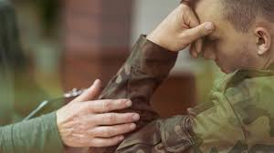
Home station PTSD?
Must be considered/planned for/addressed
Discuss in advance what may be seen in the trauma bay
Offer coping resources
  Mental Health, MFLAC, Chaplain
Provide wingman
Better support at home vs in theater

Slide 36
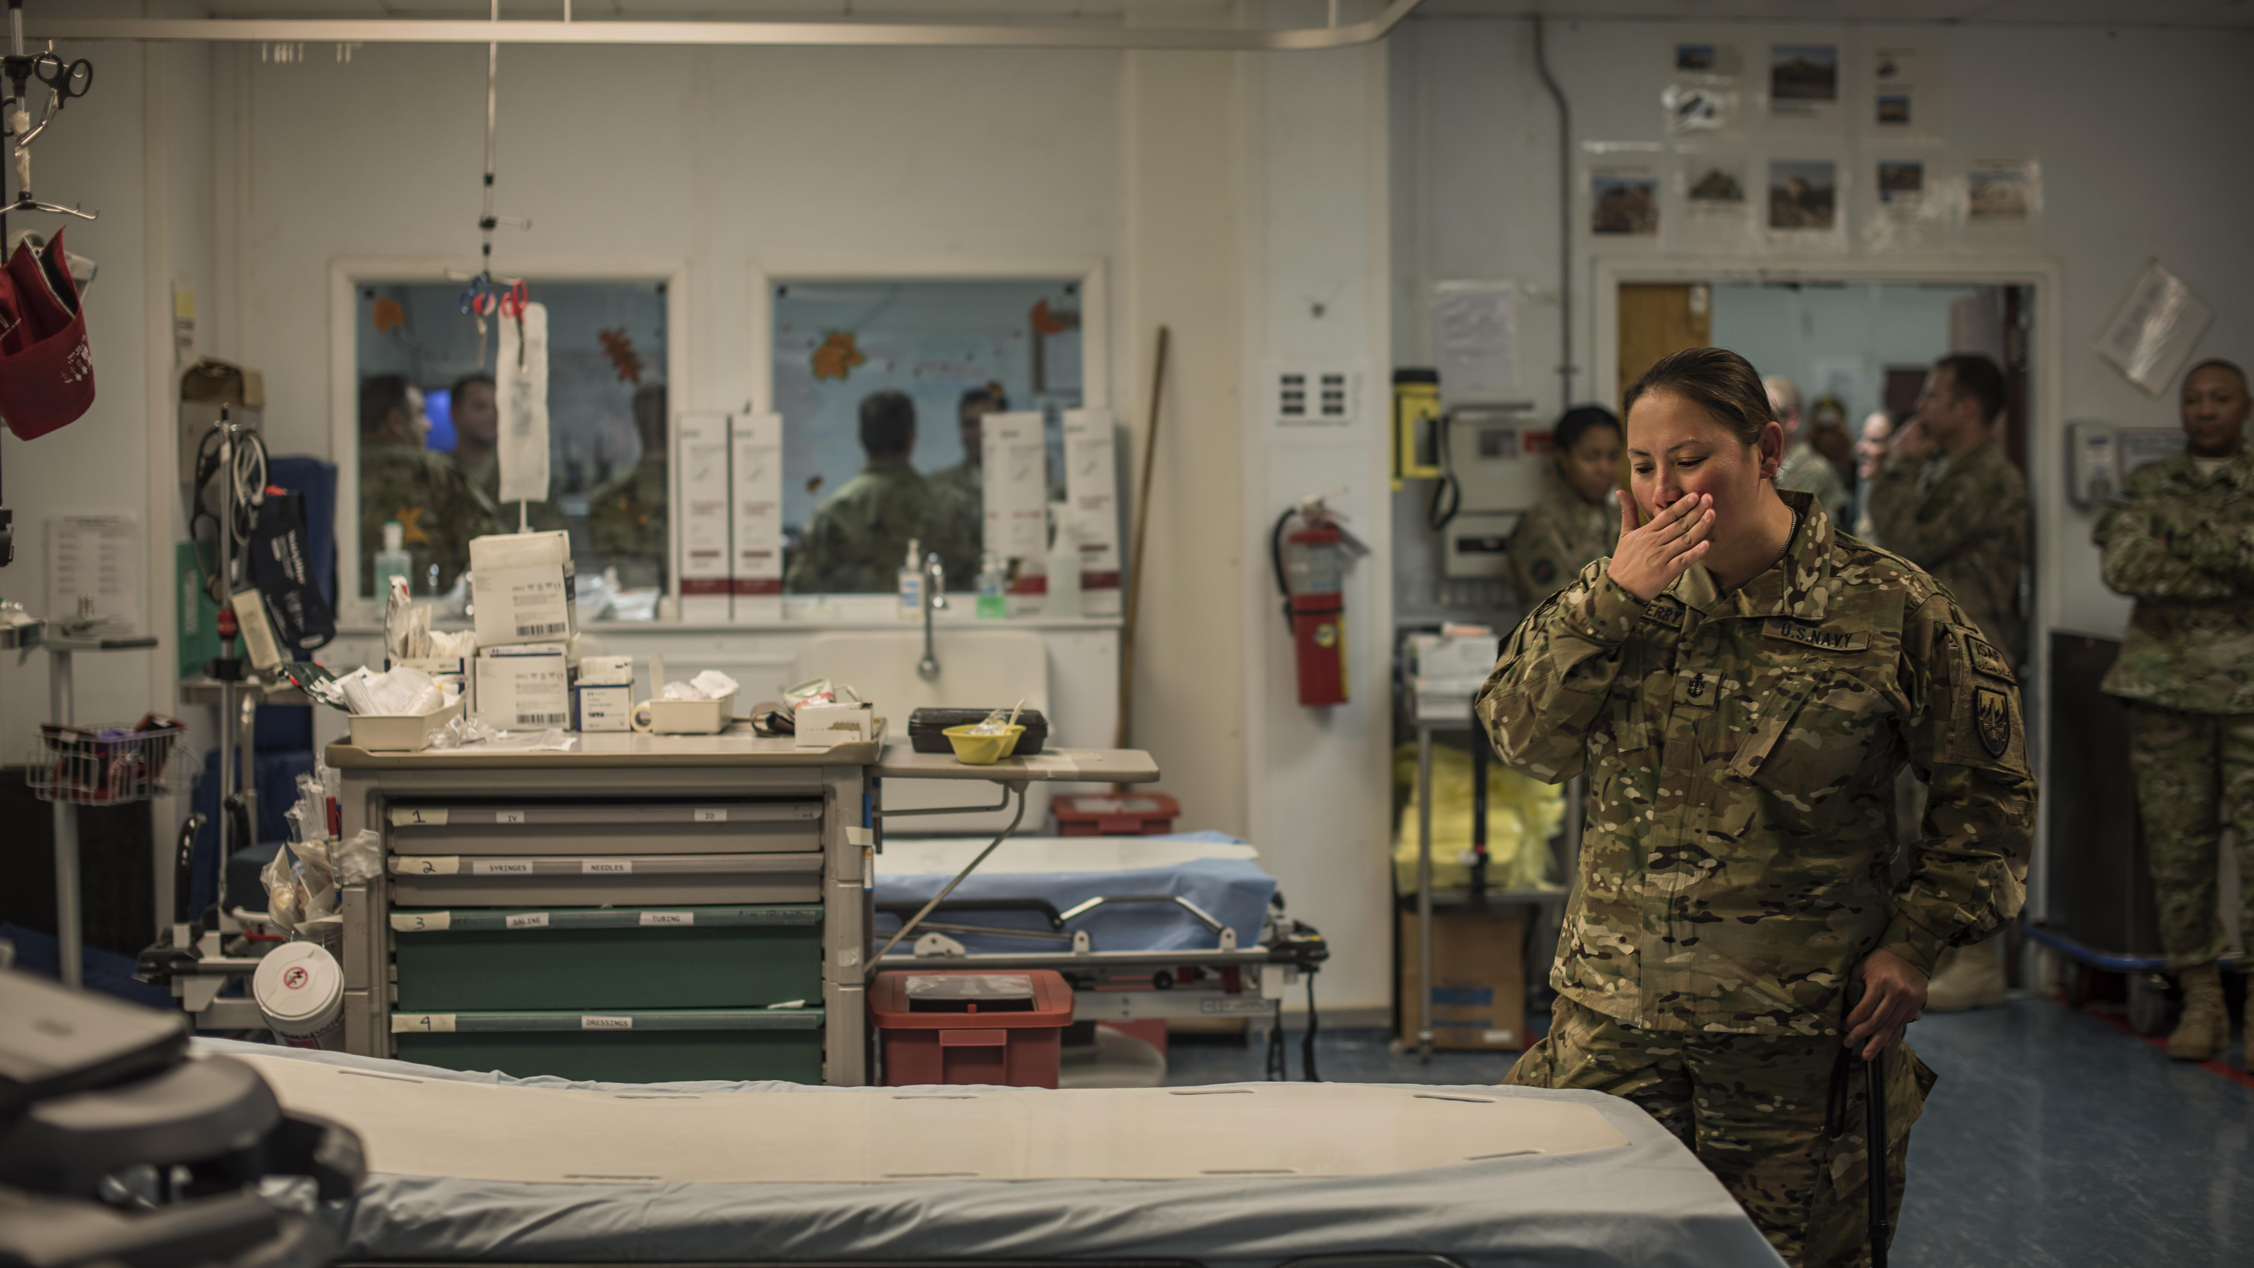
Benefits
Improved Readiness Focus
Greater understanding of theater ops
More effective patient care
You may never feel as appreciated/valued as when you are part of a trauma response team!
Notes:
U.S. Navy Senior Chief Petty Officer Reina Hockenberry, Operation Proper Exit wounded warrior, returns to the bed she occupied while a patient at the Craig Joint Theater Hospital during a return visit to Bagram Airfield, Afghanistan Nov. 16, 2016. Hockenberry was wounded in August 2014 during an attack in Kabul and went through the CJTH before being medically evacuated.
Discuss getting in trouble by Trauma Czar and DCCS separately because I was trying to help in other ways. “Don’t you dare lose your focus in there. We NEED what you have to offer more than you realize!”
U.S. Air Force photo by Staff Sgt. Katherine Spessa VIRIN: 161116-F-TY749-149.JPG https://www.afcent.af.mil/Units/455th-Air-Expeditionary-Wing/News/Display/Article/1009345/wounded-warriors-return-to-craig-joint-theater-hospital/

Slide 37
Self-Assessment Question #1
Pharmacy involvement in trauma response results in decreased time to administration for which of the following categories:
  Anti-haemorrhagic agents
  Analgesics
  Sedative Agents
  Antibiotics
  All of the Above

Slide 38
Self-Assessment Question #2
Which of the following is NOT a great way to locate a certified trauma center near you?
  https://www.facs.org/hospital-and-facilities/
  Google
  Ask faculty at a school of pharmacy
  Get hurt and see where they take you

Slide 39
Self-Assessment Question #3
Which is NOT a benefit of pharmacy trauma training?
  Improved readiness focus
  More effective patient care
  Airmen get a day away from crabby patients
  Immense sense of appreciation and value

Slide 40
Questions?

Slide 41

Continuing Education Credit
Deadline to obtain CE 5 Aug 2025

