Slide 1
Society of Air Force Pharmacy
Mid-Year Conference
16 -18 June 2025
Hilton Norfolk The Main
Norfolk, VA
Notes:
The campaign’s multi-stage approach aims to institutionalize efforts across the force with both a short-term and long-term focus. The campaign will consist of a MAJCOM-led stand-up day dedicated to risk management training and discussion. Active duty units will have 60 days to complete their stand-up day while Guard and Reserve units will have 120 days to complete.
The long-term focus of the Integrating Risk and Readiness campaign is to integrate Risk Management principles into all training, career fields, and operational environments across the U.S. Air Force, as well as implementing them within policy, directives, and education.
The campaign stems from the recognition that there will be increased risk as the USAF makes changes to the way it operates so Airmen are better prepared to make risk-informed decisions. The campaign will also focus on reviving a mindset of operational discipline in all Airmen.
“As we reoptimize for Great Power Competition, infusing risk management and operational discipline into all facets of planning, preparation, execution, and assessment is imperative across all missions and environments,” said Allvin.
Allvin emphasized this campaign is not in response to a specific safety incident but, rather, is a proactive campaign designed to maximize readiness enabling our forces to meet the operational demands of Great Power Competition.
“Mission readiness is the cornerstone of this campaign,” said Allvin. “Mission command necessitates risk management at the tactical edge. Well-executed, risk-informed decision-making preserves and protects combat power without sacrificing mission success.”
Allvin announced this campaign as a complement to DAF Safety’s recently unveiled Strategic Plan, which focuses on increasing combat readiness through training, risk management, and analysis. The Strategic Plan outlines the safety enterprise’s new mission, vision, and supporting objectives.
“Combat operations and training are inherently risky,” said Maj. Gen. Sean Choquette, DAF Chief of Safety and Air Force Safety Center commander. “They require action. We must train Airmen at all levels how to approach those actions smartly with risk management skills. Safety’s job is to arm our forces with the resources and skills to make risk-informed decisions at home or in the field.”
Choquette emphasized the role individual Airmen will play in implementing these tenants.
“Leaders at every level are crucial to transforming DAF Safety as we face new threats, capabilities, and organizational change within the Department,” said Choquette. “Ultimately, our mission relies upon the disciplined approach of individual Airmen – they are the key component in our enterprise.”

Slide 2
Risk Management and Continuous Process Improvement
Capt Brian D. Nibbelink, PharmD, PMP, CSSGB

Slide 3
Disclosure
Brian Nibbelink: “Declares no conflicts of interest, real or apparent, and no financial interests in any company, product, or service mentioned in this program, including grants, employment, gifts, stock holdings, and honoraria.”

Slide 4
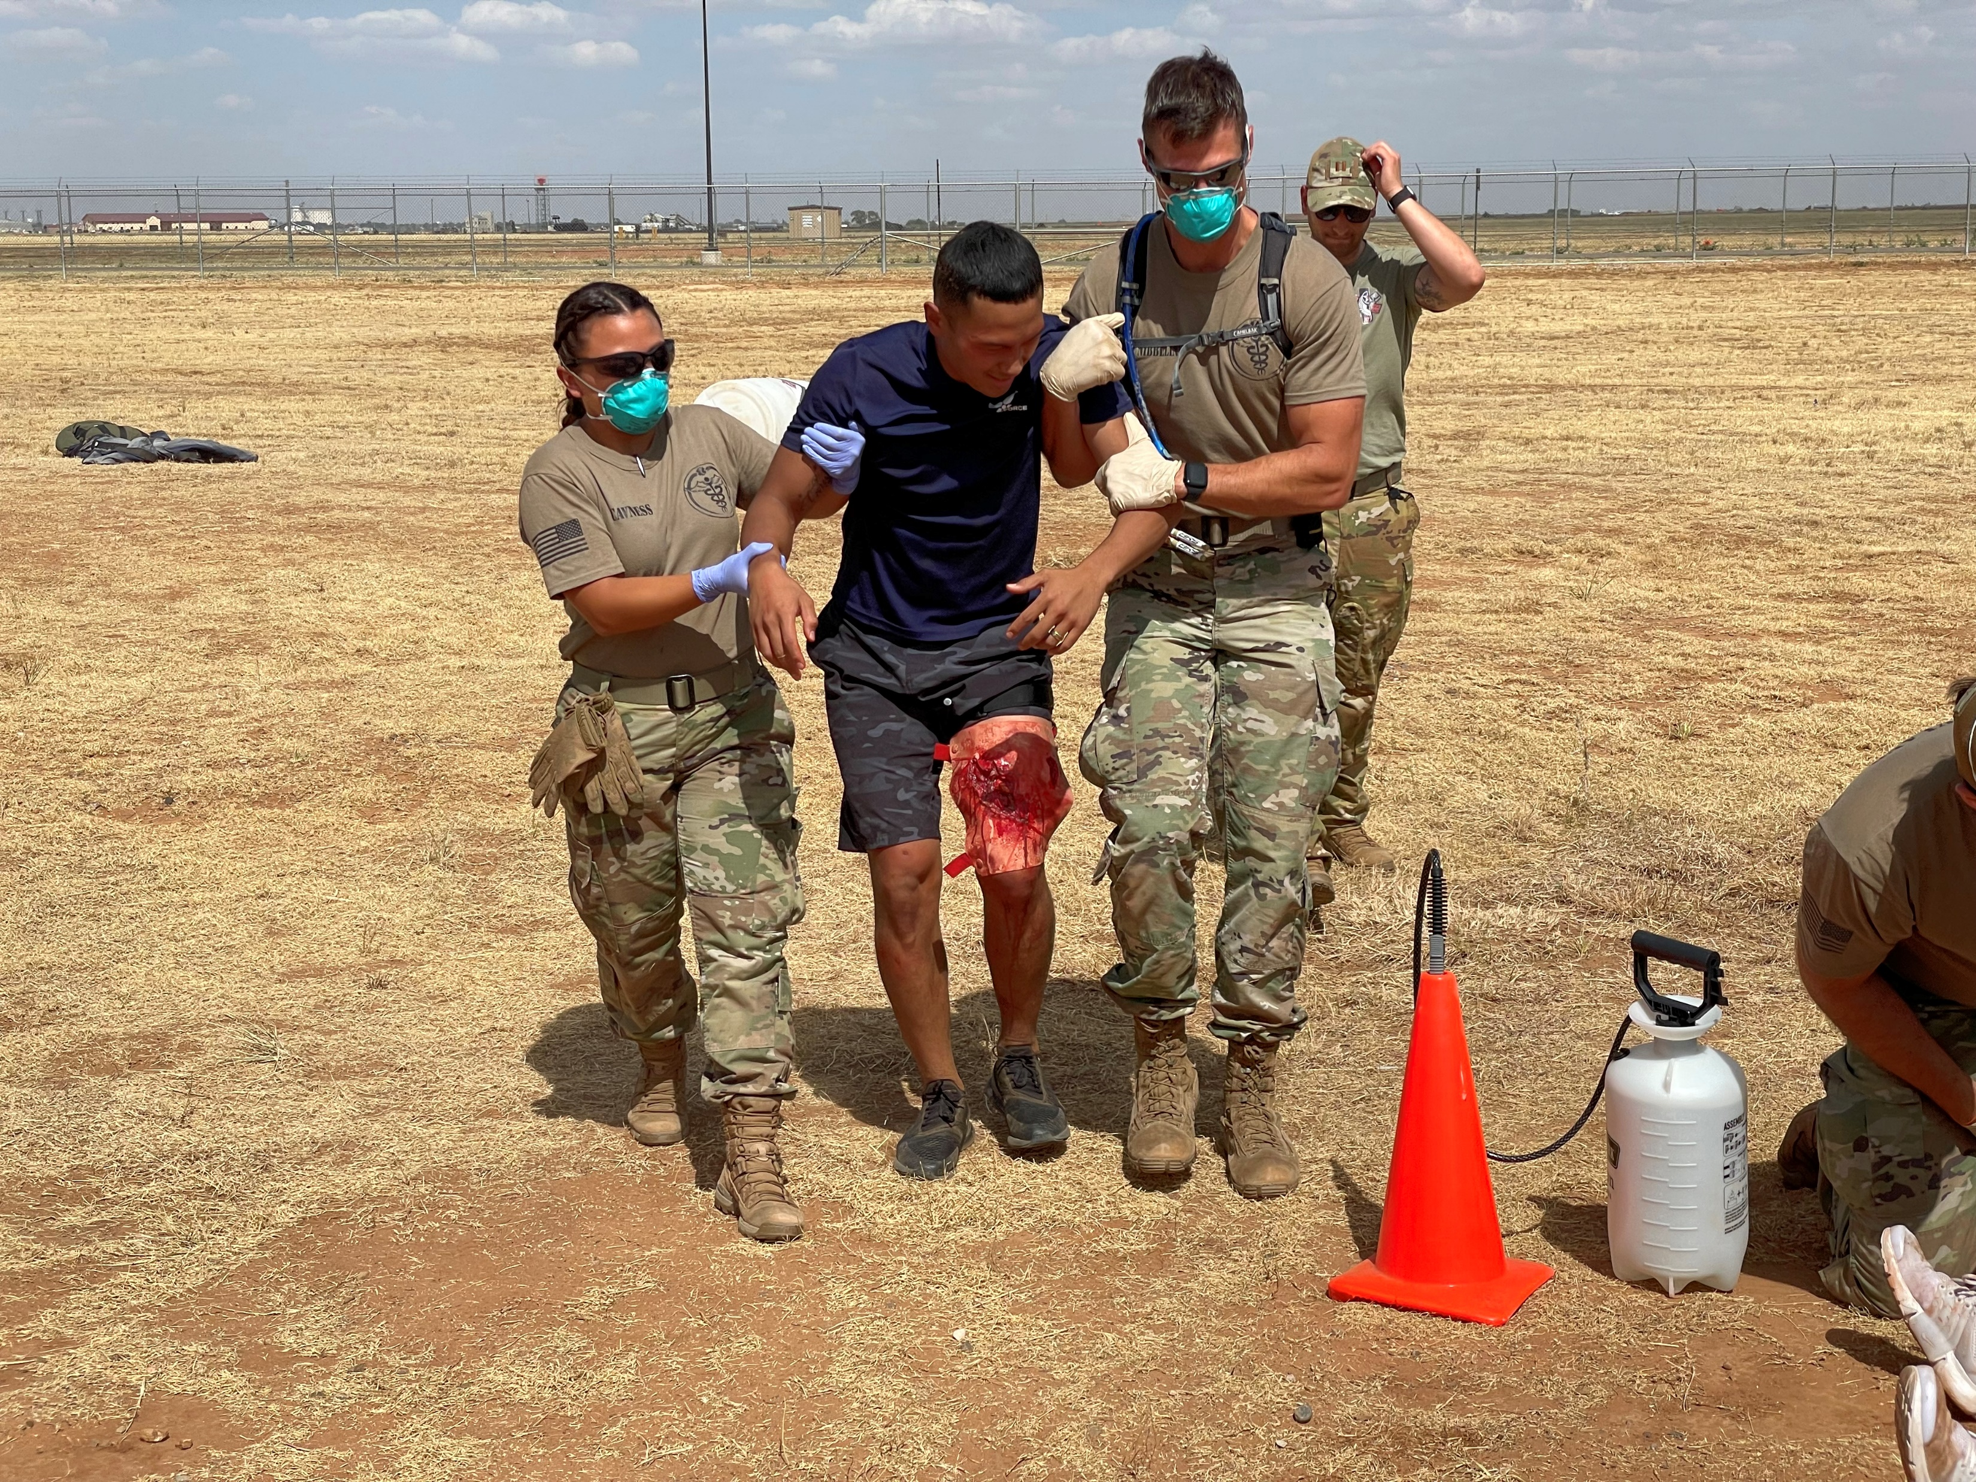
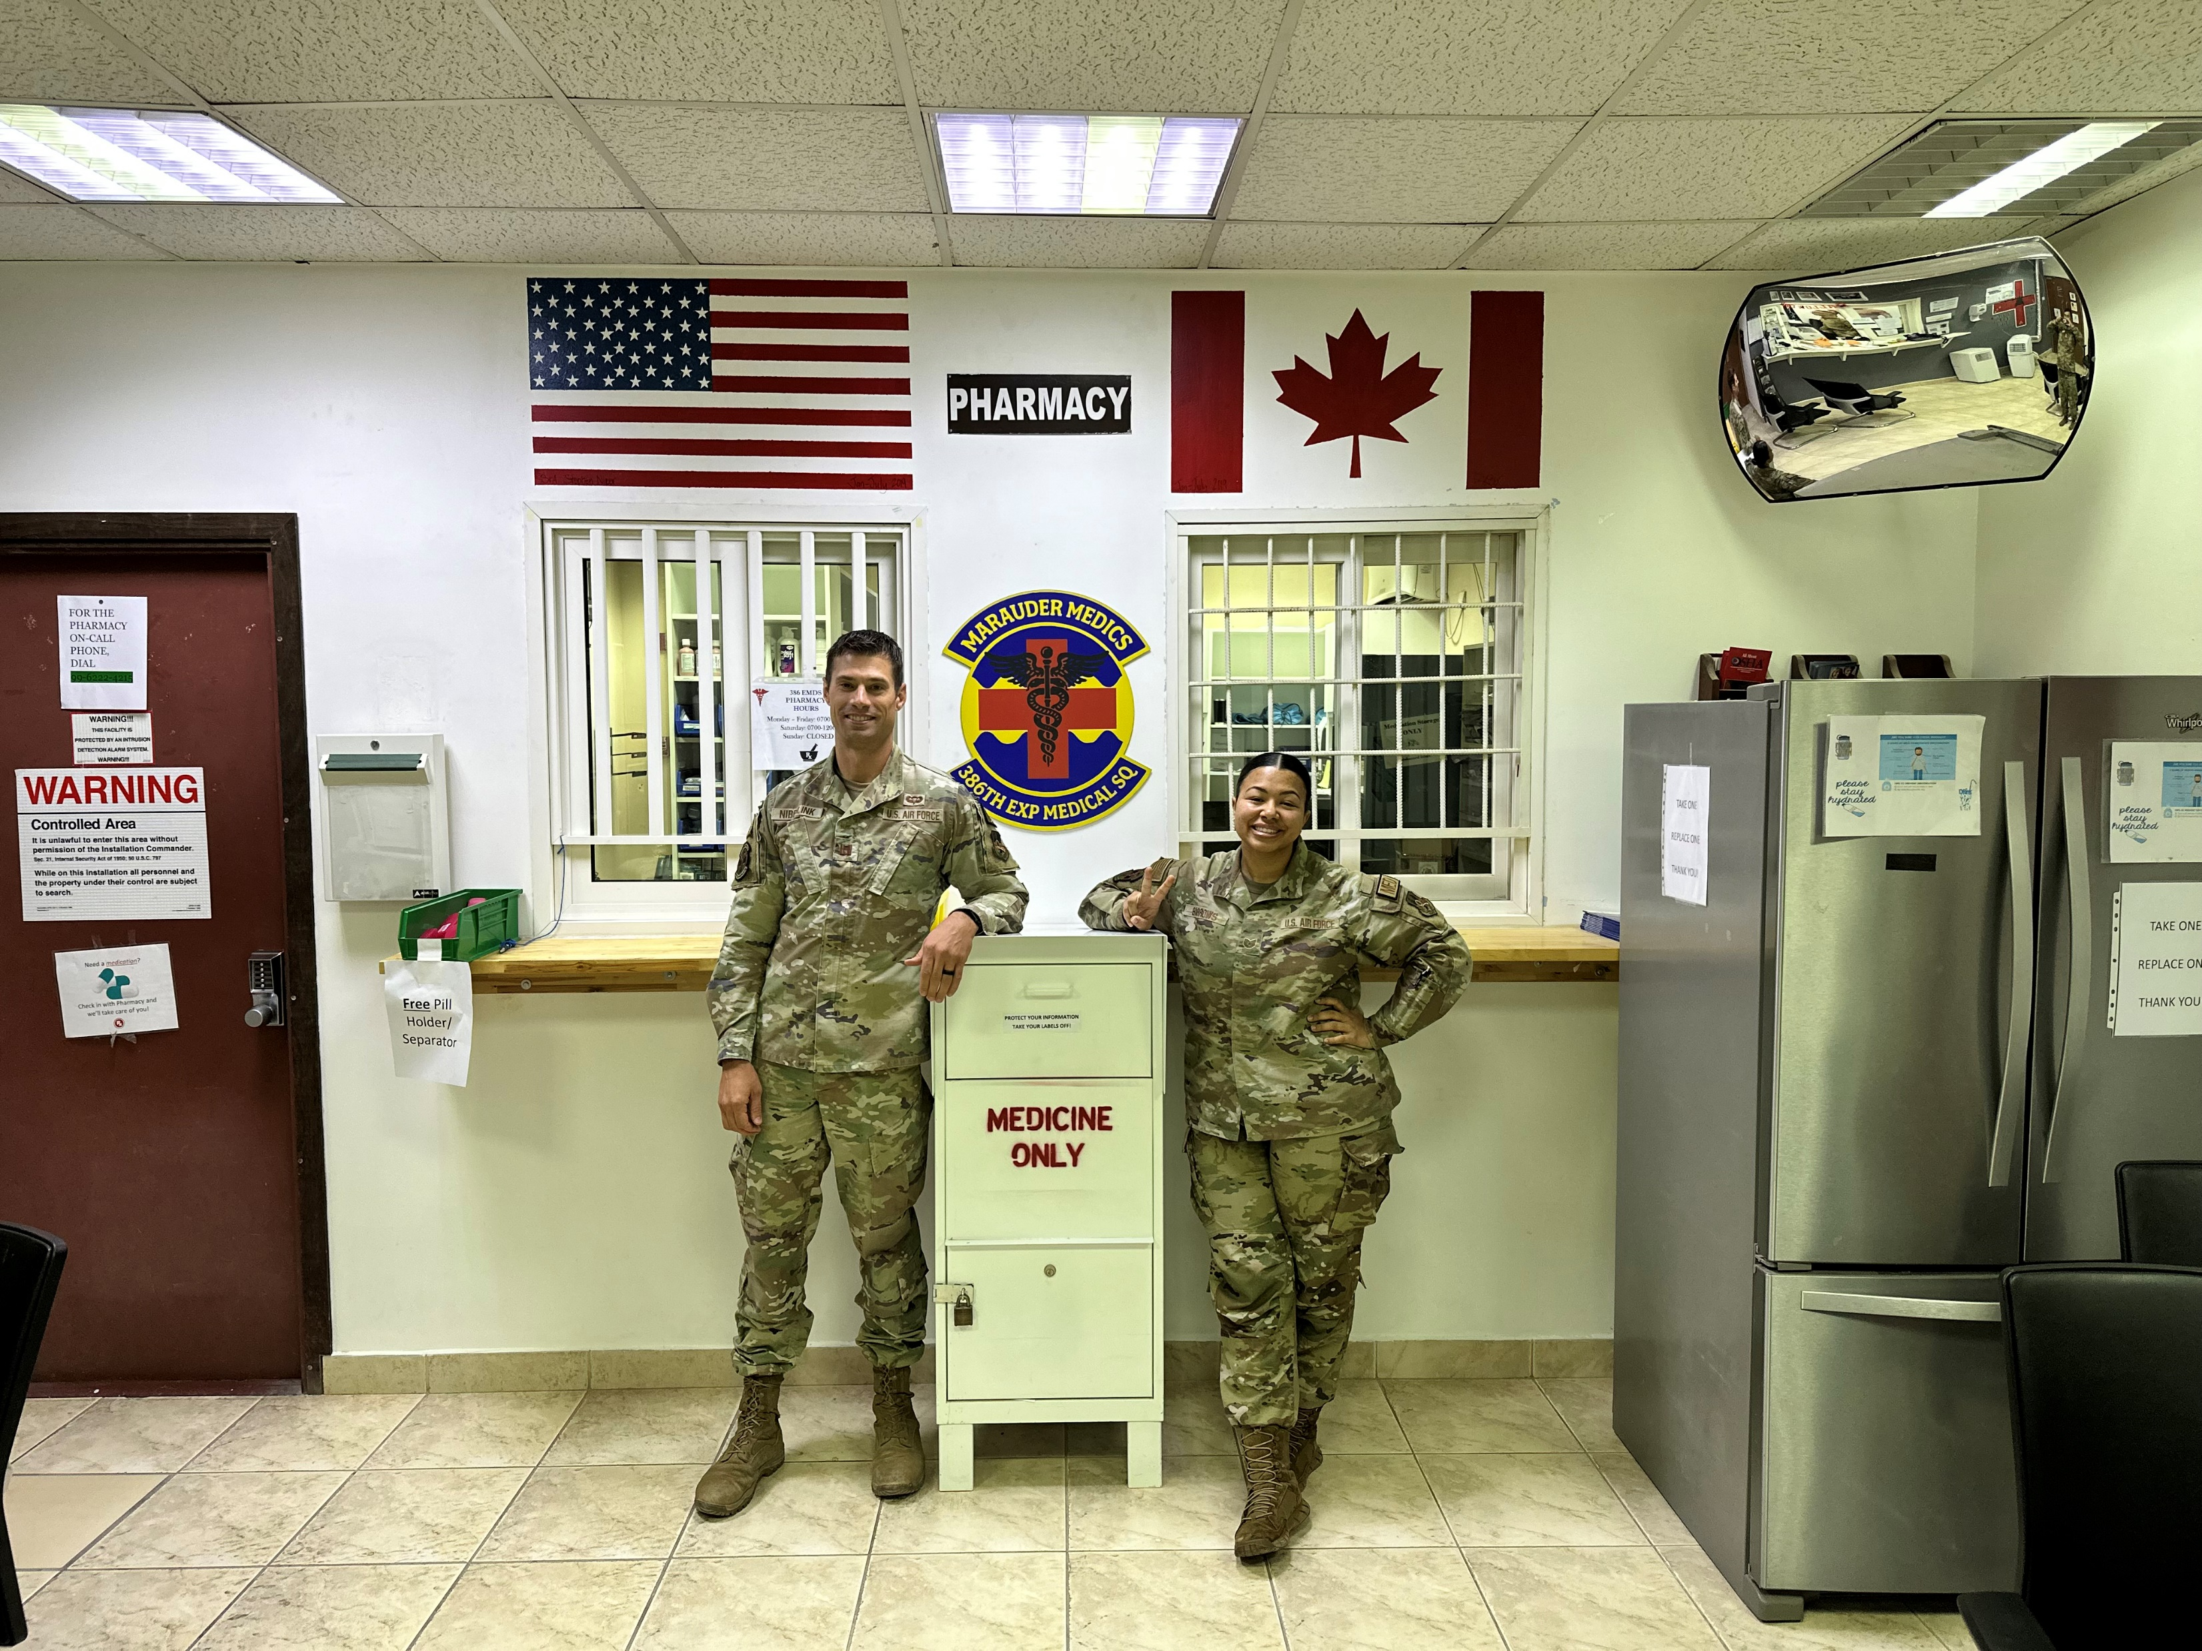
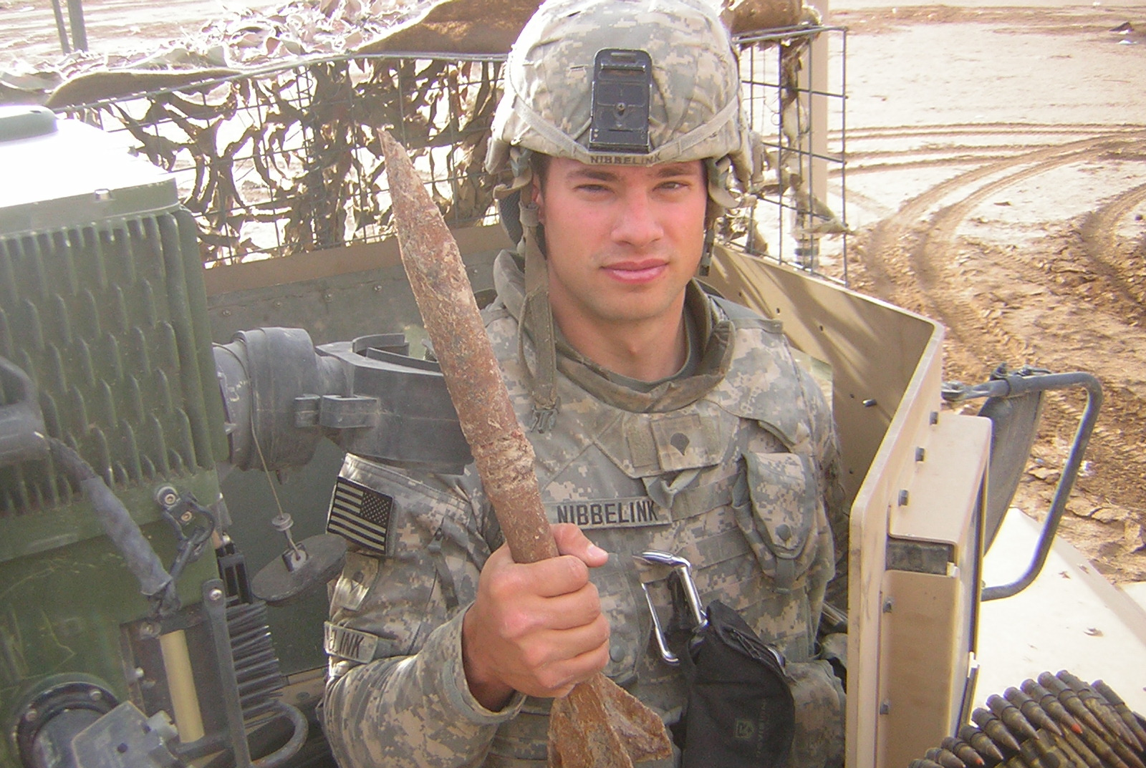

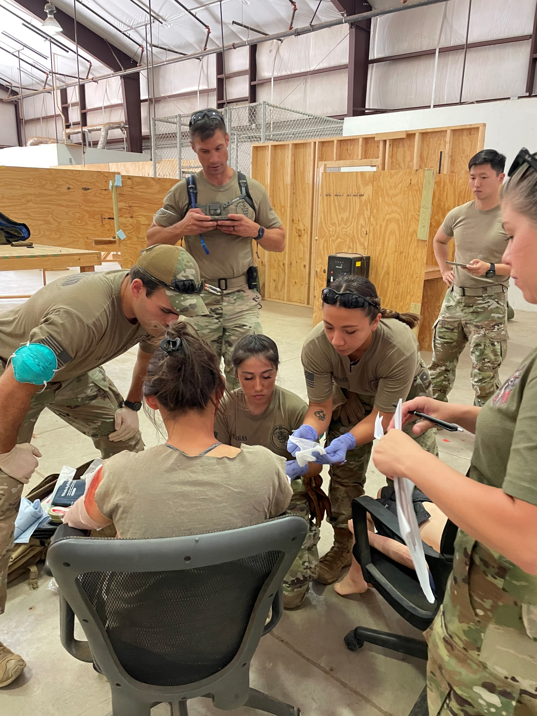
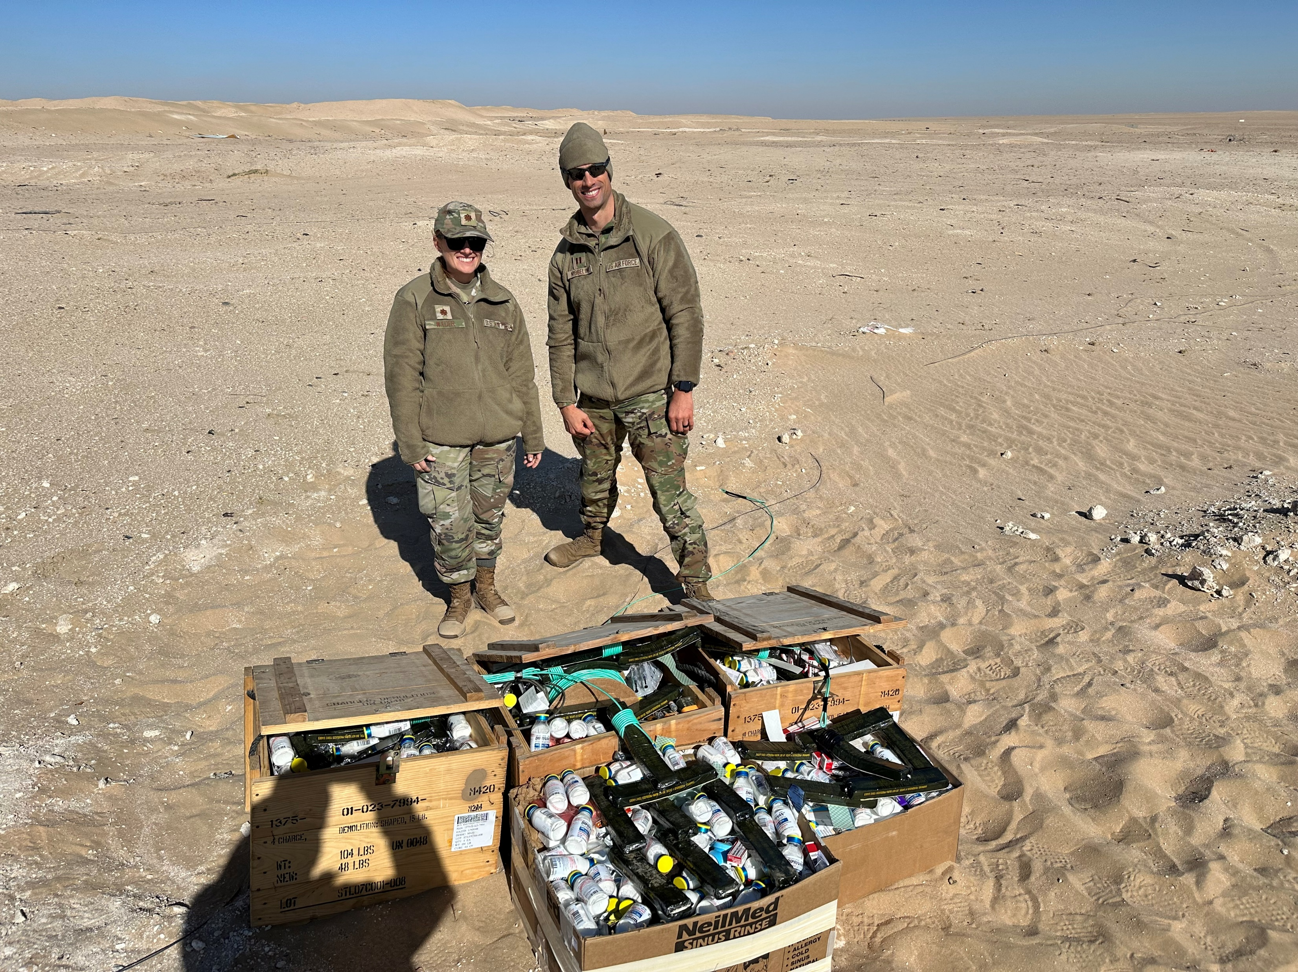
My Story
Notes:
Elevator Pitch
Army, contracting, Air Force pharmacy
Risks that became issues
The hack on change healthcare (cyber attack)
Genesis issues
Duplicate dispenses
Increased workload for main pharmacy transferred risk onto the robot pharmacy and took some of the additional workload
Downloading refills to a different site
Random refills not being fulfilled
The reason we have a disaster team
Lab process improvement project
Robotics system has a lot of moving parts – a lot can go wrong

Slide 5
Learning Objectives
Define, assess, and mitigate risk as it relates to healthcare
Highlight the unique challenges and risks in military pharmacy practice
Explain the relationship between risk management and CPI in the context of pharmacy operations
Demonstrate how applying both strategies can improve patient safety, operational efficiency, and the quality of pharmacy services
Explain how CPI and risk management support readiness, mission success, and optimal care delivery

Slide 6
Questions to Ask in Risk Management
What are we trying to achieve?
What will affect the organization?
Which things that might affect the organization are most important?
What should we do about it?
Did our actions work?
What changed?
Notes:
What will affect me/my organization?
What will hinder me from achieving my goal?
What will help me to achieve my goals?
2. Which things that might affect me are most important?
Likelihood and impact
3. What changed?
Constantly update the risk register

Slide 7
What is Risk?
Uncertainty
  Positive risks = Opportunities
  Negative risks = Threats
Be able to spot risks
  Adverse events, medication errors, near misses, complaints
Determine if they are threats or opportunities
Add identified risks to a risk register
  If the risk identified as a risk to others, it should be included here
  Identifies actions to prevent the risk from occurring
Seek input from subject matter experts (SMEs)
What is your unit’s risk appetite?
Notes:
Trigger condition – an event or situation that indicates that a risk is about to occur
Opportunity – a risk that, if developed, would create a positive effect on one or more project objectives
Threat – a risk that would have a negative effect on one or more project objectives
Issue – a current condition or situation that may have an impact on the project objectives
5% of hospital admissions are caused by preventable adverse drug events
GIVE EXAMPLES OF OPPORTUNITIES AND THREATS
Define key terms
Risk management – identifying, assessing, and mitigating risks to patient safety, operational efficiency, and resource utilization
CPI – Ongoing efforts to improve pharmacy processes through systematic approaches

Slide 8
Types of Risks
Known unknowns
  Identifiable based on past projects
  Predictable based on common sense
Unknown unknowns
  Unpredictable
  Accidents, natural disasters, security attacks (e.g. Change Healthcare)

Slide 9
Types of Risk in Air Force Pharmacy
Business risks
Clinical risks
Operational risks
Compliance risks
Air Force/Military specific
Notes:
Business risk – the inherent risk in any business endeavor that carries the potential for either profit or loss. Types of business risks are competitive, legislative, monetary, and operational
Predictive plan based – we spend a lot of time on risk management because we can only alter our plan through formal change control. We are supposed to have a bunch of contingency plans in place in case of issues.
Adaptive approach – We take a change based approach where we work in small iterations. We work hard in the sprint for 2-3 weeks, stop, and then listen to the feedback and adjust/pivot our approach based on the feedback. We might look at long term risk, but we only hyperfocus on the sprint
Risk categories in pharmacy
Clinical risks – medication errors, adverse drug reactions, drug interactions
Operational risks – workflow inefficiencies, staffing issues, inventory management problems
Compliance risks – regulatory issues, accreditation, and safety standards
Air Force specific risk considerations
Unique challenges in the military context (e.g. deployment operations, overseas or remote pharmacy services, high-stress environments)
Legal and regulatory considerations specific to military pharmacy practice (e.g. DOD directives, FDA guidelines, and military health system requirements)

Slide 10
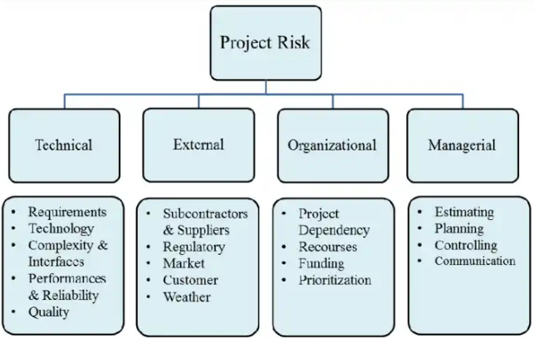
Risk Identification
Data gathering and analysis
Evaluate external environment for risks
  Prompt list
  VUCA (volatility, uncertainty, complexity, ambiguity)
  PESTLE (political, economic, social, technical, legal, environmental)
  TECOP (technical, environmental, commercial, operational, political)

Slide 11
Self-Assessment Question #1
What are the different types of risk?
  Known unknowns
  Unknown unknowns
  Known knowns
  A & B Only
  All of the Above
Notes:
1. D

Slide 12
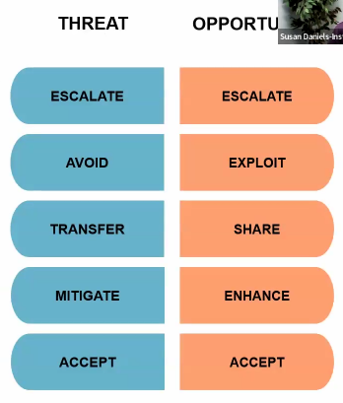
SWOT Analysis
Positive/Helpful
Potentially Negative/Harmful
THREAT
OPPORTUNITY
Internal
(Attributes of the Organization)
Strengths
Weaknesses
External
(Attribute of the Environment)
Opportunities
Threats
Notes:
GET INPUT FROM ALL STAKEHOLDERS
Key Points:
Strengths are those elements which enhance an organization's advantages and strong points. When conducting a risk analysis, an organization might identify some of its strengths .
Weaknesses can include: cost overruns, outdated technology, and product selection. In order to truly understand your organization prior to implementing an improvement initiative, it's also important to evaluate its weaknesses. Addressing weaknesses can help set the foundation for sustained improvement.
Opportunities for your organization can be further improved if you can identify the existence of, or changes in areas such as technology, operations, organization, environment, etc.
Threats are those factors that can disrupt your organization and can seriously undermine your ability to function, and in an extreme situation, may even jeopardize your mission. It is therefore very important to evaluate potential threats as part of the strategic risk analysis. Correctly identifying threats your organization might encounter can greatly reduce the dangers and risks associated with your mission.
Risk framework in pharmacy
Risk identification – Common risks in pharmacy environment (e.g. medication errors, supply chain issues, and equipment failures)
Risk assessment – Tools for assessing the likelihood and severity of risks (e.g. failure mode and effect analysis (FMEA), root cause analysis (RCA))
Risk mitigation – strategies to minimize or eliminate risks (e.g. standard operating procedures, automation, education, and training)
Risk categories in pharmacy
Clinical risks – medication errors, adverse drug reactions, drug interactions
Operational risks – workflow inefficiencies, staffing issues, inventory management problems
Compliance risks – regulatory issues, accreditation, and safety standards
Air Force specific risk considerations
Unique challenges in the military context (e.g. deployment operations, overseas or remote pharmacy services, high-stress environments)
Legal and regulatory considerations specific to military pharmacy practice (e.g. DOD directives, FDA guidelines, and military health system requirements)
Four risk responses for threats
Avoid
Transfer
Mitigate
Accept

Slide 13
Risk Response to Threats
Avoid
  If risks are too costly or unpredictable
Transfer
  Shift the risk to a third party
Mitigate
  Reduce probability that the risk will occur and/or the impact it will have to acceptable levels (i.e. building redundancy into a system to avoid failures)
Accept
  The risk is small, rare, or can’t be avoided, transferred, or mitigated
Notes:
Transfer – main pharmacy shifting RXs to CFP

Slide 14
Risk Response to Opportunities
Exploit
  Eliminate uncertainty to ensure it happens
    Change a project’s schedule, objectives, or budget
    This can be costly and use up more resources
Share
  Join with a third party to increase the chance of sharing benefits
    You want to implement perpetual inventory and team up with a base that has already done so – the risk of failing is much lower
Enhance
  Taking steps to increase the likelihood of this happening
Accept
Notes:
Share – the AF does this in pharmacy through third party software like Nexia, Parata, Audiocare
Enhance
Accept

Slide 15
SWOT Analysis
S-O → Exploit the opportunities using the strengths
S-T → Avoid threats using the strengths
W-O → Turn weakness into strength using opportunities
W-T → Fix weakness
Strengths and weaknesses are internal factors
Opportunities and threats are external factors

Slide 16
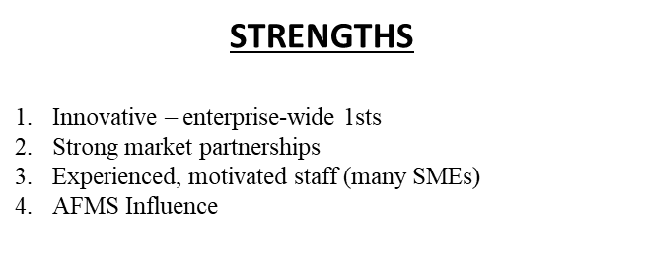
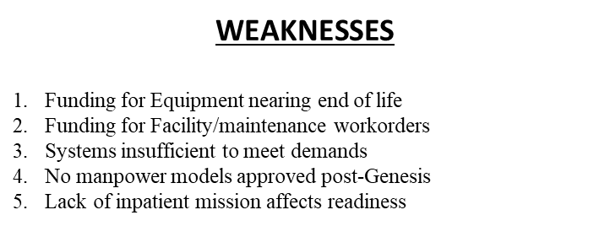
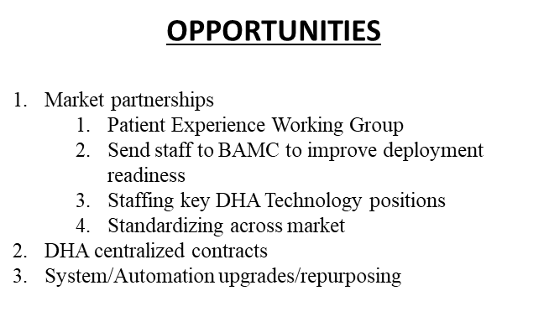
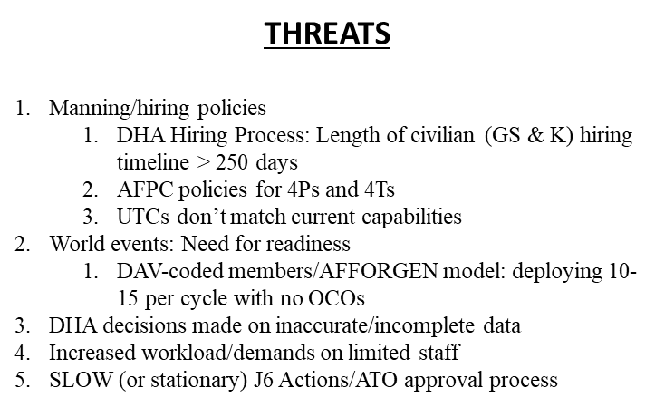
Example SWOT Analysis

Slide 17
Self-Assessment Question #2
What does SWOT stand for?
  Strengths, weaknesses, opportunities, trust
  Strengths, weaknesses, opportunities, threats
  Stability, weaknesses, opportunities, threats
  Stability, weaknesses, opportunities, trust
Notes:
1. B

Slide 18
Risk Appetite/Threshold
What is the risk appetite?
  Risk-seeking – willing to do cutting edge work
  Risk-neutral – can float with the level of risk and can absorb it as needed
  Risk-averse – look at what we did last time and make a small incremental change
Risk threshold
  You as a leader must define the threshold based on stakeholder input
  When do you need to bring the level of risk to the attention of leadership
    They can monitor and control the level of risk – now a part of their awareness

Slide 19
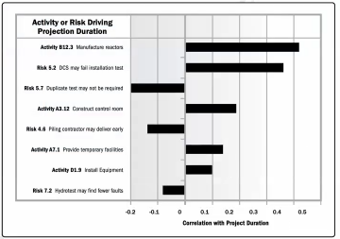
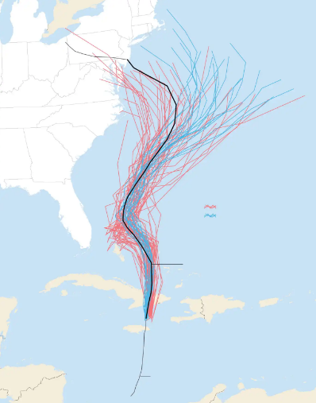
Quantitative Risk Analysis Methods
Notes:
The sensitivity analysis output is a tornado diagram – a horizontal bar chart comparing relative importance of various risks, highest on top
Can also use:
Decision tree analysis
Influence diagrams
Expected monetary value (EMV)
Simulation
An analytical technique that models the combined effect of uncertainties to evaluate their potential impact on objectives
Monte Carlo Simulation (risk analysis)
A risk management technique, which project managers use to estimate the impacts of various risks on the project cost and project timeline. Using this method, one can easily find out what will happen to the project schedule and cost in case any risk occurs. It is used at various times during the project life cycle to get the idea on a range of probable outcomes during various scenarios
These used to be only ran by the DoD, but computing has become so powerful, they can now be ran on home computers.
Sensitivity analysis
An analysis technique to determine which individual project risks or other sources of uncertainty have the most potential impact on project outcomes, by correlating variations in project outcomes with variations in elements of a quantitative risk analysis model.

Slide 20
Quantitative Risk Analysis
Decision tree analysis
  Branches represent decisions or events, each with associated costs and risks
  The end-points of branches represent the outcome (negative or positive)
Influence diagrams
  Quality management graphical aid
  Shows elements of uncertainty caused by risks using ranges or probability distributions → used when decision trees are too complex
Expected Monetary Value (EMV)
  Multiply the monetary value of a possible outcome with its probability of occurrence to calculate the EMV of each branch
  Select the optimal one
Notes:
Decision tree analysis
A diagramming and calculation technique for evaluating the implications of a chain of multiple options in the presence of uncertainty
Understand how to read a decision tree. The decision tree is used to decide whether or not to produce product X or Y (or more). You take the probability times the amount of money for each risk and sum up the total for each product. Then you decide which one is more feasible to produce.
Influence diagram
Used in quality management decisions. A graphical representation of situations showing causal influences, time ordering of events, and other relationships among variables and outcomes.
Influence diagrams show how things relate to one another. Similar to an affinity diagram.
Expected monetary value
A quantitative method of calculating the average outcome when the future is uncertain. The calculation of EMV is a component of decision tree analysis. Opportunities will have positive values and threats will have negative values.

Slide 21
Managing Risk
Reduce uncertainty
Determine appropriate responses
Assess effectiveness of the response
Set an initial risk strategy, then define and refine it
  Project characteristics
    Size
    Complexity
    Importance
    Development approach

Slide 22
Cost of Quality (Risk Mitigation)
Money spent during a project to avoid failure
  Prevention costs
  Appraisal (quality assessment)
Money spent during/after a project because of failures
  Internal failure costs → Risk became an issue
    Rework
    Scrap
  External failure costs → Risk became an issue
    Liabilities
    Warranty work
    Lost business
Notes:
Prevention costs
Training
Document processes
Equipment
Time to do work “right” – resources, infrastructure expenses
Appraisal (quality assessment)
Testing
Inspections

Slide 23
Quality Management
Monitor for risks
  Cost overruns, schedule delays, or potential disputes
Conduct inspection and testing
Physical resource management
  Equipment, materials, facilities, infrastructure
Evaluate quality of project activities and processes through reviews and audits
Focus on DETECTING AND PREVENTING errors and defects
Notes:
Procurement process compliance
Periodic progress or activity reports
Required advance notification and acknowledgement to suppliers
Formal acceptance of contracted deliverables

Slide 24
Quality Control Tools
Data gathering
  Checklists/check sheets
  Statistical sampling
  Questionnaires and surveys
Data analysis
  Performance reviews
  Root cause analysis
Data representation
  Cause-and-effect diagram
  Scatter diagram
  Control charts
  Histograms
  Pareto charts

Slide 25
Risk Response
Risk responses should be:
  Appropriate for the significance of the risk
  Cost effective
  Realistic within the project context
  Agreed to by relevant stakeholders
  Owned by a responsible person

Slide 26
Risk Response
Prepare strategies for threats (negative) as well as opportunities (positive) and for individual project risks and overall project risk.
A trigger condition signals a risk can develop
Team implements a risk response
A secondary risk can arise as a direct result of the risk response implementation
Residual risk can remain after risk responses have been implemented
Have a contingency (fallback) plan ready in case the primary risk response fails
Notes:
Different Methods for risk response:
Six Sigma – DMAIC framework (define, measure, analyze, improve, control) – focus on removing waste
Kaizen – “change for better/improve”
PDCA – Plan-Do-Check-Act – Shewhart/Deming
Agile methods – scrum, Kanban, Crystal Methods (software), etc.
Secondary risk
A risk that arises as a direct result of implementing a risk response
Example: If you implement the response plan of driving the piece of equipment to the rail station during the snowstorm, that is a secondary risk.
Residual risk
The risk that remains after risk responses have been implemented
There is always going to be a little residual risk
Example: You implement the contingency plan of flying the piece of equipment, but it gets delayed or re-routed because of a thunderstorm or plane malfunction.
Contingency plan
A risk response strategy developed in advance, before risks occur; it is meant to be used if and when identified risks become reality
Example: you have a piece of equipment to be transported through the mountains in the dead of winter. The response plan if the forecast calls for greater than 51% chance for snowstorm is to transport by rail. The contingency or fallback plan is to move it to the airport and wait for the storm to pass, and then transport it → think COAs
Contingency reserve
Time or money allocated in the schedule or cost baseline for known risks with active response strategies

Slide 27
Risk Register vs. Risk Report
Risk Register
  Date
  Description of individual risk
  Likelihood of occurrence
  Impact/severity
  OWNER
  Mitigating and contingent actions
  Progress on actions
  Status
Risk Report
  Summary of identified risks
  Quantified risk
  When to escalate
  Presented to higher leadership

Slide 28
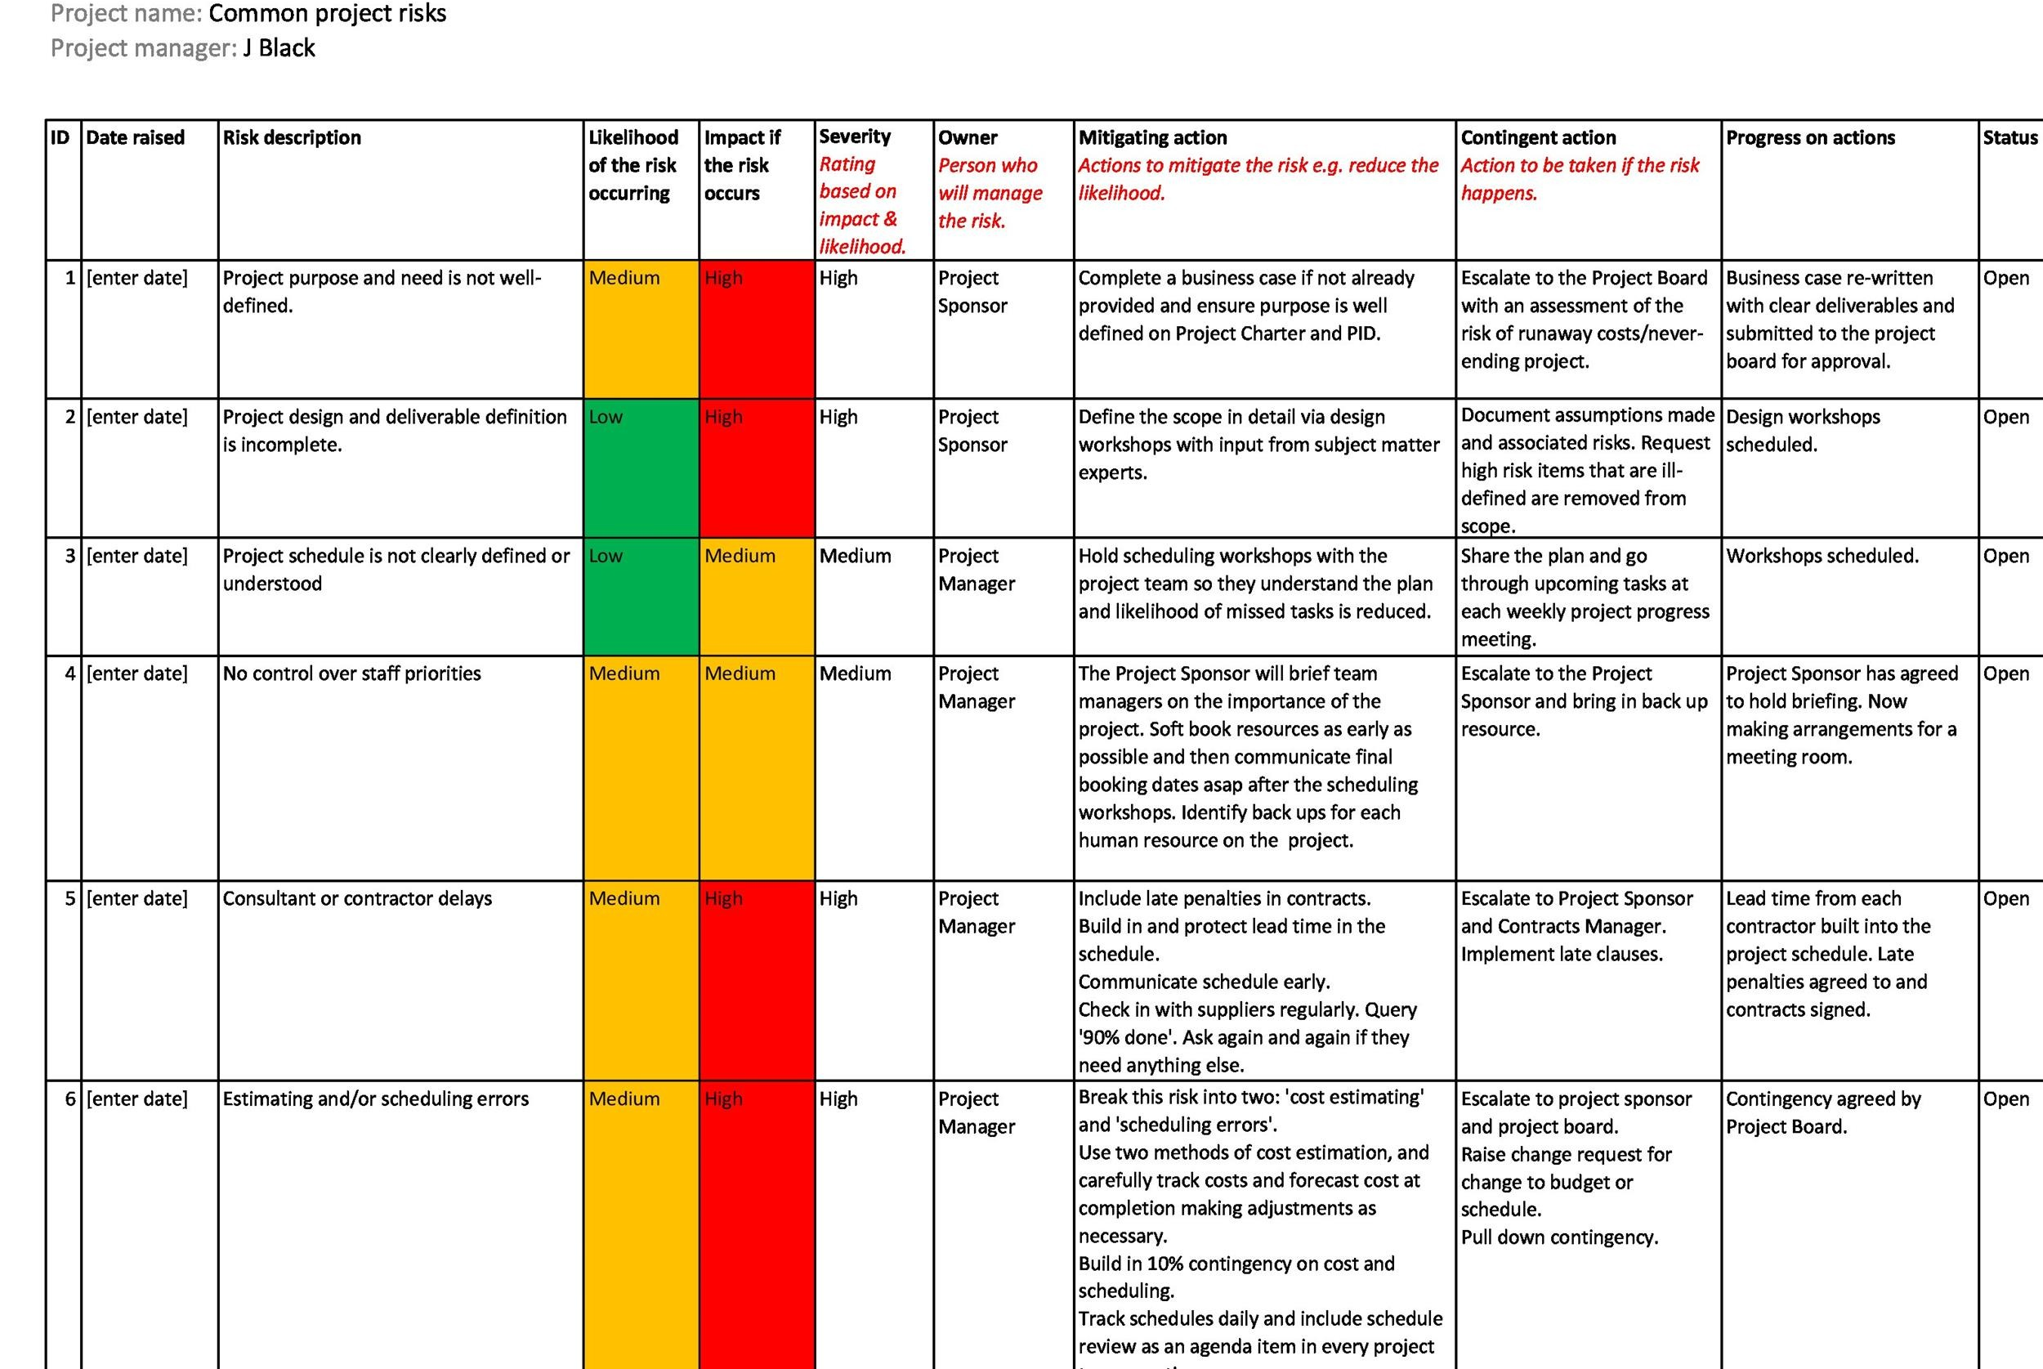
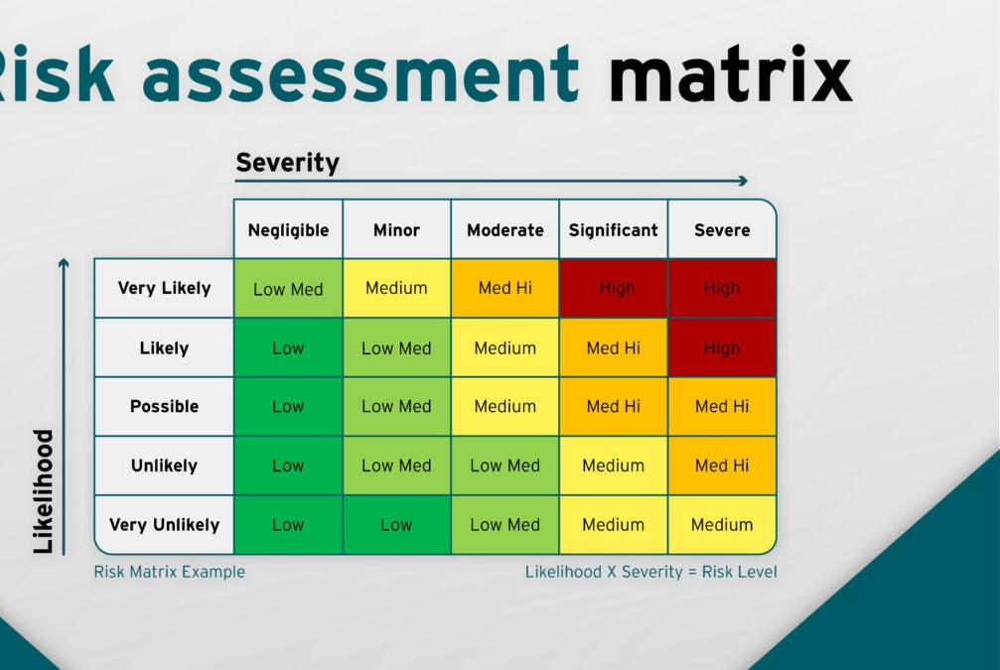
Risk Assessment using a Matrix and Register
Notes:
Prioritize risks for further analysis by assessing and combining their probability of occurrence and impact in a probability/impact matrix
Probability and impact matrix – a grid for mapping the probability of occurrence of each risk and its impact on project objectives if that risk occurs
If further support is required, then you may use a quantitative assessment
Not every risk needs quantitative assessment
What if Susie said there is a high probability of something happening but it will have a low impact on the project? We need to define
The picture is an example of what you can get people to agree on what is high/medium/low in terms of probability or impact
This will not be applicable to every project as the cost will change and time. We need to tailor these risk and probability matrices to our specific project.
I still don’t know which risks I can accept, which are unacceptable, and which I need to develop contingency reserves for.
Use numeric values and/or colors
If using numbers, multiply them to give a probability impact score – this makes evaluating relative priority easier
This is still not a quantitative evaluation
Risk register
A repository in which outputs of risk management processes are recorded. As the central planning document for project risk analysis and control, the risk register contains a list of the most important risks to the project’s completion. For each risk, it identifies the likelihood of occurrence, the impact to the project, the priority, and the applicable response plans.
The person that is accountable (owner) is the person that develops a planned response to the risk
1 risk can affect multiple packages which would mean there would be multiple contingency plans and owners for that one risk
Risk registers can get convoluted and busy
This is not as robust of an approach as we have the impact that will be adjusted based on feedback after every iteration and then the magnitude of the effect on the project.
The teams can add (tailor) columns for:
Owner
Status
Date identified
Date resolved
Days active
Resolution strategy
In addition to a risk list or risk register, teams use information radiators and a backlog refinement process with risks added, which are discussed at various planning meetings
Risks can take you by surprise and get you if you don’t have a plan in place.

Slide 29
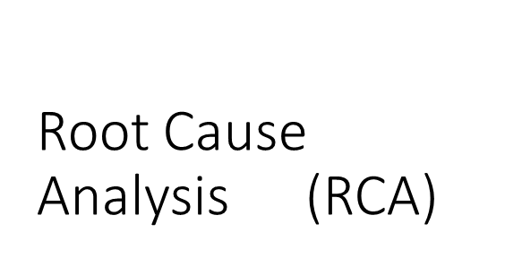
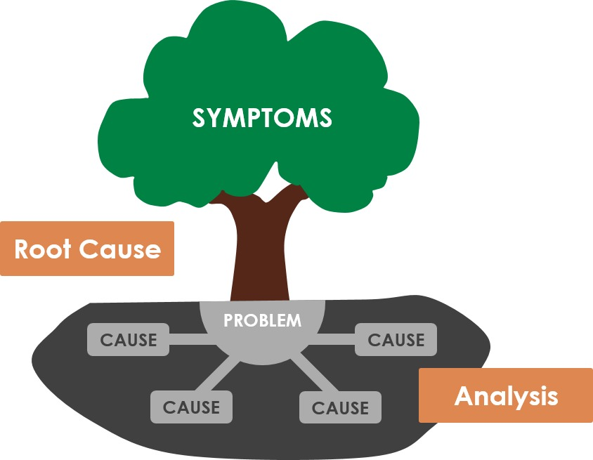
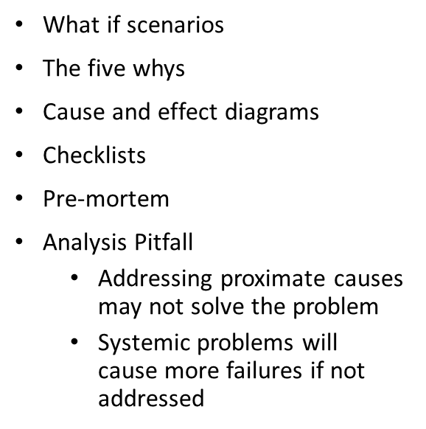
Risk Becomes an Issue

Slide 30
Change Management Plan
ADKAR
Metrics
  “Measure What Matters” – John Doerr
  Measure desired quality attributes for the product or project through testing, use of tools, processes
    Include a tolerance level that factors in what the customer will accept and describe the desired quality level in the acceptance criteria and DoD.
Notes:
Awareness for the need to change
Desire to change
Knowledge of HOW to change
Ability to change
Reinforcement – This one is very important

Slide 31
Monitor Risks
Enable decision-making based on current information about overall risk exposure and individual risks
Continuously monitor status, probability and impact
Identify new risks
Reassess current risks
Close outdated risks
Perform on a regular basis
Continuously improve risk effectiveness
Notes:
A common failure among teams is identifying and analyzing risks and developing risk responses but then take no action in managing the risk
Servant Leadership
Remove obstacles (as much as possible) for people to mitigate risks and accomplish the mission.

Slide 32
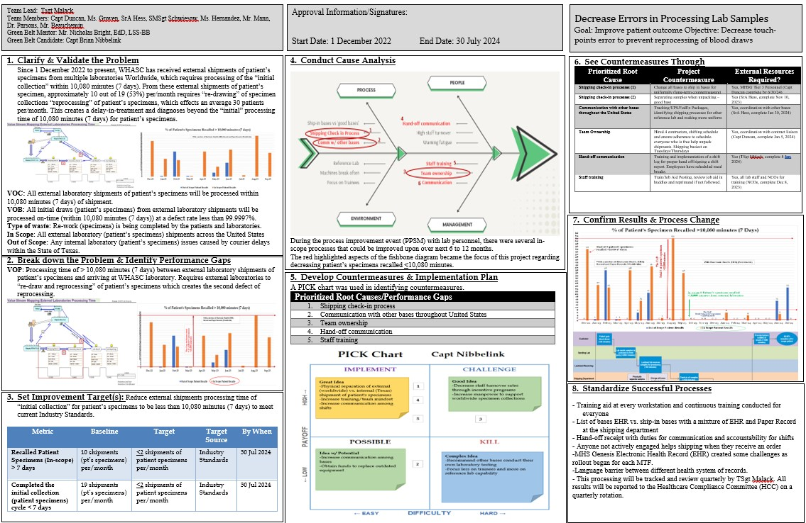
Continuous Process Improvement

Slide 33
Problem Statement
3 Parts
  The current state
  The gap
  The future state
Location & severity of the problem
Financial cost
“In the second quarter of CY 2018 (when), 15% of our customers have left the bank for another institution (what). The current rate of attrition is up from 8% to the current level of 15% (magnitude). This negatively affects our operating cash flow (impact or consequence).”
Notes:
Six Sigma Business Problem Statements Examples​
There are three parts to a problem statement: the current state, the gap, and the future state. Within these three parts, a problem statement must contain the location of the problem, the severity of the problem, and the financial cost. Two examples of a problem statement in business follow.​
​
A web-based company may have a problem statement as follows.​
The holiday discount code programmed into the system was incorrectly imputed on January 1, 2021. Web-based customers were given a 100% discount instead of a 10% discount from 00:01 to 09:47 am. This resulted in a loss of $172,567.54. Currently, there are no standard operating procedures in place to alert personnel when mistakes happen. Going forward, alerts should be set up for orders with zero cost and discount codes over 50%, and they should require manager approval.​
​
Another example problem statement for a company that makes teddy bears follows.​
​
A sharp drop in sales of Love U Teddy occurred from February 7, 2021, to February 14, 2021, when the voice chip implanted in the teddy at the San Antonio, Texas manufacturing plant that was shipped to 15 stores in Georgia, Florida, and South Carolina malfunctioned, scaring younger customers. 92% of customers returned their bears for a full refund, costing a loss of $1,765,890.12 in sales. Currently, we do not have extensive random testing of products before they hit the stores. Going forward, products should undergo extensive random testing before they are available to the public.​

Slide 34
Problem Statement
“From July 2019 to June 2020, the 59th Medical Group Pharmacy identified the severe underutilization of the ScriptCenter kiosk located at the PX on Area D. Only about 2770 (14%) prescriptions were dispensed at the ScriptCenter out of the 19.8K total dispensed to Active-Duty members. Patients not receiving prescriptions at the ScriptCenter must travel to Area 3 located 16.5 miles away to pick up medications.”
VOB/VOC: Commanders & patients want to be able to pick up 95% of their prescriptions on Area D to reduce unnecessary travel during medical appointments.

Slide 35
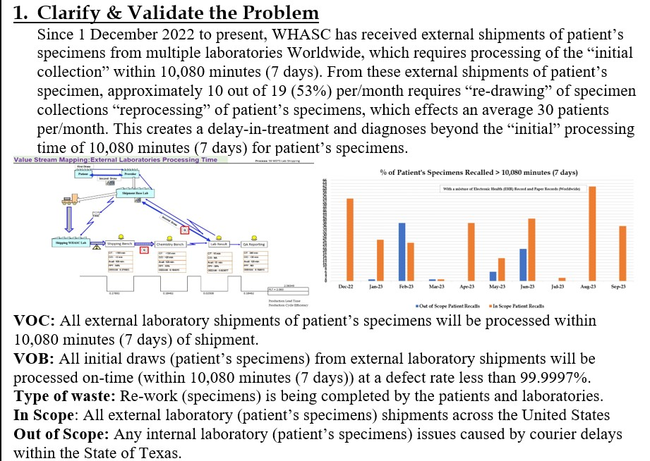

Slide 36
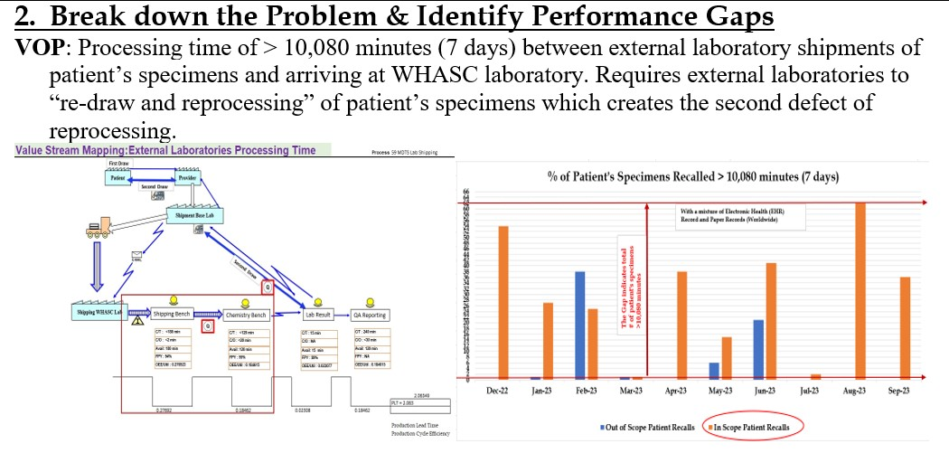

Slide 37
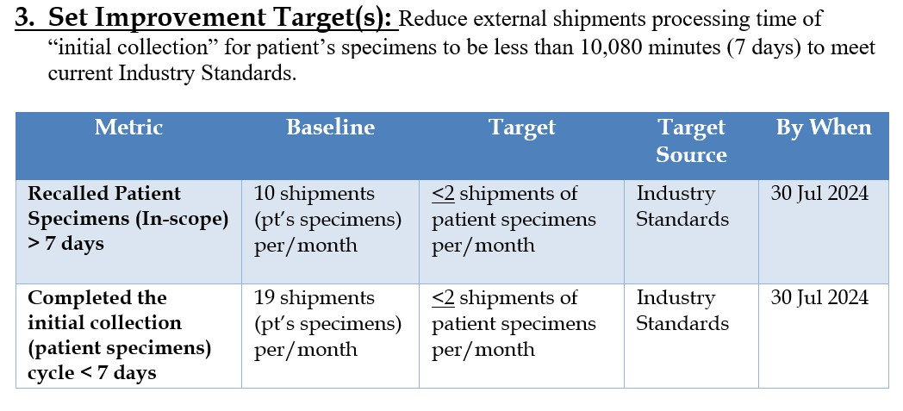

Slide 38
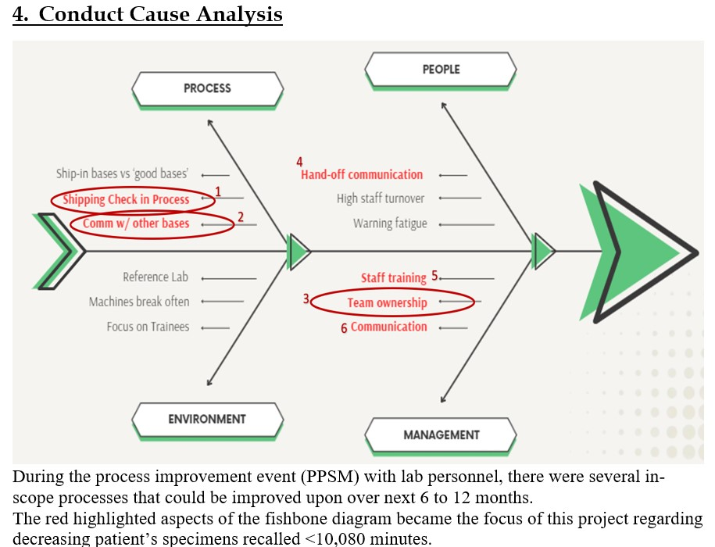

Slide 39
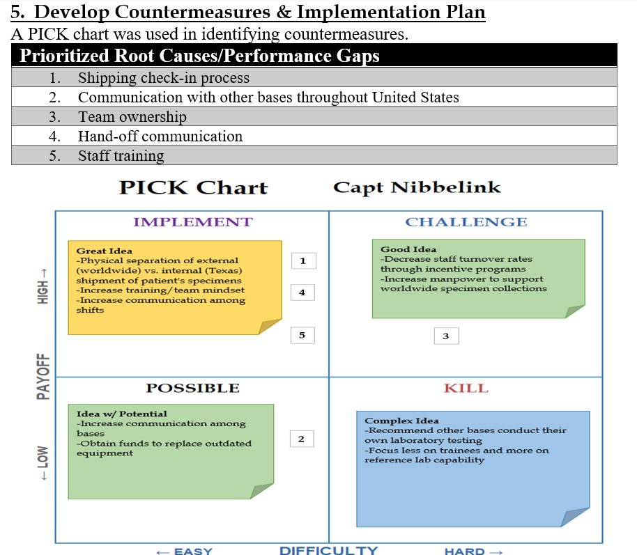

Slide 40
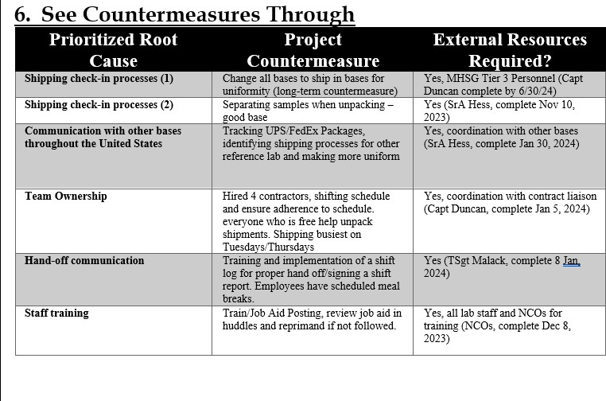

Slide 41
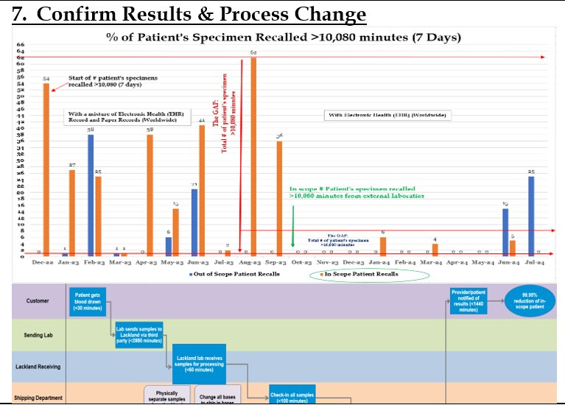

Slide 42
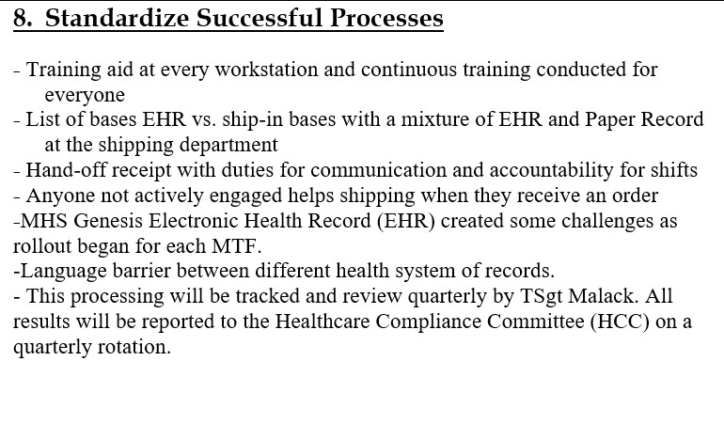

Slide 43
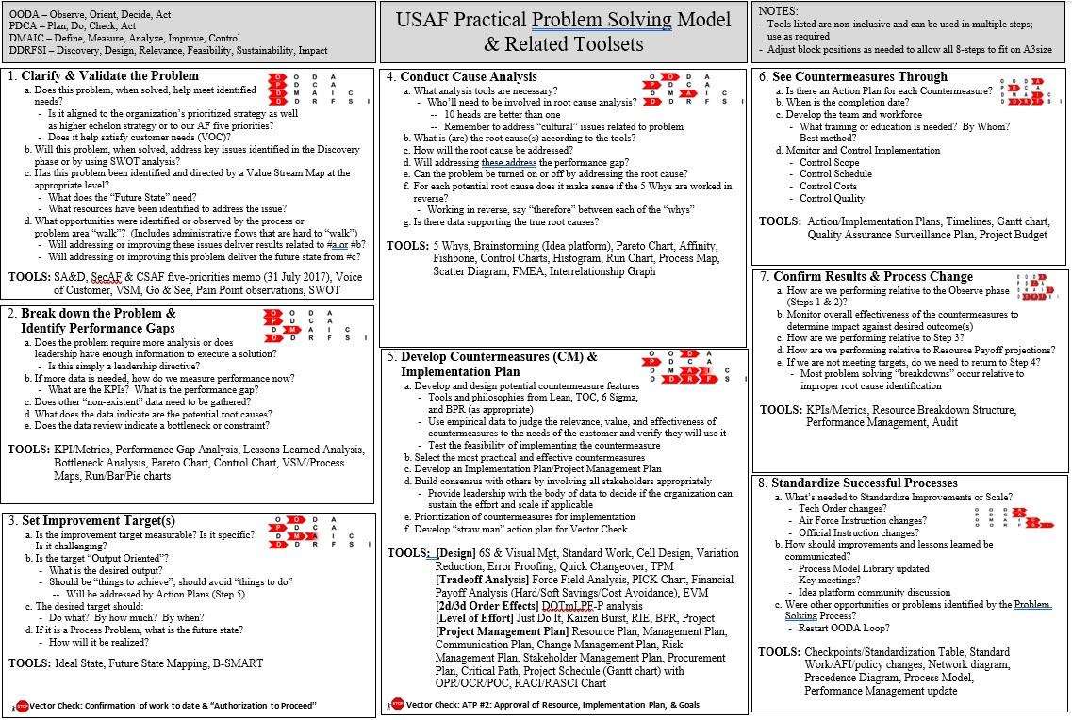

Slide 44
Integrating CPI and Risk Management
Key Performance Indicators (KPIs)
  Error reduction rate
  Patient satisfaction scores
  Compliance audit results
Air Force specific applications
  Supporting operational readiness
  Serving deployed populations
  Managing cross-functional teams
Notes:
Integrating risk management with CPI
How risk management supports CPI
Identifying high-risk areas for focused improvement efforts
Preventing recurrence of errors by integrating risk data into the CPI process
Prioritizing actions based on risk severity and potential impact on patient care
Synergy – explain how risk management and CPI are interrelated and complement each other in the pharmacy setting. Bothare focused on improving safety and operation efficiency
Real-life integration – Show an example of how integrating risk management and CPI can improve pharmacy operations. For instance, reducing medication errors through both risk management and process optimization (e.g. a new medication safety checklist combined with a process to review prescription dispensing errors.
Discuss the role of leadership and staff in creating a culture of safety and continuous improvement in pharmacy
Metrics for success
Key performance indicators (KPIs) for measuring the effectiveness of integrated risk management and CPI efforts (e.g. error reduction rates, patient satisfaction scores, compliance audit results)
Air Force specific applications
Risk management and CPI in the military pharmacy environment
How CPI and risk management can be tailored to the unique needs of air force pharmacies (e.g. supporting operational readiness, serving deployed populations, and managing cross-functional teams)
Examples of successful CPI and risk management initiatives within the air force pharmacy setting

Slide 45
Leveraging Technology
Robotic dispensing
Medication barcoding
EHR systems
Collaborative approach
Enhancing communication and feedback loops
Notes:
Leveraging technology
Role of automation and health IT systems in mitigating risk and supporting CPI (e.g. robotic dispensing, medication barcoding, EHR systems)
Data analytics in continuous monitoring and improvement
Collaborative approaches and teamwork
Engaging multidisciplinary teams (pharmacists, technicians, providers, and leadership) in the risk management and CPI process
Enhancing communication and feedback loops to drive improvements

Slide 46
Self-Assessment Question #3
What is a technique for conducting a root cause analysis?
  Pick Chart
  Fish bone diagram
  Pareto Chart
  The five whys
  B & D only
  All of the above
Notes:
1. E

Slide 47
Summary/Key Takeaways
Reinforce the importance of risk management and CPI
Encourage adoption of both strategies
Reasons incorporating CPI and risk management can improve patient safety and operational efficiency
How will YOU apply this in your daily practice?
Notes:
Key takeaways
Reinforce the importance of risk management and CPI in fostering a culture of safety and continuous improvement
Encourage adoption of both strategies as part of daily pharmacy practice
Why risk management and CPI are essential in air force pharmacy, how they can improve patient safety and operational efficiency, and the role of air force pharmacist in leading these efforts
Encourage the audience to think about how they can apply risk management and CPI principles to their own practice

Slide 48
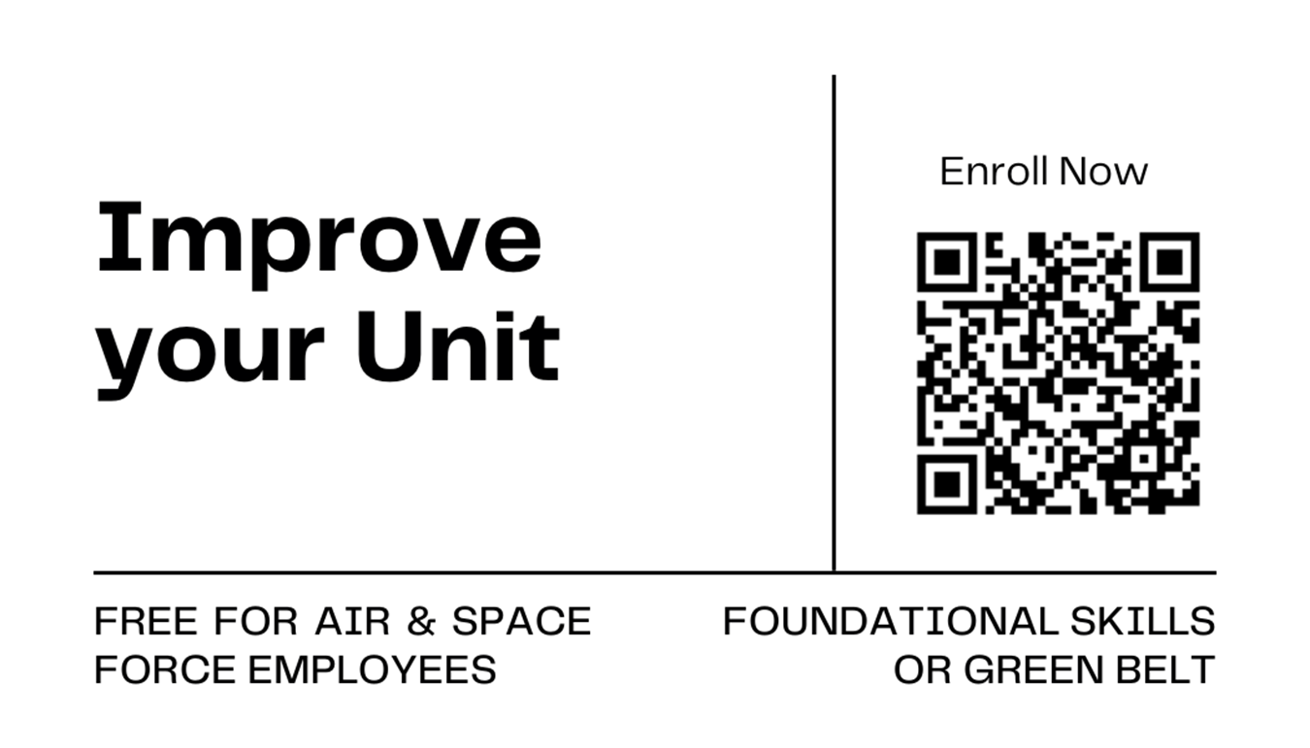
Green Belt Training

Slide 49
Questions
Book Recommendations
  The Hundred-Year Marathon: China’s Secret Strategy to Replace America as the Global superpower, Michael Pillsbury
  Start with Why: How Great Leaders Inspire Everyone to take Action, Simon Sinek
  Extreme Ownership: How U.S. Navy SEALs Lead and Win, Jocko Willink, Leif Babin
  Humble Inquiry, Ed Shein
  Radical Candor, Kim Scott
  Leaders Eat Last: Why Some Teams Pull Together and Others Don’t, Simon Sinek
  The 7 Habits of Highly Effective People: Powerful Lessons in Personal Change, Sephen Covey
  The Avoidable War, Kevin Rudd
  Dare to Lead: Brave Work. Tough Conversations, Whole Hearts, Brene Brown
  The Infinite Game, Simon Sinek
  The Long Game, Rush Doshi
  The Compound Effect: Multiply Your Success One Simple Step at a Time, Darren Hardy
  Chip War, Chris Miller
  The Fearless Organization: Creating Psychological Safety in the Workplace for Learning, Innovation, and Growth, Amy Edmonson
  Wireless Wars, Jonathan Pelson
  Talking to Strangers: What we Should Know about the People We Don’t Know, Malcolm Gladwell
  Everyone Communicates, Few Connect: What the Most Effective People Do Differently, John C. Maxwell
  Turn the Ship Around: A True Story of Turning Followers into Leaders, L. David Marquette
  Multipliers: How the Best Leaders Make Everyone Smarter, Liz Wiseman
  Call Sign Chaos: Learning to Lead, Jim Mattis
  Grit: The Power of Passion and Perseverance, Angela Duckworth
  The 5 Levels of Leadership: Proven Steps to Maximize Your Potential, John C. Maxwell
  Can’t Hurt Me: Master your Mind and Defy the Odds, David Goggins
  Option B: Facing Adversity, Building Resilience, and Finding Joy, Sheryl Sandberg & Adam Grant
  Atomic Habits: An Easy & Proven Way to Build Good Habits & Break Bad Ones, James Clear
  Thinking Fast and Slow, Daniel Kahneman
  It Worked for Me: In Life and Leadership, Colin Powell
  Make Your Bed: Little Things that can Change your Life… And Maybe the World, Admiral William H. McRaven

Slide 50

Continuing Education Credit
Deadline to obtain CE 5 Aug 2025

