Slide 1
Society of Air Force Pharmacy
Mid-Year Conference
16 -18 June 2025
Hilton Norfolk The Main
Norfolk, VA

Slide 2
43P Officer Breakout Session
Col Soo A. Sohn
43P CFM and AF/SG Pharmacy Consultant

Slide 3
Disclosure
Col Soo A. Sohn “Declare(s) no conflicts of interest, real or apparent, and no financial interests in any company, product, or service mentioned in this program, including grants, employment, gifts, stock holdings, and honoraria.”

Slide 4
Learning Objectives
To understand how to access and leverage pharmacy support system
To comprehend the BSC Development Team’s goals and process
To understand assignment matching priorities and criteria

Slide 5
Self-Assessment Question #1
Which is not a key indicator that the BSC DT members look for when reviewing officer records?
  A. Sustained exceptional duty performance
  B. Scope of responsibility and leadership
  C. Stratification among peers
  D. Push lines
  E. None of the Above

Slide 6
Self-Assessment Question #2
What is the #1 priority of assignment?
A. Member’s Location Preference
B. Needs of the AF
C. Personal/Family Challenge
D. Career Development

Slide 7
Self-Assessment Question #3
True or False: A member must be released from the career field to apply for a 43B or non-medical position (i.e., not applicable to out-of-hide job)
  True
  False

Slide 8
Pharmacy Support
MAJCOM Pharmacy Consultants
  ACC: Lt Col Mark Ballesteros/Lt Col Cory Hedin
  AETC: Lt Col Brooke Van Eeghen/Lt Col Brian Welch
  AFDW: Maj Aubrie Frazier
  AFGSC: Lt Col Quam Tram
  AFMC: Col Timothy McDowell
  AFSOC: Lt Col Sang Ngo
  AMC: Lt Col Emily Fletcher/Lt Col Heather Fenzl
  PACAF: Lt Col John Hammil
  USAFE: Lt Col Zach Finney/Lt Col Timothy Weigle
  USAFA: Lt Col Heather Kincaide
  USSF: Lt Col Lakisha Roe
Notes:
Core competency
Relevancy and competency

Slide 9
Pharmacy Support (cont’d)
MAJCOM Pharmacy Functionals
  ACC: CMSgt Timothy Schnur/SMSgt Karen Salenga
  AETC: CMSgt John Gray/SMSgt Jasmin Trumic
  AFDW: SMSgt Kendra Anthony
  AFGSC: SMSgt Donald Atkins
  AFMC: CMSgt Crystal Hollars-Connely/SMSgt Justin Viator
  AFSOC: MSgt Thoney Douangnoy
  AMC: SMSgt Raechael Machuga
  PACAF: SMSgt Traci England
  USAFE: SMSgt Cherrelle Hill
  USAFA: MSgt Theresa Vargas
  USSF: AFMC MFMs
Notes:
Core competency
Relevancy and competency

Slide 10
Pharmacy Support (cont’d)
Pharmacy SMEs
  4P CFM: CMSgt Latonya Reno
  Readiness: Lt Col Brett Christy, Lt Col (sel) Allison James, Maj Emily Lucas & SMSgt Justin Viator, etc.
  METC: Lt Col Burke Wilson & MSgt Lacey Harris
  DLA: Lt Col Charles Stallings & Lt Col Francisco Boral
  APhA Delegates: Lt Col Brandy Renner & Lt Col Christian Banasky
  ASHP Delegates: Lt Col (sel) Elizabeth Tesch & Lt Col Rohin Kasudia
  USP Delegate: Lt Col Julie Meek
  SAFP: Maj Ciera Williams, Maj Justine Seymour, Maj Cody Morcom, Maj Montana Rickey, & TSgt Shima Noga
Notes:
Core competency
Relevancy and competency

Slide 11

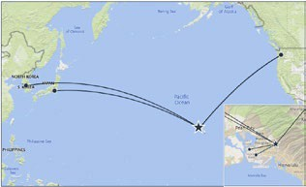
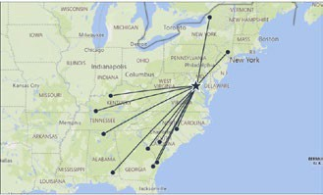


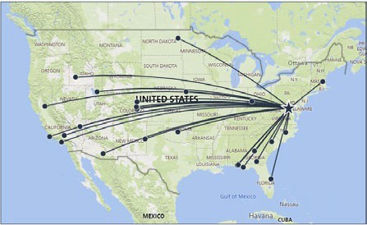
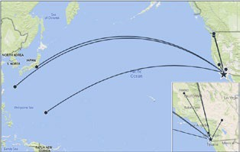
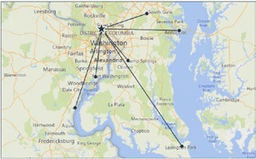
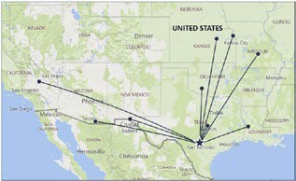
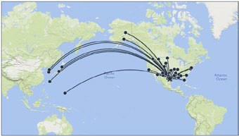
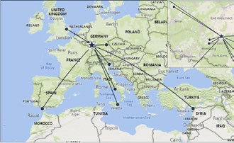

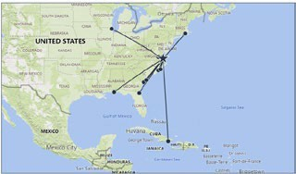




UNCLASSIFIED
UNCL_{C}AS_{U}S_{I}IFIED
DHN 6 East (11)
5 February 2025
DHN Indo-Pacific
Lt Col Sarah Kelly
DHN 1 Indo-Pacific (7)
DPC Laydown
sarah.e.kelly32.mil@health.mil
CDR Katherine Jaudon
0047 - Dwight D. Eisenhower AMC
katherine.l.jaudon.mil@health.mil
DHN East
0089 - Womack AMC (Ft Liberty)
0052 - Tripler AMC (Hawaii) 
0001 - Fox AHC (Redstone)
0125 - Madigan AMC (Ft Lewis) 0280 - NHC Hawaii
0003 - Lyster AHC (Ft Novosel) 0048 - Martin ACH (Ft Moore)
0287 - 15th MDG Hickam (Hi)
0395 - 62nd MED FLT-JBLM-McChord
DHN NCR
0049 - Winn ACH (Ft Stewart)
DHN Continental
0060 - Blanchfield ACH (Ft Campbell)
0610 - BG Crawford Sams AHC (Japan) 0612 - Brian Allgood ACH (Korea)
DHN Pacific Rim
0061 - Ireland AHC (Ft Knox)
DHN 9 Continental (26)
Lt Col Ryan Dick
william.r.dick10.mil@health.mil
0032 - Evans ACH (Ft Carson)
0033 - 10th MDG-Academy
0042 - 96th MDG-Eglin
0079 - 99th MDG-Nellis
0095 - 88th MDG-Wright-Patterson
0010 - 355th MDG-Davis Monthan
0015 - 9th MDG-Beale
0018 - 30th MDG-Vandenberg
0019 - 412th MDG-Edwards
0043 - 325th MDG-Tyndall
0046 - 45th MDG-Patrick
0050 - 23rd MDG-Moody
0051 - 78th MDG-Robins
0053 - 366th MDG-Mtn Home
0078 - 55th MDG-Offutt
0085 - 27th SPCLOPS MDGRP-Cannon
0090 - 4th MDG-Seymour Johnson
0093 - 319th MDG-Grand Forks
0096 - 72nd MDG-Tinker
0101 - 20th MDG-Shaw
0119 - 75th MDG-Hill
0248 - 61st MED SQ-Los Angeles
0252 - 21st MDG-Peterson
0310 - 66th MDG-Hanscom
7139 - 1st SPCL OPS MDG-Hurlburt
7200 - 460th MDG-Buckley
0086 - Keller ACH (West Point)
DHN West
0105 - Moncrief AHC (Ft Jackson)
DHN 2 Pacific Rim (9)
0330 - Guthrie AHC (Ft Drum)
CDR Katherine Jaudon
DHN 7 NCR (7)
katherine.l.jaudon.mil@health.mil
DHN Central
DHN Europe
LTC Emily Holcomb
0029 - NMC San Diego 
emily.b.holcomb.mil@health.mil
0024 - NH Camp Pendleton
DHN 4 Central (39)
DHN Central (con)
DHN
Atlantic
0067 – WRNMMC 
0028 - NHC Lemoore
Lt Col Brandy Renner
brandy.l.renner.mil@health.mil
0106 - 28th MDG-Ellsworth
0123 - AT Augusta MMC (Ft Belvoir)
0030 - NH Twentynine Palms
0112 - 7th MDG-Dyess
0066 - 316th MDG (M Grow)
0126 - NH Bremerton
0004 - 42nd MDG-Maxwell
0113 - 82nd MDG-Sheppard
0068 - NHC Patuxent River
0127 - NHC Oak Harbor
0005 - Bassett ACH (Ft Wainwright) 0006 - 673rd MDG JBER-Elmendorf
0114 - 47th MDG-Laughlin
0109 - Brooke AMC (Ft Sam Houston)
0069 - Kimbrough ACC (Ft Meade)
0620 - NH Guam
0009 - 56th MDG-Luke
0117 - 59th MDW-WHASC-Lackland
DHN 5 Atlantic (13)
0306 - NHC Annapolis
0621 - NH Okinawa
0013 - 19th MDG-Little Rock
0118 - NHC Corpus Christi
Lt Col Sarah Kelly
0385 - NHC Quantico
0622 - NH Yokosuka (Japan)
0014 - 60th MDG-Travis
0128 - 92nd MDG-Fairchild
sarah.e.kelly32.mil@health.mil
DHN 8 Europe (10)
0036 - 436th MDG-Dover
0129 - 90th MDG-FE Warren
0124 - NMC Portsmouth 
0038 - NH Pensacola
LTC Emily Holcomb
DHN 3 West (9)
0045 - 6th MDG-MacDill
0203 - 354th MDG-Eielson
emily.b.holcomb.mil@health.mil
Lt Col Brandy Renner
0055 - 375th MDG-Scott
0326 - 87th MDG JBMDL-McGuire
0039 - NH Jacksonville
0607 - Landstuhl Reg MEDCEN 
brandy.l.renner.mil@health.mil
0059 - 22nd MDG-McConnell
0338 - 71st MDG-Vance
0056 - James Lovell Fed Hlth Care Cntr
0609 - Bavaria MEDDACC
0008 - Bliss AHC (Ft Huachuca)
0062 - 2nd MDG-Barksdale
0356 - 628th MDG-Charleston
0091 - NMC Camp Lejeune
0617 - NH Naples
0057 - Irwin ACH (Ft Riley)
0073 - 81st MDG-Keesler
0364 - 17th MDG-Goodfellow
0092 - NHC Cherry Point
0058 - Munson AHC (Ft. Leavenworth)
0074 - 14th MDG-Columbus
PACAF Supported by CDR Jaudon
0100 - NHC New England
0618 - NH Rota
0064 - Bayne Jones ACH (Ft Johnson)
0076 - 509th MDG-Whiteman
0637 - 8th MDG-Kunsan (Korea)
0103 - NHC Charleston
0624 - NH Sigonella
0075 - Gen Leonard Wood ACH
0077 - 341st MDG-Malmstrom
0638 - 51st MDG-Osan (Korea)
0104 - NH Beaufort
0633 - 48th MDG-Lakenheath
0098 - Reynolds AHC (Ft Sill)
0083 - 377th MDG-Kirtland
0639 - 35th MDG-Misawa (Japan)
0120 - 633rd MDG JBLE-Langley
0635 - 39th MDG-Incirlik
0108 - Wm Beaumont AMC (Ft Bliss)
0084 - 49th MDG-Holloman
0640 - 374th MDG-Yokota (Japan)
0121 - McDonald AHC (Ft Eustis)
0805 - 52nd MDG-Spangdahlem
0110 - Carl R Darnall AMC (Ft Cavazos)
0094 - 5th MDG-Minot
0802 - 36th MDG-Andersen (Guam)
0122 - Kenner AHC (Ft Gregg-Adams)
0806 - 86th MDG-Ramstein
0131 - Weed ACH (Ft Irwin)
0097 - 97th MDG-Altus
0804 - 18th MDG-Kadena (Okinawa)
0615 - NH Guantanamo Bay
0808 - 31st MDG-Aviano
DHA’s 131
Parent DMIS MTFs
CUI
3

Slide 12
BSC Development Team (DT)
DT: “Provides oversight of officer and civilian development to meet both functional and AF corporate leadership requirements…the conduit between force development systems, frameworks, and policy and translate into career vectors for individuals.”
BSC DT 2x per year – Spring and Fall
Spring DT Goals:
  BSC squadron command vacancies
  BSC IDE & SDE opportunities
Fall DT Goals:
  BSC HPERB opportunities
  Graduated Sq/CC and O-4/O-5 select vectoring

Slide 13
DT Process
  a. Spring DT Board Members Selected – O-6s or higher
    Strategic thought placed into experience and skillsets
    Graduated Gp/CCs and/or Pinnacle Positions
  1.b. Fall DT Members
    O-6 CFMs
  2. Records Prepared/QC’d and Boards Created in MyVector for EACH eligible member
    Your Statement of Intent, OSB/SURF, Fitness Report, ALL OPBs/OPRs, ALL Decorations
Scoring at the Board
  Sq/CC Scoring
  IDE/SDE Scoring
  HPERB Scoring*
    Each eligible individually scored on 6-10 Scale
    Tie Breaker Scoring
    *Timing is critical
  Outbrief
  Candidate List for Sq/CC Published (by July)
  IDE/SDE Selection List Published (by Aug)
  HPERB Selection List Published (by Dec)
  Career Field & Data Trends
After the Board
Preparations for the Board

Slide 14
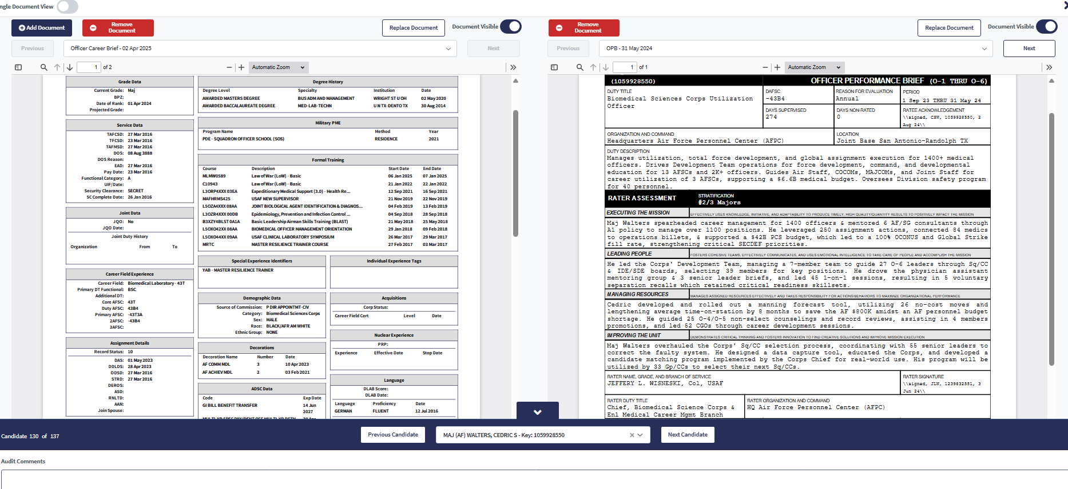
DT Member View

Slide 15
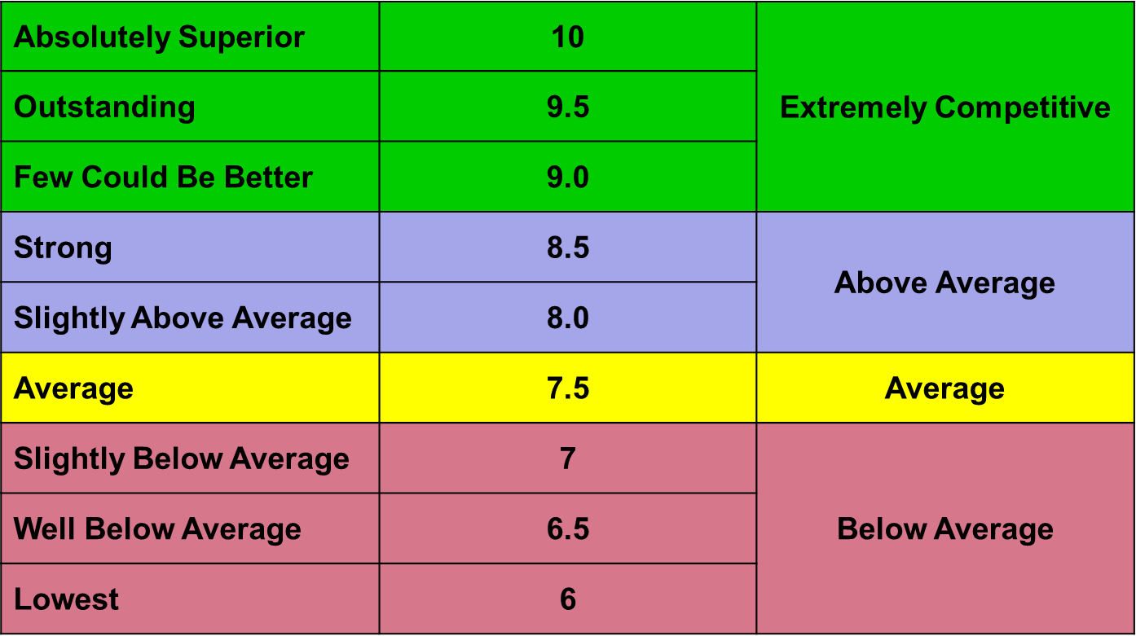
Scoring Scale

Slide 16
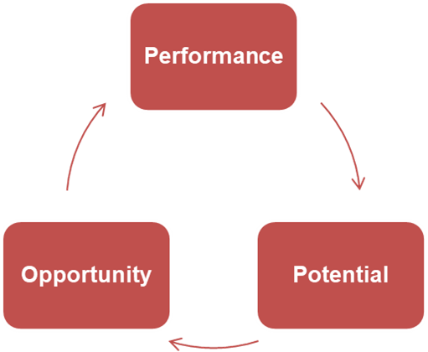
Items to Consider
Rare opportunity, critical to future – must evaluate objectively & select only the best fit for AF / BSC needs
Points to Consider
  Career trajectory
  Future potential
  Deliberate development – CC, Jt, O-6 leadership, BSC GO bench
Key Indicators
  Sustained exceptional duty performance…plus character
  Scope of responsibility, leadership, unique/valuable experiences
  Stratification among peers – OPBs/OPRs, SR’s DE nomination
  Push lines – tone, DE, future job(s) consistent with high potential
AF / BSC Leadership

Slide 17
Notable Attributes
Performance:
  Consistency of stratification and / or improving
    Attention to pin-on dates, PCS dates (consistent performance ≠ strat every yr)
  IDE/SDE completion shows initiative, timing matters
  Push line consistent with opportunity
  Individual and team awards
  Performing at the level of higher grade
  Demonstrated Leadership of people, Flight Command or equivalent
  Unique experience – fellowship, IHS, Jt, Pentagon/HHQ
SR Endorsement
  Quality of endorsement is critical
  Performance assessment, especially when a gap in OPB
Strong character, officership & soft skills – evident in record

Slide 18
Notable Detractors
Self-needs > AF-needs
No relevant/recent MTF or DHA experience
Lack of breadth or too much breadth (i.e., job hopping)
Lack of relevance and/or competence in core
Lack of Flight Command or meaningful leadership position
Lower / inconsistent / absent strats compared to peers, relevant to timing
Meeting the minimum or negative trends (standards)
Creative duty titles and/or stratifications
Member comments absent, unclear or rambling
SR comments not strong, clear, and/or addressing current performance
Declining performance
Notes:
Core competency
Relevancy and competency

Slide 19
43P Assignment
Priority 1: Needs of the AF
Priority 2: Career Development
Priority 3: LIMFACTS/Personal/Family Challenges
NOTE: Don’t forget about programs such as Joint Spouse, Humanitarian, High School Senior Assignment Deferment, Child Custody Program, and EFMP, etc.

Slide 20
Needs of the AF
AFMS 2024 Staffing Prioritization Plan
#1: Critical Fill (100%): DCW/ICW/BCS/Enlisted Pipeline Instructors/UTC Instructor Positions
#2: Must Fill (> 90%): OCONUS Positions, Other UTC, CCR Facilities, Command & 3-Letter Positions, Limited Locations with Limited Off-base Medical Resources
#3: Priority Fill (> 80%): CONUS MTFs, GME/GDE, Allied Health Education
#4: Entitlement Fill (As Resources Permit): Career broadening (e.g., 43B Positions, Non-medical Fellowships/Positions)

Slide 21
Career Development
MTF Ops Experience/Leadership Position
  Element OIC or Flt/CC Positions
  Outpatient, Inpatient, or Clinical
  Size/Scope of MTF Pharmacies
43P Positions Outside of the MTF/Pharmacy*
  DHA, DLA and METC, etc.
HPERB*
  PGY1 Residency, 43B Fellowships & ???
43B Positions/Non-medical Positions*
  Must be released from the career field
*Timing is very important

Slide 22
Assignment ROEs
Flt/CC Position: Priority goes to the O-4s who never have been Flt/CC and meeting the O-5 board
  Next optimal position is to lead large Pharmacy Element at Tier 1 MTF Pharmacy
OCONUS Assignment: 1 assignment except for remote tour of Osan, Kunsan and/or Incirlik OR for the needs of the AF
No Career Field Release for 2025 PCS Cycle
  Future PCS Cycle: based on the needs of AF, member’s career development and strength of records/recommendations, etc.

Slide 23
Assignment Tips
Research Your Preferred Assignment
  Are those positions available/vacant?
  Are you qualified/eligible for the job?
  Are those positions right for you?
Reconcile your preferences in Talent Marketplace & Pharmacy Consultant Communication Form
Talent Marketplace: Sq/CC Comments
Communication Form: Career Goals/Other Pertinent Info
Don’t Send Me Mixed Messages

Slide 24
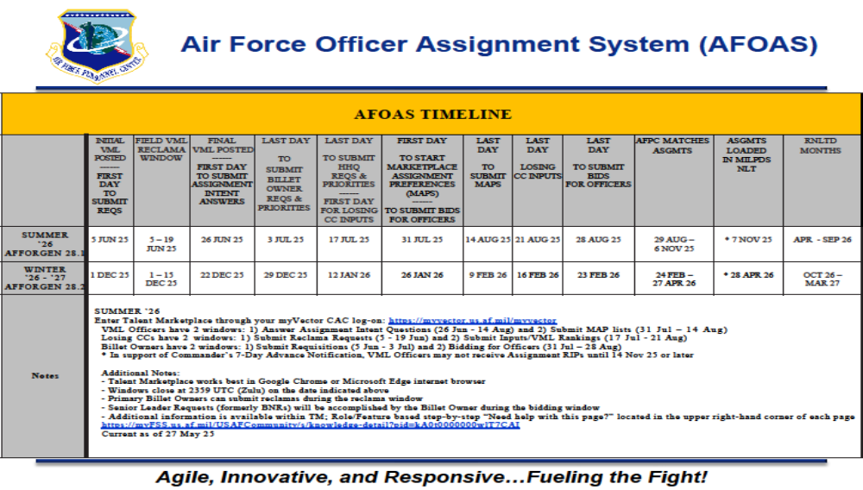

Slide 25
Self-Assessment Question #1
Which is not a key indicator that the BSC DT members look for when reviewing officer records?
  A. Sustained exceptional duty performance
  B. Scope of responsibility and leadership
  C. Stratification among peers
  D. Push lines
  E. None of the Above

Slide 26
Self-Assessment Question #2
What is the #1 priority of assignment?
A. Member’s Location Preference
B. Needs of the AF
C. Personal/Family Challenge
D. Career Development

Slide 27
Self-Assessment Question #3
True or False: A member must be released from the career field to apply for a 43B or non-medical position (i.e., not applicable to out-of-hide job)
  True
  False

Slide 28

QUESTIONS

Slide 29

Continuing Education Credit
Deadline to obtain CE 5 Aug 2025

