Slide 1
Society of Air Force Pharmacy
Mid-Year Conference
16 -18 June 2025
Hilton Norfolk The Main
Norfolk, VA

Slide 2
Frontline Pharmacists: Developing Emergency Response and CBRN Preparedness Skills
18 June 2025
Notes:
Thank you ____________ for the introduction. Today I’ll be discussing emergency medicine skills and how that relates to CBRN preparedness

Slide 3
Disclosure
Jennifer Empfield, Capt: “Declare(s) no conflicts of interest, real or apparent, and no financial interests in any company, product, or service mentioned in this program, including grants, employment, gifts, stock holdings, and honoraria.”
Notes:
Also, before we begin, I would just like to note that the thoughts and ideas presented here are just Capt Empfield’s thoughts – they do not represent AFMEDCOM or ANG.

Slide 4
Learning Objectives
Identify the necessity for emergency medicine proficiency for Department of the Air Force Pharmacists
Describe the significance of pharmacist involvement during irregular warfare
Illustrate the advantages of emergency medicine skills in large-scale casualty incidents
Notes:
During this presentation, I will be discussing the importance of developing/maintaining emergency medicine skills and how that can be beneficial to CBRN preparedness.
At the end of this presentation, you should be able to utilize the information presented when reviewing various sizes and scopes of different conflict scenarios.

Slide 5
AUDIENCE RESPONSE
Who has experience working in a:
Civilian Level I or II Trauma Center Emergency Room
Military Emergency Room CONUS
Military Emergency Room OCONUS/Expeditionary
Notes:
To help me understand the various levels of experience in emergency medicine, I’d like to see a show of hands if you have worked in.
Excellent, Thank you for your responses! That helped provide some background context for me as we go through this presentation.

Slide 6
Background
Residency Training
  Boston Medical Center
  Boston, MA
PGY1 Pharmacy Practice Residency
2014-2015
PGY2 Emergency Medicine Pharmacy Residency
2015-2016
Notes:
Trauma Center, Safetynet
BSL4 lab
Boston Marathon Bombing – mass casualty (281 field triage, 127 to 5 local level 1 trauma center, 40 severe trauma within 1-2 hrs)
- CBRN component
A little bit about me:
I completed my residency training at Boston Medical Center and then stayed on for a second year specializing in emergency medicine
To give you some context:
Boston Medical Center is the trauma center for the city of Boston. It is a city safetynet hospital, which means that it cares for mostly underserved patients who present at various stages of disease progression.
It is also located across the street from a Level 4 BSL laboratory facility studying various biological agents, so the hospital has a specific ChemPak stock and protocol in place. If accessed, it immediately reports to various authorities who then contact hospital administration and confirm the situation so that resources can be dispatched quickly.
Additionally, you may recall back in 2013 the Boston Marathon bombing occurred causing 281 casualties triaged in the field with 127 patients transported to 5 level 1 trauma centers, with ~40 severe trauma patients being received by BMC initially, providing real world massive casualty experience, that included a CBRN component.
At the time of the explosion, it was unknown whether there was concern for CBRN so it was treated as such until there could be confirmation.
Although this was prior to my arrival, I was able to work with team members who were there at the finish-line in the medical treatment tent receiving patients triaged in the field, as well as at the ER at BMC, which provided some context and understanding of their emergency management protocols and how that worked during a real-world event.

Slide 7

Professional Experience
Civilian
Boston Medical Center Jefferson Hospital ChristianaCare
Boston, MA Philadelphia, PA Newark, DE
Level 1 Trauma Center Level 1 Trauma Center Level 1 Trauma Center
130,000 ED visits/yr 80,000 ED visits/yr 100,000 ED visits/yr
City SafetyNet Hospital
Notes:
After finishing both residencies, I stayed on at Boston Medical Center as one of the emergency medicine pharmacists, and then took over interim PGY2 EM residency program director responsibilities
I then transitioned to other level 1 trauma center hospitals on the East Coast and gained insight into their patient care practices and mass casualty protocols

Slide 8

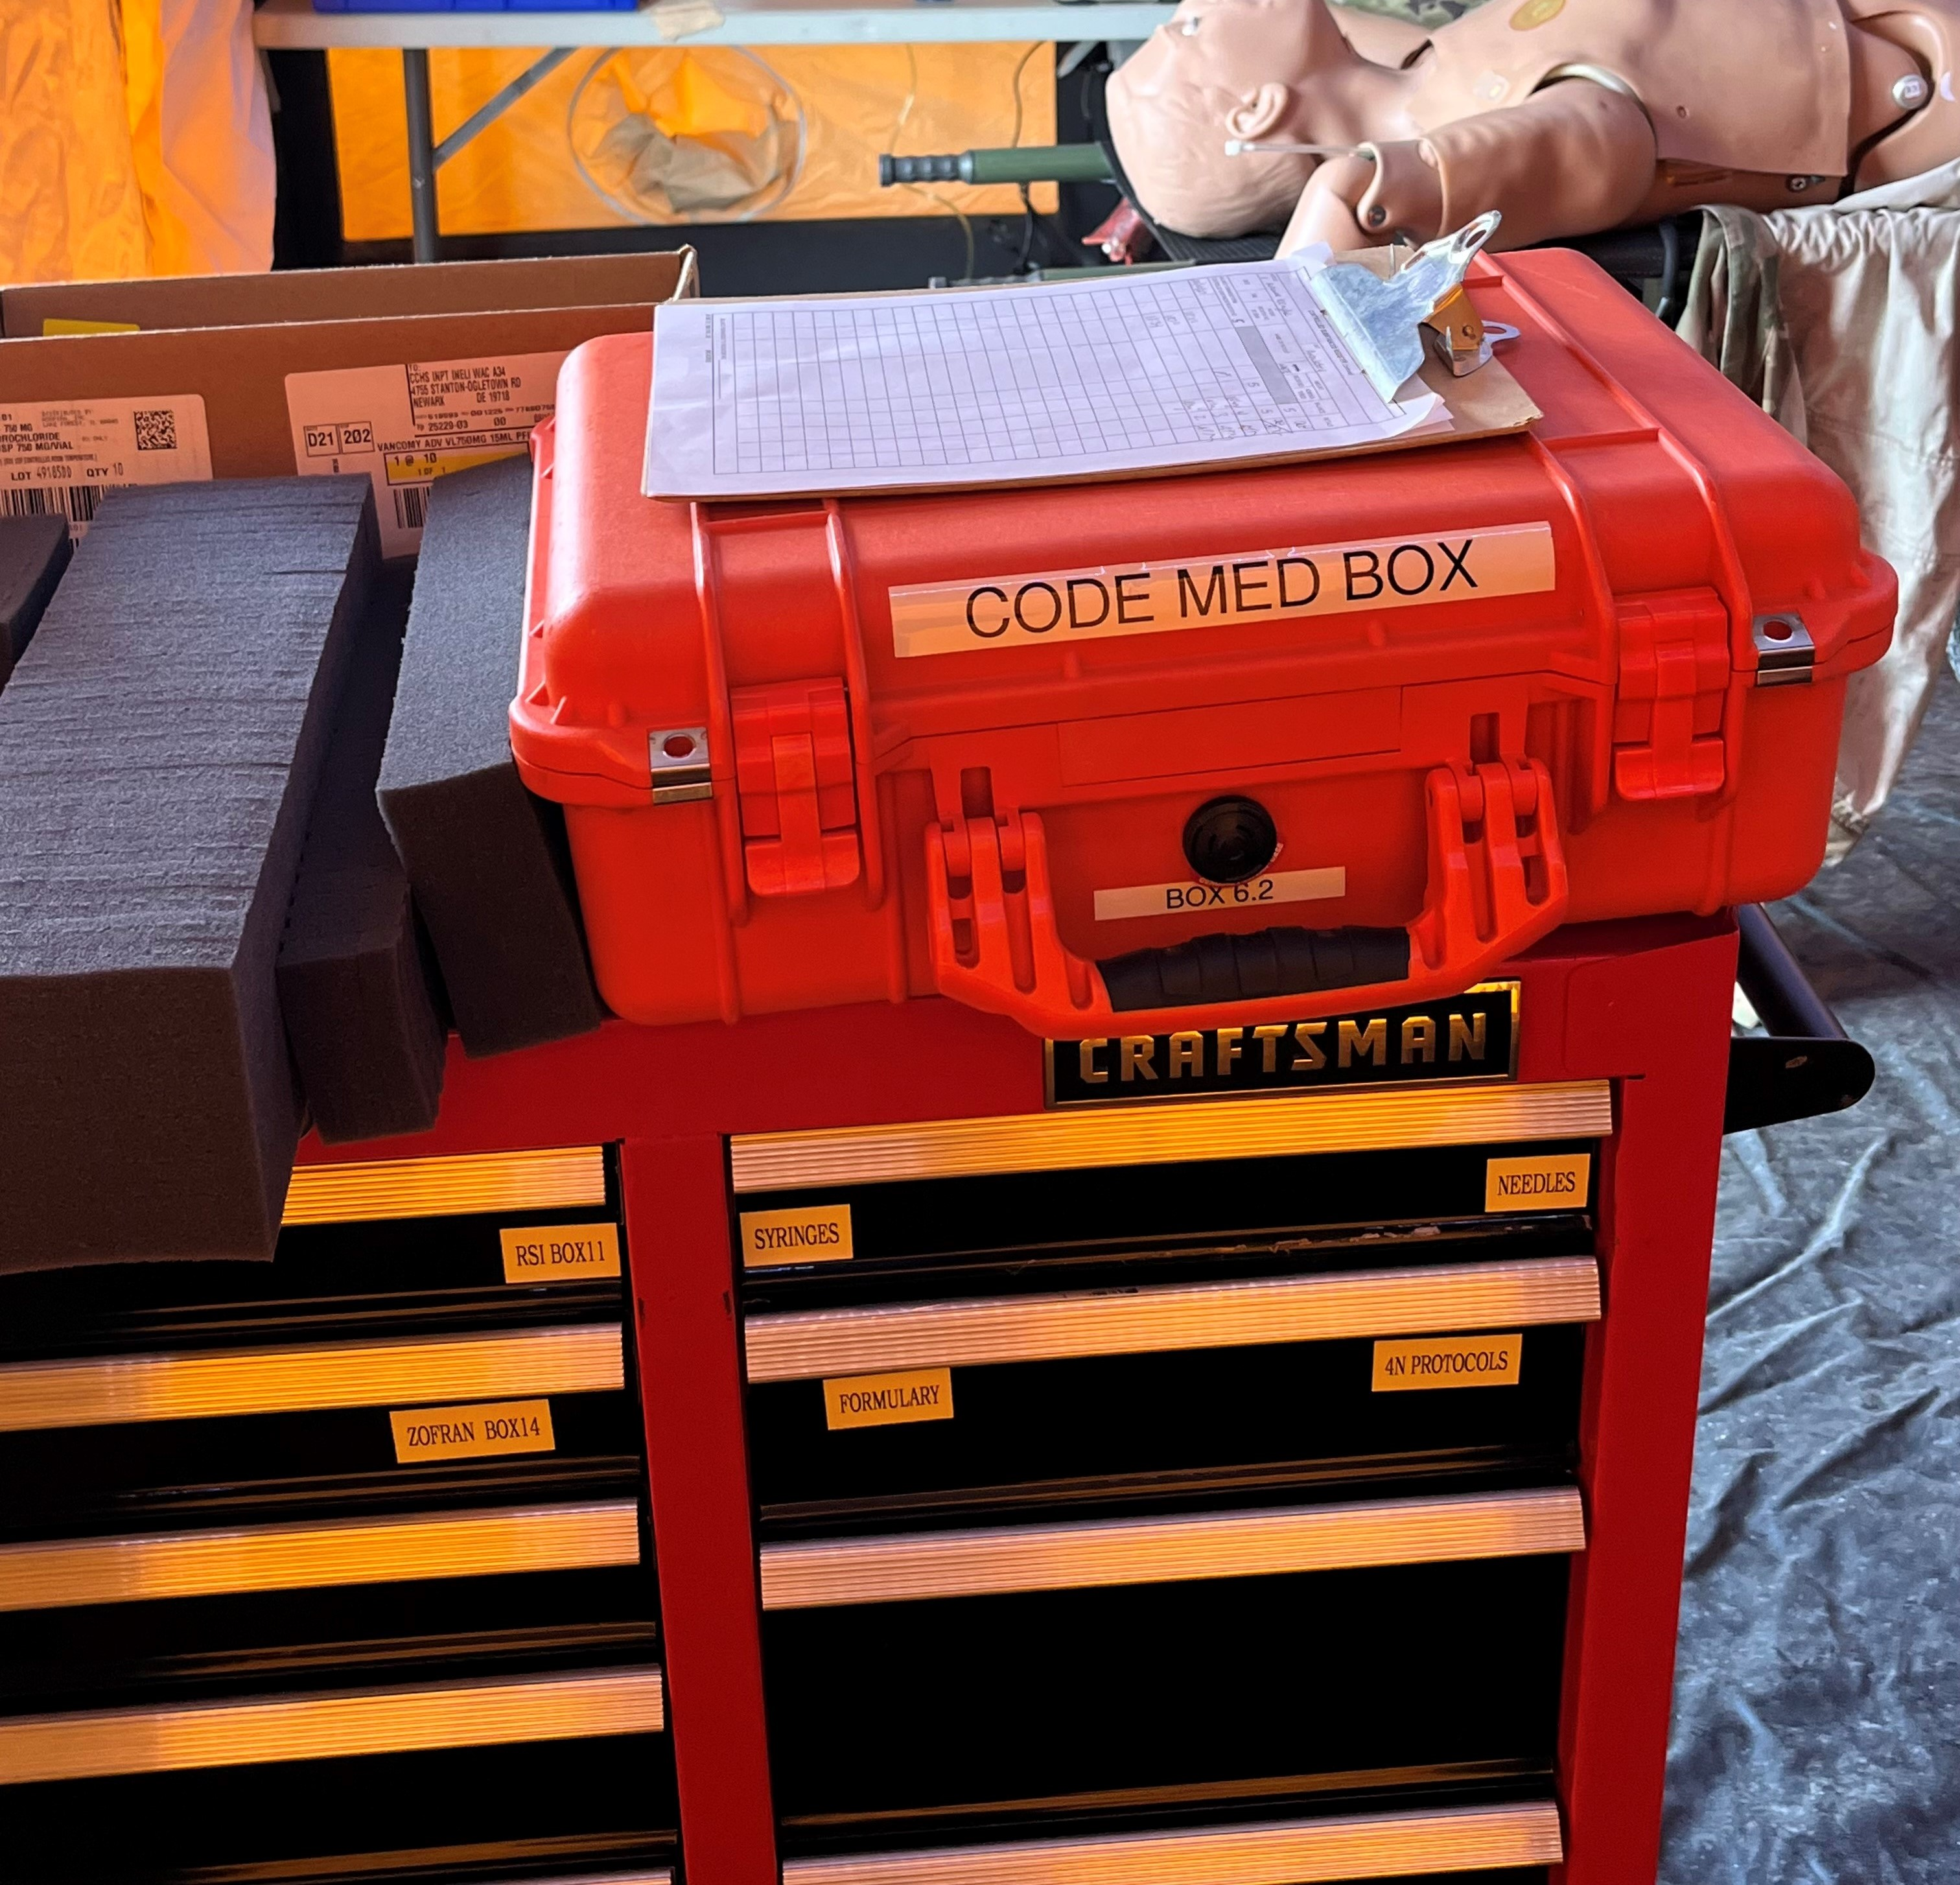
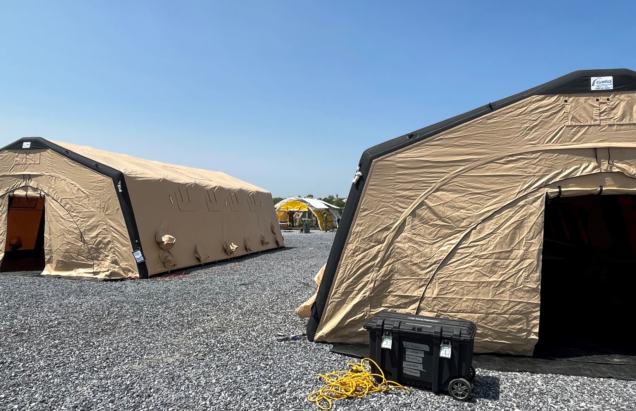
Professional Experience
Military Defense Health Headquarters (Falls Church, VA)
Medical Preparedness and Response Division, CBRN Branch Action Officer
USAF ANG 193rd SOMDG, Det 1 (Fort Indiantown-Gap, PA)
CBRN Enhanced Response Force Package (CERF-P)
Pharmacist
Notes:
Medical CBRN SEI
Additionally, on my military career, I’ve spent time as the pharmacist on the top CERFP unit in the ANG, which you can see a couple of photos here of our treatment tent and the pharmacy supplies. You can see the immediate and delayed treatment tents, as well as the decon tent that patients would go through prior to being retriaged by cold triage to either treatment tent.
On the left, you can see how our medications stored. We utilize a cart for transportation. The most critical medications are maintained in the immediate tent. Less critical medications are then dispersed to the delayed treatment tents.
Lastly, the code cart medications are stored in a mobile code medication box – shown on the left in orange.
This year I have also been a part of the CBRN Branch at DHHQ and accomplished the medical CBRN SEI.
All of this has provided a well-rounded background to combine both emergency medicine and CBRN skills and knowledge
Knowing this information in addition to certain key aspects, which we will get into later in this presentation, can help to substantially improve patient care

Slide 9


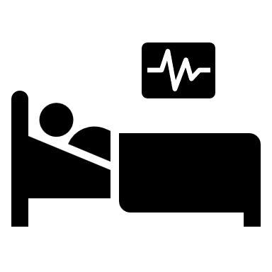

Benefit of Emergency Medicine Pharmacists
Lower cost:
  ~$5 billion savings in 1 year at 5 emergency departments
Improve patient care
  Alleviate nursing workload
  Preventing medication errors
  Timely medication administration
Decrease mortality
Dietrich SK, Bushong BT, Schneider-Smith EA, et al. Am J Emerg Med. April 2022;54:178-183
Fairbanks RJ, Rueckmann EA, Kolstee KE, et al. Clinical Pharmacists in Emergency Medicine. In: Henriksen K, Battles JB, Keyes MA, et al., editors. Advances in Patient Safety: New Directions and Alternative Approaches (Vol. 4: Technology and Medication Safety). Rockville (MD): Agency for Healthcare Research and Quality (US); 2008 Aug. Available from: https://www.ncbi.nlm.nih.gov/books/NBK43767/
Notes:
How is that accomplished? How do emergency medicine pharmacists improve patient care, and why should we care about emergency medicine skills in the military?
~10 interventions/shift saving ~$1,000/shift
There have been a lot of studies looking at the benefit post implementation of pharmacists in the ER. Here is an overview of what they found.
The main driver of expansion of services, generally is cost.
This study reviewed 5 pharmacist’s interventions at 5 different emergency rooms over a 1 year time span and found that on average each pharmacist saved ~$1 billion for an average of ~$5 billion across the 5 ERs
On the military side, this can be translated to preventing waste of medication use
Improved formularies and consolidating to critical medications can help prevent excessive medications from expiring prior to use
Additionally, cost savings can be seen through maximizing resource utilization: instead of utilizing one naloxone autoinjector for one patient, dividing the dose up to multiple patients through IV or nebulized route – can be particularly beneficial during a mass casualty situation, when resources may be limited, especially if there are anticipated delays in replenishment in supplies
Additionally, resource utilization includes personnel. This can be seen through impacting nursing workload. Pharmacists can help answer drug information questions, which alleviates time nursing spends researching the answer. Pharmacists can also assist in preparation of medications. This decreases time nursing spends on those task and increases time spent providing nursing specific services to other patients.
In addition to cost savings and resource optimization, pharmacists have been shown to be the most appropriate team member to help prevent medication errors and ensure the 5 rights of medication administration occur. improve time to administration of medications.
These are critically important in the ER, because during the patient’s healthcare stay, their time in the ER is the most likely time for a medication error to occur. Having a pharmacist available can substantially minimize this risk of harm.
Additionally, studies have reviewed pharmacist participation during cardiac arrests and found an improvement in both time to medication administration (due to minimizing delays, because of anticipation of medications needed and proactive preparation) as well as staying within the evidenced based ACLS algorithm
All of this can aid in decreasing overall mortality, which means more Airmen surviving and returning to the fight or home to loved ones

Slide 10
ER Layout
Notes:
How does all of that happen on a daily basis?
Let’s walk through a typical day in the ER. Picture yourself in a busy, level 1 ER – an example of which is shown here
you are responsible for managing pharmacy care for any patients in that area,
As you can imagine, this requires prioritization to ensure the 5 rights of medication administration are being accomplished for as many patients as feasible, then providing proactive recommendation for trauma/medical emergency patients (area where there is most likely to be a medication error), answering drug information questions when they arise, as well as order verification
This graphic depicts an example of what a typical ER may look like. (describe graphic)
All the way on the right side of the screen are the most critically ill patients awaiting transfer to the ICU vs step-down/telemedicine unit
In the middle are the next most critically ill patients, as well as the trauma rooms (one for medical emergencies, adult and pediatric traumas). Lastly, all the way on the left is the least acute emergency room patients (there was a separate but onsite psychiatric holding area and an urgent care).
As the pharmacist responsible for this area, we were positioned in a satellite near the trauma rooms so that we were easily accessible to attend any traumas/medical emergencies, and in a semi-central location for the rest of the ER
Right now, you might be thinking – doesn’t look too bad, maybe a lot to manage depending on the acuity of the patients.

Slide 11
ER Layout When Busy
Notes:
As the ER would become busier, it was common for additional stretchers to be placed in the hall outside of patient rooms in order to gain additional space for patient care
These are denoted by the blue rectangles you see on this graphic
As more patients arrived to the ER, it was illegal to turn patients away or divert ambulances, so patients built up in the waiting room and additional beds were added to alleviate the load and improve throughput
This is a common occurrence for the ER to look like this – standard rooms filled with patients and stretchers located in the hallways

Slide 12
ER Layout Exceeding Capacity
Notes:
~200 pts in ER
Mass casualty
Challenging to provide patient care – triage responsibilities (trauma, critically ill, drug info ?s, etc.)
Prevent delays in care as much as possible, even saving 1-2 hours can increase bed turnover, as well as improve outcomes such as patients with sepsis requiring antibiotics within 1-3 hrs
Leads to impact in mortality (one study and increase in 1 death for every 82 patients with a 6 hr delay to admission – which delays in treatment contributed to)
Then, at some of our most crowded, additional stretchers were added in any empty spaces and where a stretcher couldn’t be added - chairs (represented by the purple squares) were provided for patients to at least site while awaiting being seen by a provider or nurse
During these situations, it was common to have ~200 patients in the ER
No additional pharmacists were added, we still managed the ER in the same fashion – attending to the trauma/medical emergencies, assisting with review of drip rates/making recommendations for critically ill patients; and then working the way down the list of patients, reviewing orders for appropriateness, and answering drug information questions
These times are challenging to effectively provide patient care, and it requires flexibility
For example, things such as documentation of counseling, interventions, notes, etc. may not occur in a timely manner.
Order verification times may be delayed, but that means that administration may also be delayed even if verification occurred in a timely manner, because the nurse has additional patient load to care for
Especially during these times, our medical teams need to be prepared that not every patient will survive. We all do our best, but at the end of the day, we have finite resources and need to utilize them accordingly.
This is the scenario we should be prepared for should there be a CBRN event OCONUS, which we will revisit later in the presentation
Even in the civilian ERs, I have experienced times where patients have died in the waiting room while awaiting care due to capacity issues. These patients are not able to have continuous monitoring completed, and with a waiting room of 50 or more patients, it is impractical for a nurse or technician to re-evaluate patients/vitals even every hour. This creates a situation where a patient may present in a stable condition, but then decompensate
Additionally, tough conversations may need to be had with family members or next of kin with regards to removing care due to the likely outcome for the patient or possible impending demise.
Unfortunately, this is the scenario that we should expect during a CBRN incident.

Slide 13




Typical ER Patients
Trauma
  Head trauma
  Open fracture
  Traumatic amputation
  Traumatic cardiac arrest
Massive Hemorrhage
  Hypotensive crisis
Infection
  Cellulitis
  Pneumonia
  Sepsis
Respiratory Compromise
  Intubation
  Positive pressure ventilation
Notes:
During busy ER days and CBRN incidents, here are some common ER patients to expect
Trauma patients are expected if an explosion occurs, and with that would also encompass massive hemorrhage and concern for infection or prophylaxis again infections, particularly with open fractures.
Additionally, there will be a plethora of different respiratory concerns during a CBRN incident, which again puts strain on resources with limited oxygen and ventilation machines.
Even during COVID, on the civilian side, we were tracking the number of patients requiring mechanical ventilation, because there were only so many machines available in the health-system. This also posed a challenge, because that required additional nursing staff, who may or may not meet the requirements for competency to appropriately administer continuous infusions of medications, which again is where pharmacists can provide expertise and help alleviate some nursing workload constraints and ensure that medications are being safely ordered and administered – preventing patient harm.
As you can tell, there is a lot that a pharmacists can be involved in that contributes to the benefit for the healthsystem, patient care and to our Airmen.

Slide 14
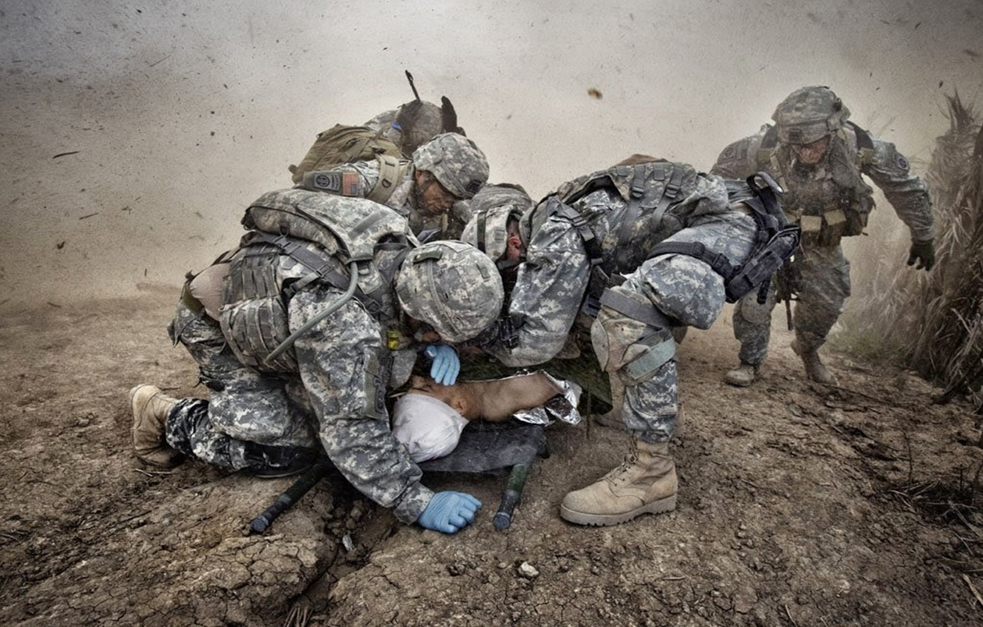
CBRN Theoretical Scenario
Notes:
In coordination with the Department of Homeland Security, a CBRN scenario was determined and run through their software program that provides close to real-world casualty numbers and capability gap analysis. This program will be available DoD wide on JWICS starting this summer.
Our scenario was a respiratory bacterial threat affecting a large metropolitan area.
Based upon the results, in a condensed timeline, the number of casualties would closely represent the previous described mass casualty situation
Additional information can be provided via SIPR if you follow up with me after the presentation.
Additionally, challenges can arise over time regarding patient care management depending on the formulary assemblage available.
These are the situations that we as Air Force pharmacists should be prepared for if we want to be ready for a CBRN incident.
There will likely be hundreds to thousands of casualties, most of which will likely not survive depending on the nature of the incident.
Additionally, as with massive casualty situations, providing care can be challenging with the number of patients outweighing various resources, such as equipment, personnel, and medications.
Describe CBRN Scenario including transition from field to MTF to larger/more capable healthcare facility
Highlight possible capability gaps
knowledge/skillset
Availability as a resource
Formulary – especially if prolonged field care due to limitations in contaminated patient transport

Slide 15
Emergency Room Patient Case
Patient Info
70 y/o M s/p head trauma
Weight: 82 kg
GCS 4
Vitals: BP 132/78, HR 88, RR 14
Eye Opening | 2
Verbal | 1
Motor | 1
Notes:
Now I’m going to present an example of a patient case that highlights the need for pharmacist advocating at the bedside.
This was a particularly challenging patient case, that unfortunately occurs all too often in the US
The patient is a 70 y/o M who presented from EMS after a head trauma
His Glasco Coma Score is 4 – equating to a severe traumatic brain injury
Vitals are listed there – all within normal limits at this time

Slide 16
Emergency Room Patient Case
Patient arrives to ER
Intubated with etomidate and rocuronium
Patient transported to CT, propofol started
Patient back from CT, propofol discontinued
Vitals
BP 220/140
HR 118
Vitals
BP 190/130
HR 118
1345
1400
1410
1420
1430
Vitals
BP 132/78
HR 88
RR 14
Discussion with ER resident to start propofol
Notes:
1345 the patient arrives to the ER from EMS and the team receives report of the incident and current status of the patient
It is determined by the medical providers that there is the possibility of respiratory compromise given the patient’s GCS so the decision is made to intubate the patient
At 1400 the patient is intubated using etomidate and rocuronium. At that point no other long-term sedation had been requested, so there is a discussion initiated by the pharmacist to start propofol
At 1410 the patient is transported over to CT to confirm any additional injuries and propofol is taken to be started en-route
At 1420 the patient arrives back from CT and the handoff report notes that propofol is discontinued
Current vitals are now: BP 190/130 and HR 118

Slide 17
AUDIENCE PARTICIPATION
Is this patient still stable?
Do they require an intervention?
Patient arrives to ER
Vitals
BP 220/140
HR 118
1345
1430
Vitals
BP 132/78
HR 88
Notes:
Show of hands
Patient requires an intervention
BP has increased dramatically – although we may not know what the underlying cause is – having this high of a BP is putting the patient as risk of head bleed – especially considering the cause of presentation is head trauma

Slide 18
AUDIENCE PARTICIPATION
Which of the following is most appropriate for the patient?
  BP lowering medication
  Sedation
Notes:
Show of hands

Slide 19
AUDIENCE PARTICIPATION
Which of the following is most appropriate for the patient?
  Sedation

Slide 20
RSI Timeline
Time: minus 2-5 min
Pre-induction
Time: minus 0.5-1 min
Induction
Time: zero
Intubation
Paralytic
Fentanyl
Not administered
1400 etomidate administered
1400 rocuronium administered
1402 patient intubated
Notes:
Blunt the sympathetic response to intubation
3 mcg/kg – dosing significantly higher

Slide 21
Pharmacology of Medications
Inducation | Dosing | Pharmacokinetics | Benefits | Precautions
Etomidate | 0.3 mg/kg | Onset: 10-60 sec Duration: 3-5 min | HTN Rapid acting | Inhibition of cortisol Decrease seizure threshold
Propofol | 1.5 mg/kg | Onset: 15 sec Duration: 5-10 min | HTN Rapid acting | HoTN
Ketamine | 2 mg/kg (IBW)* | Onset: 60-120 sec Duration: 5-15 min | Asthma, COPD | HTN
Paralytic | Dosing | Pharmacokinetics | Benefits | Precautions
Succinyl-choline | 1.5 mg/kg | Onset: 30-60 sec Duration: 5-15 min | Neuro exam | Increase potassium, Burn, Crush
Rocuronium | 1.2 mg/kg (IBW)* | Onset: 45-60 sec Duration: 45-70 min | No contra-indications | Predict difficult airway
Notes:
No difference in admin of stress dose steroid or vasopressosrs 24 hr post RSI – Groth, et al. J Crit Care 2018
No difference in recurrence of seizure post RSI – Perier, et al. Seizure 2018
This chart list common information regarding induction agents and neuromuscular blocking agents commonly used in RSI
Highlighted are the agents chosen for our patient
You can see that some precautions for etomidate are inhibition of cortisol and decreased seizure threshold. What are your thoughts about this – and this is in general, not necessarily in relation to our patient?
No difference in admin of stress dose steroid or vasopressosrs 24 hr post RSI – Groth, et al. J Crit Care 2018
No difference in recurrence of seizure post RSI – Perier, et al. Seizure 2018
What timeframe are the precautions for burn and crush injuries for succinylcholine? Why?
How much does succinylcholine increase the potassium by?
What disease state do you want to be cautious of due to increase in potassium?
What do you notice regarding the duration of each of these agents?
Correct, rocuronium is the only one that has the longest duration, averaging an hour

Slide 22
Patient Care Timeline
Vitals
BP 132/78
HR 88
Patient transported to CT, propofol started
Patient back from CT
Vitals
BP 220/140
HR 118
Patient at CT
Etomidate wears off
Discussion with ER resident to start propofol
Rocuronium still in effect
1345
1410
1412
1415
1420
1430
Determined propofol discontinued
No other sedation started
Notes:
Putting it all together

Slide 23
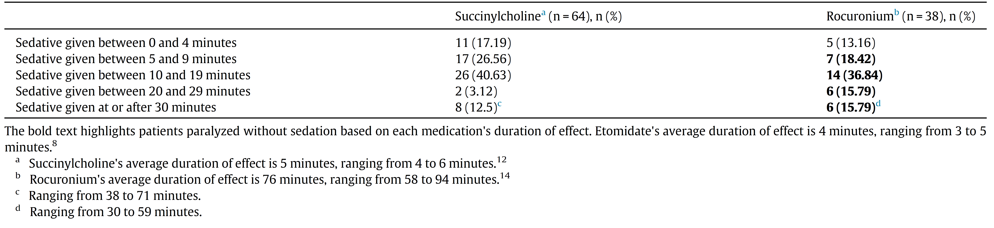
Delayed Analgosedative Intervention
Retrospective cohort study
Primary objective:
  Time to first sedative s/p RSI
    Etomidate and succinylcholine
    Etomidate and rocuronium
Notes:
Which leads us into the meat of the discussion. Regarding having appropriate analgosedative for patients intubated with rocuronium. Several studies have shown a delay in ordering and administering analgesia or sedative for patients paralyzed with rocuronium. As you can see here in this study, the authors looked to determine the time of first sedative/analgesic agent post RSI. What they found was that about 80% of patients had a delay which lead an average wakeful paralysis of 1-55 min
Patients intubated with rocuronium had an ave wakeful paralysis time of 1-55 min.
Additional studies show that only 22% of patients received post-intubation sedation within an appropriate time frame (pending duration of action of induction agent), again leading to wakeful paralysis.
This can lead to significant morbidity, including short-term impact on ICU delirium and LOS, as well as long term side effect, such as PTSD, anxiety, and depression.
Again, this is why having a pharmacist at the bedside is so important because the order for propofol may or may not come across for order verification in the computer. Often orders for emergent medications happen via verbal orders. Additionally, changes in starting/stopping/changing the rate of an infusion may or may not be documented in real time in the computer, so even if the order came across, we may not have awareness that it was stopped.

Slide 24

Are We
Ready?
Notes:
Keeping in line with the Air Force core values (integrity first, service before self, excellence in all we do) – Are we ready to integrate into the AFMS mission (to delivery trusted care… anytime, anywhere)?
Are we ready to be warrior medics – Always ready – mission ready?
Are we ready to be ready medics and multi-capable airmen?
Are we ready to provide our pharmacy expertise and improve patient care across all domains, including expeditionary?
Are we ready for the next CBRN incident?
Are we as Air Force Pharmacists ready?

Slide 25

If we aren’t?
Who is?
Notes:
And if we aren’t, then who will be?
Patient care continues regardless of if we are a member of the team or not.
I’ve worked in ERs without 24/7 pharmacist coverage and I’ve received the feedback regarding a patient case from nursing or a provider the next day. I’ve sat on medication event reporting committees and seen the mediation error event report come through. In a 1 year timeframe, we had ~100 errors reported, and many more undocumented.
I know the impact of not having a pharmacist available, which is why I know how much we are needed particularly in an expeditionary environment.
Even if we don’t know how to handle every situation, we can prepare to be better equipped than any other discipline/AFSC to contribute our pharmacy expertise to the team.
We have the capability – we understand and think about the pharmacokinetics and MOA
We are best suited to prevent medication errors and do no harm, and these situations are the most likely time in the patient’s care for a medication error to occur (according to Institute of Medicine)
Knowing this information, what we need to prepare to provide these interventions and improve patient care is training and practice

Slide 26
How do we get ready?
Develop and practice hands-on training
Prepare for different thought process
  Proactive vs reactive when verifying orders
  Verbal order verification – provide recommendation before medication prepared and administered
Utilize resources
  Medication dosing guide
  Pocket guidelines
Notes:
There are two aspects to considering when preparing:
Capability
Comfort
At one of the institutions I worked at, my capstone project was to expand pharmacy services from the ER and ICU to all cardiac arrest events across the healthsystem.
As you can imagine some pharmacists were very enthusiastic about this and some were very hesitant.
When preparing pharmacists to attend all adult cardiac arrests occurring within the hospital, we needed to understand the gaps that prevented pharmacists from attending.
First: leadership support – this would take pharmacists away from their primary responsibility so we needed leadership to approve of the reprioritization effort
Second: we provided a survey that addressed two concepts – competence and comfort
As it turned out, our pharmacists were already competent scoring >90% correct on knowledge
What they were missing was the comfort – this could only be achieved through experience, so how do we mimic that experience in a safe low-risk environment
We developed hands-on training to get them familiar with the equipment, and we developed various cases that we would run through to show them their competence and improve their comfort and familiarity with the equipment/algorithm and medication questions to expect
Additionally, showing them that they had the knowledge, it just needed to be applied in a different mindset (proactive vs reactive)
Lastly, we provided pocket sized resources for them to utilize so that if they froze or forgot something, they had a resource readily available that they could lean on to find the answer
We are in the process of developing some of those resources. There are hands-on training available and in development currently for CBRN

Slide 27
Dosing Guide
Medication | Concentration | Standard Dose | Dose to be given | Volume to draw up | Administer (fastest rate listed)
Adenosine | 3 mg/mL | 0.1 mg/kg | 0.2 mg | 0.07 mL | Rapid IV Push/IO
Amiodarone - pulseless arrest | 50 mg/mL | 5 mg/kg | 10 mg | 0.2 mL | IV Push/IO
Amiodarone - perfusing arrhythmias | 50 mg/mL | 5 mg/kg | 10 mg | 0.2 mL in 5 mL D5W | 1 drops/15 sec IV
Atropine | 0.1 mg/mL | 0.02 mg/kg | 0.04 mg | 0.4 mL | IV Push/IO/Tracheal
Calcium Gluconate | 100 mg/mL | 60 mg/kg | 120 mg | 1.2 mL | 5 drops/15 sec IV
Dextrose 10% | 0.1 g/mL | 0.5 g/kg | 1 g | 10 mL | IV Push/IO
EPINEPHrine 1 mg/10 mL (CODE) | 0.1 mg/mL | 0.01 mg/kg | 0.02 mg | 0.2 mL | IV Push/IO
Notes:
We can develop a dosing guide, similar to that one being presented to the 27 CRE for the ANG
All of these resources minimize the need for memorization of information that if not utilized regularly will most likely get forgotten

Slide 28
Medication Pocket Guide
TRAUMA*
Tranexamic Acid: within 3 hours of injury
Indication: hemorrhagic shock (SBP ≤90), traumatic amputation,
Requires separate line from blood products
Dose 1000 mg/50 mL NS bolus over 10 min
then 1000 mg/250 mL over 8 hr
PEDS: 500 mg/50 mL over 10 min → 500 mg/100 mL over 8 hrs
SEIZURES (Pediatric and Adult unless noted)
Status Epilepticus: continuous seizure activity for 30 min OR ≥2 sequential seizures without full recovery of consciousness in between seizures
Epilepsy Currents. 2016;16(1):48-61
Prophylactic Antibiotics in Trauma
Injury | Medication | PCN Allergy
Type I open fx: skin wound <1cm Type II open fx: laceration >1 cm without extensive tissue damage Deep lacerations | <120 kg: Cefazolin 30 mg/kg (max 2 g) | Clindamycin 10 mg/kg (max 600 mg)
 | >120 kg: Cefazolin 3 g
Type III open fx: >10 cm wound or a traumatic amputation | Ceftriaxone 50 mg/kg (max 2 g) | Clindamycin + Ciprofloxacin
Oral trauma/Jaw fracture | Cefazolin + metronidazole | Clindamycin
Penetrating eye | Ciprofloxacin
 | Drug | Onset | Duration | Dose | Admin Rate | Preparation
First Line | Lorazepam | 2-3 min | >60 min | 0.1 mg/kg IV/IM | 2 mg/min | Dilute 1 mg/mL with NS
 | Midazolam | 1-2 min | 30-60 min | 0.2 mg/kg IV/IM/nasal | Over 2-5 min Deep IM | 0.5-1 mg/mL
 | Ketamine | 1-2 min | 5-15 min | 1.5 mg/kg IV | Over 2-3 min | ADULT only
Notes:
Goldberg S, et al. J Trauma Acute Care Surg. 2012:73;321 – 325
Hoff W, Bonadies J, Cachecho R, Dorlac W. East practice management guidelines work group. J Trauma. 2011:70(3);751 – 754
Gustilo R, Mendoza R, Williams D. J Trauma. 1984:24(8):742 – 746
Luchette F, et al. J Trauma. 2000:48(3);508 – 518
Eron LJ. J Emerg Med. 1999:17(1):189-95
Hospenthal DR, et al. J Trauma. 2011;71:S210-34

Slide 29
Medication Guide
Nerve Agents (Organophosphates)
MCM | Dose/Delivery | Preparation | Administration | Notes
Atropine | 2 mg (0.05 – 0.1 mg/kg) IV/IM Every 2-5 min until symptoms resolve | IV: 1 mg/10 mL prefilled syringe | IV: 2 mg/20 mL IV push | Muscarinic effects (mitigation of seizure, pulmonary secretions), no nicotinic effects
 |  | IM: 0.4 mg/mL (10 mL vial) | IM: 2 mg/5 mL (vastus lateralis recommended)
Glycopyrrolate | 0.2 mg IV | 0.2 mg/mL vial | IV Push over 1-2 minutes or diluted for IV infusion | Alternate to Atropine
Pralidoxime (2-PAM)* | 600 mg x2 IM | 600 mg/2 mL autoinjector | IM: 600 mg/2 mL (vastus lateralis recommended) | Must give with atropine, reverses nicotinic effects Administer before irreversible dealkylation (soman 2-6 min, sarin 3-5 hr, tabun 14hr (2-PAM does not work – ineffective nucleophilic attack), VX 48 hr)
Diazepam | 5 mg IV every 15 min x3 doses 10 mg IM | IV: 5 mg/mL vial | IV: Slow IV Push | Indication: Seizures
 |  | IM: 5 mg/mL vial | IM: 10 mg/2 mL (vastus lateralis recommended)
Pyridostigmine* | 60 mg PO | 30 mg, 60 mg tablet | 60 mg (1-2 tablets) orally | Pre-exposure to GA/GD, acetylcholinesterase inhibitor
Kneeboard
* Subject to availability based upon UTC formulary assemblage
Notes:
There are efforts currently to develop a pocket guide for CBRN treatment

Slide 30
Take Aways
Emergency Medicine pharmacists contribute to improvement in patient care outcomes
Contributions include improving resource utilization and providing medication expertise to the medical team
Utilization of resources can improve pharmacist comfort during emergency patient care situations

Slide 31
Frontline Pharmacists: Developing Emergency Response and CBRN Preparedness Skills
18 June 2025

Slide 32

Continuing Education Credit
Deadline to obtain CE 5 Aug 2025

