Slide 1
4P Enlisted Training Updates
CMSgt LaTonya R. Reno
4P Career Field Manager

Slide 2
Disclosure
CMSgt LaTonya R. Reno: “Declare(s) no conflicts of interest, real or apparent, and no financial interests in any company, product, or service mentioned in this program, including grants, employment, gifts, stock holdings, and honoraria.”

Slide 3
Learning Objectives
Define roles and responsibilities within the DAF Training program
State minimum required components of training progress entry
Explain methodology behind new CFETP format

Slide 4
Self-Assessment Question #1
Who is the focal point of the DAF training program?
  Supervisor
  Trainee
  Commander
  Unit Training Manager

Slide 5
Self-Assessment Question #2
Which of the following is NOT a minimum requirement for a training progress entry?
  Strengths, weaknesses and attitude
  Behavioral counseling and corrective action
  Areas to improve and means to improve
  CDC, task progression, and task certification

Slide 6
Self-Assessment Question #3
What fundamental attribute is the foundation of the new CFETP?
  Task performance
  Critical thinking
  Job observation
  Competencies

Slide 7
Upgrade Training Documentation
Supervisors must document monthly
  CDC/Task progression to include volume issue/completion, comprehensive review, and end-of-course score
  Task certification, decertification, and recertification
  Training related counseling, strengths, weaknesses, attitude, areas to improve, and corrective action (if required). Chain of command will not document disciplinary actions or behavioral counseling in the training record

Slide 8
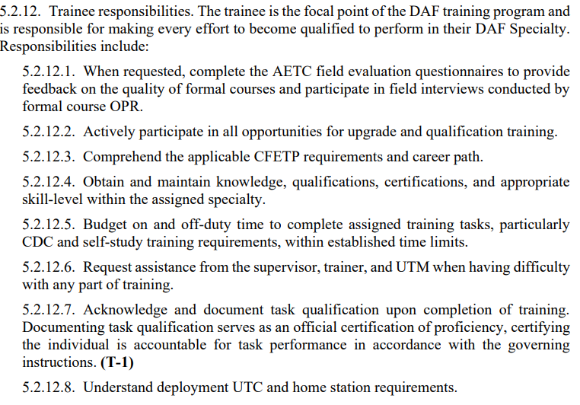
Trainee Responsibilities

Slide 9
Competency Framework
SCALABLE, RELIABLE, REPEATABLE
Competency Framework…the core of Developing the Airmen We Need
A framework that builds technical skills along with leadership, combat, joint, all-domain, and social mastery
Allows for training to be learner-centered rather than instructor-centered
Builds Airmen to become future-ready critically thinking warfighters
Challenges Airmen to grow and empowers them to optimize opportunities for learning and development
Identifies the competencies needed for key positions

Slide 10
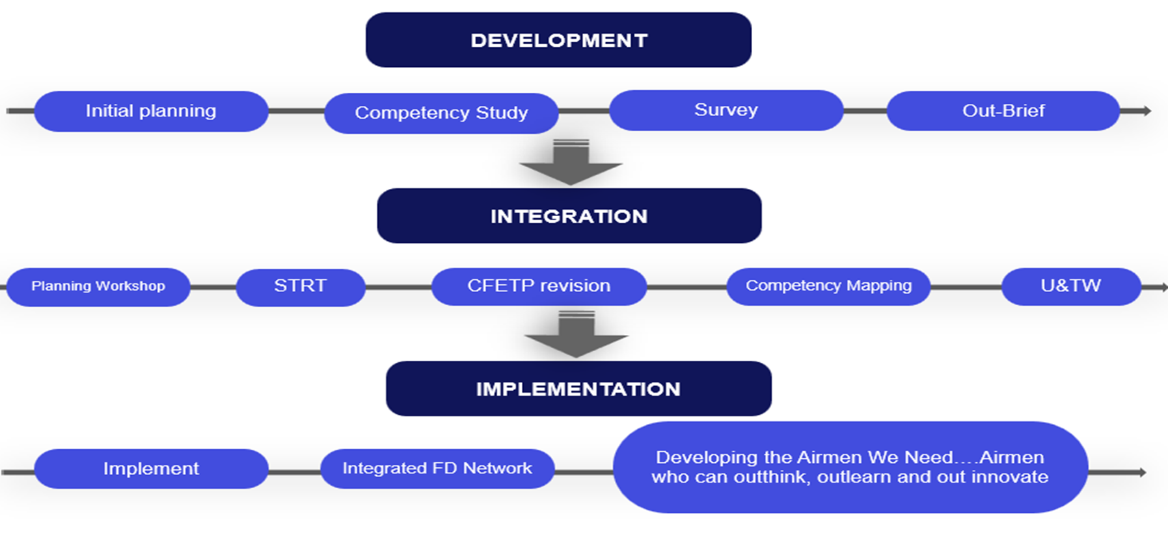
Competency Project Roadmap

Slide 11
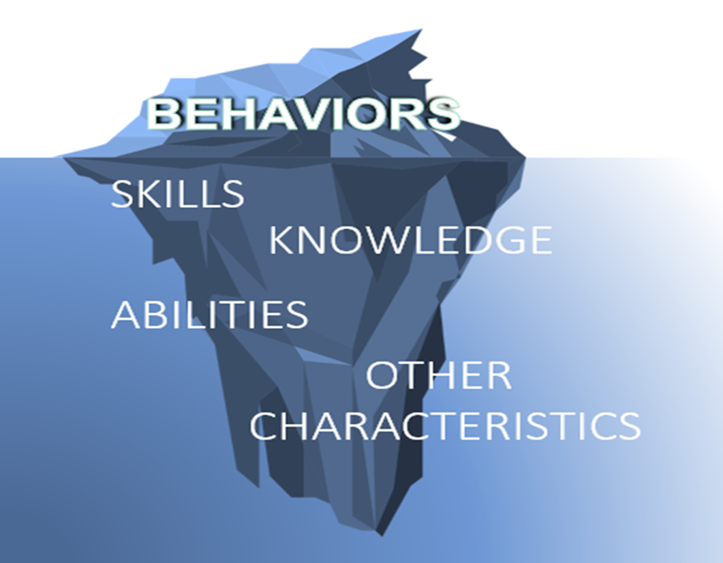
Competencies
A competency is an observable, measureable pattern of Behaviors, Knowledge, Skills, Abilities, and Other Characteristics needed to perform successfully on the job.

Slide 12
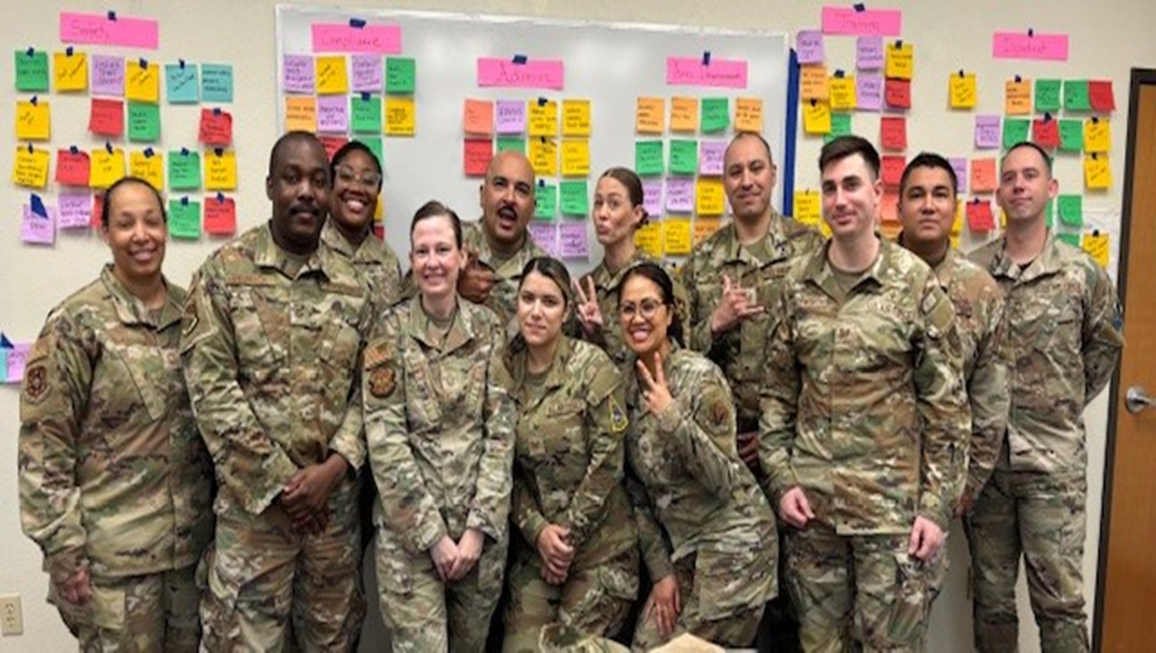
OC Model Development
Initial Planning
  Identify CF’s strategic fit & study objectives
  ID SMEs, location and dates
Competency Study
  Four-day study with 8-12 SMEs
  Build an occupational competency model (OCM) from scratch

Slide 13
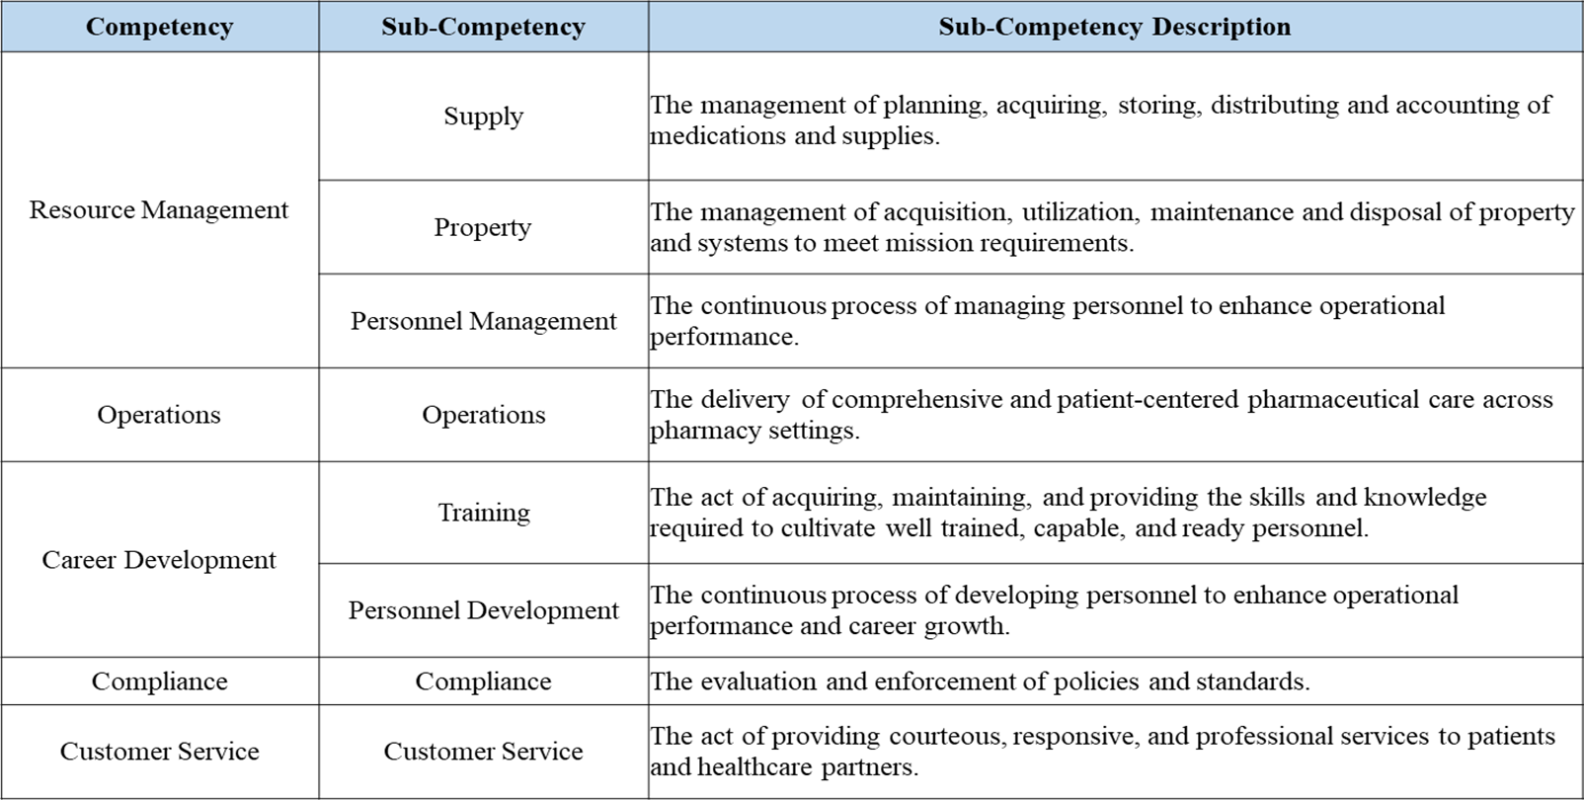
Occupational Competency Model

Slide 14
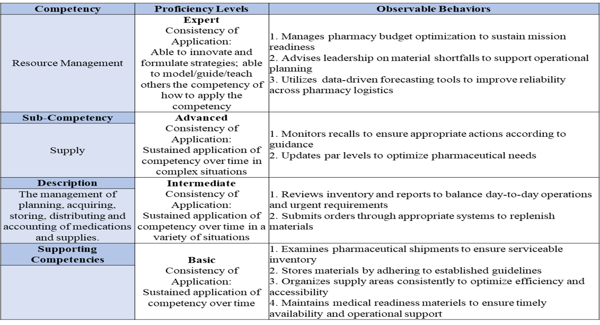
Sub-Competency Rubric

Slide 15
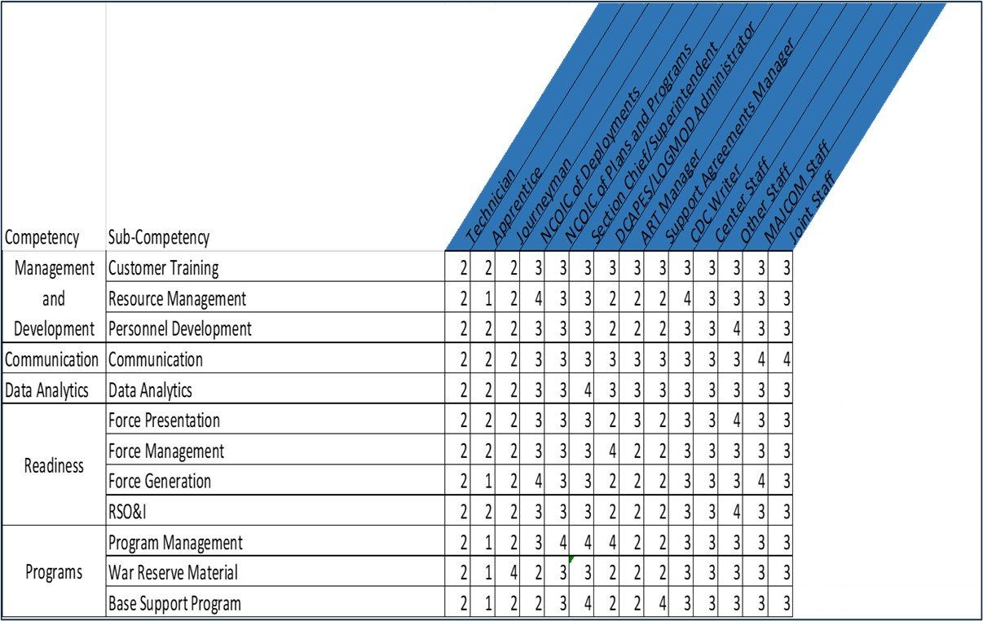
Survey Validation (Example)
  General User Survey
  (Validate OCM)
  -Frequency & Importance of Sub-Competencies
  (All Enlisted 4P0X1)
  Senior Leader Survey (Perspective)
  -Where Leaders feel Airman should be proficient based on Duty Position → → → →
  (Only 4P0X1 SNCO’s)
1 – Basic
2 – Intermediate
3 – Advanced
4 – Expert

Slide 16
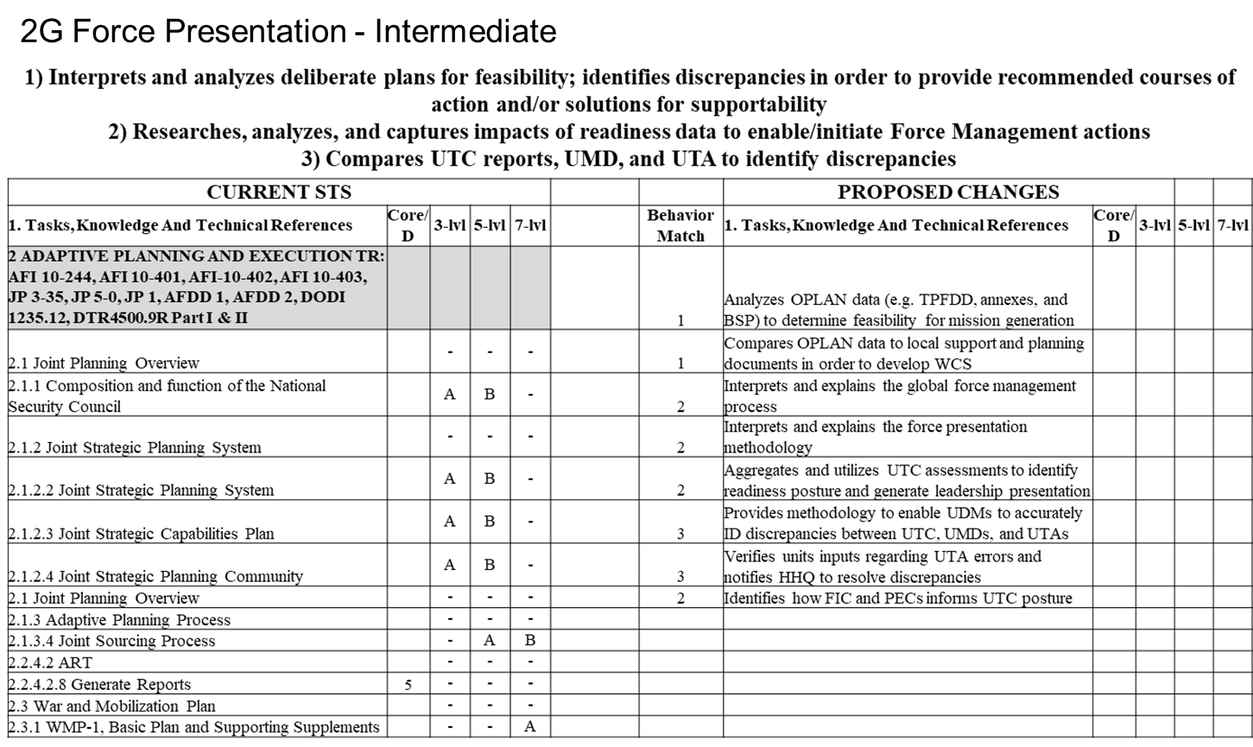
Integration (Example AFS)
Airmen are better prepared and equipped to do the job day 1!

Slide 17
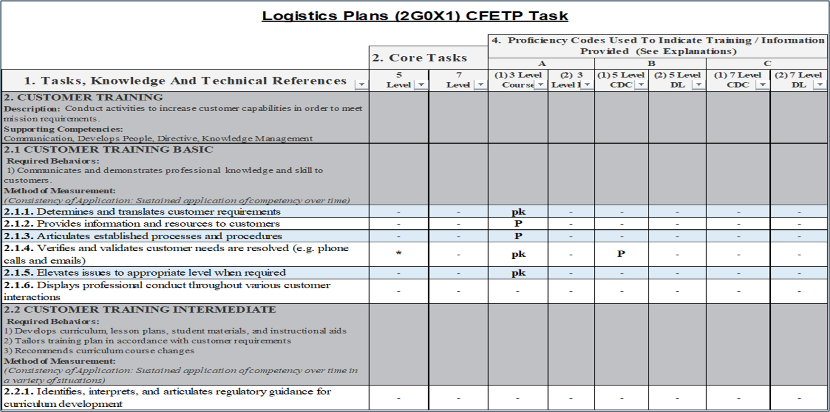
New CFETP STS Format (Example)

Slide 18

Questions

Slide 19

Continuing Education Credit
Deadline to obtain CE 5 Aug 2025

