Slide 1
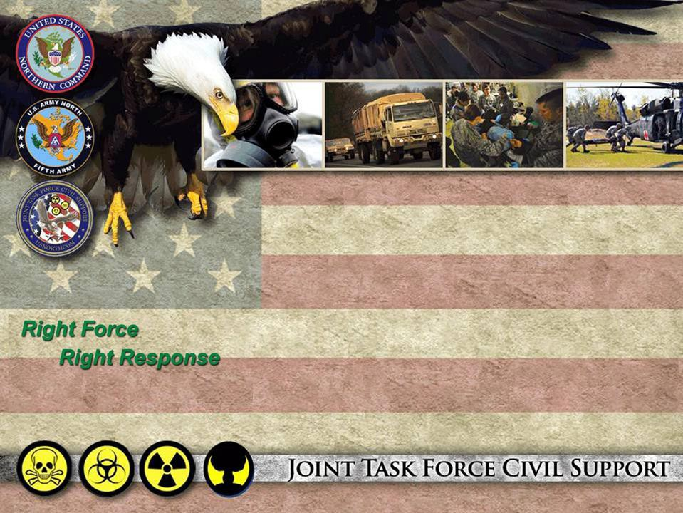


UNCLASSIFIED _{As of: 210422}
UNCLASSIFIED
Joint Task Force - Civil Support
Ever Vigilant! Always R¹eady!

Slide 2
UNCLASSIFIED
Learning Objectives
1. Describe the mission, structure, and capabilities of Joint Task Force–Civil Support (JTF-CS) in the context of Defense Support of Civil Authorities (DSCA).
2. Explain the role of medical operations in CBRN response missions and how JTF-CS integrates with interagency partners during domestic emergencies.
3. Identify key challenges, lessons learned, and best practices in planning and executing large-scale medical support during no-notice, all-hazard DSCA operations.
Notes:
Slide OPR: J3 / J5
This is how we would like to array the DCRF in an operation. What we’ve done here is that the 36th Engineering Brigade is the Task Force Operations commander and underneath him he has 3 battalion task forces. Every year it will change who the C2 is based on the sourcing solution for the DCRF. For this year, battalion Task Force 1 and 2 are organized under engineering battalions and battalion task force 3 is organized under an MP battalion. And that’s okay; he doesn’t have to be an expert at search and rescue. What we need is that battalion HQ to C2 the 600 people that are underneath each of these battalion task forces.
The most important part of the slide is the lower right hand corner here. The 6 core capabilities that each of the battalion task forces are expected to do, and they have been sourced to have enough of the assets across the DCRF to do those.
So obviously mission command, but they also need to be able to identify, detect and map out whatever the threat is, whether it’s chemical, radiation or the like. Also the ability to do technical and nontechnical search and rescue, mass casualty and non-casualty decon, medical triage and stabilization need to pause here a second. We don’t want to treat anyone medically. We don’t want to hold anyone medically in our 6 hospital facilities. We want to treat them, stabilize them and then we want to medivac them, either to a local hospital, a hospital in the next county over or to the medivac APOE where they may be flown to a hospital on the other side of the country. But with 150 beds total, we can’t be a holding place for patients long term. We need to triage them, stabilize them and then get them on to some definitive medical treatment. And then finally speaking of that, the last mission is air and ground evacuation of personnel over to civilians and our interagency partners for further treatment or processing/sheltering. Supporting this operation, we have Task Force Aviation with their 36 helos, Task Force Medical with their 2 field ambulance companies, Task Force Signal with their 30 points of presence and then Task Force Log with the capability and capacity to support the DCRF.
I wrap this one up with a foot stomper. This is how we would like to employ the DCRF; being able to do these 6 missions in 3 different sectors if that’s how the incident commander wants to array our force. But at the end of the day, our civilian partners are in charge of the operation. So if the incident commander says, gee that’s nice, I love your diagram but I’m going to use Lucas Oil Stadium as the single point of decontamination for all survivors coming out of the incident and I want all five of your chemical companies plus the CBIRF on the 50 yard line doing mass decon, that’s the way we’re going to do it. Because the incident commander and the people in that state are in charge.
NOTE: As of 01 June 2017 there is no longer a TF Signal. The 63rd ESB (-) is an enabler rather than a TF. They are assigned to NC and OPCON to ARNORTH. JTF-CS would have signal assets OPCON to them during Phase 3, but the 63rd ESB also supports A & B C2CREs.

Slide 3
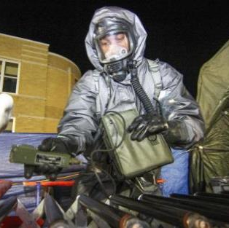
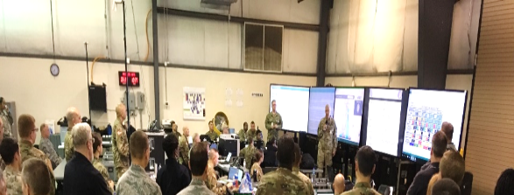
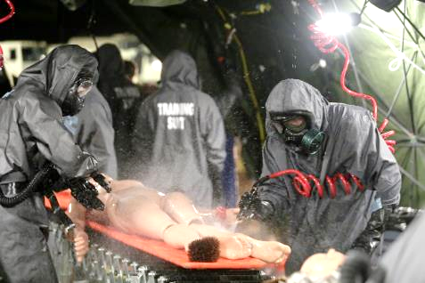
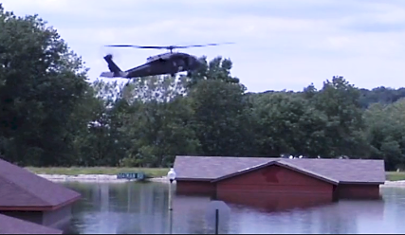
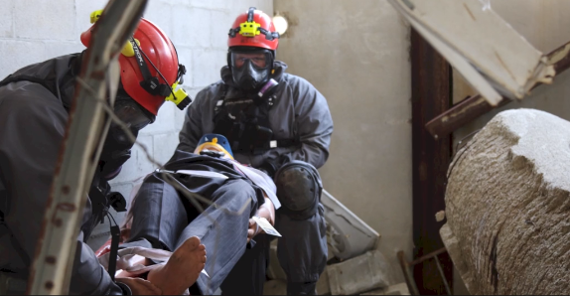
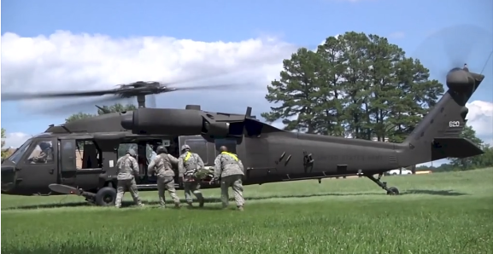
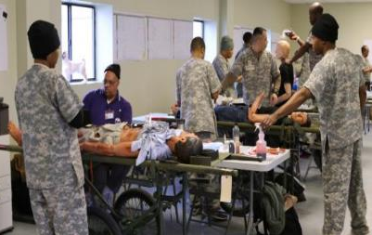

UNCLASSIFIED
DCRF Core Capabilities
6 Core Capabilities
Mission Command
Identification & Detection
Technical & Non-technical Search & Rescue
Mass Casualty & Non-casualty Decontamination
Medical Triage & Stabilization
Air & Ground Evacuation (Medical & Non-medical)
Notes:
Slide OPR: J3 / J5
This is how we would like to array the DCRF in an operation. What we’ve done here is that the 36th Engineering Brigade is the Task Force Operations commander and underneath him he has 3 battalion task forces. Every year it will change who the C2 is based on the sourcing solution for the DCRF. For this year, battalion Task Force 1 and 2 are organized under engineering battalions and battalion task force 3 is organized under an MP battalion. And that’s okay; he doesn’t have to be an expert at search and rescue. What we need is that battalion HQ to C2 the 600 people that are underneath each of these battalion task forces.
The most important part of the slide is the lower right hand corner here. The 6 core capabilities that each of the battalion task forces are expected to do, and they have been sourced to have enough of the assets across the DCRF to do those.
So obviously mission command, but they also need to be able to identify, detect and map out whatever the threat is, whether it’s chemical, radiation or the like. Also the ability to do technical and nontechnical search and rescue, mass casualty and non-casualty decon, medical triage and stabilization need to pause here a second. We don’t want to treat anyone medically. We don’t want to hold anyone medically in our 6 hospital facilities. We want to treat them, stabilize them and then we want to medivac them, either to a local hospital, a hospital in the next county over or to the medivac APOE where they may be flown to a hospital on the other side of the country. But with 150 beds total, we can’t be a holding place for patients long term. We need to triage them, stabilize them and then get them on to some definitive medical treatment. And then finally speaking of that, the last mission is air and ground evacuation of personnel over to civilians and our interagency partners for further treatment or processing/sheltering. Supporting this operation, we have Task Force Aviation with their 36 helos, Task Force Medical with their 2 field ambulance companies, Task Force Signal with their 30 points of presence and then Task Force Log with the capability and capacity to support the DCRF.
I wrap this one up with a foot stomper. This is how we would like to employ the DCRF; being able to do these 6 missions in 3 different sectors if that’s how the incident commander wants to array our force. But at the end of the day, our civilian partners are in charge of the operation. So if the incident commander says, gee that’s nice, I love your diagram but I’m going to use Lucas Oil Stadium as the single point of decontamination for all survivors coming out of the incident and I want all five of your chemical companies plus the CBIRF on the 50 yard line doing mass decon, that’s the way we’re going to do it. Because the incident commander and the people in that state are in charge.
NOTE: As of 01 June 2017 there is no longer a TF Signal. The 63rd ESB (-) is an enabler rather than a TF. They are assigned to NC and OPCON to ARNORTH. JTF-CS would have signal assets OPCON to them during Phase 3, but the 63rd ESB also supports A & B C2CREs.

Slide 4
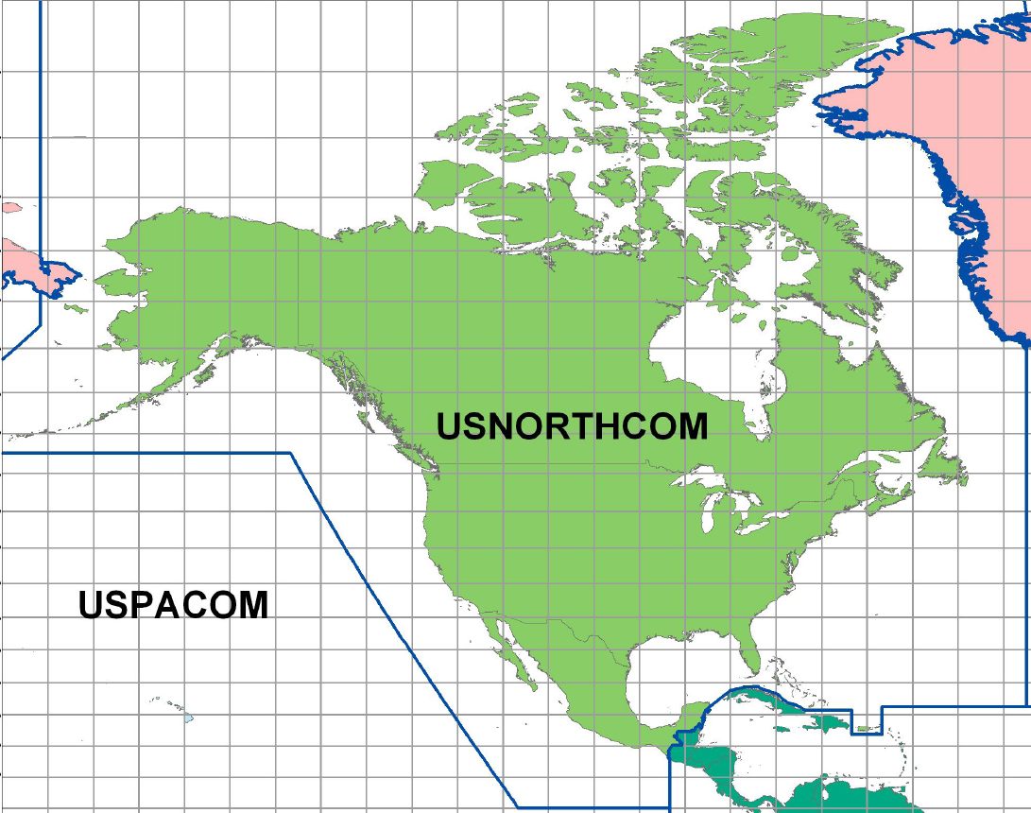










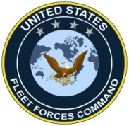




Command Relationships
The President
Relationships
Secretary of Defense
Coordinating
OPCON
COCOM
U.S. Coast
Guard
National Guard
Bureau
JOINT TASK FORCE
CIVIL SUPPORT
JOINT TASK FORCE NORTH
ALASKAN
COMMAND
JOINT FORCE
HEADQUARTERS
NATIONAL
CAPITAL REGION
SOCNORTH
ARNORTH
JFLCC
AFNORTH
JFACC
MARFORNORTH
NAVNORTH
EPLOs
EPLOs
EPLOs
DCO
EPLOs
DCO
DCO
DCO
DCO
DCO
DCO
DCO
DCO
DCO
DCO
DCO
DCRF
DTRA
IA DoE
FEMA
DCO
Staff Enablers
Mission Enablers
DCO
Notes:
Slide OPR: J5
JTF-CS is assigned to US Northern Command, the combatant command for North America.
In 2008, Gen Renuart, then the combatant commander, decided that his span of control was a little too broad so he moved JTF-CS and at that point JTF North under the operational control of Army North, which he designated as his standing Joint Force Land Component Commander.
This makes sense when you think about it from a lot of different angles.
Already, ARNORTH is responsible for all-hazard DSCA such as hurricanes, tornadoes, and earthquakes.
They are responsible for any Title 10 response that would be brought forth to support the response to those incidents.
Additionally, they also have the ten Defense Coordinating Officers assigned to them along with the Army Emergency Preparedness Liaison Officers (EPLOs).
When you think about it, CBRN is just a fancy form of DSCA. It’s just DSCA in JLIST gear or COTS PPE.
So consolidating us from OPCON under ARNORTH makes a lot of sense.

Slide 5
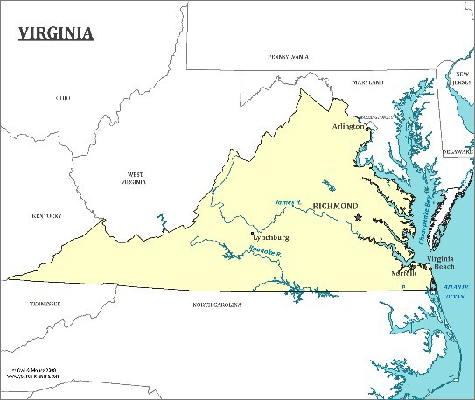
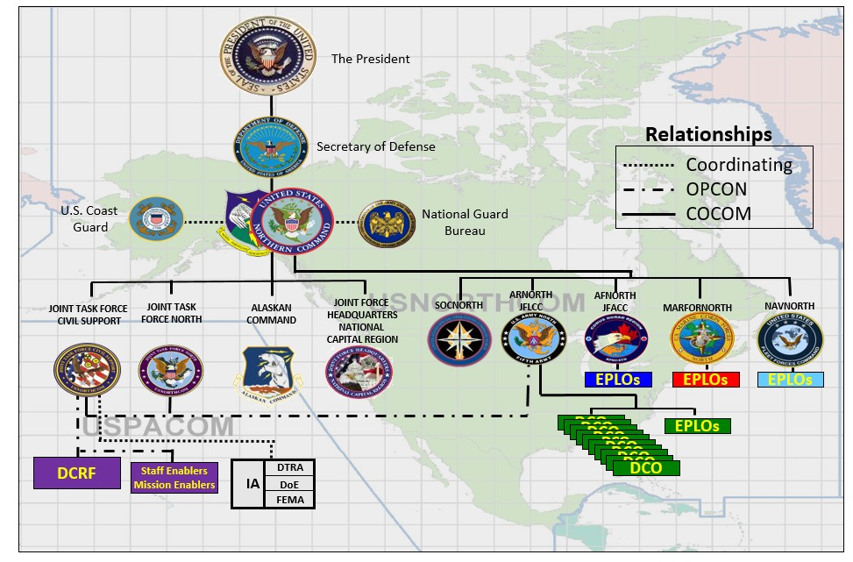
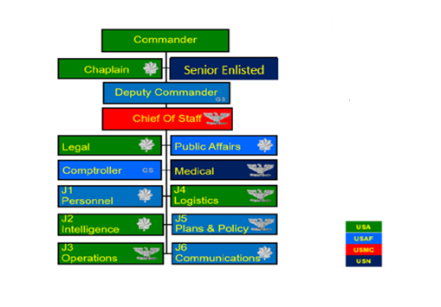
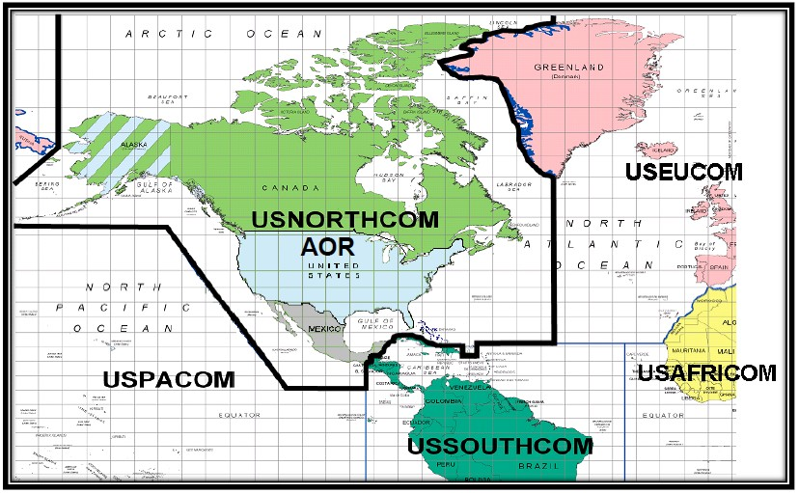
UNCLASSIFIED
Who/What is JTF-CS?
Nation’s only standing CBRN Joint Task Force
Plans and executes CBRN response to save lives and provide temporary critical support to enable recovery
Command and Control for the Title 10 response of All-Hazards
Command Relationships
Prepared to conduct all-hazards domestic response (e.g., hurricane, earthquake, pandemic)
Specialties: Nuclear, Chemical, Biological; Interagency; full time JTF
Area of Responsibility
Includes Alaska, Puerto Rico,
U.S. Virgin Islands & The Bahamas
2-Star Billet
Commander
COL McGonegal
CSEL
CSM Bumanglag
Can also support Indo-Pacific Command in HI, Guam, Commonwealth of the Northern Mariana Islands
UNCLASSIFIED
2

Slide 6
UNCLASSIFIED
Defense Coordinating Elements
TEAM ~9
REGION X
DCO
AC Colonel
OPCON
Seattle
I
X
Boston
Deputy
USAR LTC
VIII
II
New York
V
Chicago
Operations
DSCA Planner
Admin LOG
III
Philadelphia
Oakland
Denver
VII
IX
Kansas City
AC Major
DAC Ops
AC SFC
DAC
Planner
AC SFC
AC SSG
AC SSG
IV
Atlanta
VI
Denton
HI
JRMPO
REPLO
SEPLO
VI
REGION II
PR
USAR COL
Team of 5
USAR COL
USAR SFC
GUAM
REGION IX
A permanently assigned defense coordinating officer and element is located in each FEMA region in order to plan, coordinate, and integrate DSCA with local, state, and federal agencies augmented by Service-owned emergency preparedness liaison officers; and/or the joint regional medical planning office.
UNCLASSIFIED

Slide 7

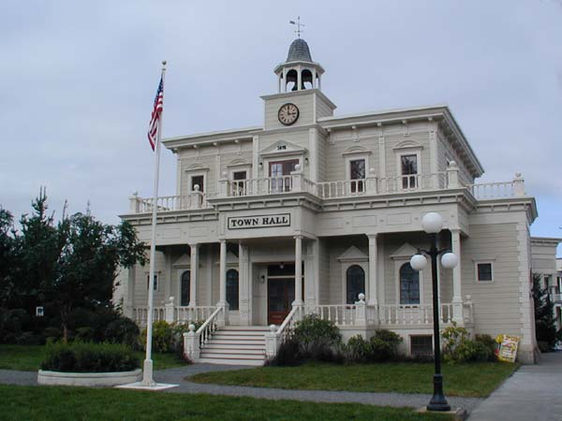


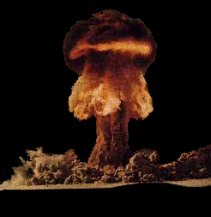

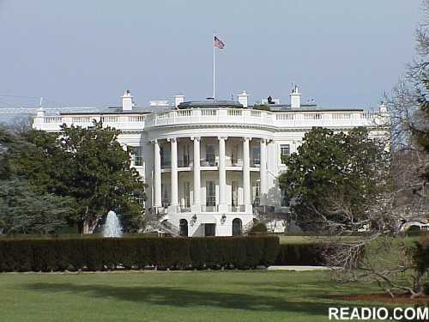





DSCA Response Process
Governor
Mayor
Requests Aid
From Governor
FEMA Regional Director
Declares State Emergency
Request Aid (mutual aid, EMAC)
Local
Response
Requests President
Disaster Declaration
Disaster Site
State Response
President
Federal Response
Joint Field Office
Declares Federal Emergency or Disaster
15 Emergency Support Functions
Federal Coordinating Officer
+
Defense Coordinating Officer
State Coordinating Officer
UNCLASSIFIED
Notes:
The CBRN response starts and builds from the local level and escalates to the state/federal levels only when available resources are not sufficient.
Deployment of JTF-CS would occur only after an established sequence of events:
- Governor’s request
- Presidential declaration
- DOD support requested by FEMA
- Force deployment authorized by the Secretary of Defense
The question becomes, “how can we fill the gap between when the incident occurs and when DOD forces reach the incident site?
JTF-CS closes this time gap 5 ways …..

Slide 8
UNCLASSIFIED
DCRF Capabilities
Direct Lifesaving Capabilities
  Search and Extraction
  Decontamination of DoD Personnel and Equipment
  Evacuee and Casualty Decontamination
  Emergency Medical Care
  Role 2 Medical Care (patient triage
  along with trauma and emergency medical care)
Role 3 Medical Care (surgical and intensive care)
Critical Lifesaving Enabling Capabilities
  CBRN Incident Assessment
  First Responder and Emergency
  Equipment Decontamination
  Patient Holding
  Ground and Rotary-Wing Air
  Patient Movement (MEDEVAC
  and CASEVAC)
  General Purpose Support to Enhance Lifesaving and Reduce Human Suffering
Other CBRN Response Operational Capabilities
  Force Health Protection Measures
  Military Personnel and Equipment Operational Security
  Site Accessibility Horizontal/Vertical Engineering
  Logistics
  C2 Aviation Lift
  Mortuary Affairs
  Transportation

Slide 9

















Emergency Support Functions
1. Transportation
9. Search and Rescue
(Dept of Transportation)
(Dept of Homeland Security FEMA )
2. Communications
10. Oil & Hazardous Materials Response
(Dept of Homeland Security -
(Environmental Protection Agency)
National Communications System)
3. Public Works and Engineering
11. Agriculture & Natural Resources
(Dept of Defense US Army Corps of Engineers)
(Dept of Agriculture)
4. Firefighting
12. Energy
(Dept of Energy)
(Dept of Agriculture)
5. Emergency Management
13. Public Safety & Security
(Dept of Homeland Security – FEMA)
(Dept of Justice)
6. Mass Care, Emergency Assist., Housing & Human Services
14. Long Term Community Recovery
(Dept of Homeland Security – FEMA)
(Dept of Homeland Security FEMA)
15. External Affairs
7. Logistics Mgmt. & Resource
Support
(Dept of Homeland Security)
(GSA and FEMA)
Emergency Support Functions (ESFs) provide the structure for coordinating Federal interagency support for a Federal response to an incident. Highlighted ESFs are primary lines of support provided by JTF-CS.
8. Public Health and Medical Services
(Dept of Health and Human Services)

Slide 10
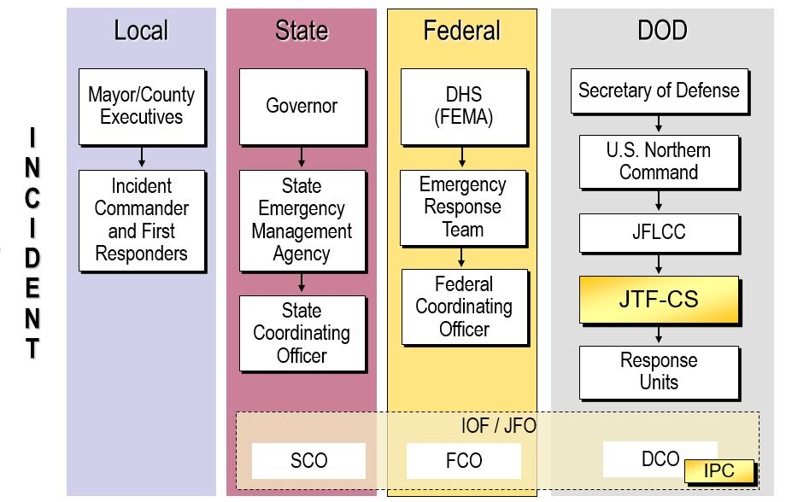
National Incident Management
IPC – Interagency Planning Cell/ IST Coordination
Notes:
Slide OPR: J5
The National Incident Management System. The incident commander and the first responders are the reason we’re all there from any level of government or any department.
They are all there in support of the incident commander. When the incident commander needs more capability or capacity, they’re going to upchannel their request through local and state EM organizations which will be collocated with the initial operating facility or the joint field office depending on where the response is in the timeline.
If the state coordinating officer is out of capability or capacity they’ll turn to the FCO, which will look to FEMA or CDC or Health and Human Services or any of the other federal ESFs to fill the gap that the incident commander has identified.
We’re actually going in order there for a reason, because the DOD is extremely expensive and under the Stafford Act, if FEMA or HHS or CDC uses DOD assets, they’ve got to reimburse DOD for the movement, the execution, the use of those assets and the redeployment of them.
We are not exactly fast and we are very expensive, so we’re the solution of last resort. But if the SCO doesn’t have enough (capability) and the FCO can’t identify another federal asset , then they’ll turn to the Defense Coordinating Officer. The DCO works for ARNORTH and he will see what the DOD can provide to the incident commander.
Now you’ll notice down here this little IPC box. That’s part of JTF-CS. That’s our interagency planning cell. This is approximately 6 personnel who embed with the Defense Coordinating Officer and the DCE, and it’s their responsibility to be sure that the DCO has the most up to date information on what DCRF capabilities are arriving in the JOA or have arrived in the JOA.
The IPC is nested with the DCO and they help the JFO understand DCRF response capabilities and capacities in real time to inform MA writing based on available DoD assets. This ensures that we’re not executing missions or attempting to execute missions that we don’t have the resources for at the right time.

Slide 11



UNCLASSIFIED
Task Organization (JTF-CS + DCRF)
JTF HQ
(JTF-CS)
OPCON to JTF-CS when mobilized
JTF-OPS
O-6 CMD
TF-AV
O-6 CMD
JTF-MED
O-6 CMD
TF-LOG
O-5 CMD
Capabilities:
HQ
8 x Medium Lift
15 x Med Evac
12 x Heavy Lift
Capabilities:
HQ
2 x Role 3 (EMEDS)
1 x ASMC
4 x Med Det Fwd Res & Surgical
2 x Med Co, Grd Amb
1 x Med Det, Blood Spt
1 x Med Co, Logistics
1 x Med Det, Vet Svc Spt
1 x Med Det, COSC
1 x Med Det, Prev Med
Capabilities:
HQ
2x CTC
1x ICTC
1x CSC
1x Maint CO
CBRN TF-1
O-5 CMD
CBRN TF-2
O-5 CMD
CBRN TF-3
O-5 CMD
IRF
Capabilities:
HQ
LNO Team
RECON
Tech and non-Tech Search & Rescue
Mass Casualty Decon
Triage/Stabilization
MEDEVAC
CASEVAC
Communications
Capabilities:
HQ
LNO Team
RECON
Tech and non-Tech Search & Rescue
Mass Casualty Decon
Triage/Stabilization
MEDEVAC
CASEVAC
Communications
Capabilities:
HQ
LNO Team
RECON
Tech and non-Tech Search & Rescue
Mass Casualty Decon
Triage/Stabilization
MEDEVAC
CASEVAC
Communications
Capabilities:
HQ
RECON
Tech and non-Tech Search & Rescue
Mass Casualty Decon
Triage/Stabilization
EOD
HQs JTF-CS + DCRF = 5,500 personnel
Notes:
Slide OPR: J3 / J5
This is how we would like to array the DCRF in an operation. What we’ve done here is that the 36th Engineering Brigade is the Task Force Operations commander and underneath him he has 3 battalion task forces. Every year it will change who the C2 is based on the sourcing solution for the DCRF. For this year, battalion Task Force 1 and 2 are organized under engineering battalions and battalion task force 3 is organized under an MP battalion. And that’s okay; he doesn’t have to be an expert at search and rescue. What we need is that battalion HQ to C2 the 600 people that are underneath each of these battalion task forces.
The most important part of the slide is the lower right hand corner here. The 6 core capabilities that each of the battalion task forces are expected to do, and they have been sourced to have enough of the assets across the DCRF to do those.
So obviously mission command, but they also need to be able to identify, detect and map out whatever the threat is, whether it’s chemical, radiation or the like. Also the ability to do technical and nontechnical search and rescue, mass casualty and non-casualty decon, medical triage and stabilization need to pause here a second. We don’t want to treat anyone medically. We don’t want to hold anyone medically in our 6 hospital facilities. We want to treat them, stabilize them and then we want to medivac them, either to a local hospital, a hospital in the next county over or to the medivac APOE where they may be flown to a hospital on the other side of the country. But with 150 beds total, we can’t be a holding place for patients long term. We need to triage them, stabilize them and then get them on to some definitive medical treatment. And then finally speaking of that, the last mission is air and ground evacuation of personnel over to civilians and our interagency partners for further treatment or processing/sheltering. Supporting this operation, we have Task Force Aviation with their 36 helos, Task Force Medical with their 2 field ambulance companies, Task Force Signal with their 30 points of presence and then Task Force Log with the capability and capacity to support the DCRF.
I wrap this one up with a foot stomper. This is how we would like to employ the DCRF; being able to do these 6 missions in 3 different sectors if that’s how the incident commander wants to array our force. But at the end of the day, our civilian partners are in charge of the operation. So if the incident commander says, gee that’s nice, I love your diagram but I’m going to use Lucas Oil Stadium as the single point of decontamination for all survivors coming out of the incident and I want all five of your chemical companies plus the CBIRF on the 50 yard line doing mass decon, that’s the way we’re going to do it. Because the incident commander and the people in that state are in charge.
NOTE: As of 01 June 2017 there is no longer a TF Signal. The 63rd ESB (-) is an enabler rather than a TF. They are assigned to NC and OPCON to ARNORTH. JTF-CS would have signal assets OPCON to them during Phase 3, but the 63rd ESB also supports A & B C2CREs.

Slide 12
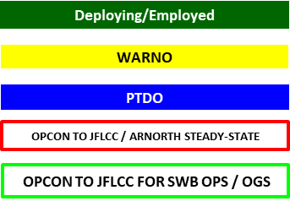

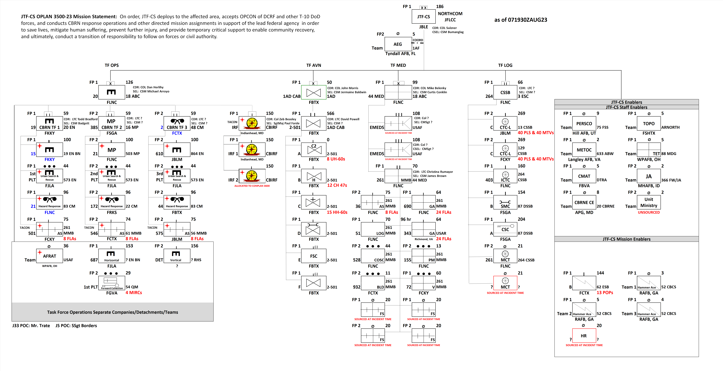
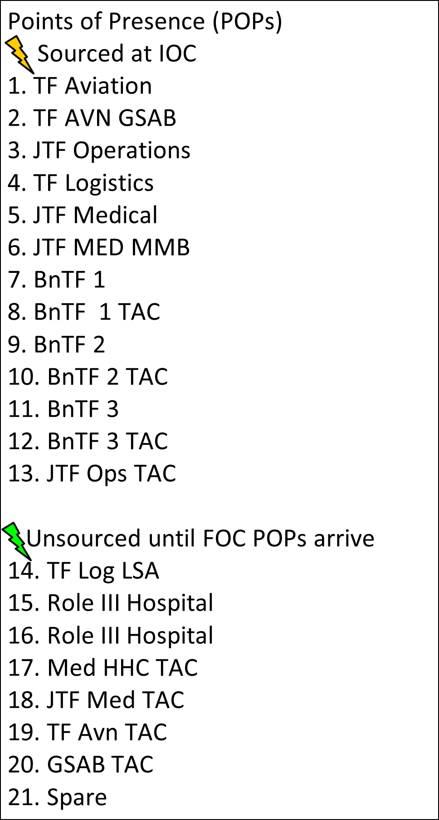


Joint Task Force - Civil Support
OPLAN 3500 Task Organization: Mission Year 24 (will assume mission 01 Jun 24)
Changes:
EMEDS capabilities will be sourced at time of incident
HR PLT & 2nd MCT capabilities administratively moved to FY24 TSC EXORD
- these capabilities will be sourced at time of incident
BNTF-3 HQ changed from 110 CM BN (JBLM) to 2 CM BN (FCTX)
Replaced 51 CM CO (FSGA) with 21 CM CO (FLNC) in BNTF-2
Replaced 887 EN CO (FCKY) with 15 EN CO (FKKY) in BNTF-1
1AD CAB/2-501 GSAB assumes DCRF TF AVN mission 01 May 24
3ID CAB/2-3 GSAB (FBTX) will replace 1AD CAB/2-501 GSAB on 01 Jan 25
TF OPS
TF MED
TF AVN
24x
56x
15x
Primary Sources:
GFMAP FY24 Annex A Consolidated thru Mod 5
ANNEX A to FRAGORD 01 to FORSCOM EXORD ISO CRE FY24

Slide 13



CBRN Response Enterprise Elements
UNCLASSIFIED
As of: 20422
~10,500
State Response Federal Response
~8,000
State National Guard (NG) assets may operate under State or Federal control
CBIRF IRF #2
Non-CRE
Non-allocated
JTF-CS
161 w/o enablers
~361 w/ enablers (188)
DCRF
~5200 personnel
FP 1 (2,100) / FP 2 (3,100)
C2CRE A & C2CRE B
~1,300 Each
Homeland Response Forces (HRF)
(10 units)
583 / 5,830
Weapons of Mass Destruction Civil Support Teams (WMD-CST)
(57 Teams)
22 / 1,254
CBRNE
Enhanced Response Force Packages (CERFP)
(17 units)
203 / 3451
-Ground MEDEVAC / CASEVAC
-Aviation MEDEVAC / CASEVAC
-Aviation Lift
-CBIRF IRF #1
-Role 2/3 Med w/ Surgical
-Engineering
-Logistics
-Transportation
-Command & Control
-CBRN Assessment
-Search & Rescue
-Decontamination
-Emergency Medical
+ Additional RFF Forces
-Role 2 Med
-Engineering
-Logistics
National Guard and Army Reserve
-Security
-Command & Control
-CBRN Assessment
-Search & Extraction
-Decontamination
-Emergency Medical
-Transportation
-Command & Control
-CBRN Assessment
-Search & Extraction
-Decontamination
-Emergency Medical
-186 personnel
-Detection / ID
-Rapid Hazmat Assessment
-Search & Extr
-Decontamination
-Emergency Med
Prepared to Deploy NLT N+3 Hours
Prepared to Deploy NLT N+6 Hours
Prepared to Deploy NLT
N+12 Hours
Prepared to Deploy FP 1 NLT N+24 Hours FP 2 NLT N+48 Hours
Prepared to Deploy NLT N+96 Hours
Assigned to the State NG
Allocated to USNORTHCOM
UNCLASSIFIED
4

Slide 14
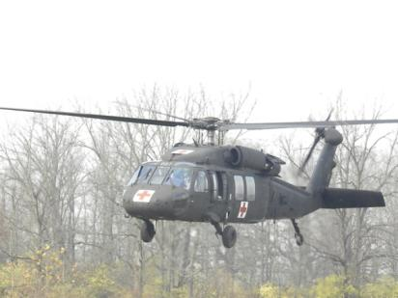
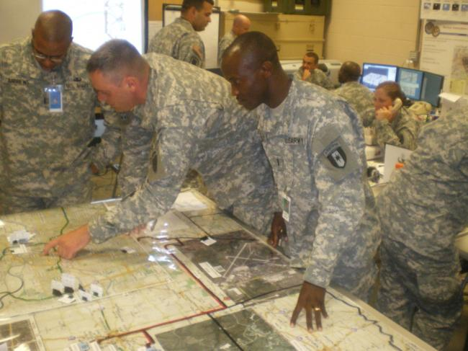
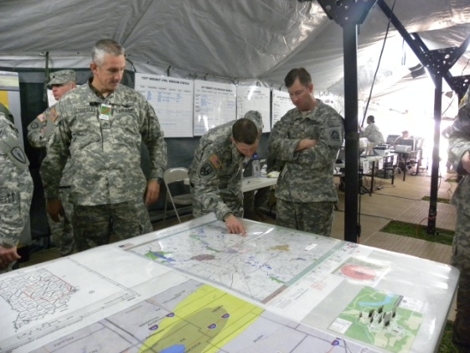
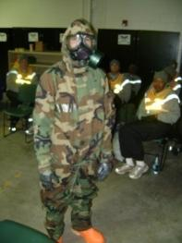
DCRF Medical Response
  Incident Response and Decontamination
  Triage / Pre-Hospital Treatment
  Medical Surge Augmentation
  Patient Movement – Ground and Air
  Medical Supplies Management/Distribution

Slide 15
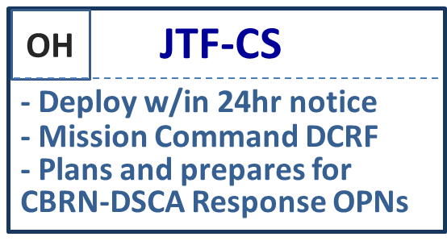
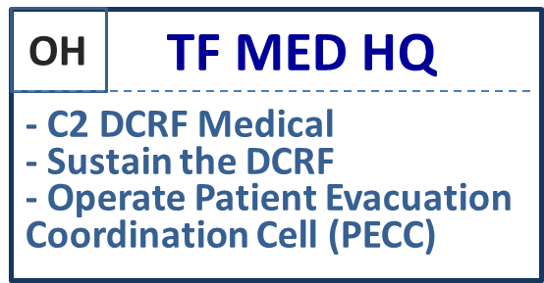
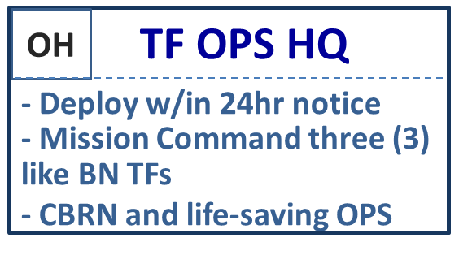
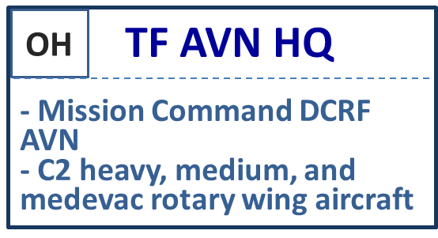
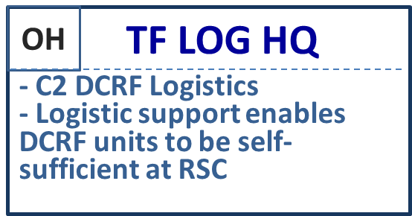
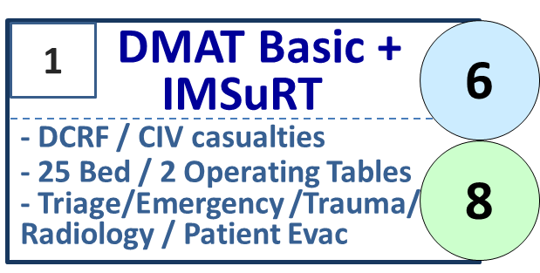
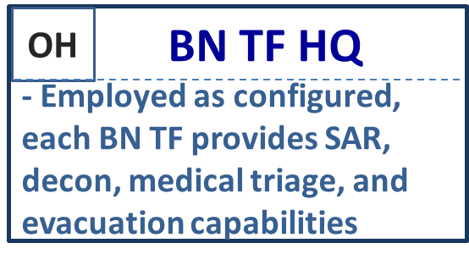
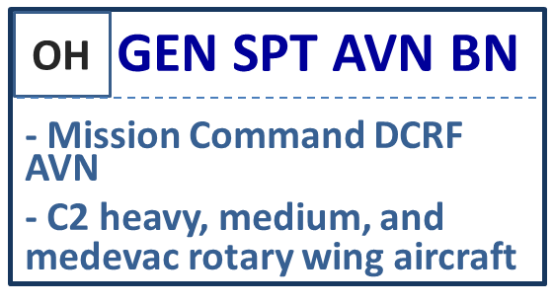
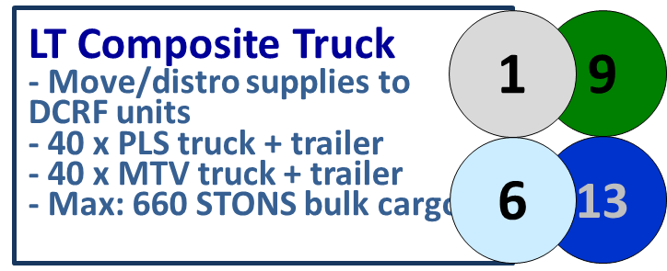
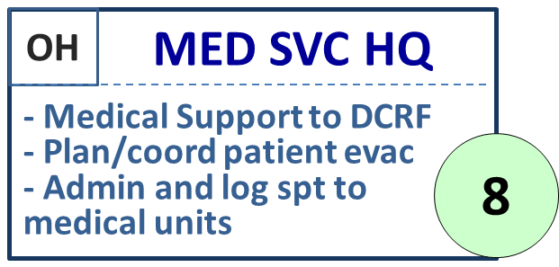
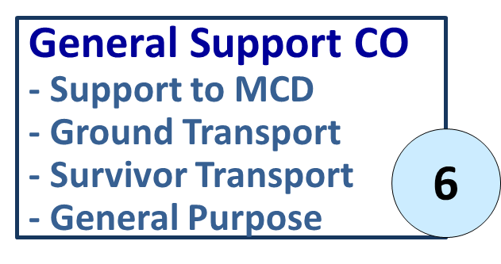
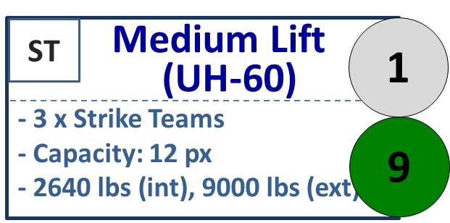
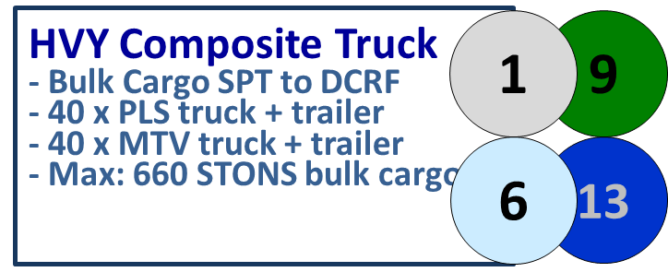
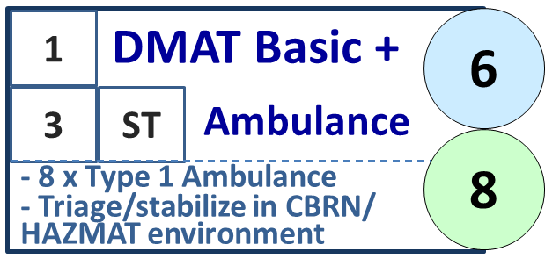
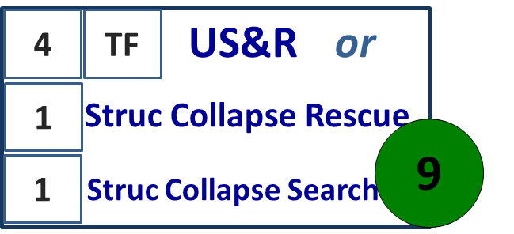
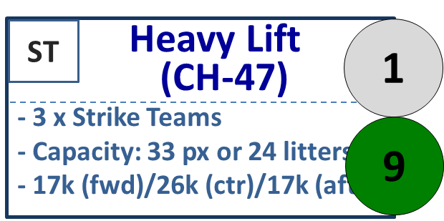
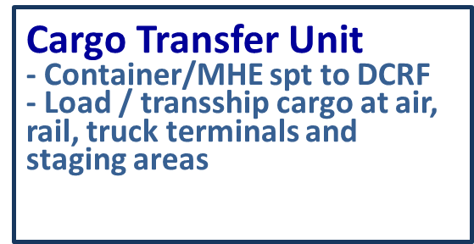
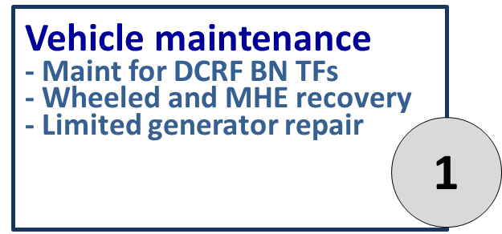

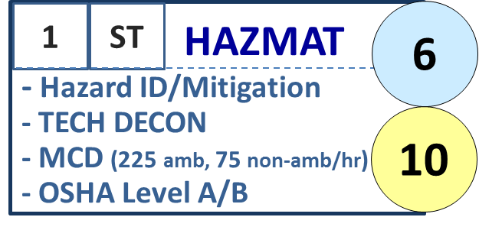
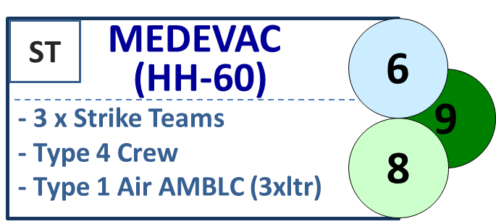
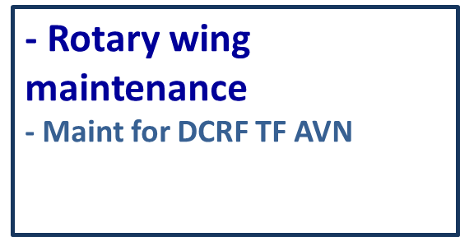
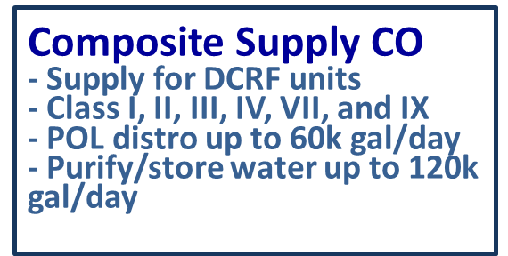
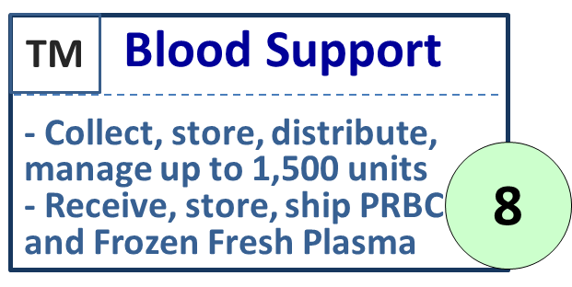
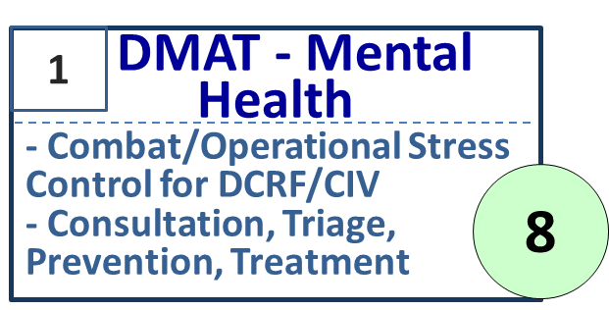
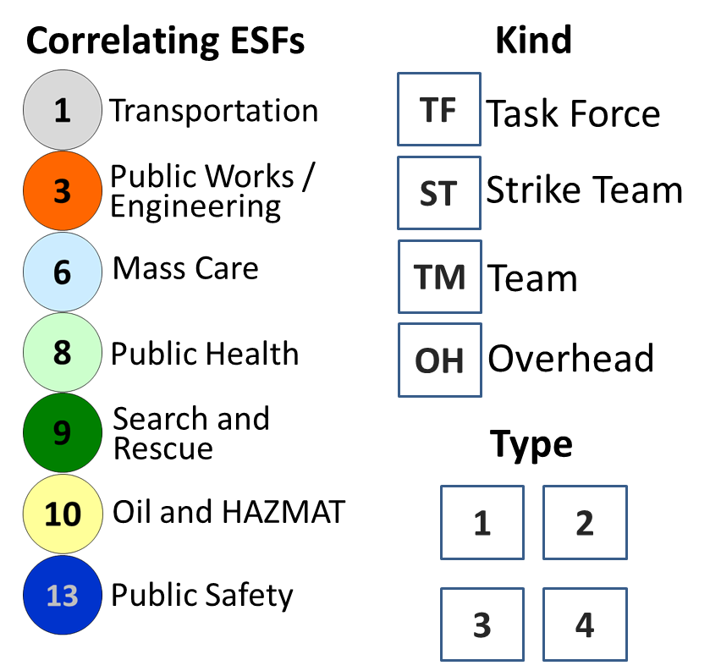








UNCLASSIFIED//FOUO
JTF-CS and DCRF Task Organization Crosswalk to NRF (ICS/NIMS)
175 pax
X X
JTF-CS
TF OPS
TF AVN
TF LOG
TF MED
100 pax
69 pax
CSSB
89 pax
X 2
EMEDS
78 pax
44 pax
164 pax
+25
3 x BN Task Forces (TFs)
77 pax
CTC-L
65 pax
48 pax
UH-60
164 pax
MP
U
78 pax
M
CTC-H
44 pax
48 pax
CH-47
140 pax
AS
US&R
U
H
ICTC
13 pax
36 pax
HH-60
147 pax
95 pax
U
PM
M
145 pax
53 pax
11 pax
78 pax
CSC
BS
AS
44
pax
135 pax
Separate Detachments/Teams
COSC
CBIRF
IRF
157
pax
59 pax
36 pax
RED HORSE
V
AFRAT
157
pax
20 pax
147
pax
X 4
FS
65 pax
X 2
UNCLASSIFIED // FOUO

Slide 16
DCRF Medical Assets Breakdown
2 x Field Hospitals – 50 total beds, 4 OR tables; ICU
4 x Forward Surgical/Resuscitation Teams – 8 OR tables; temp post-op holding (sourced at time of incident)
4 x Triage/Treatment Centers – 160 cots to hold, then move pts w/ 32 ambulances
2 x Ground Ambulance Units – 48 ambulances
Mental Health Personnel
Veterinary Teams
Medical Logistics Unit – supplies DCRF, assists w/ civilian needs (POD’s, SNS)
Preventive Medicine/Public Health personnel
Overall patient movement assets in DCRF:
Total of 80 ambulances in DCRF (EMEDS, ASMC, Ground Ambulance Co)
~15 x medical evacuation helicopters for patient movement

Slide 17
MA / MATO to Orders Process
UNCLASSIFIED
REQUIREMENT
FRAGORD (NET 60 min, but
will not violate 1/3, 2/3)
POC’s
Incident Location
Time-Distance Analysis
Operational Environment Analysis
Route Analysis
Protection Analysis
MOPs/MOEs
Legal Review
J3 Approval and Publication
WARNORD (~20 Min)
Date / Time required
FEMA/LFA Priority
Capability Available or RFF?
Within SOW
Assign Subordinate Unit to MA/MATO
JOINT FIELD OFFICE
DEFENSE COORDINATING OFFICER
COORDINATION IST / LNO
DDASS
SUBORDINATE UNIT LNO
JOINT OPERATIONS CENTER
MISSION ANALYSIS (CAT/FUOPS)
WARNORD (~ 20 min)
FUOPS Updates MA/MATO tracker upon MA posting in DDASS, CUOPS updates after FRAGO publication.
IPC (IST-C) provides DCRF’s estimates of supportability and capabilities to assist DCO/E shape SOW before the MA/MATO is finalized.
DCRF TF or other OPCON/TACON element
JOINT PLANNING PROCESS
FRAGORD (NET 60 min)
SUBORDINATE UNIT LNO

Slide 18
  Local Response
  Federal Response
  Title 10 Military Response
  State Response
  National Guard Response
UNCLASSIFIED
Integrated Response
N+0
N+6
N+48 - 120
N+3
N+12
N+36
JTF-State
Homeland
Response Force
Aerial Port of Debarkation (APOD)
Incident CMD
APOD Coord Cell
DCRF
BN TF 1
CST
Task Force AVN
Incident CMD
DCRF
Bn TF 2
Task Force LOG
Base
Support Installation
Incident CMD
JFT-CS
IST -S
Task Force MED
CERFP
Task Force OPS
CERFP
JTF-CS FCE
CST
DCRF
Bn TF 3
Joint Field Office
Area Cmd
Initial Operating Facility
STATE
EOC
Defense Coordinating Officer
JTF-CS IST -OPs
JTF-CS IST Coord
Location of JTF-CS commander is determined at time of incident based on the needs
of the response in order to build trust and common understanding in order to best support the lead federal agency
UNCLASSIFIED
Notes:
Slide OPR: J5
An integrated response is when the local, county, and state authorities respond to an incident; The surrounding National Guard unit and/or civilians respond, the interagencies respond and then if it really is America’s worst day, DOD responds. So what does this look like?
Next. So here we are at N+0 response the incidence happens. These are local responders responding to the incident and incident command centers are being set up to coordinate the effort, the overall response to the effort.
Next…at N+3 estimate the civil support from that state has arrived. (Describe Civil Support Team).
Next. At N+6, perhaps a CERFP from that state or a nearby state has arrived. There may be more than one. A state joint task force is up and operating. An area commander has been set up to oversee and coordinate the operations of the incident commanders and therefore the overall response. The state emergency operations center is in full swing right now coordinating the response effort.
Next. At approximately N+12 FEMA has arrived and an IMAT team has established an initial operating facility. DCO is embedded with the IOF. The APOD has been designated, a base support installation has been designated and now one or perhaps more homeland response forces are arriving as we discussed on one of the earlier slides for the CRE.
Next. Again at N+12 we expand the JTF-CS interagency planning cell that was part of the early entry command post; it is now embedded with the DCO providing updated information on the arrival of JTF-CS and DCRF units. Our TAC CP has been established at the BSI, the APOD or in the vicinity of the area command, wherever the commander determines we can best effect the operation. Our BSI coordination cell is at the BSI helping establish where we’re going to bed down our folks and resupply and our APOD coordination cell is at the APOD receiving DCRF units and JTF-CS members as they arrive.
Next. At N+36 JTF-CS main command post has arrived and is now set up so the tactical command post has been relieved. Our task force ops has established its command post and the DCRF Force Package 1, along with the Marine Corps CBIRF, have arrived in the area and are starting operations.
Next. From N+48 out to N+120 Task Force Aviation, Logistics, Signal, and Medical have arrived.. Furthermore Battalion Forces 2 and 3 have now engaged in the operation and the operation is in full swing.

Slide 19

DCRF Concept of Medical Support
N+0
N+24
N+36
N+48
N+60
N+72
N+96
N+108
N+120
FP1 deploys; 1 BNTF with 1 ASMC, 1 GA Co, 2 FST’s, MED BDE & MMB EET, FDT
BNTF 1 IOC
FP2 deploys with the bulk of TF Med Units
TF Meds MCAS FOC
EMEDS arrive in the JOA
EMEDS IOC
EMEDS FOC
RES GA FOC
Res GA Deploys
Res GA IOC
Mission: Save lives, mitigate suffering and provide temporary medical support to the DCRF and civilian population IOT enable community recovery.
TF Ops: Conduct triage and stabilization of casualties within a CBRN contaminated area.. Monitor and care for patients throughout the decontamination process. Assist with the movement of casualties to a CCP. Provide emergency treatment, stabilization and temporary holding. Maintain casualty accountability and prepare for the movement of casualties .
TF Med: Provide mission command to all TF Medical units. Ensure FHP for the DCRF. Coordinate Role II-III care for both DCRF and civilian personnel. Provide medical advice to the JTF Commander, conduct medical regulating functions and provide consultative services and technical advice to subordinate health service units.
Class VIII Push Packs
TF MED
TF OPS
TF OPS MED Personnel

Slide 20
Surgeon General Directorate
Military
GS
JTMD-Funded
JTMD-Unfunded
Joint Medical Operations Center*
(Operations, Training, Exercises)
Command Surgeon (SG)
CDR Stuart
00041787/USN/06/2100
JTD Assigned/Authorized:
2/3 Civilians
3/4 Officers
1/2 Enlisted
7/9 Total
JT Medical Readiness Officer (SGX)
<VACANT >
00031505/USAF/05/R41A4
Deputy Surgeon (SG2)
Mr. Jeff Schuler
00020859/GS/13/0671
Joint HSS Operations Officer
Mrs. Rodriguez-Thorne
00103293/GS/12/0671
JT Medical Operations Officer (SG3)
LCDR Fears
00089003/USN/04/2900
JT Health Services Support Officer (SG5)
LCDR Gaxiola
00066477/USN/05/2300
Joint HSS Operations Officer
Mr. John Cronin
00089079/GS/12/0671
Force Health Protection LPO
<VACANT >
00033460/USN/E5/8404
Medical Plans NCO
SSG Sweeney
00089004/USA/E6/68W
JT Medical Plans Officer
LTC Norris
00047976/USAR/04/70H
MOC OPS NCO
<VACANT>
00012963/USAR/E5/68W
Veterinary Medical Officer
<VACANT>
00047979/USAR/05/64B
MOC OPS NCO
<VACANT>
00047981/USAR/E5/68W
* Joint Medical Operations Center stands up on-order
POC: Jeff Schuler, Current as of 22 Apr 25

Slide 21
CLASSIFICATION
QUESTIONS

Slide 22

Continuing Education Credit
Deadline to obtain CE 5 Aug 2025

