Slide 1
Society of Air Force Pharmacy
Mid-Year Conference
16 -18 June 2025
Hilton Norfolk The Main
Norfolk, VA

Slide 2
“A day’s work is a day’s work, neither more nor less, and the man who does it needs a day’s sustenance, a night’s repose, and due leisure, whether he be a painter or a ploughman” – George Bernard Shaw

Slide 3
Disclosure
Colonel Corey Munro declares no conflicts of interest, real or apparent, and no financial interests in any company, product, or service mentioned in this program, including grants, employment, gifts, stock holdings, and honoraria.

Slide 4
Learning Objectives
Explain the importance of discussing work-life balance (WLB)
Define different faith-based perspectives on WLB
Differentiate between contemporary approaches to WLB
Discuss the importance of promoting WLB in your organization

Slide 5
Work/Life Balance – Why Discuss?
Why is WLB important? Arguably a contemporary topic
  Employee retention – satisfied employees remain in place
  Improved productivity and performance
  Employee health – stressed employees are unhealthy employees
  Military WLB leads to mission success
  Reduced incidence of burnout

Slide 6
Faith Perspectives
Buddhism - Emphasizes the “middle way”
  Encourages moderation and balance in all aspects of life
Islam – WLB rooted in ‘wasatiyyah’
  Emphasizes finding balance of worldly pursuits and spiritual obligations
  Engage in work while prioritizing faith and family
Christianity
  Emphasizes a balanced approach to work & life
  Work is a vocation from God
  Sabbath is a day of rest
Notes:
Christianity promotes a work-life balance where work is meaningful and diligent but does not come at expense of rest, family, and spiritual well-being

Slide 7
WLB Approaches in Today’s Workplace
Traditional Separation – I will not read emails on weekends
Integration – I will read emails as required anytime
Prioritization – I will read emails if I’m not doing something else that’s important to me
Energy Management – I like to manage my emails in the evening, regardless of what day it is
Work/Life Fusion – I like to read emails anytime because I have a work phone
Notes:
Christianity promotes a work-life balance where work is meaningful and diligent but does not come at expense of rest, family, and spiritual well-being

Slide 8
WLB Approaches – Traditional Separation
Clear separation between work and life
Static equilibrium where one does not encroach on the other
Historical context: rooted in the industrial revolution
  Robert Owen proposed idea of dividing time into 8 hour segments – work/rest/sleep

Slide 9
WLB Approaches - Integration
Blending work and life, not balancing
Seeking synergy and harmony vs. balance
Recognizes that work is just one aspect of life and should fit into the broader context of one’s overall well-being
Tactics:
  Focus on productivity vs. hours
  Utilize peak productivity times
  Champion flexibility

Slide 10
WLB Approaches - Prioritization
Entails identifying your core values
  Create realistic schedule
  Set boundaries
  Practice time management
Prioritizes self care
Review regularly and adjust
Incorporates all other approaches once priorities are established
Tactics:
  30/60/90 day plan for new positions or projects
  Eisenhower Matrix
  Personal Kanban

Slide 11
WLB Approaches – Energy Management
Prioritizes physical, emotional, mental, and spiritual well-being
Requires understanding and adherence to 4 dimensions of energy
Entails adjusting your work and life routine to your personal rhythms
Tactics:
  Recognize staying at high energy is very difficult
  Give yourself daily boosts (e.g., practice gratitude)
  Don’t ‘bundle’ all tasks that drain your energy

Slide 12
WLB Approaches – W/L Fusion
Contemporary approach centered around shifts in technology
Line between work and life no longer there
Technology in current environment serves as an annex to merge W/L into a larger, more complex system
WLB “dual-centricity” supports better overall well-being (Bourne et al., Business Horizons, 2009)

Slide 13
How does the Air Force Support WLB?
Military leave policy
Physical fitness policies and activities
Morale support and activities
Rest and relaxation following deployments
Morale, welfare, and recreation
Spiritual support
More attention to this topic is required!

Slide 14
How Should You Support WLB?
Define WLB for your team that is relevant to the work environment
Distinguish between work-life balance and convenience
Relentlessly focus on team efficiency
Discourage working too much
  Per Stanford study, productivity declines after 50 hours/week
Bonus: help your team learn to get the most of their leisure time

Slide 15

Pharmacy Senior Leader Perspectives
Col Achilles Hamilothoris – AMC/SG2
  Advice – make yourself replaceable for absences
    Establish electronic continuity binders
    Available only if I’m the last person that can assist
    Offer emergency numbers if decisions can’t wait
  Tactics
    Try not to use family time for sounding board
    Check cell phone sparingly (once/day)
    Avoid opening email app

Slide 16

Pharmacy Senior Leader Perspectives
Col Liz Howarth – 61st Medical Squadron CC
  Advice – balance is a very subjective thing
    Unrealistic to expect harmony/balance at all times
    Surges are normal (e.g., mission/position/drive)
    Understanding this will help you be accepting
  Tactics
    Avoid procrastination because action reduces stress
    Develop and cultivate your hobbies
    Avoid opening the laptop on the weekends

Slide 17

Pharmacy Senior Leader Perspectives
Col Dave Walmsley – Commandant, METC
  Advice: reach agreement with family about work and family priorities
    Avoid missing significant family events
    Take care of yourself physically and mentally
  Tactics
    Have an agreed time to leave work each day
    Communicate if unplanned changes occur
    Set aside time each week for family
    Follow daily schedule for exercise

Slide 18

Pharmacy Senior Leader Perspectives
Brig General Jason Lennen – Chief, Air Force BSC
  Advice: make time for the things you value most
    Take your leave! (use/lose is not a badge of honor)
    Be comfortable with the uncomfortable decisions
    Recognize that life is full of choices and tradeoffs
  Tactics
    Schedule activities that are important to you & family
    Take advantage of slower times (e.g., between assignments)
    Communicate and re-prioritize as needed

Slide 19
Challenge #1 – Determine Your WLB Approach
What are your values? Are they compatible with Air Force service?
Are you communicating enough with your family?
Are you effectively managing your stress?
Are you being realistic about WLB?
What are your priorities?

Slide 20
Challenge #2 – Make Work Fulfilling
What perceptions or attitude have you adopted toward work?
What actions are you taking to find fulfillment in your job?
  Are you aligning your values with the organization’s?
  Are you building supportive relationships?
  Do you have clear goals?

Slide 21
Challenge #3 – Don’t Dwell on WLB
Establish milestones to reprioritize if needed, but don’t overthink
Be vigilant for signs that balance needs adjusting
Be accepting and thankful for what you do and what work does for you
Understand and accept that working is living

Slide 22
Parting Thoughts
“This is the true joy in life, the being used for a purpose recognized by yourself as a mighty one; the being a force of nature instead of a feverish, selfish little clod of ailments and grievances complaining the world will not devote itself to making you happy.
I am of the opinion that my life belongs to the whole community, and as long as I live it is my privilege to do for it whatever I can. I want to be thoroughly used up when I die, for the harder I work, the more I live. I rejoice in life for its own sake.
Life is no brief candle for me. It is a sort of splendid torch which I have got hold of for the moment, and I want to make it burn as brightly as possible before handing it on to future generations.”
– George Bernard Shaw

Slide 23
Self-Assessment Question #1
Islamic expression that relates to WLB is:
  Bismillah
  Da’wah
  Jannah
  Wasatiyyah

Slide 24
Self-Assessment Question #2
Contemporary WLB blending work and life is commonly referred to:
  Integration
  Merging
  Disintegration
  Diffusion

Slide 25
Self-Assessment Question #3
How does the Air Force promote work-life balance:
  Encourages using leave only in emergencies
  Enforces strict leave regulations
  Discourages loss of leave due to mismanagement
  Mandates daily physical fitness activities

Slide 26
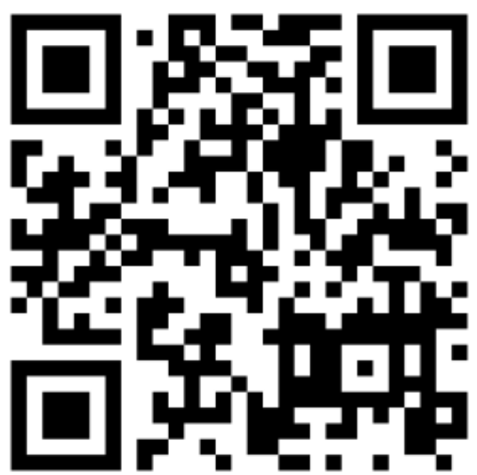
Continuing Education Credit
Deadline to obtain CE 5 Aug 2025

