Slide 1
Cencora DoD Pharmacy Prime Vendor (PPV) & Understanding the Pharmacy Supply Chain
Yessenia Ramirez
June 2025

Slide 2
Disclosure
Yessenia Ramirez declares no conflicts of interest, real or apparent, and no financial interests in any company, product, or service mentioned in this program, including grants, employment, gifts, stock holdings, and honoraria.

Slide 3
Learning Objectives
Name the pharmacy contracts Cencora partners with DoD in delivering
List the Cencora contacts or resources to assist in facilitating supply chain issues experienced by DoD
Identify efficiencies and resources extended as a DoD stakeholder

Slide 4
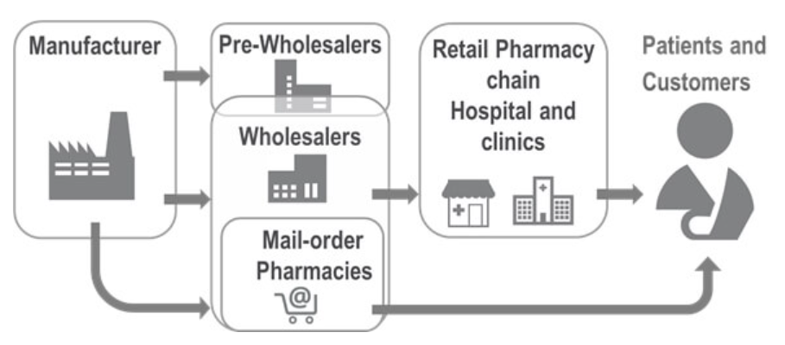
Pharmaceutical Supply Chain

Slide 5
Pharmaceutical Supply Chain Challenges
Prime Vendor
Industry Partners
MTF Pharmacy
Availability due to:
  Backorder
  Short Dating
  Market Spike
  Weather
  DC Stock Level
  Non-Stock Item (NSI)

Slide 6
Usages
Updated usage is required when:
Changing preferred NDC
New item monthly usage
Increase or decrease demand
Discontinued item
Customer Service:
dodservice@amerisourcebergen.com
877.774.6329
Customer Service (OCONUS):
dodoconus@amerisourcebergen.com
885.283.1104

Slide 7
Year-end Prebooks
Prebooks are utilized for large or one-time orders
Only one manufacturer/vendor per PO
Allow approximately three days for Cencora to get an approval
Product will be set aside upon arrival to distribution center and not added to inventory
Email DoDService@AmerisourceBergen.com or call 877.774.6329 to request a "Pre Book“
Or place an 1155 drop ship order

Slide 8




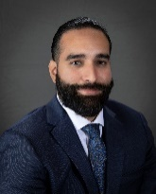









Government Services & Solutions Team
Marian Benz
SVP – Government Services & Solutions
Alex Merrit
VP – Government Services & Solutions
Aaron Middlekauff
VP – Government Accounts, DoD
Aaron Adams
Director – Government Contracts
Michael Marquez
Director – Government Account Management
Jennifer Bennett
Director – Government Business Development
Teresa Oakley Readiness Support – DoD
Yessenia Ramirez
Sr. Account Manager – Government
Sharon Pritchett
Account Manager – Government
Lauren Stroman
Account Manager – Government
Maria Ramos
Account Manager – Government
Maureen Soto
Account Manager – Government
Stephanie Mitchell
Account Manager – Government
Stefanie Anacabe
Account Manager – Government

Slide 9

Bio
Yessenia Ramirez
Senior Account Manager, DoD
Located in Aurora, IL
10+ years experience supporting DoD
CONUS & OCONUS
Passion for problem solving & continuous improvement
Sales Advisory Board Member
Government Team Business Resilience Coordinator

Slide 10
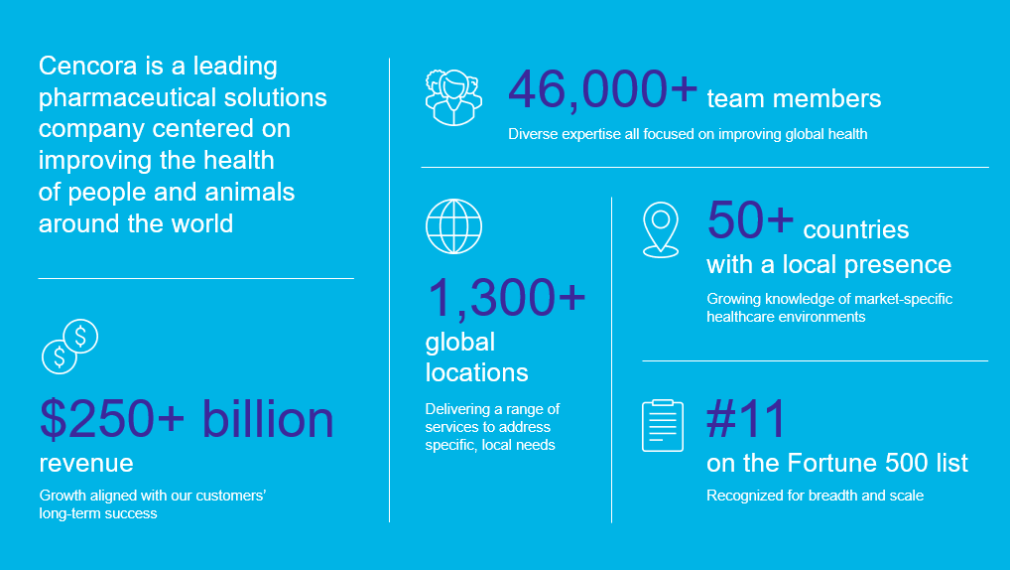
About Cencora

Slide 11
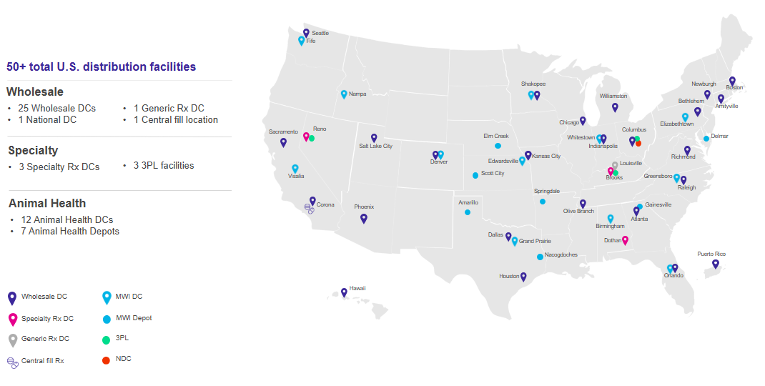
U.S. Enterprise Distribution Network

Slide 12
Drug Supply Chain Security Act (DSCSA) Update

Slide 13
Where are we today?
All distribution centers are active and capturing inbound and outbound data
  Note that at this moment not all EPCIS messages have 100% of the serial #s as some MFGs are still not sending all the data and we are still using the stabilization period to make enhancements at our DCs.
We are currently working with manufacturers to ensure that they are sending all DSCSA data ahead of the 2025 full implementation and continue to make significant progress towards full readiness.
NEW DSCSA report live and available in the ‘Reports’ section of ABC Order.

Slide 14
Cencora Updates

Slide 15
AmerisourceBergen is now Cencora
What is the change?
Cencora, Inc. replaces AmerisourceBergen Corporation
as the new legal name for our parent company
You may have already seen the Cencora name and logo in use and branding will continue to rollout
At this time, there are no legal changes to subsidiary companies and our services will continue to operate without interruption
Why the change?
Cencora brings our companies and services together under one new name
This integration will allow us leverage our growth to the benefit of our customers, their patients, and team members
The change will make it easier
to understand our offerings and partner with us
What is next?
Our number one priority during this transition is to continue service without disruption
Over time, our intent is for most individual subsidiary brands to transition to the Cencora brand as part of Cencora’s larger set of services

Slide 16
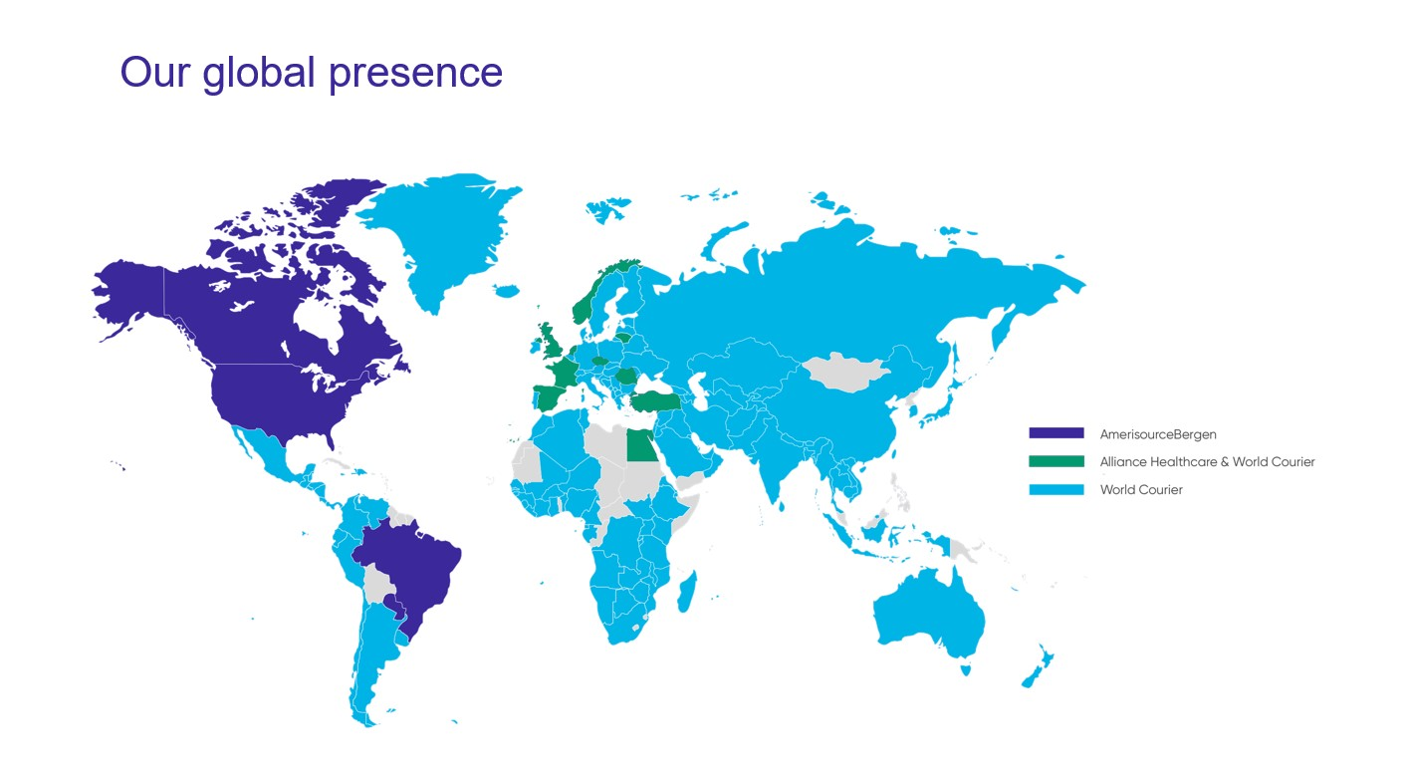
Cencora’s Global Reach

Slide 17
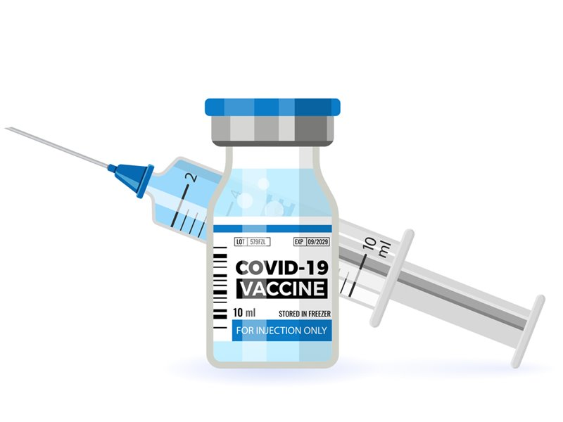
COVID-19 Vaccine Update

Slide 18

MTF & DC Visits

Slide 19
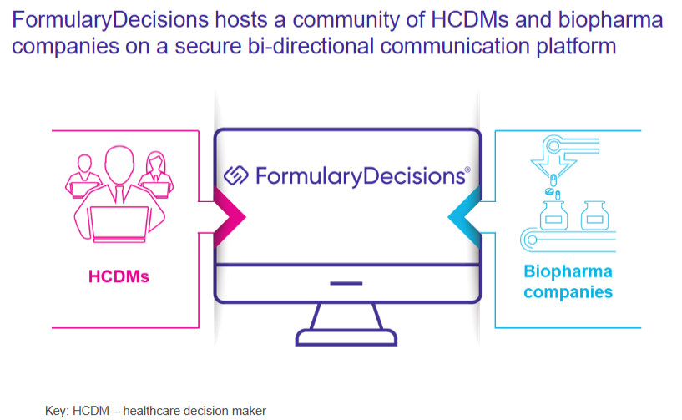
FormularyDecisions
Notes:
An online platform and product information resource designed exclusively for healthcare decision makers (HCDMs)
Complimentary access is available for all eligible HCDMs

Slide 20
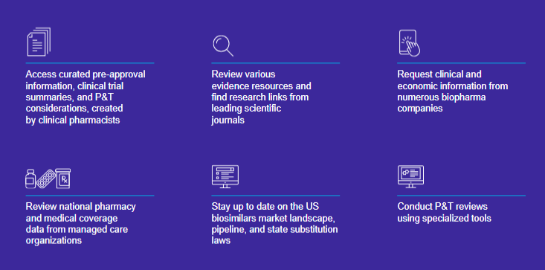
FormularyDecisions

Slide 21

FormularyDecisions
Register today for your complimentary FormularyDecisions account at
www.formularydecisions.com/register

Slide 22
Medication Tray RFID Solution
Key advantages for our RFID solution
Pre-tagged products from Cencora can save time and reduce costs
Mountable touchscreen kiosk and hand-held scanner minimize footprint and improve flexibility for hospital-wide monitoring
Entire medication tray can be scanned in seconds
Medication Tray technology features
Dedicated mobile application for convenient tray management hospital-wide
Expiry date and tampered product flagging
Compatible with all storage cabinets
Online dashboard with real-time data and insights

Slide 23
Buyer’s Academy
Product Availability
Allocations
Order Types
Reporting Analytics & insights
ABC Order platform overview
Omits
Distribution training
Limited distribution
Transportation

Slide 24
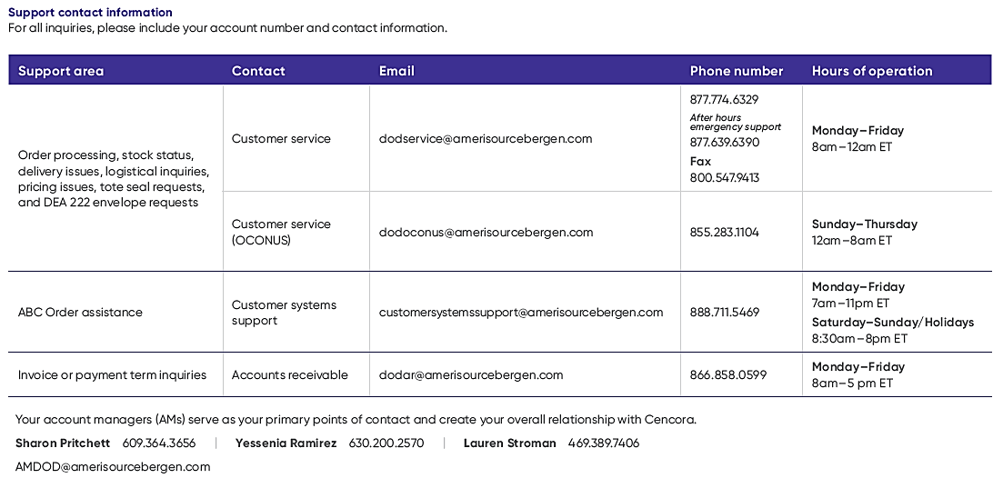
DoD Support at Cencora

Slide 25
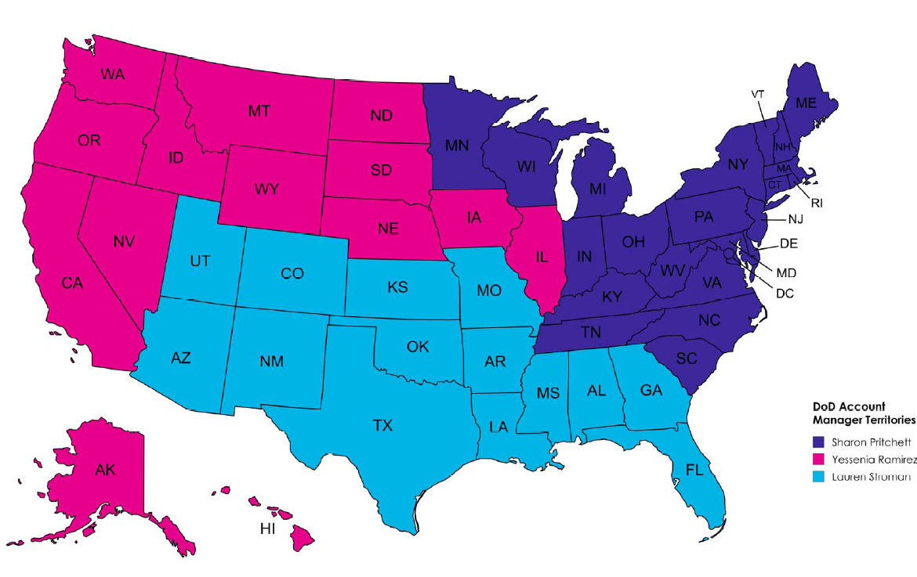
Account Manager Territories

Slide 26
PPV Program Overview
New Global Pharmaceutical Prime Vendor Contract awarded March 2025
Previous Global PPV contract expired Nov 2024 (bridge in place until Nov 2025)
MTFs worldwide (except Navy’s fleet contract)
Emergency Orders
Reverse Distribution Program
DMS back-up PPV supplier
National Prime Vendor Contract (17 Dec 2022)/TPharm5 (1 Jan 2023)

Slide 27
Self-Assessment Question #1
How many account managers support DoD MTFs at Cencora?
  1
  3
  14
  8

Slide 28
Self-Assessment Question #2
An online platform and product information resource designed exclusively for healthcare decision makers (HCDMs).
  Formulary News
  DoD Formularies
  FDA website
  FormularyDecisions

Slide 29
Self-Assessment Question #3
What are the names of the pharmacy contracts that Cencora partners with DoD in delivering?
  Global Prime Vendor
  Defense Global
  National Prime Vendor
  Pharmacy Supply

Slide 30
Self-Assessment Answers
1. How many account managers support DoD MTFs at Cencora?
  B. 3
2. An online platform and product information resource designed exclusively for healthcare decision makers (HCDMs).
  D. Formulary Decisions
3. What are the names of the pharmacy contracts that Cencora partners with DoD in delivering?
  A. Global Prime Vendor & C. National Prime Vendor

Slide 31
What questions do you have?

Slide 32

Continuing Education Credit
Deadline to obtain CE 5 Aug 2025

