Slide 1
Society of Air Force Pharmacy
Mid-Year Conference
16 -18 June 2025
Hilton Norfolk The Main
Norfolk, VA

Slide 2
43P/4P Career Field Update
Col Soo A. Sohn
AF/SG Pharmacy Consultant/43P CFM
&
CMSgt LaTonya R. Reno
4P Career Field Manager

Slide 3
Disclosure
Col Soo A. Sohn and CMSgt LaTonya R. Reno “Declare(s) no conflicts of interest, real or apparent, and no financial interests in any company, product, or service mentioned in this program, including grants, employment, gifts, stock holdings, and honoraria.”

Slide 4
Learning Objectives
To comprehend the AF Pharmacy Past, Present, and Future
To understand the changing battlefield(s) for pharmacy support
To be aware of current 43P and 4P manning status/demographics
To understand the recent impacts of resource constraints

Slide 5
Self-Assessment Question #1
  Which is not a medical initiative related to GPC?
  Medical CBRN
  Home Station Response
  Consolidated Training Platform
  Deployment Force Posture
  N/A; all of them are medical initiatives relate to GPC

Slide 6
Self-Assessment Question #2
  Role 2 Care focuses on
  Post-surgery Treatment
  Immediate Lifesaving Measures
  Trauma and Emergency Medical Treatment
  Return to Duty

Slide 7
Self-Assessment Question #3
  How many 43Ps are assigned to “Out of Core” positions?
  12
  21
  28
  30

Slide 8
Pharmacy – Past, Present and Future
Past: Which came first: the Pharmacy Tech or the pharmacist?
  Medical Officers & Technicians
  Field Medicine
Present: Advancements & Modernization
  Licensed Pharmacists/Certified Pharmacy Technicians
  Technology Integration, e.g., EHR & Pharmacy Management Software
  Healthcare Delivery/Inpatient Care – Limited Scope/Specialization
  PGY1 Residency, Medic X & Tactical Combat Casualty Care, etc.
Future: Innovation & Transformation
  Licensed Pharmacists/Certified Pharmacy Technicians with add’l Trainings
  Artificial Intelligence/Automation & Precision Medicine
  Combat Medicine Focusing Trauma/Critical Care

Slide 9
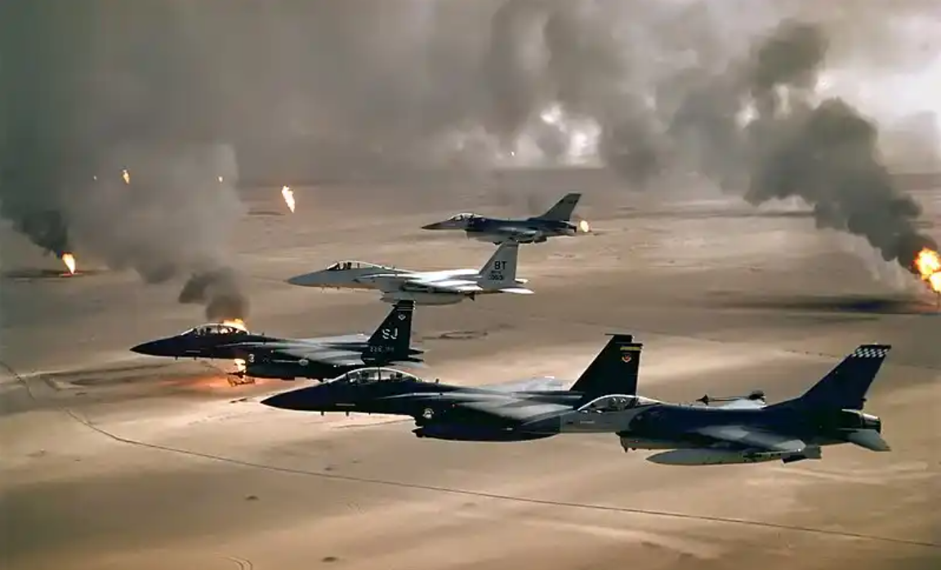
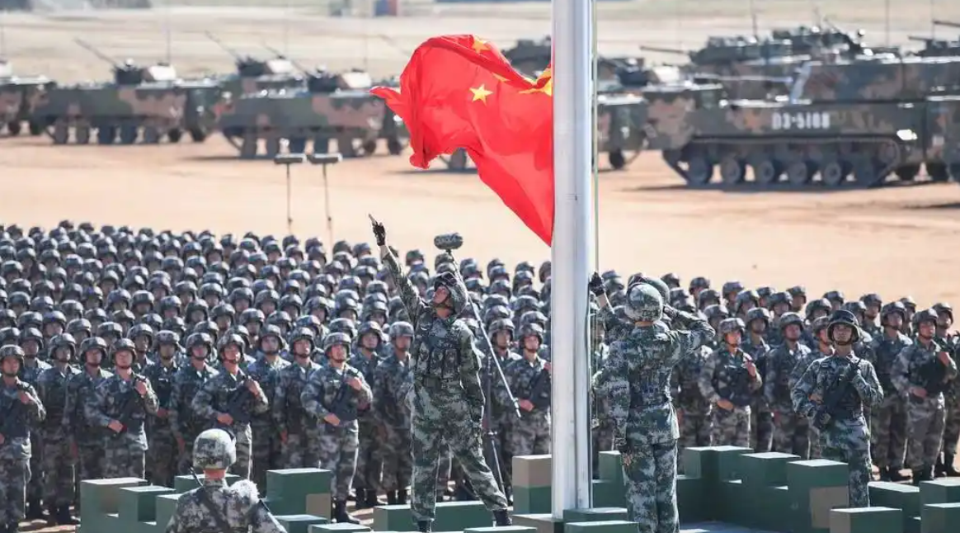
The Changing Character of War
Pacing Threat of China
Change in strategic environment
Must compete and deter Great Power Conflict
To do so, WE MUST BE READY
USAF aircraft of the 4th Fighter Wing (F-16, F-15C and F-15E) fly over Kuwaiti oil fires, set by the retreating Iraqi army during Operation Desert Storm in 1991.
The Chinese flag is raised during a military parade at the Zhurihe training base in China's northern Inner Mongolia region on July 30, 2017.

Slide 10
Force Presentation Evolution:
Air Expeditionary Wing to Combat Wing
Employment Start Date
Air Expeditionary Wing (AEW):
from ~83 bases
Assemble & Organize
Employ
Assemble & Organize
Train
Employ
Expeditionary Air Base (XAB):
from ~63 bases
AFFORGEN
Implemented
Reset
Prepare & Certify
Available
Assemble & Organize
Train & Certify
Employ
Ready to Employ
Air Task Force (ATF):
from 3-4 bases
Reset
Prepare & Certify
Available
Train & Certify
Employ
Ready to Employ
Deployable Combat Wing (DCW):
1 base
Great Power
Competition
Initiatives
Reset
Prepare & Certify
Available
Desired End State:
Standing Combat Wings organized for warfighting… ready across the warfighting spectrum… competition to conflict.

Slide 11
Great Power Competition
DAF is implementing Units of Action by separating into Combat Wings, Air Base Wings and Institutional Wings, starting with a phased approach in summer of 2025.
Combat Wings focus on mission-level warfighting readiness, supported by Air Base Wings who are focused on power projection platform readiness (the installation).
Institutional Wings continue to provide support and capabilities essential to the organize, train and equip requirements of the U.S. Air Force.

Slide 12
Deployable Combat Wings
Deployable Combat Wings
  The Deployable Combat Wing (DCW) will have a redesigned concept of support for GPC schemes of maneuver, including Agile Combat Employment, to ensure the wings are prepared to execute their wartime functions and missions with assigned Airmen and units.
  The plan is to have 24 DCWs, 16 active duty and 8 Reserve. Each will have a standardized three-tiered wing structure consisting of a command and staff layer, a mission layer, and a sustaining layer.
    Command layer: Command team, special staff, and A-staff
    Mission layer: Generates combat power
    Sustaining layer: Ensures sustained ops via a Combat Airbase Squadron (CABS)

Slide 13

Medical Initiatives Related to GPC
Great Power Competition is DAF’s #1 Priority … AFMS #1 Priority
Medical Initiatives
  Deployment Force Posture
  Home Station Response
  Consolidated Training Platform
  Medical CBRN
Current Medical Footprint in a DCW
Role 1
Protect & Regenerate
Open the Airbase
The Air Task Force
Medical ADVON / GRL
PREVMED/Primary Care
Threat Level I
Medical Footprints for Base Commands, ICWs, and CGWs
Home Station Medical Response

Slide 14

Theater – AFMS Force Posture
CUI
Role 1
Protect & Regenerate
Role 3
En Route Care (ERC)
Deployable Combat Wing
ERC Small
ERC Large
Open the Airbase CGT
En Route Care
En Route Care
SG & Special Staff
Hold/Stage
Advanced Specialties
Medical ADVON /
Enhanced Global Reach Laydown Tm
Msn Gen Force Element
Hold/Stage
Role 1: Return to Duty & Preventive Medicine
Patient Movement CGT
Critical Care
Air Transport Tm
Threat Level I
Hold/Stage
Role 1 & 2 Support CET
Med Logistics
Mobile Emergency Tm
Role 2
Casualty care
Damage Control Surgery
Mental Health Augmentation
EMEDS Small
EMEDS Large
Mental Health Maneuver
Special Purpose CGT
Surgical Hospital
Surgical Hospital
Preventive Medicine
Med CBRN Planning
Hold/Stage
Hold/Stage
Global Health
Med CBRN ADVON
Threat Level II
Threat Level III
Med CBRN Response
Med Logistics
AF Mission – Treat & Return To Duty
Joint Mission – Patient Movement
CUI

Slide 15
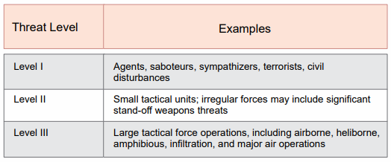



Medical Support to DCW
Non-FF UTC
  Medical is not FAM for Role 1 UTCs
    CTH11, XMST1, CSST-L
28 PAX Experiment Underway
  26.1 Sourcing
  16 DCWs/4 per AFFORGEN cycle
Threat-Based Capabilities
Ref: JP 3-10, Joint Security Operations in Theater
2
2
1
+
OR
MST / CSST-L
Role 2 Small
Role 2 Large
Notes:
First time joint MEFPAK capability development

Slide 16
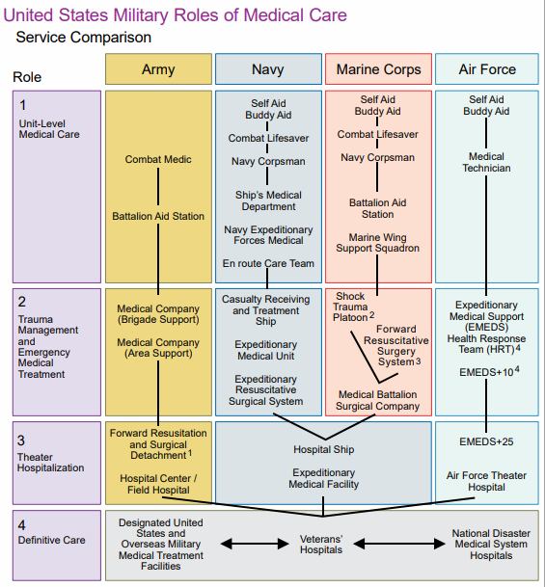
Back to the Basics
Theater Patient Movement (PM)
Role 1 Care:
First medical care military personnel receive (unit-level/medic care)
Immediate lifesaving measures, treatment for DNBI, Combat operational stress casualty (COSC), Preventive Measures, Return to Duty
Patient location & acquisition/collection, Walking Blood Bank
Provided by the Services
(Intra-Theater PM)
USA & USMC (Ground MEDEVAC) via Rotary Wing
(Inter-Theater PM)
USAF via Fixed-Wing Air Evac
3-Person
Critical Care Air Transport Team (CCATT)
Squadron Medical Element &
Mission Support Team
Mission Clinic
Role 2 Care:
Forward trauma management & emergency medical treatment including resuscitation from Role 1
May include damage control surgery; capable of volume blood resuscitation, limited labs, x-ray, dental, COSC
Limited patient holding up to 72 hours; may provide support to units without organic medical assets. Telehealth possible.
Provided by the Services
Surgical Hospital
En Route Care Facility
Role 3 Care:
Theater Hospitalization, equipped to provide all categories of patients to include post-surgery treatment
Coordinates regulated patient movement out of the theater to Role 4
Provided by Joint Services
* Adapted from Joint Publication 4-02, Joint Health Services, 29 Aug 23

Slide 17
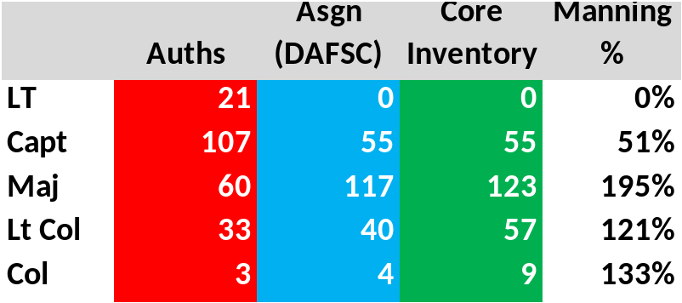
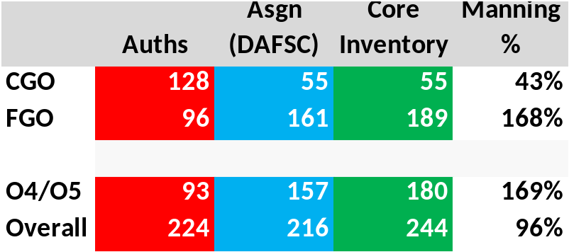
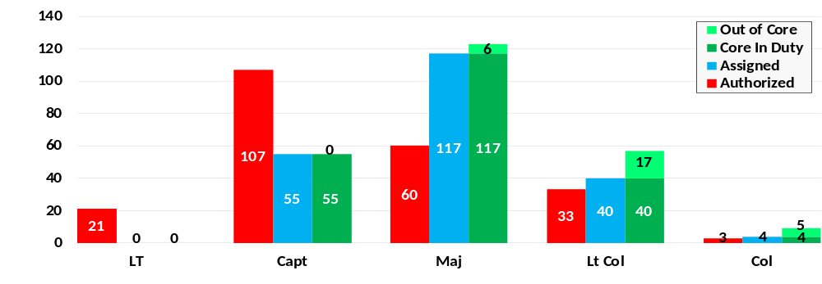

43P Manning

Slide 18
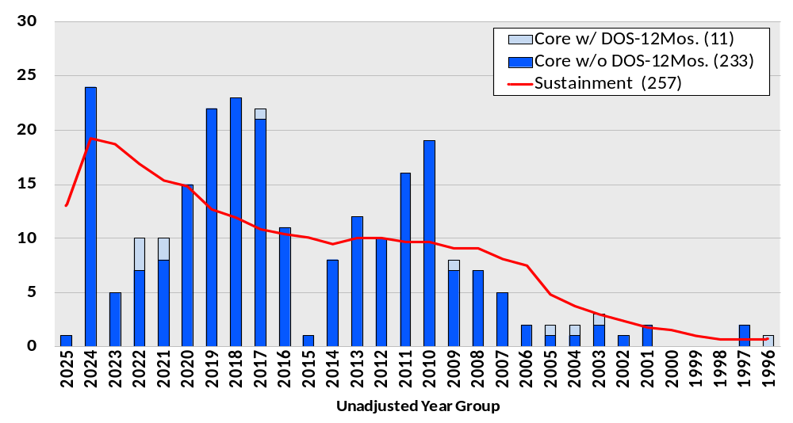
43P Projected DOS Within 12 Months

Slide 19
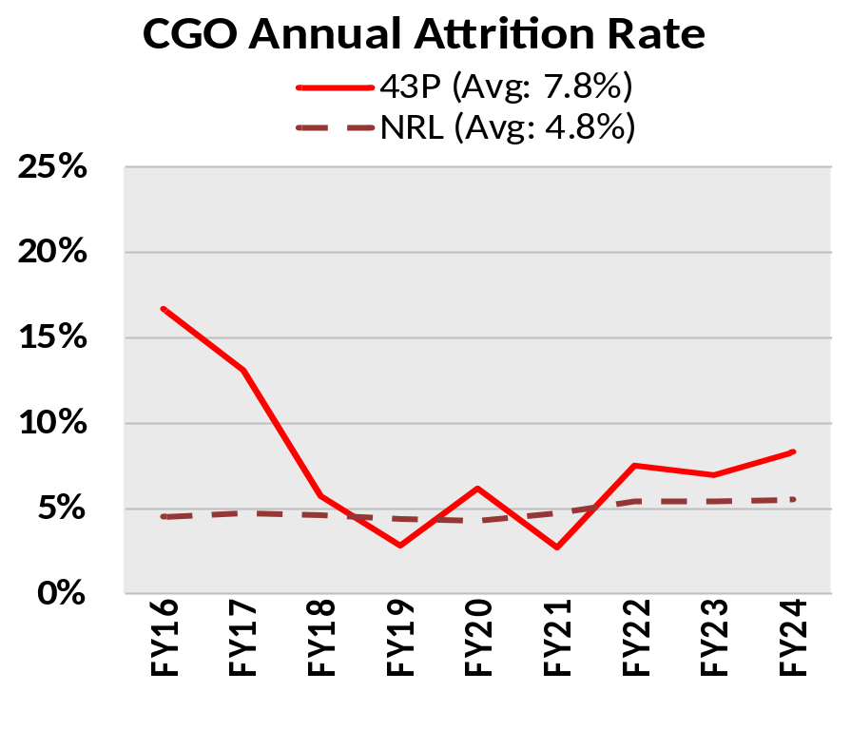
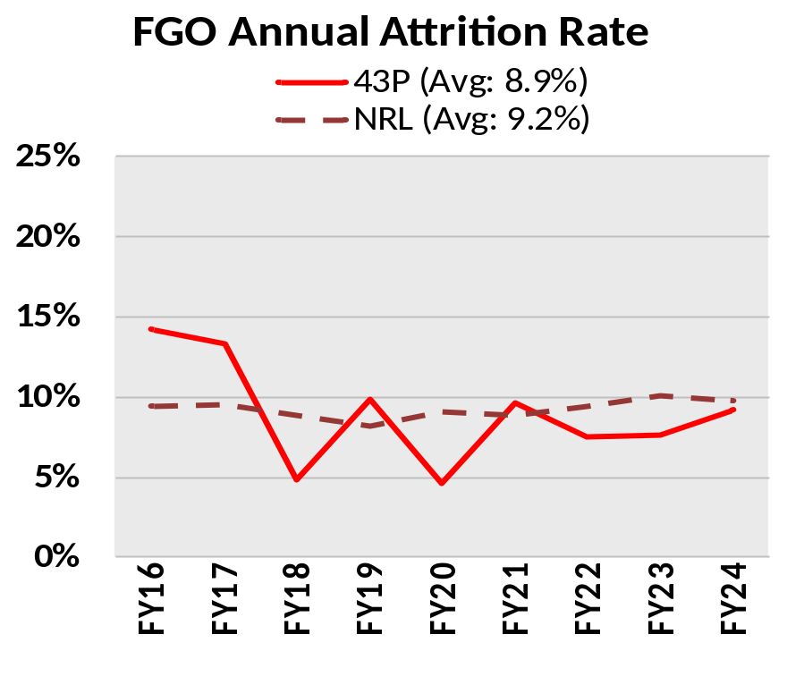
43P CGO/FGO Attrition Rates

Slide 20
43P O-3/O-4/O-5 Attrition #s
FY | O-3s |  |  | O-4s |  |  | O-5s
 | Start | Loss | Loss % | Start | Loss | Loss % | Start | Loss | Loss %
2016 | 120 | 20 | 16.7 | 78 | 13 | 16.7 | 40 | 3 | 7.5
2017 | 84 | 11 | 13.1 | 96 | 10 | 10.4 | 36 | 6 | 16.7
2018 | 87 | 5 | 5.7 | 101 | 5 | 5.0 | 36 | 1 | 2.8
2019 | 104 | 3 | 2.9 | 103 | 10 | 9.7 | 39 | 4 | 10.3
2020 | 114 | 7 | 6.1 | 107 | 6 | 5.6 | 33 | 0 | 0.0
2021 | 111 | 3 | 2.7 | 103 | 9 | 8.7 | 36 | 3 | 8.3
2022 | 120 | 9 | 7.5 | 92 | 7 | 7.6 | 38 | 2 | 5.3
2023 | 101 | 7 | 6.9 | 94 | 5 | 5.3 | 50 | 3 | 6.0
2024 | 72 | 6 | 8.3 | 108 | 7 | 6.5 | 53 | 5 | 9.4

Slide 21
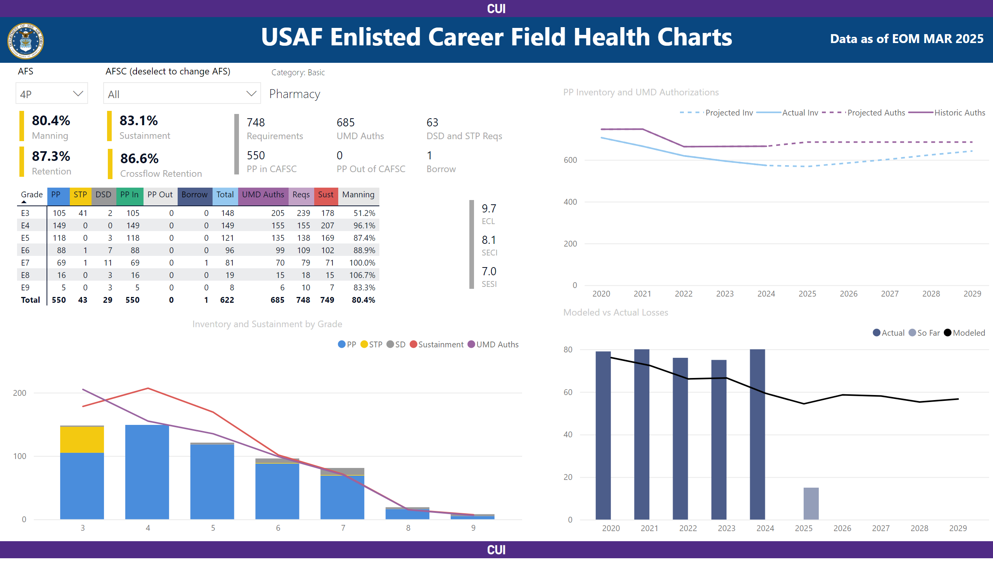
4P Career Field Health

Slide 22
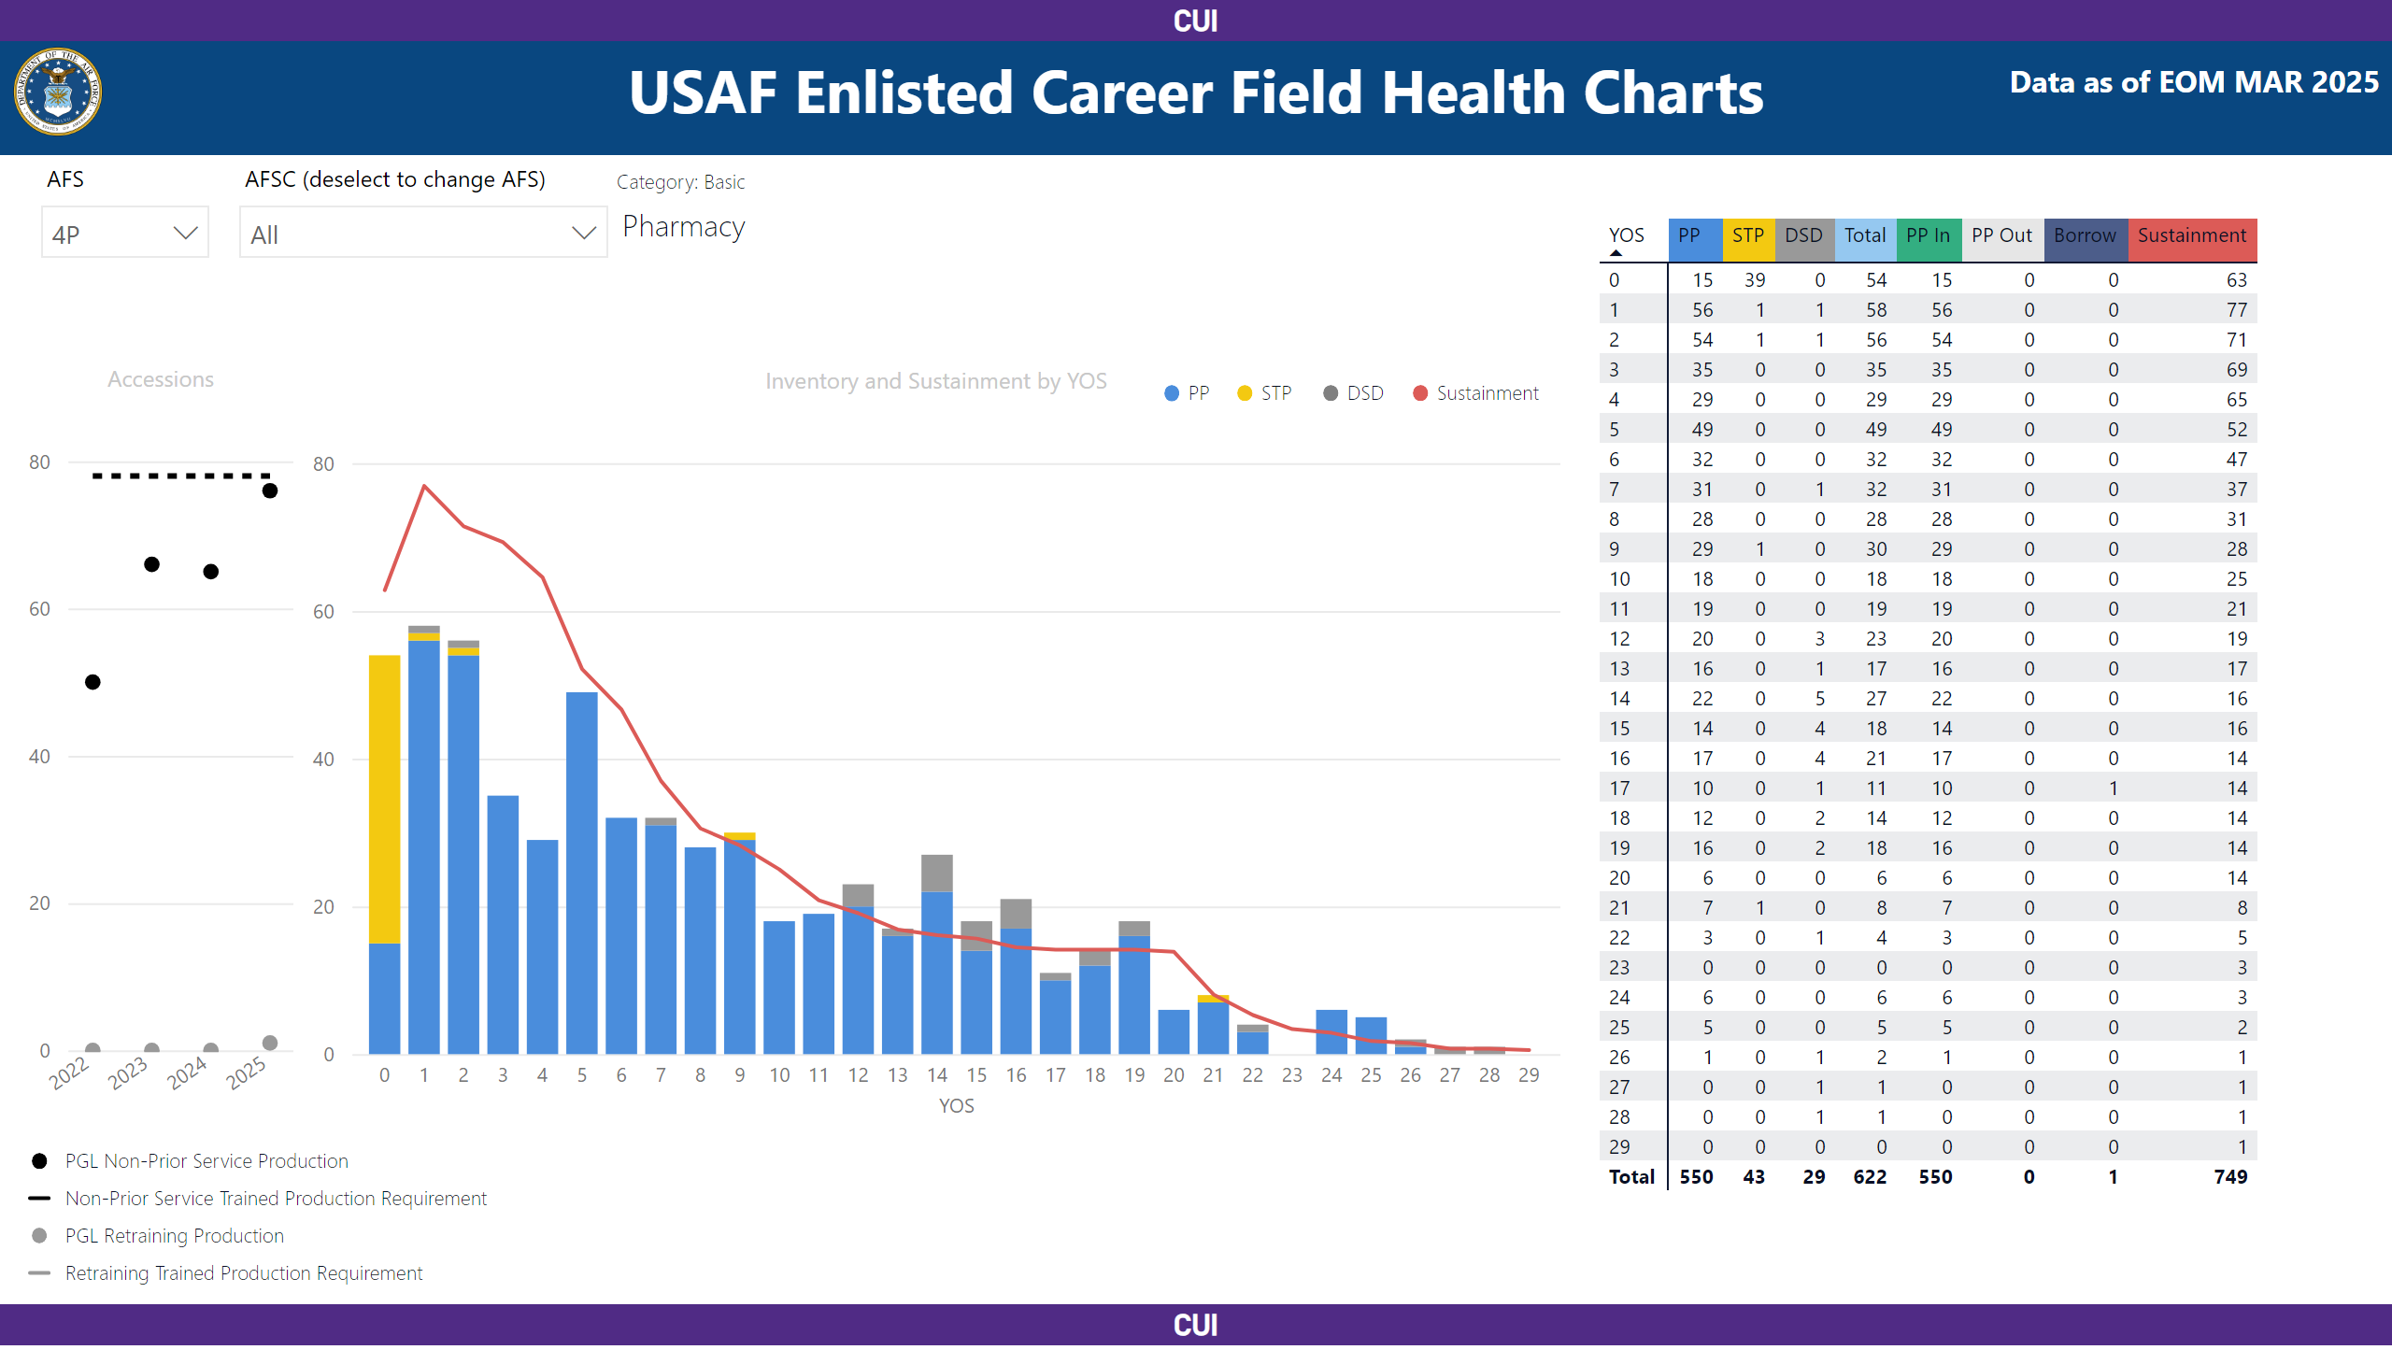
4P Sustainment & Production

Slide 23
Resource Constraint Impacts
Medical AFSC retraining pause
Cancellation of conference funding
Contract solvency
TDY travel
Suspension of SRB Program – 20 May 2025
  $11M of budget obligated in 7 months

Slide 24
Resource Constraint Impacts
PCS Target Reductions – 22 May 2025
  Frequency
  Weight Limit Reductions
  Temp Lodging Reimbursements
  Dislocation Allowances
  Training Travel
    FY 2027 – 10%
    FY 2028 – 30%
    FY 2029 – 40%
    FY 2030 – 50%

Slide 25
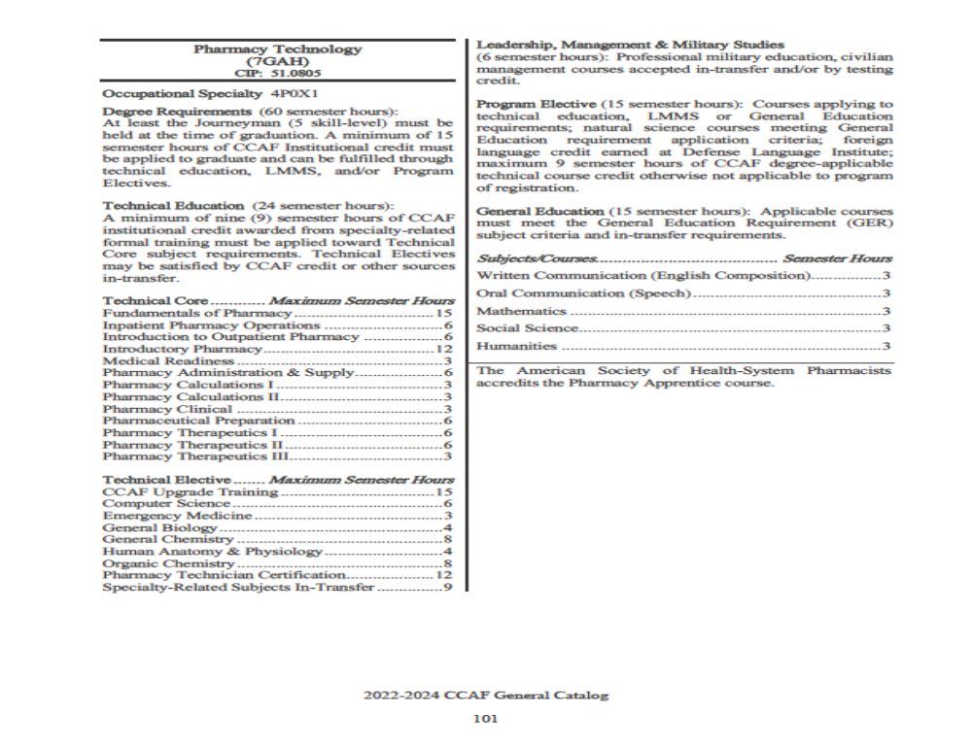
CCAF Teach-Out
1 year remaining
End Date - 28 Oct 2026
All requirements complete prior to end date
Must register through College of Allied Health Sciences (CAHS) afterwards

Slide 26
Self-Assessment Question #1
  Which is not a medical initiative related to GPC?
  Medical CBRN
  Home Station Response
  Consolidated Training Platform
  Deployment Force Posture
  N/A; all of them are medical initiatives relate to GPC

Slide 27
Self-Assessment Question #2
  Role 2 Care focuses on
  Post-surgery Treatment
  Immediate Lifesaving Measures
  Trauma and Emergency Medical Treatment
  Return to Duty

Slide 28
Self-Assessment Question #3
  How many 43Ps are assigned to “Out of Core” positions?
  12
  21
  28
  30

Slide 29

QUESTIONS

Slide 30

Continuing Education Credit
Deadline to obtain CE 5 Aug 2025

