Slide 1
Attention-Deficit/Hyperactivity Disorder Clinical Treatment Guidelines Update
Jennifer P. Tomlinson, Maj, USAF, BSC
75th Medical Group
Hill Air Force Base, Utah
16 February 2025

Slide 2
Presenter
Jennifer Tomlinson, PharmD
Chief of Pharmacy Operations
75th Medical Group
Hill AFB, Utah

Slide 3
Jennifer Tomlinson, PharmD, MS
University of Colorado
  Doctor of Pharmacy
  Chief intern, clinical pharmacist at the University of Colorado Hospital
Philadelphia College of Osteopathic Medicine
  Master of Science in Biomedical Sciences
    Thesis: Fibronectin signaling pathways in tumorigenic breast carcinoma
Emory University
  Bachelor of Science in Neuroscience and Behavioral Biology
    Thesis: Maternal intake of alpha-linolenic acid on newborn acuity
    Music Performance

Slide 4
Disclosures
I have no relevant financial or non-financial relationships to disclose relating to the content of this activity.
The views expressed in this presentation are those of the author and do not necessarily reflect the official policy or position of the Department of Defense, nor the U.S. Government.
Commercial support was not received for this activity.

Slide 5
Learning Objectives
At the conclusion of this activity, participants will be able to:
Understand the neurobiology and pathophysiological theories of the genesis of ADHD
Understand different treatment protocols in geographically separated locations influenced by various ADHD clinical practice guidelines
Provide a global perspective to flight physicians and PCMs when recommending alternative ADHD medications during supply chain disruptions

Slide 6
Knowledge Check #1
What is attention-deficit/hyperactivity disorder (ADHD)?
  Neurobehavioral disorder inclusive of a pattern of inattention and hyperactivity
  Neurobehavioral disorder inclusive of a pattern of inattention and/or hyperactivity
  Theoretical disorder that adolescents create in their minds to get drugs to do better in school
  Theoretical disorder that is stress-induced

Slide 7

Defining ADHD
Developmental disorder characteristic of a pattern of inattention and/or hyperactivity and impulsivity
  Symptoms often interfere with daily activities
  Not an adult disorder
  Diagnostic criteria includes reviewing symptoms from childhood to age 12
  Often affects social, behavioral and school performance
DSM-5 Criteria for ADHD Diagnosis. (October 22, 2024). Copyright 2024 MAVA Behavioral Health.

Slide 8
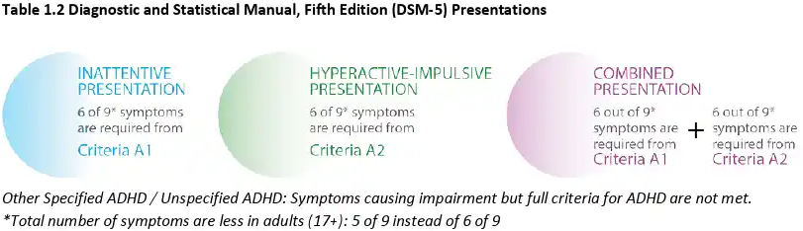
Defining ADHD
Inattention:
  Task orientation
  Focus and organization
Hyperactivity:
  Restlessness
  Inappropriate timing of actions
  Excessive speaking
Impulsivity:
  Thought to action disconnect
  Interrupting
  Self-control
  Long-term consequences
Neuropsychiatria i Neuropsychologia 2023. (December 29, 2023). Copyright 2023 American Psychiatric Association.
Notes:
Note: these are symptoms that require a pattern of behavior, not just spontaneous, singular events
Inattention: not due to defiance or lack of comprehension
Hyperactivity: constantly moving around, fidgety/tapping, talking too much
Impulsivity: taking action without thinking, interrupting other’s speech, lack self-control, seeks immediate rewards and can’t delay or foresee downstream consequences

Slide 9
Defining ADHD
Neuropsychiatria i Neuropsychologia 2023. (December 29, 2023). Copyright 2023 American Psychiatric Association.
Notes:
Inattention Symptoms
NOTE: Symptoms of inattention have been present for at least 6 months, and they are inappropriate for developmental level.
Often fails to give close attention to details or makes careless mistakes in schoolwork, at work, or with other activities.
Often has trouble holding attention on tasks or play activities.
Often does not seem to listen when spoken to directly.
Often does not follow through on instructions and fails to finish schoolwork, chores, or duties in the workplace (e.g., loses focus, side-tracked).
Often has trouble organizing tasks and activities.
Often avoids, dislikes, or is reluctant to do tasks that require mental effort over a long period of time (such as schoolwork or homework).
Often loses things necessary for tasks and activities (e.g. school materials, pencils, books, tools, wallets, keys, paperwork, eyeglasses, mobile telephones).
Is often easily distracted.
Is often forgetful in daily activities.
Hyperactivity-impulsivity Symptoms
NOTE: Symptoms of hyperactivity-impulsivity have been present for at least 6 months, and they are inappropriate for the person's developmental level.
Often fidgets with or taps hands or feet, or squirms in seat.
Often leaves seat in situations when remaining seated is expected.
Often runs about or climbs in situations where it is not appropriate (adolescents or adults may be limited to feeling restless).
Often unable to play or take part in leisure activities quietly.
Is often “on the go” acting as if “driven by a motor.”
Often talks excessively.
Often blurts out an answer before a question has been completed.
Often has trouble waiting their turn.
Often interrupts or intrudes on others (e.g., butts into conversations or games).

Slide 10
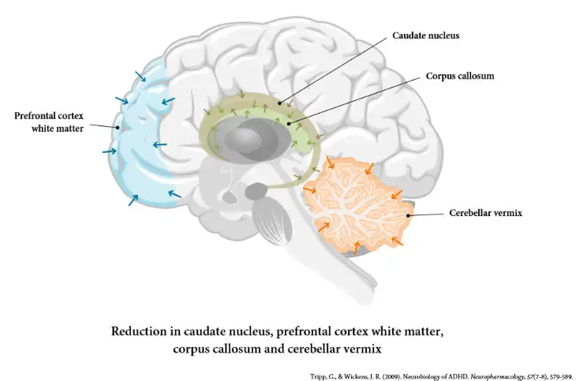
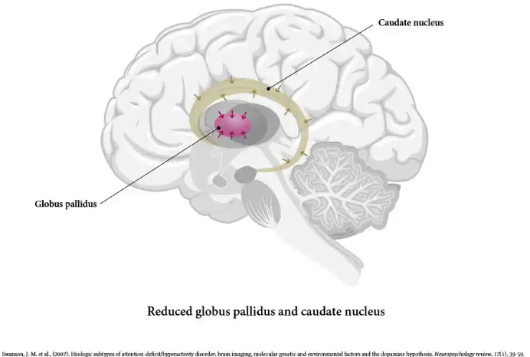
Neurobiological changes in ADHD
Drawings indicating reductions in specific structures and other anatomical brain changes in ADHD
Notes:
Left:
Overall reduction in total brain size→ caudate nucleus, PFC white matter, corpus callosum, cerebellar vermis (Tripp and Wickens, 2009)
Right:
Caudate nucleus and globus pallidus of the basal ganglia are supposed to have high density of dopamine receptors, yet, they are smaller in ADHD (Swanson et al., 2007)

Slide 11
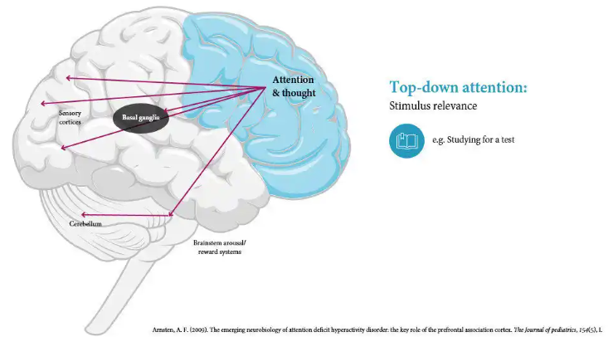
Neurobiology: Attention Regulation

Slide 12
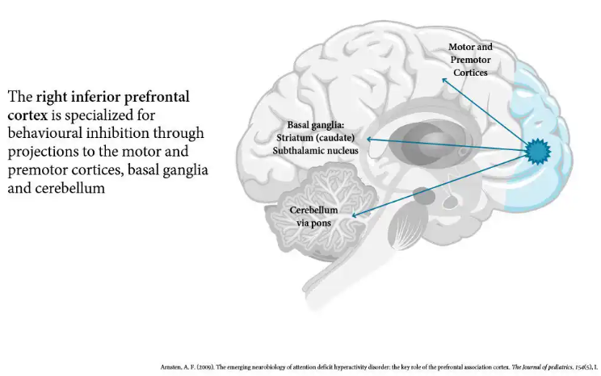
Neurobiology: Behavior Regulation

Slide 13
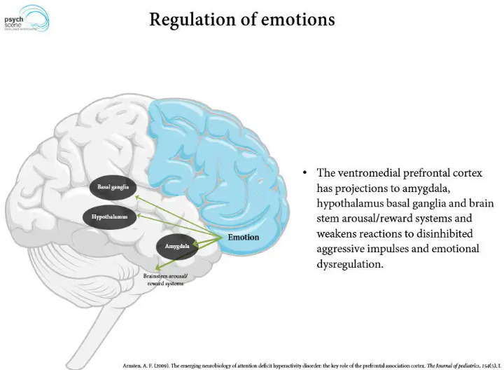
Neurobiology: Emotion Regulation

Slide 14
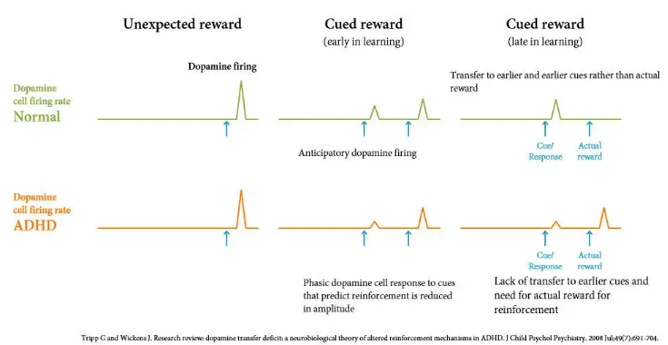
Dopamine Deficit Transfer Theory

Slide 15
Current Guidelines: Pharmacological Treatments
American Academy of Pediatrics (AAP) ADHD Clinical Practice Guidelines 2019
Canadian ADHD Resource Alliance Guidelines 2020
Spanish ADHD Guidelines 2017
National Instituted for Health and Care Excellence (NICE) ADHD Guidelines 2018
Practical Clinical Guidelines and Pharmacological Treatment for ADHD in Asia 2024
Notes:
Focusing on these four guidelines based on relevancy and global perspective
European ADHD Guidelines Group (EAGG) 2021 gives summarized information from these specific guidelines
Asia guidelines pose as a striking contrast to Western guidelines
AAP: United States
Spanish: Spain, Europe
NICE: UK, Europe
Asia: Japan, Malaysia, Singapore, India, Republic of Korea

Slide 16
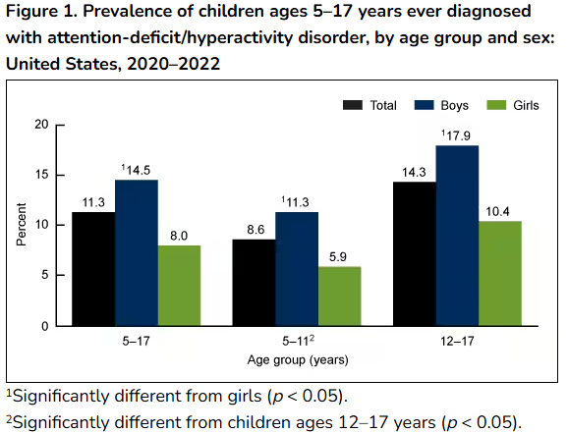
American Academy of Pediatrics (AAP) 2019
Children 4 – 5 years old:
1st line: Parent training in behavioral management (PTBM) and/or behavioral classroom intervention
Children 6 – 8 years old:
1st line: FDA-approved ADHD Rx in combination with PTBM and/or behavioral classroom intervention
Adolescents 12 – 18 years old:
1st line: FDA-approved ADHD Rx with behavioral training/interventions coupled with educational interventions and support
National Center for Health Statistics, National Health Interview Survey, 2020–2022.
Notes:
FDA-approved: methylphenidate, amphetamine
-As of 2019, only methylphenidate is available in Korea
Discuss boys vs. girls, social, cultural, genetic, expectations.
Before pre-school age, PTBM, as the first treatment, has shown to improve symptoms of ADHD significantly, which is why the guidelines push to not diagnose a pre-school aged child with ADHD prior to PTBM.
Why >6? There is insufficient evidence to recommend diagnosis or treatment for children younger than 4 years (other than parent training in behavior management [PTBM], which does not require a diagnosis to be applied); in instances in which ADHD-like symptoms in children younger than 4 years bring substantial impairment, PCCs can consider making a referral for PTBM.
Explain why after 6y.o. no PTBM w/o Rx

Slide 17
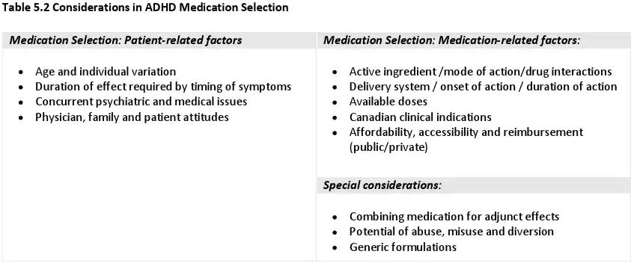
Canadian (CADDRA) Guideline 2020
1st line: Long-acting psychostimulants approved by Health Canada (methylphenidate, amphetamines)
2nd line: Atomoxetine, guanfacine XR, short/immediate acting psychostimulants
3rd line: Bupropion, clonidine, imipramine, modafinil
Canadian ADHD Practice Guidelines 2020
Notes:
-no age specific criteria

Slide 18
Spanish Guideline 2017
Unlike the United States (since 1955), Spain only has certain medications available to treat ADHD:
Methylphenidate IR has been available since 1981
Methylphenidate OSM XR was only recently available in the last 10 years
Atomoxetine (2006)
Non-stimulants:
  Clonidine, bupropion, modafinil reboxetine, imipramine, risperidone, aripiprazole (off-label use approved since 2009)

Slide 19
National institute for Health and Care Excellence (NICE) Guideline 2018 (United Kingdom)
Adult ADHD pharmacological treatment
1st line: Methylphenidate, Lisdexamfetamine (off-label if no childhood diagnosis)
  Not all preparations of methylphenidate are approved
2nd line: Dexamphetamine (off-label)
  If not responding to lisdexamfetamine or cannot tolerate
3rd line: Atomoxetine (off-label if no childhood diagnosis)
  Cannot tolerate lisdexamfetamine or methylphenidate, or
  no response to 6-week trial
Notes:
*If adult cannot tolerate methylphenidate or lisdexamfetamine for the 6-week trial, switch to the other
“Do not offer any of the following medication for ADHD without advice
from a tertiary ADHD service:
• guanfacine for adults (off-label use)
• clonidine for children with ADHD and sleep disturbance, rages or tics (off-label
use)
• atypical antipsychotics in addition to stimulants for people with ADHD and
coexisting pervasive aggression, rages or irritability”
Since 2018, all recommended medications below are considered off-label for children 5 years old
Children >5 years old and young people:
1st line: Methylphenidate IR/LA
Children >old and young people who failed a 6-week trial:
2nd line: switch to lisdexamfetamine
Children >5 years old and young people who respond to lisdexamfetamine but cannot tolerate long lasting effect
3rd line: dexamphetamine only approve dot treat ADHD in 6-17 year old when response to methylphenidate clinically inadequate ; not for intolerance of lisdexamfetamine
Children 5 years and over and young people
4th line: atomoxetine or guanfacine if cannot tolerate methylphenidate or lisdexamfetamine failed 6 week trials of both (off-label)

Slide 20
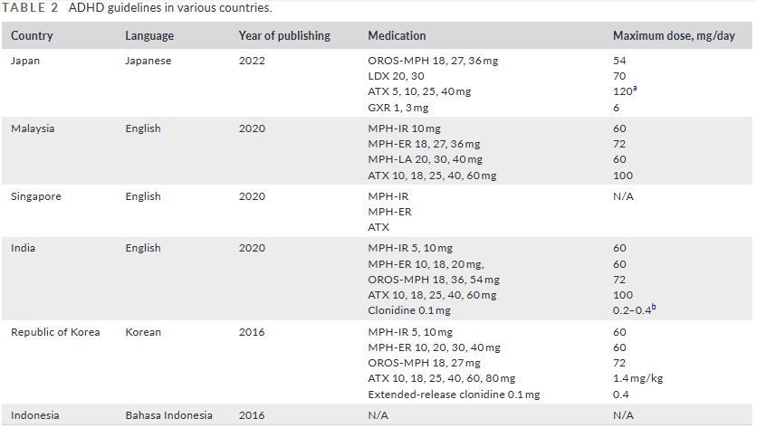
Asia Guideline 2024
Notes:
Kawabe et al. 2024
For the most part, data collected from national databases and guidelines unclear (based off of prescribed Rxs)
2022 Japanese guidelines for ADHD:
1st line: psychosocial treatment in the school environment
2nd line: pharmacological treatment

Slide 21
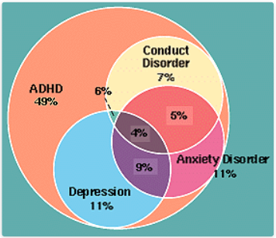
Co-morbid Conditions to Consider
Autism spectrum disorder
Anxiety and Depression
Learning and language disorders
Substance use
Sleep apnea
Conduct disorder
Obsessive-compulsive disorder
Joseph Biederman and Stephen Faraone, Harvard Mahoney Neuroscience Institute Letter – Winter 1996 Volume 5 Number 1
Notes:
More common co-morbidities: not to be confused with definitive traits of ADHD

Slide 22
Determining a Pharmacological Treatment
Stimulants
  Most prescribed and used in adults
  Increase specific neurotransmitter (NT) levels in the synaptic cleft that are responsible for thought processing, focus and attention
Non-stimulants
  Used for adults who prefer or cannot tolerate stimulants
  Longer onset of action
  May help improve attention, impulsivity and focus
Amphetamine:
Mixed amphetamine salts (Adderall, Adderall XR)
Mixed salts of a single entity amphetamine (Mydayis)
Dextroamphetamine (Dexedrine, Dextrostat, ProCentra, Zenzedi)
Lisdexamfetamine (Vyvanse)
Methylphenidate:
Dexmethylphenidate (Focalin)
Methylphenidate (Ritalin, Concerta, Daytrana, Jornay PM, Metadate, Quillivant XR)
Serdexmethylphenidate and dexmethylphenidate (Azstarys)
Atomoxetine (Strattera)
Clonidine (Kapvay)
Guanfacine (Intuniv)
Viloxazine (Qelbree)
Notes:
For adults, it is about medical history/contraindications and preference
For many people with ADHD, medication reduces hyperactivity and impulsivity and improves their ability to focus, work, and learn. Sometimes, several different medications or dosages must be tried before finding the one that works for a particular person. Anyone taking a medication must be monitored closely by their prescribing doctor.

Slide 23
Medication Side Effects to Consider
Short-term
Weight loss
Sleep quality loss
Social discordance
Decreased appetite
Long-term
Abuse and addiction
Skin discolorations
Seizure
Irregular heartbeat
Heart disease
Pronounced (may require switch)
Stomach pain
Nausea
Pronounced increase in blood pressure and/or heartrate
Dizziness
Headache

Slide 24
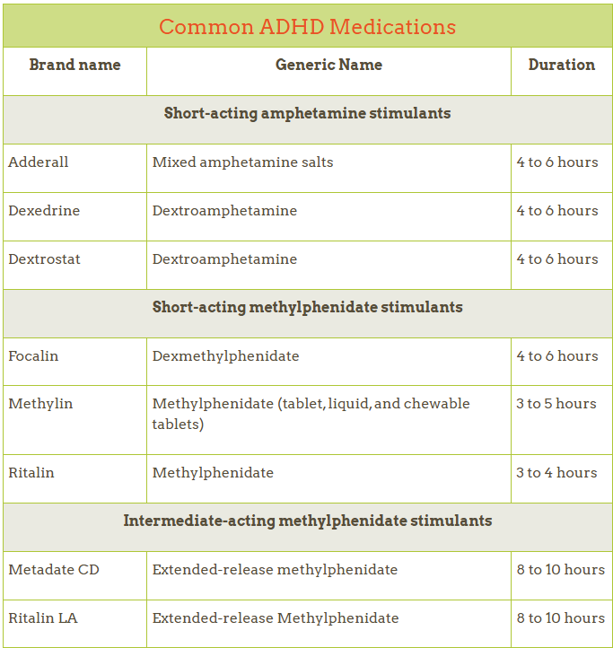
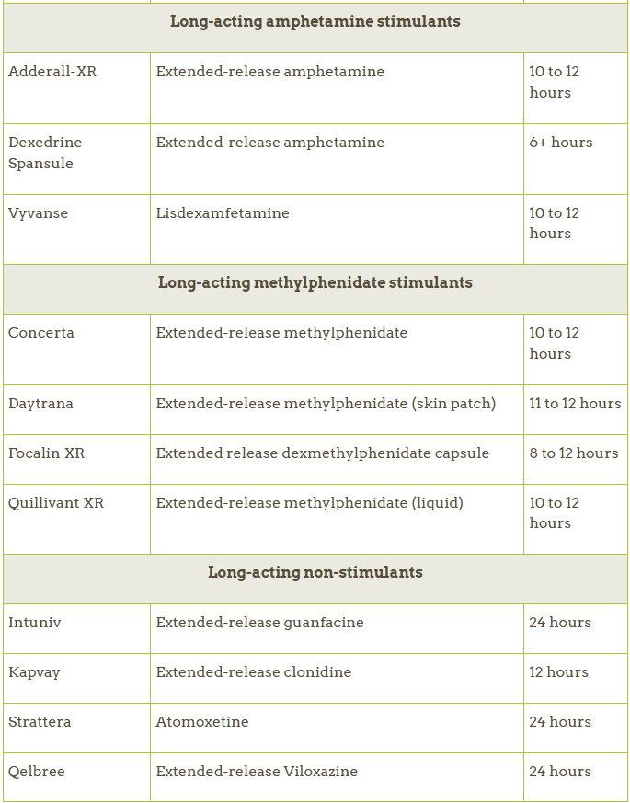
Other Considerations
Stimulant Drug Shortages
Mechanism of Action
Pharmacokinetics
Pharmacodynamics
Medication delivery release
technology
Drug-drug interactions
Administration requirements
American Academy of Pediatrics. 2024.
Notes:
XR, IR, OSM

Slide 25
Knowledge Check #2
Which of these co-morbidities is commonly seen in individuals who have ADHD?
Anxiety and depression
Tics, Tourette's syndrome
Suicidal ideation
Insomnia

Slide 26
FDA-Approved non-stimulants
Adjunctive therapies may be considered:
  Stimulant therapy not effective
  Stimulant therapy causes unwanted side effects
Atomoxetine (limited evidence of safety and efficacy as adjunct)
  Norepinephrine reuptake inhibitor
Clonidine ER, Guanfacine ER
  Selective alpha-2 adrenergic agonists
Notes:
Adding omega-3 to diet increases its concentration in the cell membrane therefore improving
transmission of neurotransmitters by diminishing neuroinflammation, especially in the frontal cortex.
Studies have found that omega-3 levels are lower in the blood of children with ADHD. Most data reveal minimal improvement, though.

Slide 27
Multimodal Approach to Treatment: Non-pharmacological
Cognitive training
  Improves executive function and training
  Repeated activity that focuses on attention and memory, coupled with exercises to reinforce practice
Neurofeedback
  Requires device monitors to provide real-time neuro activity feedback
  Patient learns to self-regulate brain activity to alter the behavior they are trying to remediate

Slide 28
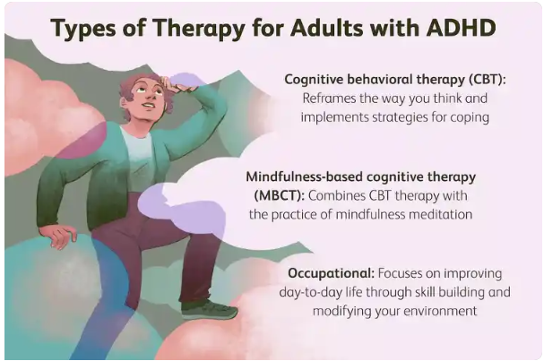
Lifestyle multimodal approach: Cognitive Behavioral Therapy
Cognitive Behavioral therapy
  Therapist helps organize tasks and gives guidance
  Patients are taught to monitor behavior, give praise, control anger, and are counseled to think before acting

Slide 29
Lifestyle multimodal approach: Mindfulness Cognitive Behavioral Therapy
Mindfulness Cognitive Behavioral Therapy
Accepting thoughts and feelings to improve focus and concentration
Learning to pause and think before acting, resisting urge to take unnecessary risks

Slide 30
Lifestyle multimodal approach: Social Skills Training
Social Skills Training-
Occupational
Interpersonal development to learn to communicate needs, desires, goals
Active listening in social environment, reading facial expressions to learn to respond appropriately

Slide 31
Long-term Prognosis
ADHD is not curable
Treatment methods to reduce symptoms remain effective in improving functioning
Overall guideline recommendations:
  Medication, psychotherapy, behavioral therapy, all in combination is the best approach

Slide 32
Knowledge Check #3
True or False: Multimodal approaches to treating ADHD will likely yield positive long-term effects over medication monotherapy.

Slide 33
Bridging the gap for Patients, Providers, and Mission
Pharmacists are in a unique role to relay trusted, crucial information on medication compliance, intolerance, and treatment failure to the care team
Understanding stimulant, non-stimulant, and non-pharmacological alternatives/adjunctive to treatment can help a service member avoid unnecessary deployment setbacks
Recommending a multimodal approach to a patient/provider and following-up with the patient may become a touchpoint that changes the patient’s long-term treatment course
Notes:
A professional therapist or life coach can help adults with ADHD learn to organize their life with tools. They can also provide practical tips for managing daily life, such as:
Stick to routines.
Make lists for different tasks and activities.
Use a calendar for scheduling events.
Write reminder notes.
Get regular exercise, especially when feeling hyperactive or restless.
Assign a special place for important items, like keys, bills, and paperwork.
Break down large tasks into more manageable, smaller steps so that completing each part of the task provides a sense of accomplishment.

Slide 34
Knowledge Check #1
What is attention deficit hyperactivity disorder?
  Developmental disorder inclusive of a pattern of inattention and hyperactivity
  Developmental disorder inclusive of a pattern of inattention and/or hyperactivity
  Theoretical disorder that adolescents create in their minds to get drugs to do better in school
  Theoretical disorder that is stress-induced

Slide 35
Knowledge Check #1
What is attention deficit hyperactivity disorder?
  Developmental disorder inclusive of a pattern of inattention and hyperactivity
  Developmental disorder inclusive of a pattern of inattention and/or hyperactivity
  Theoretical disorder that adolescents create in their minds to get drugs to do better in school
  Theoretical disorder that is stress-induced

Slide 36
Knowledge Check #2
Which of these co-morbidities is commonly seen in individuals who have ADHD?
Anxiety and depression
Tics, Tourette's syndrome
Suicidal ideation
Insomnia

Slide 37
Knowledge Check #2
Which of these co-morbidities is commonly seen in individuals who have ADHD?
  Anxiety and depression
  Tics, Tourette's syndrome
  Suicidal ideation
  Insomnia

Slide 38
Knowledge Check #3
True or False: Multimodal approaches to treating ADHD will likely yield positive long-term effects over medication monotherapy.

Slide 39
Knowledge Check #3
True or False: Multimodal approaches to treating ADHD will likely yield positive long-term effects over medication monotherapy.
True

Slide 40
References
American Psychiatric Association, Diagnostic and statistical manual of mental disorders: DSM-5. 2013, Washington, DC: American
Psychiatric Association.
Antshel KM, Zhang-James Y, Faraone SV. The comorbidity of ADHD and autism spectrum disorder. Expert Rev Neurother
2013;13:1117-28
Barbaresi WJ, Campbell L, Diekroger EA, Froehlich TE, Liu YH, O'Malley E, et al. Society for developmental and behavioral pediatrics clinical practice guideline for the assessment and treatment of children and adolescents with complex attentiondeficit/hyperactivity disorder. J Dev Behav Pediatr 2020;41 Suppl 2S:S35-57.
Barbaresi WJ, Katusic SK, Colligan RC, Weaver AL, Jacobsen SJ. Modifiers of long-term school outcomes for children with attention-deficit/hyperactivity disorder: does treatment with stimulant medication make a difference? Results from a population-based study. J Dev Behav Pediatr 2007;28:274-87.
Biederman, J., et al., Adult outcome of attention-deficit/hyperactivity disorder: a controlled 16-year follow-up study. J Clin Psychiatry,
2012. 73(7): p. 941-50.
Coghill D, Banaschewski T, Cortese S, Asherson P, Brandeis D, Buitelaar J, Daley D, Danckaerts M, Dittmann RW, Doepfner M, Ferrin
M, Hollis C, Holtmann M, Paramala S, Sonuga-Barke E, Soutullo C, Steinhausen HC, Van der Oord S, Wong ICK, Zuddas A,
Simonoff E. The management of ADHD in children and adolescents: bringing evidence to the clinic: perspective from the
European ADHD Guidelines Group (EAGG). Eur Child Adolesc Psychiatry. 2023 Aug;32(8):1337-1361. doi: 10.1007/s00787-
021-01871-x. Epub 2021 Oct 22. PMID: 34677682; PMCID: PMC8532460.
Dalrymple RA, McKenna Maxwell L, Russell S, Duthie J. NICE guideline review: Attention deficit hyperactivity disorder: diagnosis and
management (NG87). Arch Dis Child Educ Pract Ed. 2020 Oct;105(5):289-293. doi: 10.1136/archdischild-2019-316928.
Epub 2019 Nov 27. PMID: 31776172.
Elia J, Ambrosini P, Berrettini W. ADHD characteristics: I. Concurrent co-mobidity patterns in children & adolescents. Child Adolesc Psychiatry Ment Health. 2008;2(1):15

Slide 41
References
Eom TH, Kim YH. Clinical practice guidelines for attention-deficit/hyperactivity disorder: recent updates. Clin Exp Pediatr 2024;67:26-34.
Eom TH, Kimn YH. Clinical practice guidelines for attention-deficit/hyperactivity disorder: recent updates. Clin Exp Pediatr (2024).67:26-34.
Kawabe K, Horiuchi F, Matsumoto Yu, Inoue S, Okazawa M, Hosokawa R, et al. Practical clinical guidelines and pharmacological treatment for attention-deficit hyperactivity disorder in Asia. Neuropsychopharmacol Rep. 2024; 44: 29–33.
LarsonK, Russ SA,Kahn RS, Halfon N. Patterns of comorbidity, functioning, and service use for US children with ADHD, 2007. Pediatrics 2011;127:462-7
Mueller KL, Tomblin JB. Examining the comorbidity oflanguage disorders and ADHD. Top Lang Disord. 2014;32(3):228-246
NeuroPsychopharmacotherapy. Springer, Cham. https://doi.org/10.1007/978-3-030-62059-2_403
Sugimoto, A., Someya, T. (2022). International Comparison of ADHD Clinical Practice Guidelines: Comparing NICE, UMHS, and CADDRA Guidelines to Consider the Latest ADHD Practice. In: Riederer, P., Laux, G., Nagatsu, T., Le, W., Riederer, C. (eds)
Swanson, J.M., Kinsbourne, M., Nigg, J. et al. Etiologic Subtypes of Attention-Deficit/Hyperactivity Disorder: Brain Imaging, Molecular Genetic and Environmental Factors and the Dopamine Hypothesis. Neuropsychol Rev 17, 39–59 (2007). https://doi.org/10.1007/s11065-007-9019-9
Wolraich, ML., Hagan, JF et al. Clinical practice guidelines for the diagnosis, evaluation, and treatment of attention-deficit/hyperactivity disorder in children and adolescents. American Academy of Pediatrics (2019). 144 (4): e20192528.
Wolraich ML, Wibbelsman CJ, Brown TE, Evans SW, Gotlieb EM, Knight JR, et al. Attention-deficit/hyperactivity disorder among adolescents: a review of the diagnosis, treatment, and clinical implications. Pediatrics 2005;115:1734-46.

Slide 42
Questions?

Slide 43
Attention Deficit Hyperactivity Disorder Clinical Treatment Guidelines Update
Jennifer P. Tomlinson, Maj, USAF, BSC
75th Medical Group
Hill Air Force Base, Utah
16 February 2025

