Slide 1


Force Health Protection Prescription Products (FHPPP)
Major Huette Wong and SSgt Damarinda Baylis
26 Nov 2024

Slide 2
Attendance Code
To obtain CPE credit for this activity, you are required to actively participate in this session. You will need this attendance code in order to access the evaluation and CPE form for this activity. Your CPE must be filed by XXXXXX 23, 2025, at 1700 EST in order to receive credit.

Slide 3

CPE Information and Disclosures
Maj Huette Wong: “declare(s) no conflicts of interest, real or apparent, and no
financial interests in any company, product, or service mentioned in this program,
including grants, employment, gifts, stock holdings, and honoraria.” or declare
disclosures.
SSgt Damarinda Baylis: “declare(s) no conflicts of interest, real or apparent, and no
financial interests in any company, product, or service mentioned in this program,
including grants, employment, gifts, stock holdings, and honoraria.” or declare
disclosures.
The Tennessee Pharmacists Consortium for Education is accredited by the Accreditation Council for Pharmacy Education as a provider of continuing pharmacy education.

Slide 4
CPE Information
Target Audience: Pharmacists and Pharmacy Technicians
ACPE#: 0575-0000-20-091-L04-P
0575-0000-20-091-L04-T
Activity Type: Knowledge

Slide 5
Learning Objectives
Identify Force Health Protection Prescription Products (FHPPP) items
Understand why they are distributed
  Recognize the strategic process involved in determining the distribution
Understand why they are needed and what they protect against
  Understand the pharmacology, including their mechanism of action (MOA) and what they protect against.
Review the general distribution process of FHPPP items
  The roles and responsibilities of individuals involved in receiving and distributing
  Identify the best places for distribution
  Describe the process on how to get the items distributed

Slide 6
Questions
1. Which following medication is NOT considered a Force Health Protection Prescription Products (FHPPP) item
a) Potassium Iodide
b) Doxycycline
c) Anthrax Vaccine
d) Influenza Vaccine
d) None of the above
2. How long are pyridostigmine tablets good for outside of refrigeration?
a) 1 year
b) 3 months
c) 6 months
d) Manufacture Expiration Date
3. What nerve agent is P-Tabs useful against?
a) Soman
b) Sarin
c) Chlorine Gas
d) Soman and Sarin

Slide 7
FHPPP Description and Requirements (What)
FHPPP include medications, vaccines, and other medical products useful for protecting military personnel against threats that could impact their health and readiness
They are often required for deployments and for participation in daily military operations
  Chemical Threats
  Biological Threats
  Nuclear Threats
  Malaria
  Infectious Diseases

Slide 8
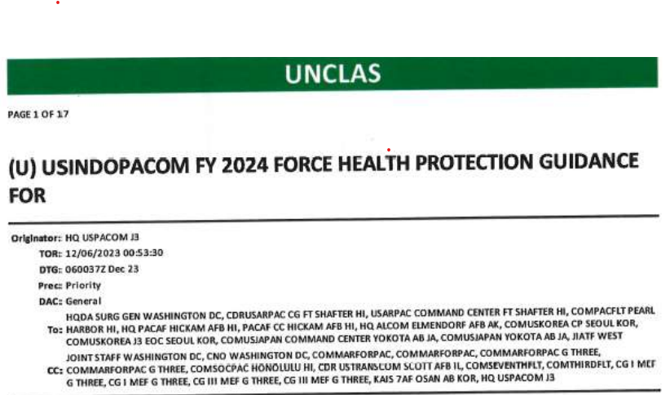
FHPPP Requirements (Why)
Understand why they are distributed
  Recognize the strategic process involved in determining the distribution
Notes:
INDOPACOM Theater Entry Requirements FY24_Shareable.pdf

Slide 9
Deployment Requirements - INDOPACOM
  Completed by Public Health or the Deployment Provider
  Accessed on Air Force Reporting Instructions Tool
  • Select a COCOM
  • INDOPACOM
  • USINDOPACOM FY24 Force Health Protection Guidance

Slide 10
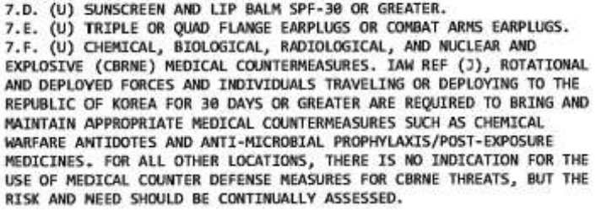
Deployment Requirements - INDOPACOM

Slide 11
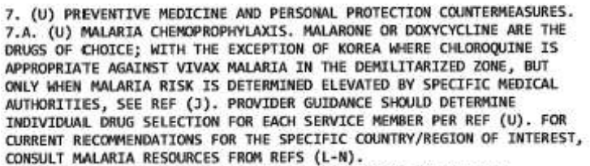
Deployment Requirements - INDOPACOM

Slide 12
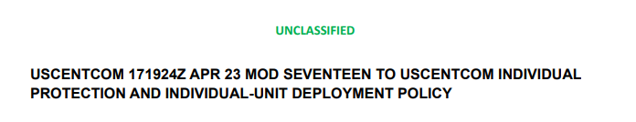
Deployment Requirements - CENTCOM
Accessed on Air Force Reporting Instructions Tool
Select your COCOM
    CENTCOM
    General Policies
    AFCENT Medical Pre-deployment Requirements
  MOD17_Tab_D.pdf
  https://www.centcom.mil/Portals/6/MEDICAL/MOD17_Tab_D.pdf
Notes:
MOD17.pdf

Slide 13
Deployment Requirements - CENTCOM
Accessed on Air Force Reporting Instructions Tool
Select your COCOM
    CENTCOM
    General Policies
    AFCENT Medical Pre-deployment Requirements
  MOD17_Tab_D.pdf
  https://www.centcom.mil/Portals/6/MEDICAL/MOD17_Tab_D.pdf
Notes:
MOD17.pdf

Slide 14
Deployment Requirements - CENTCOM
3. (U) GENERAL. 3.A. (U) THIS POLICY IS A DEPARTURE FROM PREVIOUS VERSIONS OF MCDM GUIDANCE IN THE USCENTOM INDIVIDUAL PROTECTION AND INDIVIDUAL-UNIT DEPLOYMENT POLICY AS IT MOVES SELECT ITEMS LISTED IN PARAGRAPH 4 FROM BEING REQUIRED FOR EACH DEPLOYER TO EITHER BEING IN A REGIONALLY PROXIMAL SERVICE CONTROLLED CONTINGENCY STOCK PROGRAM OR INTO A “BE PREPARED TO ACQUIRE” STATUS. THIS IS MEANT TO BALANCE RESOUCING WITH CURRENT RISK BASED ON EXISTING LIMITATIONS OF ACQUISTION SUPPLY CHAINS FOR SELECT MCDM AND CHANGING THREAT DRIVERS FOR MCDM WITHIN THE USCENTCOM AOR.
Notes:
MOD17.pdf

Slide 15
Deployment Requirements – CENTCOM
UNCLASSIFIED
3.B.4. (U) BE PREPARED TO ACQUIRE (BPT-A). THESE ARE ITEMS THAT SERVICE COMPONENTS WILL BE PREPARED TO PURCHASE OR PROCURE THROUGH SERVICE PROGRAMS AND / OR THE DOD SUPPLY CHAIN IN ORDER TO DISTRIBUTE IN A MANNER DICTATED UPON IDENTIFICATION OF CREDIBLE THREAT INDICATIONS AND WARNINGS./
Notes:
MOD17.pdf

Slide 16
Deployment Requirements – CENTCOM
UNCLASSIFIED
3.B.3. (U) CONTINGENCY STOCK ITEM (CSI).
3.B.3.A. (U) CSI ARE CONTROLLED AND MAINTAINED IAW SERVICE SPECIFIC REQUIREMENTS BY USCENTCOM SERVICE COMPONENTS, AND RELEASED WHEN REQUIRED FOR USE AS IPE.
CONSISTENT WITH AUTHORITIES IN REF D, USCENTCOM REQUIRES CBRN CSI (ITEMS 4.B. AND 4.C. OF THIS MESSAGE) BE MANAGED ACCORDINGLY:
Notes:
MOD17.pdf

Slide 17
Deployment Requirements – CENTCOM
UNCLASSIFIED
3.B.3.A.1. (U) ENROLLED AND MAINTAINED IN THE SHELF-LIFE EXTENSION PROGRAM PER GUIDANCE IN REF C.
3.B.3.A.2. (U) CSI WILL BE STORED IN A REGIONALLY PROXIMAL LOCATION IN ORDER TO ALLOW TRANSFER TO THE CONTROL OF THE SUPPORTED COMMANDER FOR FURTHER DISPOSITION WITHIN 72 HOURS OF RELEASE.
3.B.3.B. (U) SERVICE COMPONENTS WILL ENSURE SERVICE PERSONNEL CONTINUE TO DEPLOY WITH ITEMS THAT ARE LISTED AS CSI IF THERE ARE INSUFFICIENT STOCKS TO MEET THE PROXIMITY/AVAILABILITY REQUIREMENTS OF PARAGRAPH 3.B.3.A.2
3.B.4. (U) BE PREPARED TO ACQUIRE (BPT-A). THESE ARE ITEMS THAT SERVICE COMPONENTS WILL BE PREPARED TO PURCHASE OR PROCURE THROUGH SERVICE PROGRAMS AND / OR THE DOD SUPPLY CHAIN IN ORDER TO DISTRIBUTE IN A MANNER DICTATED UPON IDENTIFICATION OF CREDIBLE THREAT INDICATIONS AND WARNINGS.//
Notes:
MOD17.pdf

Slide 18
Deployment Requirements – CENTCOM
UNCLASSIFIED
4. (U) THEATER MCDM REQUIREMENTS. THE FOLLOWING MCDM ITEM ALLOCATIONS AND AVAILIBILITIES CONSTITUTE THE MINIMUM REQUIREMENT FOR THE USCENTCOM THEATER IAW APPLICABILITY REQUIREMENTS OUTLINED IN PARA 2.
4.A. (U) M291A SKIN DECONTAMINATION KIT OR REACTIVE SKIN DECONTAMINATION LOTION (RSDL).
4.A.1. (U) ALLOCATION: ONE M291AKIT OR ONE POUCH CONTAINING 3 PACKETS OF RSDL PER AFFECTED INDIVIDUAL.
4.B. (U) LEVEL OF AVAILABILITY: REQUIRED AS IPE FOR ALL FORCES.
4.C. (U) ANTIDOTE TREATMENT NERVE AGENT AUTOINJECTOR (ATNAA) (6505- 01- 362-7427).
4.D. (U) ALLOCATION: THREE EACH PER INDIVIDUAL.
4.D.1. (U) LEVEL OF AVAILABILITY: MAINTAINED AS CSI.
4.E. (U) DIAZEPAM INJECTION (CANA) (6505-01-274- 0951). 4.E.1. (U) ALLOCATION: ONE EACH PER INDIVIDUAL. 4.E.2. (U) LEVEL OF AVAILABILITY: MAINTAINED AS CSI.

Slide 19
Deployment Requirements – CENTCOM
UNCLASSIFIED
4.F. (U) CIPROFLOXACIN 500MG TABS OR DOXYCYCLINE 100MG TABS.
4.F.1. (U) ALLOCATION: SIX TABS (BLISTER PACKS PREFERABLE) PER AFFECTED INDIVIDUAL OF EITHER MEDICATION.TO COVER INITIAL DOSAGE AND SUPPORT PROPHYLAXIS AND/OR TREATMENT FOR THREE DAYS PER INDIVIDUAL. AVAILABILITY OF COMPLETE 30-DAY COURSE OF MEDICATION (60 TABLETS) SHOULD BE CONSIDERED GIVEN MISSION REQUIREMENTS. INDIVIDUALS USING DOXYCYCLINE FOR MALARIA PROPHYLAXIS MAY BE CONSIDERED TO BE COVERED FOR THESE REMAINING DOSES.
4.F.2. (U) LEVEL OF AVAILABILITY: BPT-A.
4.G. (U) PYRIDOSTIGMINE BROMIDE (PB) 30MG TABS (SOMAN NERVE AGENT PRETREATMENT PYRIDOSTIGMINE - SNAPP).
4.G.1. (U) ALLOCATION: 42 TABLETS PER INDIVIDUAL.
4.G.2. (U) LEVEL OF AVAILABILITY: BPT-A.
4.H. (U) POTASSIUM IODIDE (KI) TABLETS (FOR BETA/GAMMA RADIATION EXPOSURE).
4.H.1. (U) ALLOCATION: 14 TABS PER AFFECTED INDIVIDUAL.
4.H.2. (U) LEVEL OF AVAILABILITY: BPT-A.

Slide 20
Deployment Requirements – CENTCOM
UNCLASSIFIED
5. (U) COORDINATING INSTRUCTIONS.
5.A. (U//FOUO) CSI STOCKS MUST BE MAINTAINED IN SUFFICIENT QUANTITY TO SUPPORT APPLICABLE CURRENT THEATER POPULATION.
5.B. (U) USCENTCOM COMPONENTS RETAIN THE AUTHORITY TO DIRECT THE ISSUE ITEMS LISTED AS EITHER CSI OR BPT-A BASED UPON MISSION REQUIREMENTS AND SERVICE REQUIREMENTS.
3.B.4. (U) BE PREPARED TO ACQUIRE (BPT-A). THESE ARE ITEMS THAT SERVICE COMPONENTS WILL BE PREPARED TO PURCHASE OR PROCURE THROUGH SERVICE PROGRAMS AND / OR THE DOD SUPPLY CHAIN IN ORDER TO DISTRIBUTE IN A MANNER DICTATED UPON IDENTIFICATION OF CREDIBLE THREAT INDICATIONS AND WARNINGS./

Slide 21

Deployment Requirements - CENTCOM

Slide 22
Chemical War Threats
Chemical Threats toxic chemicals as a weapon to harm or kill people, animals, or plants
Nerve Agents: Soman, Sarin, VX
Blister Agents: Mustard Gas
Choking Agents: Phosgene
Blood Agents: Hydrogen Cyanide
Riot Control Agents: CS Gas
Toxic Industrial Chemicals (TICs): Chlorine
Other Chemical Agents: Ricin

Slide 23
Chemical War Threats
Nerve Agents: Causes respiratory failure, seizures, and death
  Soman (German Agent GD): Highly toxic liquid
  Sarin (German Agent B GB): Highly toxic and volatile gas
    Iran-Iraq War
    Syrian Civil War
  VX (Venomous agent X): Highly toxic liquid
  Tabun GA (German Agent A) : Highly toxic liquid
Blister Agents: Causes severe blistering, skin burns, and eye damage
  Mustard Gas: colorless, odorless liquid that can be released as a gas or a liquid
  Lewisite: colorless, odorless liquid, arsenic-based compound
    World War I and World War II
Choking Agents: Cause severe damage to the lungs, skin, and eyes
  Phosgene : Highly toxic and corrosive gas
    World War I and World War II
  Diphosgene (DP): Highly toxic and corrosive gas

Slide 24
Chemical Protection
RSDL (Reactive Skin Decontamination Lotion)
  Nerve Agents
  Blister Agents
  Choking Agents
  Neutralize chemical agents making them less toxic and less likely to cause harm.

Slide 25
Chemical War Threats
Normal Function of Acetylcholine (ACh):
Acetylcholine is a neurotransmitter that plays a role in signals between nerve cells to other cells.
ACh bins to receptors on cells causing actions, and after it completes its function, an enzyme called acetylcholinesterase breaks down ACh to stop the signal
  Stimulates muscle contractions
  Inhibits muscle contractions
  Regulates heart rate
  Regulates respiration
Nerve Agent Mechanisms of Action:
Irreversible organophosphate inhibitor of the enzyme acetylcholinesterase, which is responsible for breaking down Ach
Leads to an accumulation of ACh in the nervous system
Continuous signals without relaxation can lead to spasms, twitching, paralysis

Slide 26
Chemical Protection
Pyridostigmine bromide (P-Tabs, PB)
  Used as a pre-treatment for exposure to the nerve agent Soman
  Protects the nervous system
    Reversible competitive inhibitor of the enzyme acetylcholinesterase
    Temporarily prevents the enzyme from breaking down Ach but allows normal function to resume after the drug is metabolized
  Reduce the effects of Soman by competing with Soman at each receptor
  Enhance the effectiveness of Atropine
  The standard dosing:
    30 mg every 8 hours, starting 24 hours before potential exposure to Soman

Slide 27
Pyridostigmine bromide (P-Tabs, PB)
The labeled use for Pyridostigmine Bromide tablets is indicated for pre-treatment before exposure to the organophosphorus nerve agent, Soman ONLY.
  After review by the Department of the Army Surgeon General and agreement from the FDA on 23 May 2017 utilizing Pyridostigmine Bromide in any circumstance concerning the threat of exposure to a chemical nerve agent is recommended and an on-label indication.
  There is currently no detection capability that can accurately dismiss the threat of specifically Soman among other chemical nerve agents
Facts and Comparisons or Lexicomp

Slide 28
Pyridostigmine bromide (P-Tabs, PB)
A/O 5 Feb 2019 -The FDA approved the Department of the Army Surgeon General’s Supplemental New Drug Application that requested a change in storage conditions for Pyridostigmine Bromide tablets utilized for operational use
  Change in Storage Conditions
    (2°C -8°C) →(20°C -25°C)
Facts and Comparisons or Lexicomp

Slide 29
Chemical Protection
  ATNAA (Antidote Treatment - Nerve Agent, Auto-Injector)
  Atropine and Pralidoxime chloride
    Nerve Agents
    Blister Agents
    Choking Agents
  Atropine: Works by blocking the action of acetylcholine, alleviates excessive secretions (e.g., salivation, sweating), Bronchospasm (constriction of airways)
  Pralidoxime (2-PAM): Works by reactivating acetylcholinesterase to restore normal muscle function

Slide 30
Chemical Protection
CANA (Convulsant Antidote for Nerve Agent)
Diazepam
    Nerve Agents
    Blister Agents
    Choking Agents
  Enhances the effects of GABA, a neurotransmitter that helps to calm the nervous system, control seizures and convulsions, reduces anxiety and agitation

Slide 31
Chemical Protection
Upcoming Innovations Research and Development
  Midazolam Injector (Already replacing expired Diazepam)
  Extended Release Pyridostigmine bromide (P-Tabs, PB)

Slide 32
Biological War Threats
Use of microorganisms, toxins, or other biological agents
Bacteria:
  Anthrax (Bacillus anthracis): Respiratory failure, meningitis, and death.
  Plague (Yersinia pestis): Bubonic plague, pneumonic plague, and septicemic plague
  Tularemia (Francisella tularensis): Tularemia, a fatal disease if left untreated
Viruses:
  Smallpox (Variola major): A highly contagious and deadly virus
  Ebola: Hemorrhagic fever, fatal disease if left untreated
  Lassa fever: Fatal disease if left untreated
Toxins:
  Botulinum toxin: Can cause botulism, fatal disease if left untreated
  Ricin: Potent toxin from the castor bean plant, causes respiratory failure, cardiac arrest, and death
  Saxitoxin: Highly potent toxin produced by certain species of marine algae, which can cause paralytic shellfish poisoning
Fungi:
  Coccidioides: Causes coccidioidomycosis, fatal disease if left untreated
Other biological agents:
  Abrin: Highly potent toxin derived from the rosary pea plant, causes respiratory failure, cardiac arrest, and death.
  Shiga toxin: Highly potent toxin produced by the bacterium Shigella dysenteriae, causes severe diarrhea, dehydration, and death

Slide 33
Biological Protection
  Anthrax (Bacillus anthracis)
    Anthrax prophylaxis, treats cutaneous, inhalational, and gastrointestinal anthrax
  Plague (Yersinia pestis)
    Bubonic and pneumonic plague
  Tularemia (Francisella tularensis)
    Ulceroglandular and pneumonic tularemia
    Treatment & Prophylaxis: Ciprofloxacin or Doxycycline

Slide 34
Biological Protection
Ciprofloxacin
  500 mg every 12 hours for 60 days
  ADE
    Tendinitis and tendon rupture (patients over 60 years old)
    Seizures
    Clostridioides difficile-associated (C-Diff) diarrhea (patients with a history of antibiotic use)
Doxycycline
  100 mg every 12 hours for 60 days
  ADE
    Sun hypersensitivity
  Contraindicated
    Pregnancy: Can harm the developing fetus and is excreted in breast milk
    Reference Facts and Comparisons or Lexicomp as drug info resources

Slide 35
Daily Biological Force Protection
Malaria is caused by the Plasmodium parasite, transmitted through the bite of an infected Anopheles mosquito
Transmission
  When an infected mosquito bites a human, it injects sporozoites into the person's bloodstream
Liver Stage
  In the liver, the sporozoites undergo a process called exo-erythrocytic schizogony, during which they multiply and differentiate into merozoites. Typically lasts 7-10 days and is asymptomatic
Blood Stage
  Merozoites infect red blood cells (RBCs), where they undergo a process called erythrocytic schizogony. The parasites multiply and differentiate into trophozoites, schizonts, and gametocytes.
Trophozoite Stage
  Characterized by feeding on the RBC's hemoglobin, causing the cell to be enlarged and misshapen. Typically lasts 2-3 days.
Schizont Stage
  Multiplication and differentiation into more merozoites. Typically lasts 2-3 days and the RBC ruptures releasing more merozoites into the bloodstream
Gametocyte Stage
  Final stage of the parasite's life cycle in the human host. Differentiate into male and female gametocytes, which are then ingested by an Anopheles mosquito, allowing the parasite to complete its life cycle.
  Reference Facts and Comparisons or Lexicomp as drug info resources.

Slide 36
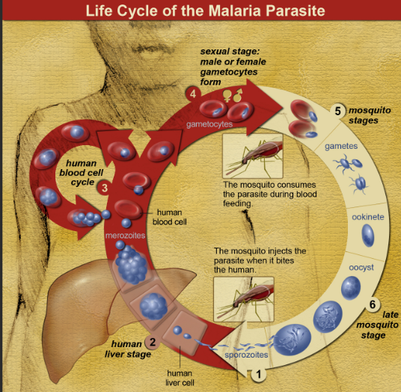
Biological Force Protection

Slide 37
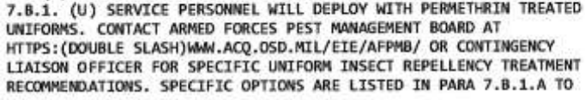
Biological Force Protection
FHHHP for Malaria include a range of medications and treatments that are used to prevent and treat malaria in military personnel who are at risk of exposure
https://www.pacom.mil/Media/News/Article/2670460/force-health-protection-guidance-supplement-17-revision-1/

Slide 38
Biological Force Protection
Doxycycline
  Taken once a day, starting 1-2 days before deployment to a malaria-endemic area and continuing for 4 weeks after return.
  Mechanism of action:
    Inhibits protein synthesis
    Interferes with the parasite's DNA replication
    Disrupts the cell membrane
Atovaquone-proguanil (Malarone)
  Taken once a day, starting 1-2 days before deployment to a malaria-endemic area and continuing for 7 days after return
Chloroquine
  Taken once a week, starting 1-2 weeks before deployment to a malaria-endemic area and continuing for 4 weeks after return

Slide 39
Biological Force Protection
Mefloquine (Lariam)
  Taken once a week, starting 1-2 weeks before deployment to a malaria-endemic area and continuing for 4 weeks after return.
  Mechanism of Action
    Interferes with the parasite's ability to produce ATP (adenosine triphosphate), which is the energy source
    Inhibits the parasite's mitochondria
    Interferes with the protein synthesis
    Disrupts DNA replication
  ADE: Linked with psychological issues
    Neuropsychiatric adverse effects, including anxiety, depression
    Psychotic episodes including hallucinations, delusions, and disorganized thinking
    Mood changes, Sleep, Cognitive impairment

Slide 40
Biological Force Protection
Primaquine: Taken once a day, starting 1-2 days before deployment to a malaria-endemic area and continuing for 14 days after return
Tafenoquine: Taken 300 mg once weekly, starting 1-2 days before traveling to an area where malaria is common, and continuing for 7 days after returning
MOA:
  Kills the liver stages of the parasite
  Prevents multiplying in the liver, which prevents from progressing to the blood stage
  Kills the gametocytes stages of the parasite that are responsible for transmitting the disease to mosquitoes
ADE
  Gastrointestinal effects: nausea, vomiting, and diarrhea
  Hematologic effects: anemia, leukopenia, and thrombocytopenia
  Neurological effects: headaches, dizziness, and insomnia
Contraindications
  G6PD deficiency: may cause hemolysis
  Pregnancy and breastfeeding

Slide 41
G6PD (Glucose-6-Phosphate Dehydrogenase) deficiency
Genetic disorder that where the enzyme G6PD is either partially or completely deficient, the enzyme is responsible for maintaining the integrity of red blood cells
With a deficient enzyme, there is a reduction in the production of another enzyme that protects the cells called NADPH (Nicotinamide Adenine Dinucleotide Phosphate)
Any trigger such as medications, stress or infections can cause red blood cells to be vulnerable to oxidative damage, via a reactive oxygen species (ROS)
  Without enough NADPH, the ROS are not broken down and it damages the red blood cells leading to hemolysis and initiates a chain reaction

Slide 42
Radioactive Threats
What is Radioactive Iodine?
  Type of radiation that can be released into the environment. It can be inhaled or ingested, and can accumulate in the thyroid gland, where it can cause damage and increase the risk of thyroid cancer
Potassium iodide (KI)
  Used to protect the thyroid gland from radioactive iodine, which can be released into the environment during a nuclear accident
  Indicated for individuals who are at risk of exposure to radioactive iodine (Near a nuclear power, exposed during medical procedures or industrial processes)
  MOA:
    Saturates thyroid gland with non-radioactive iodine "thyroid blocking"
    Thyroid gland is unable to absorb radioactive iodine, which reduces the risk of thyroid damage and cancer
  Likely not useful for deployment health
    Does not provide protection against gamma radiation, beta radiation, or alpha radiation
    Radiation exposure causes acute radiation syndrome, cancer, and genetic damage
    Not for Nuclear Attacks!

Slide 43
Distribution of FHPPP items
  Pharmacy Daily Operations
    All FHPPP shall be issued under prescription by qualified personnel who have been instructed on the exclusion criteria and other medical guidance applicable to the products
    The medical record and genesis drug file of all patients issued FHPPP will be documented with the drug name, strength, quantity, directions and name of ordering provider.

Slide 44
Mass Distribution of FHPPP items
Personnel involved: Pharmacy team, logistics team, CAT, EOC, MCC, PACOM leadership
Time estimation: 24-72 hours (distribution to day and night shifts)
SG will issue a blanket prescription for BW/CW for all AD personnel per HA Policy 03-007 (NOTE: AFI 41-209 only requires physician prescription; SG may be unrealistic considering demands of COCOM during contingency)
CAT-D will direct units to pick up kits and then distribute BW/CW kits to their members and return notated alpha roster to MCC
Pharmacy team will request names of authorized personnel from the MCC
Unit representative arrive to designated pick-up point
If unit representative is not on the authorized list, and cannot produce an authorization letter the pharmacy team will request the MCC contact the unit through the EOC to verify member’s authorization
Pharmacy will verify their identity (CAC) and provide an educational briefing on member distribution
Units will distribute to members and provide patient education. (AFI 41-209)
Unit representatives will utilize an alpha roster to record when members receive BW/CW kits. This roster will be turned in to the pharmacy team (through UCC –EOC –MCC) for documentation in the medical record.
If alpha roster not received, pharmacy team will utilize the rosters requested from FSS at the beginning of contingency to annotate patient records
Units will confirm distribution through the FHPPP chatroom or other means if commout
Pharmacy team will annotate medications in the patient record

Slide 45
  Identify the best places for distribution
If primary logistics building is open, unit representatives will be directed to pull their vehicle directly to the logistics loading dock. If buildings are locked down, unit representatives will be directed into the facility and to the logistics warehouse
Keep in mind the extra manpower that may be needed due to weight of full battle rattle and gear. (Logistics)
Transport Requirements
  CAT-D should advise units on appropriate vehicles for pick-up
  Units with more than 50 members are advised to bring a flatbed truck for pick-up
Footprint of FHPPP for 50 members is 20”L x 24”H x 24”W.
  Units with 300 members will have one tri-wall to transport.
  The tri-wall dimensions are 40”L x 46”H x 48”W, and each tri-wall weighs 200-300 pounds

Slide 46
  Kit Returns
•Once the threat of BW/CW has diminished and the CAT directs return of kits, units will collect unused BW/CW kits from their members
•Collection of the FHPPP in bulk will be done at the squadron/group level and inventoried
•An accurate count of each item is required and will be verified upon return
•Units will return FHPPP kits to the Medical Logistics loading dock where they were issued
•Once counts have been verified with Medical Logistics the BW/CW will be signed over to transfer ownership of the items
•Medical Logistics will process returns in the Defense Medical Logistics Standard Support (DMLSS) system and then conduct appropriate destructions

Slide 47
  Key Points
Exercises
  Use a scale or the printer as a page counter to count the “bw/cw kits”
  Order “bw/cw kits” from a paper company
  If your exercises require a true count, ask logistics want to move the supplies onto the movable wire racks
  Do as much as your can before the exercise, survival is unlikely if issues during an exercise
Real World Operations
  Do not diverge significantly from regular operations, don’t put your name/license on the line!
  All FHPPP should be issued under prescription by qualified personnel who have been instructed on the exclusion criteria and other medical guidance applicable to the products
  The medical record and genesis drug file of all patients issued FHPPP will be documented with the drug name, strength, quantity, directions and name of ordering provider.
300 Real World Deployers going through Ramstein, did NOT have their BW/CW Kits issued from their base. Ramstein Pharmacy was able to receive orders and issue all the kits needed, and it only required a few hours to process them correctly! It can be done!
    However good communication and robust administrative work between the Pharmacy, SGA, Logistics and their deploying unit commander was paramount before they were able to safely issue the BW/CW Kits

Slide 48
Key Points continued
Identify Force Health Protection Prescription Products (FHPPP) items
Understand why they are distributed
  Recognize the strategic process involved in determining the distribution
Understand why they are needed and what they protect against
  Understand the pharmacology, including their mechanism of action (MOA) and what they protect against.
Review the general distribution process of FHPPP items
  The roles and responsibilities of individuals involved in receiving and distributing
  Identify the best places for distribution
  Describe the process on how to get the items distributed

Slide 49
Questions
1. Which following medication is NOT considered a Force Health Protection Prescription Products (FHPPP) item
a) Potassium Iodide
b) Doxycycline
c) Anthrax Vaccine
d) Influenza Vaccine
d) None of the above
2. How long are pyridostigmine tablets good for out of refrigeration?
a) 1 year
b) 3 months
c) 6 months
d) Manufacture Expiration Date
3. What nerve agent is pyridostigmine Tabs useful against?
a) Soman
b) Sarin
c) Chlorine Gas
d) Soman and Sarin

Slide 50
Questions
1. Which following medication is NOT considered a Force Health Protection Prescription Products (FHPPP) item
a) Potassium Iodide
b) Doxycycline
c) Anthrax Vaccine
d) Influenza Vaccine
d) None of the above
2. How long are pyridostigmine tablets good for out of refrigeration?
a) 1 year
b) 3 months
c) 6 months
d) Manufacture Expiration Date
3. What nerve agent is pyridostigmine Tabs useful against?
a) Soman
b) Sarin
c) Chlorine Gas
d) Soman and Sarin

Slide 51
Attendance Code
To obtain CPE credit for this activity, you are required to actively participate in this session. You will need this attendance code in order to access the evaluation and CPE form for this activity. Your CPE must be filed by XXXXXX 23, 2025, at 1700 EST in order to receive credit.

