Slide 1
DLA Troop Support Update: Supplying the Needs of Warfighters and Nation
Charles “Josh” Stallings, Lt Col, USAF, BSC
Customer Pharmacy Operations Center

Slide 2
Lt Col Stallings declares no conflicts of interest, real or apparent, and no financial interests in any company, product, or service mentioned in this program, including grants, employment, gifts, stock holdings, and honoraria.
The information in this presentation was developed through the cumulative knowledge and expertise of the pharmacists at the Customer Pharmacy Operation Center as well the whole of the Defense Logistics Agency Troop Support Medical Supply Chain.
The Customer Pharmacy Operations Center are DoD pharmaceutical procurement subject matter experts as the only pharmacists in the Defense Logistics Agency Medical Supply Chain, integrating customer requests and challenges with e-commerce tools and solutions derived from other teams within the Medical Supply Chain.

Slide 3
Summary
Describe the mission of Defense Logistics Agency (DLA) Troop Support
Discuss the Medical Supply Chain organization and its dual focus
Customer Pharmacy Operations Center (CPOC) and the services provided
Familiarization with National Contract Compliance, Medical Master Catalog, Prime Vendor Ordering

Slide 4
Objectives
Recall the mission of Defense Logistics Agency (DLA) Troop Support
Discuss the Medical Supply Chain organization and its dual focus
Describe the role of Customer Pharmacy Operations Center (CPOC) and the services provided
Identify tools to help with National Contract Compliance, sourcing and accessing shortage or allocated supplies

Slide 5
What organization does CPOC fall under?
Defense Health Agency
Defense Logistics Agency
Department of Health and Human Services
Department of Veterans Affairs

Slide 6
What is the most accurate source for current on-hand supply of a medication?
DAPA Manager
Medical Master Catalog
Prime Vendor Catalog
DMLSS

Slide 7
What is the best source for locating alternate NDCs of a product?
DAPA Manager
Medical Master Catalog
Prime Vendor Catalog
DMLSS

Slide 8
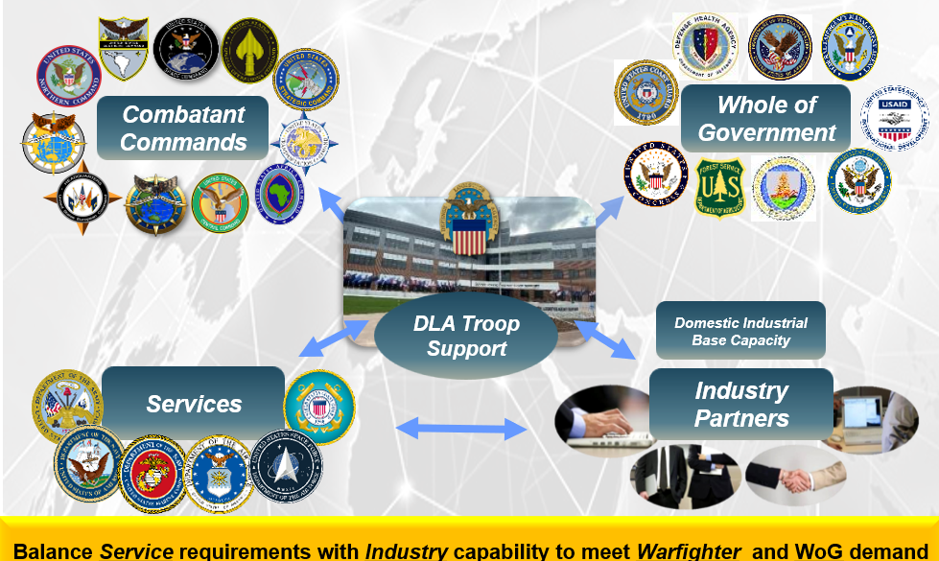
DLA Troop Support Partnerships

Slide 9
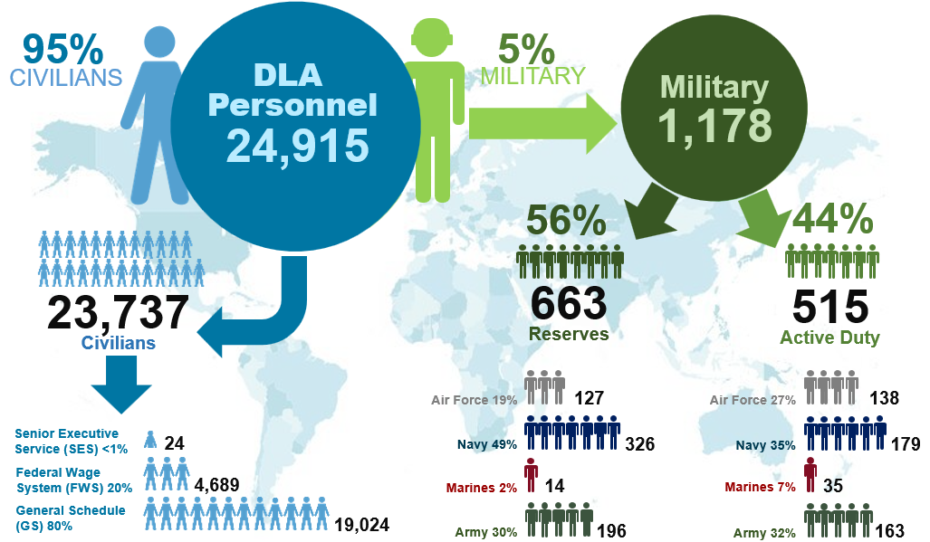
DLA Personnel

Slide 10
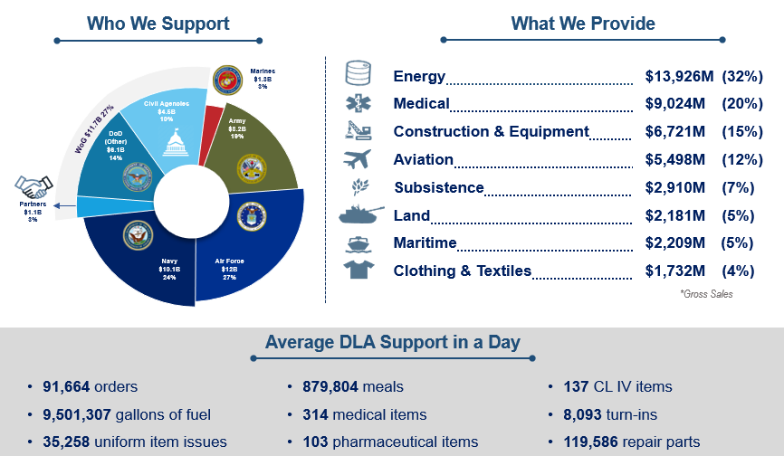
DLA By the Numbers – FY23

Slide 11
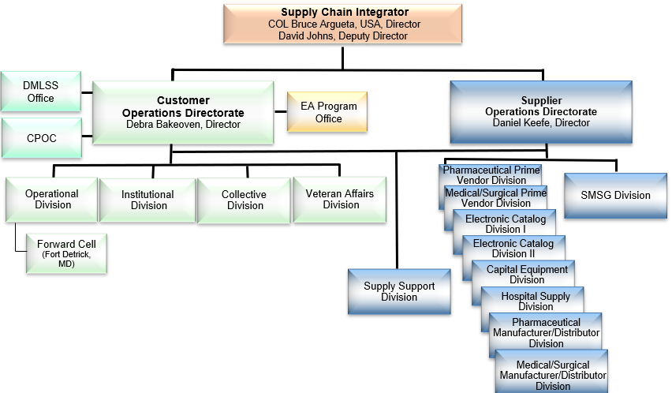
Medical Supply Chain Organization

Slide 12
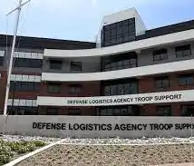

Customer Pharmacy Operations Center Team
Located in Naval Support Activity Philadelphia
Eight Joint Pharmacists:
  CAPT William “Bill” Kelly, USN
  Lt Col Francisco Boral, USAF
  Lt Col Josh Stallings, USAF
  LCDR Sean Szad, USN
  LTC Triet Nguyen, USA
  Jose Ramos, RPh
  Sooyun Kim, PharmD
  GS-12 Pharmacist (vacant)

Slide 13
Strategic Relationships
Defense Health Agency (DHA) Pharmacy Operations Division
  DoD P&T Committee, Home Delivery (TMOP), UF BPAs
DoD Pharmacy and Medical Logistics Consultants
  MTFs, Fleet, readiness rqmts, pricing, metrics, credits and data analysis
Department of Veterans Affairs (DVA)
  Joint pharmaceutical national contracts, Federal Supply Schedule
Industry Partners; Manufacturers/suppliers and wholesalers
  Product availability, sales data, gov’t pricing, TAA compliance, shortages
Other Federal Agencies; FDA, DEA, USPHS, CDC
  Drug Shortages, Recalls, Controlled Substances, stockpiles

Slide 14
Customer Pharmacy Operations Center
Drug Shortages
Monthly Newsletter
Industry Liaison
Reverse Distribution Guidance
General Logistical Questions
MTF Liaison into DLA Troop Support
Advisor to multiple DHA and Corp Specific working groups
National Strategy Initiatives – Pharm SCRMWG, NATO MPUG

Slide 15
Customer Pharmacy Operations Center
What CPOC is:
What CPOC is not:
Advisors
Contracting (technical review)
Logistical Guidance
Optimizers
Strategic Analytics
Access Granters
Credit Manager
Reverse Distribution
OCONUS controlled substances
Depot/Distributor
B2G/NCCR Police
Clinical Decision Makers
Transporters
Requirement generators

Slide 16
Sourcing
PPV = Pharmaceutical Prime Vendor = Wholesalers
  Provide government contracted drugs directly to Military Treatment Facilities (MTF) and eligible customers based on region
  Primary (PVP) are Cencora, Dakota Drug (Upper Prairie Region), and Cardinal (Navy Fleets)
  Secondary (PV2) is DMS for all regions
NPV = National Prime Vendor
  TRICARE Home Delivery Program
  New NPV is Cencora (Prev. McKesson)
Med/Surg PPV = Medical/Surgical Prime Vendor
  Cardinal
  Owen & Minor
ECAT = Electronic catalog
  An online ordering, distribution, and payment system providing access to laboratory, dental, optical and misc. medical/surgical items not available through PPV or Med/Surg PPV
DVD = Direct Vendor Delivery MILSTRIP = Military Standard Requisitioning and Issue Procedure
  A uniform procedure established by DoD to govern the requisition and issue of material within standardized priorities
Placing an order: PVP -> PV2 then other programs
Note: Government Purchase Credit Card is NOT a DLA source of supply

Slide 17
Primary (PPV1) vs. Secondary (PPV2)
Primary
Cencora – MTFs, OCONUS
Cardinal – CONUS Navy Ships
Dakota Drug – Upper Prairie Region
Cencora – Tricare Mail Order Pharmacy
  Secondary
  Second option for all regions or users
  OCONUS – used to order temperature-controlled items and controlled substances
  ALL mixed handling pharmaceuticals going OCONUS must be procured via PV2 (DMS Pharmaceuticals)
  DMS only items

Slide 18
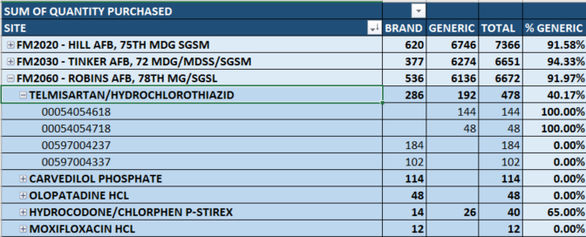
Brand To Generic Report
DHA Goal is 90%

Slide 19
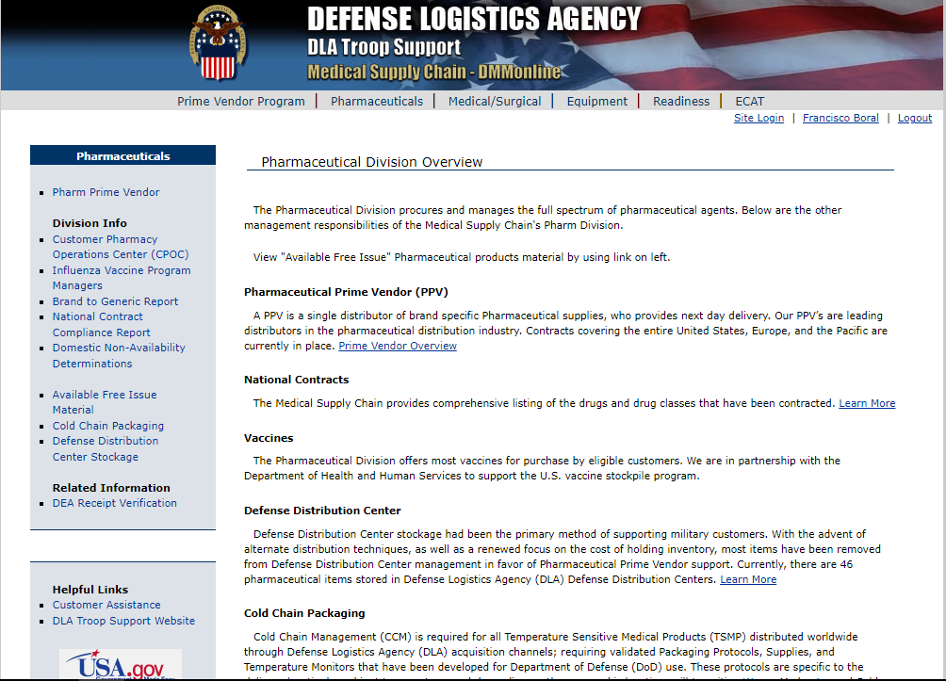
DMM Online
DLA tools that support strategic sourcing
Register via https://www.medical.dla.mil
Pharmaceutical PV
National Contracts Compliance
Business Intelligence Reporting
Medical Master Catalog
Vaccines
Cold Chain Packaging
Reverse Distribution

Slide 20
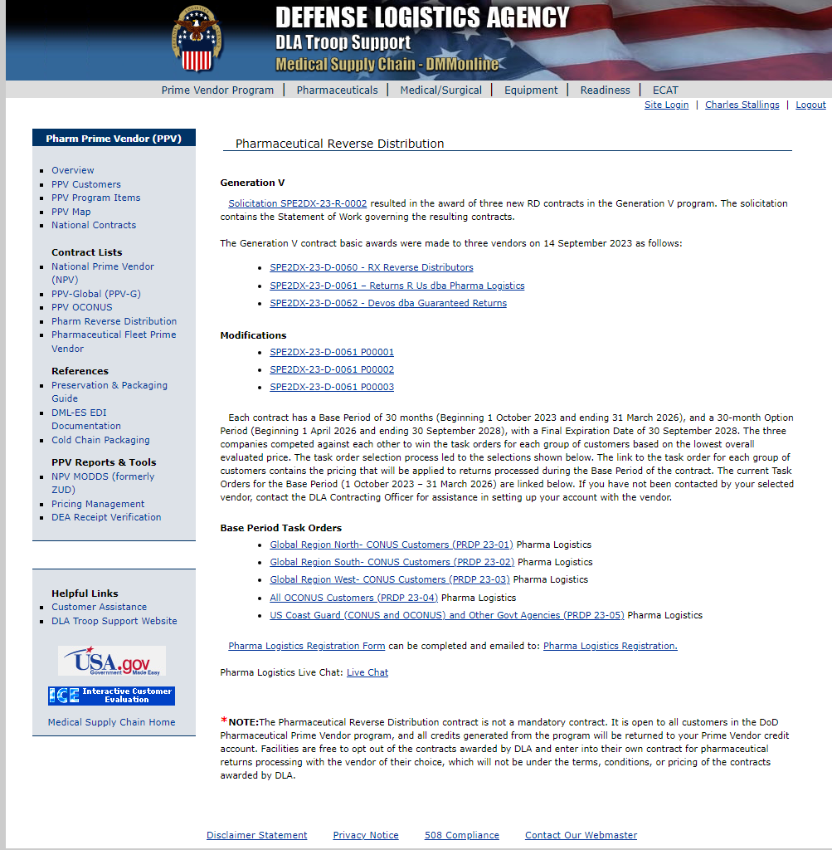
Reverse Distribution
Not:
  a mandatory contract
  a destruction contract
Eligible items
  Purchased through Prime Vendor Program
  Within 120 days of expiration
    No more than 11 months past for CONUS and 9 months past for OCONUS
  In the manufacturers original packaging
  Not an CBRN/BWCW, SLEP, or MEDSURG item
  Not damaged
Note: Recalls do not supersede these guidelines. Items pulled from your shelves for any reason outside of the 120-day window will either need to be held until the window or disposed of through a destruction/disposal contract.

Slide 21
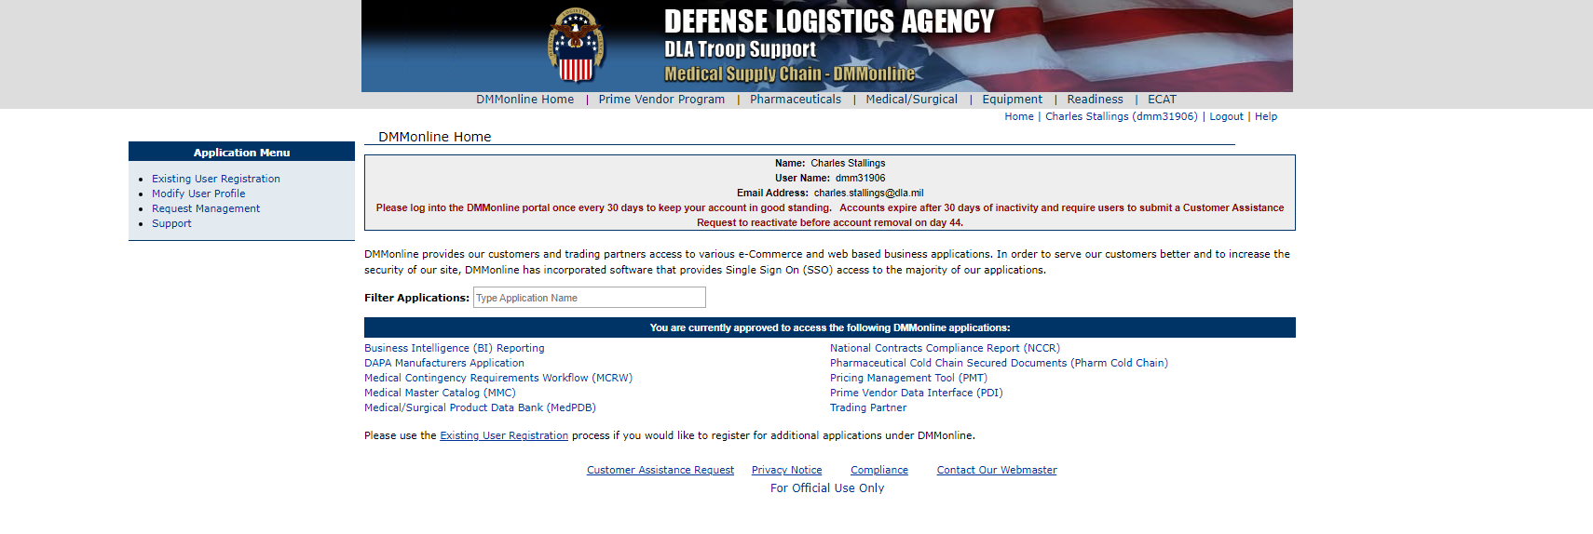
DMM Online

Slide 22
Terms – Pricing Agreements
National Contract (NC) = Joint National contract (JNC)
  VA or DLA generated
  Open for bid
  Price based on potential supply commitment from vendor
  Examples: Levofloxacin 500mg tablets
Distribution and Pricing Agreement (DAPA)
  DLA generated
  2 week process, gateway agreement
  DoD’s version of FSS
  Example: Bicillin LA
Uniform Formulary Blanket Purchase Agreement (UF BPA)
  DHA generated cost agreement based upon pricing concessions for DoD formulary placement
  Example: Humira

Slide 23
National Contract Compliance Report
Military Medical Treatment Facility Pharmacy Operations - DHA-PI 6025.31 December 20, 2019 , pg 10
(7) MTF Pharmacy Chiefs will ensure compliance with national pharmacy contracts and “Brand to Generic” conversions established by The Defense Logistics Agency in conjunction with the Chief, DHA, POD and the DoD P&T Committee. MTF directors will not permit prescribers or pharmacy industry initiatives to supplant or circumvent contract requirements. Only medications which have been approved by the Food and Drug Administration (FDA) are authorized for use in MTFs except for investigational use.
DHA goal of 90%
Document in P&T off contract purchases
  Not available
  Package size for efficient workflow – critical analysis is allowed

Slide 24
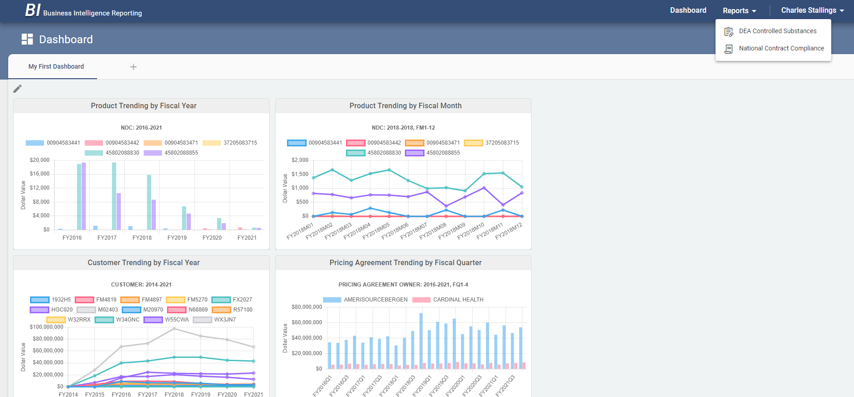
DMM Online

Slide 25
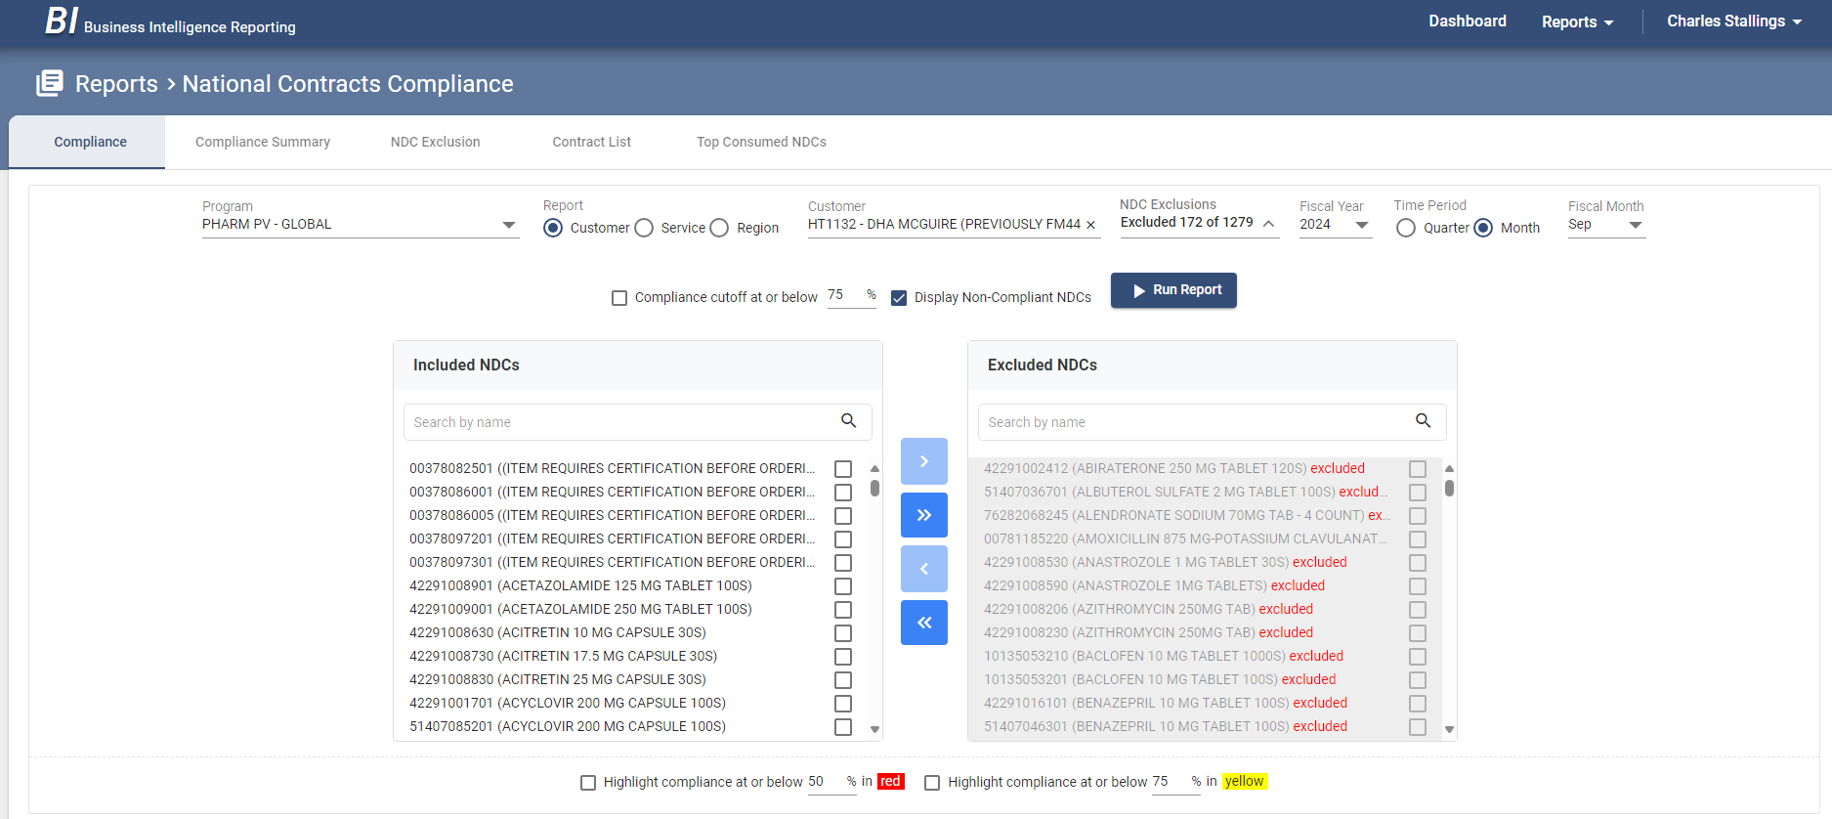
DMM Online

Slide 26
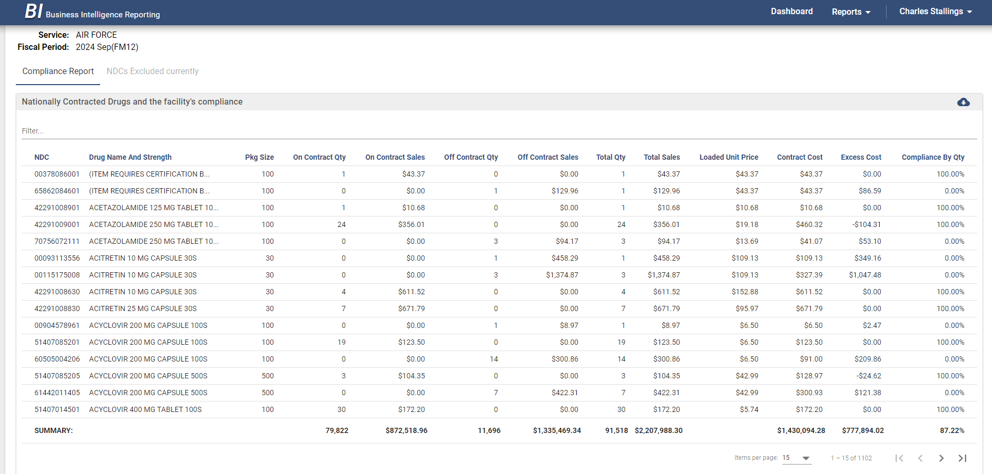
DMM Online

Slide 27
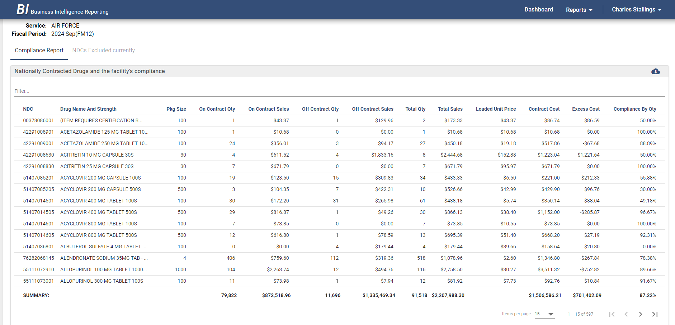
DMM Online

Slide 28
ABC Order – Pricing Agreements
DLA National Contract = Orange Bar
Federal Pricing Agreement (Veterans Affairs (VA) Federal Supply Schedule (FSS), VA Big4, Distribution and Pricing Agreement (DAPA), Blanket Purchase Agreement (BPA)) = Green Bar
Regional DAPA (AWP-15%) = No icon
Click on Icon Legend for specific details

Slide 29
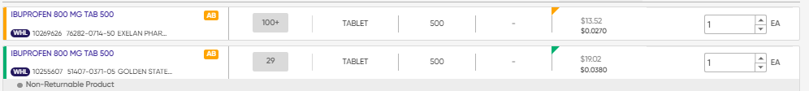
ABC Order – Pricing Agreements

Slide 30
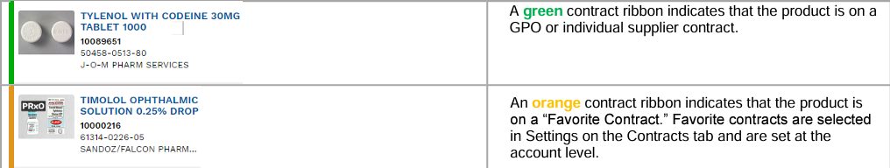
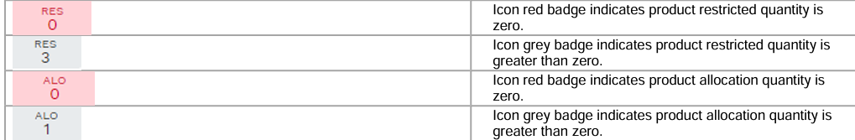
ABC Order – Icons Explained

Slide 31
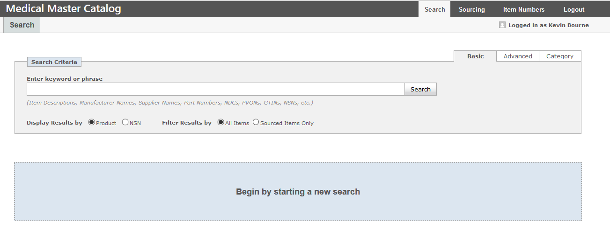
Medical Master Catalog

Slide 32
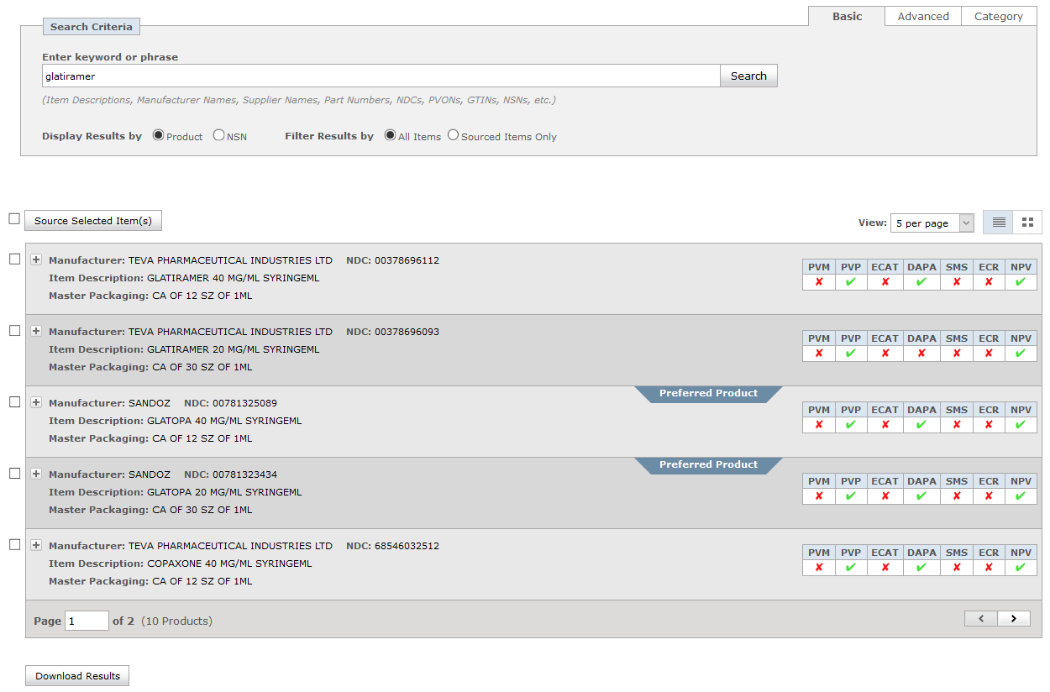
Medical Master Catalog

Slide 33
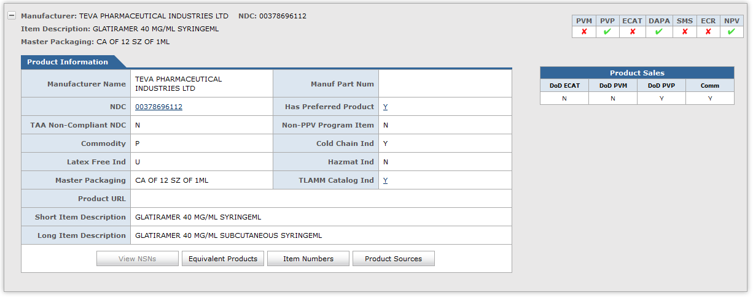
Medical Master Catalog

Slide 34
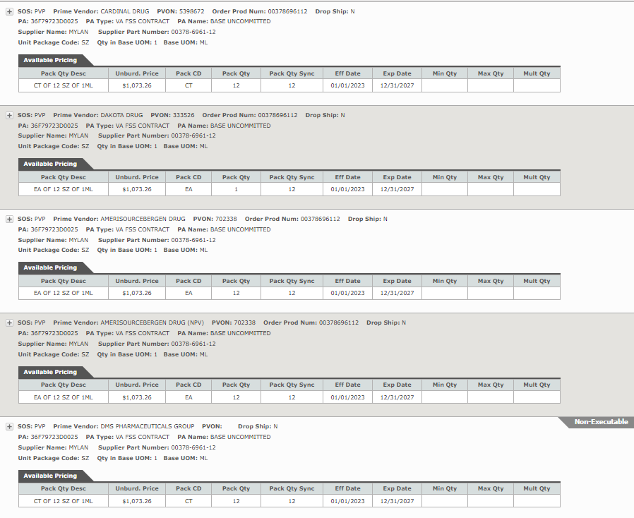
Medical Master Catalog

Slide 35
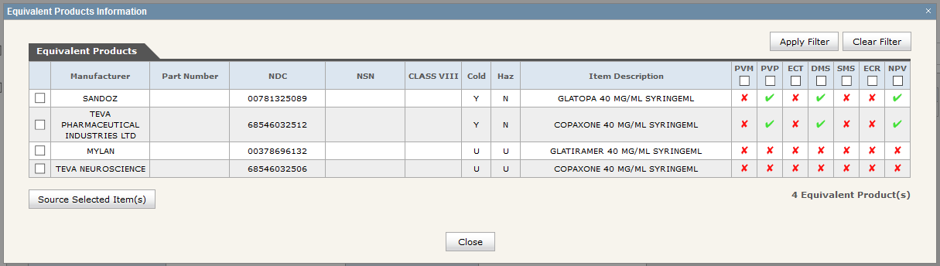
Medical Master Catalog

Slide 36
Medical Master Catalog

Slide 37
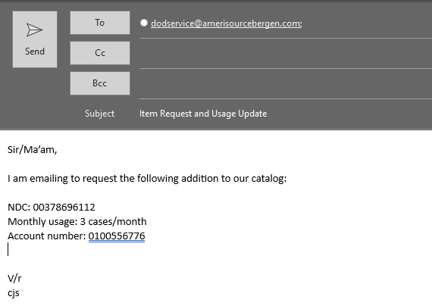
Product Sourcing

Slide 38
COVID Therapeutics
Nirmatrelvir/ritonavir is the only COVID therapeutic managed by CPOC
  Same process until 2028, based on current government contract with Pfizer
  Molnupiravir is available commercially through Cencora
All sites should have the FDA approved nirmatrelvir/ritonavir (commercially available)
  EUA labeled nirmatrelvir/ritonavir are no longer authorized for dispensing
    Discard IAW local procedures (can NOT use Reverse Distributor)
  If you haven’t received nirmatrelvir/ritonavir in 2024, you have EUA nirmatrelvir/ritonavir, contact CPOC to acquire FDA approved nirmatrelvir/ritonavir
Check the HHS and the CPOC news for updates on shelf-life extensions
  No current shelf-life extension in effect for Commercial nirmatrelvir/ritonavir

Slide 39
Current Topics
TIRF Discontinuation
Typhoid vaccine vials
REMS
Mifepristone
PV2 Only Items
Combo Controlled Items for OCONUS
Product updates:
  Omnipod

Slide 40
Holding Orders
Keep non-narcotic orders open for up to 180 days (60 days for narcotics)
  Place only in ordering accounts (non-credit accounts)
  Manual offline holding orders can be placed using non-submit generated 1155
  $25 flat fee using credit account when order is fulfilled
  Holding orders are NDC specific

Slide 41
Manual Orders
For urgent needs, CPOC can assist with coordinating manual orders when DMLSS/TEWLS is down or there is a catalog issue pending long term resolution
  Placed on credit accounts using credit balances
  Coordination between PPV, KOs, CPOC, and the customer
  No fees are applied
  Limited to urgent and emergency requests only
  Send an email to CPOC@dla.mil with justification
Ex. Chartwell Ondansetron tablets

Slide 42
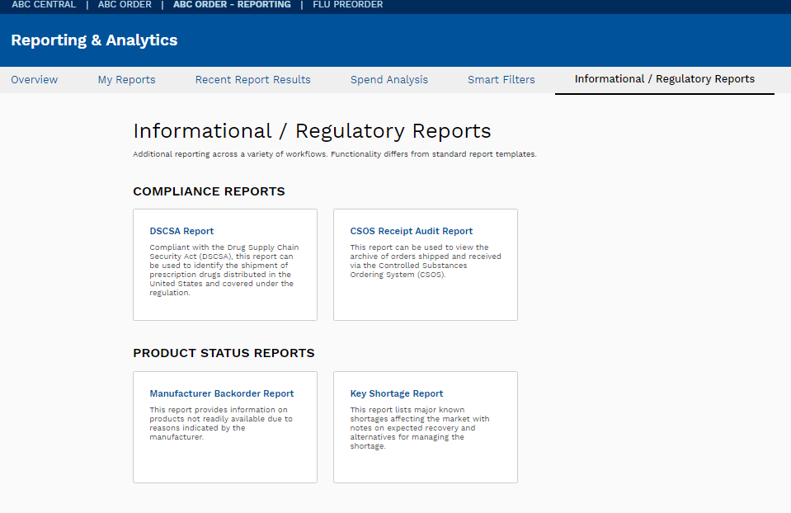
Manufacturer Backorder Reports

Slide 43
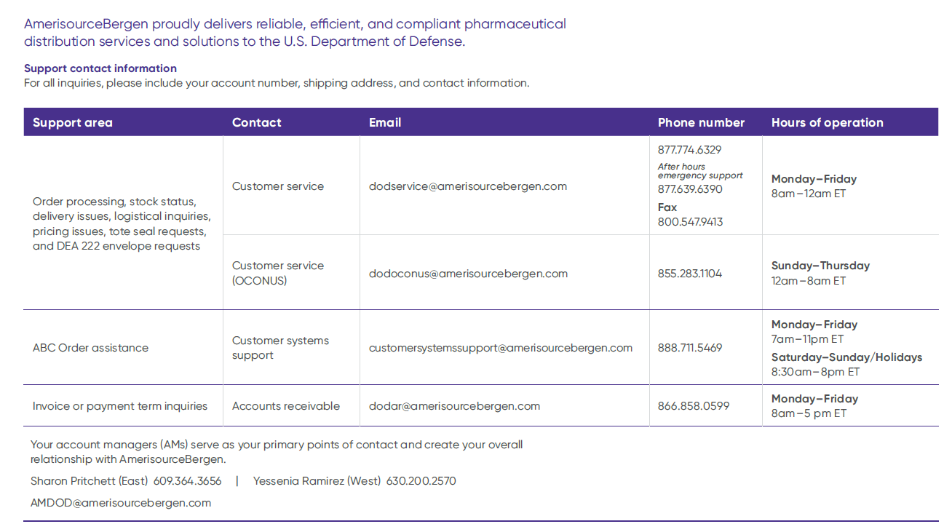
Cencora DoD Support Team Contacts

Slide 44
What organization does CPOC fall under?
Defense Health Agency
Defense Logistics Agency
Department of Health and Human Services
Department of Veterans Affairs

Slide 45
What is the most accurate source for current on-hand supply of a medication?
DAPA Manager
Medical Master Catalog
Prime Vendor Catalog
DMLSS

Slide 46
What is the best source for locating alternate NDCs of a product?
DAPA Manager
Medical Master Catalog
Prime Vendor Catalog
DMLSS

Slide 47

Closing Remarks
Charles “Josh” Stallings, Lt Col, USAF, BSC – charles.stallings@dla.mil
Dr. Sooyun Kin, PharmD – sooyun.kim@dla.mil
Defense Logistics Agency (DLA) Troop Support
Philadelphia, PA
cpoc@dla.mil

Slide 48
Closing Remarks
Customer Pharmacy Operations Center
cpoc@dla.mil

