Slide 1
Pharmacy Readiness in the Great Power Competition
James A. Holt, Maj, USAF, BSC
75th Medical Group
Hill Air Force Base, Utah
16 February 2025

Slide 2
Presenter
James Holt, PharmD
Pharmacy Flight Commander
75th Medical Group
Hill AFB, Utah

Slide 3
James Holt, PharmD
Medical University of South Carolina
  Doctor of Pharmacy
University of Kentucky
  Bachelor of Science in Biology

Slide 4
Disclosures
I have no relevant financial or non-financial relationships to disclose relating to the content of this activity.
The views expressed in this presentation are those of the author and do not necessarily reflect the official policy or position of the Department of Defense, nor the U.S. Government.
Commercial support was not received for this activity.

Slide 5
Learning Objectives
At the conclusion of this activity, participants will be able to:
Provide a global perspective on unique threats and challenges that will be faced in conflict with a peer/near-peer adversary
Understand the specific roles and responsibilities of Pharmacy in deployments
Understand different strategies to integrate and streamline the Pharmacy’s role in enabling deployments

Slide 6
Knowledge Check #1
How much advance notice would MTFs have in a first strike scenario with China/North Korea/Russia?
  5 minutes
  1 hour
  6 hours
  24 hours
  They may have the first strike, but we will provide the last

Slide 7
Knowledge Check #2
What system, when granted access, will give you eyes on current/future deployment taskings?
  DMHRSi
  ASIMS
  JKO
  SPDR

Slide 8
Knowledge Check #3
What are the components of a BW/CW kit?
  Diazepam, Cipro, Pyridostigmine, iOSAT, ATNAA, RSDL
  P-Tabs, Midazolam, Cipro, Potassium Iodide, ATNAA, RSDL
  Atorvastatin, Sildenafil, Aciphex, baby aspirin, Mounjaro, Adderall
  P-Tabs, iOSAT, Cipro, ATNAA, fentanyl, RSDL

Slide 9
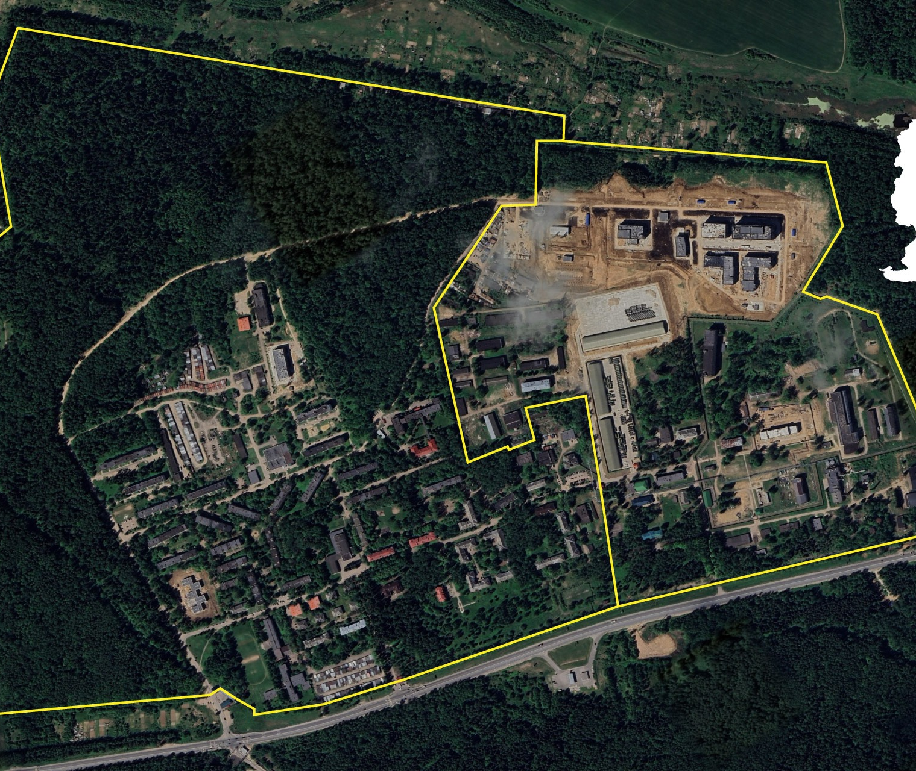
What is the threat?
Notes:
***************and/or

Slide 10

Chemical and Biological Agents
Sergiev Posad-6
Cold War biological weapons development center
Construction/renovation began in 2022
    10 new buildings
    Confirmed site for study of hemorrhagic pathogens
Notes:
***************and/or

Slide 11
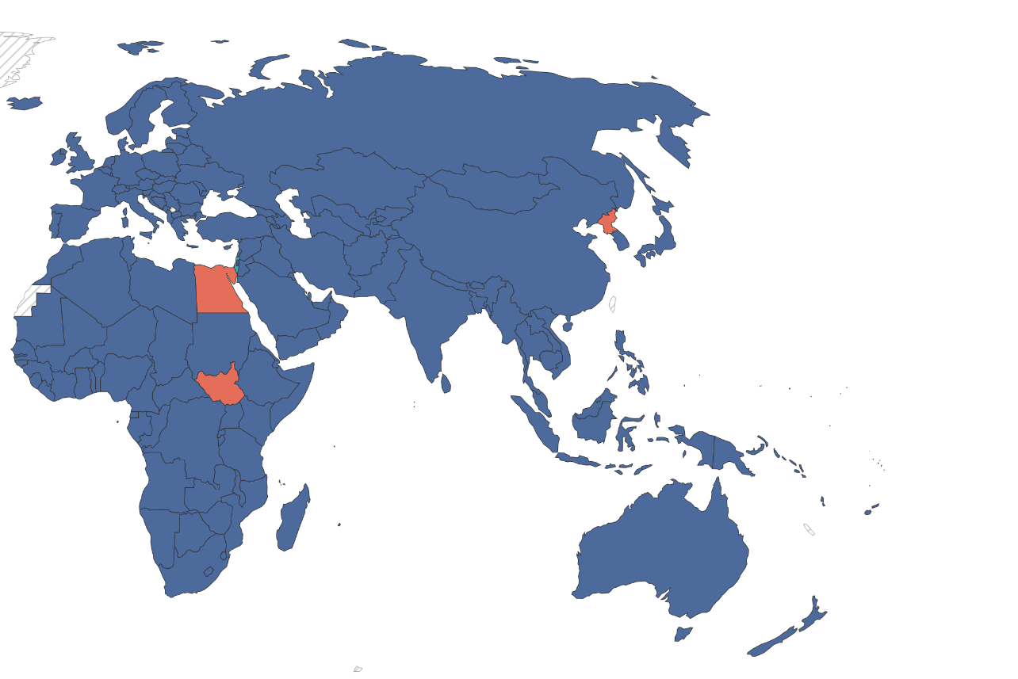
What is the threat?
Notes:
North Korea has neither ratified or signed the Chemical Weapons Convention
chemical weapons arsenal: nerve agents, blister agents, blood agents, choking agents, and riot-control agents
2.5-5K tons
Delivery methods: artillery, rockets, aircraft, ballistic missiles, & naval

Slide 12
Chemical and Biological Agents
North Korea:
  Never ratified or signed the Chemical Weapons Convention
  Chemical weapons arsenal: nerve agents, blister agents, blood agents, choking agents, and riot-control agents
  2.5-5K tons
  Delivery methods: artillery, rockets, aircraft, ballistic missiles, & naval

Slide 13
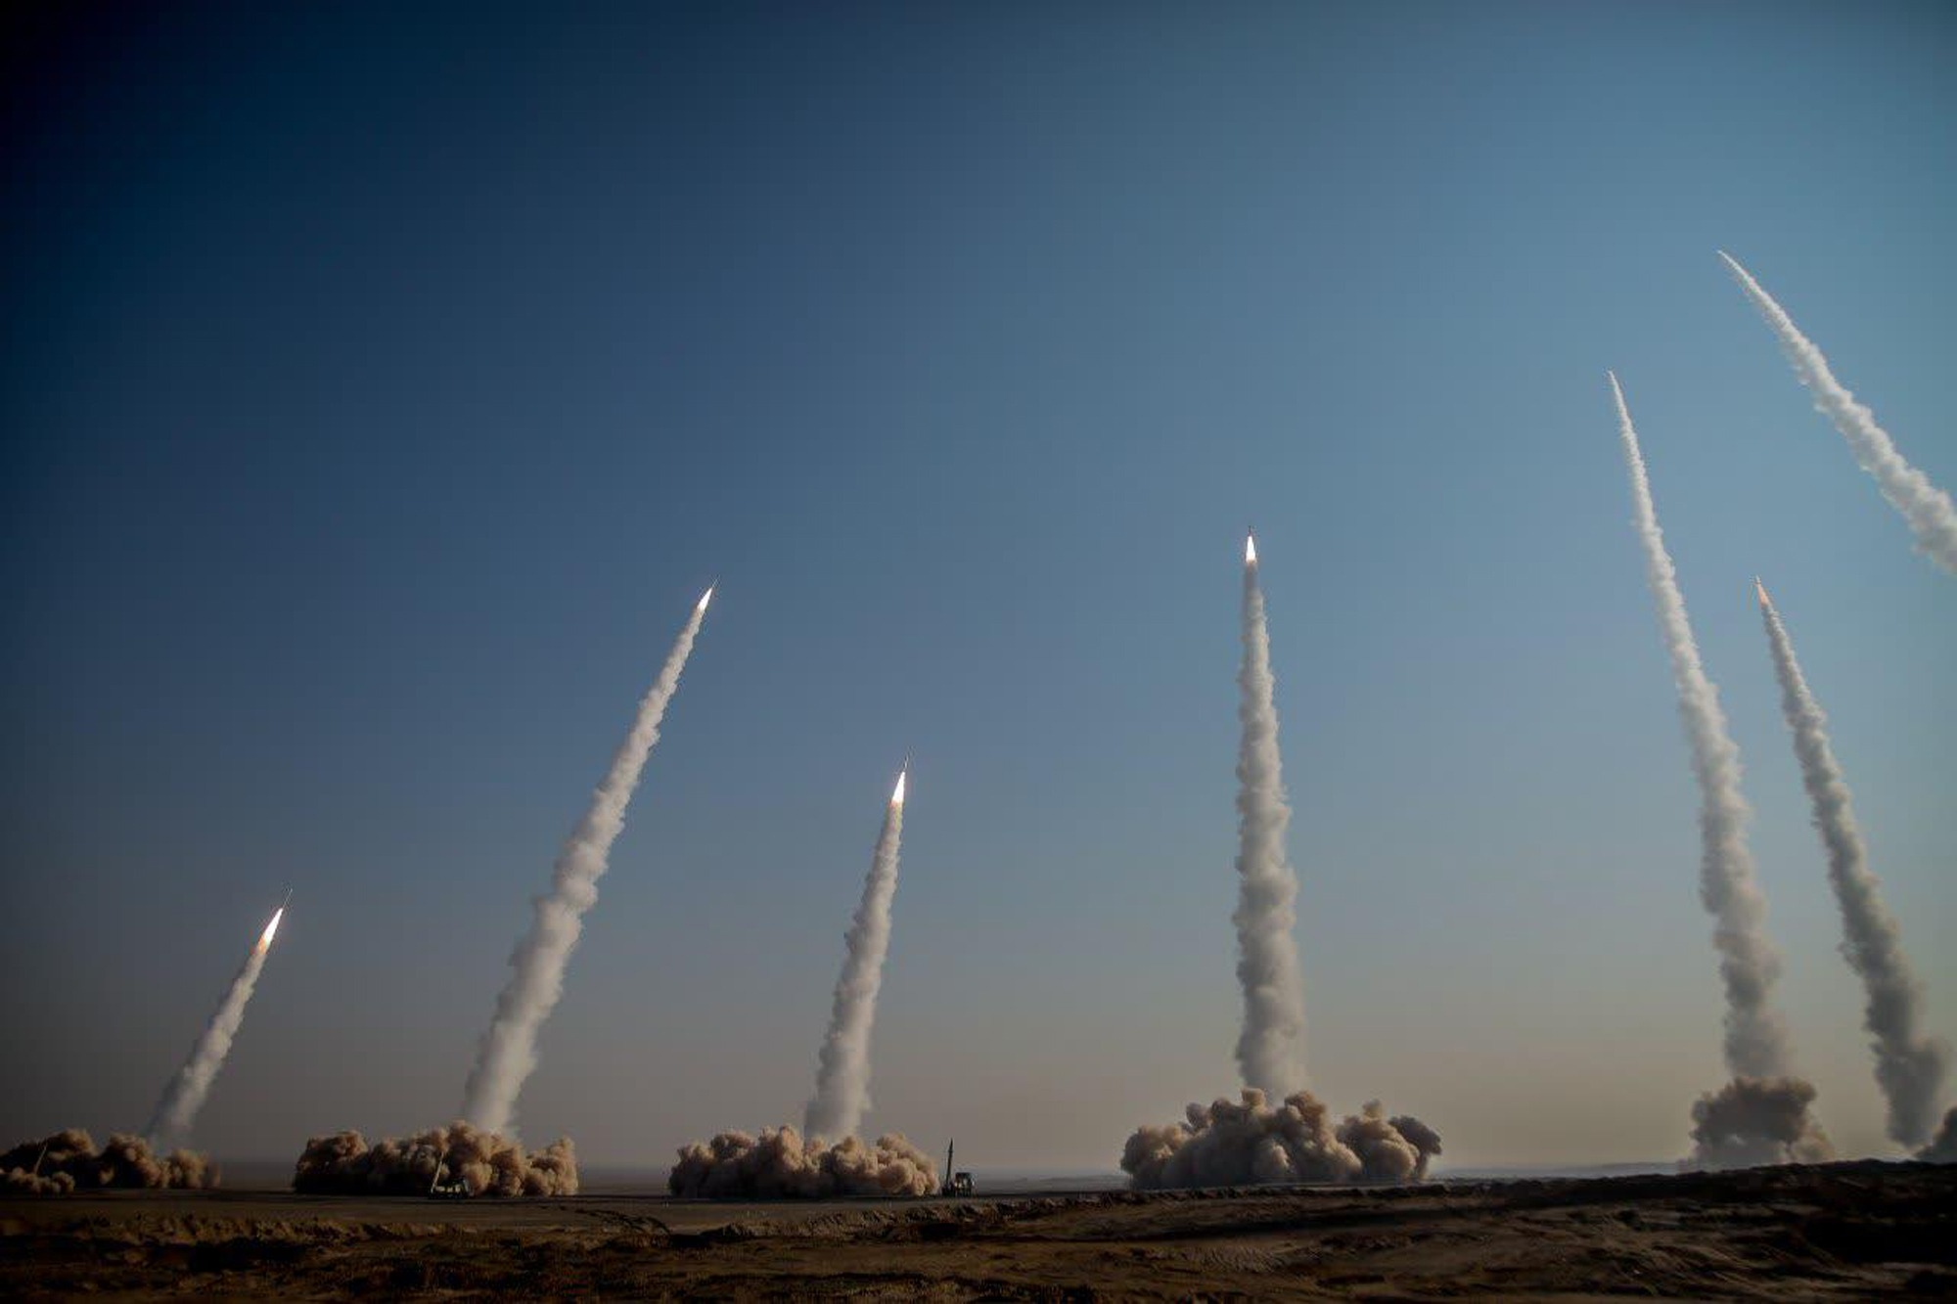
What is the threat?

Slide 14
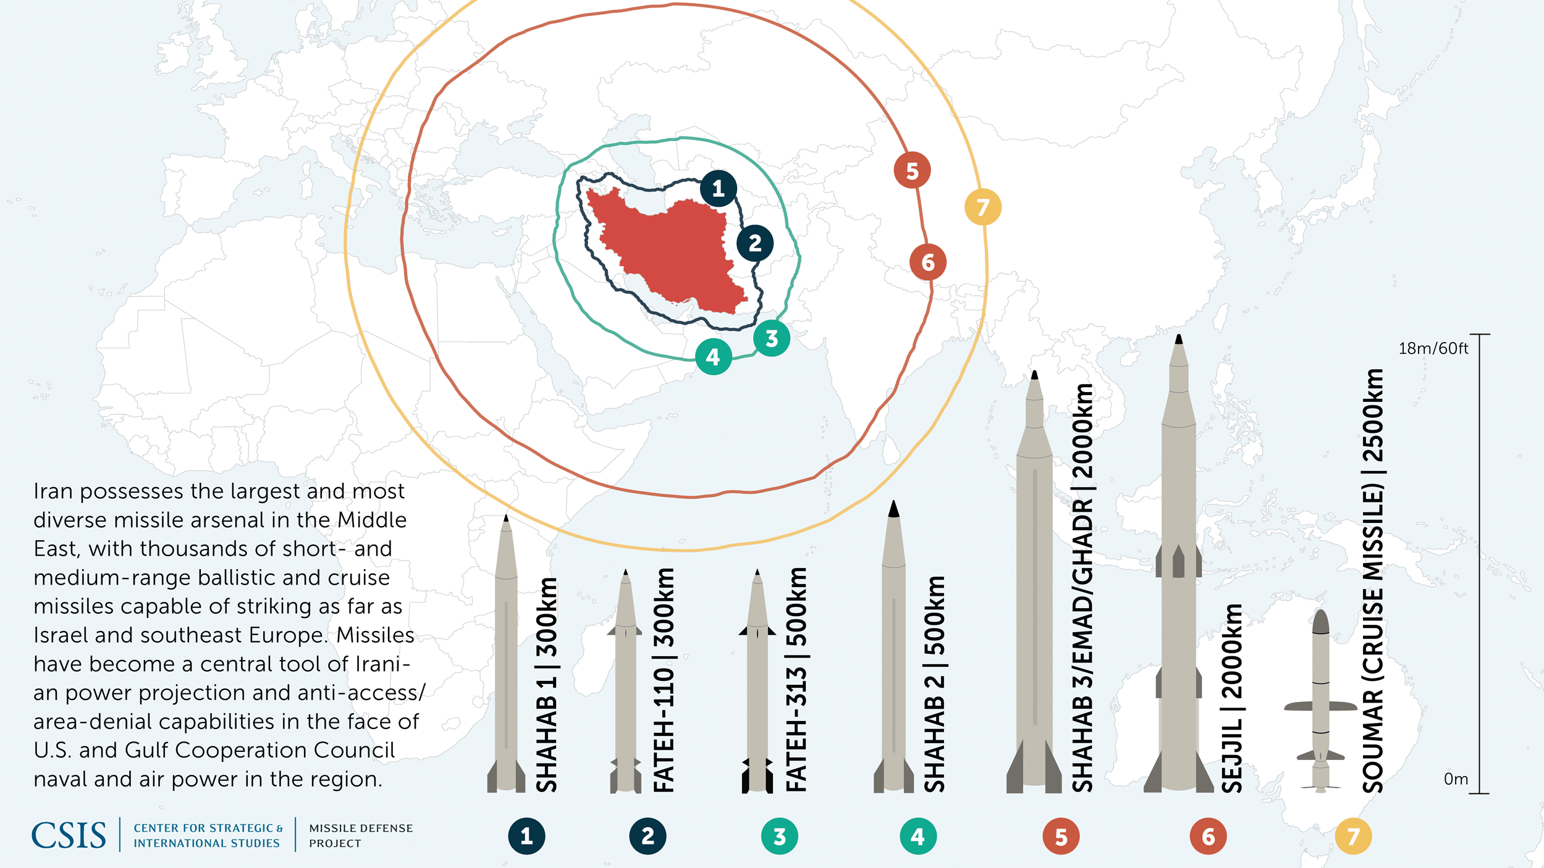
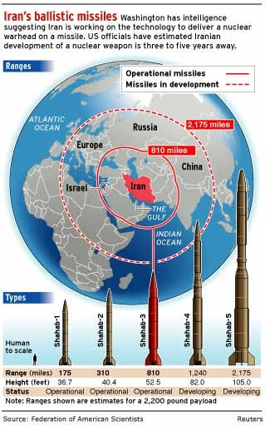
IRAN’S MISSILE PROGRAM ¹

Slide 15
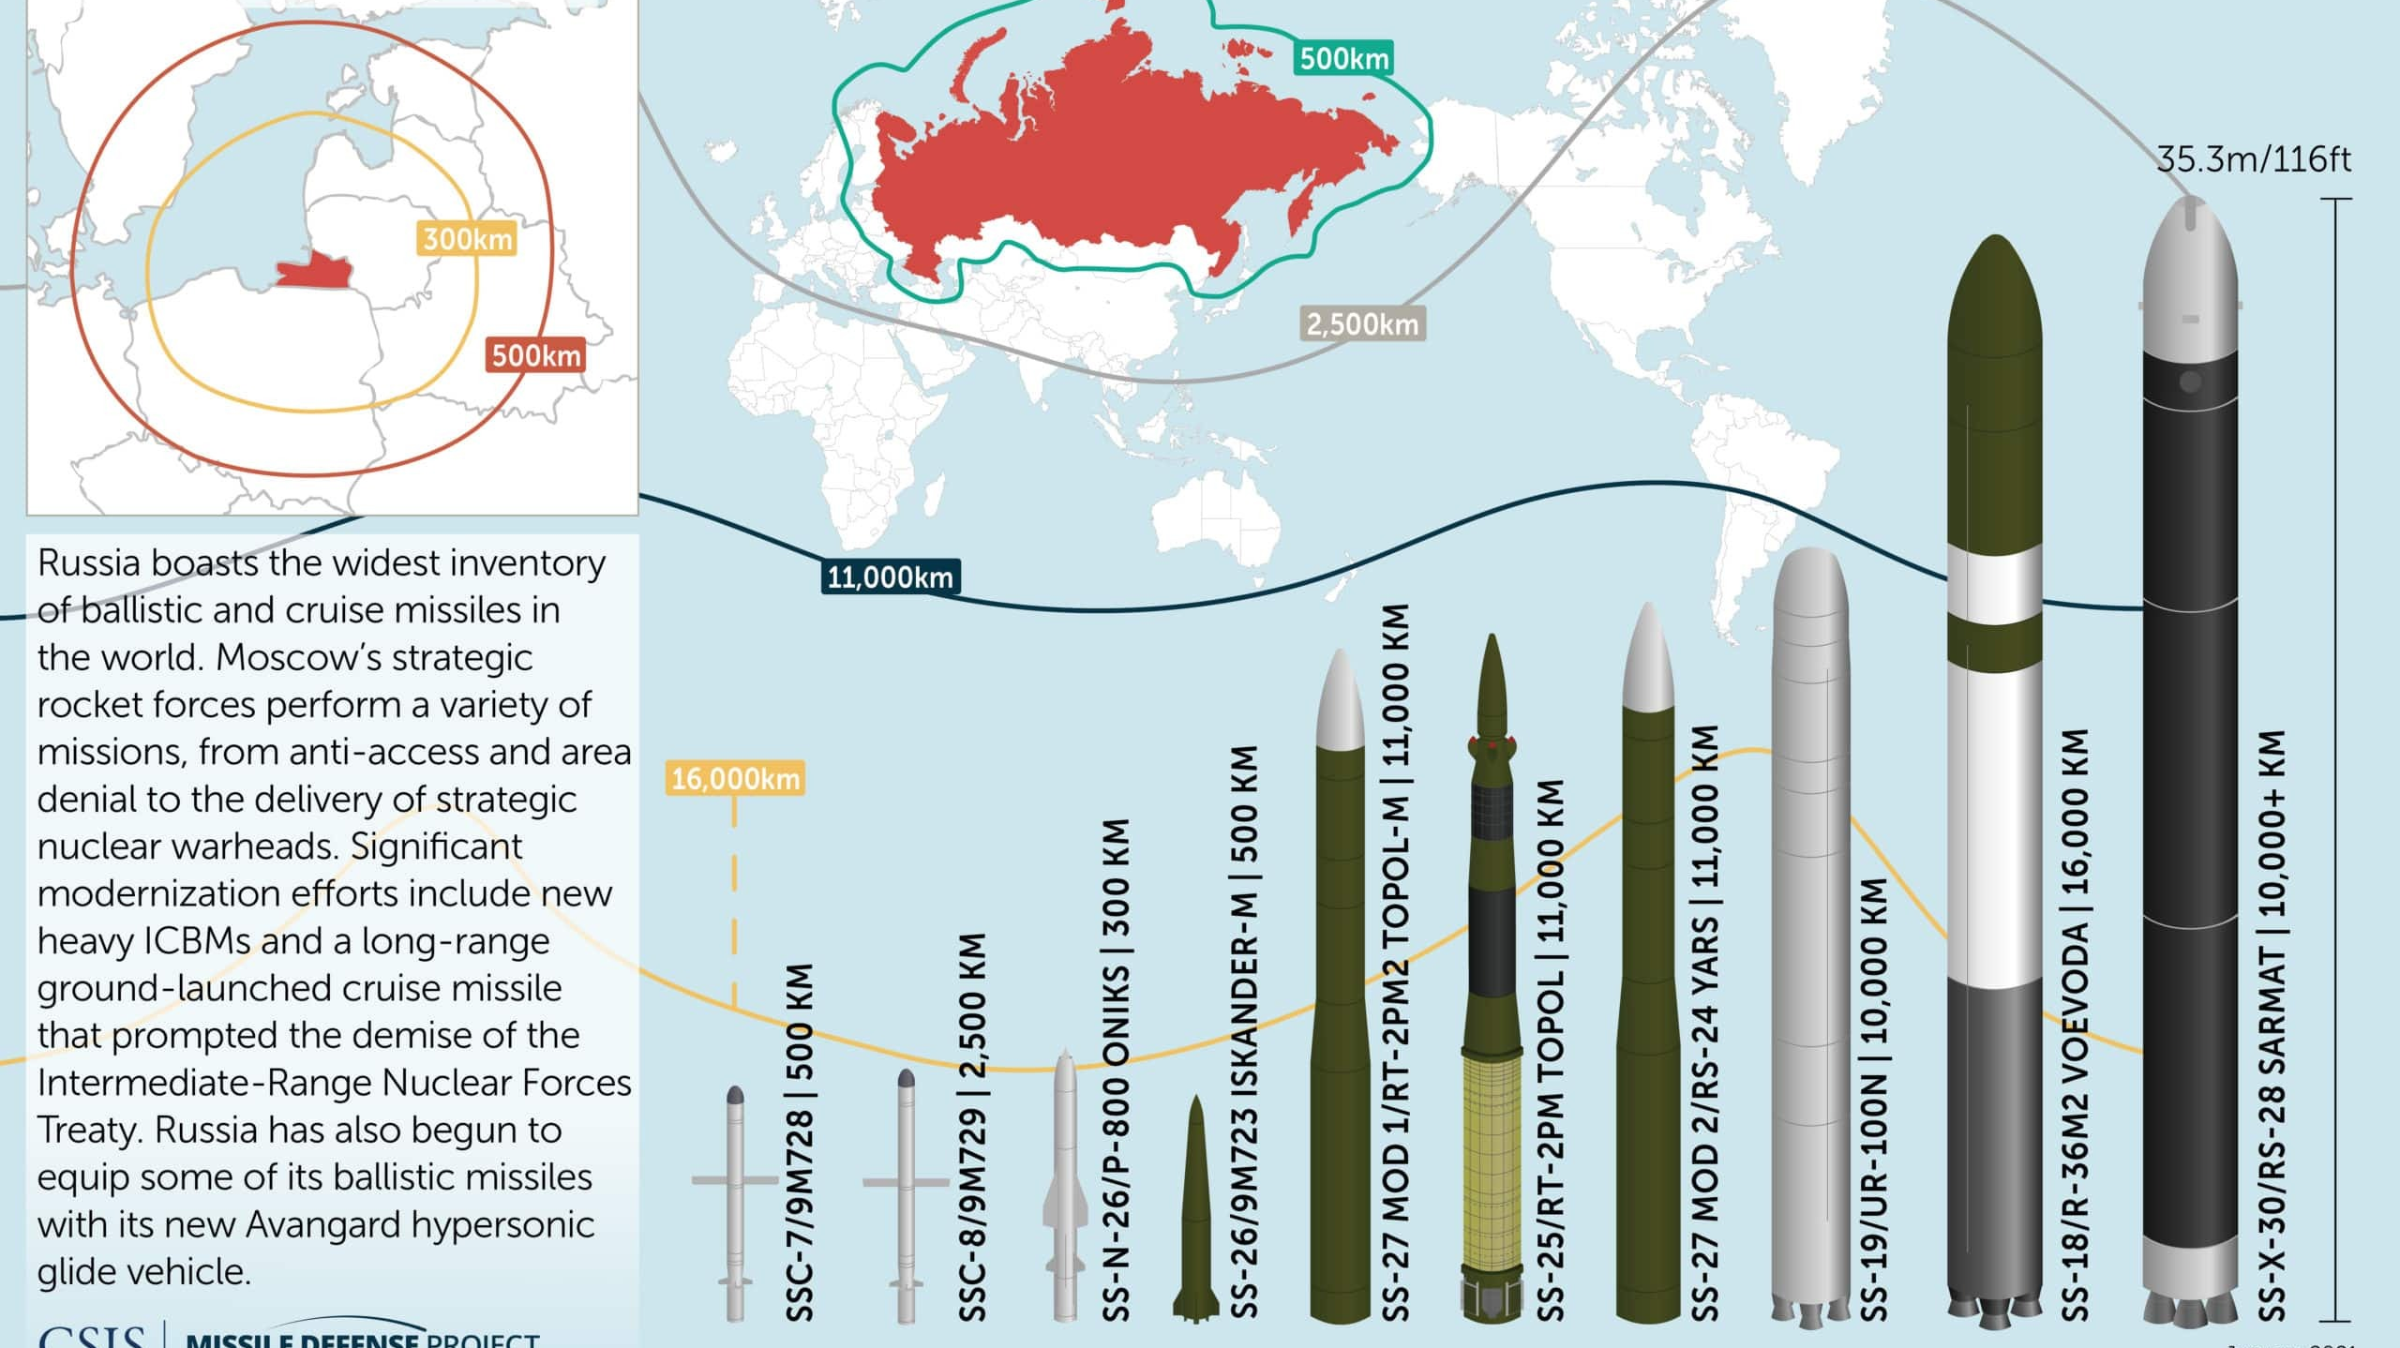
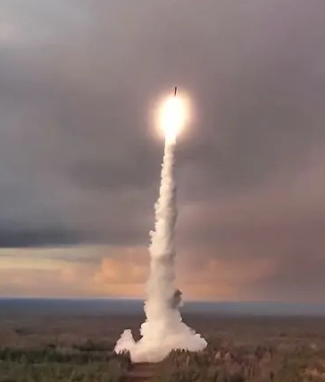
RUSSIA’S MISSILE PROGRAM ²

Slide 16
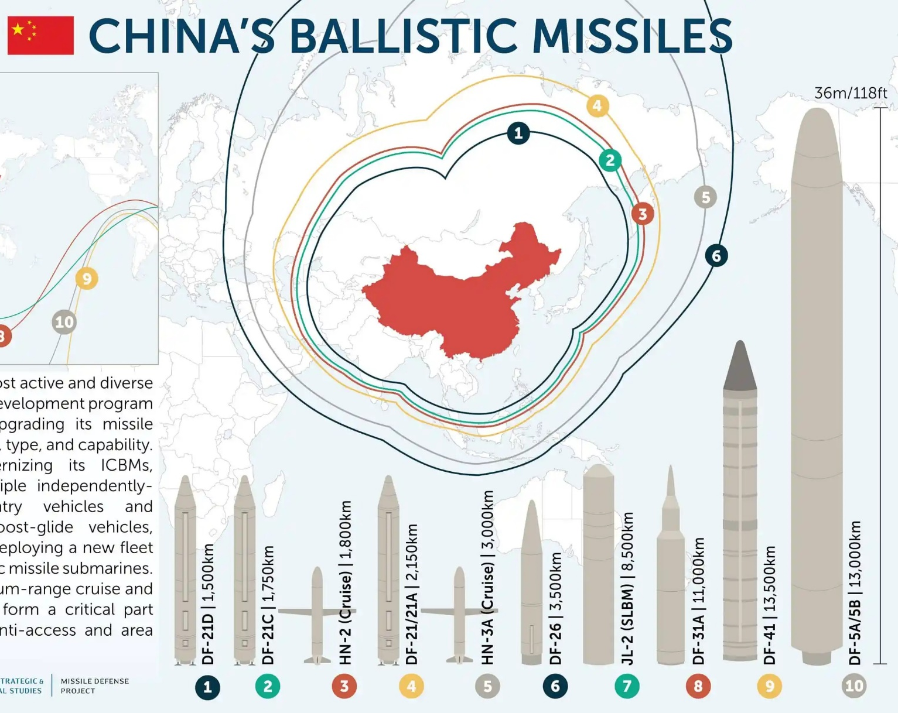
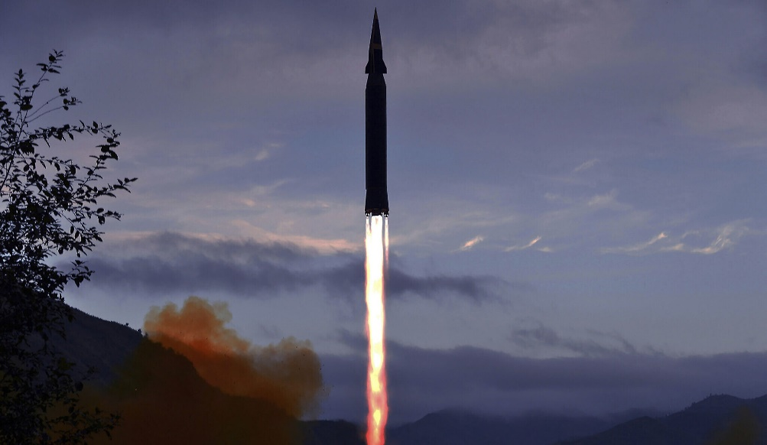
What is the threat?
³

Slide 17
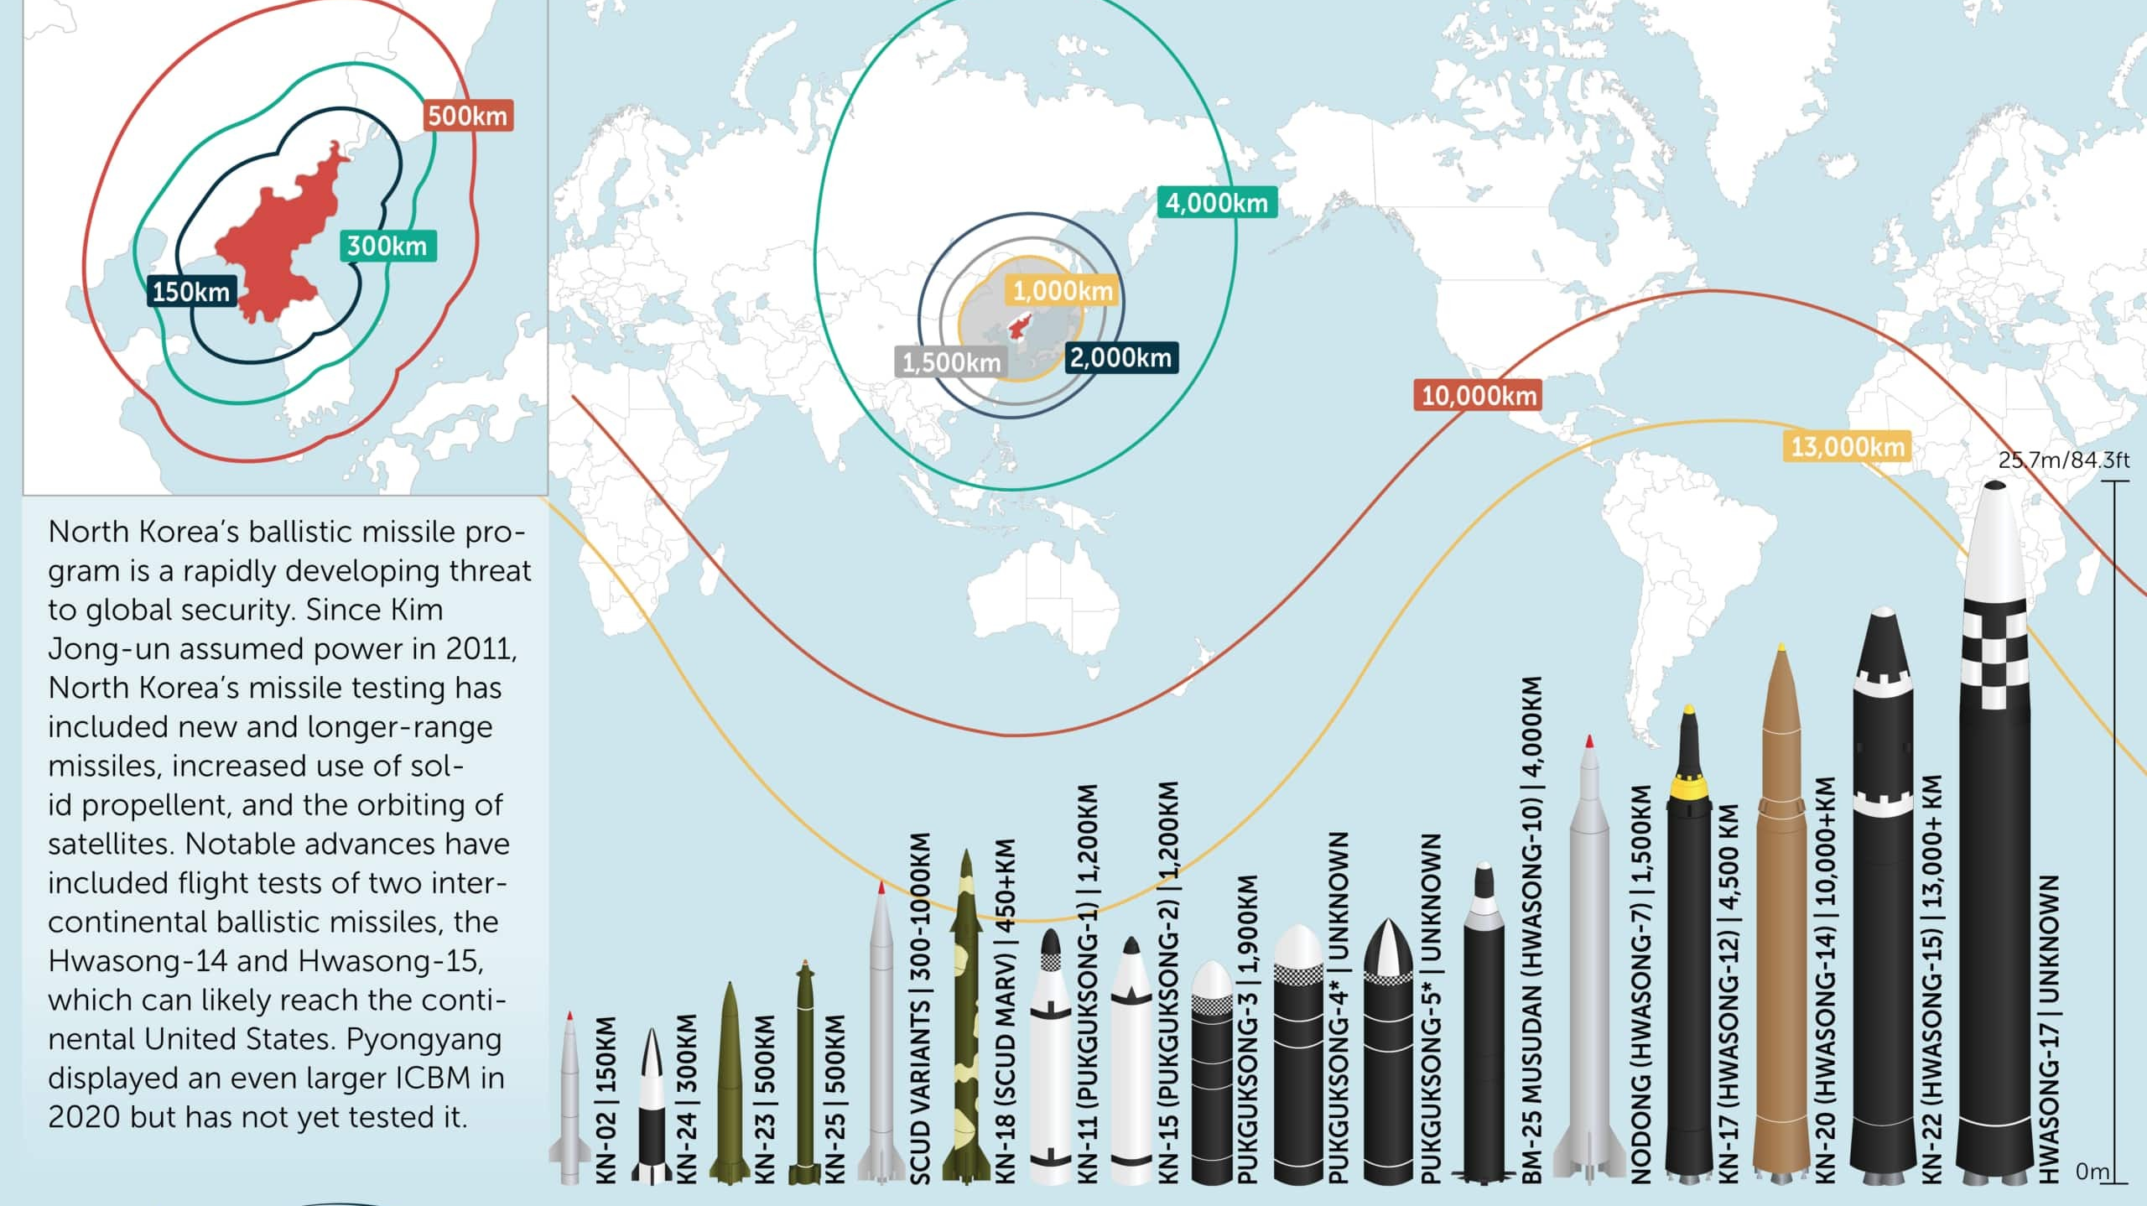
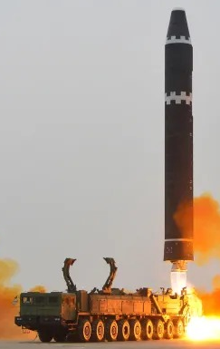
NORTH KOREAN MISSILE PROGRAM ⁴

Slide 18
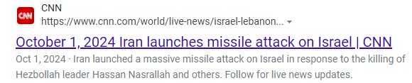
Missiles
Notes:
***************and/or

Slide 19
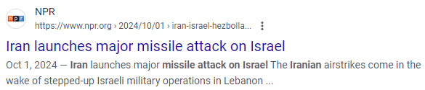
Missiles (cont’d)
Notes:
***************and/or

Slide 20
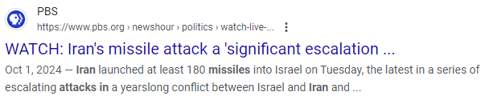
Missiles (cont’d)
Notes:
***************and/or

Slide 21
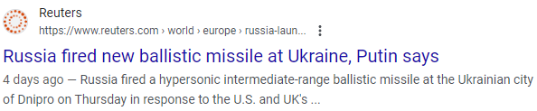
Missiles (cont’d)
Notes:
***************and/or

Slide 22
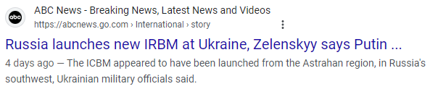
Missiles (cont’d)
Notes:
***************and/or

Slide 23
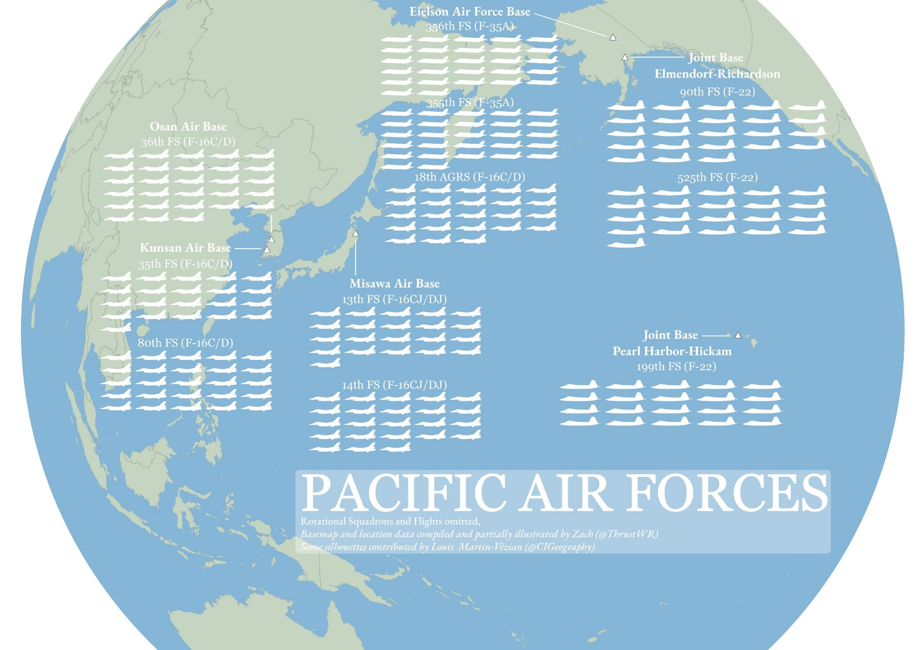
Notes:
All bases outside of JBER

Slide 24

What is the threat?
“In particular, nation-states are targeting critical infrastructure to collect information and gain access to industrial control systems in the energy, nuclear, water, aviation, and critical manufacturing sectors. Additionally, sophisticated nation-state attacks against government and private-sector organizations, critical infrastructure providers, and Internet service providers support espionage, extract intellectual property, maintain persistent access on networks, and potentially lay a foundation for future offensive operations.”
- Department of Homeland Security ⁵

Slide 25
Significant/recent hacking events
Russian state-sponsored hackers breached MS corporate email ⁶
2.7 billion records leaked to include SSN’s, names, addresses, etc.⁷
Chinese linked hackers:
  Target critical US infrastructure
  Breach telecom companies creating 2FA vulnerabilities⁸
CHC
NK IT workers attempting to get jobs in US/other countries ⁸

Slide 26
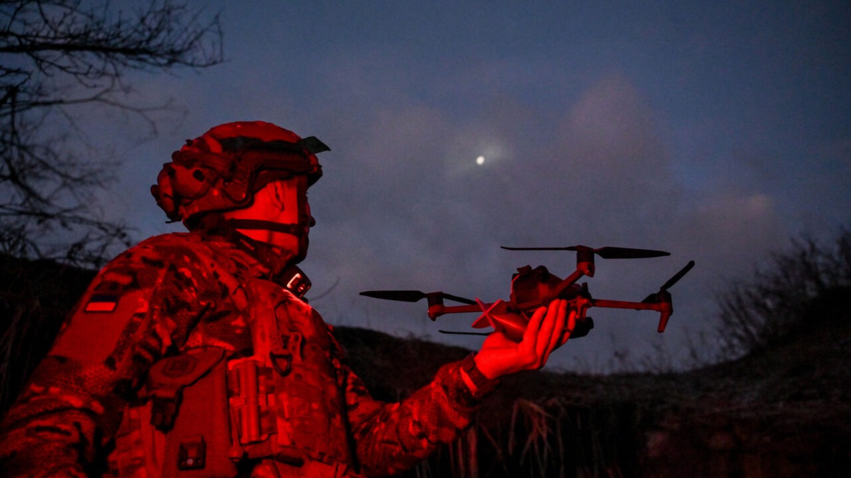
What is the threat?

Slide 27
DRONES!
Ukraine vs Russia ⁹
Cheap
Short to long range ¹⁰
DJI removes geofencing within the US ¹¹
Notes:
5km for FPV

Slide 28
What to do with this information
Ask lots of questions:
  How do you maintain visibility/stay on top of taskings?
  Can you operate with no power/internet?
  Plan for fridge meds?
  How do you order?
  How do you communicate with no cell phones?
  Do you have access to pharmacotherapy information?
  Can you quickly redeploy your ops?
  Can we train appropriately?

Slide 29
What does HAFB do?
Tasking Visibility: DMC access
Addressing power/internet concerns: The COOP Box
Plan for fridge meds: generator backup for red outlets
Ordering: engage with MedLog to tabletop
Comms: Radios
Pharmacy resources: Hardcopy of various pharmacotherapy resources
Moving Ops: Exercise in different locations
Training: Exercise outside of your comfort area & think outside the box

Slide 30
Tasking Visibility
Why is the right ASIMS access important?
How do you get it?
What does it look like?
Notes:
DMC
How often have your pharmacies been last to hear about a deployment?
Our Log dept has been difficult at times when ordering BWCW supplies

Slide 31
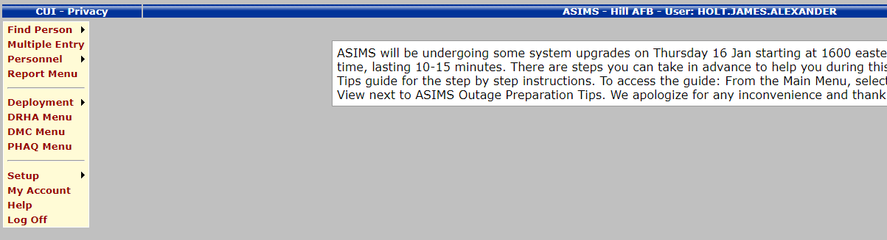
What does the DMC look like?
Step 1: Request access from your ASIMS manager
Step 2

Slide 32
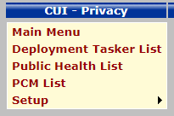
What does the DMC look like?
Step 3

Slide 33
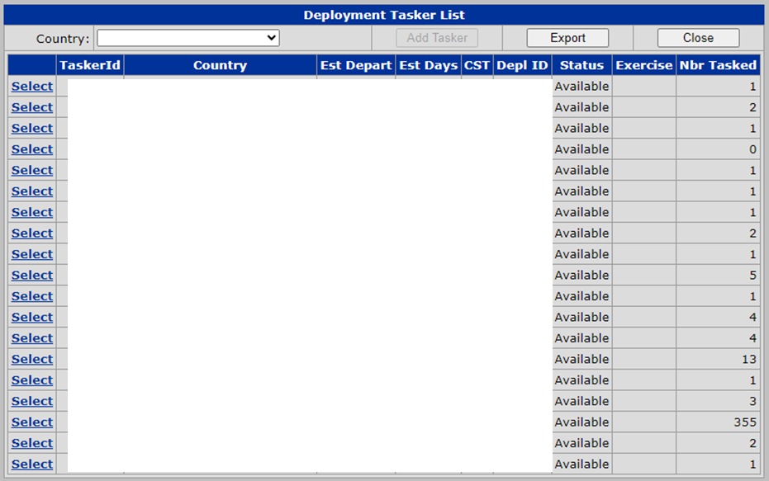
What does the DMC look like?
Step 4

Slide 34
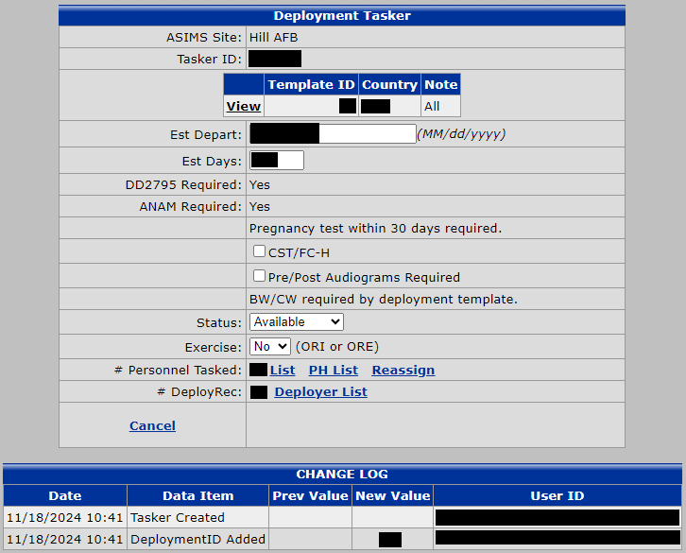
What does the DMC look like?
If BW/CW required:

Slide 35
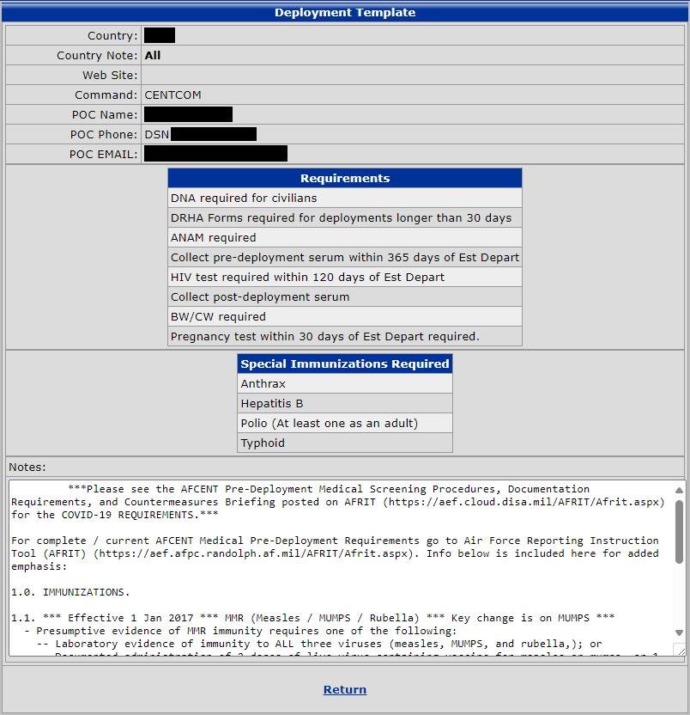
What does the DMC look like?
If BW/CW required:

Slide 36
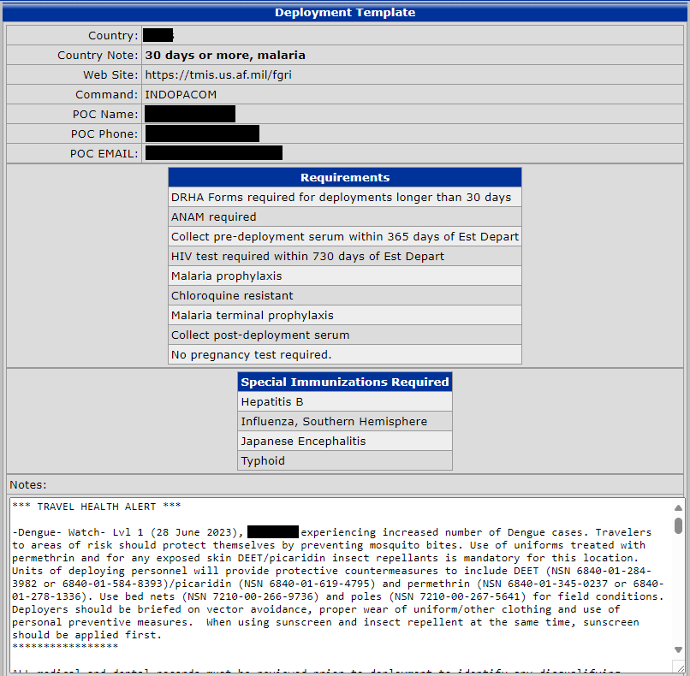
What does the DMC look like?
Non-BW/CW
Pharmacy
requirements

Slide 37
Force Health Protection Prescription Products (FHPPP)
FHPPP include medications, vaccines, and other medical products useful for protecting the health of deployed personnel.
  ATNAA (Antidote Treatment - Nerve Agent, Auto-Injector)
    Atropine and pralidoxime chloride
  CANA (Convulsant Antidote for Nerve Agent)
    Midazolam autoinjectors
  P-Tabs (Pyridostigmine bromide)
  RSDL (Reactive Skin Decontamination Lotion)
  Antimicrobials
  Antimalarials

Slide 38
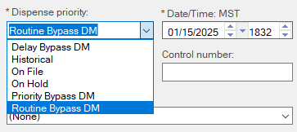
Getting FHPPP out the window quickly:
Put non-controlled meds in MHSG under ‘Historical’ dispense priority
Historical Rx’s will adjudicate for workload credit
Fully activate midazolam

Slide 39
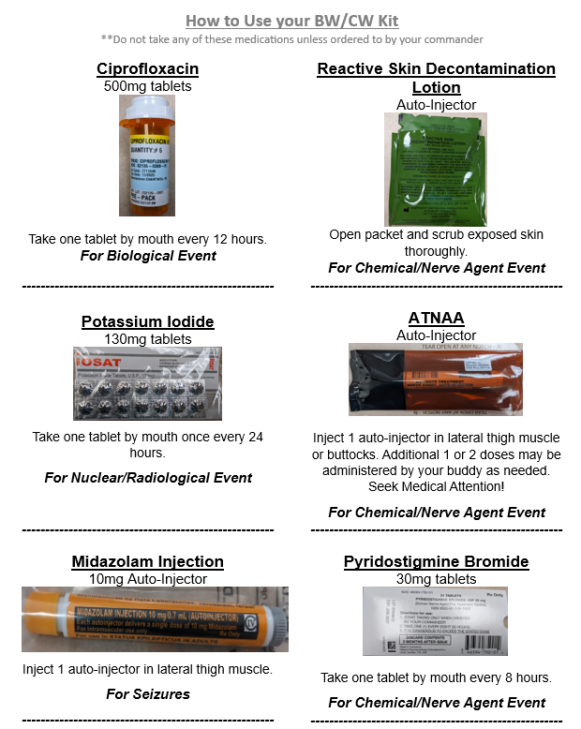
Getting FHPPP out the window quickly:
Place info sheet in bag with contents
Meet with stakeholders regularly
Connect with MedLog to develop PAR/reorder plan

Slide 40
ALL OF THE LIGHTS

Slide 42
Power/systems outages….
HAFB breaks out the COOP Box:
Contingency Binder
Blank AF Form 781’s
Blank AF Form 579’s
Blank Rx labels
Activation sheets
Tamper tape
Pens
Sharpies
Window signage (pick-up/drop-off)
Walkie talkies
Clip boards
Glow sticks
Julian calendar
Blank AF Form 75’s
Flashlight
Batteries
Distilled water
MRE’s
Blankets

Slide 43
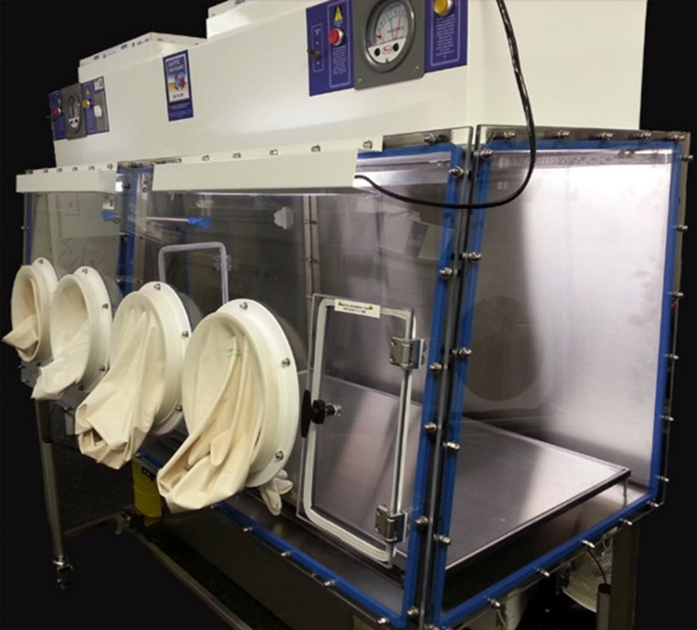
Practice like you play:
Don’t do your annual flu POD in the base theater (or AmBay) every year
How do you practice sterile
compounding?

Slide 44
Knowledge Check #1
How much advance notice would MTFs have in a first strike scenario with China/North Korea/Russia?
  5 minutes
  1 hour
  6 hours
  24 hours
  They may have the first strike, but we will provide the last
Notes:
**********************I don’t know what is most correct but most places I could find write it as Attention-deficit/hyperactivity disorder (ADHD)

Slide 45
Knowledge Check #1
How much advance notice would MTFs have in a first strike scenario with China/North Korea/Russia?
  5 minutes
  1 hour
  6 hours
  24 hours
  They may have the first strike, but we will provide the last
Notes:
**********************I don’t know what is most correct but most places I could find write it as Attention-deficit/hyperactivity disorder (ADHD)

Slide 46
Knowledge Check #2
What system, when granted access, will give you eyes on current/future deployment taskings?
  DMHRSi
  ASIMS
  JKO
  SPDR
Notes:
**********************I don’t know what is most correct but most places I could find write it as Attention-deficit/hyperactivity disorder (ADHD)

Slide 47
Knowledge Check #2
What system, when granted access, will give you eyes on current/future deployment taskings?
  DMHRSi
  ASIMS
  JKO
  SPDR

Slide 48
Knowledge Check #3
What are the components of a BW/CW kit?
  Diazepam, Cipro, Pyridostigmine, iOSAT, ATNAA, RSDL
  P-Tabs, Midazolam, Cipro, Potassium Iodide, ATNAA, RSDL
  Atorvastatin, Sildenafil, Aciphex, baby aspirin, Mounjaro, Adderall
  P-Tabs, iOSAT, Cipro, ATNAA, fentanyl, RSDL

Slide 49
Knowledge Check #3
What are the components of a BW/CW kit?
  Diazepam, Cipro, Pyridostigmine, iOSAT, ATNAA, RSDL
  P-Tabs, Midazolam, Cipro, Potassium Iodide, ATNAA, RSDL
  Atorvastatin, Sildenafil, Aciphex, baby aspirin, Mounjaro, Adderall
  P-Tabs, iOSAT, Cipro, ATNAA, fentanyl, RSDL

Slide 50
References
https://missilethreat.csis.org/country/iran/
Missiles of Russia. (n.d.). Missile Threat. https://missilethreat.csis.org/country/russia/‌
Missiles of China | Missile Threat. (2018). Missile Threat. https://missilethreat.csis.org/country/china/‌
Project, M. D. (2022, November 22). Missiles of North Korea | Missile threat. Missile Threat. https://missilethreat.csis.org/country/dprk
Cybersecurity | Homeland Security. (2024, December 6). U.S. Department of Homeland Security. https://www.dhs.gov/topics/cybersecurity
Abrams, L. (2025, January 3). The biggest cybersecurity and cyberattack stories of 2024. BleepingComputer. https://www.bleepingcomputer.com/news/security/the-biggest-cybersecurity-and-cyberattack-stories-of-2024/
Gatlan, S. (2024, December 10). US sanctions Chinese firm for hacking firewalls in ransomware attacks. BleepingComputer. https://www.bleepingcomputer.com/news/security/us-sanctions-chinese-firm-for-hacking-firewalls-in-ragnarok-ransomware-attacks/
Secure Cyberspace and critical Infrastructure | Homeland Security. (n.d.). U.S. Department of Homeland Security. https://www.dhs.gov/secure-cyberspace-and-critical-infrastructure
Comms, E., & Comms, E. (2025, January 10). Drones in Ukraine: Four lessons for the West. ECFR. https://ecfr.eu/article/drones-in-ukraine-four-lessons-for-the-west/
Molina, M. Z., Hunder, M., Rao, A., & Kiyada, S. (2024, March 26). How drone combat in Ukraine is changing warfare. Reuters. https://www.reuters.com/graphics/UKRAINE-CRISIS/DRONES/dwpkeyjwkpm/
Hollister, S. (2025, January 15). DJI will no longer stop drones from flying over airports, wildfires, and the White House. The Verge. https://www.theverge.com/2025/1/14/24343928/dji-no-more-geofencing-no-fly-zone‌

Slide 51
Questions?

Slide 52
Pharmacy Readiness in the Great Power Competition
James A. Holt, Maj, USAF, BSC
75th Medical Group
Hill Air Force Base, Utah
16 February 2025

