Slide 1
Updates in DHA Pharmacy Informatics
LTC Kenesha Pace, PharmD, BCPS
R. Scott Holuby, PharmD, BCPS
DHA Pharmacy Operations Division, Informatics Integration Branch

Slide 2

Disclosure
Kenesha Pace and R. Scott Holuby: “declare no conflicts of interest, real or apparent, and no financial interests in any company, product, or service mentioned in this program, including grants, employment, gifts, stock holdings, and honoraria.”
The Tennessee Pharmacists Consortium for Education is accredited by the Accreditation Council for Pharmacy Education as a provider of continuing pharmacy education.

Slide 3
Learning Objectives
List three centrally managed pharmacy informatics solutions for DHA
Identify resources and pathways for pharmacy equipment acquisition
Describe the process to relocate or remove equipment from DHA pharmacies
Discuss recent & future changes to MHS GENESIS functionality and the ticket/issue resolution processes

Slide 4
Pre-Assessment Questions
Question 1: Which of the following programs are centrally managed by DHA POD?
  A. ScriptPro, ScriptCenter, NEXiA, Pyxis
  B. Q-Flow, MHS GENESIS, RapidRx (GSL), Parata
  C. Audiocare, RapidRx, Parata, Q-Flow
  D. Electronic Clinical Reference, ScriptPro, CII-Safe, RapidRx (GSL)

Slide 5
Pre-Assessment Questions
Question 2: What is the new web-based platform used to request medical equipment?
  A. DMLSS
  B. MHS GENESIS
  C. LogiCole
  D. Carepoint

Slide 6
Pre-Assessment Questions
Question 3: What is the first step in the process to relocate or remove any pharmacy automation equipment?
A. Coordinate with specific vendor to request a quote
B. Communicate with DHA POD IIB team
C. Contact local medical logistics
D. Communicate with pharmacy chief and DHA Pharmacy Consultant

Slide 7
Pre-Assessment Questions
Question 4: You recently purchased generic lisinopril from Viona Pharmaceuticals. You tried to flex on the NDC using the retail flexing utility, but it is not listed. What is the best and quickest way to have your NDC added into the MHS GENESIS drug file?
  Call the GSC and request a high priority ticket
  Submit a regular case through the Global Service Center website
  Submit a Service Catalog request via the GSC portal to “Add/Modify/Remove Medication NDC”
  Contact the Formulary Management Branch directly and ask them to do it

Slide 8

Program Management and DHA Strategic Plan
Defense Health Agency (DHA) Goal – Stabilize, optimize, and modernize the system
Priorities
Deliver the right mix of products, services, and knowledge
Leverage emerging technology
Transform delivery and lifecycle management of equipment and devices
Enabling Combat Support to the Joint Force in Competition, Crises, or Conflict
Building a Modernized, Integrated and Resilient Healthcare Delivery System
Dedicated and Inspired Teams of Professionals Driving Military Health’s Next Evolution
Defense Health Agency Strategic Plan Fiscal Year 23-28. Falls Church, VA; 2023
Taking Care of People Initiative 2023. Falls Church, VA: Defense Health Agency; 2023
Notes:
Improve the delivery and management of new products, services, and knowledge to enable better
readiness and care for Service members and beneficiaries, through an integrated support enterprise.
Through seamless integration across the lifecycle, responsive to user needs, and deliver the right solution at the speed of relevance.
Without decrementing effectiveness, create efficiencies through tailored support to ensure the appropriate balance of enterprise approaches that eliminate
unwanted variation and regional/local approaches when warranted.
Initiative Driver- A specific action or focus area within an initiative supported by a set of projects that collectively drives progress towards success.
Taking Care of People Under SECDEF Initiative
Make Access to health care easier and more convenient for patients
PHARMACY Focus - Pharmacy automation to make it easier to access prescription medications and shorten wait times.
DHA will implement pharmacy automation processes (Rx Lockers; cellphone/texting services; and other innovations) that will reduce wait times at MTF pharmacies and simplify processes for refills and pickups at MTFs. Requires some acquisition of equipment.
A digital front door is a strategy health care institutions are employing to use technology to improve patient experiences and
Defined as “all the touchpoints where providers can digitally interact with patients to drive better access, engagement and experiences across the service continuum,”
- Improve Acquisition of Services to Support Local, Regional, and Enterprise Approaches
- Deliver the Right Mix of Products, Services, and Knowledge.
Transform Delivery and Lifecycle Management of Equipment and Devices
Leverage Emerging Technology
Leverage Innovative Business Intelligence and Analytics Tools to Optimize Allocation and Execution of Enterprise Resources
Patient Centered Workflow Review and Redesign (i.e. Related to New Clinical Technology, Implementing AI/ML Related to Diagnostics and Ordering)
The DHA Strategic Portfolio is comprised of the strategic functions, initiatives, drivers, key performance indicators (KPIs), and projects that demonstrate the agency’s approach to stabilize and modernize the system in order to achieve its five-year end states. for pharmacy automation

Slide 9
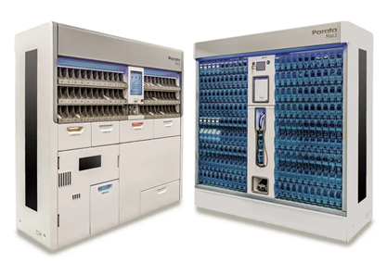
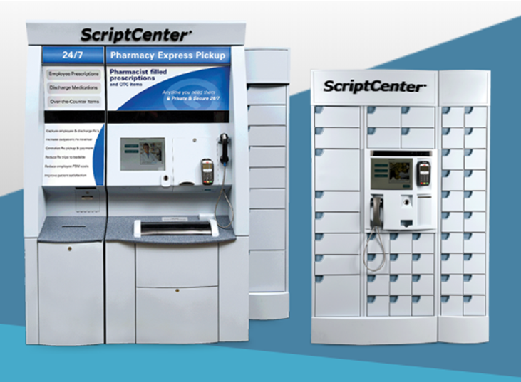
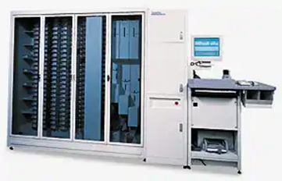
Centrally Managed Pharmacy Operations Division (POD) Automation Programs**
Pharmacy Outpatient Automation Solution (POAS)
  ScriptPro
  Parata
  Innovations (iA)/NEXiA
Pharmacy Inpatient Automation Solution Enterprise (PIAS-E)
  Pyxis
RxRefill *
  AudioCare >> IVR
Pharmacy Will Call System (PWCS)
  Intellicab (aka GSL / RapidRx)
  Innovations (iA)
  ScriptCenter
  PickPoint
** Does not constitute government endorsement
Notes:
The Program Management team is responsible for the general management and oversight of all pharmacy equipment programs
Work with service representatives to meet pharmacy equipment requirements
What does centralized contracting mean?
DHA Program Management means we own procurement, lifecycle management / upgrades, and maintenance contracts
IVR Changes / Impact / Timeline

Slide 10

POD By the Numbers**
469 DHA Automated Pharmacy Locations
Note: All pharmacy locations can contain a percentage of each type of automation equipment, resulting in a total percentage greater than 100.
For example: One pharmacy site can have Parata Max or Mini, ScriptPro 200 Robot with NEXiA Workflow Software, GSL Will-Call inside the pharmacy, and ScriptCenter located in the PX/BX.
Parata | RapidRx (GSL) | NEXiA | ScriptCenter | ScriptPro | PickPoint
27% | 31% | 51% | 17% | 23% | 1.2%
** Does not constitute government endorsement
Notes:
ScriptCenter 2023 New Units: Beaufort, Ft. Bliss, Jacksonville, Ft. Eisenhower, Langley, Schriever, Ft. Gregg Adams, Wright Patterson, Walter Reed, Sheppard AFB, Ft. Sill, Lemoore, Tripler
ScriptCenter 2023 Expansions: Keesler aFB, Schriever, Hill, Ft. Carson, Bremerton, Luke, Camp Pendelton, Ft. Riley
PickPoint Will Call System is only installed in Air Force pharmacies:
- Buckley AFB
- Barksdale AFB
- Kirtland AFB
- Shaw AFB
- RAF Lakenheath
- Ramstein AB

Slide 11
Centralized Portfolios (non-POD)**
Collaborative Programs, not managed by POD
  Patient Queueing Notification System (PQNS)
    Q-Flow, Q-Anywhere / Q-Anywhere Web
    POCs: Mr. McDonald or LCDR Tanesia Maul
  DoD Healthcare Management System Modernization (DHMSM)
    Military Health System (MHS GENESIS)
  Electronic Clinical Reference (ECR)
    Medical Library: Up to Date® Lexidrug™, Pharmacist’s Letter (includes Hospital Pharmacist’s Letter, Hospital Pharmacy Technician’s Letter and Pharmacy Technician’s Letter)
** Does not constitute government endorsement
Notes:
Discuss:
Cost-saving initiative to transition Q-Anywhere to web platform (current 40 sites out of 112)

Slide 12
Equipment Acquisition - Requirements
Priority 1: No loss of existing capabilities
  End of Life (EOL) notifications
Priority 2: Improve patient safety
Priority 3: Improve operational efficiency
Priority 4: Improve patient satisfaction
Priority 5: Enterprise infrastructure enhancements
  Server consolidations
Priority 6: Cost-savings opportunities

Slide 13


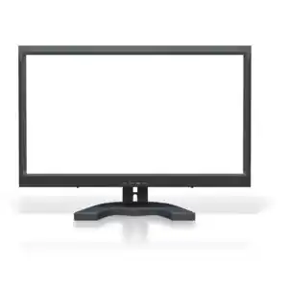



Fiscal Year Equipment Request Process
Rework
Rework
Site Coordinator
Portfolio Coordinator
Portfolio SME
Portfolio Coordinator
Higher Review
Deadline is April 15 for following fiscal year funding consideration through LogiCole Process
Request Requires Portfolio Review, Send to Higher via LogiCole
Portfolio Coordinator assigns Subject Matter Expert (SME)
SME Reviews, Provides Recommendation
Prioritized by Portfolios into FY
1-N List
DHA
Equipment Review Board (DHAERB)
Approved Prioritization List
Site Coordinator
Portfolio Coordinator
Site Process
ACCEPTED BY DMLLSS
Site Coordinator processes order in DMLSS and awaits delivery
Funding received; Central Execution/ Contracting Coordination
Waiting for Funding
Notes:
1: Site submits request through LogiCole
Deadline is April 15 for upcoming fiscal year consideration
2: POD (Pharmacy Ops Division) reaches out to MTF for additional clarification if needed
3: POD “Rack and Stack”
Criteria reviewed: marketing plan, current usage, prescription volume, local workflow changes
4: MEDLOG, Integrated Clinical Systems (ICS), Medical Simulation and Training (MST), and POD “Rack and Stack” at DHAERB (DHA Equipment Review Board)
“1-N” list created
In queue for next FY
5: POD centrally executes pharmacy equipment purchase
POD initiates project execution with site and vendor once funding is received

Slide 14
Pharmacy Equipment Acquisition - Process
Site submits request through LogiCole
POD “Rack and Stack”
DHAERB (DHA Equipment Review Board)
“1-N” list created
Projects Funded
POD centrally executes contract purchase
Project Executed with site and vendor
POD Sustainment & Maintenance
Deadline is April 15 for following fiscal year funding consideration through LogiCole Process
Notes:
1: Site submits request through LogiCole
Deadline is April 15 for upcoming fiscal year consideration
2: POD (Pharmacy Ops Division) reaches out to MTF for additional clarification if needed
3: POD “Rack and Stack”
Criteria reviewed: marketing plan, current usage, prescription volume, local workflow changes
4: MEDLOG, Integrated Clinical Systems (ICS), Medical Simulation and Training (MST), and POD “Rack and Stack” at DHAERB (DHA Equipment Review Board)
“1-N” list created
In queue for next FY
5: POD centrally executes pharmacy equipment purchase
POD initiates project execution with site and vendor once funding is received

Slide 15
LogiCole - Request Process Flow
Site
Approve
Requestor Submits NER
Coordinator Assigns Reviewers
Reviewers Recommendations
Conduct Equipment Review Board
Coordinator Prioritizes Request
Higher Review?
No
Yes
Send to Higher
Network
Send to Service for Review
Skip SME Reviews
DHA HTM Network Level Review of Request
DHA Service
HTM, POD, DMMSO Portfolio
Coordinator Identifies Portfolio
Service Level?
Yes
Coordinator Assigns SME and Portfolio Manager
SME and Portfolio Manager Recommendation
Agency Coordinator
Approve
No
Agency/DoD
ICS PMO Portfolio
ICS Coordinator Assigns SME
ICS SME Recommendation
ICS Coordinator
Approve
LogiCole Workflow. Database. https://logicole.health.mil/login/loginForm. Accessed October 1, 2023
Notes:
LogiCole
Web based system
New version of DMLSS platform that encompasses all legacy MEDLOG applications
All new equipment requests should go through LogiCole
Pharmacy has access and submits requirement.
DHA is the “Service” level
We see it get hung up at the site level because facilties, IT, logistics are still pending review.
POD (DHA Service Level) unable to approve until site completes total review.

Slide 16
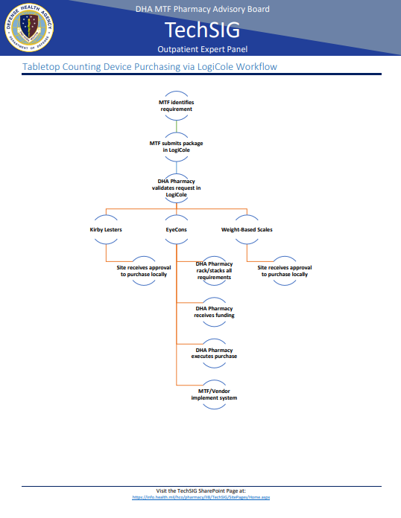
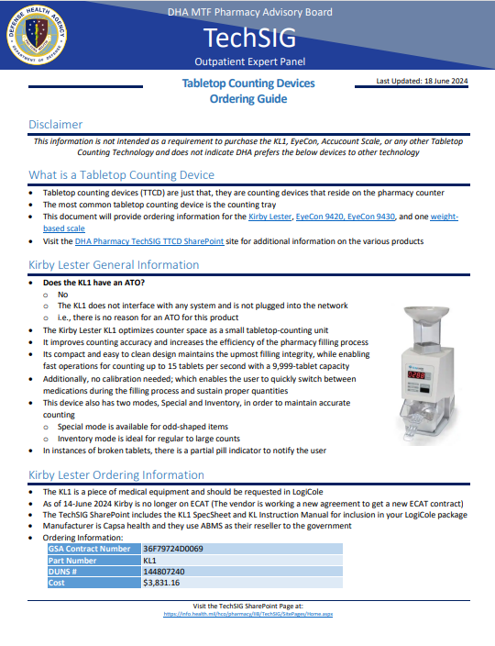
Ordering Guides**
Fillmaster (June 2024)
Asteres ScriptCenter (Jul 2024)
Tabletop Counters (June 2024)
  Kirby Lester
  EyeCon
  Weight Scale
iA Supply Ordering Guide (Dec 2019)
Parata Vial Filling Solutions (April 2024)
** Does not constitute government endorsement
https://info.health.mil/hco/pharmacy/IIB/TechSIG
Notes:
Counting Devices: Pharmacies earn one device for every 150 Rxs filled per day (37.5K/year) with a maximum of three devices per filling line.
Example: a pharmacy that has two filling lines: one for POEs that fills ~600/day and one for off-base Rxs that fills ~300/day would earn a total of 5 units (3 for POEs and 2 for off-base)

Slide 17
Equipment Turn-In
Always contact DHA POD IIB before removing or relocating any pharmacy automation equipment
  Email DHA POD IIB Team (First and Always)
  Includes Pyxis Medstation and ScriptPro Datapoints/workstations
Removing or relocating equipment without appropriate coordination can:
  Void the warranty
  Create financial obligation (server offline; re-connection fee)
  Potentially require a new IP address and network connection
  Inability to efficiently manage the equipment list
Defense Health Agency Strategic Plan Fiscal Year 23-28. Falls Church, VA; 2023
Taking Care of People Initiative 2023. Falls Church, VA: Defense Health Agency; 2023
Notes:
It is important for IIB to maintain an accurate equipment list.
Contact DHA POD IIB team first and always prior to relocating(temporarily) or removing any equipment.
This is usually not a concern for big robots, however the smaller pieces of equipment such as workstations, medstations, have a tendency to move around
If equipment is relocated or moved improperly and damage is done; the cost to repair the damage is not covered under the contract.

Slide 18
Current Projects
Taking Care of People Initiative DHA Strategic Plan
  Standardize, optimized, modernized
  Enterprise architecture / Interoperability between capabilities
Nexia Workflow Standardization**
IV Workflow Management Software
** Does not constitute government endorsement
Defense Health Agency Strategic Plan Fiscal Year 23-28. Falls Church, VA; 2023
Taking Care of People Initiative 2023. Falls Church, VA: Defense Health Agency; 2023
Notes:
IV Workflow Software
Takes digital pictures of IV preparations in the hood
Allows for remote verification either locally or off-site
Funding is likely available, Plan for FY24 Acquisition
Sites that have a hood would qualify initially:
AMC BAMC-FSH AMC Darnall-Hood AMC Eisenhower-Gordon AMC Madigan-Lewis AMC Tripler-Shafter AMC William Beaumont-Bliss AMC Womack-Bragg Eglin AFB Ft Belvoir Community Hosp Keesler AFB Landstuhl Regional Med Center Langley AFB Nellis AFB NMC Camp Lejeune NMC Portsmouth NMC San Diego Travis AFB Walter Reed Natl Mil Med Center Wright Patterson AFB
Nexia Standardization/Interfacing with other-than-iA automation (SP, Parata)
2018 – JBER piloted; proof-of-concept w/ SP
2019 – Ft Wainwright – first Army site w/SP
2020-2023 – continued expansion
Parata announced sunsetting of software
No longer extensively developing/updating its software
PAWS-E (Pharmacy Automation Workflow Software-Enterprise) POD decided to stand up a program to move to a standardized workflow software for the enterprise

Slide 19
Future Initiatives
Strengthening Outpatient Remote Verification capabilities
Growing central execution of Pharmacy Requirements
Notes:
Central FTE Contract Package
Continue to grow the central execution of pharmacy requirements
Ideally, we would stick to network-interfacing equipment/software
Non-network equipment still being considered

Slide 20
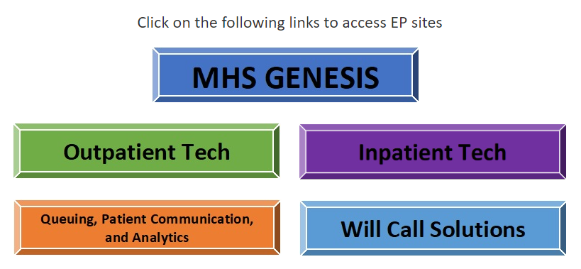
Resources
POD Teams Channel: POD_PharmacyOperationsDivision(Public) | General | Microsoft Teams
TechSIG SharePoint: https://info.health.mil/hco/pharmacy/IIB/TechSIG/SitePages/Home.aspx

Slide 21
MHS GENESIS Update
R. Scott Holuby, PharmD, BCPS

Slide 22
Federal EHR Statistics
138 parent Military Treatment Facilities (3,628 DoD locations)
  FHCC (Great Lakes) – last DoD facility went live in March 2024; all DoD locations currently live
6 VA Medical Centers (25 associated clinics and 104 remove services)
109 US Coast Guard Sites
7 NOAA sites
207,000+ Federal EHR Users (clinicians, nurses, pharmacists, etc.)
9.6M+ unique patients currently in the Federal EHR

Slide 23
Recent Accomplishments
IVR/Patient Portal refills
  Prescription pickup reminds, refill too soon capability and improved reporting
Floorstock inventory location flexing
  Facilitates auto-verification
Duplicate medication checking enabled in PowerChart ordering
  Still suppressing duplicates in PowerPlans
Heparin PowerPlans optimized/standardized
Hepatic Dysfunction Alerts

Slide 24
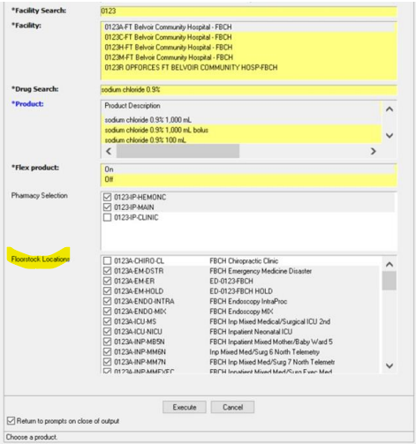
Floorstock Inventory Location Flexing
Notes:
Selecting the corresponding Nursing Unit or Floorstock Location where the product is stocked and utilized will allow AutoProduct Assignment (APA)/AutoVerification (AV) to occur without requiring pharmacy verification. As a default configuration, floorstock locations should be selected if the medication is ever expected to be stocked in the location and used by clinic staff without pharmacist verification first.

Slide 25
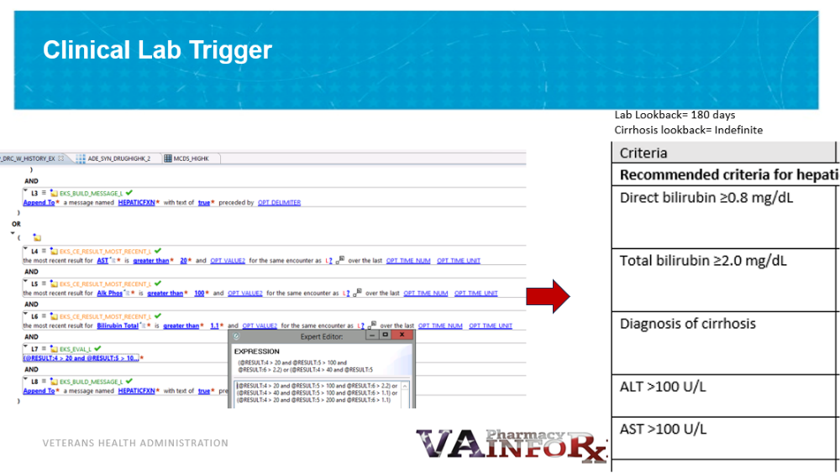
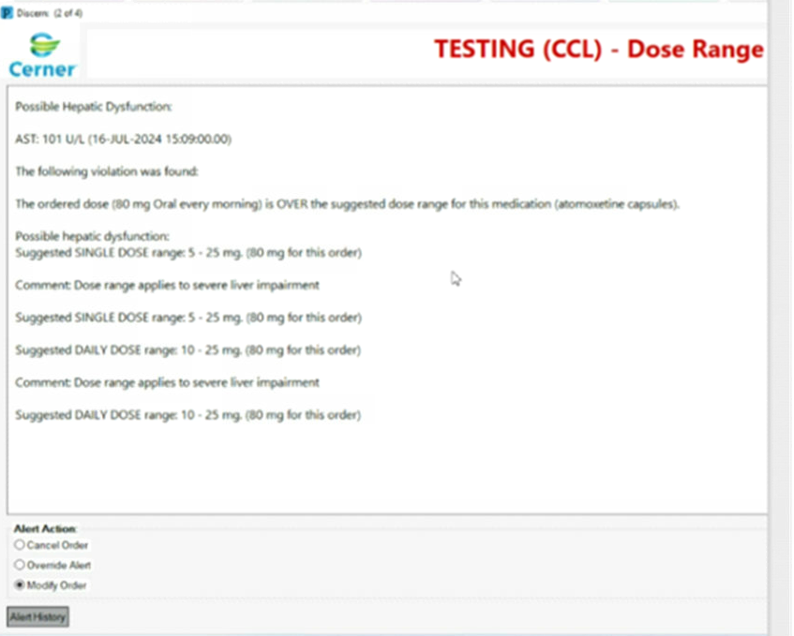
Hepatic Dysfunction Alert DRC Enhancement
DRC content has native hepatic protocols built into it that helps identify the appropriate dosing for patients with diagnosed hepatic dysfunction. A new alert was created to help to further refine those protocols using updated criteria but also to provide lab values within the alert to help ordering providers further determine the level of hepatic dosing modifications that may or may not be required.

Slide 26
Current Projects
PowerForms update for adult/ped/NICU parenteral nutrition (TPN/PPN)
Biosimilar optimization
IVIG/SC updates
Ongoing PowerPlan updates
Align continuous IV drips to Joint Commission requirements
  Titration parameters, order sentences, etc.

Slide 27
Future Enhancements/Projects
Update DKA PowerPlans
Align PCA orders with ASHP Standard Concentrations
Supply Chain mobile
3b functionality (Feb 2025)
  PRN indication; quantity per dose visible in MMR and writes back to PowerChart

Slide 28
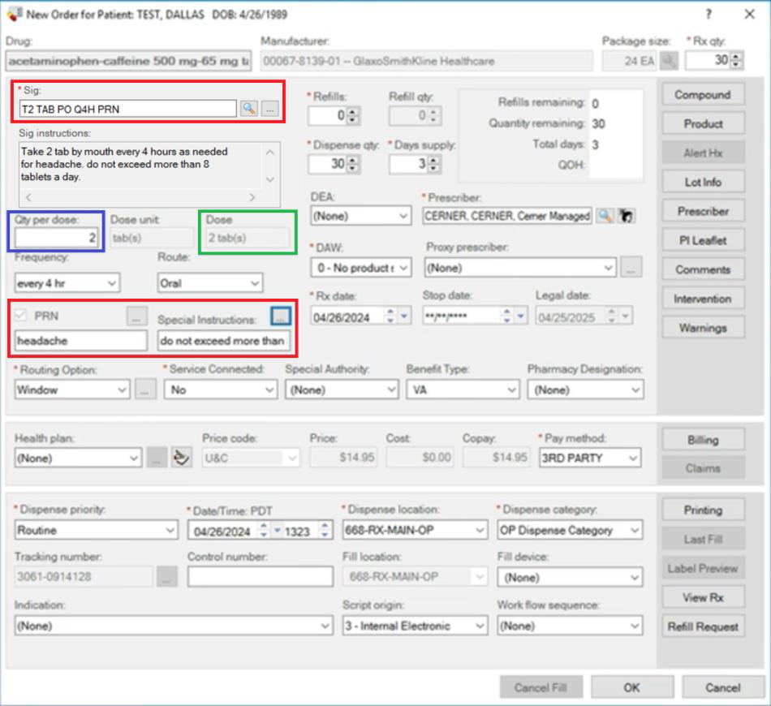
3b Functionality in MMR

Slide 29
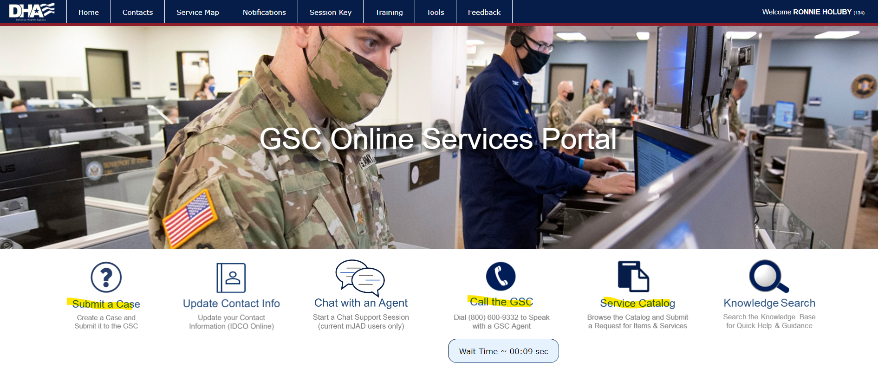
Troubleshooting & Ticket Submission
For DHA users, there are multiple ways to submit trouble ticket for MHS GENESIS issue
  Phone: work stoppage, high priority tickets
  Global Service Center (https://gsc.health.mil/portal/): all other issues
    Service Catalog Request: Add/Modify/Remove Drug File Entry in MHS GENESIS (bypasses triage) https://mhsservicehelpdesk.servicenowservices.health.mil/csm?id=sc_cat_item&sys_id=c0be157fdb280590ca67340a3296195c&sysparm_category=2a875d0d1b81e4909eeced3be54bcbbf&catalog_id=-1
    Submit case: low priority issues only (goes through triage)

Slide 30
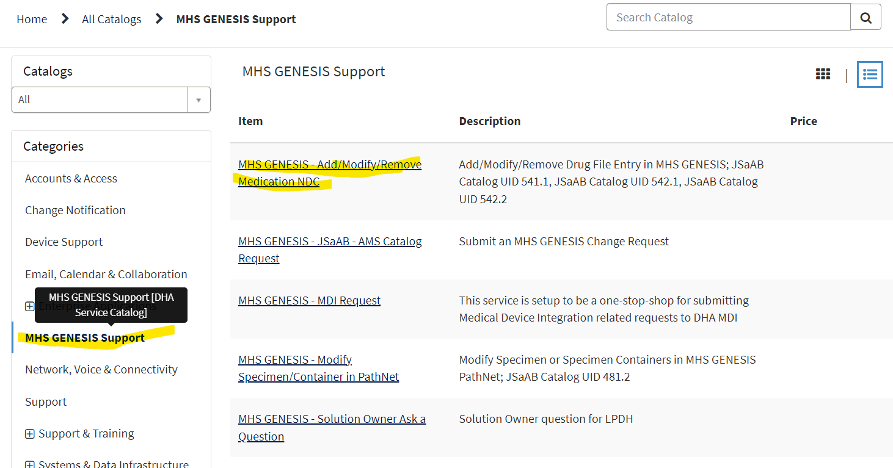
Service Catalog Ticket Submission

Slide 31
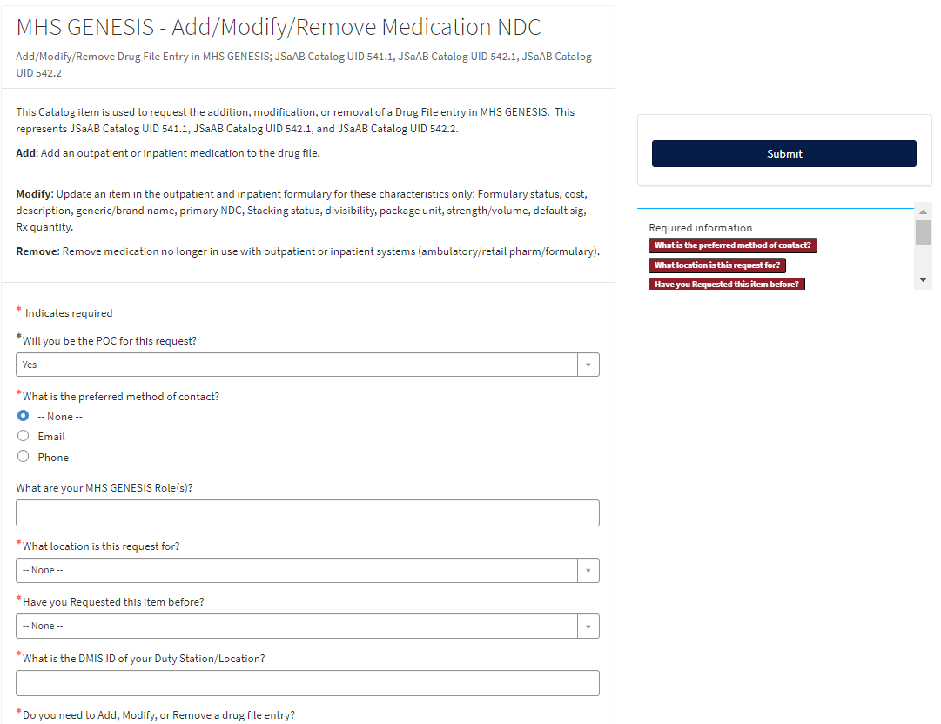
Service Catalog Ticket Submission

Slide 32
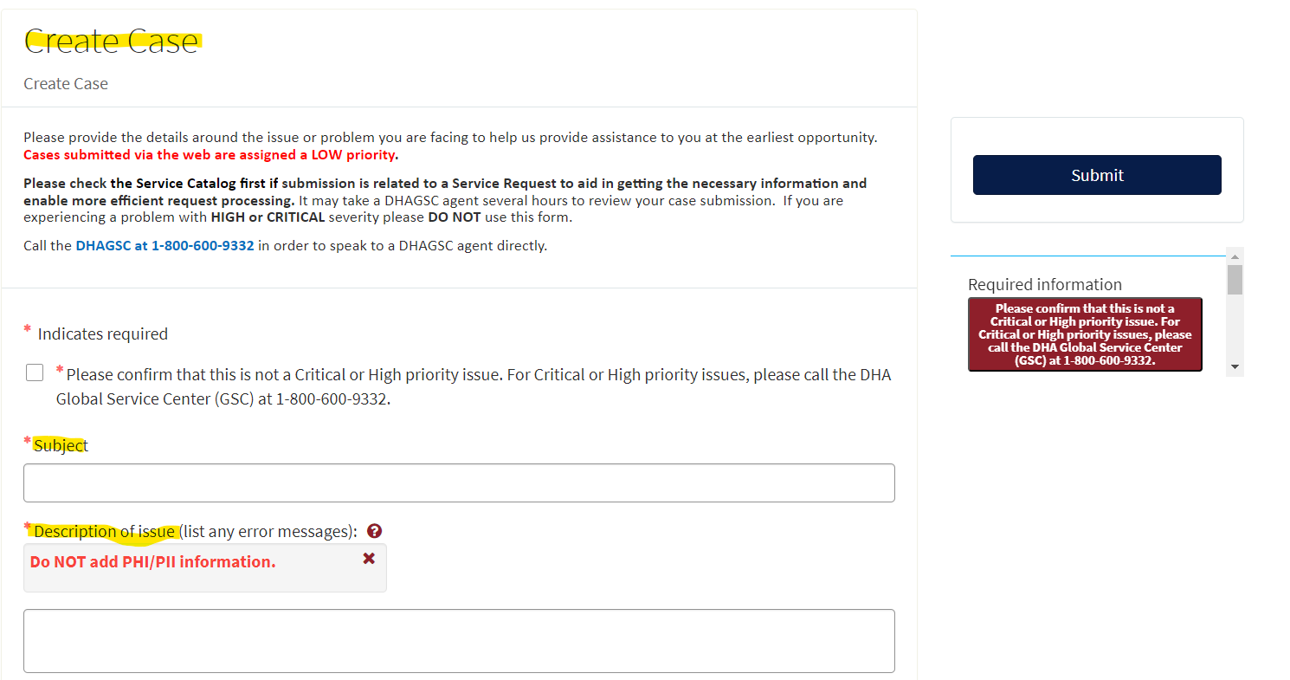
Case Ticket Submission

Slide 33
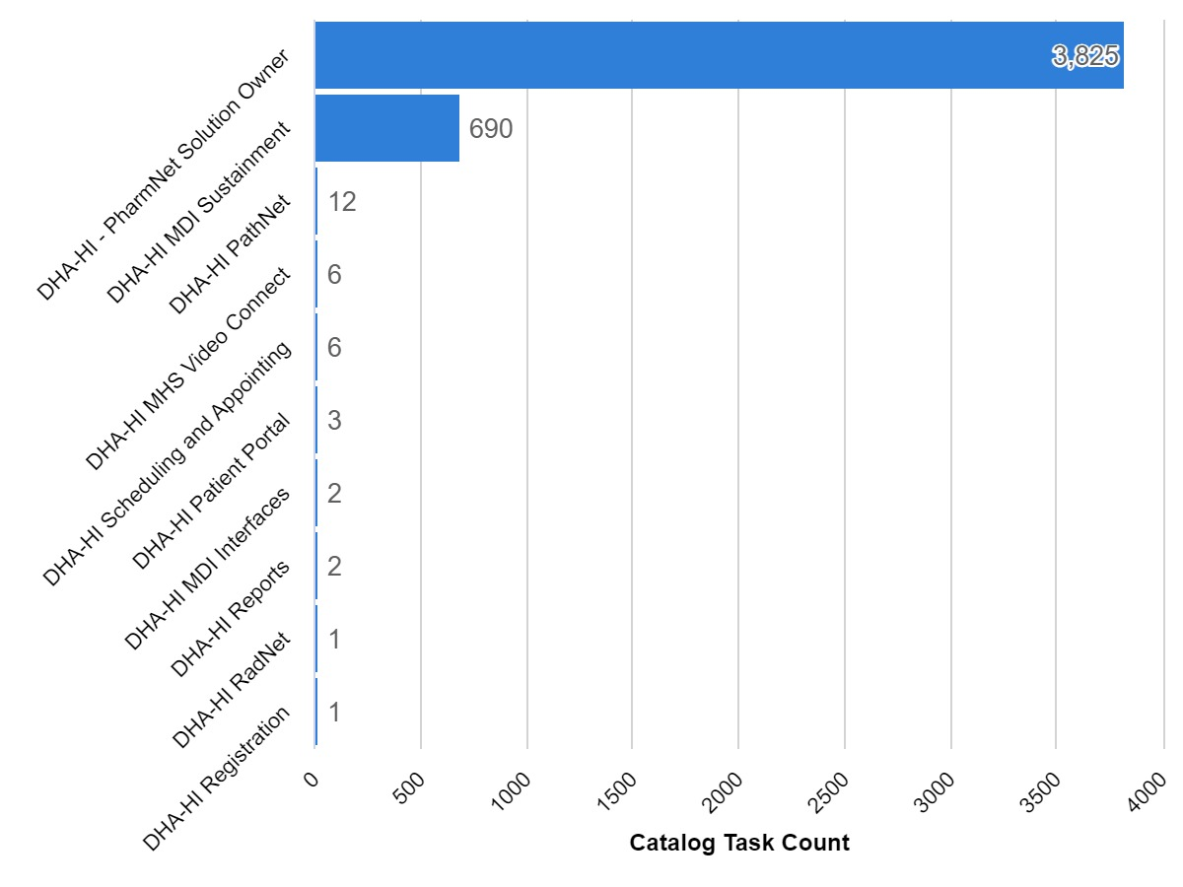
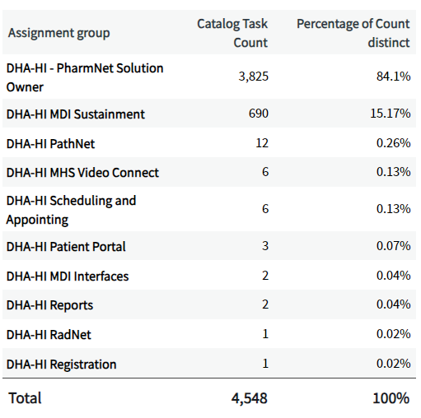
Task Ticket Statistics
*As of 30 September 2024

Slide 34
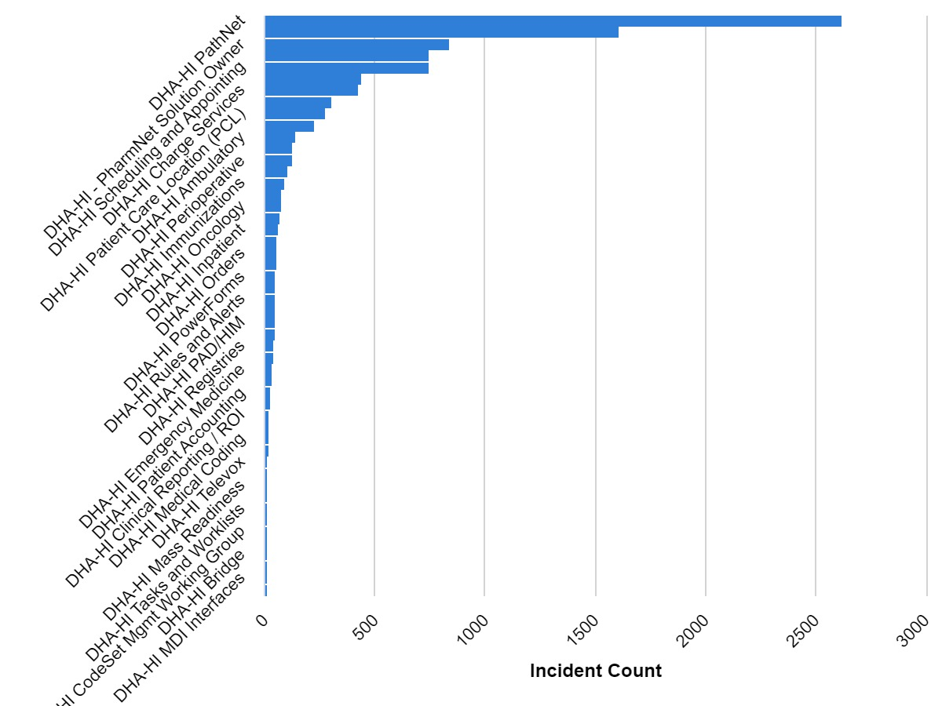
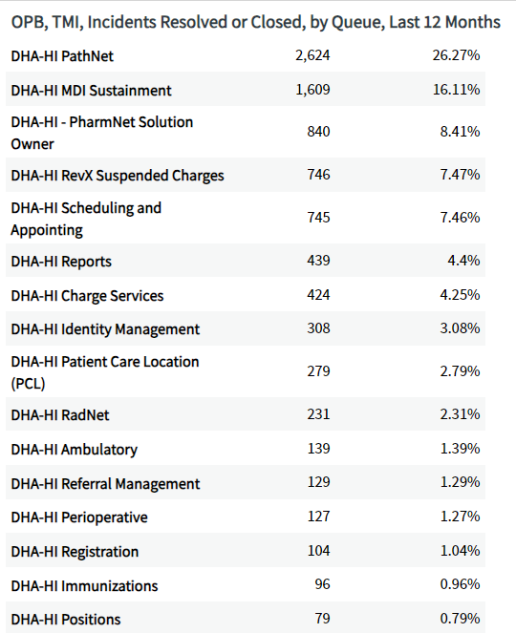
Incident Ticket Statistics
*As of 30 September 2024

Slide 35
MHS GENESIS Troubleshooting
Pharmacy tipsheet page
  https://info.health.mil/hco/pharmacy/IIB/TechSIG/Pages/MHSGenesisEP.aspx
DoD MilSuite page
  https://www.milsuite.mil/book/community/spaces/mhs-genesis-mtf
POD TEAMs Channels
  General
  Drug File & Formulary Management
  Inpatient
  Outpatient
  Supply
Health Informatics End User Engagement (EUE) TEAMs Channel

Slide 36
Post-Assessment Questions
Question 1: Which of the following programs are centrally managed by DHA POD?
  ScriptPro, ScriptCenter, NEXiA, Pyxis
  Q-Flow, MHS GENESIS, RapidRx(GSL), Parata
  Audiocare, RapidRx, Parata, Q-Flow
  Electronic Clinical Reference, ScriptPro, CII-Safe, RapidRx (GSL)
Question 2: What is the new web-based platform used to request medical equipment?
  DMLSS
  MHS GENESIS
  LogiCole
  Carepoint

Slide 37
Post-Assessment Questions
Question 3: What is the first step in the process to relocate or remove any pharmacy automation equipment?
A. Coordinate with specific vendor to request a quote
B. Communicate with DHA POD IIB team
C. Contact local medical logistics
D. Communicate with pharmacy chief and DHA Pharmacy Consultant
Question 4: You recently purchased generic lisinopril from Viona Pharmaceuticals. You tried to flex on the NDC using the retail flexing utility, but it is not listed. What is the best and quickest way to have your NDC added into the MHS GENESIS drug file?
  Call the GSC and request a high priority ticket
  Submit a regular case through the Global Service Center website
  Submit a Service Catalog request via the GSC portal to “Add/Modify/Remove Medication NDC”
  Contact the Formulary Management Branch directly and ask them to do it

Slide 38
Final Thoughts
1. Consider your impact to the Enterprise
a. All pharmacy equipment requests must route through POD
b. DO NOT remove or relocate equipment without first notifying POD
2. Utilize resources and references on Pharmacy Sharepoint for acquisition information
3. Utilize available tools for troubleshooting MHS GENESIS issues and submit tickets correctly to facilitate timely resolution

Slide 39
Closing Remarks
LTC Kenesha Pace, PharmD, BCPS (kenesha.d.pace.mil@health.mil)
R. Scott Holuby, PharmD, BCPS (Ronnie.s.Holuby.civ@health.mil)
DHA POD, Informatics Integration Branch

