Slide 1
The Augmented Reality of Air Force Pharmacy
Maj Mason Zhang, PharmD, MBA, BCPS
Director, Pharmacy Operations
Hickam AFB, HI
MSgt James Lobban, CPht
Pharmacy Flight Chief
Hickam AFB, HI

Slide 2
Disclosures
Neither the speaker(s) nor contributors for this program have any financial relationships or conflicts of interest to disclose.

Slide 3
Learning Objectives
Learning Objectives
At the conclusion of this educational activity, participants will be able to:
Understand how the implementation of E-RX, MHS-G and the DHA has changed pharmacy
Understand the current limitations of the pharmacy workflow
Identify the most time intensive step to the prescription process
Identify pieces of technology that can be used to bridge the gaps in workflow.
…

Slide 4
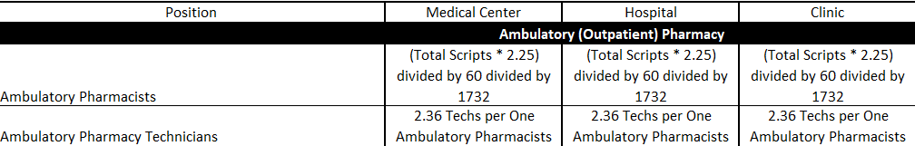
Why are we doing this?
 | Total RX’s | Pharmacists | Technicians | Total Force
Hickam (Current) | 92,944 | 4 | 6 | 10
Hickam (Projected) | 92,944 | 2 | 5 | 7

Slide 5



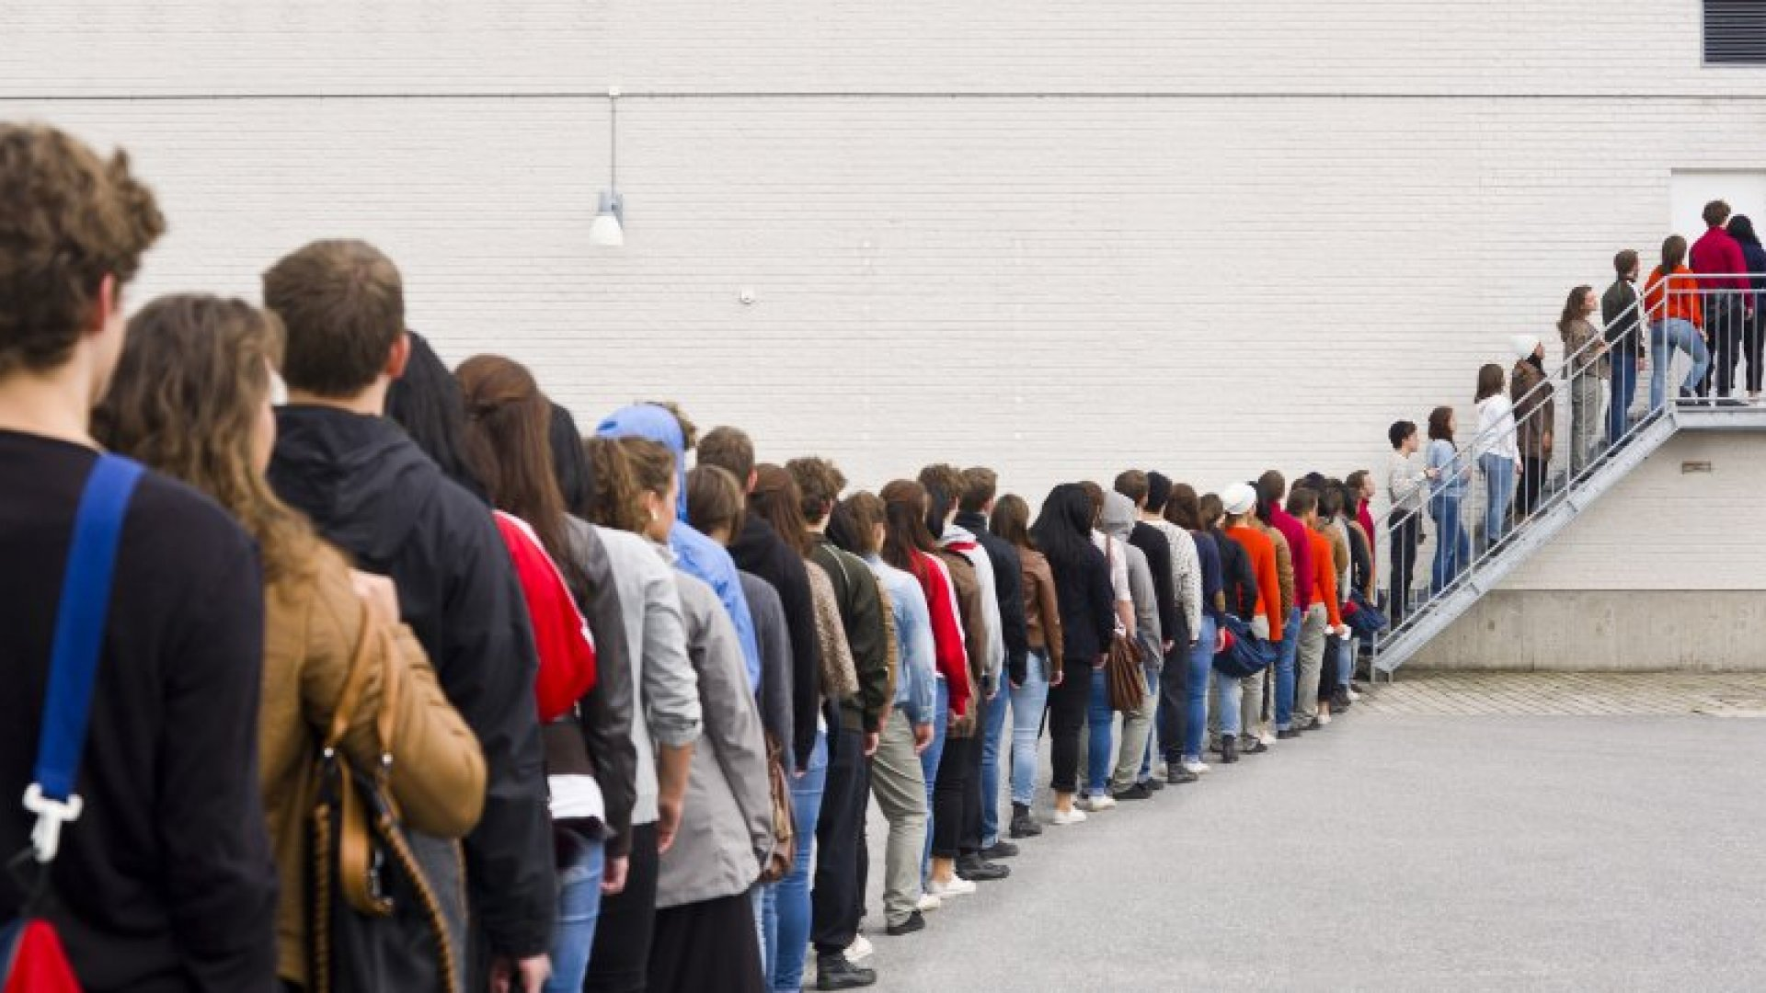


Traditional process
You leave the doctor’s office…..

Slide 6
Traditional process
You leave the doctor’s office…..

Slide 7
Supply

Slide 8
Perpetual Inventory Timeline
10. 2021 MHS Genesis, Scanfest
12 2024 Full Perpetual
09. 2022 First attempt at Perpetual
07. 2024 Second Scanfest
10. 2024 Scanfest finished

Slide 9
Perpetual Inventory Lessons Learned
Trust Logistics
Phased roll out
Get key player buy in FIRST
Frequent reinforcement

Slide 10
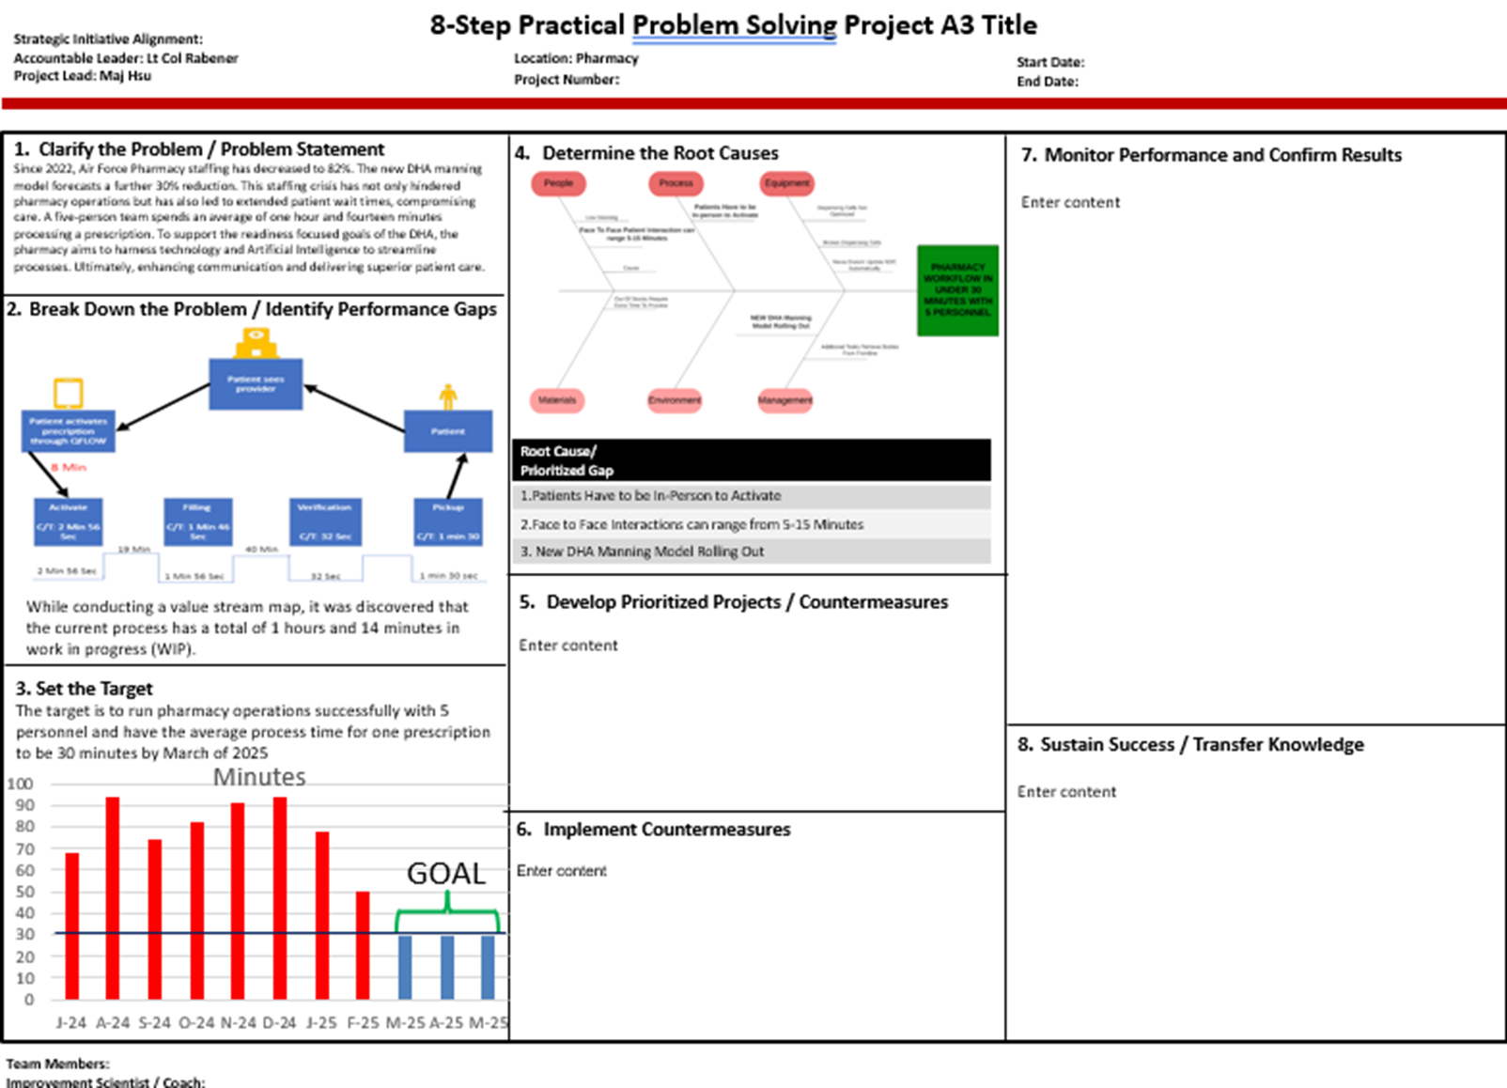
Pharmacy Workflow A3

Slide 11
Demonstration
Current Activation Steps

Slide 12
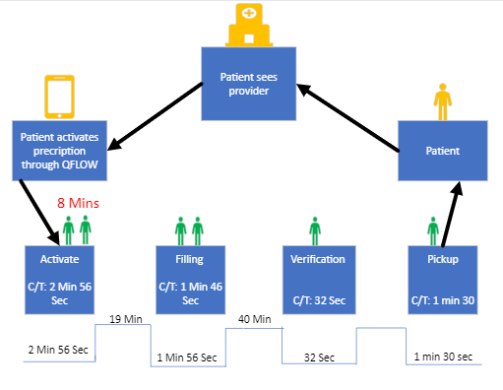
Identify Performance Gaps
Small Facility
While conducting a value stream map, it was discovered that the current process has a total of 1 hours and 14 minutes in work in progress (WIP).

Slide 13
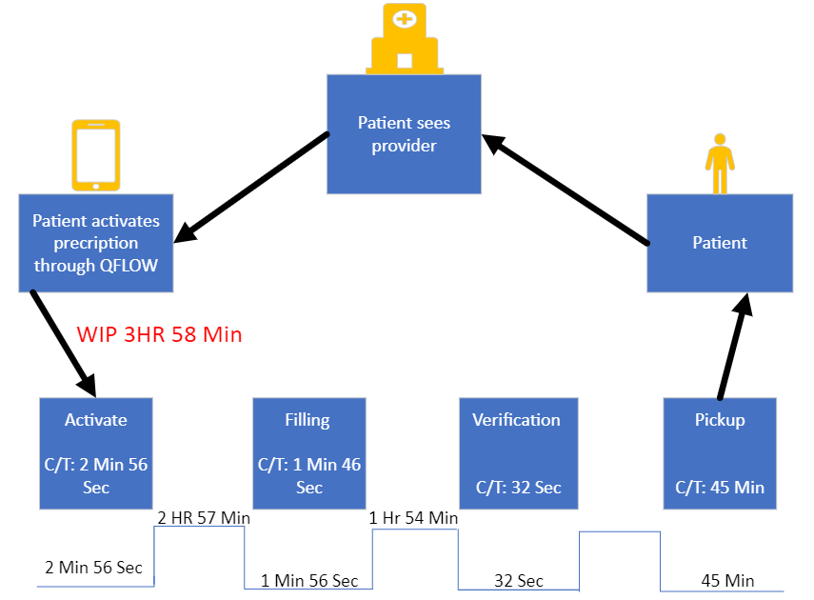
2. Break Down the Problem / Identify Performance Gaps
Large Pharmacy Manning Model

Slide 14
Future Activation Steps

Slide 15
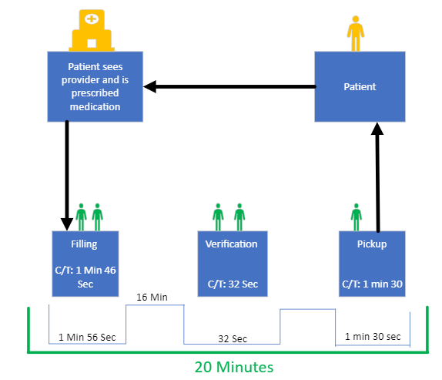
Goal Workflow

Slide 16

The future: UI Path
A program able to execute a series of pre-defined functions
Q Anywhere
Batch Refills
Batch Pickups
Activation

Slide 17
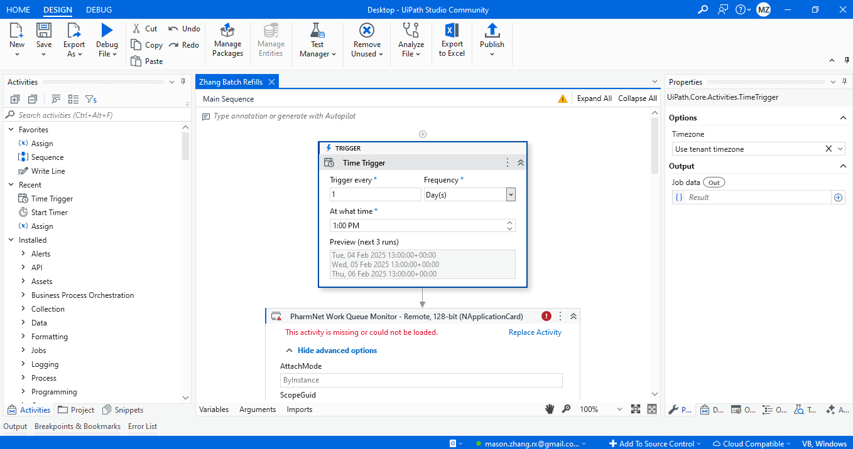
Activation: UI Path
A program able to execute a series of pre-defined functions

Slide 18
Automation Showcase
Automation Showcase
https://www.youtube.com/watch?v=UN5RSfSqyu4

Slide 19
The Future
If you had a robot, what would you use it for?

Slide 20
CE Question 1
What is the most labor-intensive step to the traditional prescription process?
Data Entry
Filling
Verification
Prescription drop-off
…

Slide 21
CE Question 2
How much is pharmacy manning expected to decrease in the upcoming years?
10%
20%
30%
40%
…

Slide 22
CE Question 3
What strategy is the Hickam Team implementing to bridge the gap in anticipated manning shortage?
Requesting more manning
Shutting down a pharmacy
Consolidating operations
Leveraging artificial intelligence

Slide 23
Questions?

