Slide 1
Resiliency
Ch, Capt, Basil O. Eruo
Chaplain 374AW/HC
Yokota AFB Japan

Slide 2
Disclosures
Neither the speaker nor contributors for this program have any financial relationships conflicts of interest to disclose

Slide 3
My Background
Ordained a Catholic priest August 1999
Ministry in Nigeria and USA for 21 years
Obtained a masters in clinical mental health counseling at Quincy University Ill
Practicum/Internship
Served for 4 years in the Air Force

Slide 4
Learning Objectives
At the conclusion of this educational activity, participants will be able to:
Understand the meaning of resiliency
Identify their stressors
Identify ways to handle stress
Be aware of helping agencies
Resiliency ready

Slide 5
Understanding Resiliency
The capacity to recover quickly from difficulties; toughness
The ability of a substance or object to spring back into shape; elasticity
Restoring and refilling

Slide 6
Spiritual Resiliency
AFI 36-2618 (para 4.4.6.4)
“Be spiritually ready to accomplish the mission. Spiritual readiness is the proactive practice of establishing a sense of purpose or personal priorities to develop the skills needed in times of stress, hardship, and tragedy. Spiritual readiness may or may not include religious activities.”

Slide 7
Our Stressors
Our work
Our relationships
Our families
Our past experiences-hurts, losses, pains
Our failures-regrets, guilts

Slide 8

Restoration
Exercise-walk, run, lift weights, swim
Link up with community/friends
Listen to music-any music
Play some instruments
Take a vacation
Watch a movie
Good sleep:6-8 hours
Yoga

Slide 9
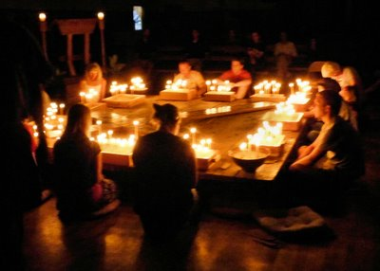
Strictly Spiritual
Connect to your higher being
Read some inspirational books
Pray and meditate
Music & art
Retreat & renewal
Engage with community

Slide 10
Unhealthy Coping skills
Going on a shopping spree
Drinking, smoking
Overeating
Taking it out on others
Physical abuse

Slide 11

We are Humans!
You are human: it can happen to you
You are not alone
You are strong enough

Slide 12
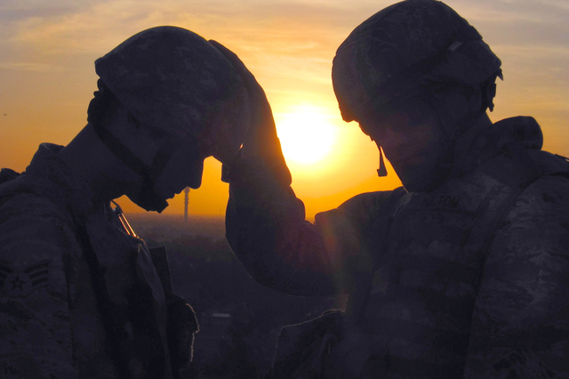
Find Support
You Have Help: -Friends, Family, Leadership
Connect with a support group
  Seek/be a wingman!
Chaplain Support
  Privileged Communication = 100% Confidentiality
  Chaplain on-call emergency #
    DSN 315-225-7009
    Command post 315-225-3740
Mental health: 315-225-3566

Slide 13
Questions?

