Slide 1
USP <797>: Review & Updates
Major Justine Seymour
Inpatient Pharmacist
Joint Base Elmendorf-Richardson, Alaska

Slide 2
Disclosures
Maj Justine Seymour declare(s) no conflicts of interest, real or apparent, and no financial interests in any company, product, or service mentioned in this program, including grants, employment, gifts, stock holdings, and honoraria.

Slide 3
Learning Objectives
1. Describe the purpose for USP <797>
2. Explain sterile compounding & understand the difference between the three compounded sterile preparation (CSP) categories
3. Distinguish between a beyond-use date (BUD) and an expiration date
4. Identify key USP 797 revisions from the 2022 updates

Slide 4
Questions
How often are compounding personnel required to pass a written or an electronic test?
  Every month
  Every 4 months
  Every 6 months
  Every 12 months
What is an expiration date?
  The final date after which a CSP must not be used or administered
  The final date in which the manf. can guarantee the full potency and safety of a medication
  The final date that is determined from when the preparation of the CSP began
  Both A and C
Which statement is FALSE regarding the purpose of USP chapter <797>?
  Provides the standards for the sterile compounding
  Provides the standards for the safe handling of hazardous drugs
  Aims to minimize harm that could result from microbial contamination
  Both A and C

Slide 5
USP 797 - Background
The USP 797 standards published in 2023 began 1 Nov 2023.
These standards were enforceable by The Joint Commission on 1 Jan 2024.
The revised changes defer hazardous and radiopharmaceutical compounding to USP 800 & 825 respectively.

Slide 6
USP 797 - Background
USP 797 describes the minimum standards for preparing compounded sterile preparations (CSPs).
Its purpose is to minimize harm that could result from the following:
  Microbial contamination (non-sterility)
  Excessive bacterial endotoxins
  Variability from the intended strength of correct ingredients
  Physical and chemical incompatibilities
  Physical and chemical contaminants
  Use of ingredients of inappropriate quality

Slide 7
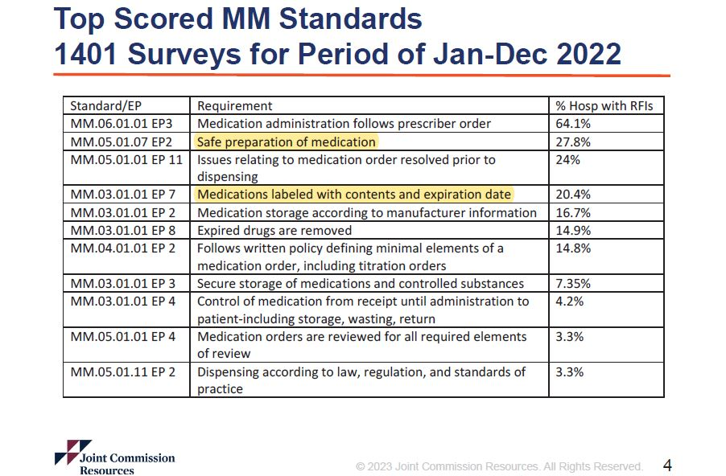

Slide 8
Compounded Sterile Preparation Category Revisions

Slide 9

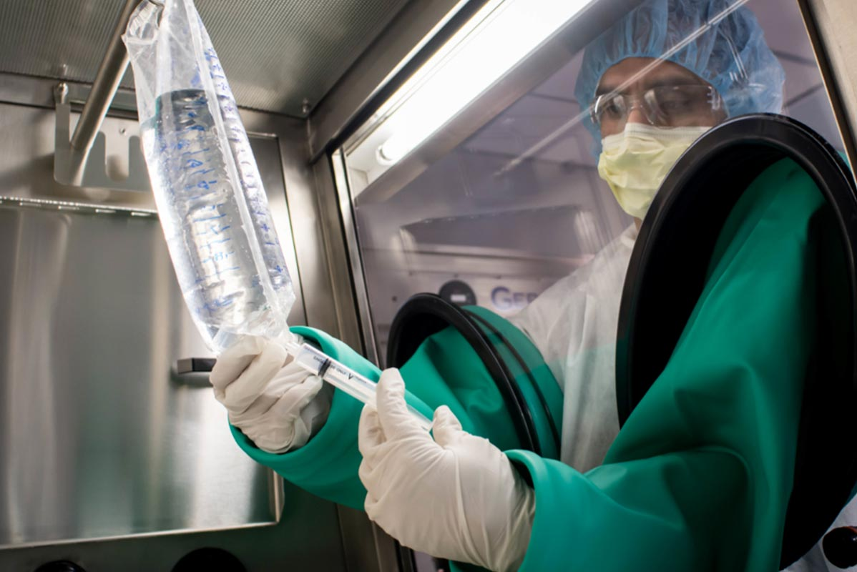
USP Category Revisions
Low-Risk in a Segregated Compounding Area
  Fewer than 3 ingredients combined
Low-Risk
  Fewer than 3 ingredients combined
Medium-Risk
  3 ingredients combined
High-Risk
  More than 3 ingredients combined

Slide 10
USP Category Revisions
In the USP 797 update, the categories of low, medium and high have been replaced with Category 1, Category 2 and Category 3
Old CSP Categories were based on type & quantity of products
New CSP Categories are now based on overall contamination risk:
  Conditions under which the CSPs are made
  Probability for microbial growth
  Time period within which the CSPs must be used

Slide 11
USP Category Revisions
In the USP 797 update, the categories of low, medium and high have been replaced with Category 1, Category 2 and Category 3
Category 1
  Prepared in an ISO 5 Primary Engineering Control (PEC)
  Space is uncontrolled or unclassified
    “Less-than-ideal circumstances”
      An SCA with inadequate air pressure, air exchanges, or filtration
      Temporary break in control of the buffer area, such as a power failure or loss of pressure

Slide 12
USP Category Revisions
In the USP 797 update, the categories of low, medium and high have been replaced with Category 1, Category 2 and Category 3
Category 2
  Prepared in an ISO 5 PEC with a classified clean room suite
  Most modern-day pharmacy compounding environments
  Start with sterile products*

Slide 13
USP Category Revisions
In the USP 797 update, the categories of low, medium and high have been replaced with Category 1, Category 2 and Category 3
Category 3
  Prepared in an ISO 5 PEC with a classified clean room suite
  Start with non-sterile ingredients
  Must undergo sterility testing

Slide 14
Beyond-Use Date Revisions

Slide 15
Beyond-Use Date vs. Expiration Date
Beyond-Use Date:
  Definition- Either the date, or hour and date, after which a CSP must not be used. The BUD is determined from the date and time that preparation of the CSP is initiated.
  Applicability- Applies to all CSPs
Expiration Date:
  Definition- The time during which a product can be expected to maintain expected quality provided it is kept under the specified storage conditions.
  Applicability- Applies to all conventionally manufactured products, APIs, and added substances

Slide 16
Expiration Date
Identifies the final date in which the manufacturer can guarantee the full potency & safety of a medication
These dates are estimated using stability testing under good manufacturing practices as determined by the FDA:
  Note: storage conditions can affect the stability of the medications
Applies to all conventionally manufactured products, active pharmaceutical ingredients (APIs), and excipients
**BUDs generally do not extend past the expiration date of a drug**

Slide 17
Beyond-Use Date Revisions
Date or hour/date after which a CSP must not be used (hung), stored, or transported
Determined from the date/time the preparation was compounded
From start of preparation to start of administration
BUDs should be conservative to ensure that the drug maintains its required characteristics:
    Chemical and physical properties of the drug and/or its formulation
    Compatibility of the container-closure system with the finished preparation

Slide 18
Beyond-Use Date Revisions
Factors that influence how a BUD is set:
  Environment in which the CSP is prepared
  Aseptic preparation and sterilization method
  Components and starting ingredients (i.e. sterile or nonsterile)
  Whether or not sterility testing is performed
  Storage conditions

Slide 19
Beyond-Use Date Revisions
Immediate-Use:
  2008
    1 hour from start of compounding
  Revisions
    4 hours from start of compounding
    Must be 3 or fewer ingredients (including diluent)

Slide 20
Beyond-Use Date Revisions
Low-Risk in a Segregated Compounding Area
  12 hours at CRT
Low-Risk
  48 hours at CRT
  14 days in refrigerator
Medium-Risk
  30 hours at CRT
  9 days in refrigerator
High-Risk
  24 hours at CRT
  3 days in refrigerator

Slide 21
Beyond-Use Date Revisions
Category 1
  12 hours at Controlled Room Temperature
  24 hours in refrigerator
  No freezer allowed

Slide 22
Beyond-Use Date Revisions
Category 2
  Complex categories involving:
    With or without sterile ingredients
    Non-Sterile ingredients: with or without testing
    Aseptic technique
    With or without terminal sterilization
  Most common: aseptic technique, no sterility testing (of products), only sterile ingredients

Slide 23
Beyond-Use Date Revisions
Category 2
  Complex categories involving:
    With or without sterile ingredients
    Non-Sterile ingredients: with or without testing
    Aseptic technique
    With or without terminal sterilization
  Most common: aseptic technique, no sterility testing (of products), only sterile ingredients
    4 days at CRT
    10 days in refrigerator
    45 days in freezer

Slide 24
Beyond-Use Date Revisions
Preparation Characteristics |  | Storage Conditions
Compounding Method | Sterility Testing Performed and Passed | Controlled Room Temperature (20°–25°) | Refrigerator (2°–8°) | Freezer (−25° to −10°)
Aseptically processed CSPs | No | Prepared from one or more nonsterile starting component(s): 1 day | Prepared from one or more nonsterile starting component(s): 4 days | Prepared from one or more nonsterile starting component(s): 45 days
 |  | Prepared from only sterile starting components: 4 days | Prepared from only sterile starting components: 10 days | Prepared from only sterile starting components: 45 days
 | Yes | 30 days | 45 days | 60 days
Terminally sterilized CSPs | No | 14 days | 28 days | 45 days
 | Yes | 45 days | 60 days | 90 days

Slide 25
Beyond-Use Date Revisions
Preparation Characteristics |  | Storage Conditions
Compounding Method | Sterility Testing Performed and Passed | Controlled Room Temperature (20°–25°) | Refrigerator (2°–8°) | Freezer (−25° to −10°)
Aseptically processed CSPs | No | Prepared from one or more nonsterile starting component(s): 1 day | Prepared from one or more nonsterile starting component(s): 4 days | Prepared from one or more nonsterile starting component(s): 45 days
 |  | Prepared from only sterile starting components: 4 days | Prepared from only sterile starting components: 10 days | Prepared from only sterile starting components: 45 days
 | Yes | 30 days | 45 days | 60 days
Terminally sterilized CSPs | No | 14 days | 28 days | 45 days
 | Yes | 45 days | 60 days | 90 days
Most Likely

Slide 26
Beyond-Use Date Revisions
BUDs for Category 1, 2 and 3 CSPs
 | Storage Conditions
 | Controlled Room Temperature (20°- 25°C) | Refrigerator (2°- 8°C)
Category 1 | ≤ 12 hours | ≤ 24 hours
Category 2/3 | > 12 hours | > 24 hours

Slide 27
Personnel Training & Evaluation

Slide 28
Personnel Training & Evaluation Revisions
Each compounding facility must develop a written training program that describes the following:
    The required training
    The frequency of the training
    The process for evaluating the performance of individuals involved in preparing CSPs

Slide 29
Personnel Training & Evaluation Revisions
Designated Person
  This individual is accountable for the performance of the facility & personnel
  Responsibilities:
    Ensure the SOPs are appropriate & implemented
    Monitor personnel training and competency
    Review SOPs at minimum every 12 months
      This must be documented that is occurred and by whom
    Communicate revisions to all personnel involved
**ONLY the Designated Person can make changes to SOPs**

Slide 30
Personnel Training & Evaluation Revisions
Didactic Testing
  Any individual involved in compounding CSPs (to include those overseeing compounding) must be initially trained and qualified.
  Training is to be completed every 12 months to include passing a written or an electronic test (6 months for category 3).
  Those involved with other tasks within the compounding area (ie restocking/cleaning)
    Training is defined by the local facilities SOPs

Slide 31
Personnel Training & Evaluation Revisions
Garbing Competency
  This includes both visual observation & gloved-fingertip samplings
    Initial garbing evaluation must include no fewer than 3 separate times. The 3 successful completions must be in succession.
    Failure to accomplish will require individual to repeat testing until successful completion of 3 evaluations in a row.
Frequency of competency for direct compounders:
  Category 1 & 2: at least every 6 months
    Increase in frequency from annually
  Category 3: at least every 3 months
    Increase in frequency from every 6 months

Slide 32
Personnel Training & Evaluation Revisions
Reusing Garb
  2008:
    Allows gown to be reused if used on the same workday
  Revisions (Category 1 & 2):
    “Gowns may be reused within the same shift by the same person if the gown is maintained in a classified area or adjacent to the segregated compounding area in a manner that prevents contamination.”

Slide 33
Personnel Training & Evaluation Revisions
Handwashing
  2008:
    Gave a specific order for garbing & handwashing
    Sterile gloves should be donned in the buffer room
  Revisions:
    The order of handwashing and garbing is determined by the placement of the sink
      Facility specific
      Must be outlined in SOPs
    Donning and doffing should not occur in the same area at the same time
    Hand dryers are not allowed
    Cannot refill or “top off” a soap dispenser, must replace entirely

Slide 34
Personnel Training & Evaluation Revisions
Aseptic Manipulation Competency
  This includes visual observation, media-fill testing with post-gloved fingertip, & surface sampling
    Initial manipulation evaluation must include 1 successful aseptic manipulation.
    Failure in either media fill test, gloved fingertip test, or surface sampling constitutes an overall failure for this competency.
Frequency of competency for direct compounders:
  Category 1 & 2: at least every 6 months
    Increase in frequency from annually
  Category 3: at least every 3 months
    Increase in frequency from every 6 months

Slide 35
Personnel Training & Evaluation Revisions
Incubation standards
  Gloved fingertip sampling
    2008: Incubate at 30-35ºC for 2-3 days
    Revision: “Incubate the media device at 30-35ºC for no less than 48 hours AND then at 20-25ºC for no less than 5 additional days”
  Media-fill testing
    2008: Incubate at 20-25ºC or 30-35ºC for 14 days
    Revision: “Incubate the final containers at 30-35ºC AND 20-25ºC for no less than 7 days at each temperature band”
      Order of incubation temperatures must be described in the facility SOPs

Slide 36
Cleaning & Disinfecting

Slide 37
Cleaning & Disinfecting Revisions
Supplies
  Revision:
    Must be low-lint
    Reusable cleaning tools must be dedicated and not removed from the segregated area.
      They must be made of cleanable material (i.e. no wood or porous materials)
    All supplies used within the PEC must be sterile

Slide 38
Cleaning & Disinfecting Revisions
Cleaning Application
  2008:
    Minimum frequencies are based on method (cleaning or disinfecting)
  Revisions:
    Minimum frequencies are broken down into 3 categories (cleaning, disinfecting, and applying sporicidal disinfectant)

Slide 39
Cleaning & Disinfecting Revisions
Cleaning & Disinfecting Frequencies
Daily | Monthly
Empty trash, dispose of all waste, restock supplies/equipment as necessary | Clean all storage units (containers) and storage shelving
Clean/Mop floors beginning with the farthest, cleanest point to the dirtiest, closest point (Buffer to Ante Room) | Clean ceilings, wall surfaces, doors, door frames
PEC and all equipment inside PEC | Equipment outside the PEC (stool, cart)
All work surfaces/counters, pass through(s), sink (s) | Area underneath the work tray
**For further detail see USP 797; Section 7, Table 10. Minimum Frequency for Cleaning and Disinfecting Surfaces and Applying Sporicidal Agents in Classified Areas and in the SCA**

Slide 40
Cleaning & Disinfecting Revisions
Sporicidal Frequencies
  Category 1 & 2 monthly frequency for the following:
    Inside the PEC
    Pass through(s)
    Work surfaces outside PEC (i.e. counters, sink)
    Floors, walls, door frames, ceilings
    Storage shelving and bins
    Equipment outside the PEC

Slide 41
Cleaning & Disinfecting Revisions
Sporicidal Agent Application
  Revision:
    Use a low lint wipe to clean and disinfect all surfaces with sporicidal agent first
    Allow to sit for the specified time by the manufacturer
    Use low lint wipe with 70% isopropyl alcohol
  **Note: can use a one-step disinfectant sporicidal cleaner instead.**

Slide 42
Master Formulation & Compounding Records

Slide 43
Master Formulation Record Revisions
Master Formulation Record (MFR)
  Definition: a detailed record of procedures and preparation instructions for CSP
    New requirement
    Required for all CSPs that are prepared for more than 1 patient or when using non-sterile ingredients
    Any changes or alterations in MFR must be approved and documented by the facilities SOP

Slide 44
Master Formulation Record Revisions
Summary of the Requirements for a Master Formulation Record
What is required? | Name, strength, dosage form of CSP Identities and amounts of all ingredients Type, size of container-closure system(s) Instructions for preparing CSP Equipment Supplies How To Special Precautions Physical description of CSP BUD and storage requirements Reference to support stability Quality control (QC) procedures pH testing Filter integrity testing Relevant info needed to describe the compounding process and ensure repeatability Adjusting pH and tonicity Sterilization method

Slide 45
Master Formulation Record Revisions
Who is responsible? | Designated Person
How can this be documented? | Electronic Log (must be retrievable) Hard Copy
When is this required? | CSPs prepared in a batch for more than 1 patient 10 gram cefazolin vial used to make five 2 gram IV piggybacks CSPs prepared from nonsterile ingredients Compounding sterile normal saline from sodium chloride powder
Other considerations? | None

Slide 46
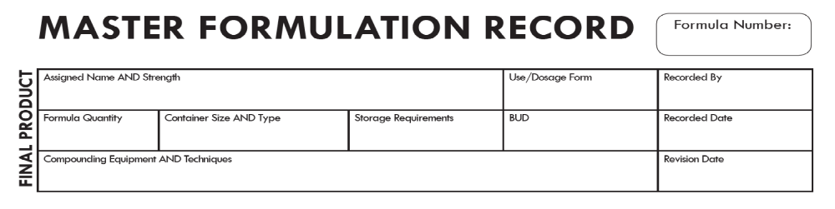
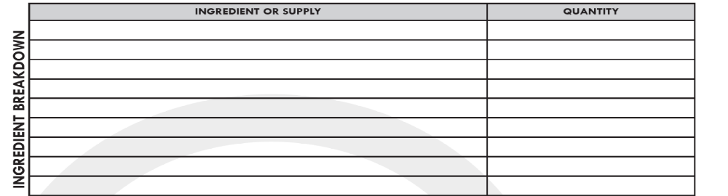
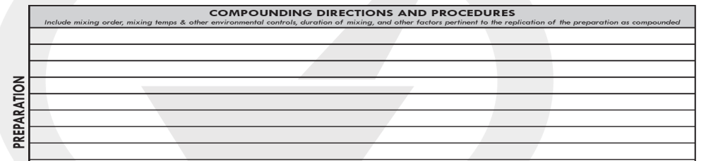
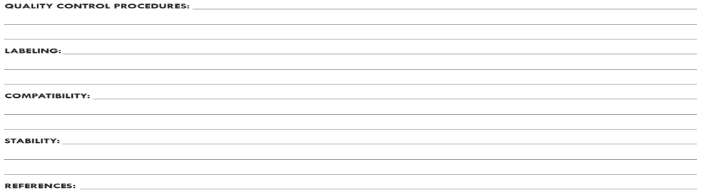

Slide 47
Compounding Record Revisions
Compounding Record (CR)
  Definition: documents the compounding process of each CSP
    Revision:
      A MFR can serve as the basis for preparing a CR
      A prescription or medication order or label may serve as the record

Slide 48
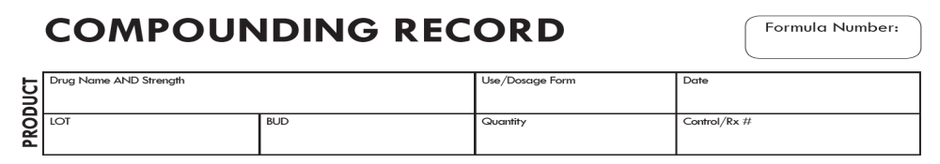
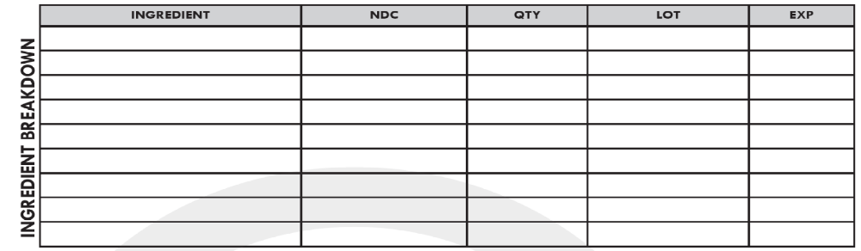
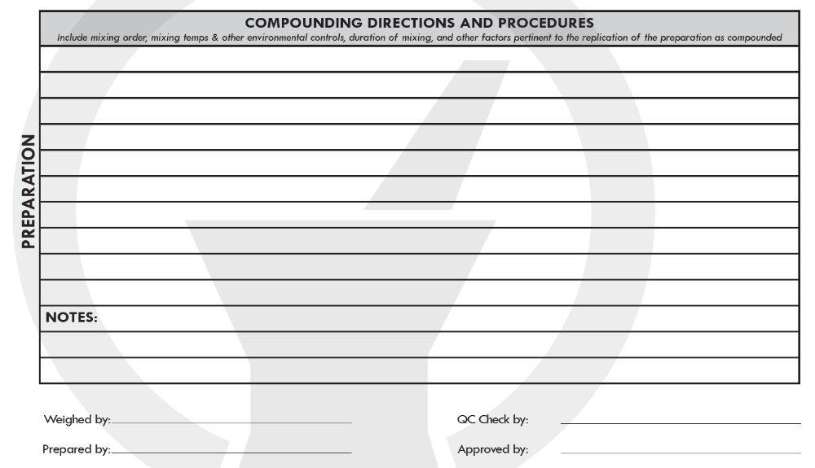

Slide 49
The Joint Commission Standards

Slide 50
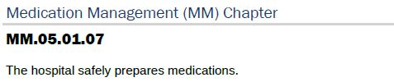
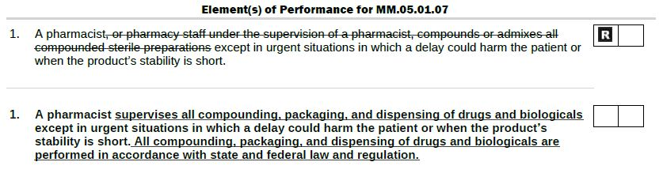
The Joint Commission Revisions
Indicates a risk area
**Enforceable by The Joint Commission since 1 Jan 2024**

Slide 51
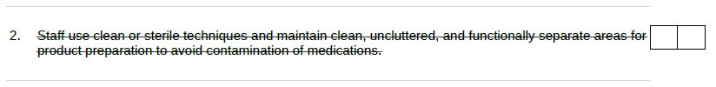
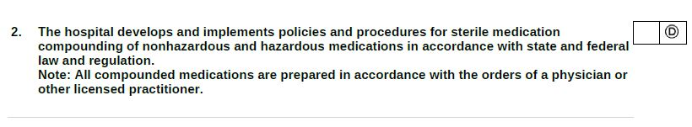
The Joint Commission Revisions
Indicates documentation is required
**Enforceable by The Joint Commission since 1 Jan 2024**

Slide 52
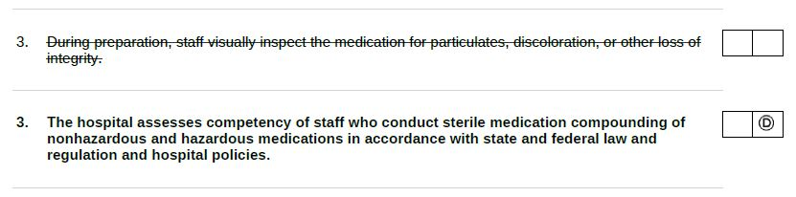
The Joint Commission Revisions
Indicates documentation is required
**Enforceable by The Joint Commission since 1 Jan 2024**

Slide 53
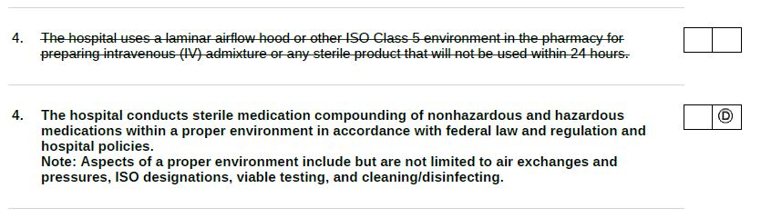
The Joint Commission Revisions
Indicates documentation is required
**Enforceable by The Joint Commission since 1 Jan 2024**

Slide 54
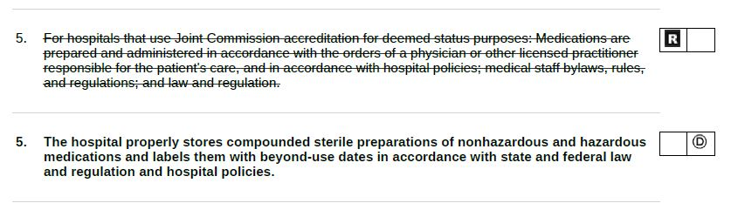
The Joint Commission Revisions
Indicates a risk area
Indicates documentation is required
**Enforceable by The Joint Commission since 1 Jan 2024**

Slide 55
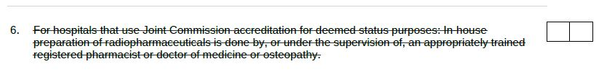
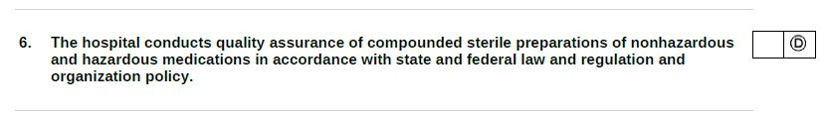
The Joint Commission Revisions
Indicates documentation is required
**Enforceable by The Joint Commission since 1 Jan 2024**

Slide 56
How Do We Meet These Standards?

Slide 57
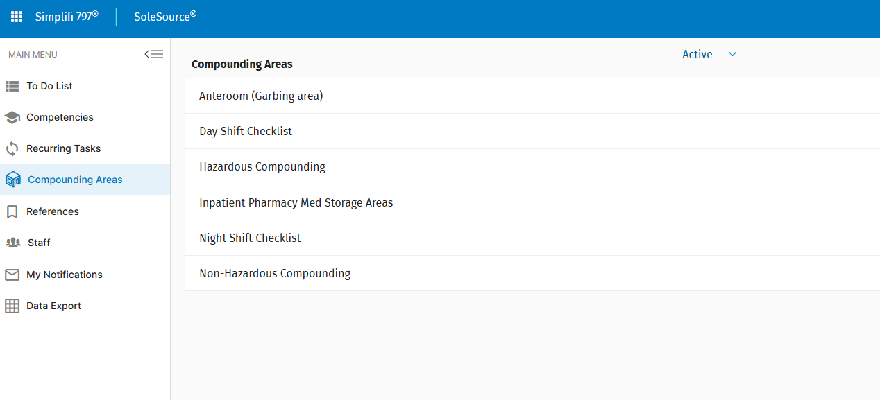
How Do We Meet These Standards?
Organization!!

Slide 58
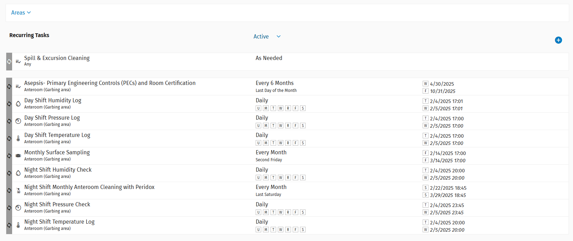
Simplifi 797®
Example of Recurring Tasks

Slide 59
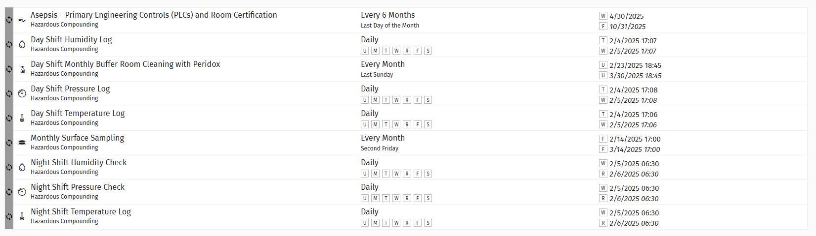
Simplifi 797®
Example of Recurring Tasks

Slide 60
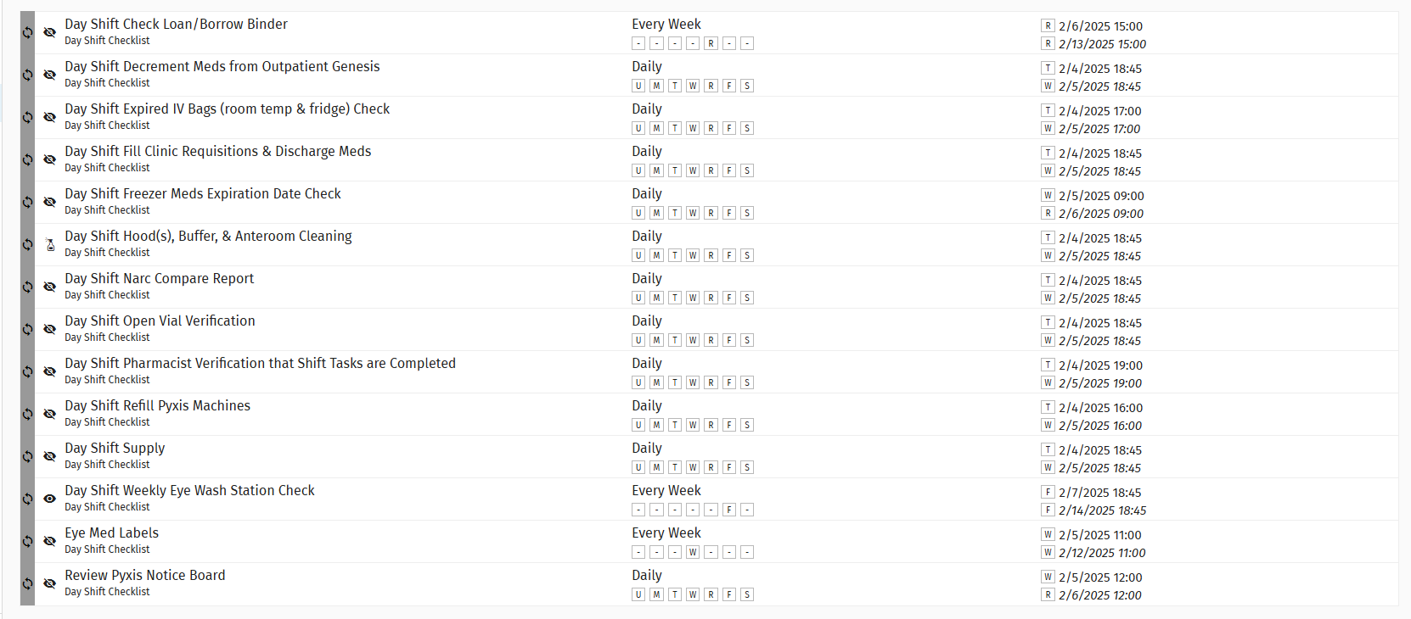
Simplifi 797®
Example of a built out daily checklists

Slide 61
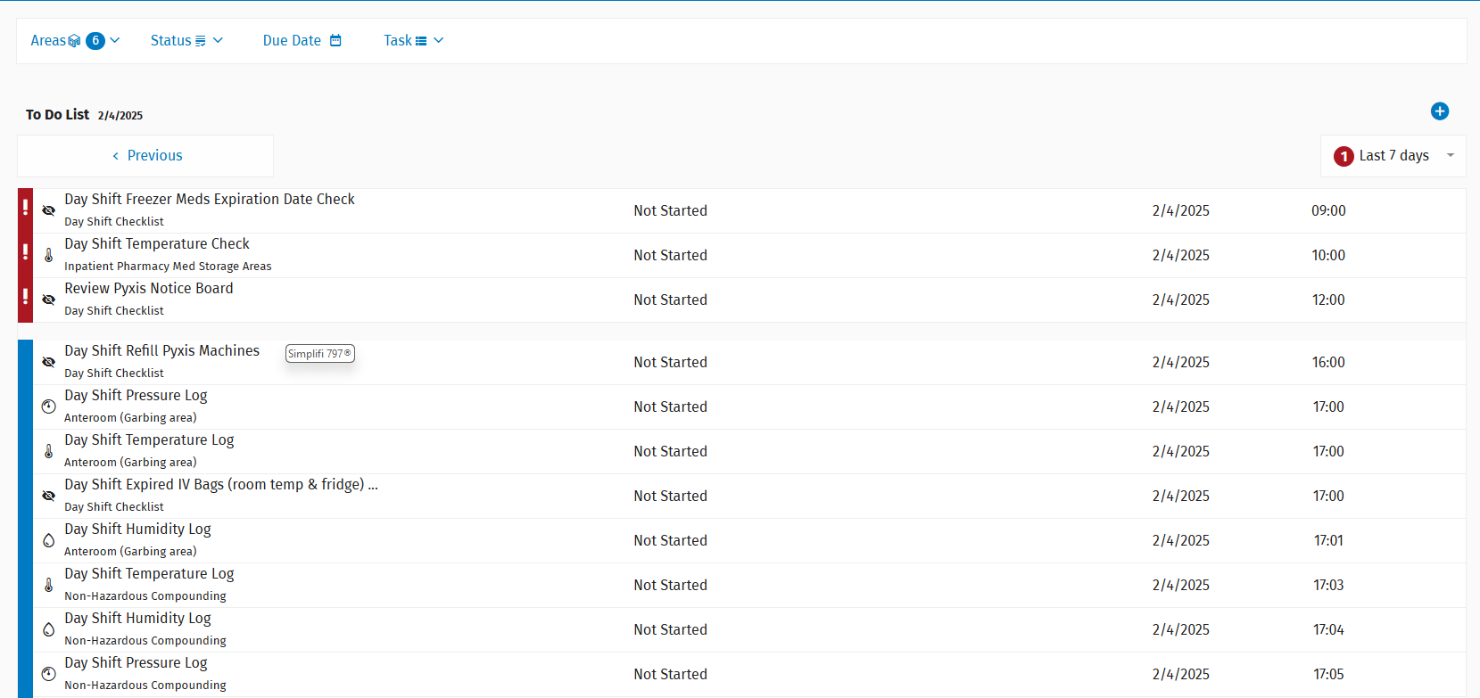
Simplifi 797®
Example of an Active To Do List

Slide 62
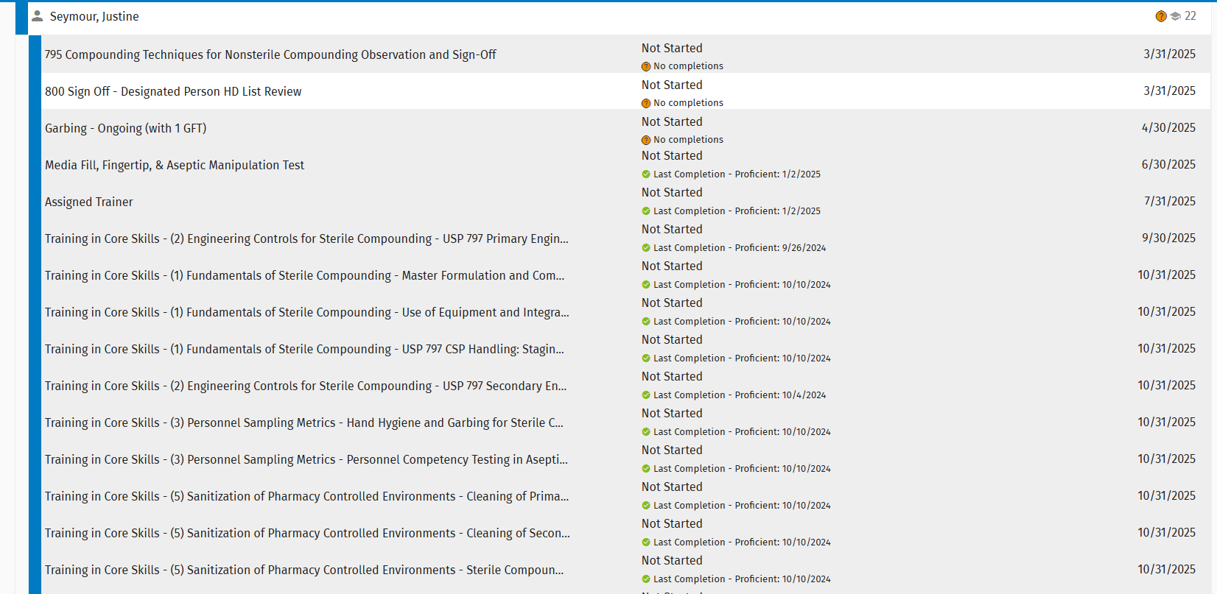
Simplifi 797®
Example of Competencies built out

Slide 63
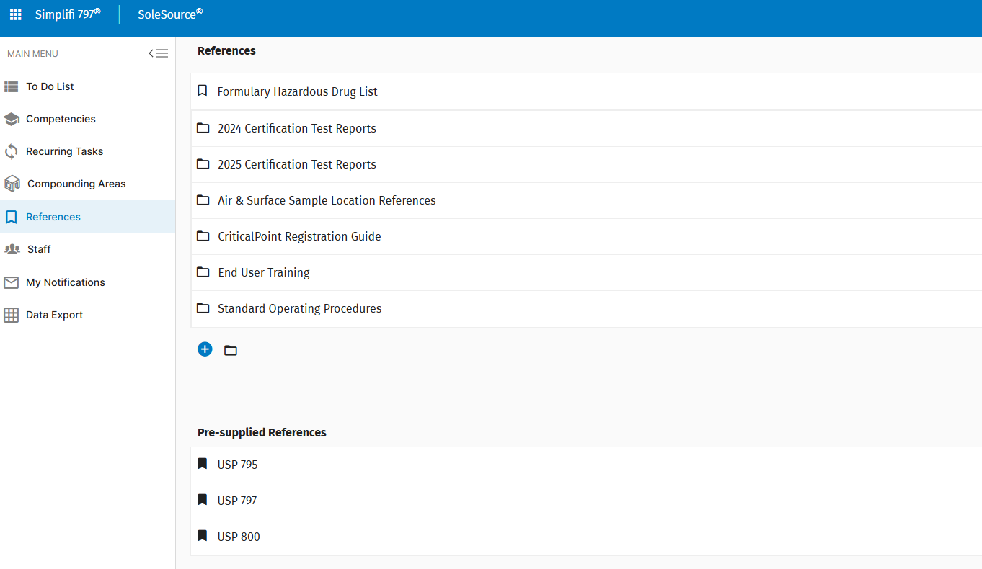
Simplifi 797®
Example of References plus materials locally added (Published SOPs, HD Lists, Certification Results, etc)

Slide 64
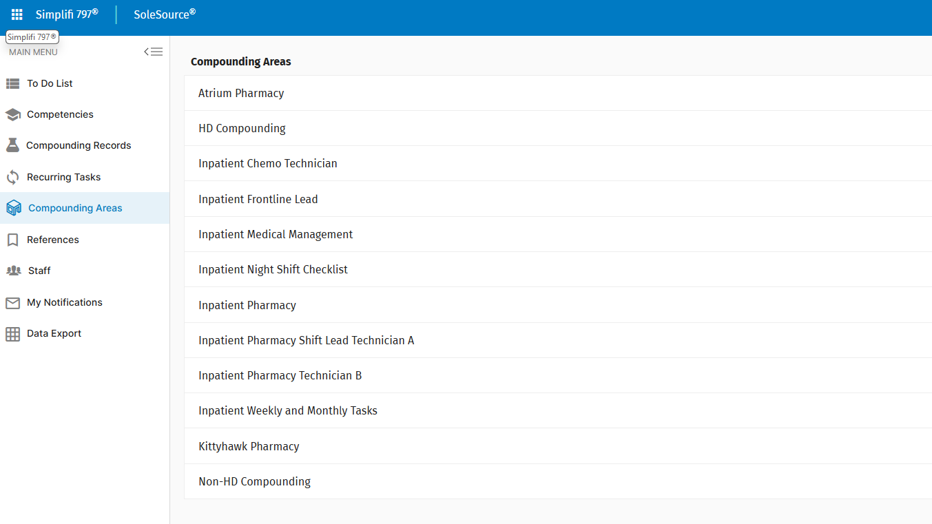
Simplifi 797®… A Step Further
Example of built out sections for an entire Flight

Slide 65
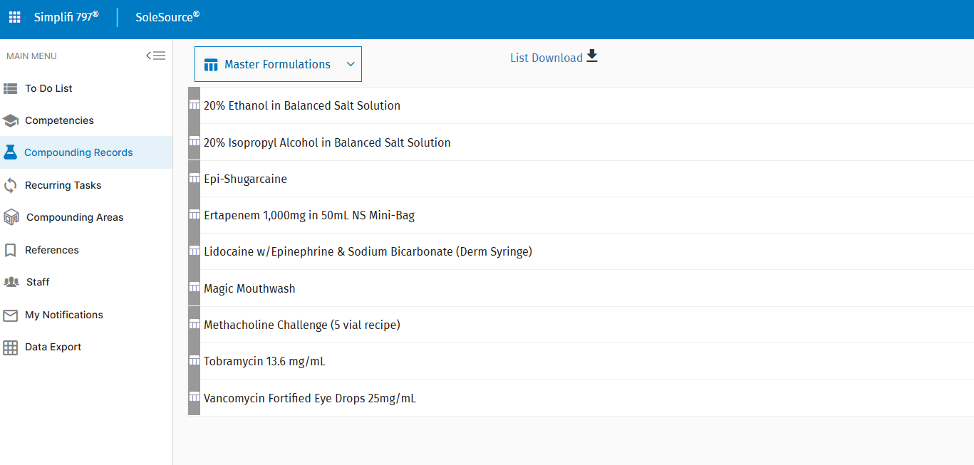
Simplifi 797®… A Step Further
Example of MFRs and CRs

Slide 66
Learning Objectives
1. Describe the purpose for USP 797
2. Explain sterile compounding & understand the difference between the three compounded sterile preparation (CSP) categories
3. Distinguish between a beyond-use date (BUD) and an expiration date
4. Identify key USP 797 revisions from the 2022 updates

Slide 67
Questions
How often are compounding personnel required to pass a written or an electronic test?
  Every month
  Every 4 months
  Every 6 months
  Every 12 months
What is an expiration date?
  The final date after which a CSP must not be used or administered
  The final date in which the manf. can guarantee the full potency and safety of a medication
  The final date that is determined from when the preparation of the CSP began
  Both A and C
Which statement is FALSE regarding the purpose of USP chapter <797>?
  Provides the standards for the sterile compounding
  Provides the standards for the safe handling of hazardous drugs
  Aims to minimize harm that could result from microbial contamination
  Both A and C

Slide 68
Questions
How often are compounding personnel required to pass a written or an electronic test?
  Every month
  Every 4 months
  Every 6 months
  Every 12 months
What is an expiration date?
  The final date after which a CSP must not be used or administered
  The final date in which the manf. can guarantee the full potency and safety of a medication
  The final date that is determined from when the preparation of the CSP began
  Both A and C
Which statement is FALSE regarding the purpose of USP chapter <797>?
  Provides the standards for the sterile compounding
  Provides the standards for the safe handling of hazardous drugs
  Aims to minimize harm that could result from microbial contamination
  Both A and C

Slide 69
Questions
How often are compounding personnel required to pass a written or an electronic test?
  Every month
  Every 4 months
  Every 6 months
  Every 12 months
What is an expiration date?
  The final date after which a CSP must not be used or administered
  The final date in which the manf. can guarantee the full potency and safety of a medication
  The final date that is determined from when the preparation of the CSP began
  Both A and C
Which statement is FALSE regarding the purpose of USP chapter <797>?
  Provides the standards for the sterile compounding
  Provides the standards for the safe handling of hazardous drugs
  Aims to minimize harm that could result from microbial contamination
  Both A and C

Slide 70
Questions
How often are compounding personnel required to pass a written or an electronic test?
  Every month
  Every 4 months
  Every 6 months
  Every 12 months
What is an expiration date?
  The final date after which a CSP must not be used or administered
  The final date in which the manf. can guarantee the full potency and safety of a medication
  The final date that is determined from when the preparation of the CSP began
  Both A and C
Which statement is FALSE regarding the purpose of USP chapter <797>?
  Provides the standards for the sterile compounding
  Provides the standards for the safe handling of hazardous drugs
  Aims to minimize harm that could result from microbial contamination
  Both A and C

Slide 71
References
United States Pharmacopeia. USP general chapter <797> pharmaceutical compounding – sterile preparations. 30 Oct 24. https://www.usp.org/

Slide 72
Questions?

Slide 73
USP 797: Review & Updates
Major Justine Seymour
Inpatient Pharmacist
Joint Base Elmendorf-Richardson, Alaska

Slide 74
How to Obtain CE/CME Credits

