Slide 1
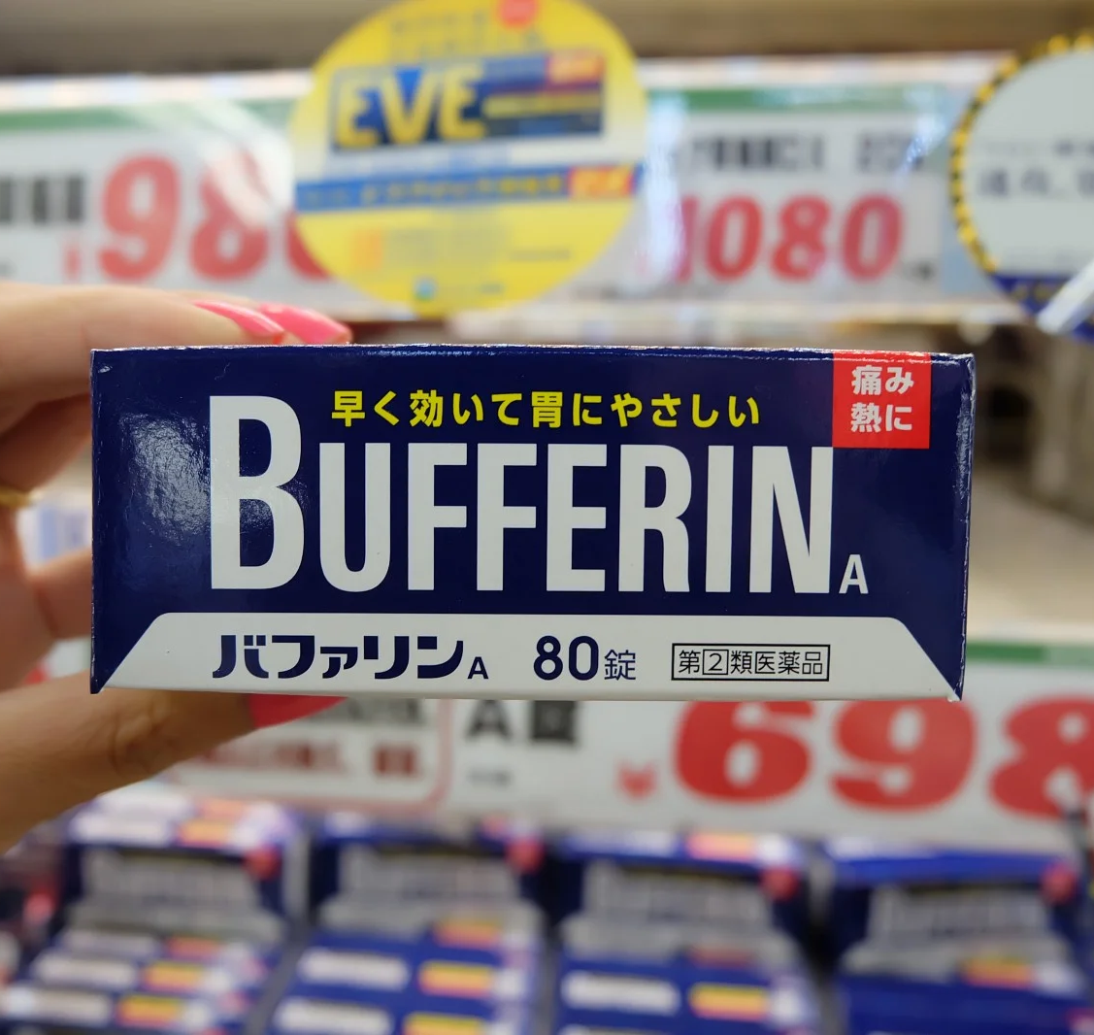
Over-the-counter Medications in Japan
Maj Lam T. Chung, USAF
Pharmacy & Nut Med Flt CC
35th MDG
Tyrome L. Brown, USAF
Inpatient Pharmacy Element Chief
35th MDG
CDR Kikuchi Hiroshi, JMSDF
Department Chief of Pharmacy
Ominato Medical Service Unit

Slide 2
Disclosure
Maj Lam T. Chung, Maj Tyrome L. Brown, & CDR Kikuchi Hiroshi nor any contributors for this educational activity have any financial relationships or conflicts of interest to disclose.

Slide 3
Disclosure of Unlabeled Use
This educational activity may contain discussion of published and/or investigational uses of agents that are not indicated by the FDA. The planners of this activity do not recommend the use of any agent outside of the labeled indications.

Slide 4
Learning Objectives
After conclusion of this educational activity, participants will be able to:
  Recognize common over-the-counter medications available in the US and their equivalents available in Japan.
  Categorize common Japanese medications based on therapeutic classes and indications (e.g., analgesics, cough suppressants, antihistamines).
  Evaluate potential safety issues and OTC classifications for Japanese retail drugs.

Slide 5
Learning Assessment Question
What common Japanese medication below can be used to treat headaches?
  Bufferin Premium DX
  NOGOGLE spray
  Gaster 10
  Selbelle

Slide 6
Learning Assessment Question
What medication below contains Famotidine (H2 Blocker) as the active ingredient?
  Tylenol A
  Loxonin S
  Gaster 10
  KAMPO

Slide 7
Learning Assessment Question
What OTC classification requires (mandatory) written information to be provided by a pharmacist?
  Class 1
  Class 2
  Class 3
  Class 1 & 2

Slide 8
Japan Self-Medication Industry (JSMI)
Established in 1985
National Association of over-the-counter drug manufacturers
OTC drugs are categorized into classifications for safety reasons
JSMI.JP. (n.d.). https://www.jsmi.jp/english/activities/index.html

Slide 9
OTC Classifications
Classification | Safety profile
Class 1 pharmaceuticals | Has side effects and interactions that require special attention. Requires counseling from a Pharmacist and written information
Class 2 pharmaceuticals | Has mild side effects and interactions that require special attention. Best effort to provide Counseling from a pharmacist but not mandatory
Class 3 pharmaceuticals | Relatively safe, no counseling required by a pharmacist
JSMI.JP. (n.d.). https://www.jsmi.jp/english/activities/index.html

Slide 10
OTC Classification Guidance
OTC Classification |  | Corresponding experts | Requirement | Internet sales by mail, etc.
Medicines requiring guidance |  | Pharmacist | Provide information in writing (mandatory) | No
 | Class 1 |  |  | Yes
 | Class 2 | Pharmacist or registered seller | Obligation to strive | Yes
 | Class 3 |  | No legal provisions | Yes
JSMI.JP. (n.d.). https://www.jsmi.jp/english/activities/index.html

Slide 11
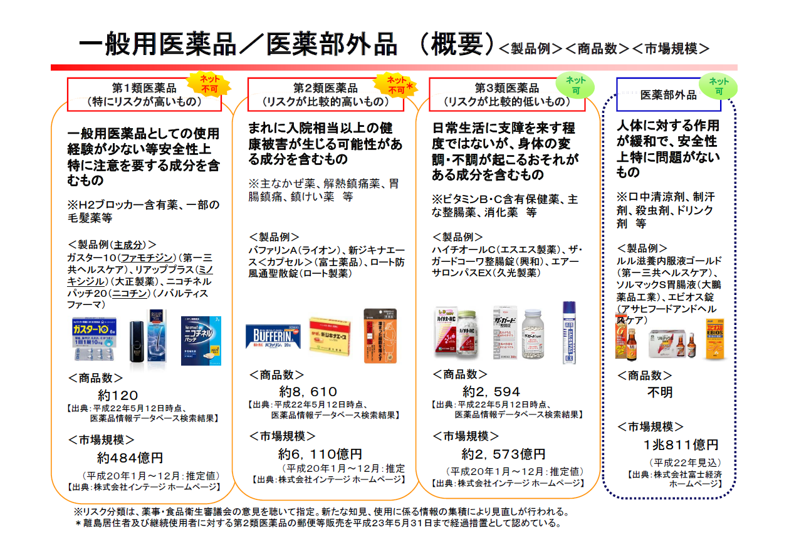

Slide 12
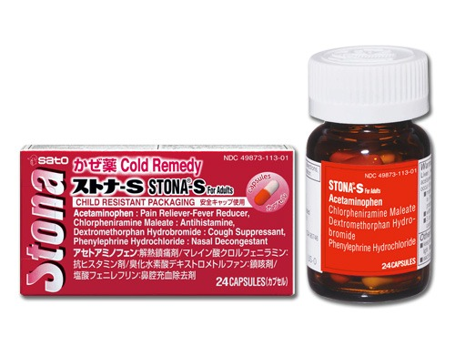
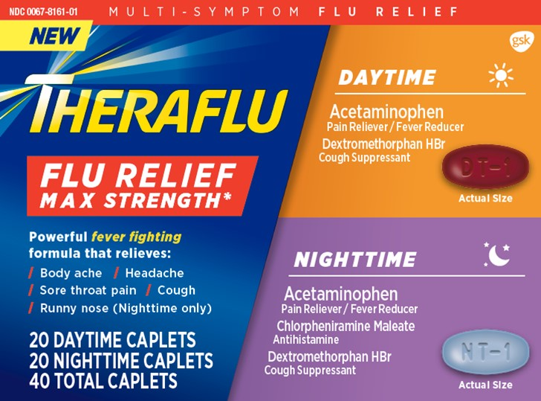
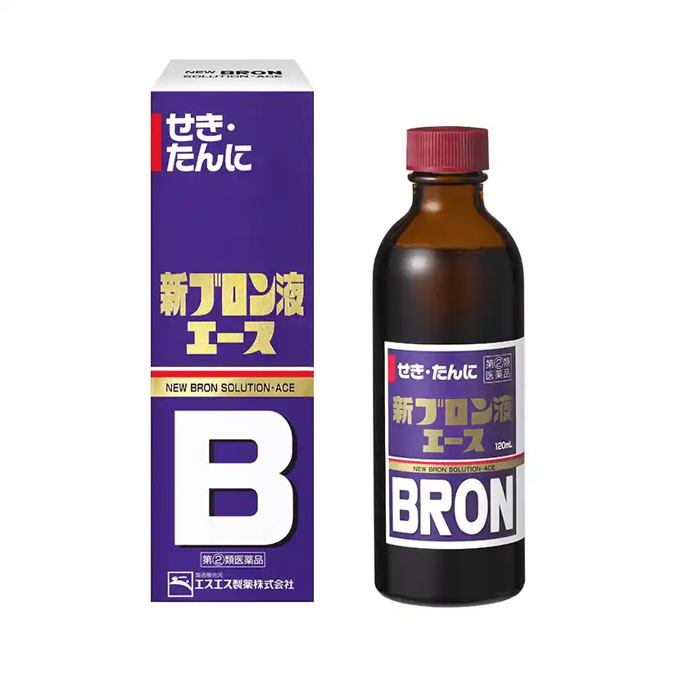
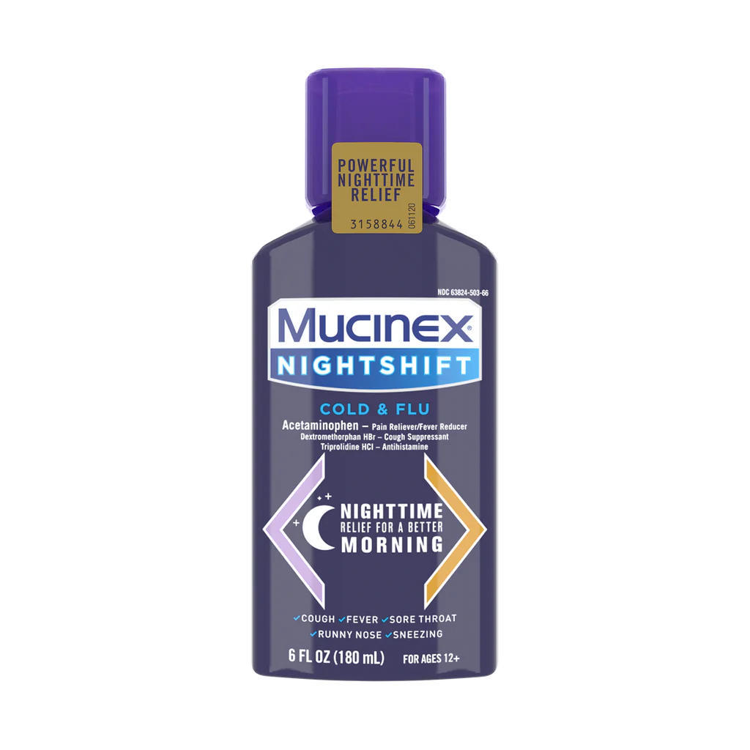
Cough
Drug names/Active ingredient | Japanese Equivalent
Suppressant Dextromethorphan Expectorant Guaifenesin | Stone-S: Acetaminophen 162.5mg, Chlorpheniramine 2mg, Dextromethorphan 10mg New Bron (II): Dihydrocodeine phosphate 30mg, Guaifenesin 170mg, Chlorpheniramine 12mg, Caffeine 62mg
(n.d.). https://www.kobayashi.co.jp/seihin/otc_seihin/

Slide 13
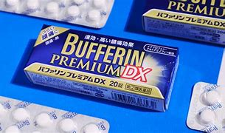
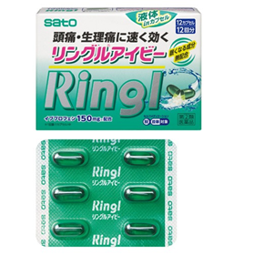
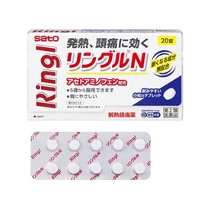
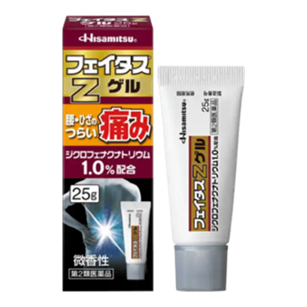
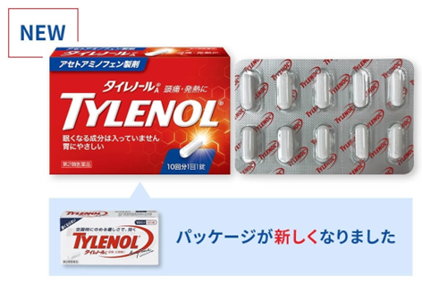
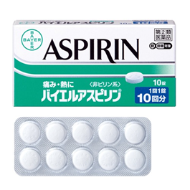
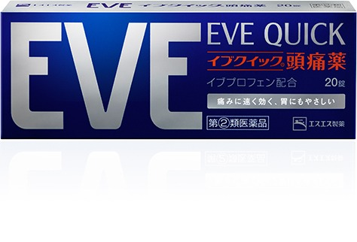
Aches and Pain
Drug names/Active ingredient | Japanese equivalent
NSAIDs/Analgesic Acetaminophen – 325mg, 500mg Aspirin – 81mg, 325mg Ibuprofen – 200mg Diclofenac Gel – 1% | Bufferin Premium DX – Ibuprofen (160mg), Acetaminophen (160mg), Caffeine (50mg) RinglN – Acetaminophen (900mg), Caffeine (75mg) Aspirin – 500mg Ringl Ivy – Ibuprofen (150mg) Eve Quick – Ibuprofen 150mg, Mag Ox 100mg, Caffeine 80mg Fates Z gel – Diclofenac 1%
(n.d.). https://search.sato-seiyaku.co.jp/pub/product/4904/

Slide 14
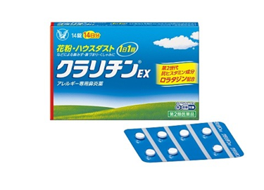
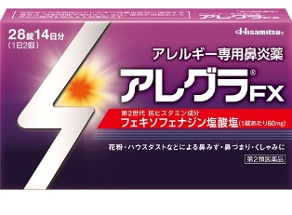
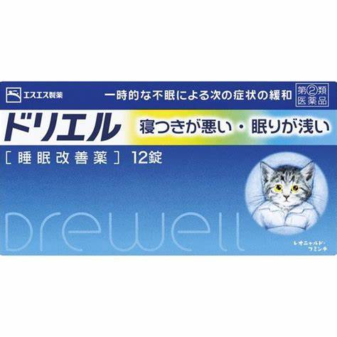
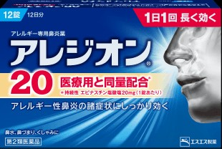
Anti-histamines
Drug Names/Active Ingredient | Japanese Equivalent
Allergy/Cough & Cold Fexofenadine Loratadine Diphenhydramine Chlorpheniramine | Claritin EX (II) – Loratadine 10mg Elesion20 (II) - Epinastine 20mg Allegra FX – Fexofenadine 60mg
Sleep Aid Doxylamine or Diphenhydramine | Drewell – Diphenhydramine 25mg
(n.d.). https://www.catalog-taisho.com/category/02/003/04839/

Slide 15
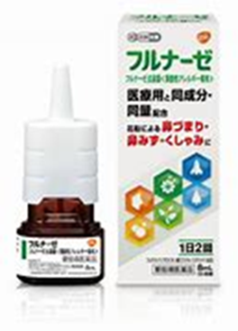
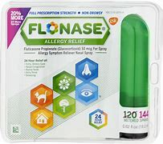

Nasal Spray for Allergic Rhinitis
Drug names/Active ingredient | Japanese equivalent
Seasonal Allergies Fluticasone | Flunase – Fluticasone 50mcg
(n.d.). https://www.flunase.jp/

Slide 16
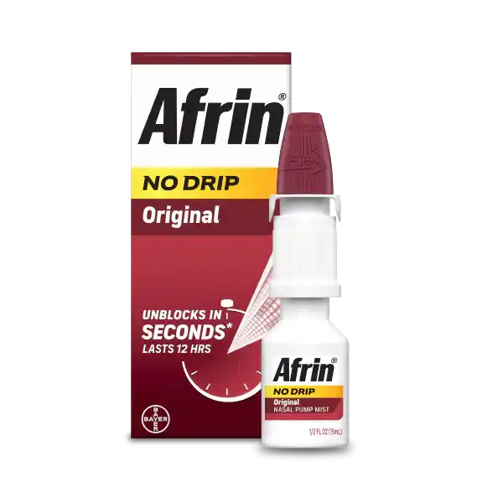
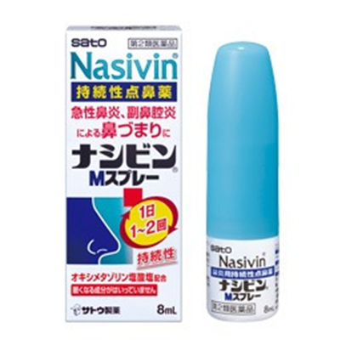

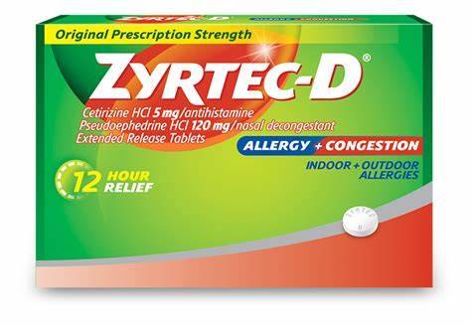
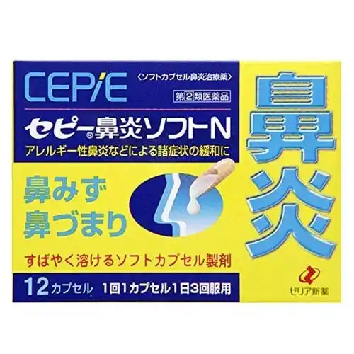
Nasal Decongestant
Drug names/Active ingredient | Japanese equivalent
Nasal Spray/Rinse Oxymetazoline Oral Decongestant Pseudoephedrine | Nasal Spray Nasivin – Oxymetazoline 0.05% Oral Decongestant ZERIA Cepie Rhinitis Soft N – Pseudoephedrine 120mg, Chlorpheniramine 6mg
(n.d.). https://search.sato-seiyaku.co.jp/pub/product/2188/

Slide 17
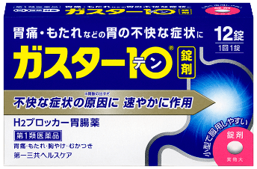
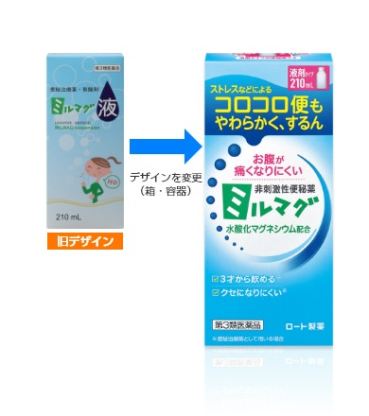

Gastrointestinal
Drug names/Active ingredient | Japanese equivalent
Heartburn Proton Pump Inhibitors Omeprazole Esomeprazole Lansoprazole H2 Blockers Famotidine Antacids Magnesium Hydroxide Antidiarrheal Loperamide | PPIs – Requires prescription H2 Blockers Gaster 10 – Famotidine 10mg Antacid Mill Mag - Magnesium Hydroxide 12g Antidiarrheal – Geridome tablets Kunihiro with Scoplia extract
https://www.kobayashi.co.jp/seihin/otc_seihin/

Slide 18
Learning Assessment Question
What common Japanese medication below can be used to treat headaches?
  Bufferin Premium DX
  NOGOGLE spray
  Gaster 10
  Selbelle

Slide 19
Learning Assessment Question
What medication below contains Famotidine (H2 Blocker) as the active ingredient?
  Tylenol A
  Loxonin S
  Gaster 10
  KAMPO

Slide 20
Learning Assessment Question
What OTC classification requires (mandatory) written information to be provided by a pharmacist?
  Class 1
  Class 2
  Class 3
  Class 1 & 2

Slide 21
Contact
Maj Lam T. Chung (lam.t.chung.mil@health.mil)
Maj Tyrome L. Brown (tyrome.l.brown.mil@health.mil)
CDR Kikuchi Hiroshi (Hiroshi.Kikuchi.jmsdf@gmail.com)

Slide 22

Questions?

Slide 23
Over-the-counter Medications in Japan
Maj Lam T. Chung, USAF
Pharmacy & Nut Med Flt CC
35th MDG
Tyrome L. Brown, USAF
Inpatient Pharmacy Element Chief
35th MDG
CDR Kikuchi Hiroshi, JMSDF
Department Chief of Pharmacy
Ominato Medical Service Unit

