Slide 1
Society of Air Force Pharmacy
Mid-Year Conference
6 - 8 May 2024
Planet Hollywood Resort & Casino
Las Vegas, NV

Slide 2
USP <800> Update: DHA-wide AoR Templates to Beat TJC
IAN C DETTMAN, Capt, USAF, BSC

Slide 3
Learning Objectives:
Define Assessment of Risk (AoR) and its role in USP <800> compliance.
Explain AoR relevance to compendially applicable USP General Chapters and TJC inspections
Describe examples of alternative containment strategies.
Identify facility-dependent considerations.
Notes:
Lt Col Mock: TELL THEM WHY THEY CARE
Tell them what you’re going to tell them: [pull from word doc]
Goal is to connect with resources.
Admit to working at small clinic.

Slide 4
Financial Disclosure
I/my spouse/partner do NOT have any relevant financial relationships.

Slide 5
Compounding Definitions
“The process of combining, admixing, diluting, pooling, reconstituting, repackaging, or otherwise altering a drug or bulk drug substance to create a sterile medication.”
United States Pharmacopeia (USP) 2022
“Compounding is preparing a medication that is not commercially available in the strength, concentration, or form needed for a specific patient pursuant to a prescription, according to the National Association of Boards of Pharmacy Model Act, 2012.”
- American Society of Health-System Pharmacists (ASHP) 2016
Notes:
I’m sure most of us have a pretty good idea of what compounding is. USP (the United states Pharmacopeia) and ASHP (the American Society of Health-System Pharmacists) have their definitions, which you can read, but what we’re most often talking about in the context of USP <797> and <800> is IV admixtures in hospital settings. <797> is sterile compounding, (concerned with safety of the patient) and <800> is hazardous drug handling (which is really geared toward protecting healthcare personnel).

Slide 6
USP <800> Expert Panel:
A resource to military treatment facilities (MTFs) for…
  Assessment of Risk (AoR) templates
  Personnel training
  Anything you think may be useful!
…available in the near future on milSuite.mil!
Notes:
…my message today—my bottom line, if Vegas makes you forget everything else—is to create an awareness of the USP <800> Expert Panel and to communicate the committee and organizational resources at your disposal to prepare for Joint Commission (TJC) inspection on USP <800> items. Our committee is composed of Army, Navy, and Air Force pharmacists who meet monthly to produce and disseminate tools like these that we hope will make life easier for MTFs.
What we’ve made—and are still refining before we make it available on Milsuite in the coming months—is a repository of Assessment of Risk (AoR) templates for every hazardous drug formulation you may dispense at your facility. We’ll get into the details of what an Asssessment of Risk is soon enough, but our intention is for you take a look at what drugs you stock, pull these templates, and mold them to your site’s needs and actual practices, using them as a head start to comply with TJC inspections. TJC requirements regarding HDs will apply to any site dispensing them, but the mechanism of enforcement and applicable chapter standards change slightly depending on whether your site compounds, but the HD list and assessment of risk process is relevant across the board.
I’ve also included some discussion on most of the other USP <800> TJC inspection items since it’ll be covering a lot of the same terrain that the AoR touches.
Shoutout to CDR Jose Pulido, our committee lead, whose leadership and insight have been invaluable for my preparation. I’d also like to thank our own Maj Jessica Pabon for ideas on the Q&A section, and Dr. Jeanell Mansur, the TJC principal consultant for MM who I interviewed for this presentation.

Slide 7
Surveying to Compendially-Applicable Sections
“Compendially-applicable” – only sections of USP 800 that replace previous sections of USP 797 will be surveyed
The Joint Commission [TJC] will survey to only requirements that are “must” or “shall” requirements
  Includes sterile compounding of hazardous drugs
    Will not include non-sterile compounding of hazardous drugs for HAP
    Will not include requirements that are part of administration of hazardous drugs
  An Assessment of Risk (AoR) will be expected at the time of survey
Notes:
I wanted to include this slide completely unadulterated from the Joint Commission’s wholly owned education-focused affiliate, Joint Commission Resources. Here, they’re telling you very broadly what they will and will not survey for USP <800>.
Before we discuss these bullets, let me do some signposting for you. This slide is general guidance, but more specifically, I’ll be using the specific parts of the TJC Surveyor Checklist that our committee is working to helping your comply with as an outline to guide our trajectory.
To be compendially applicable is to be a USP <800> item that USP <797>or <795> formerly referenced. If you are an entity that is required to implement those chapters (i.e., a site that engages in compounding), the process I’m going over explicitly applies to you. If your site doesn’t compound, you still will be held accountable for a HD list and following “a process for managing high-alert and hazardous medications”
Where <797> references <800>, TJC will survey “must” or “shall” <800> requirements, as opposed to “should” items, which can give you some guidance on your read-through of <800>
-Non-sterile compounding will not be surveyed
- Administration is out of scope of USP and won’t be surveyed. [CSTD = example of a containment supplementary engineering control or C-SEC. The only “must” requirements for CSTDs are in the non-surveyed administration sections].
What the TJC will expect and what we’ll spend the majority of today on is the Assessment of Risk (AoR).
[Compendially applicable:
“In the future, if the revised USP and contain reference to USP , would be applicable and compendially required only to the extent to which USP General Chapters and apply. For hazardous drugs, this means only when a practitioner is ‘compounding’ (as that term is defined in USP and ) would be applicable and compendially required. Since administration is out of scope of USP and , General Chapter would not be applicable or compendially required in this context.”
12 Mar 2020: https://www.usp.org/sites/default/files/usp/document/our-work/compounding/compendial-applicability-of-usp-800.pdf
<757> not applicable to Hospital Accreditation Program (HAP) and Critical Access Hospital Accreditation (CAH)]

Slide 8
USP <800> Go-Live Timeline
1 February 2016 – Publication date of USP General Chapter <800>
1 December 2019 – Official Date of USP General Chapter <800>
1 November 2022 – Publication date of USP General Chapter <797> (and <795>)
1 November 2023 – Official date of USP General Chapter <797> (and <795>)
1 November 2023 – <800> enforcement vis-à-vis <797> (and <795>)
1st quarter 2024 – TJC begins surveying <800> compendially applicable items.
Notes:
First we’ll do a little history to give ourselves context for USP <800> implementation.
So in February 2016, USP published General Chapter <800> with an official date in December 2019.
After much delay and turmoil, USP publishes our nonsterile and sterile general chapters, USP <795> and <797>, in Nov 2022 with an official and TJC-enforceable date in Nov 2023.
By extension, at the same time, USP <800> goes live, particularly for entities required to implement <795> and <797> (i.e., sites that engage in compounding)
The take home point is that the TJC began surveying key USP <800> items in the first quarter of this year.

Slide 9
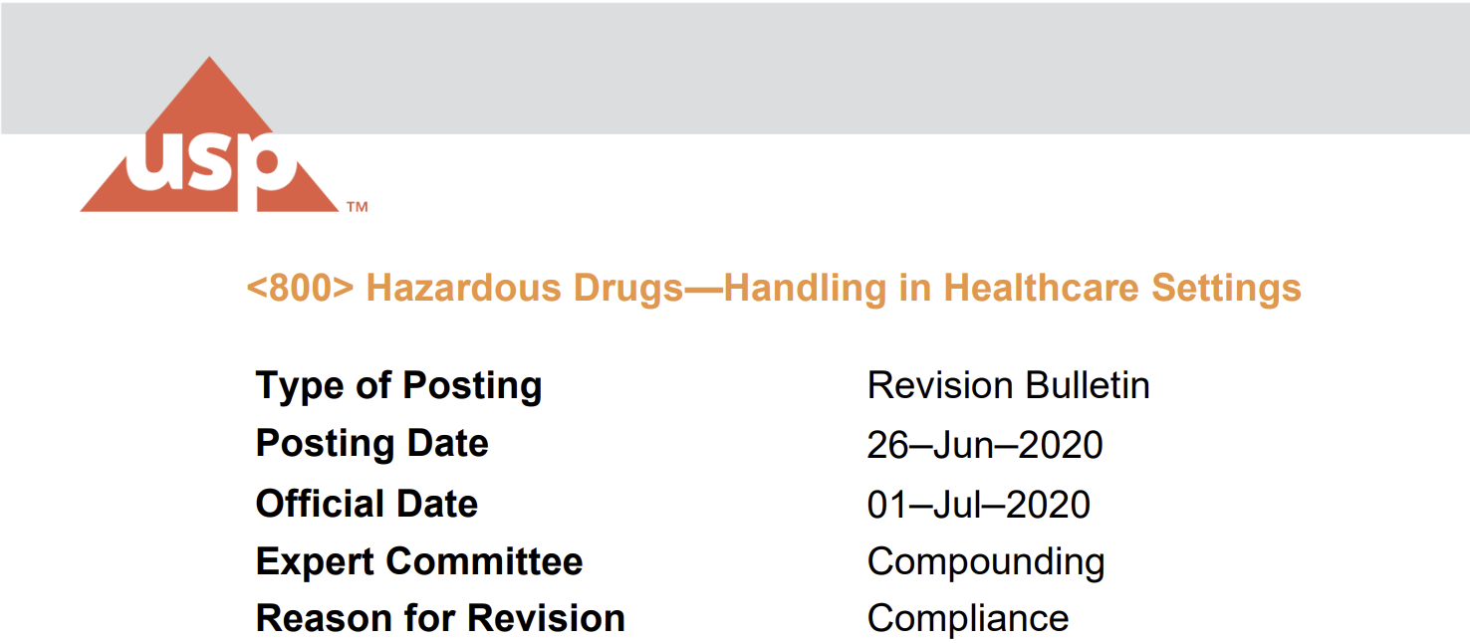
USP <800> Go-Live Timeline (Cont’d)
Notes:
As for USP <800> itself, the latest and greatest revision bulletin we have is from summer 2020. [Where to access?]

Slide 10
Tools: Organizational Resources
USP General Chapters <797> and <800>
NIOSH List 2016
NIOSH Managing Hazardous Drug Exposures: Info for Healthcare Settings
TJC Chapter Standards: MM.01.01.03 and MM.05.01.07
TJC Surveyor Guidance Checklist for On-Site Activity
  Hospital Accreditation Program (HAP)
  Ambulatory Accreditation Program
Notes:
If you’re going to be the designated <800> person, a TJC chapter champion or delegated individual, or anyone on a committee tasked with oversight of review and/or implementation of <797> or <800> (that could people from many disciplines, especially nurses), this is a list of resources you should become very familiar with.
- You’ll obviously want to read <800> in its entirety - it’s only 20 pages and not a bad read.
NIOSH List 2016 is also critical; we’ll discuss that next.
NIOSH also has a resource that condense a lot of literature review and gives a breakdown of performing AoRs, the main subject for today.
TJC
More important than the standards themselves, are the TJC Checklists for whatever site you are at (Work with your TJC coordinators to find these checklists; they’re buried in the TJC connect extranet site as of late 2023.

Slide 11
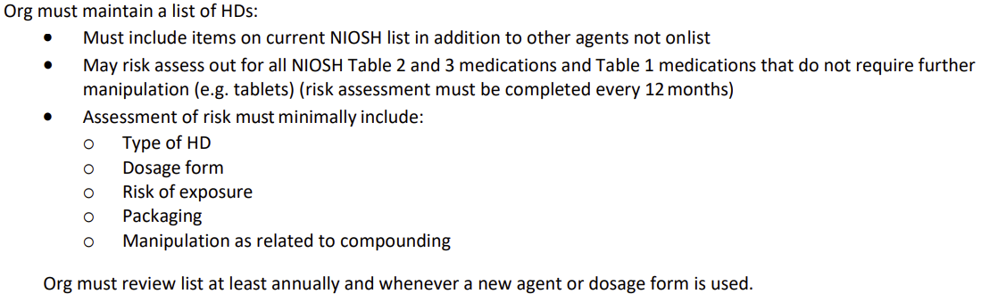
TJC Medication Management (MM)
Surveyor Checklist – MM.05.01.07
Notes:
All right; we’ll start with the easy stuff: Your site will develop and maintain a list of hazardous drugs, review it annually, and make changes as new products are brought to market and/or added or removed from your formulary.
Until placed on this list, new drugs meeting HD criteria that come to market should be treated as such.
HAVE A LIST

Slide 12
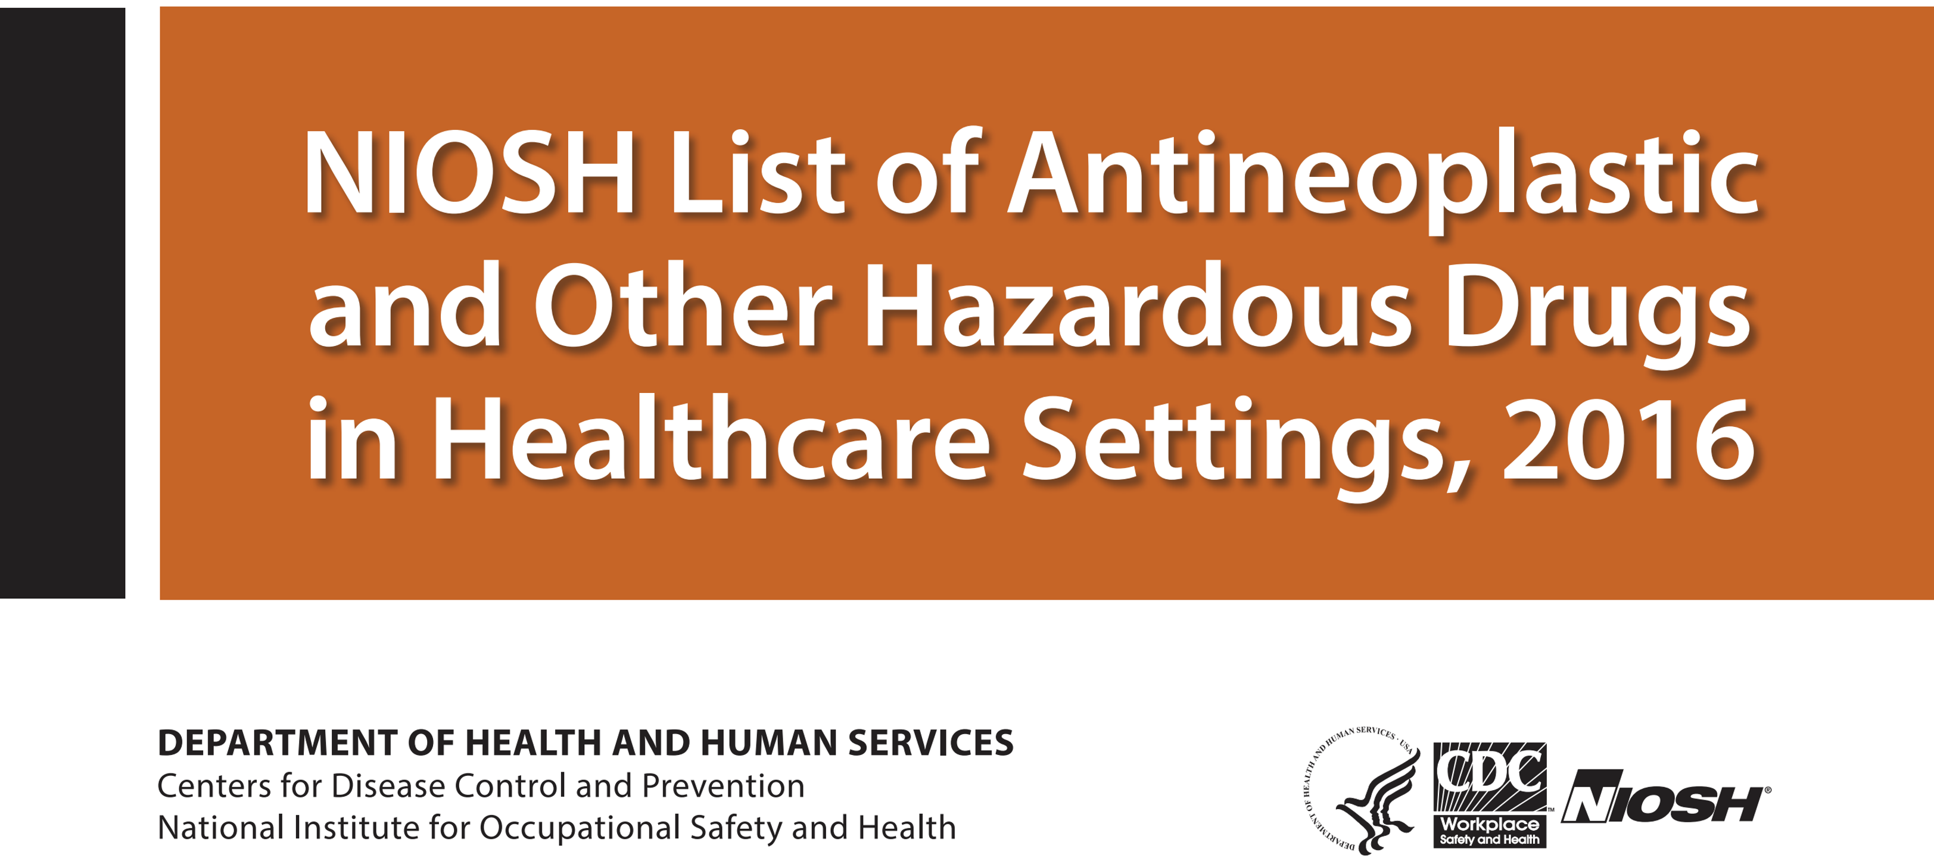
Tools: Organizational Resources
Notes:
The National Institute of Occupational Safety and Health’s (NIOSH) List of Hazardous Drugs is the list that you will use. The goal is to cross reference what you dispense at your site that you also see on this list, and that’s your site’s list that TJC will want to look at.
NIOSH 2016 is still the most recent list until the long-awaited 2020 (now rebranded to 2023) list comes out. The list has been contingent on development and feedback of other NIOSH resources on hazardous drugs that we’ll get into shortly.
[ASHP:
https://news.ashp.org/news/ashp-news/2023/04/27/niosh-finalizes-procedures-for-developing-hazardous-drug-list
NIOSH update:
https://www.cdc.gov/niosh/topics/hazdrug/default.html
NIOSH publications:
https://www.cdc.gov/niosh/topics/hazdrug/pubs.html]

Slide 13
Tools: Organizational Resources
NIOSH List
  Group 1 – Antineoplastic HDs
  Group 2 – Non-antineoplastic HDs
  Group 3 – Reproductive-only HDs
The list of hazardous drugs is updated periodically on the website http://www.cdc.gov/niosh
Defense Centers for Public Health – Aberdeen (DHA Public Health Office: 410.436.5231)
Notes:
Within this document, NIOSH categorizes HDs intro groups 1, 2, and 3 (or “Tables” 1, 2, and 3) that you see listed here. The USP <800> revision bulletin for June 2020 that we just talked about clarifies that the several antineoplastic HDs newly categorized in Group 2 in the (still upcoming) 2023 NIOSH list won’t require Group 1 treatment. So as far as USP and TJC are concerned, Group 1 is Group 1 is Table 1 is Table 1.
[NIOSH adopts and revises ASHP definition:
Carcinogenicity
Teratogenicity or other developmental toxicity
Reproductive toxicity
Organ toxicity at low doses
Genotoxicity
Structure and toxicity profiles of new drugs that mimic existing drugs determined hazardous by above criteria.]
When the new NIOSH list does drop, the CDC will post it here: [http://www.cdc.gov/niosh/topics/hazdrug/]. They also post updates about delays here.
(…) can take a site’s formulary and provide them with the applicable NIOSH and RCRA categories [Department of Toxic Substances Control: ignitability (D001), corrosivity (D002), reactivity (D003), and toxicity (D004 - D043)].
BUT without giving too much away, we have a excel format for a site’s hazardous drug list that works together with all of the other material

Slide 14
TJC Medication Management (MM)
Surveyor Checklist – MM.05.01.07
Notes:
Here’s our big-ticket item for the day: The organization performs an assessment of risk (AoR) annually if alternate containment strategies are utilized. It lists required components, but we’ll get into them.
For now, know that a containment strategy is anything measure taken described in USP <800> to mitigate the hazardous drug exposure to staff. An alternative containment strategy, is any measure that, due to a site’s documented judgement, deviates from those described in <800> but achieves the same goal of protecting staff. This may also be called an “exemption.”
PERFORM AN ASSESSMENT OF RISK

Slide 15
AoR: Foundational Principles
Organizational decision: whether to perform an Assessment of Risk (AoR)
  Option 1#: Treat all hazardous drugs with all containment strategies in <800>
  Option 2#: Perform an Assessment of Risk
TJC Surveyors will be looking for whether an AoR has been completed and can survey to preparation requirements within.
Notes:
All of which is to say… you have to decide whether to perform an AoR. […]
TJC surveyors will be looking….
Differentiating example: private compounding pharmacy handling API that only prepares topical formulations vs. larger healthcare institution. [CDR Pulido couldn’t think of any realistic examples, either.]

Slide 16
AoR: Foundational Principles
***Antineoplastics for manipulation and any bulk HD active pharmaceutical ingredients (API) must follow USP <800>***
***An AoR is performed and documented at least annually for antineoplastics with dosage forms that are in final form or only require minimal manipulation, non-antineoplastic agents, and reproductive-only HDs.***
Notes:
If you are performing an AoR, (which is likely your situation if you’re here at this conference from an MTF), this is the fundamental rule of which drugs are subject to USP <800> and which drugs you may perform an AoR on.
Antineoplastics (that is, Group 1 aka Table 1 drugs) for manipulation (…)
For what I mean by manipulation, look to the second box: you may perform an AoR for Group 1 NIOSH drugs in final form (think tablets, capsules, prefilled syringes—anything you don’t do more to than count or slap a label on or repackage). You may also perform an AoR on all Group 2 and Group 3 drugs regardless of dosage form.

Slide 17
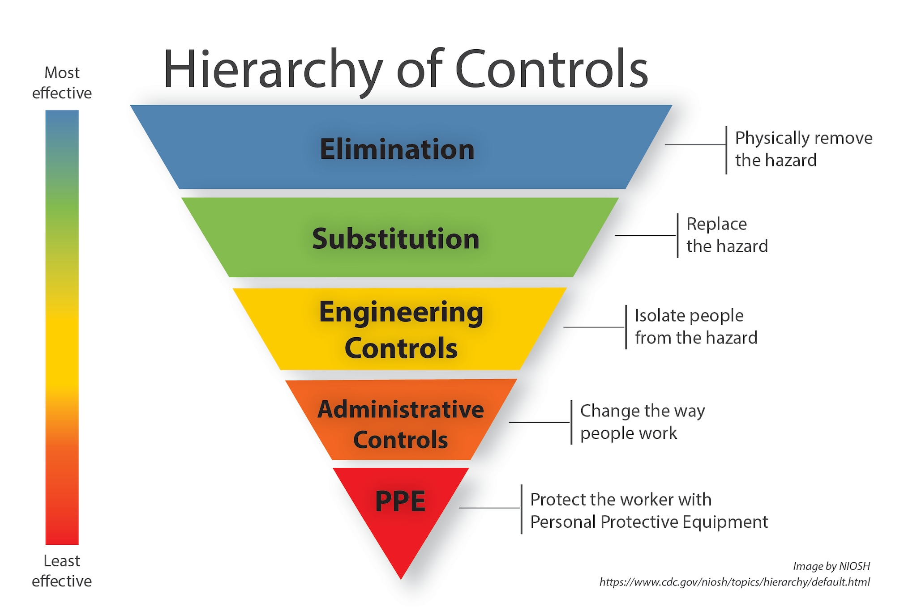
Risk Assessment & Exposure Control: USP <800>
WHAT’S THE ASSESSMENT OF RISK ALL ABOUT?
CONTAINMENT STRATEGIES
USP <800> establishes the containment strategies and work practices best known to control hazardous drug contamination:
      Engineering controls
      Protective equipment
      Work practice
RISK ELEMENTS
  Required Assessment of Risk Elements:
  Drug
  Dosage form
  Risk of exposure
  Packaging
  Manipulation
  Documentation of alternative containment strategies and/or work practices
  Review annually and document
Notes:
So what is an assessment of risk? What is a containment strategies?
We defined containment strategies before—those are our safety measures. Some containment strategies have been evaluated more than others—those would be everything that USP <800> talks about bulleted here: engineering controls, PPE, and work practices. Your alternative containment strategies that you document on your AoR will likely be a work practice.
Containment strategies help you control risk elements—these are the components of the AoR
the drug,
formulation,
exposure risk,
manipulation, and most importantly,
the alternative containment strategies.
Alternative containment strategies are the end goal and purpose of why we do an assessment of risk. If we treated every drug with every stipulation of USP <800>, we’d have no problems. BUT that would suck. The AoR let’s us tailor our work practices to the reality of the lower risk of medications that we manipulate minimally. BUT WE HAVE TO DOCUMENT WHAT WE DO. The TJC will look for exactly that—documentation as to what we actually do if we’re not implementing all USP <800> containment strategies.

Slide 18
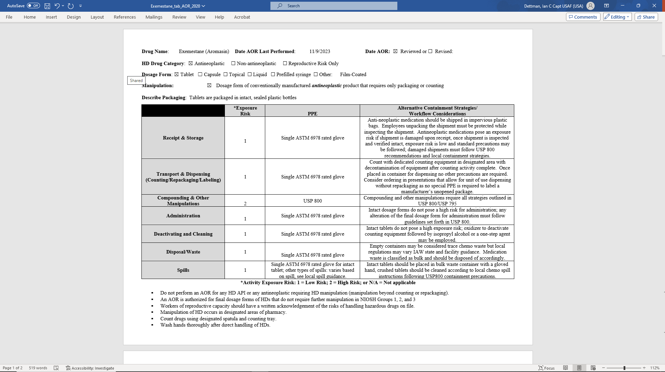
Notes:
Here’s an example of what our committee has made for the NIOSH drugs.
Up on top we have the NIOSH Drug category, the dosage form, the type of manipulation it undergoes, the packaging description—all of the components of the AoR as outlined in <800>.
As for the table, we have activity sorted on the left column vertically coupled with an exposure risk. The exposure risk (a necessary AoR component) drives our PPE considerations—more on that later.
In the rightmost column, we’ve prepared example expected, middle-of-the road descriptions of possible alternative containment strategies in the rightmost column.
Examples might include use of specific closed system drug-transfer devices CSDT across departments, the type of cleaning agent or EPA-registered oxidizer you use for deactivating and cleaning of a given agent, and so on—whatever it is, its specific to your site and documented.
Notice that what will not change for the group 1 drugs is the “Compounding & Other Manipulations” row. For group 1, that’ll always read “USP <800>” because you have to use all USP <800> containment strategies when you compound those drugs.

Slide 19
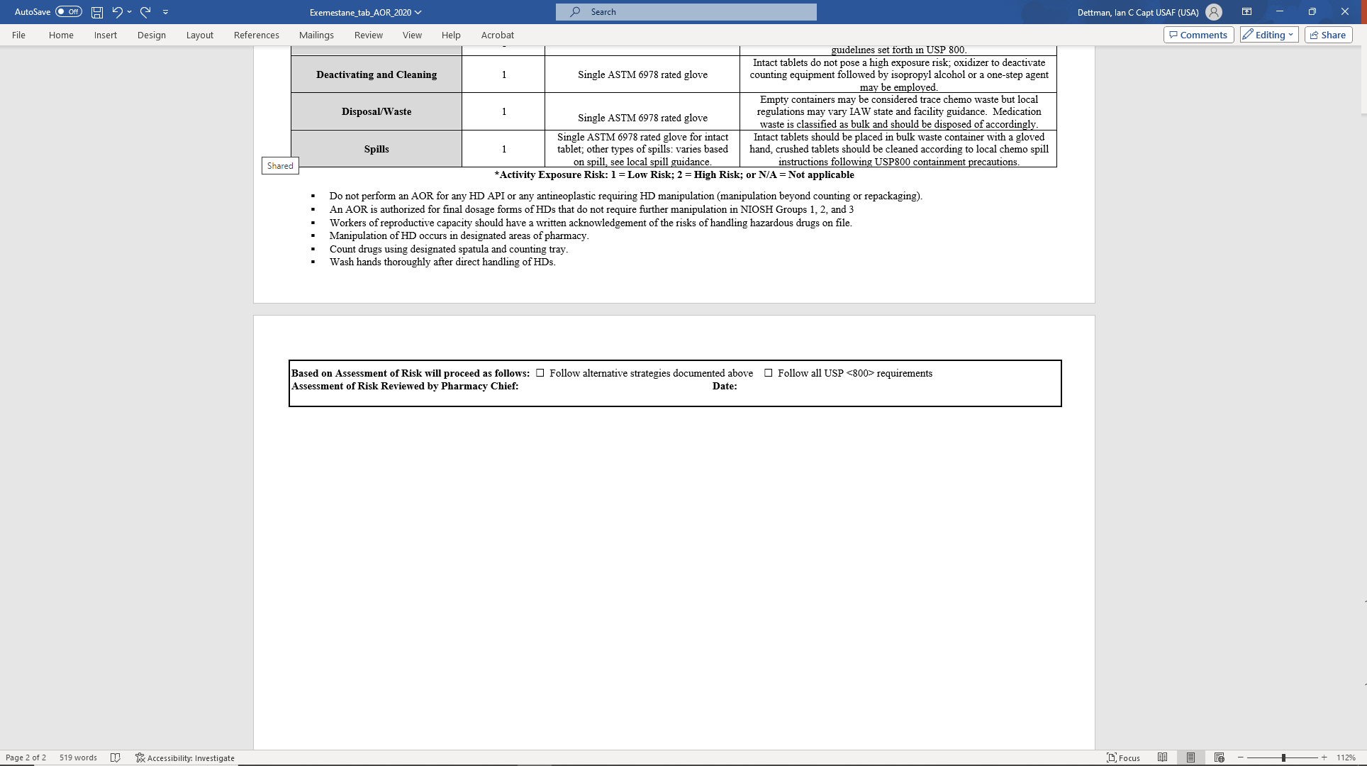
Notes:
Also pay attention to the bottom of this document. Whoever your USP <800> designated person can indicate your site’s organizational handling of this particular hazardous drug and annotate your yearly review.
We have one of these for every NIOSH drug Tables 1-3—including one for every formulation as stipulated in <800>. It was a fairly extensive undertaking, and it’s still not a final product. You’ll have to select the ones that your site dispenses, and mold them to your actual workflow practices.
[Maj Zsido: Bottom box for the unit to fill out at their own MTF for implementation—whoever their USP 800 “Designated person” is.]

Slide 20
USP <800> EP Outcomes
Specificity of PPE requirements
  Single/double ASTM D6978-rated glove(s)
Consistency of recommendations within risk categories
  Role of Formulation
  Deactivating and Cleaning vs. Disposal/Waste vs. Spills
Flexibility to site-specific considerations
  Your containment strategies are yours!
Notes:
Several issues we’re currently workshopping before releasing to MTFs ideally a few months from now include fine-tuning specific PPE recommendations, the consistency of recommendations for a given formulation for a specific risk category, and keeping the alternative containment strategies general enough.

Slide 21

Assessment of Risk—Wrap Up
MINIMUM CO NSIDER AT IONS
Type of HD
Dosage Form
Risk of Exposure
Packaging
Manipulation
RECALL:
Document alternative containment strategies and/or work practices
Review and document every 12 months
Notes:
As a quick recap, AoRs require at a minimum type of HD (group 1 vs. 2 vs. 3), dosage form, risk of exposure (that we pair that with our PPE recommendations), packaging description, and manipulation (i.e., this is the answer to the question: is it a group 1 drug that we compound or HD API? If not, an AoR is fair game.
The good news is we’ve included all of those items on our AoR templates.
As another reminder, the goal of committee is to produce an end product that is a middle ground in site practices, but you need to document your actual alternative containment strategies—i.e., any drug that you don’t subject to the entirety of <800> requirements needs to be written down.

Slide 22
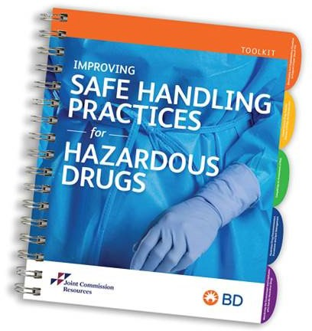
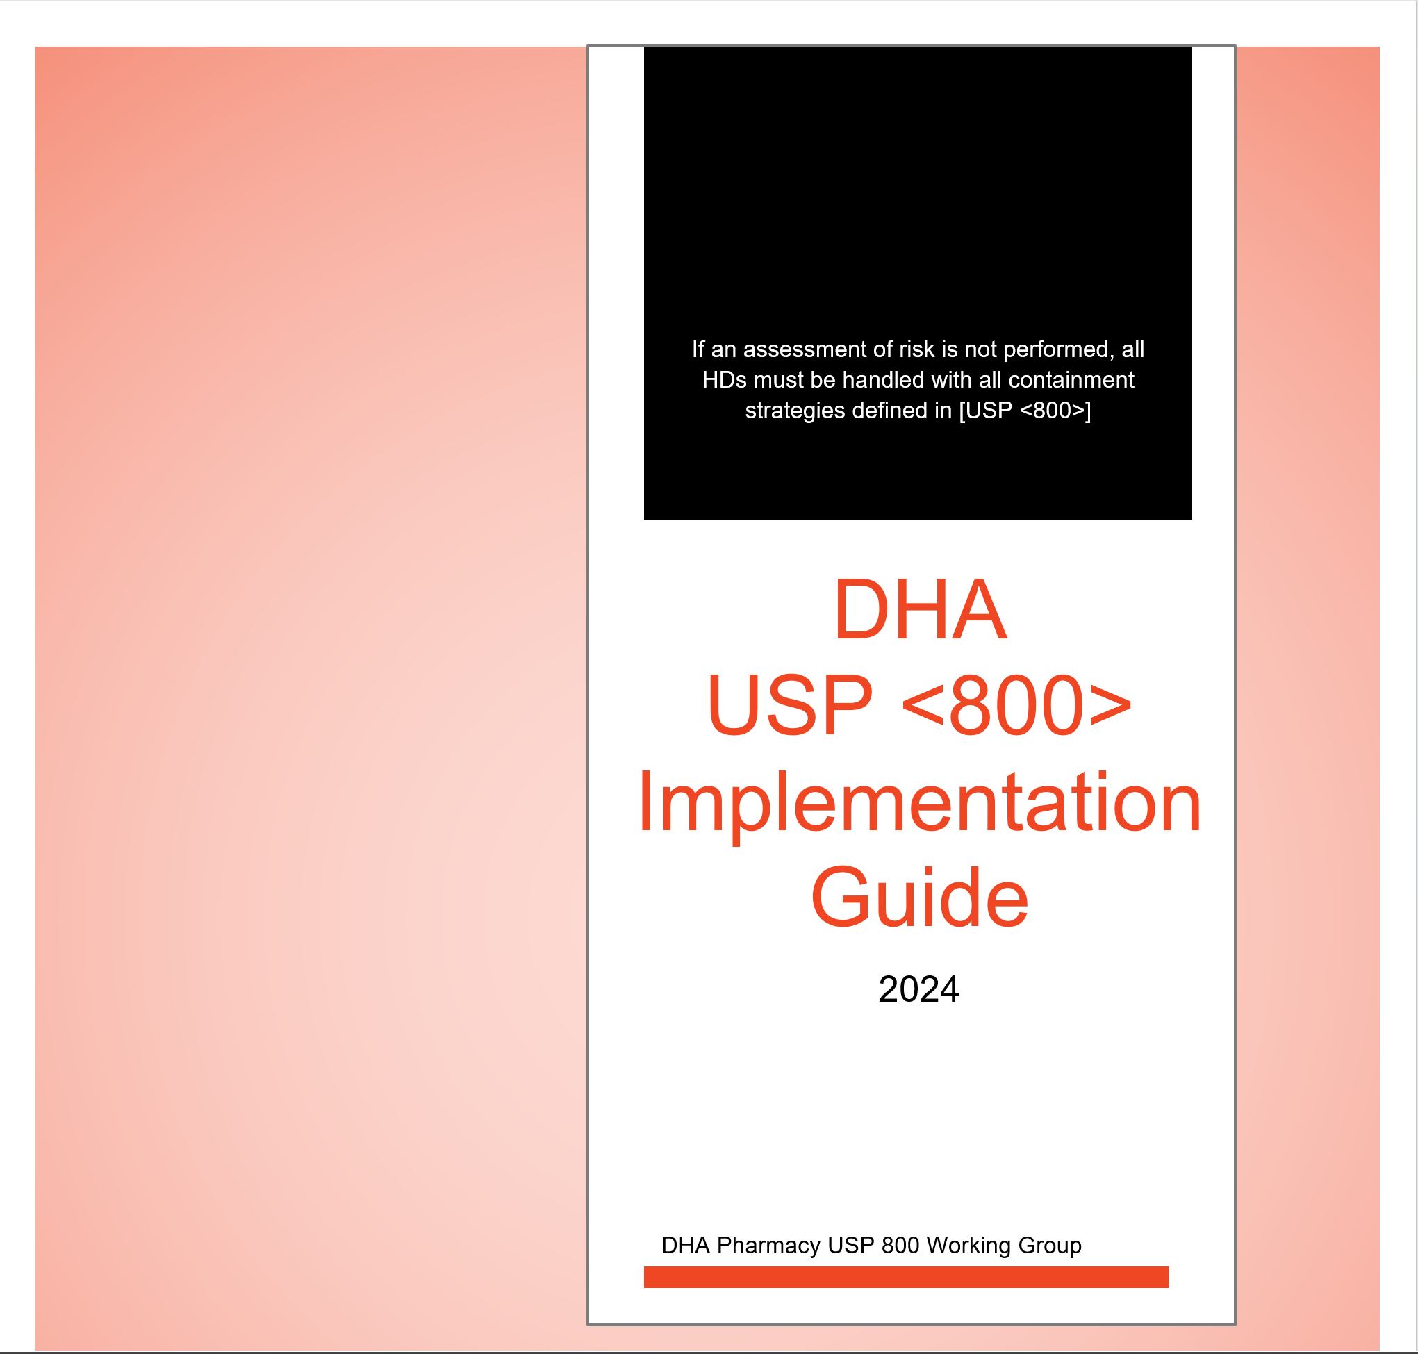
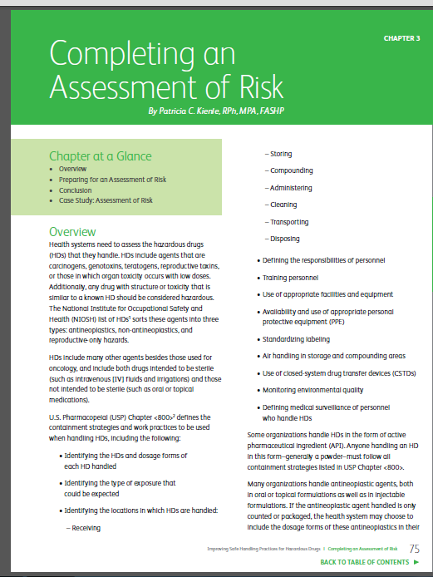
Additional Detailed Guidance for Performing an Assessment of Risk
Coming soon to milSuite.mil!
https://go.bd.com/hazmedsafety-toolkit-request.html
Notes:
To that end, for your reading pleasure, we have a DHA guide for <800> implementation that will walk you through this process I’m describing.
There are also third-party resources out there like BD that can help you with a very detailed Assessment of Risk walkthrough as well as gap analysis to develop an action plan to address surveyable items. [© 2023 Joint Commission Resources. All Rights Reserved.]
Come find me if you’re interested in this, but one thing I do want to share that I learned reading from this and from talking to Dr. Jeanelle Mansur is if you form a committee at your own site to investigate and implement hazardous drug handling, involve nurses. Get them on the committee. They’re a huge part of the picture of HD handling across departments, they’re the ones who administer (and as we know, TJC doesn’t assess administration), and they deserve to know when a drug they’re handling is hazardous.

Slide 23
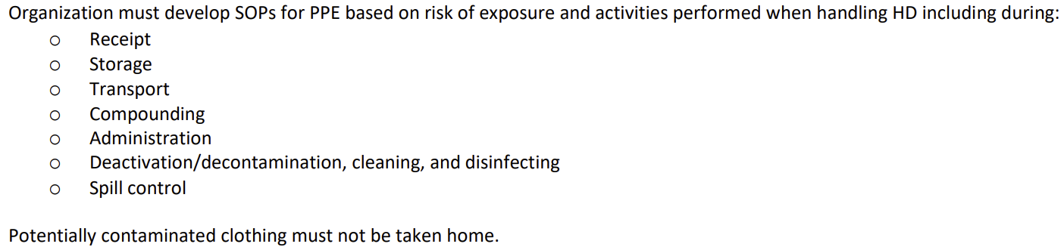
TJC Medication Management (MM)
Surveyor Checklist – MM.05.01.07
Notes:
{Move to AoR section?}
Again, directly from our surveyor checklist, there’s a lot of sections with guidance on PPE—chemo gloves, gowns, and other PPE all have their specifications use instructions in non-hazardous compounding vs. hazardous, etc. You can find it all in <800> and TJC checklist. Rather than get lost in those details today [next slide!], note the language used here: (…)
That sounds a lot like the structure of our AoRs, and look! Every category mentioned here—receipt, storage, transport, down the list—is included in our AoRs. Much of this guidance is rooted in…

Slide 24


Personal Protective Equipment (PPE)
Chemotherapy Gloves
Gowns
Other PPE
Must meet ASTM D6978 standards
Must be powder free
Must be inspected during use and replaced if torn, punctured or contaminated
Should be changed every 30 mins or as specified by manufacturer
1 pair recommended for administration of intact tablet or capsule
2 pairs recommended for compounding an administration
If working within a CACI the outer glove must be sterile
Must be disposable
Must be shown to resist permeability by HD
Must close in the back
Must be long sleeved
Must have elastic or knit closed cuffs
Must be worn for compounding HD
Must be worn for administering injectable antineoplastic HDs
Must be replaced per manufacturer’s information for permeation or every 2-3 hours if no permeation information
Must be replaced after spill, splash, or other contamination
Shoe covers
  Must have 2 pairs for HD compounding
Face (shield) protection
  Must be used when there is a risk of a spill or splash outside of the C-PEC
Eye Protection
Activities outside of a C-PEC with a spill/splash risk
Administration activities spill/ splash risk
  Oral HD to resistant patient
  Irrigations of HD
Notes:
X

Slide 25
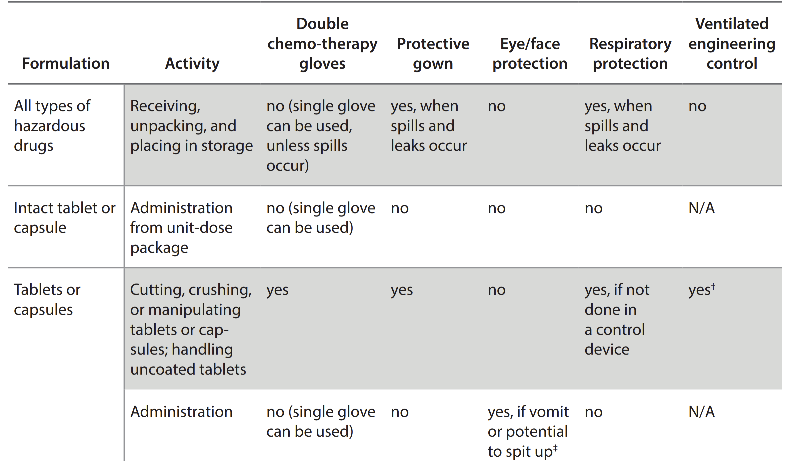
Tools: Organizational Resources
Notes:
…the same document as our NIOSH List! So addition to USP <800> itself, the NIOSH recommendations here for PPE are a starting point for what goes into the AoRs. So again, the benefit here is that we’ve done this work and written the policy for you.
Table 5 in the NIOSH List document pictured here is a lot longer than this, but I wanted to highlight two overarching points that informs performance of an AoRs: (Formulation vertically in the lefthand column is organized against the type of PPE needed as you go right.)
1) The common denominator here for the recommendation for single vs. double chemotherapy gloves, whether to wear a gown, etc. usually comes down to—at the risk of repeating myself—whether the worker is directly handling HD API—which includes cutting, crushing, or otherwise manipulating tablets or capsules.
2) Where PPE is concerned, a given drug’s formulation and what you’re doing dictates the handling recommendations, not the simply NIOSH group it falls into. The recommendations from this NIOSH table refers to all groups 1-3. BUT the NIOSH group WILL help us determine other handling practices that we’ll see on the next slide.

Slide 26
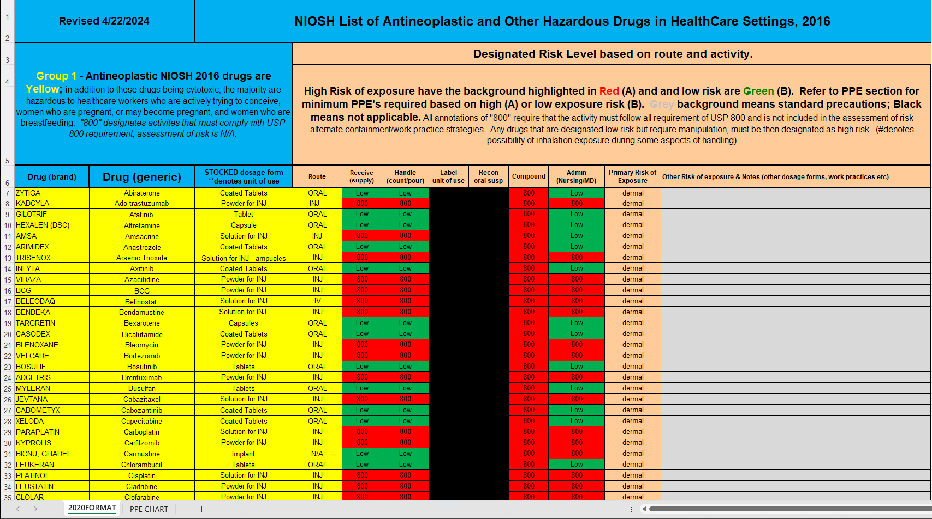

Slide 27
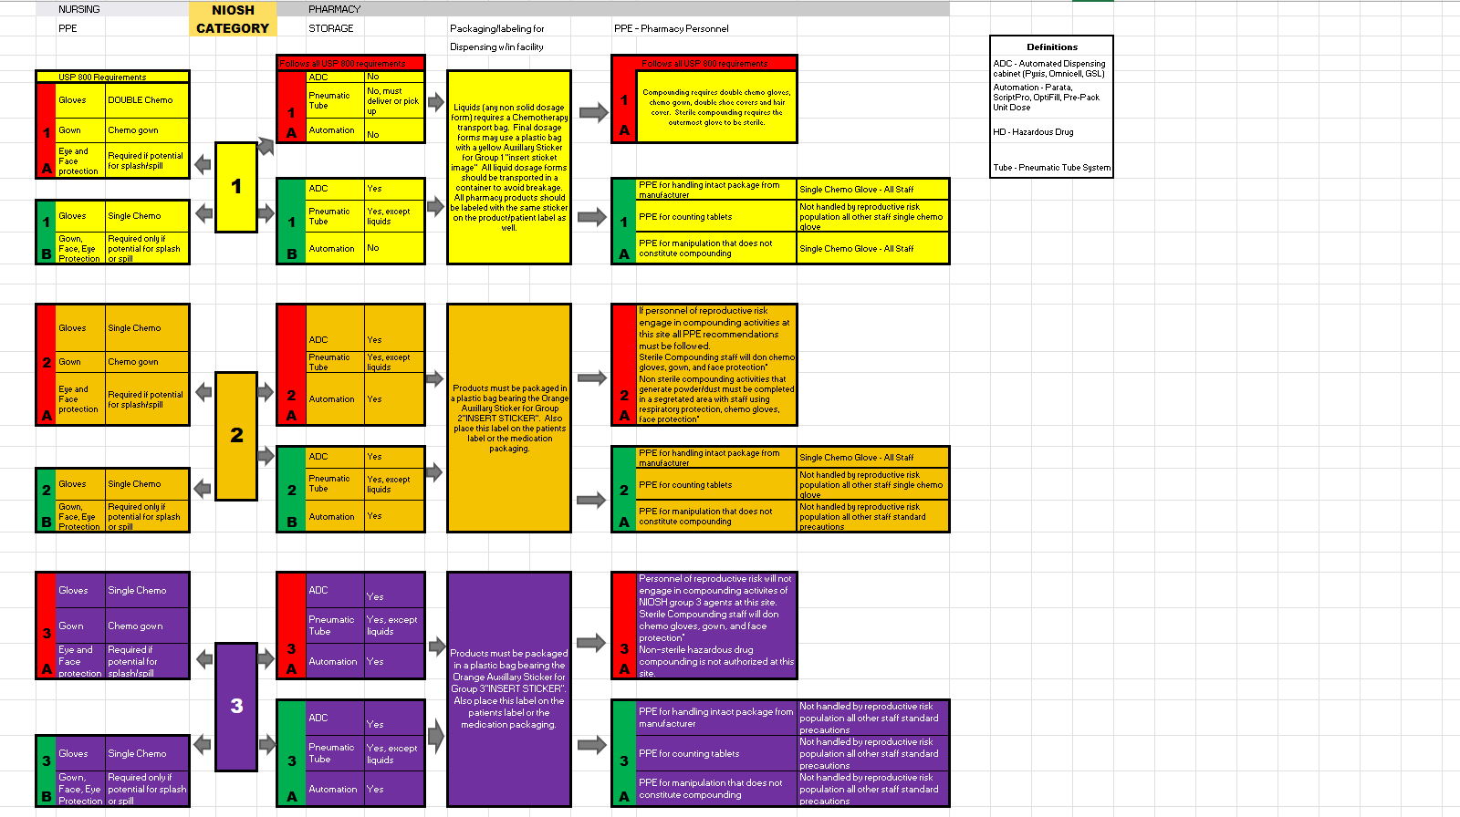
Notes:
Color-coded PPE chart from meeting!
This document isn’t so much strictly for educational purposes necessarily—you all work in pharmacy and know your site certainly better than I do and have access to the same organizational resources—as it is for helping to provide standardized documentation—a written policy that you can point to during surveys.
Goal of committee is to produce an end product that is universally available, but able to be tailored to your sites needs.

Slide 28
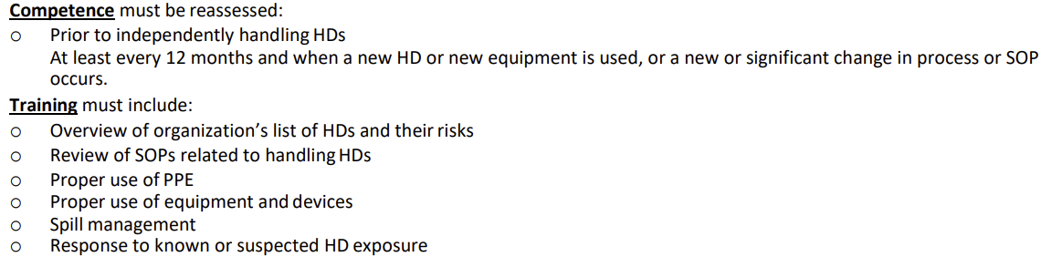
TJC Medication Management (MM)
Surveyor Checklist – MM.05.01.07

Slide 29
Personnel Training: USP <800>
The training must include at least the following:
  Overview of entity’s list of HDs and their risks
  Review of the entity’s SOPs related to handling of HDs
  Proper use of PPE
  Proper use of equipment and devices (e.g., engineering controls)
  Response to known or suspected HD exposure
  Spill management
  Proper disposal of HDs and trace-contaminated materials
Notes:
The TJC will also be looking
To satisfy USP 800 requirements, the training has to require these components. I’m not going to read them off to you; they can be found in <800>. More importantly, know that our committee has a template that we’re working on finishing and pushing out to MTFs to help them meet this training requirement.
[Recommend USP <800> team also produce a standardized training to compliment the handling guidance and to satisfy USP 800 training requirements in Relias – working on template
I’ve noted these discrepancies at a few bases, either the training is absent and/or not all encompassing.]

Slide 30
FAQs: #1
Q: Does USP <800> require environmental sampling?

Slide 31
FAQs: #1
Q: Does USP <800> require environmental sampling?
A: No*
*Surface wipe sampling has been controversial at many facilities.
Example: Fort Carson requires this; although NIOSH and USP <800> recommend this practice, though there is no “acceptable” limit for surface contamination.
Notes:
SEPARATE FROM USP 797 SURFACE MONITORING WHICH IS REQUIRED, neither USP <800> itself nor TJC requires testing for the presence of hazardous drugs. This is an example of a “should” requirement, not a “shall” or “must” Some facilities, like Evans Army Community Hospital at Fort Carson, choose to require it, but it’s really up to the facility how to handle it.

Slide 32

BEST PRA C TICES
SURFACE-WIPE SAMPLING
  Recommended practice to detect surface HD residue.
  Done initially and at least every 6 months.
  Data is lacking regarding sampling method and contamination limits.
  Verify sampling kits have been properly tested—none currently certified
If opting to conduct environmental wipe sampling (as suggested but not required by USP <800>), contact an analytical lab or vendor to discuss such a program.
Consider the periodic examination of all areas where HD are stored, compounded and disposed of, and where reusable utensils and equipment are cleaned.
Notes:
If you do decide to test, contact an analytical lab or vendor (such as BD) and target obvious areas—that is, those in proximity to where you handle and store drugs.
BD surface monitoring info:
https://www.bd.com/content/dam/bd-assets/na/medication-delivery-solutions/documents/brochure/BD-9639_BD_Hazardous_Drug_Surface_Contamination_Assessment_Program_Brochure.pdf
On the right-hand column, you’ll see a list of recommendations generated from the publication “NIOSH Managing Hazardous Drug Exposures”; pp 21-22 strongly recommends surface sampling, citing a number of studies demonstrating detectable amounts of hazardous drugs:
https://www.cdc.gov/niosh/docs/2023-130/2023-130.pdf?id=10.26616/NIOSHPUB2023130

Slide 33
FAQs: #2
Q: We receive shipments from our drug vendor with NIOSH list medications mixed in. What are the PPE requirements?
Notes:
x

Slide 34
FAQs: #2
Q: We receive shipments from our drug vendor with NIOSH list medications mixed in. What are the PPE requirements?
A: ASTM-rated gloves are needed.
Challenges
Notes:
Lack of DHA policy to enforce
<800> applies and spells things out pretty clearly.
Drug Vendor [Amerisource Bergen] identification of NIOSH medications
We have found and voiced to ABC several times to label and appropriately segregate these drugs. What the logistics team has found, is the totes are always marked accordingly (e.g., NT-1), and are mixed with other legend medications.
Unsure what can be done to appropriately address this issue. In turn, it has caused issues with MedLog (1) there’s currently no DHA policy to enforce USP 800 standards [ICD: recall question by Newman to CDR Pulido] (2) resistance to wear ASTM rated gloves during receiving of all drugs due to NIOSH mixing issue.

Slide 35
Receipt & Storage: Flowchart
Shipment Received
Place in negative pressure room
NO
Refrigerator placed in YES
negative pressure room
Refrigerated?
NO
Appears Damaged?
NO
NIOSH Group 1?
YES
Final dosage form?
YES
NO
YES
Can you refuse?
NO
See damaged HD flow chart
API?
NO
May place in general stock
YES
YES
Refuse Shipment
Place in Negative pressure room
Notes:
I have a couple of simple flowcharts sourced from our <800> committee.
If we stop and reason for moment and apply that fundamental distinction—NIOSH Group 1 than needs to be compounded or any HD API vs. a minimally manipulated Group 1 drug or Group 2/3—we see that same reasoning played out here.

Slide 36
Receipt & Storage: Damaged Shipment
Receipt of Damaged HD
Treat as shipment received (Receipt and Storage flowchart)
UNDAMAGED PRODUCT
Is part of shipment usable?
Transport to HD CPEC and open on plastic backed absorbent mat.
Wipe down the usable product with a disposable wipe, being careful not to obscure the labeling.
Deactivate, decontaminate, and clean CPEC. Dispose of mat and cleaning disposables with hazardous waste
Must it be opened?
YES
YES
NO
NO
Dispose of as hazardous waste in accordance with (IAW) local policy
NO
Can it be returned?
Enclose in impervious container while in CPEC and label as hazardous
DAMAGED PRODUCT
Ensure it is sealed in impervious container and labeled as hazardous, and return to supplier IAW local policy
YES
Notes:
And any damaged shipment must follow <800> containment strategies.

Slide 37
FAQs: #3
Q: Will TJC survey medication administration?
Notes:
Preparation vs. administration: spiking IV bags (#3 and #4 are the same)

Slide 38
FAQs: #3
Q: Will TJC survey medication administration?
A: Not assessed by TJC; USP has defined administration outside of the scope of <797> and <800>
Notes:
Key question to clarify: what looks like compounding, but isn’t
These chapters pertain to preparation; they apply when a user is “actively compounding.”

Slide 39

Administration: Best Practice Discussion
HDs must be administered safely using protective medical devices and techniques. Best practices include:
Using CSTDs when administering hazardous drugs when the dosage form allows.
  “Must” or “shall” vs. “should”
Advance spiking of IV bags priming IV tubing with non-HD solution in CPEC.
  TJC has no specific requirements
Notes:
I do have some examples of practices, which of course if your site performs, would be an alternative containment strategy that you could document.
CSTDs are a good example of an alternative containment strategy. [do bit—. Look in your AOR guide/earlier presentation.
Drug and bag proprietary systems (e.g., Add-Vantage, Mini-bag plus)
Advance assembly – Assembly must be within a laminar flow hood
Just in time assembly – Assembly outside of a hood is allowed

Slide 40
References
Managing hazardous drug exposures: information for healthcare settings. (2023). https://doi.org/10.26616/nioshpub2023130
Mansur, J., Connor, T., Douglass, K., Eisenberg, S., Kastango, E., Kienle, P., Massoomi, F., & Parsad, S. (2016). Improving Safe Handling Practices for Hazardous Drugs (1st ed.) [Ebook]. Joint Commission Resources.
Connor TH, MacKenzie BA, DeBord DG, Trout DB, O’Callaghan JP. Cincinnati, OH: NIOSH [2016]. NIOSH list of antineoplastic and other hazardous drugs in healthcare settings, 2016. U.S. Department of Health and Human Services, Centers for Disease Control and Prevention, National Institute for Occupational Safety and Health, DHHS (NIOSH) Publication Number 2016-161 (Supersedes 2014-138).
The Joint Commission Resources. (2023). Medication Compounding Checklist HAP: Surveyor Guidance Checklist for On Site Activity: Sterile Compounding Assessment. The Joint Commission Connect (extranet)
United States Pharmacopeia. (2020). <800> Hazardous Drugs—Handling in Healthcare Settings. USP Compounding Compendium.

Slide 41
Society of Air Force Pharmacy
Mid-Year Conference
6 - 8 May 2024
Planet Hollywood Resort & Casino
Las Vegas, NV

