Slide 1
The REAL Nuclear Med: Bringing Pharmacy from 0 to 4 Petajoules in Support of the Nuclear Triad
Matthew (Matt) Jordan, PharmD, MS, BCMTMS, CMA
Major, USAF, BSC

Slide 2
Disclosures
I have nothing to disclose.
The views and opinions presented herein are those of the author and do not necessarily represent the views of the DoD or its components.
The information presented here is all at the unclassified level.
I am a pharmacist… not a nuclear operator. ☺

Slide 3
Objectives
Define the three arms of the nuclear triad.
Explain the Personnel Reliability Assurance Program (PRAP) mission.
Recall the major medication classes of concern for PRAP members.
List the “Big Six” criterion.
Describe the potential roles of the pharmacy technician and pharmacist with PRAP.

Slide 4
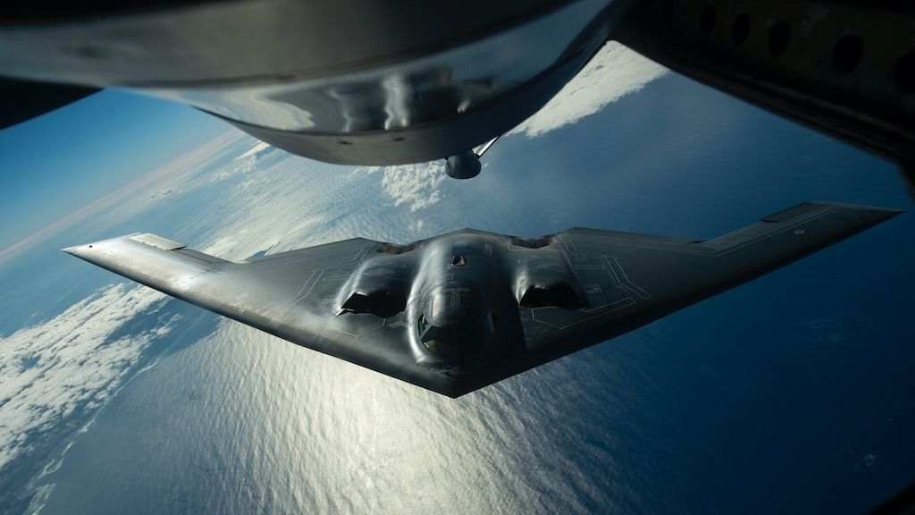
Outline
The Nuclear Mission & Triad
Personnel Reliability Assurance
Program (PRAP)
Role of Pharmacy
MHSG Tools

Slide 5
The Nuclear Mission & Triad

Slide 6
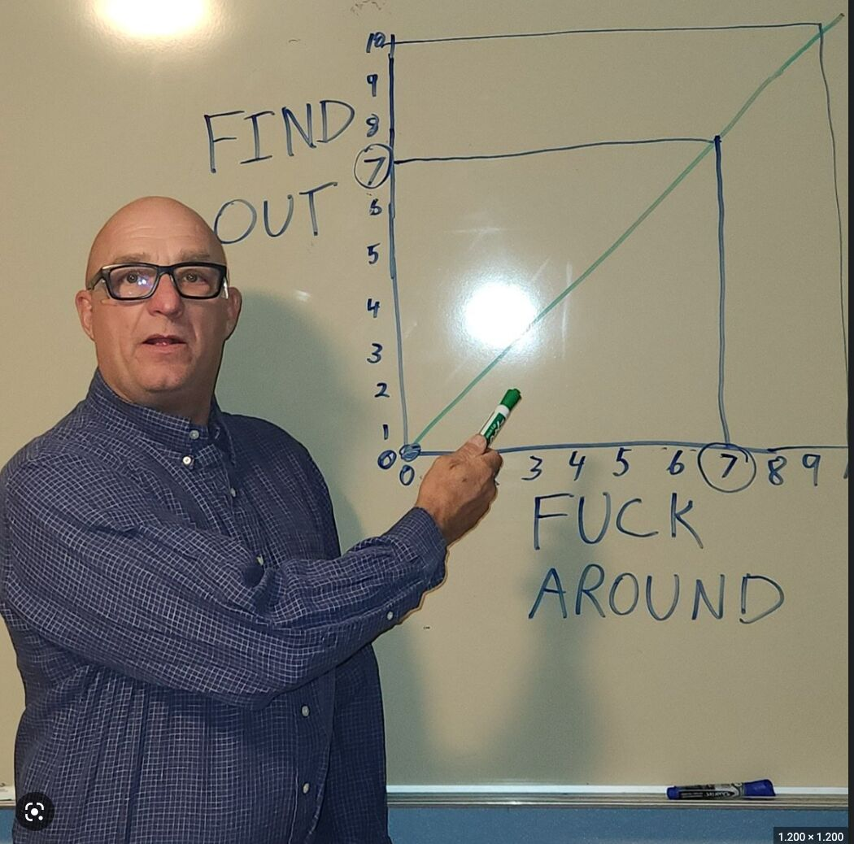
The Nuclear Mission
Our most significant and consequential no-fail mission
  World’s strongest, lethal weapon
  Nuclear command, control, and comms (NC3)
Demands significant precision & training
Global Strike’s sole focus
Significant historical changes
  Delivery mechanisms
  Precision targeting
MESS

Slide 7
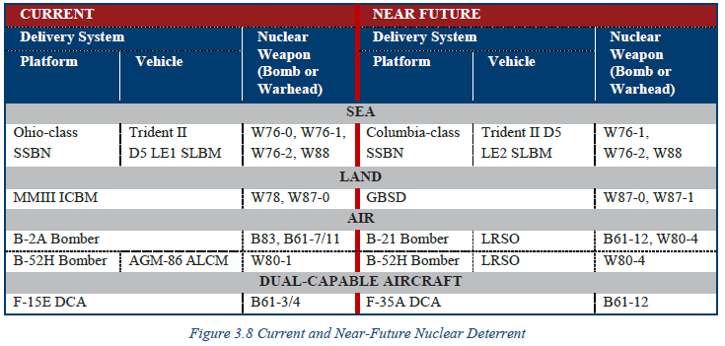
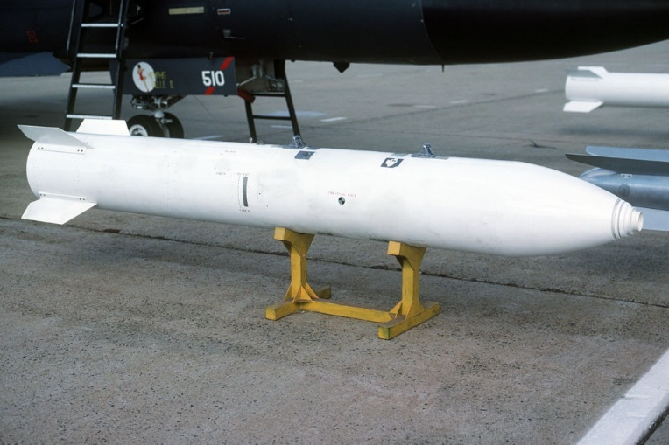
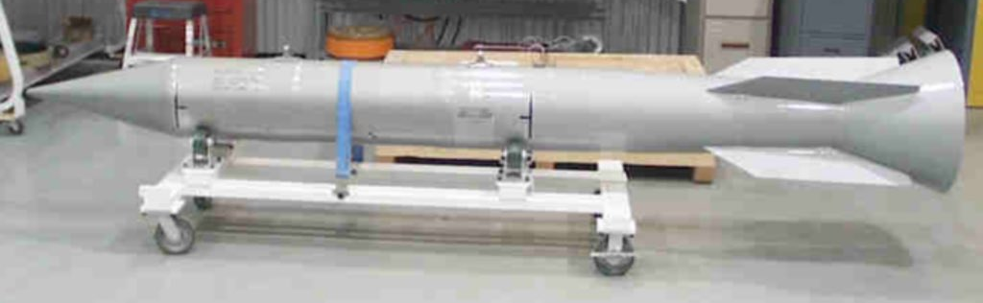
Understanding the Weaponry
B-83
B61-11
1.2 MT
7 or 400 KT

Slide 8
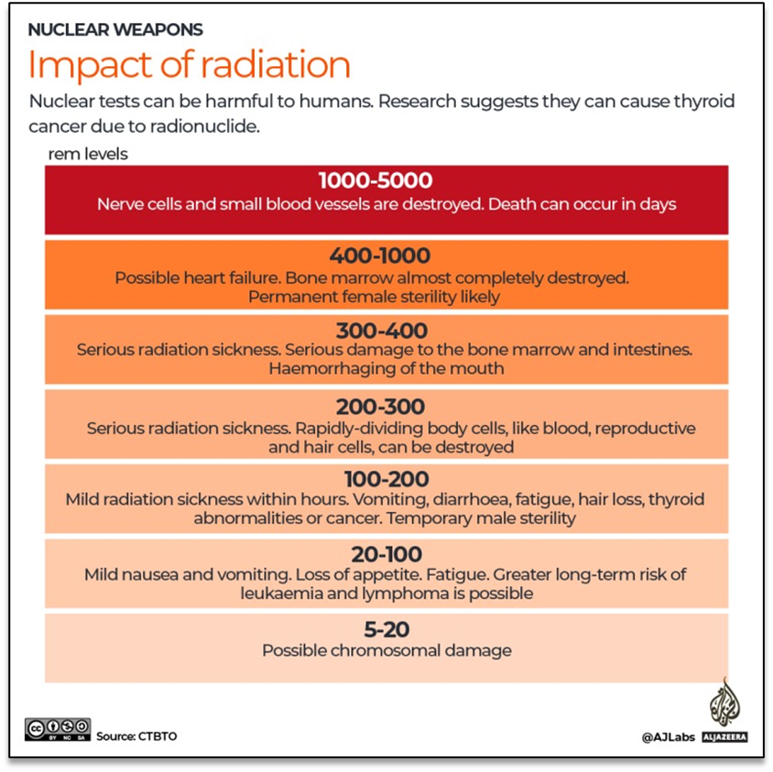
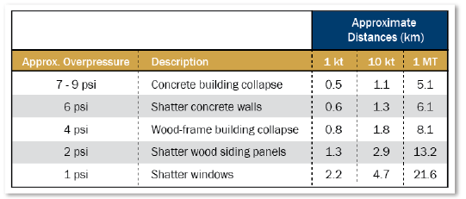
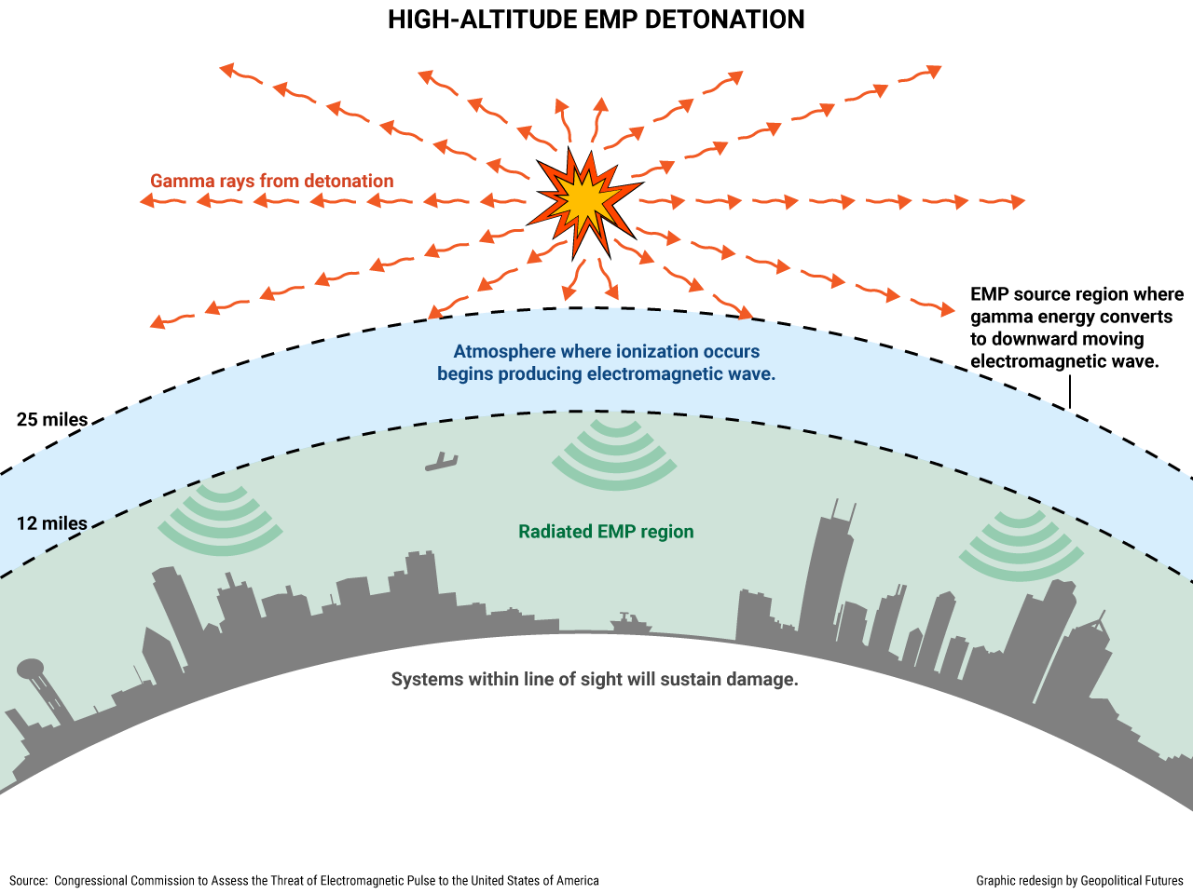
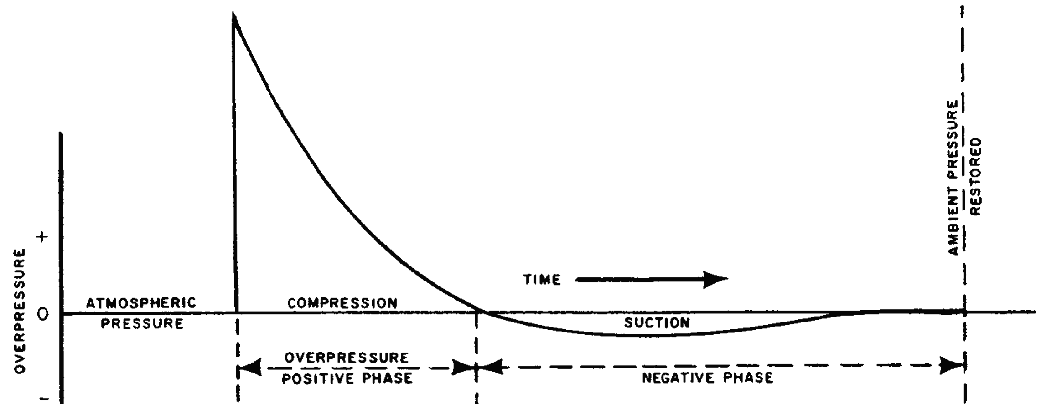
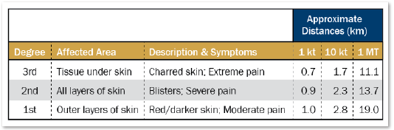
Impact of Nuclear Weaponry
Four significant impacts:
  Thermal
  Blast
  Radiation
  EMP

Slide 9
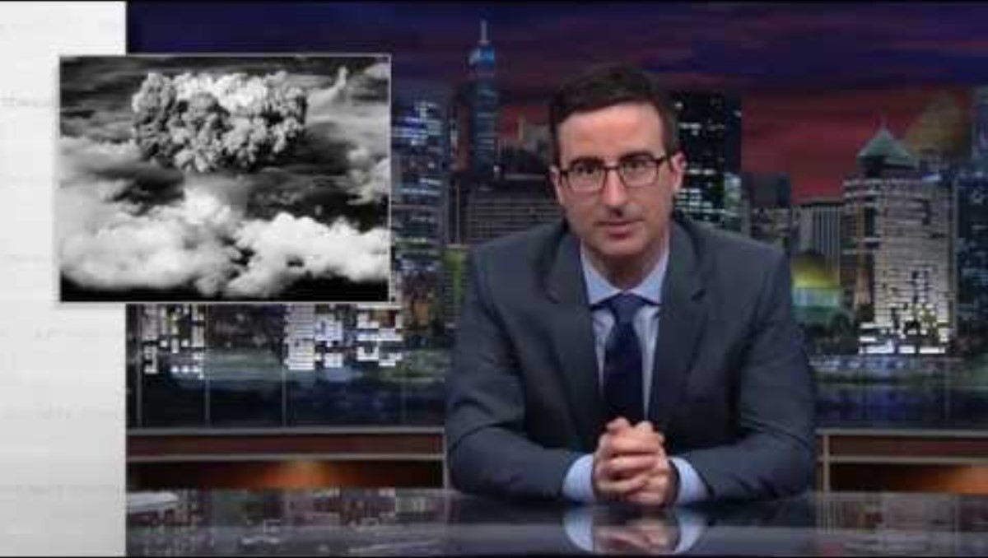
Bringing it Together
YouTube Video

Slide 10
The Nuclear Triad
Surety
Response
Strike
Deter and Assure
Response
Reactions to nuclear accidents or incidents.
Involves teams, plans, and equipment used to secure weapons, reduce contamination, or counter proliferation.
Surety
Ensures secure, reliable, safe nuclear weaponry.
Requires Maintenance, Personnel, Log, Security, and Medical.
Strike
Generates & executes nuclear missions.
Requires aircrew, maintenance, airfields, plans, credibility, etc.

Slide 11
Question
Which of the following arms of the Nuclear Triad does medical play the most significant role in support of the mission?
  Response
  Surety
  Strike
  None of the Above

Slide 12
Question
Which of the following arms of the Nuclear Triad does medical play the most significant role in support of the mission?
  Response
  Surety
  Strike
  None of the Above

Slide 13
Personnel Reliability Assurance

Slide 14
PRAP
PRAP = umbrella term
  PRP – Personnel Reliability Program (Weapons/MX/CP/MSG/CE)
  AUoF – Arming/Use of Force (Security Forces)
Where ‘rubber’ (medical) meets ‘road’ (surety)
  Base-wide program
  MTF governs medical aspect, usually Flight Medicine/FOMC
  Governed by DoDM 5210.42_AFMAN13-501 and AFI 31-117

Slide 15
PRAP
Mission = no fail
  Ensure reliability of those in this special duty
  Protect assets by protecting those who work with/around them
How is it accomplished?
  Competent Medical Authorities (CMAs) – Lead, Alt, trained providers
  PRAP monitors
  MDG-All
    “PRAP Culture”
    Every member plays a role

Slide 16
PRAP
Patient Presents
Identified as PRAP
Evaluate/Treat
Provide good medical care first
Suitability Factors
Carries special ID
Recommendation
Are any present?
Abbreviated – SF
Sent to Unit monitor
CC/CO makes call
Document ASIMS/EHR
Will discuss shortly

Slide 17
Question
Which statement regarding the PRAP mission is CORRECT?
  It is a no-fail mission
  It involves providing good medical care first and foremost
  It ensures protection and assurance of assets and people
  All of the above

Slide 18
Question
Which statement regarding the PRAP mission is CORRECT?
  It is a no-fail mission
  It involves providing good medical care first and foremost
  It ensures protection and assurance of assets and people
  All of the above

Slide 19
How Do We Contribute?
A review of the Incirlik AB model of care

Slide 20
Our Focus Points
Medication expertise – Pharmacy is a go-to point for patients
  Supplements or OTCs
  Off-base care & foreign prescriptions
  Alternative MTF care/medications
Providing high-quality clinical care
  Clinical service programs
  Identification of SFs / Big 6 / Automatic notification medications
  Ensuring appropriate medication use
These are possible at ANY MTF!

Slide 21
Medication Expertise
We are medication experts
Key items to consider:
  Supplements – Operation Supplement Safety (https://opss.org)
  OTCs – Certain meds/conditions are NOT APPROPRIATE for self care
  External Scripts – Ensure Flt Med/FOMC are tracking
  Script interpretation – Is this foreign med actually APAP? Or something else?

Slide 22
Medication Concerns
The “Top 3” – Immediate notification required for:
  Sedating
  Narcotics
  Psychoactive
If seen by a CMA, should be good to go, but if not:
  Ensure the FOMC/PRAP Cell is tracking this
  Notification required (usually) prior to member leaving MTF

Slide 23
Common Medications
Sedating Medications | Opiate Medications | Psychoactive Medications*
Cetirizine | Tramadol | SSRI/SNRIs
Melatonin | Oxycodone | TCAs
Cyclobenzaprine | Hydrocodone | Clonidine / Guanfacine
Diphenhydramine | Hydromorphone | Benzodiazepines
Hydralazine | Oxymorphone | Antipsychotics
Doxylamine | Morphine | Isotretinoin
Meclizine |  | Gabapentin/Pregabalin
Doxepin
Butalbital
“Z-Drugs”
* Mandatory reporting should be for new starts; only report new ADEs

Slide 24
Clinical Care Considerations
Pharmacists can be CMAs
  Requires buy-in from Lead CMA, MDG Leadership
  Value depends on ability to offer clinical services
  Pharmacy (all staff) can engage with PRAP Cell
Our programs
  Renewal clinic
  Smoking cessation
  Self Care Clinic
  Emergency contraception

Slide 25
Suitability Factors (SFs)
Whole Airmen evaluation
Considerations:
  What is the current situation?
  What is the condition?
  What is/are the treatment(s) for this?
  Can any of the above distract or deter the member from their duty?

Slide 26
Suitability Factors (SFs)
Pain (4-5/10)
Dizziness
Inability to concentrate
Down or hopeless
Sleep problems
Excessive fatigue
Harm to self or others
Anxiety
Depression
Stress
Head injury or trauma

Slide 27
Real-World Example
A1C Sandy visits pharmacy seeking Plan-B following a 3-day weekend. She is wearing her AUoF badge. She also seems a bit nervous and edgy as you are working the intake form with her. As you take the intake form to enter the prescription, you notice she is in your lobby pacing back and forth, refusing to sit down.
Is there a SF present?
What is it?
What should you do?

Slide 28
Local Program Considerations
Emergency contraception
  Concerns of sexual assault, discomfort with situation
  Side-effects associated with Plan-B / Ella
Self Care
  Avoid sedating meds
  Identify any SFs (i.e., diarrhea, distracting pain, sleep disturbances)
  Any conditions inappropriate for self-care?
Renewals
  Stability?
  Side effects?

Slide 29
PRAP Dispositions
CMAs MUST review and provide recommendation
  CMAs provide recommendation & notification
    Documented in ASIMS and MHSG
  CC/CO determines disposition
    Ultimate asset owner; must assess force end strength and mission needs
    Accepts responsibility, but will often go with your recommendation as the expert
Options
  Continue current status
  Temporary step-down
    AUoF: Temporary Arming Withdrawal (TAW)
    PRP: Suspend/Decertify

Slide 30
The “Big 6”
Immediate disqualifying conditions:
  Alcohol use disorder who fails prescribed rehabilitation program/treatment
  Involved in trafficking, cultivation, processing, manufacturing, sale of any controlled drug (including cannabis)
  Used a drug which could cause flashbacks (PCP, LSD, Peyote, shrooms)
  Severe substance use disorder diagnosed (except alcohol)
  Loss of confidence by CO
  Revocation of security clearance

Slide 31
Pharmacy Summary/Considerations
Any pharmacy member can support PRAP
  CMA training/appointment required for pharmacists
  Foundational training is (usually) done with your in-processing
Requires additional site training for staff
  Set-up programs/forms to help staff ID/catch PRAP-related issues early
  Coordinate with cells to avoid additional stressors on pharmacy ops
  Ensure availability of resources and support for questions

Slide 32
Question
An 23 year-old AUoF member presents to the pharmacy with four prescriptions from an off-base provider. Which medication is the MOST concerning?
  Fexofenadine 180mg – New start
  Sertraline 100mg – Renewal
  Isotretinoin 30mg – New start
  Azithromycin 250mg – New start

Slide 33
Question
An 23 year-old AUoF member presents to the pharmacy with four prescriptions from an off-base provider. Which medication is the MOST concerning?
  Fexofenadine 180mg – New start
  Sertraline 100mg – Renewal
  Isotretinoin 30mg – New start
  Azithromycin 250mg – New start

Slide 34
Question
Which of the following individuals are presenting with a mandatory disqualifying condition as defined by the “Big 6” list?
  A member with alcohol use disorder currently enrolled in ADAPT
  A member whose parents own a marijuana dispensary in Colorado
  A member who was diagnosed with a mild case of addiction to gambling
  A member who used Peyote in accordance with their native customs

Slide 35
Question
Which of the following individuals are presenting with a mandatory disqualifying condition as defined by the “Big 6” list?
  A member with alcohol use disorder currently enrolled in ADAPT
  A member whose parents own a marijuana dispensary in Colorado
  A member who was diagnosed with a mild case of addiction to gambling
  A member who used Peyote in accordance with their native customs

Slide 36
MHSG Support Tools

Slide 37
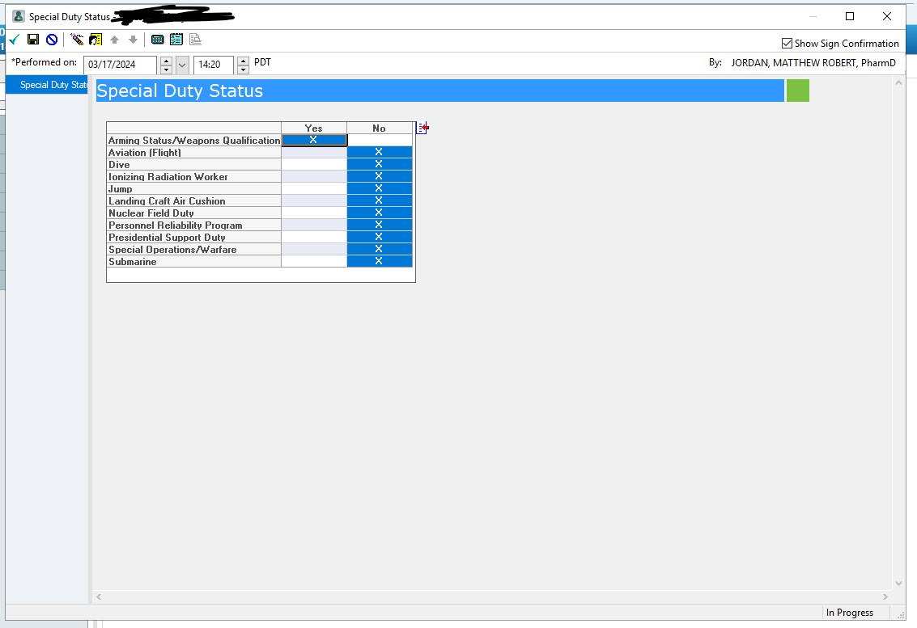
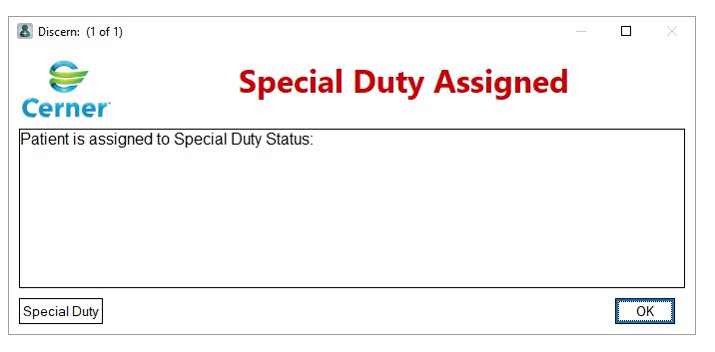
Special Duty Notification

Slide 38

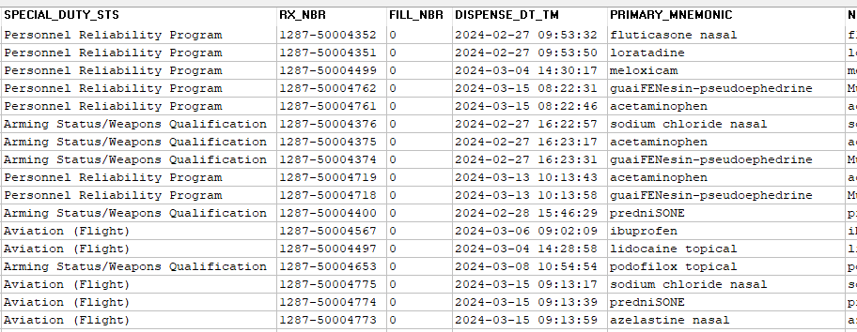
Outpatient Scripts to Special Duty
Available via Discern Reporting Tool

Slide 39
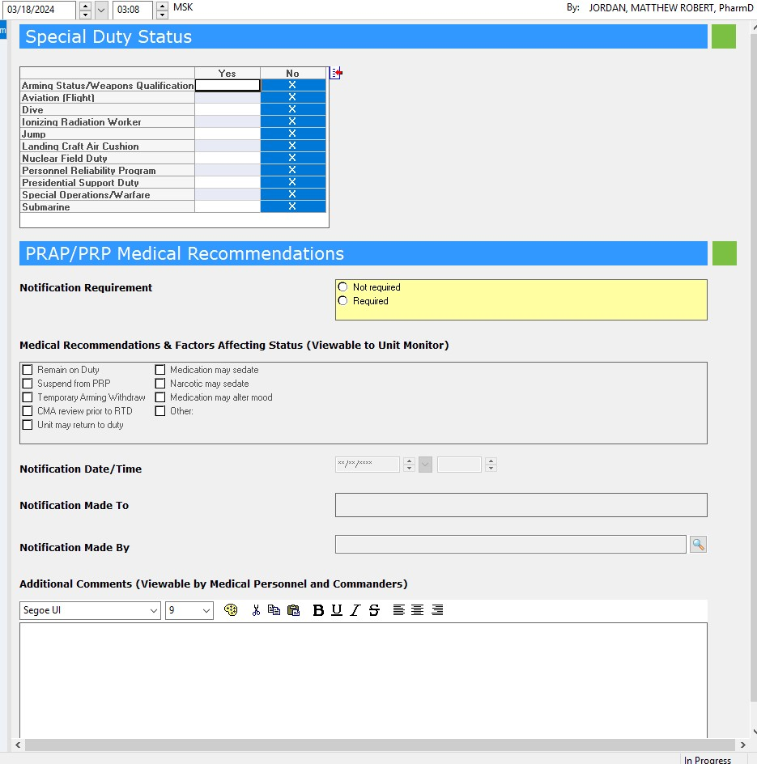
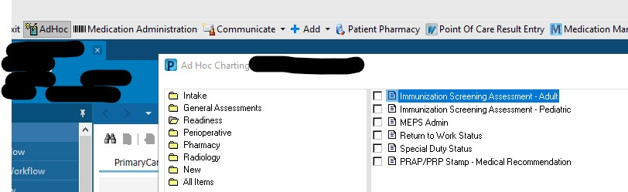
PRAP Stamp
Follow local policies first

Slide 40
Summary
Nukes, and those around them, are a critical, no fail mission
We can leverage team/skills regardless of MTF
  Expand access/support as able
  Help ensure mission success
  Continue to remain relevant amidst Great Power Competition – Part 2
This is a readiness skill the Air Force cannot lose, but one which we can aid to prevent any ‘gambling’ with the odds

Slide 41
References
Curtis E. LeMay Center for Doctrine , 3–72 Nuclear Operations § (2020).
Lieber, Keir A., and Daryl G. Press. “The New Era of Nuclear Weapons, Deterrence, and Conflict.” Strategic Studies Quarterly 2, no. 1 (2013): 3–12.
Halleman, Travis. “February Nuke Academics Weapons & Weaponeering.” Staff Academics. Lecture, February 15, 2024.

Slide 42
Questions?

