Slide 1
Society of Air Force Pharmacy
Mid-Year Conference
6 - 8 May 2024
Planet Hollywood Resort & Casino
Las Vegas, NV

Slide 2
Professional Burnout, the 3 R’s
Recognize
React
Reduce
Tim Gallagher, LCSW, BCD
LT, USPHS

Slide 3
Outline
Intro to Presenter
Disclaimer
Burnout Defined
Added pressure of military readiness
Small group discussion – What have you seen?
How do we counter/prevent burnout
Q&A

Slide 4
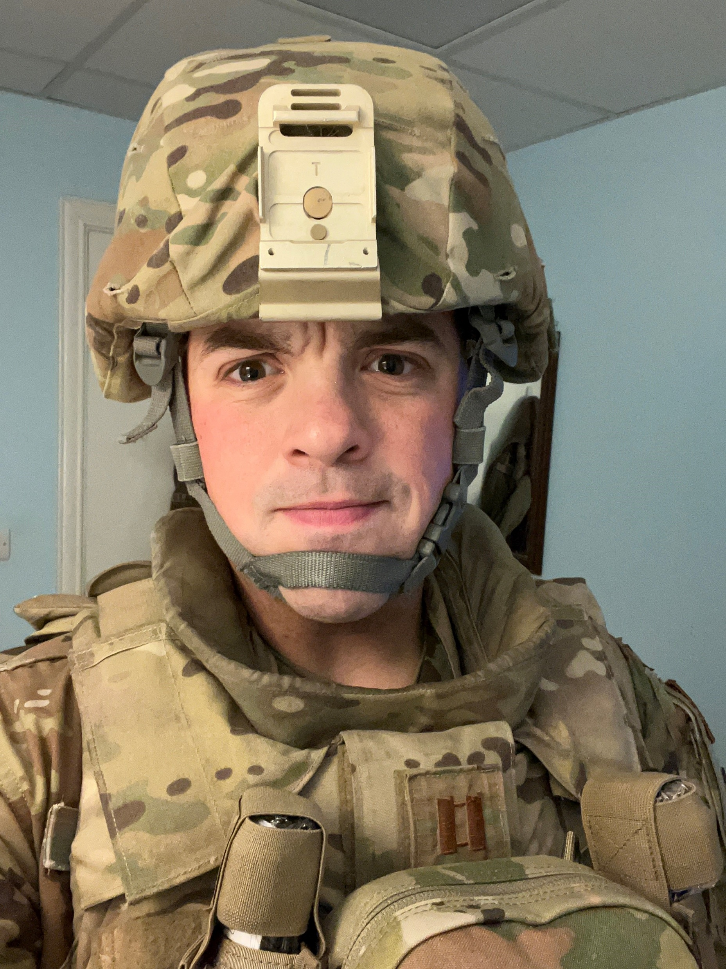
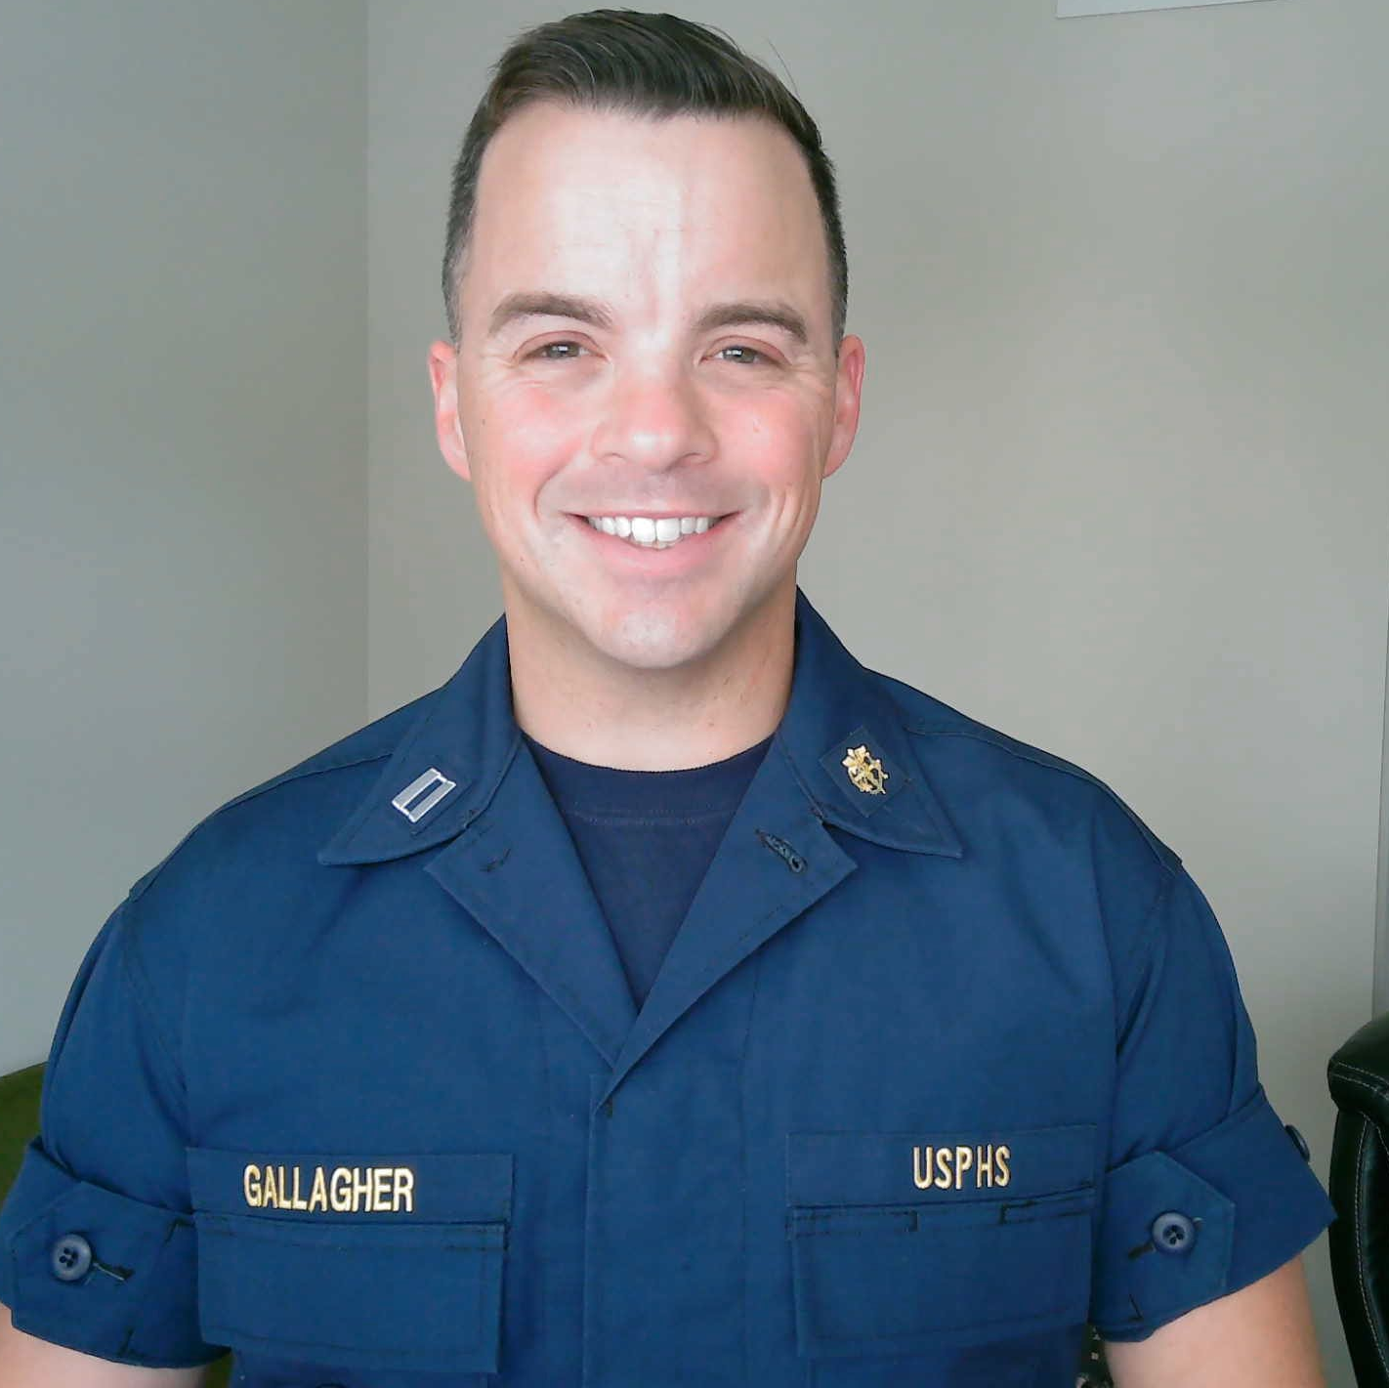
Who is the guy in the Navy uniform?
USAF
USPHS

Slide 5
Disclaimer
All views, opinions, and statements made during this presentation are those of Tim Gallagher and DO NOT represent the Office of the Assistant Secretary of Health, The Commissioned Corps of the USPHS, The Department of Homeland Security, or ICE

Slide 6
Objectives
Identify some of the most common signs/symptoms of professional burnout
Describe healthy and unhealthy coping strategies for burnout
Define how to reduce burnout in the workplace

Slide 7

My Style
DEATH BY POWERPOINT!
Let's talk
Participate fully
Engage

Slide 8
Recognize

Slide 9
Burnout
How do you define it?
Give me some examples of what it looks like or what you’ve seen?
What is the example or image in your head of the “burnt out Airman or professional”?

Slide 10
Burnout definition (cont.)
The 11th Revision of the International Classification of Diseases (ICD-11) defines burnout as “a syndrome conceptualized as resulting from chronic workplace stress that has not been successfully managed”
  Characterized by:
    Feelings of energy depletion or exhaustion
    Increased mental distance from one’s job
    Feelings of negativism or cynicism related to one’s job
    Reduced professional efficacy

Slide 11
Burnout definition (cont.)
Maslach Burnout Inventory
  Most widely used measure
  1981
  Approaches burnout as a syndrome induced by insurmountable work-related stress that comprises symptoms of exhaustion, cynicism, and inefficacy
  Exhaustion is considered burnout’s core!
Notes:
Does a clinical DX matter? What are we doing when we list a clinical dx…putting a title to SXs usually. So do we need to dx “burnout” or do we need to recognize it and respond to it?

Slide 12
Six Factors that Contribute to Burnout
Work Overload
Lack of Control
Insufficient Rewards
Breakdown of Community
Absence of Fairness
Value Conflicts
(Maslach, 2015)
Notes:
Talk about military specific burnout here

Slide 13
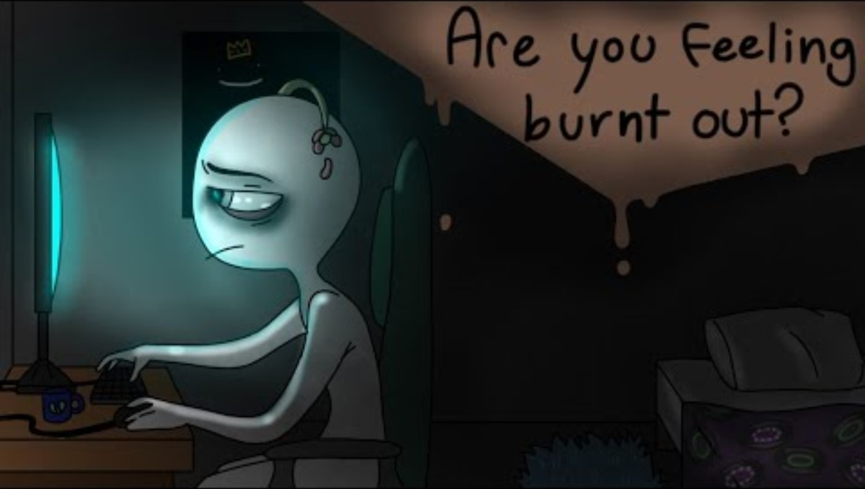
Burnt out or lazy?!
Notes:
(Psych2go, 2021)

Slide 14
Common Symptoms
What are some common symptoms of burnout that you’ve seen or experienced
Did you learn any new symptoms from the video?
Notes:
Add animation to bring in answers second

Slide 15
Common Symptoms
Physical and Emotional Exhaustion
Depression
Anxiety
Sleep Issues
Increased negativity
Heightened irritability
Feeling distracted or disconnected
(Christina Maslach, 2021)

Slide 16
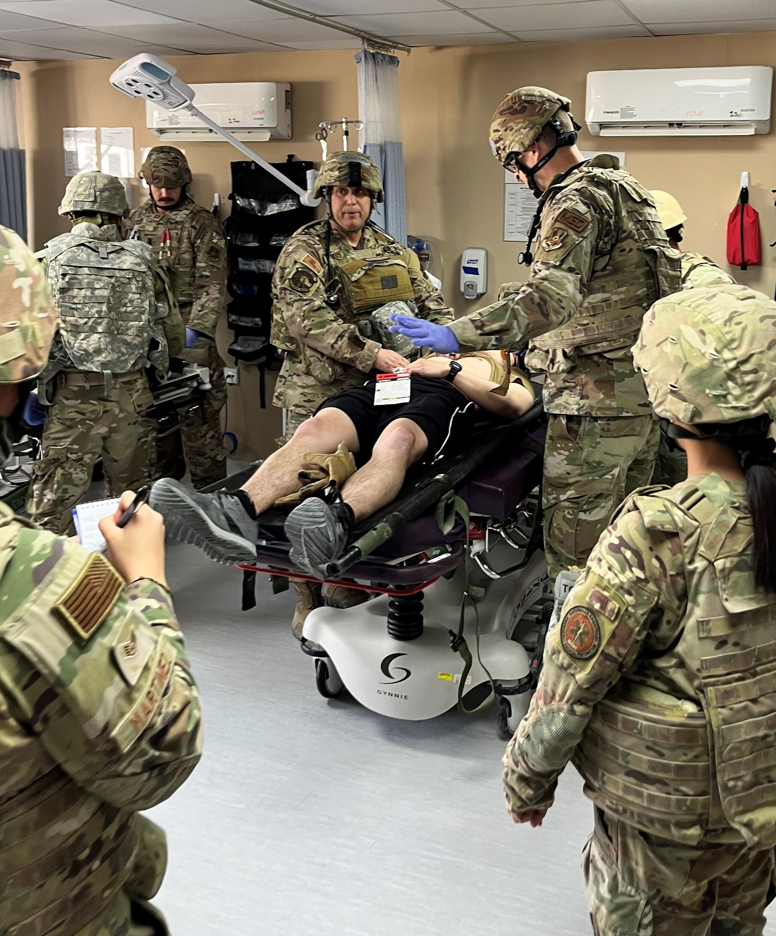
Military Pharmacy
Added Stressors?
Specifics about the military that might increase the likelihood of burnout?

Slide 17
Knowledge Check # 1
Which of the following is a common contributor of burnout
  A. Poor diet
  B. Work overload
  C. Change of Seasons
  D. Poor pay

Slide 18
Knowledge Check # 1 (Answer)
Which of the following is a common contributor of burnout
  A. Poor diet
  B. Work overload
  C. Change of Seasons
  D. Poor pay

Slide 19
React

Slide 20

Small Group Discussion (~10 minutes)
What are the least healthy coping mechanisms/strategies you’ve seen for burnout
What are the healthiest coping mechanisms/strategies you’ve seen for burnout
Who is one person that stands out to you as being incredibly resilient even in the face of high stress at work or home? How do you think they do it?

Slide 21
Unhealthy Coping
Withdrawing from friends or partners, or conversely jumping into frenzied social life to avoid facing problems
Overeating
Sleeping too much
Lashing out at others in emotionally or physically violent outbursts
Drinking
Drugs
Reckless behavior (gambling, violence, sex)
Watching endless TV
Notes:
https://www.health.harvard.edu/healthbeat/watch-out-for-unhealthy-responses-to-stress

Slide 22
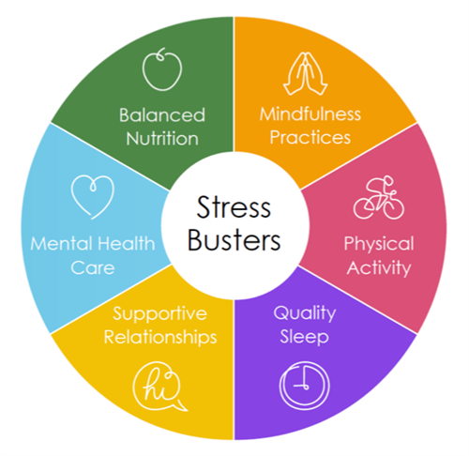
Healthy Coping
Yoga
Mindfulness
Cardio/exercise
Breathing techniques
Take a break or vacation
Delegate
Speak up
Have realistic expectations
Notes:
https://www.pharmacist.com/Publications/Transitions/the-pharmacists-guide-to-recognizing-and-preventing-burnout
https://images.app.goo.gl/em5FhX2osrffCa5Q8

Slide 23
Knowledge Check # 2
Which of the following are unhealthy coping mechanisms
  A. Increased alcohol consumption
  B. Increased fitness/working out
  C. Staying later at work to get more done to reduce the stress on tomorrow
  D. Engaging in high-risk activities like sky-diving to finally feel something positive again

Slide 24
Knowledge Check # 2 (answer)
Which of the following are unhealthy coping mechanisms
  A. Increased alcohol consumption
  B. Increased fitness/working out
  C. Staying later at work to get more done to reduce the stress on tomorrow
  D. Engaging in high-risk activities like sky-diving to finally feel something positive again

Slide 25
Reduce

Slide 26

Small Group Discussion (~10 minutes)
What are some ways your flight or team works to reduce burnout?
What are some ideas you have that might decrease burnout
What do you do if you notice a co-worker is starting to get burnt out?

Slide 27
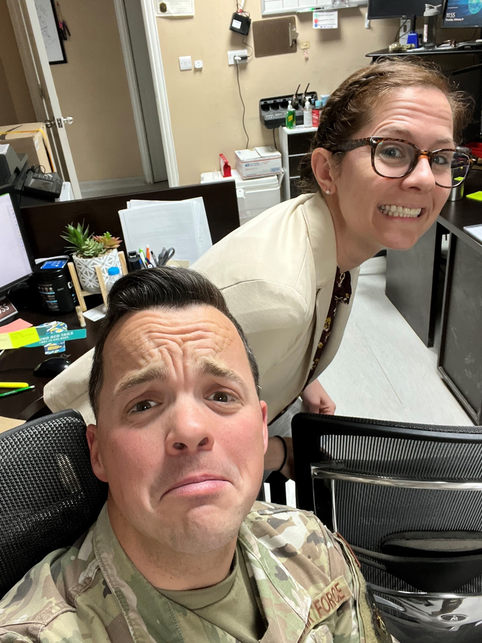
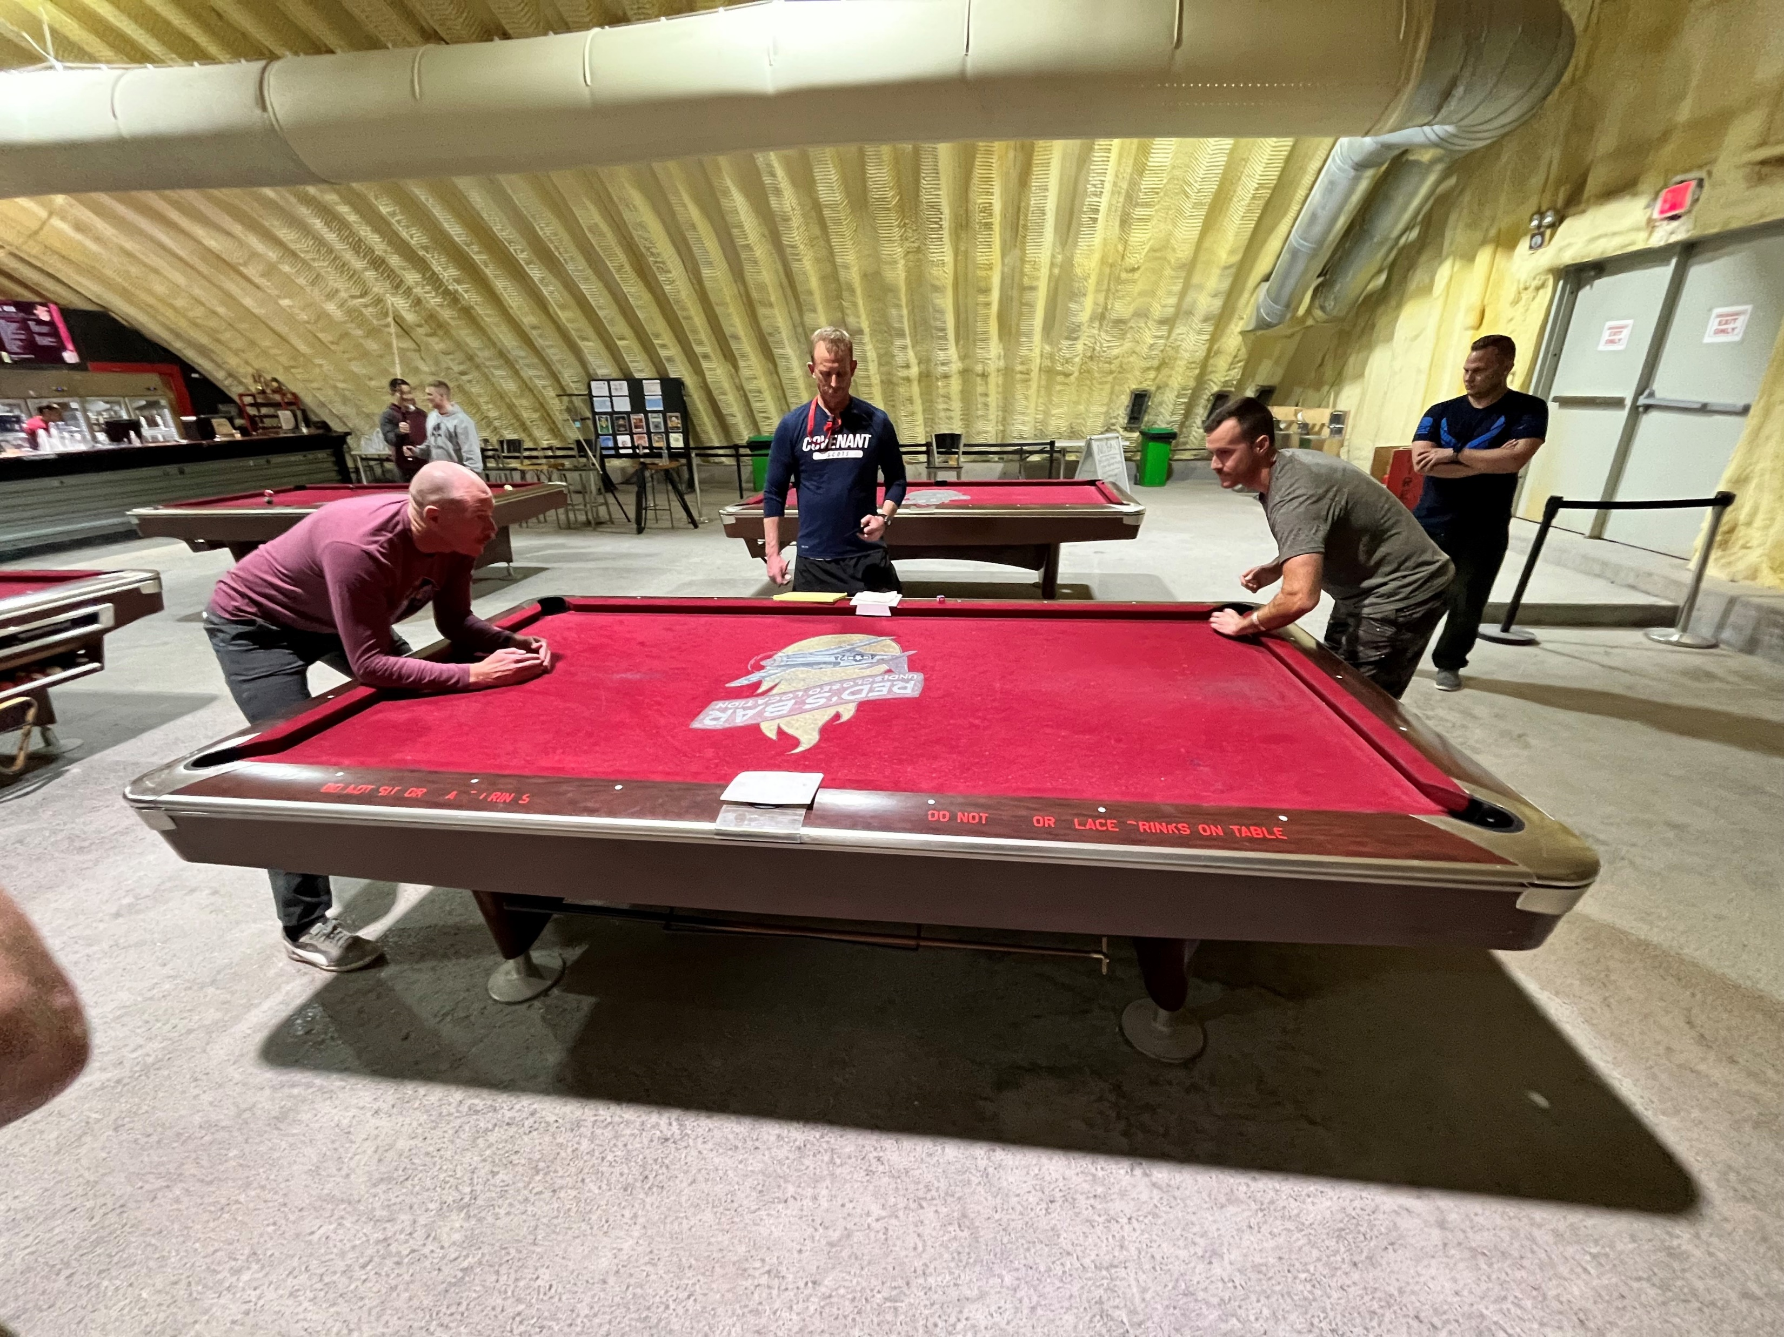
Story Time

Slide 28
Ways to reduce burn out in your team
Create a sense of team spirit
  Holiday/birthday/promotion parties
  Attend awards ceremonies or outside activities when invited
Encourage Good Boundaries
  Set the example of leaving on time as often as possible
Encourage teammates to take leave OFTEN!
Notes:
When we deploy…they find a way to cover for six months…encourage leave
1-3 minutes of breathing relaxes the nervous system and increases focuse while decreasing stress…try it in presentation (at very beginning) and then tell Camden story (kids with the quarter and that being one of the things they remembered most from the entire life skills class
Fitness app reference Amn Freeman
Hard to give good feedback to teammates when we barely know their names

Slide 29
Ways to reduce burn out in your team
Get creative by having a “fit to fight” competition with an app
Take time in a presentation or CC’s call to practice 1-3 minutes of deep breathing
Know people’s names!
Notes:
When we deploy…they find a way to cover for six months…encourage leave
1-3 minutes of breathing relaxes the nervous system and increases focuse while decreasing stress…try it in presentation (at very beginning) and then tell Camden story (kids with the quarter and that being one of the things they remembered most from the entire life skills class
Fitness app reference Amn Freeman
Hard to give good feedback to teammates when we barely know their names

Slide 30
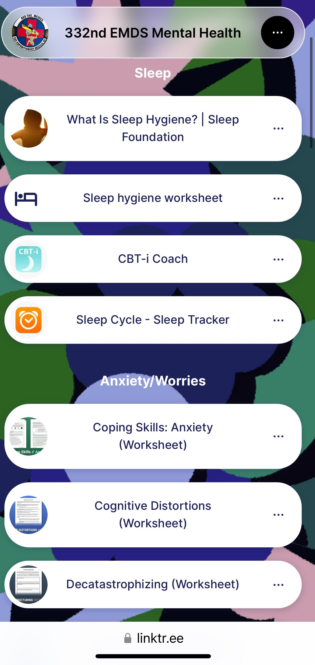
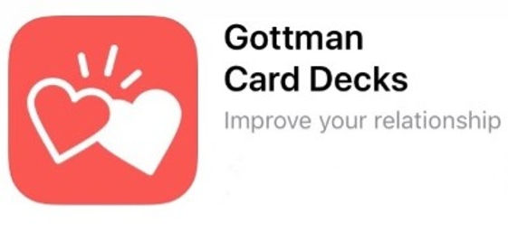

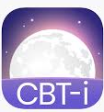

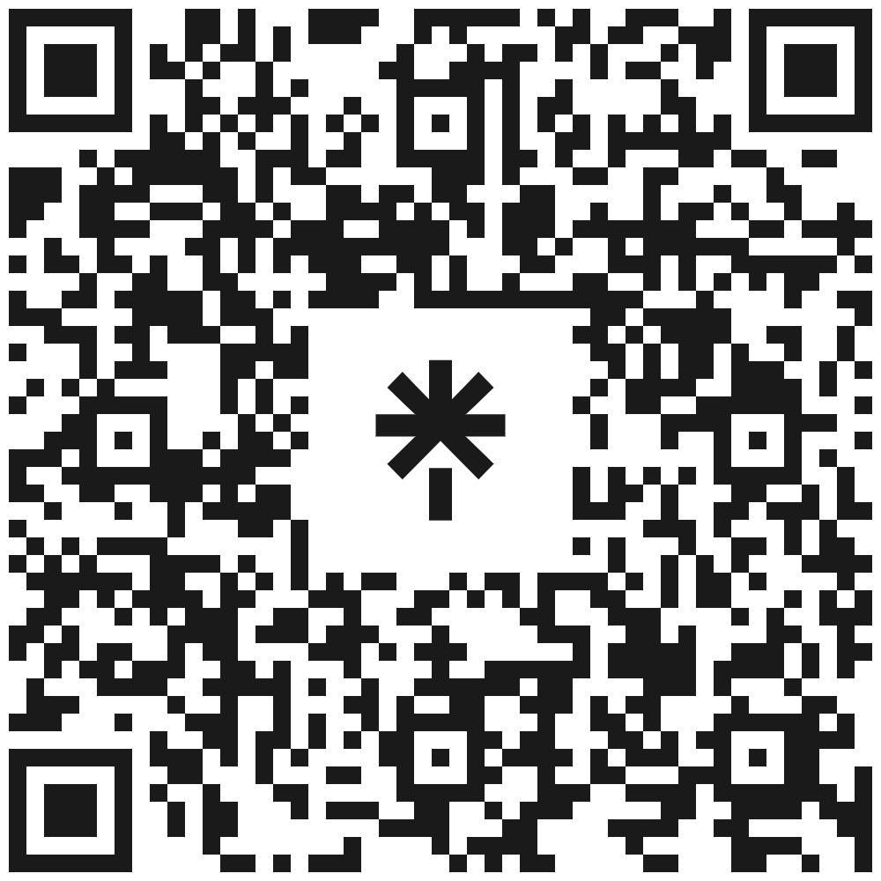
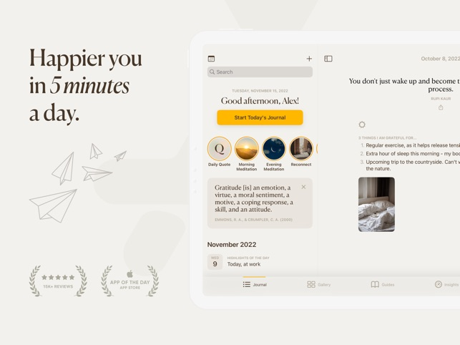
Tools/Resources
Resources
  Military OneSource
  MFLC
  Mental Health
  Chaplain
  PCM
  Friends
  Peers/mentors
Apps/tools

Slide 31
Knowledge Check # 3
Which of the following are ways to reduce burnout
  A. Avoid work whenever possible (call out sick/dodge your boss’ calls…etc.)
  B. Increase comradery at work (birthday parties, promotion celebrations)
  C. Set boundaries from the top down…take your leave!
  D. Have open dialogue about work expectations and needs with your team

Slide 32
Knowledge Check # 3 (Answers)
Which of the following are ways to reduce burnout
  A. Avoid work whenever possible (call out sick/dodge your boss’ calls…etc.)
  B. Increase comradery at work (birthday parties, promotion celebrations)
  C. Set boundaries from the top down…take your leave!
  D. Have open dialogue about work expectations and needs with your team

Slide 33
Recap
How can you create a personal routine to decrease your likelihood of burnout?
How can you create a work environment that connects people and increases a sense of team spirit?
RECOGNIZE
REACT
REDUCE

Slide 34
Questions?

Slide 35
References
Christina Maslach, W. B. (2001). Job Burnout. Annual Review of Psychology, 397-422.
English, T. (2021, July). American Pharmacists Association. Retrieved from https://www.pharmacist.com/Publications/Transitions/the-pharmacists-guide-to-recognizing-and-preventing-burnout
Harvard Medical School. (2012, August 4). Harvard Health Publishing. Retrieved from https://www.health.harvard.edu/healthbeat/watch-out-for-unhealthy-responses-to-stress
Psych2go. (2021). 6 signs your burnt out, not lazy. Retrieved from https://www.youtube.com/watch?v=MLuJ249WnkE

