Slide 1
Pharmacogenomics (PGx)
Personalized Medicine for the Modern Warfighter
MICHAEL E. BRAUD, Maj, USAF, BCGP
michael.e.braud2.mil@health.mil
Notes:
Good morning,
I am Maj Michael Braud, currently stationed at Keesler Medical Center, and today I will be discussing PGx and how it specifically relates to medical readiness, what our current capabilities are, and steps the DHA is taking to implement more utilization of this tool.

Slide 2
DISCLOSURES
The presenter declares no conflicts of interest, real or apparent, and no financial interests in any company, product, or service mentioned in this program, including grants, employment, gifts, stock holdings, and honoraria.
The views expressed in this presentation are those of the author and do not necessarily reflect the official policy of position of the Defense Health Agency, Department of Defense (DoD), nor the U.S. Government.
Appearance of, or reference to, any commercial products or services or non-federal organizations does not constitute DoD endorsement of those products, services or entities. The appearance of external hyperlinks does not constitute DoD endorsement of the linked websites, or the information, products, or services therein.
Notes:
I have no conflicts of interests or financial interests to disclose.

Slide 3
LEARNING OBJECTIVES
1. Understand the impact of pharmacogenomics on military readiness and safety
2. Evaluate the current implementation strategies for DHA adoption of pharmacogenomics
3. Describe the clinical utility and available resources to utilize pharmacogenomics
4. Analyze various implementation models and barriers to implementation
Notes:
Here are the learning objectives for this presentation. We will be examining PGx from an implementation perspective with clinical information spread throughout the presentation. I wont spend too much discussing what PGx is and the nuances of genetic nomenclature or dogma, but I will point you in the direction of some resources that can assist with that if you require more information. My main overarching objective is that you walk away from this presentation with a solid familiarity of PGx, the DHA’s current capabilities, and where to find more information should you be asked by a provider regarding PGx results.

Slide 4
DEFINING PGX
Drug effective, no side-effects
Drug effective, many side-effects
Same diagnosis, same treatment
Drug ineffective, many side-effects
Drug ineffective, no side-effects
Notes:
Engagement. In your own words, how would you define the term PGx? Definition: How an individual's genetics affect the likely response to drugs. We understand PK and PD – what the body does to the drug, what the drug does to the body, and this is another parameter. PGx can affect both PK and PD responses. Typically we see a lot of research and development in PGx field pertaining to the genetic differences in PK, specifically metabolism when we consider Cytochrome p450 enzymes and the differences in their ability to metabolize meds. We can see how PGx can be appealing, many of our guidelines foxus on a same diagnosis, same treatment approach, but we know patients will respond to medications differently, the worst case scenario being that drug in ineffective with many side effects. With PGx, the claim is that you can arrive to an effective drug with minimal side effects more predictably.

Slide 5
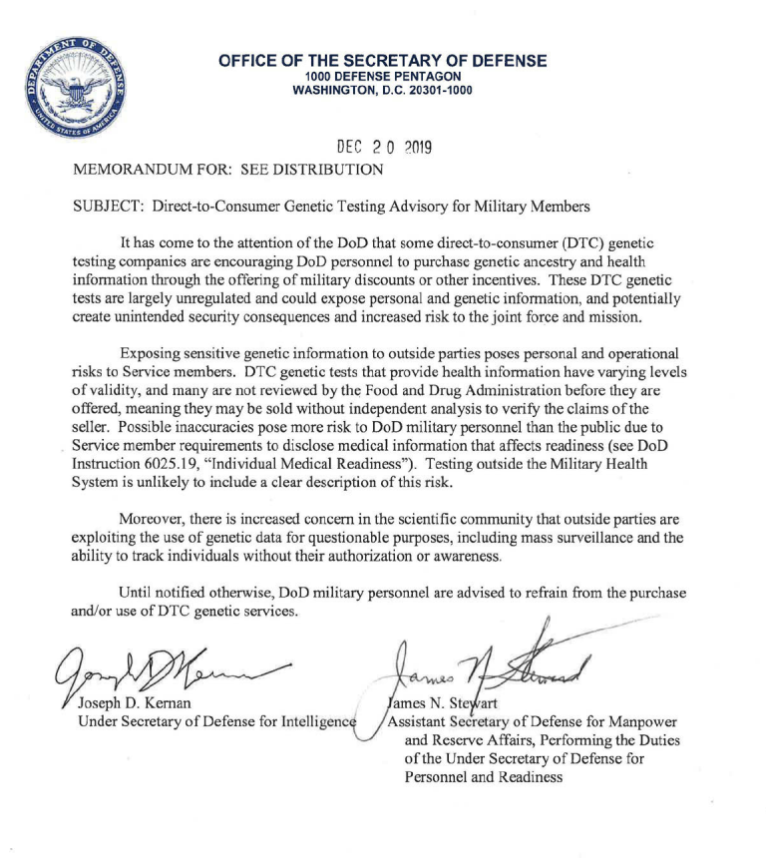
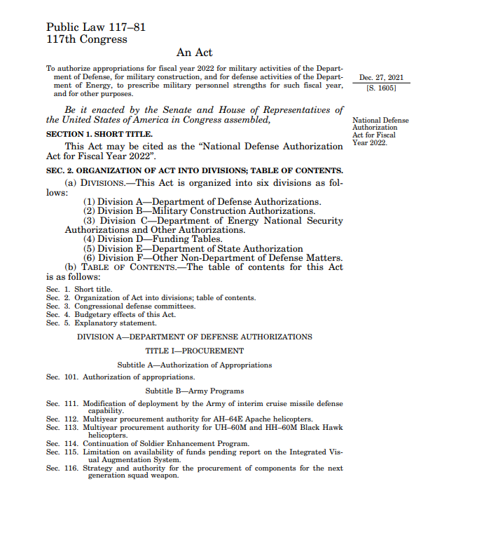
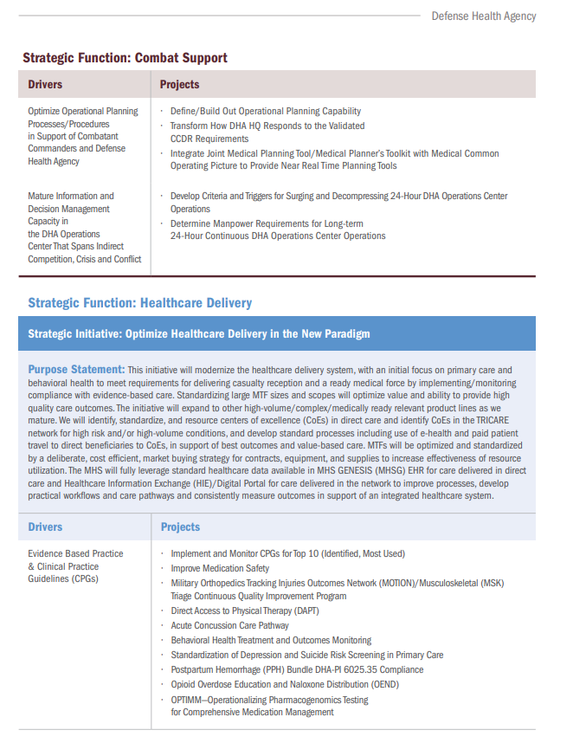
A QUICKLY EVOLVING STORY…
2019 - Pentagon releases memo deterring military members from Direct-to-Consumer Testing
2022 – NDAA FY22 directs the SD to implement a plan to integrate PGx testing to optimize medications and reduce ADEs
2023 – DHA Strategic Plan 2023-2028 prioritizes OPTIMM initiative to improve healthcare delivery
2024 – NDAA FY24 directs the SD & ASD to provide briefings on enterprise-wide PGx testing implementation for healthcare benefits, cost savings, national security enhancement, and optimization of military readiness
Notes:
PGx is a quickly evolving story in the DoD. While the appeal for PGx testing has been around for a while, in 2019 the Pentagon released a memo to field warning of Direct-to-Consumer testing. This was your 23 and me/ancestry genetic tests that were growing increasingly popular. Remember that black Friday special? The problem with this testing was the military members were doing the tests but the results of that information could be accessed by enemy states. In 2022, the NDAA directed the Secretary of Defense to explore the and implement PGx in the DoD to optimize medications and reduce ADEs (while also discouraging AD members from DTC and outside labs). In 2023, the DHA Strategic Plan listed an implementation plan for PGx, called OPTIMM, which we will discuss in a few moments, and in the 2024 NDAA, we again saw the Secretary and Assisatnt Secretary of Defense be charge with implementing an enterprise-wide PGx program to save costs, enhance national security, and optimize military readiness.

Slide 6

A QUICKLY EVOLVING STORY…
President Biden’s executive order to stop the sale of US genetic data to China (and other countries of concern)
Specifically mentions barring any transfer of any volume of genomic data to countries of concern
Notes:
And hot off the press, even as I was creating these slides, President Biden released an executive order to completely stop the sale of US genetic data to China, underpinning the nation security threat PGx and genetic data may pose to our country, and solidifying the need to secure DoD member’s genetic data.

Slide 7
OPTIMM
Operationalizing Pharmacogenomic Testing for Comprehensive Medication Management
  Component of Deputy Assistant Director-Medical Affairs (DAD-MA) Clinical Genomics and Precision Medicine (CGPM) program for a multi-year enterprise-wide integration within the Military Health System (MHS)
  Goals: Optimize military readiness, protect beneficiaries’ genetic data, reduce cost of genetic testing and analysis
    Phase 1 – Expand DHA Genetic Reference Lab at Keesler AFB (DHAGRL) infrastructure to meet essential OPTIMM capabilities requirement
    Phase 2 – Expand Joint Pathology Center infrastructure for gene testing associated with cancer therapeutics
    Phase 3 – Establish a distributed system of DHA satellite labs for PGx testing and experts to implement enterprise-wide integrated clinical decision support system
Notes:
For these reasons, the OPTIMM program (or operatiolizing pharmacogenomic testing for comprehensive medication management) was established in February 2022 under the DHA’s DAD-MA Clinical genomics and Precision medicine program to implement genomic and precision medicine services to the Enterprise. This is a mult-phasic program with the goals to optimize military readiness, protect beneficiaries genetic data, and reduce the costs of genetic testing and analysis. To do this, several phases were established, and the first phase was to expand the infrastructure that currently exists. The DHA Genetic Reference Lab or DHAGRL at Keesler Air Force Base is the center of excellence for genetics for the DoD and is currently offering PGx testing and analysis.

Slide 8
PRECISION CARE ADVISORY PANEL (PCAP)
CHAIRED BY DHA & HEALTH AFFAIRS/
DEPUTY ASSISTANT SECRETARY OF DEFENSE (DASD)
HEALTH READINESS POLICY AND OVERSIGHT (HRPO)
PGx Advisory Subpanel
  Multidisciplinary PGx expert subpanel of clinical pharmacists, clinical and molecular geneticists, molecular pathologists, genetic counselors, healthcare administrators to assist in implementing OPTIMM under DAD-MA
  Developed several products in 2023…
    OPTIMM Education Module in JKO LMS: Course Number DHA-US1209
    Assisted in “Genetics Tab” creation in MHSG
    DHA Practice Recommendation (PR) - Genetic Testing for Prescribing Behavioral Health Medications (11 January 2024)
  Working towards developing…
    OPTIMM Education for patients in MHS Genesis (MHSG)
    DHA- PR for PGx in Pain Management (ECD September 2024)
    Clinical Decision Support (CDS) for behavioral health medication management (drug alerts) in MHSG
Notes:
Under the CGPM, we have the Precision Care Advisory Panel, and the Advisory Panel consists of subpanels, one being the PGx Advisory Subpanel that I chair. Hopefully that helps understand the organizational structure. Our PCAP ASP consists of a multidisciplinary experts of geneticists, pathologists, counselors, administrators, etc to assist in implementing OPTIMM and was established in 2022. Some of the products we delivered in 2023 include a OPTIMM education module in JKO, see the course number, so if you wanted to learn more about PGx this will be a great resource. Additionally, we established a new “Genetics” test tab in MHSG, so that any genetic results can be easily accessed and viewed in a patient chart. Lastly, we just released a DHA Practice Recommendation for Genetici Testing for Prescribing of Beahvorial Health Medications. On the horizion, we are creating education material for patients to be easily printed and accessed through MHSG, developing the draft of a DHA Practice Recommendation for Pain management, and working on developing genetic drug alert clinical decision support in MHSG.

Slide 9
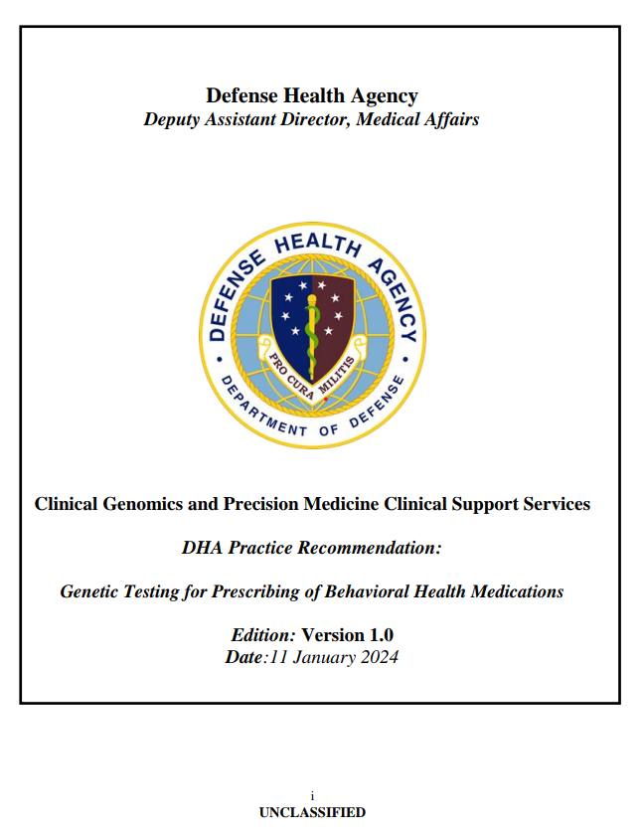
PGX PR BEHAVIORAL HEALTH
(PURPOSE)
99% of those who have served in the military have at least one genetic variant that could impact drug response
Approximately 1 in 2 veterans are prescribed a medication which could be informed by PGx testing
1 in 10 individuals will have a prescription modified by PGx testing, potentially impacting 600K veterans.
Adverse drug reactions account for 125K hospital admissions per year, costing $528.4B in 2016
Kohn LT, et al. To Err is Human: Building a Safer Health System. Institute of Medicine Report, 2000 (https://pubmed.ncbi.nlm.nih.gov/25077248/).
Chanfreau-Coffinier C, et al. Projected Prevalence of Actionable Pharmacogenetic Variants and Level A Drugs Prescribed Among U.S. Veterans Health Administration Pharmacy Users. JAMA Netw Open. 2019;2(6): e195345.
Watanabe JH, et al. Cost of Prescription Drug-Related Morbidity and Mortality. Ann Pharmacother. 2018; 52:829-37.
Notes:
I wanted to spend the next few slides jumping into our PGx Practice Recommendation for Behavorial Health. It’s important to note that this is not policy or an admisnitrative instruction, but rather a recommendation. The first section of the PR discusses the “why” this is important. Read bullets.

Slide 10
PGX PR BEHAVIORAL HEALTH
(CLINICAL MANAGEMENT)
Initial assessment should be conducted as per standard of care in conjunction with CPGs
PGx testing results do not substitute clinical judgement.
A provider may consider PGx testing to help guide therapy, to minimize ADRs, and to maximize effectiveness in the following scenarios:
  Prior to starting antidepressants, antipsychotics, or mood stabilizers in non-urgent patients
  In individuals who have experienced an inadequate response to a previous antidepressant, antipsychotic, or mood stabilizer
  In individuals who have experienced ADR or intolerable side effects with the antidepressant, antipsychotic, or mood stabilizer
For patients requiring immediate intervention, do not delay treatment for PGx testing results
DHA Practice Recommendation: Genetic Testing for Prescribing of Behavioral Health Medications. 11 January 2024.
Notes:
When we look at the actual recommendation, we overemphasize that PGx MAY be used in conjunction with standard of care and CPGs to assist in certain populations, either prior to starting an antidepressant, antipsychotic, or mood stabilizer in non-urgent patients, those who have inexperience inaqeuqate response or untoward side effects to these drugs. Most importantly, if patients require immediate intervention, it is ill advised to delay treatment simply based on PGx testing results

Slide 11
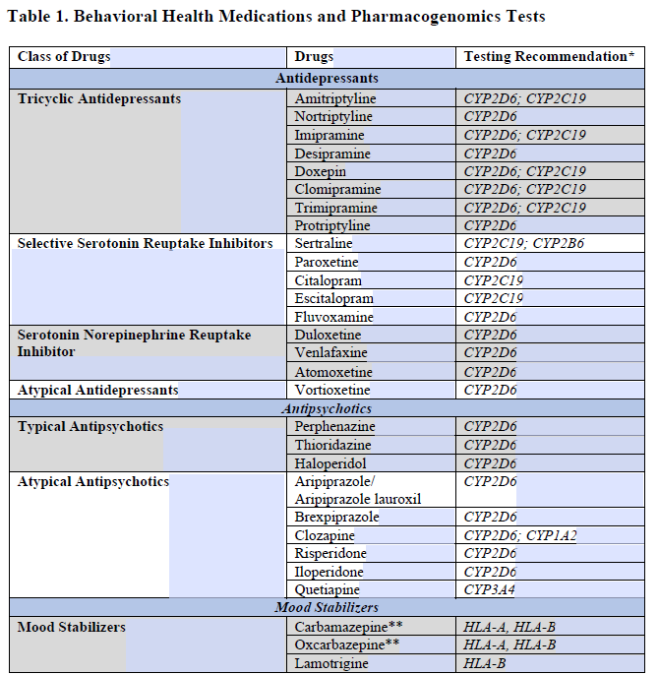
PGX PR BEHAVIORAL HEALTH (MEDICATIONS)
DHA Practice Recommendation: Genetic Testing for Prescribing of Behavioral Health Medications. 11 January 2024.
Notes:
In the PR you will find a list of behavioral health medications that have an associated testing recommendation. You can see the corresponding biomarker that should be tested next to the drug.

Slide 12

PGX PR BEHAVIORAL HEALTH
International Society of Psychiatric Genetics (ISPG):
  Providers are encouraged to integrate PGx information into their medication selection and dosing decisions
  CYP2C19/CYP2D6 would be most beneficial for individuals who have experienced an inadequate response or adverse reaction to a previous antidepressant or antipsychotic
  Recommend HLA-A and HLA-B testing prior to use of carbamazepine and oxcarbazepine
  PGx testing should be viewed as a decision-support tool to assist…in clinical care, enhancing rather than offering an alternative to standard protocols
Indication, patient preference
Current/prior medications
PGx
Comorbidities, age, organ function
International Society of Psychiatrics Genetics (ISPG), March 11, 2019 (https://ispg.net/genetic-testing-statement/).
Notes:
It’s so important to note that PGx is just one piece of the clinical picture when looking at your patient among other factors that we as pharmacists know to look for. Our PGx PR is in direct line with the International Society of Psychiatric Genetics (ISPG) which states: read bullets.

Slide 13
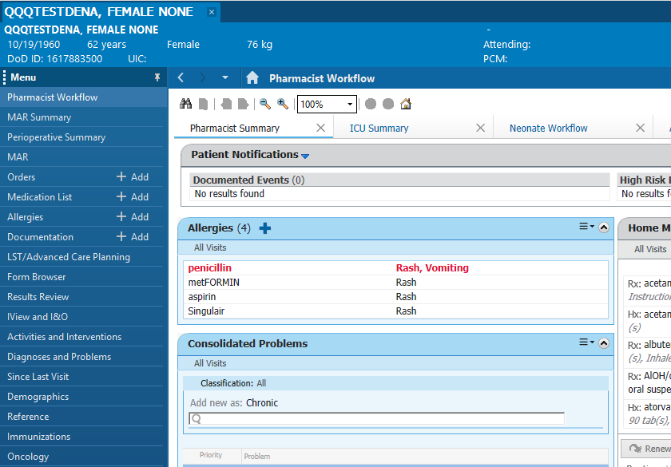
ORDERING A PGX TEST
Indication, patient preference
Current/prior medications
PGx
Comorbidities, age, organ function
Notes:
Ordering PGx Tests is extremely easy, and I’ve shared a few screenshots to point out the steps. This will help either your provider in ordering a PGx test or assist in implementing a PharmD run service, should that be something your site can/wants to support.

Slide 14
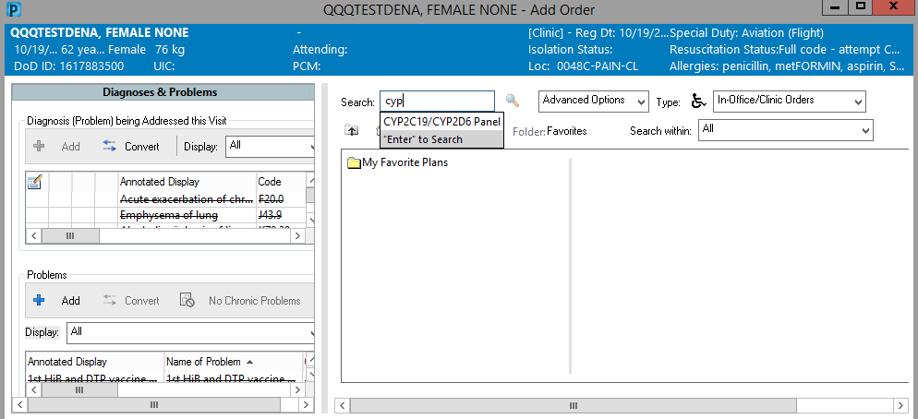
ORDERING A PGX TEST
Indication, patient preference
Current/prior medications
PGx
Comorbidities, age, organ function
Notes:
The specific lab for PGX testing available at this time is CYP2C19/2D6. These are the only genes available for testing at this time, however the plan is the build more this year and create a PGx panel of multiple genes. The process for ordering this panel will follow the same steps as ordering for Cyp2c19 and 2d6.

Slide 15
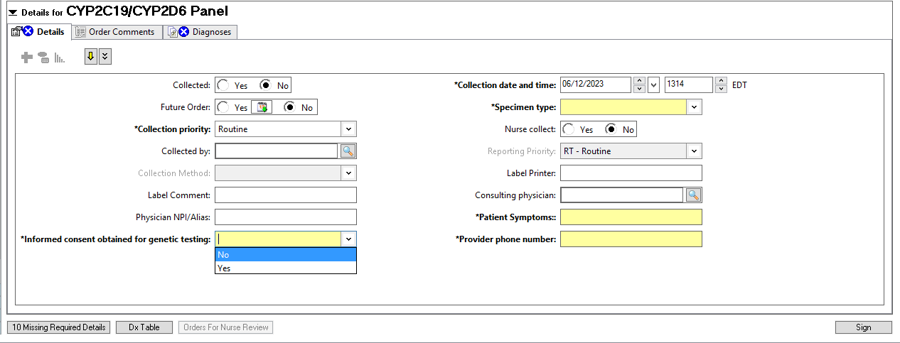
ORDERING A PGX TEST
Indication, patient preference
Current/prior medications
PGx
Comorbidities, age, organ function
Notes:
When you choose the lab, you will need to complete a quick questionnaire, and must complete all yellow fields. Specifically, I get a lot of questions about informed consent, and informed consent can either be written or verbal consent for PGx testing and this guidance comes directly from the DHAGRL. It is a blood draw lab, vs buccal, and more information regarding specifics about the lab can be found at the DHAGRL’s milsuite listed on this slide.

Slide 16
IMPORTANT ORDERING INFORMATION
  CYP2D6/CYP2C19 currently the only available test that can be ordered for DHAGRL
  40+ gene panel on the horizon…
  Test results appear in NEW Genetics tab for ease of viewability (added to Pharmacist roles January 24)
  Test results available in 6-8 days (largely dependent on volume)
  DHAGRL accompanies results with clinical explanation utilizing CPIC Guidelines
Indication, patient preference
Current/prior medications
PGx
Comorbidities, age, organ function
Notes:
Here are some important information regarding ordering a PGx test that I get a lot of questions about. We already discussed that CYP2D6/2C19 genes are the only currently available tests and that we have a panel for future tests. All pharmacists should have had the new genetic tab added under their roles so you can easily see all genetic information pertaining to your patients. Test generally result in 6-8 days, but a lot of this is dependent on volume. The good news is since we released our DHA Practice Recommendation, demand had nearly tripled, meaning we are getting a good amount of tests in from the enterprise, while hopefully removing tests being sent to Labcorp. With the results, you will get a report from DHAGRL with a clinical explanation of the results.

Slide 17
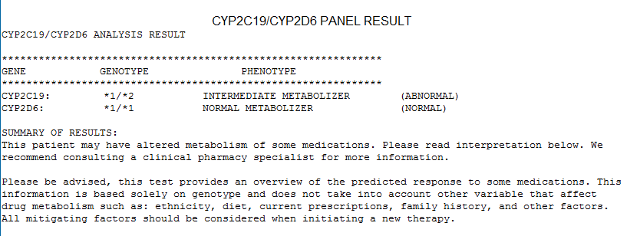
PGX PANEL RESULT EXAMPLE
Indication, patient preference
Current/prior medications
PGx
Comorbidities, age, organ function
Notes:
This is what a typical report will be look like. You will see the genotypes and phenotypes for each enzyme, a summary of the results….

Slide 18
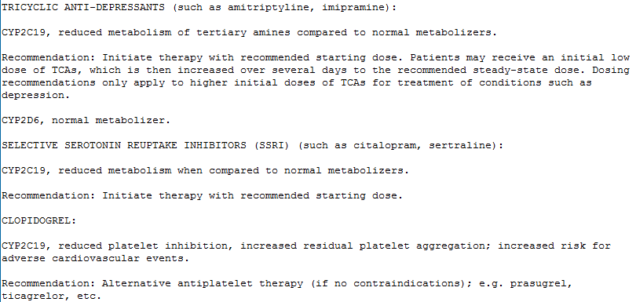
PGX PANEL RESULT EXAMPLE
Indication, patient preference
Current/prior medications
Comorbidities, age, organ function
Notes:
And then some recommendations. The recommendations for therapy change come directly from CPIC, or the Clinical Pharmacogenetics Implementation Constortium…

Slide 19
CLINICAL PHARMACOGENETICS IMPLEMENTATION CONSORTIUM (CPIC)
  NIH-funded international consortium that creates, curates, and posts peer-reviewed, evidence-based gene/drug clinical practice guideline. Does not tell you when or if you should PGx test.
  DHAGRL uses this information for reporting test results and providing recommendations
  CDS Alert verbiage largely pulled from CPIC guidelines
    Currently, 5 post-test drugs alerts are live in MHSG
      Tramadol (CYP2D6), Codeine (CYP2D6), Clopidogrel (CYP2C19), Tafenoquine (G6PD), Primaquine (G6PD)
    Further alert development in process
Indication, patient preference
Current/prior medications
Comorbidities, age, organ function
Notes:
And I’m sure you’ve heard of CPIC before, but if you have not, this an internation consortium that created evidence-based gene/drug clinical practice guidelines. While they do not tell you when or who you should test, they do offer clinically actionable guidelines for medication management once you have a result.
Our ASP has created 5 post-test drug alerts that are currently live in MHSG. This means that if a patient has a drug/gene interaction and has a PGx result reported in their record, a CDS alert will pop up upon ordering explaining the interaction. Our Team is currently working on developing more of these alerts.

Slide 20
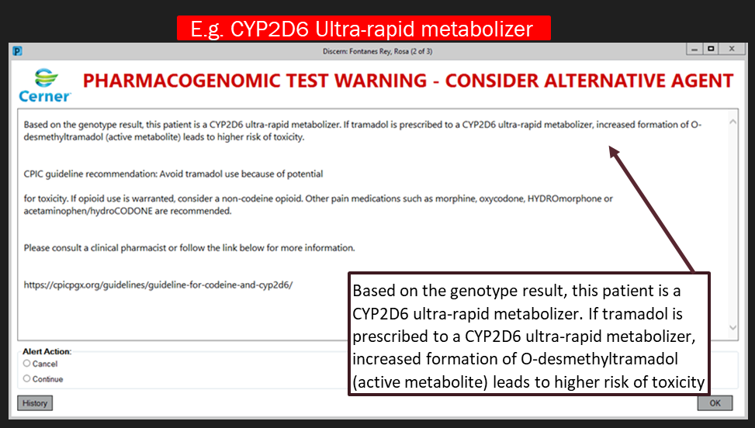
CDS POST-TEST ALERTS
  Drug alerts that fire based on post-test lab results
    Example – Tramadol ordered for a patient once a “ultra-rapid metabolizer” phenotype has been documented in MHSG
    Exception: G6PD, which fires based on a listed “problem list”
  Alert provider to “cancel” the medication or “continue” with prescribing
  Pre-test alerts for carbamazepine and oxcarbazepine (HLA-A/HLA-B) based on current evidence
Indication, patient preference
Current/prior medications
Comorbidities, age, organ function
Notes:
Here is an example of what a PGx CDS alert will look like. At every CDS alert, there will be the option to cancel or continue with therapy. These orders fire upon the lab phenotype, with the exception of G6PD which will fire based on a listed problem. While this is an example of a post test alert, our Team is currently building pre-test alerts for high-risk medications such as carbamazepine and oxcarbazepine in line with FDA guidance.

Slide 21

CARBAMAZEPINE
– HLA-B*15:02
  Carbamazepine used commonly in treatment of epilepsy, trigeminal neuralgia, and bipolar disorder
  Carriers of HLA-B*15:02 gene have a strong association with the development of Stephens Johnson Syndrome (SJS).
  Strong presence of HLA-B*15:02 in patients with Asian ancestorial decent
  FDA Boxed Warning: HLA-B*15:02 testing should be performed in those with Asian ancestry
Indication, patient preference
Current/prior medications
Comorbidities, age, organ function
Photo: https://dermnetnz.org/
Notes:
When we look at Carbamazepine and polymorphisms in human leukocyte antigen B or (HLA-B), we see a strong association in the development of SJS and TEN, mostly in the Asian cestorial decent with *15:02 gene. This is a overreaction immune response vs your typical metabolic polymorphisms that we think about with CYP Enzymes or TPMT. The FDA has a boxed warning, suggesting that HLA-B*150:02 should be performed in those with Asian ancestry. A pre-test alert for an HLA-B 15:02 test for patients initiated with carbamazepine would help prevent the occurrence of this immune response.

Slide 22


A READINESS PERSPECTIVE
  1 in 5 Active-Duty Service Members (ADSM) have mental health concerns; suicide rates continue to rise to record-highs
  Many SSRIs and SNRIs, first line therapies for mental health disorders, require 4-6 weeks to reach peak effectiveness. Adjusting the dose or changing the medication can result in more time
  An ADSM is placed in a non-deployable code for 90 days at every new psychoactive medication start
  A potentially prolonged treatment process and medical readiness issue…
Indication, patient preference
Current/prior medications
Comorbidities, age, organ function
Meadows, Sarah O., Charles C. Engel, Rebecca L. Collins, Robin L. Beckman, Matthew Cefalu, Jennifer Hawes-Dawson, Molly Waymouth, Amii M. Kress, Lisa Sontag-Padilla, Rajeev Ramchand, and Kayla M. Williams, 2015 Health Related Behaviors Survey: Mental and Emotional Health Among U.S. Active-Duty Service Members. Santa Monica, CA: RAND Corporation, 2018. https://www.rand.org/pubs/research_briefs/RB9955z3.html.
Photos: https://health.mil/News/Articles/2022/01/01/Covid19-Dep-MSMR, health.mil, https://deadsounds.com/soldiers-sound-effects
Notes:
So let’s apply this to a readiness perspective: 1 in 5 active duty services members have a health concerns, and its no surprise that we have mental health concerns in the military, which is making headlines, particuarily a few years ago when we hit record high in sucidices. Here’s the problem for the ADSM – beyond mental health be stigmatized, SSRIS and SNRIs, which are used as first line for mental health disorders are metabolized by Cyp2d6 and some TCAs etc by cyp2c19, which we know are polymorphic. Once a ADSM is prescribed one of these medications….they are place in a non-deployable code for 90 days at every new psychoactibve medication start. We also know that these medications can take 4-6 weeks to reach peak effectiveness, so this results in a potentially prolonged treatment process whereby we keep trying SSRIs and SNRIs, keeping our patients on a non deployable status and waiting long periods for treatment success. However, a potential model is we have this information for the start, and can use PGX, among other factors, to make a more educated guess on which medication might benefit a patient better, and potentially get our service members back a deployable status.

Slide 23
EVIDENCE
  Meta-analysis of five prospective RCTs (n=1737) in patients who received DST-guided PGx therapy demonstrated that DST guided therapy was 1.71 times more likely to achieve symptom remission compared with usual treatment (p = 0.0005)
    Inclusion criteria: Moderate to severe depression with history of inadequate response or intolerability to previous trial
  RCT compared PGx guided treatment with usual care (n=1944) demonstrated improved remission rates at 8 and 12 weeks compared with usual care, but no differences between groups at 18 and 24 weeks.
    Secondary outcomes: response to treatment (p=0.03) and symptom improvement (p=0.02) favored PGx group at 24 weeks
Indication, patient preference
Current/prior medications
Comorbidities, age, organ function
Bousman CA. Pharmacogenomics 2020; 20(1): 37-47
Oslin DW, et al JAMA 2022;328(2): 151-161
Notes:
While there is a growing breadth of evidence for PGx clinical utilization, two recent larger trials in support of PGx guided therapy showed faster resolution of depressive symptoms than usual care. These sort of studies are excellent to conduct at your locations – PGx vs usual care and significant changes in remission, specifically for SSRis and SNRIs.

Slide 24
GLOBAL PGx IMPLEMENTATION CHALLENGES
    Lack of education for providers & pharmacists
      PCPEPs, JKO Education Module, ASHP PGx Certification
    Lack of strong decision support tools
      Continuing to build CDS into MHSG
    Conflicting guidelines
      PharmGKB assists…
    Lack of strong cost effectiveness/benefit studies
    Ethical concerns
    Regulation and laws
Indication, patient preference
Current/prior medications
Comorbidities, age, organ function
Notes:
Read the slide. Almost there!

Slide 25
INTO PRACTICE…
  United States Coast Guard
    Provider-referral model
    Pharmacists handles pre-test counseling, lab orders, result interpretation, and post-test counseling
    All pharmacists received ASHP PGx Certification
Indication, patient preference
Current/prior medications
Comorbidities, age, organ function
Notes:
I always like hearing about how other sites are implementing PGx into their practice, and I wanted to highlight what the USCG pharmacy is doing to champion PGx. They have a provider-referral model, whereby they consult the PharmD for PGx services should they encounter a patient who they believe could benefit from testing. The patient meets face to face with the pharmacists, and the pharmacist conducts lab ordering, result interpretation and provides any medication recommendations after consulting the patient. All their pharmacists received payment to get their ASHP Pgx Certification – which I thought was fantastic because ASHP has pretty comprehensive cert course., Just last year, they had 7 patients that were seen, and 5 the patients had an actionable PGX result. This is pretty much in line with the results I got at the clinic I stood up at Hurlburt Field.

Slide 26
ADDITIONAL RESOURCES
    Food and Drug Administration (FDA)
      261 drugs have identified drug-biomarker pairs (DBPs) listed in their labeling
      Largely based on research development, pre-marketing data
      Most labels do not provide specific recommendations
    Dutch Pharmacogenomic Working Group
    PharmGKB (https://www.pharmgkb.org/)
      Curates PGx information and evidence from DPWG, FDA, and CPIC
      Excellent resource for comprehensive PGx picture
Indication, patient preference
Current/prior medications
Comorbidities, age, organ function
Bousman CA. Pharmacogenomics 2020; 20(1): 37-47
Oslin DW, et al JAMA 2022;328(2): 151-161
Notes:
While CPIC is a great first “go-to” for information on how to use PGx clinically, there are also other important resources to consider, seen here. The biggest challenge with PGx is that sometimes these bodies don’t all agree with each other. Or rather, the FDA may have PGx listed on a drug that CPIC hasn’t been able to actionably determine. I usually used PharmGKB in these instances, as this site curates information on PGx across multiple sites to give you a comprehensive picture on PGx.

Slide 27
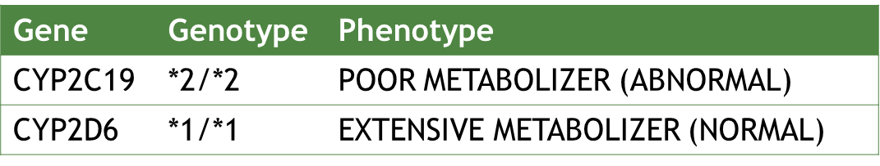
PATIENT CASE*
  MB is a 23 YO ADSM male who is being seen by his PCM for anxiety and major depressive disorder.
  Past Prescriptions: citalopram (2 months, discontinued due to side effects), hydroxyzine
  PCM decides to change to sertraline 50mg and orders a PGx test which results in the following:
Indication, patient preference
Current/prior medications
Comorbidities, age, organ function
*case above represents a hypothetical patient and does not release any true patient information
Notes:
Let’s take a hypothetical patient case. Read.

Slide 28
PATIENT CASE
  CPIC:
    May be at risk for higher plasma concentrations. Consider a lower starting dose, slower titration schedule, and a 50% reduction of standard maintenance dose
    Options:
      Start sertraline at 25mg
      Switch antidepressant to one not metabolized by CYPC19
  Remember, this is a small piece to the larger clinical picture. Consider all aspects: adherence, social factors, substance use, family history, other medications, etc..
Indication, patient preference
Current/prior medications
Comorbidities, age, organ function
*case above represents a hypothetical patient and does not release any true patient information
Notes:
Based on this patient’s cyp2c19 phenotype as a poor metabolizer, we can predict that this patient may not metabolzie sertraline to its inactive component as efficiently, thus resulting in higher plasma concentrations. For this reason, it is reasoabvle to start the sertraline at 25mg (vs the usual 50mg start) or to switch to an antidepressant not metabolized by cyp2c19.
And again, and this is critical, the patients metabolic genotype is only a small piece to the larger clinical picture. We also know that serotenrgic recpetors are highly polymorphic and we all know that there are many other factors that could lead to an increase in side effects or ineffixcieny. Must take all things into consideration vs reacting to a PGx lab result.

Slide 29
KNOWLEDGE CHECK #1
  PGx guidance and resources are available through _______?
    A. CPIC
    B. PHARMGKB
    C. DPWG
    D. All of the above
Indication, patient preference
Current/prior medications
Comorbidities, age, organ function

Slide 30
KNOWLEDGE CHECK #1
  PGx guidance and resources are available through _______?
    A. CPIC
    B. PHARMGKB
    C. DPWG
    D. All of the above
Indication, patient preference
Current/prior medications
Comorbidities, age, organ function

Slide 31
KNOWLEDGE CHECK #2
  Which genetic biomarker is critical to know to avoid carbamazepine-induced SJS?
    A. CYP2C19
    B. TPMT
    C. HLA-B
    D. SLCO1B1
Indication, patient preference
Current/prior medications
Comorbidities, age, organ function

Slide 32
KNOWLEDGE CHECK #2
  Which genetic biomarker is critical to know to avoid carbamazepine-induced SJS?
    A. CYP2C19
    B. TPMT
    C. HLA-B
    D. SLCO1B1
Indication, patient preference
Current/prior medications
Comorbidities, age, organ function

Slide 33
KNOWLEDGE CHECK #3
  Universal barriers to PGx implementation include all of the following EXCEPT:
    A. Lack or robust cost/effectiveness studies
    B. Provider/patient/pharmacist education & training
    C. Ethical concerns
    D. Actionable clinical guidelines
Indication, patient preference
Current/prior medications
Comorbidities, age, organ function

Slide 34
KNOWLEDGE CHECK #3
  Barriers to PGx implementation include all of the following EXCEPT:
    A. Lack or robust cost/effectiveness studies
    B. Provider/patient/pharmacist education & training
    C. Ethical concerns
    D. Actionable clinical guidelines
Indication, patient preference
Current/prior medications
Comorbidities, age, organ function

Slide 35
SUMMARY
  PGx is a rapidly evolving field with potential impact to clinical practice
  Multiple resources exists to assist with PGx implementation and understanding
  DHAGRL’s CYP2D6/2C19 PGx test is available to order in MHSG
  OPTIMM is a DHA Strategic Initiative set to enhance the DoD’s PGx capabilities to maximize medical readiness and securely store genetic data
Indication, patient preference
Current/prior medications
Comorbidities, age, organ function

Slide 36
Pharmacogenomics (PGx)
Personalized Medicine for the Modern Warfighter
MICHAEL E. BRAUD, Maj, USAF, BCGP
michael.e.braud2.mil@health.mil

