Slide 1

Maximizing Military Financial Benefits: A Credit Journey
Maj Timothy Corbin, CPFC

Slide 2
Disclaimer: This guide is meant for educational and informational purposes only and does not constitute any financial or tax advice. Terms and information on this presentation may change over time as well. Please talk to a financial advisor if you have any concerns about your financial health.

Slide 3
BLUF: These cards have the potential to save you thousands of dollars a year in travel and other costs, WHEN USED CORRECTLY AND WHEN ALL BALANCES ARE PAID OFF IN TIME.
TAKE YOUR TIME AND ASK QUESTIONS!!!

Slide 4
Introduction
Benefits and Requirements of Cards (Who is eligible)
Potential Free Money/Year
MLA and SCRA- How to get these benefits
Rules of the game
Optimal Credit Card Holdings
Maintaining cards during active duty
Downgrading cards after active duty

Slide 5
Benefits of Credit Cards
Safety and Convenience
  No need to carry cash—use your credit card instead.
  Fraud protection keeps your money safe.
Cash Back
  Unlimited cash back on dining, grocery shopping, entertainment, etc…
One-Time Bonuses
  Earn a signing bonus when you get a new credit card.
  Spend a certain amount within the first few months to unlock rewards.

Slide 6

Benefits of Credit Cards
Special Experience Credits
  Enjoy perks like food and beverage credits.
  Treat yourself to a fancy dinner or a spa day.
Fine Hotels and Resorts Program
  Room upgrades, early check-in, and late check-out.
  Complimentary Wi-Fi and breakfast.
  Your credit card turns your hotel stay into a VIP experience! 🏨
Maximize Points and Miles
  Use your credit card for flights and earn points.
  Redeem them for travel, gifts, or statement credits.

Slide 7
Requirements for Benefits
Who is eligible?
  Have good credit
  Pay entire balance
  Follow guide diligently
  Keep on the path
  Make minimum spends (staggering)
  Keep Cards open while AD (active duty)
  Keep serving country for at least 2 years
  Downgrade to low fee or free products after service

Slide 8
Why Do This?
My Mid-Tour Costs
  Flight- ICN to DEN= $831
  Flight- DEN to ASE=$169x2=$338
  Flight- ASE to EWR= $319x2= $638
  Flight- EWR to SAT= $279x2= $558
  Flight- SAT to ICN= $1,393
  Hotel- 3 nights in Denver= $550x 3= $1650
  Hotel- 2 nights in Philadelphia= $345
  TOTAL= $5,753

Slide 9
Why Do This?
Actual Mid Tour Cost
Ask Me How I did this! You can do it too!
+$580!!!
Notes:
Yes, you read that correctly. I am actually making money from booking all of those flights and hotels. And today I will tell you how. All through holding these credit cards and by earning points through spending money that I was already spending.

Slide 10
Cost to you (and Dependents!)
$0
Notes:
There is no cost to you for having these cards. You just have to hold them in your wallet and spend the free money that they already give to you. Business cards used to be free but are unfortunately no longer free but all of the normal charge and credit cards still are.

Slide 11
My total $$ in Annual Benefits
$25,462
Only recurring benefits used each year!
  Not including points, lounge access, status, etc…
  Untaxed credits
  This is just the credits the companies give you by having their cards!
Notes:
Amex Cards= $21,402
Chase Cards= $2,385
Citi= $250
US Bank=$525
BOFA= $900

Slide 12
Charge Card Vs. Credit Card
Charge Card (Amex Platinum, Gold, Green)
  No preset spending limit
  MUST PAY OFF ENTIRE BALANCE EACH MONTH
    Ex: if you spend 10K, must pay all 10K next month
    Charge cards now have ”pay over time” feature which is similar to how credit card works.
Credit Card
  Preset spending limit (can pay off $25-50 a month)
  Can pay minimum amount required each month
    Rest of balance will accrue interest
Notes:
American express gold, green and platinum cards are all charge cards. Any other American express is going to be a credit card.
American express is the only company that has charge cards. All others you will be getting are credit cards.

Slide 13
MLA and SCRA
THESE TWO ACTS ALLOW US TO HAVE THESE CARDS FOR FREE!
SCRA (Servicemembers Civil Relief Act)
  Only applies to cards or accounts opened before Active Duty or joining reserves
  Drops yearly interest rate (APR) to ≤6%
  No annual fees on credit cards, interest rate down to 6%.
MLA (Military Lending Act)
  36% APR is capped on any new debt (after Sept 2017) issued to a service member
  Applies to all service members while on active duty or reservist
  No annual fees on credit cards exceeding a normal annual fee of $100 (interest rate stays the same)
Notes:
SCRA benefits are for any cards or loans that you had before starting active duty. If you have not called your bank yet to get those benefits you should! And they will reimburse you for all of the interest accrued during your active duty time on that car.
MLA only applies to any of the cards that you open after active duty. This will apply to most of you when opening new cards.

Slide 14
MLA and SCRA
Not sure if family Member Qualifies?
If you want to verify that your dependents will have their annual fees waived, you can check their MLA eligibility at:
https://mla.dmdc.osd.mil/mla/#/home
This is especially useful if you have recently joined the military or added dependents to your benefits. (You will have to create an account before you are able to look records up.)
Notes:
SCRA benefits are for any cards or loans that you had before starting active duty. If you have not called your bank yet to get those benefits you should! And they will reimburse you for all of the interest accrued during your active duty time on that car.
MLA only applies to any of the cards that you open after active duty. This will apply to most of you when opening new cards.

Slide 15
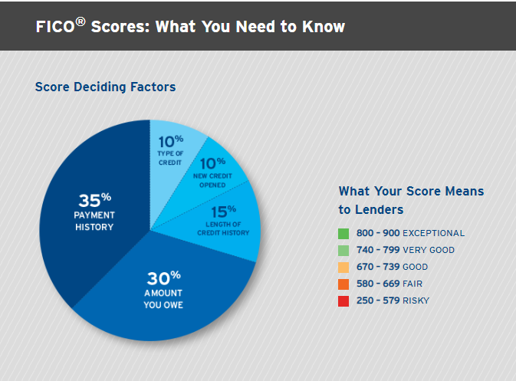
Credit Score
Notes:
Fico Score it what the credit card companies use in order to approve you for a credit card. The higher the score, the better. The breakdown of what goes into your score is above. Creditkarma.com is a good website to get your base score. It is not a fico score but gives you a good idea of what you score is near. Most of the cards discussed in this presentation require at least a credit score of >700

Slide 16
Ways to Increase Credit Score
Review your credit reports.
Get a handle on bill payments.
Use 30% or less of your available credit.
Treat Credit Cards like a debit card (only spend what you have)
Pad out a thin credit file.
Keep your old accounts open and deal with delinquencies.
Consider consolidating your debt.
Track your progress with credit monitoring.
Notes:
Fico Score it what the credit card companies use in order to approve you for a credit card. The higher the score, the better. The breakdown of what goes into your score is above. Creditkarma.com is a good website to get your base score. It is not a fico score but gives you a good idea of what you score is near. Most of the cards discussed in this presentation require at least a credit score of >700

Slide 17
Where/How Do I start?

Slide 18
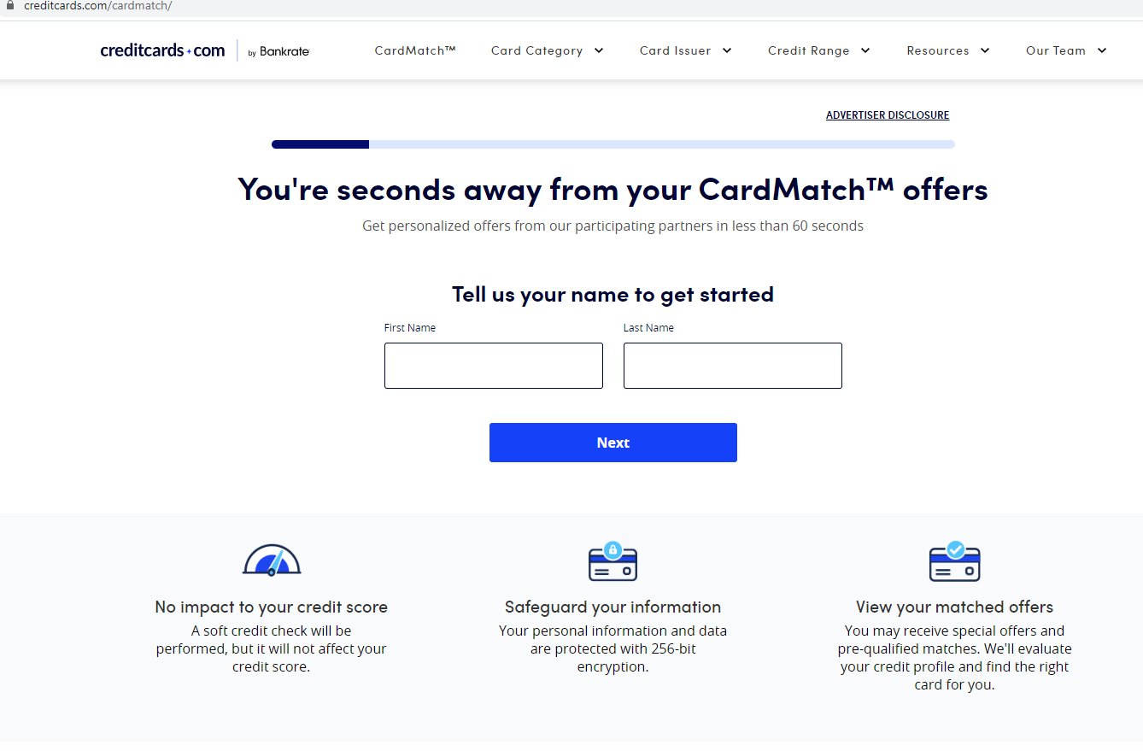
Card Match (https://www.creditcards.com/cardmatch/)
Start Your Journey Here! It will tell you which cards you have the best chance of getting approved for.
  Only works with U.S. address (use previous address/parent’s address)
  Use to see if you have offers with larger sign up bonuses as well!
Notes:
Start here! Card match is great site that tells you exactly what cards you would qualify for with your current credit score. It’s a great place to begin if you don’t know which card you want to start with!

Slide 19
Card Match (https://www.creditcards.com/cardmatch/)
Will ask for:
  Name
  Mailing Address (only works with CONUS address! Use previous address/parent’s address
  Employment Status (choose employed)
  Annual Income
    Include all income available to you (Include spouses!)
    Figure in your non taxable income (can be found on your LES)
      Multiply this by 25%.
  Rent/Mortgage Payment (put 0 if you do not have)
  Last 4 of SSN and Email Address

Slide 20
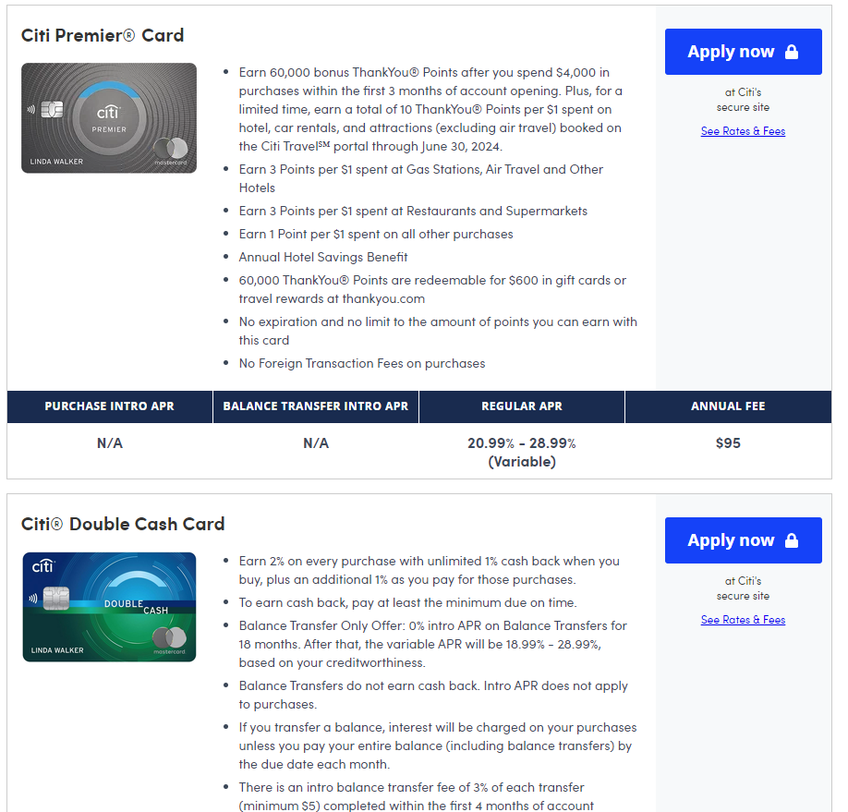
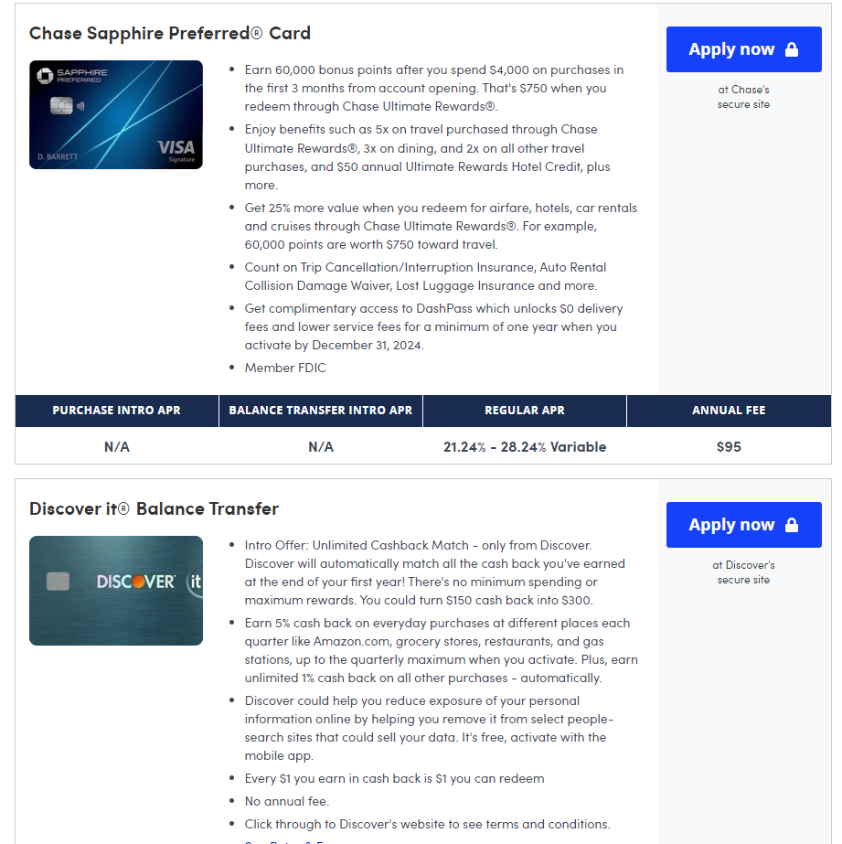
Card Match

Slide 21
If Nothing Else… Have These Two!
Click here for full review!
Click here for full review!
Chase Sapphire Reserve (CSR)
Amex Platinum (AP)
-If these are the only cards you are interested in, click on the links to find out all about them!
-If you are interested in getting more than these two, or learning how to get multiple Amex Platinums or CSR’s, continue reading on!
Notes:
If nothing else, these are the two cards you should always have with you. They are important because they give you all kinds of travel insurance and extended warranties that protect basically all of your purchases. You will see what it covers later in the powerpoint. These two cards also offer you the most benefits and free money every year.

Slide 22
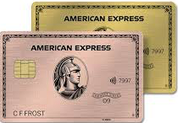
If More Than Those…
1. Discover (If no Credit History)
2. Chase (start here for max cards)
3. Amex Charge Cards
4. Amex Credit Cards
5. US Bank
6. Citibank
7. Amex Business Charge Cards
  Annual fee now charged ☹
8. Other Cards

Slide 23
Order of Obtaining Cards
Discover
1. Discover (If no Credit History)
  Open Discover It card
    Cash Back or Travel Card
Only open if no credit history.
  Build credit for first 6 months-1 year
Start with Chase if you have Credit history

Slide 24
Starting From Ground Zero
Chase
  Rejected if no Credit History
Starting Out
  Discover Card for 12 months
    Secured or student card
Freedom or Freedom Unlimited
  $500 limit
  Prepay mid-cycle

Slide 25
Chase

Slide 26
Chase Rules (start here for max cards!)
5 Cards in 24 months
  Will be rejected for any card after this limit is reached
Due to 5/24 you should always accrue chase cards Chase first
2/30 rule: two applications every 30 days
24 month bonus rule: Sign Up bonus per 24 months
48 month bonus rule: One Sapphire Sign-up Bonus per 48 months
***Business Cards do not add to 5/24***
Notes:
Chase is very strict with their rules. And any card that you open, whether chard card or credit card counts towards this 5/24 rule. Also, if you add an authorized user to one of your cards it also counts towards the 5/24 rule.

Slide 27
Chase Sapphire Reserve
(Must Have!)
Click Here for Full Review!
Sapphire Reserve (check www.frequentmiler.com for best offer)
  $300 travel credit every card anniversary
    Good for any type of travel
  Points worth 50% more! (1.50 cents per point)
  Priority Pass (family members can get if Auth user!!!)
  TSA Precheck or Global Entry Credit (done at Airport)
  Transfer Partners (Ex: Southwest, United, Hyatt)
  Primary rental car insurance
  $60 per year DoorDash credit plus DashPass
  Free Lyft Pink membership (10x points on Lyft rides)
Notes:
The 2nd best card in the game! So many great benefits and travel credits. All of the points you earn on this card, along with the freedom flex and freedom unlimited, go into the same point bank. This card makes them worth 1.5 cents per point instead of 1 cent per point when used for travel on chase’s website. You earn 60K ultimate rewards points after spending $4,000 in 3 months.

Slide 28
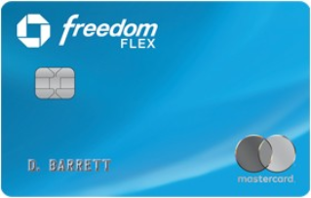
Chase Freedom Flex
Click here for full review!
Chase Freedom Flex $200 (20k UR) bonus with $500 spend in 90 days (Free)
  Rotating 5X categories that you can transfer as UR to Chase Sapphire Reserve
  MasterCard World Elite benefits
    Cell phone protection, hotel perks, etc…
  3% cash back at drugstores and dining
  5% on travel purchased through Chase Ultimate Rewards
  Upgrade to another Chase Sapphire Reserve in one year
    ***Note!!! Make sure to upgrade after getting first CSR (will not get sign-up bonus if upgraded before getting CSR)***
Notes:
They just upgraded this card an the new bonuses are awesome! And the card is free. A must have along with the freedom unlimited to accrue your chase ultimate rewards’ points. After one year you upgrade it to another chase sapphire reserve.

Slide 29
Chase Freedom Unlimited
Click here for full review!
Chase Freedom Unlimited $200 (20k UR) bonus with $500 spend in 90 days (Free)
  1.5% UR point per dollar on all purchases
  3% cash back on dining
  3% cash back on drugstores
  3% cash back on travel purchased through Chase Ultimate Rewards
  Upgrade to another Chase Sapphire Reserve in one year
    ***Note!!! Make sure to upgrade after getting first CSR (will not get sign-up bonus if upgraded before getting CSR)***
Notes:
Another great card with great benefits. Treat this just like the freedom flex, upgrading after one year.

Slide 30

Chase Sapphire Preferred
(Good Starter Before Reserve and for downgrading to after AD Service)
Click Here for Full Review!
Sapphire Preferred (80K UR on $4k in 90 Days)
  $50 annual UR hotel credit
  10% point anniversary boost (1 point per $10 spent)
  Transfer Partners (Ex: Southwest, United, Hyatt)
  Primary rental car insurance
  3x points on travel and Dining
    Points worth 25% more! (1.25 cents per point)
  Must wait 48 months to get another bonus
  Upgrade to another Chase Sapphire Reserve in one year
    ***Note!!! Make sure to upgrade after getting first CSR (will not get sign-up bonus if upgraded before getting CSR)***

Slide 31
Earning Points with Sapphire Reserve
10 points per dollar on hotels and car rentals purchased through Chase Travel.
10 points per dollar on dining purchases through Chase Ultimate Rewards.
10 points per dollar on Lyft rides (through March 31, 2025).
10 points per dollar on Peloton equipment and accessory purchases (through March 2025) of $250 or more, with a maximum of 50,000 points.
5 points per dollar on flights purchased through Chase Travel.
3 points per dollar on all other travel (excluding the $300 travel credit) and dining purchases worldwide.
1 point per dollar on everything else.

Slide 32
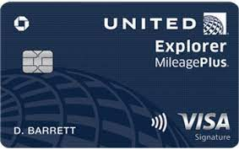
Chase United Explorer
United Quest Card
  60k bonus miles on 3K spend in 3 months.
  2x miles on United Purchases
    2x miles on dining and hotel stays
    1st bag free
    Global Entry (TSA Precheck Included) credit

Slide 33
Chase United Quest
Click here for full review!
United Quest Card
  70k bonus miles+ 500 PQP (premier qualifying points) on $3K spend in 90 days
    3x miles on United Purchases
    2x miles on dining, travel and streaming
    1st and 2nd bags free
    $125 annual united purchase credit
    10,000 miles every card anniversary
    Priority Boarding

Slide 34
Chase United Club Infinite
Click here for full review!
United Club Infinite Card
  80k bonus miles+ 1000 PQP (premier qualifying points) on $5K spend in 90 days
    United Clubs and Star Alliance Lounges
    4x miles on United Purchases
    2x miles on dining and travel
    1st and 2nd bags free
    Premier Access
    IHG $75 credit and Platinum Status
Notes:
Great offer on the united club card right now. The 75k bonus miles is awesome, but the card isn’t that great otherwise for you, since we get into united lounges anyway being active duty military. You also must be flying united in order to get into lounges. This is explained on a later slide as well. You would mostly be getting either of these cards for the miles and that’s it.

Slide 35
Chase Southwest
Click here for full review!
Southwest Priority Card (40K RR after 1K spend)
  7.5K Rapid Rewards (RR) points each year
  4 priority boarding passes
  $75 yearly credit on SW Flights
  Can only have one SW card
Southwest Premier Card
  6K RR points per Year put into your account!
Notes:
Priority card is a great card if you fly southwest all of the time. Gives you a $75 credit towards SW flights every year and 4 upgraded boardings. REMEMBER THOUGH, YOU SHOULD NOT BE USING ANY OF THE AIRLINE CARDS FOR YOUR REGULAR SPEND. YOU SHOULD BE USING THE SAPPHIRE RESERVE OR YOUR AMEX CARDS. YOU CAN USE THOSE CARDS TO TRANSFER TO THESE AIRLINES.

Slide 36
Chase Marriott
Chase Marriott Bonvoy Boundless
75k Marriott points with $3k spend in 90 days
  Free annual night worth 35k points
Upgrade Boundless to Ritz-Carlton Card in 1 year
  One free 85K point night per year
  $100 hotel credit with any two-night stay at Ritz
  3 Club Level Upgrades per year (Rack Rate)
  $300 Airline Fee Credit per calendar year (good for southwest gift cards and United Travel Bank)
Notes:
The chase Marriott card is great because you get the 3 free nights as your bonus, then after a year can upgrade it to ritz carlton credit card. You can only get the Ritz card through an upgrade. You can not open it anymore. The ritz card gives you a $300 travel credit every year and a free night at any Marriott, Ritz Carlton, or SPG property up to 50K points.

Slide 37
Chase Ink Preferred
Chase Ink Business Preferred $95 a year (No AF Waiver)
  100k UR on $8k spend
  3x UR on Travel, Shipping purchases, internet, cable
  Does not add to 5/24 Status!
Notes:
The ink preferred is a great business card and worth the $95 annual fee. You do not need a business to open a business card! That is talked about later in the slides as well. Remember, these points go into the same bank as your freedom and sapphire points, so if you have the sapphire reserve they are worth 1.5 cents per piece! That makes 80k points worth $1200 in travel on the chase website!
The only reason you get the chase slate is to upgrade it to another Chase sapphire reserve after a year.

Slide 38
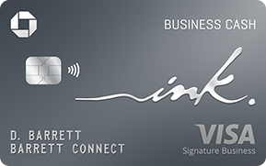
Chase Ink Cash
Chase Ink Business Cash ($0 annual fee, does not effect 5/24 Status!)
  90k UR points on $6k spend in 3 months
  5x points at
    Office supply stores (in-store Visa and Mastercard gift cards at Staples!!!)
    Internet, cable and phone services
  2x points at
    Gas stations and Restaurants
Notes:
The ink preferred is a great business card and worth the $95 annual fee. You do not need a business to open a business card! That is talked about later in the slides as well. Remember, these points go into the same bank as your freedom and sapphire points, so if you have the sapphire reserve they are worth 1.5 cents per piece! That makes 80k points worth $1200 in travel on the chase website!
The only reason you get the chase slate is to upgrade it to another Chase sapphire reserve after a year.

Slide 39
Chase Hyatt
Hyatt Card 30k on $3k spend, in 90 days then 30k on another $15k in 180 days ($95 waived)
  Free annual night Category 1-4
  4x points on Hyatt Spend and Exhale Locations
  2x on gym memberships
  Instant Discoverist Status (2 pm Checkout)
Notes:
Only really useful if you like to stay at Hyatts. 25K points goes a lot further for Hyatt hotels than it does with Hilton or Marriott, but I still think you get more value out of the SW or United card, or the Chase ink preferred!

Slide 40
Chase Travel Benefits

Slide 41
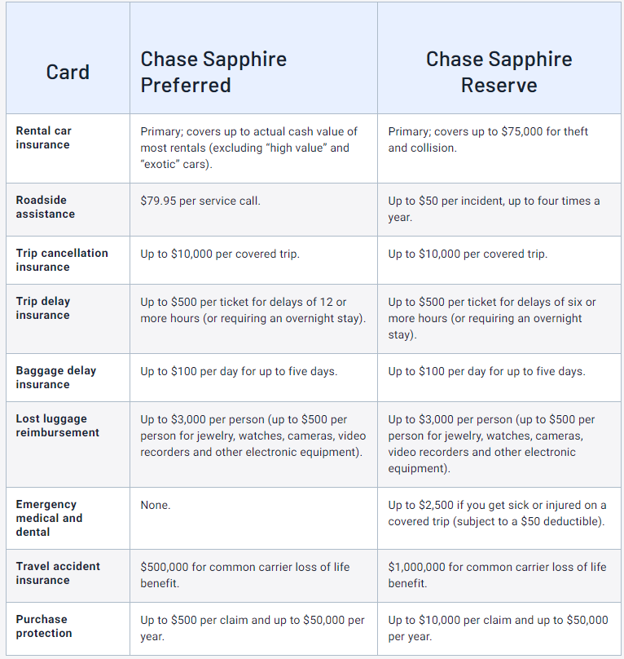
https://thepointsguy.com/guide/chase-sapphire-preferred-vs-chase-sapphire-reserve/
Notes:
Chase has great travel benefits as seen above. It basically covers every part of your travel. Whether you have a delayed flight, or the airlines loses your bags, the card will cover it as long as you paid for the flight with your card.
The reserve also offers you primary rental car insurance. Which basically takes the place of your regular insurance if you are in a wreck. Which is great because then your premium will not rise on your car insurance like it would in a regular wreck.
The CSR also adds extended warranties to anything you purchase! This is especially important if you buy something with only a 1 month or a 2 month warranty.

Slide 42
Chase Wrap Up
If you have player 2 (Spouse), they can apply for cards and get annual fees waived as well!
Upgrade, Upgrade, Upgrade!
Utilize Transfer Partners
  Southwest, United, Hyatt, etc…
  ***ALL CHASE POINTS CAN BE COMBINED INTO ONE POOL. That means if you have the CSR you can multiply your point total by 1.5!!!***
Notes:
A spouse gets all the same benefits that you do on these cards, so you can double up on all of the benefits listed in this powerpoint!
Upgrading is the best way to get the most travel credits possible. Basically any card you have you must wait one year to upgrade it.
Transfer partners are great and are the main reason you want to use your chase sapphire reserve, citi prestige, or amex plat for travel. Because you can just transfer those points to the airlines of your choosing. This way you get more points than if you were just using your airline credit card to get miles.

Slide 43


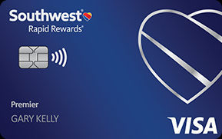
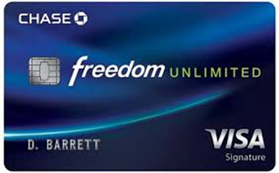
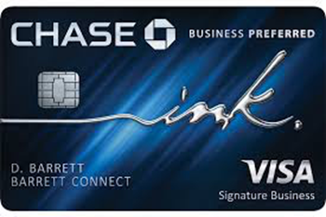
Order of Obtaining Cards
Chase
Freedom Flex
Freedom Unlimited
Month 1-3
Sapphire Reserve
United Club/Quest
Last chase card of your choice!
Month 7-9
Month 4-6
Notes:
This is the basic way to obtain your chase cards. You want to do this first before anything else. Make sure you get your spend bonuses before opening another card. That way you can get max points possible.

Slide 44
American Express

Slide 45
Amex Rules
Amex Charge Cards (Platinum, Gold, Green)
  Limit of 10 charge cards, 5 credit cards
  1/5 rules: one new card every 5 days
  2/90 rule: only 2 cards in a 90 day period (mainly applies to credit cards, may be able to get more than 2 if also opening charge cards (platinum, gold, green)
  Lifetime Bonus Rule: 7 years between receiving bonus again
  New As of Aug 2023: Only 1 Signup Bonus between Amex Plat Cards ☹
    Can’t get bonus on Green or Gold if have gotten Bonus on Platinum
  Active Duty Waiver of Annual Fees Always
    Automatically done by Amex, do not need to send them anything
  Must wait 12 months to upgrade personal cards
Notes:
Most of these rules are pretty brand new for Amex. They have always been the best to military but have recently become more strict. But still they allow you to have up to ten charge cards (i.e, ten platinum cards!!!) You will not have that many probably, but still good to know you have that cushion.
You can open four credit cards of your choosing as well after the charge cards, which I will go over in later slides.

Slide 46
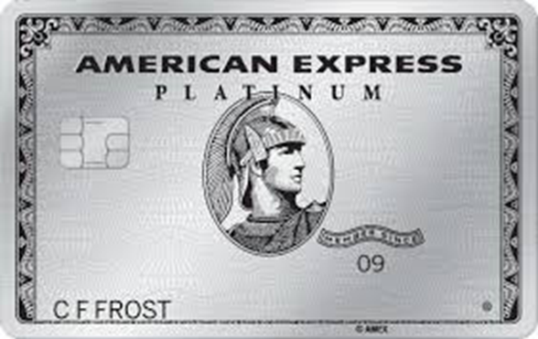
Amex Platinum (Must Have!)
AmEx Platinum 150K MR with $8k spend in 180 days
(offer located here https://frequentmiler.com/AmxPlat/#Goto)
  $200 a year on Uber @ $15 a month / $35 in December (Use on Uber Eats @ end of month)
  $200 annual travel credit every calendar year (must assign to airline)
  $200 annual hotel credit every calendar year (must use with Fine Hotels and Resorts)
  $100 on Saks 5th Ave. gift cards bought in person ($50 Jan to June, then $50 July to Aug. Can also use for online purchases. )
  $20/month streaming credit (good for Hulu, Disney+, ESPN, Peacock, Wall Street Journal, Sirius (Sirius Radio going away May 8 2024)
Notes:
The best of the best for Amex. So many benefits I could not list them all here. They even have added benefits right now because of covid, including $20 towards your phone bill every month and $20 towards streaming services every month. So if you have multiple platinums, you get multiple of these credits.
The travel credit for the amex platinum must be assigned to an airline, unlike the chase, citi and us bank travel credits, which you can use for any type of travel. The travel credit for amex still works for flights on jetblue or Southwest, but other than those airlines you can only use the credit for upgrades, baggage costs, and food on the plane.

Slide 47
Amex Platinum Cont.
  $300 Equinox Credit (Can use to buy gift cards in store or for membership)
  $300 SoulCycle at-home bike credit
  Free Airport Lounge Access: Airspace, Centurion, Escape, Delta When Flying
  Free authorized Users while Active Duty! They get lounge access and Marriot/Hilton Gold Status! ($195/year if not AD)
  Cellphone loss or damage protection
  Marriot and Hilton Gold Status
  Priority Pass Membership (does not include restaurants)
  Global Entry Credit
  $189 Clear Annual Credit
Notes:
The best of the best for Amex. So many benefits I could not list them all here. They even have added benefits right now because of covid, including $20 towards your phone bill every month and $20 towards streaming services every month. So if you have multiple platinums, you get multiple of these credits.
The travel credit for the amex platinum must be assigned to an airline, unlike the chase, citi and us bank travel credits, which you can use for any type of travel. The travel credit for amex still works for flights on jetblue or Southwest, but other than those airlines you can only use the credit for upgrades, baggage costs, and food on the plane.

Slide 48
Amex Charles Schwab
Charles Schwab AmEx Platinum 80k MR points on $6k spend in 180 days ($550 annual fee waived)
  New As of Aug 2023: Only 1 Signup Bonus between Plat and Schwab card ☹
  Same exact benefits as normal Amex Platinum
    1 free Authorized user per year if not Active Duty
  Must have Schwab account, use code “refer” for $100 bonus on $1000 deposit
  Use Schwab for Roth IRA ($5,500 max per year)
  Transfer Membership Rewards Points to Schwab account for 1.10 cents per point!
Notes:
This card is a must. You must get this card so if you decide to cash out your amex points, you get 1.10 cents per point!

Slide 49
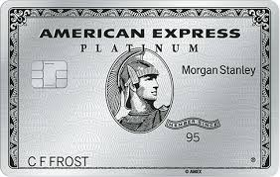
Amex Morgan Stanley
Morgan Stanley AmEx Platinum 100k MR points on $6k spend in 180 days ($550 annual fee waived)
  Cannot receive bonus if received on regular platinum or Charles Schwab platinum card .
  Must have Morgan Stanley account ($5,000 minimum otherwise $55/mo fee)
  Can transfer MR points to $$$ this way as well but only at 1 cent per point (not worth it)
  Same benefits as regular Amex platinum
    1 free Authorized user per year if not Active Duty
Notes:
Only open this for the spend point bonus and the normal amex benefits. Travel credit, saks credit, etc…

Slide 50
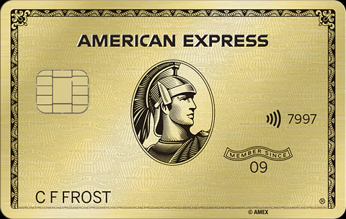
Amex Gold
AmEx Personal Gold 90k MR on $4k spend in 90 days (offer located here: https://frequentmiler.com/AmxGoldCard/#Goto)
  $120 Uber credit ($10/month)
  $120 for dining ($10 a month) (GrubHub, Cheesecake Factory, and more)
  4x Points on Dining (worldwide) and Groceries (CONUS and most Commissaries)
  3x on Airfare
  Upgrade to another Platinum in 1 year
Notes:
Open for points and then upgrade after a year. Also gives you some great cash back during that first year.

Slide 51
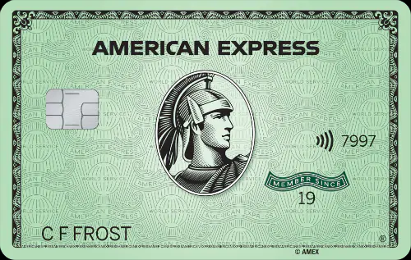
Amex Green
AmEx Green Card 50k MR for $2k spend in 90 days ($150 AF Waived)
  Upgrade to another Platinum in one year
  3X points on travel, transit and restaurants
  $100 credits for CLEAR and lounge access
  Can’t get bonus if you received bonus on Platinum card.
Notes:
Also has some great benefits, and a huge sing up bonus right now! Upgrade to another platinum after a year.

Slide 52
Amex Charge Card Review
Remember the Platinum, Gold and Green Amex cards are charge cards, which means:
  No credit limit
  Must pay all charges put on card the following month!
The ultimate goal is to upgrade gold and green cards to multiple Platinum cards. Over time, you can open up to 10 charge cards total.
  THAT MEANS YOU CAN HAVE UP TO 10 AMEX PLATINUMS! THAT IS 10X THE BENEFITS OF EACH CARD!
Notes:
Also has some great benefits, and a huge sing up bonus right now! Upgrade to another platinum after a year.

Slide 53
Amex Credit Cards Rules
  5 Credit Card Limit 1/5 rules: one new card every 5 days
  2/90 rule: only 2 cards in a 90 day period
  Lifetime Bonus Rule: 7 years between receiving bonus again
  Active Duty Waiver of Annual Fees Always
    Does this automatically. Call if not waived
  Can Upgrade Lower tier cards to have multiple upper tier cards!

Slide 54
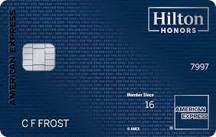
Amex Hilton Aspire
(Great Card!)
Hilton Aspire Card 175k HHonors Points on $6k in 180 days ($550 AF Waived)
  $200 for airfare purchases ($50/quarter, good for United travel bank)
  $400 on Hiltons Resort Credits (Hilton RESORTS only)
    ($200/biannually)
  Free Night every year including first year
  Diamond Status
  Can have all 3 Hilton cards! ( upgrade to 3 Hilton aspires after one year, or open multiple Aspires with no second sign up bonus)
Notes:
The best Amex credit card. Top status at Hilton hotels, 250 travel credit and a $250 resort credit, plus a free night at a Hilton hotel every year. You should have at least two of these out of the 4 you can have! (must upgrade the other two Hilton cards to this one)

Slide 55
Amex Hilton Cards
Hilton Surpass Card 130k HHonors on $2k spend in 90 days ($95 Yearly Fee Waived)
  Upgrade to another Hilton Aspire in 1 year to repeat benefits
Hilton Honors Card 100k HHonors for $1k spend in 90 days (free)
  Upgrade to another Hilton Aspire in 1 year to repeat benefits
  $100 credit at Hotels with sign-up bonus
Notes:
Only get for the spend bonus and upgrading purposes.

Slide 56
Amex Marriot Bonvoy
Bonvoy Brilliant 125k Marriott points on $5k spend in 90 days ($450 annual fee)
  $25/month dining credit (good for food delivery as well)
  85k point free night per year (after first year)
  Automatic Platinum Elite Status
  Can’t get bonus if you had the Marriott Card in 24 months
Notes:
Great card if you stay at marriotts. 85K free night credit and $25/month dining credit

Slide 57
Amex Delta Reserve
Personal Delta Reserve 100K Sky Miles, 5k MQM $5k spend in 90 days ($450 AF Waived)
  Great Card if you fly Delta a lot!
  Amex Centurion longue access
  Delta Sky Club Access
  First Class Delta Companion Pass Every Year
  Can have all three Delta Cards
Notes:
Great card if you fly delta. If you do not, I would avoid and get another Hilton card.

Slide 58
Amex Delta Cards
Delta Platinum 90K Sky Miles, 5k MQM, $100 credit on $3k spend in 90 days ($250 AF Waived)
  Main Cabin Delta Companion Pass Every Year
  Upgrade after 1 year to another Delta Reserve for another First Class Companion
Delta Gold 70K Sky Miles, $50 credit on $2k spend in 90 days ($95 AF Waived in 1st year)
  Upgrade after 1 year to another Delta Reserve for another First Class Companion
Notes:
Only if you fly delta.

Slide 59
Amex Travel/Insurance Benefits
CLICK HERE FOR FULL LIST!

Slide 60
Amex Wrap Up
Upgrade, Upgrade, Upgrade!
  Multiple platinum cards
Many Chances for travel credits, best way to use is:
  United Travel Bank credits (Best way!)
  Southwest flights under $100
  JetBlue flights under $100
  Delta flights (split gift card purchase with rest of ticket purchse)
Notes:
Upgrading is so important so you can have multiple platinums. This gives you multiple travel credits and money towards uber eats, saks fifth avenue, phone bill costs and streaming costs.

Slide 61
Amex Wrap Up
How do I best Use my Amex points?
  Here are some great articles explaining how to use them!
  https://www.valuepenguin.com/travel/american-express-membership-rewards-guide-earning-redeeming
  https://upgradedpoints.com/credit-cards/best-ways-to-redeem-amex-membership-rewards-points/
Notes:
Upgrading is so important so you can have multiple platinums. This gives you multiple travel credits and money towards uber eats, saks fifth avenue, phone bill costs and streaming costs.

Slide 62
U.S. Bank

Slide 63
US Bank Altitude Reserve
(My Favorite Card!)
US Bank Altitude Card 50k points for $4.5k spend in 90 days ($450 annual fee)
  3x points on mobile wallet purchases (apple and android pay)
  Each point worth 1.5 cents in travel booked through U.S Bank)
  $325 annual credit for travel and dining (all travel and dining categories)
  Will get denied if too many CC applications at other banks (eg: 2 AmEx in 1 month, 3 total in 6 months)
Notes:
The US Bank altitude card is best hidden gem out of any of the credit cards. It is basically the same as the chase sapphire reserve, but with a $325 travel credit instead of a $300. It does not offer all of the benefits that chase has, but has a better travel credit and the same point structure. (1.5 cents per point) Also, you get 3% back on every single smart phone wallet purchase (apple pay, Samsung pay, etc…) no other card offers this!
You must open a checking account with us bank to get this card as well. If you do not live in a state with a US bank in it (i.e., Texas) you can call them and tell them you are military and they will open the account for you! You then wait 30 days and after that checking account is opened and then you can apply for the card.

Slide 64
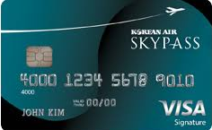
US Bank Skypass Select
US Bank Skypass Select Visa Signature Card 60k with $5k spend
  $200 Travel Credit on airlines, hotels, or car rental companies
  Two Korean Airlines Lounge Passes for Seoul and North America
  $100 off coupon for Korean Air ticket purchase each year
  2 Korean Air in-flight duty free $25 coupons each year
  5% ticket discount 2X annually for cardholder and companion
  3X miles for Korean Air ticket purchases
    2X miles on dining
  Additional 5,000 bonus miles after spending $15,000 annually
Notes:
Really only getting this card for the $200 travel credit.

Slide 65
Other US Bank Cards
Altitude Go and Connect
  Get these cards to upgrade to another altitude Reserve after one year!
  Must have 5K credit limit in order to upgrade
US Bank Flexperks
  Same as above.
Notes:
Really only getting this card for the $200 travel credit.

Slide 66
US Bank Travel Benefits

Slide 67
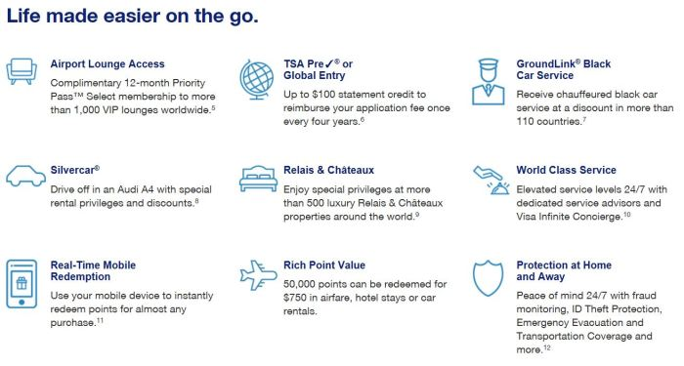
https://www.middleagemiles.com/2019/07/15/keep-or-cancel-us-bank-altitude-reserve-and-did-i-get-a-retention-offer/
Notes:
All of these are very similar to chase, but not as good.

Slide 68
US Bank Wrap Up
Obtain Altitude Reserve and SkyPass Visa. Then get other cards and upgrade to Altitude Reserves after one year.
  Must have $6K credit limit to upgrade to Reserve
  If not US bank in your state, you will get denied at first
  Must call and tell them you are military! They will then approve the account for you.
  Once account approved, wait 35 days then you can open card.

Slide 69
Citi

Slide 70
Citi Rules
1/8 rule: one application every eight days
2/65 rule: two applications every sixty five days
6/6 rule: max six hard inquiries in 6 months
Can Product Change from any card to any card (cross family)
24 months between initial family bonuses (not by card, but by brand)
  AA points earned on Executive will deny points on new platinum
  TY points on Prestige would deny TY on Premier
  Use Mailers to get around this language
Notes:
You can open any citi card in any offer. I would recommend opening the Citi prestige after your 5 chase cards if you decide to go down that path. Then you can open the American Aadvantage card and the citi premier at a later date. The citi prestige gives you the most benefits and a $250 travel credit that can be used on any type of travel.

Slide 71
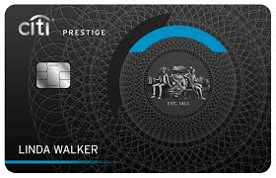
Citi Prestige (not available anymore)
Citi Prestige 50K ThankYou Rewards points after $4K spend in 3 months
  5X airfare, dining, and travel agencies
  3X hotels and cruise line
  1X everywhere else
  $250 travel credit per calendar year (all travel)
  Citi Proprietary Lounges
  4th night free hotel benefit (twice a year)
Notes:
Best citi card out there. Has some great benefits. Mainly want to get it for the points and the $250 yearly travel credit.

Slide 72
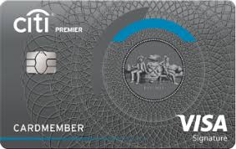
Citi Premier
Citi Premier 60K with 4k spend in 3 months
  3X travel, gas and supermarkets
  2X dining and entertainment
  Can transfer points to travel partners
  $100 hotel discount off of $500 when booked through Citi.
Notes:
The best card for earning citi points that you can transfer to travel partners.

Slide 73
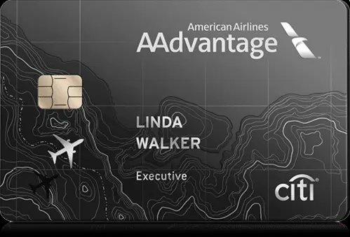
Citi AAdvantage
(Best Citi Card!)
Citi AAdvantage® Executive World Elite MasterCard®
  100K AA miles after 10k Spend
  AA Admirals Club Lounge Membership
  Premium Access
  Can add 10 authorized users that will get AA lounge access on own
    (usually $175 per person, not for us!)
$120 annual car rental credit (Avis & Budget only)
$10/month on GrubHub Purchases
Notes:
Since you get into American Airlines, lounges already being active duty, the main reason to get this card would be to share with your family!!! If you add them on an authorized user on the account, they get their own card and get into American airlines lounges with that card!

Slide 74
Business Cards (Now Charging Annual Fee ☹)
What? Business Cards? I don’t own a business…..
  You don’t have to!!!
How to fill out business application
  Tax ID- Social Security Number
  Business Income- Anything you want
  Business- Sole Proprietor
  Business name
    Your full name
Notes:
If this was a year ago, this would be my favorite slide set. Unfortunately, Amex has taken away this great benefit and business cards are no longer free for active duty military.

Slide 75
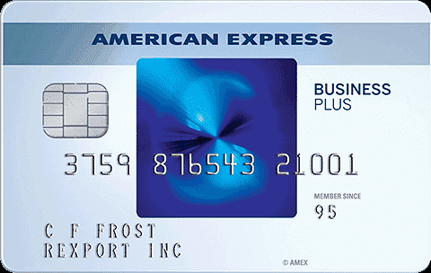
Blue Business Plus
Still Worth getting! No annual fee and 2% cash back on all purchases!
Great way to earn maximum Amex Membership Rewards (MR)points.
Great for balance transers (0% APR on purchases for 12 months)
10k MR points after 3k spend

Slide 76
Amex Business Platinum
($695/year) GREAT CARD!
150K MR on $15k spend and an extra
$200 Airline Credit
35% points back on Points booking (Makes MR points worth 1.5 cents on travel)
  1.5 MR on $5,000+ purchases
$400 dell credit each year ($200 every six months)
$10/month toward wireless phone bill
Notes:
This is my favorite business card by far. If I was to get out of the military I would have this over the regular Amex platinum even having to pay the $695 per year. You really get so much value from it.

Slide 77
Amex Business Platinum
($695/year)
1.5x the points on business purchases
  Hardware stores, electronic goods retailers, shipping providers
$189 Clear airport security credit
$150 Adobe yearly credit
$360 yearly Indeed credit

Slide 78
Amex Business Gold
($295/Year)
AmEx Business Gold 70K MR on $10k spend in 90 days
4x points on two of your highest spends:
    Airfare, advertising, gas stations, shipping, computer products, dining
    2x on the remaining categories
  Upgrade to Business Plat anytime after bonus is earned

Slide 79

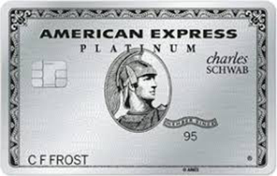



Order of Obtaining Cards
Amex Charge Cards
Amex Green
Amex Gold
Month 1-3
Schwab Platinum
Amex Platinum
Morgan Stanley Platinum
Month 9-12
Month 4-6
Amex Platinum
Amex Platinum
Month 7-9
Notes:
Get green first, then gold so you can get bonuses. If you open platinum first you will not get bonuses on green and gold. If you only want one card, get platinum!!!!

Slide 80
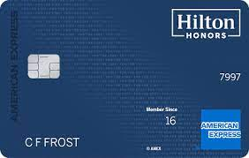
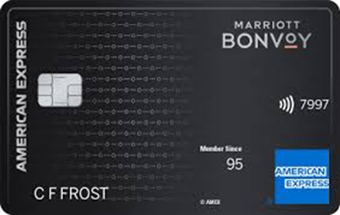
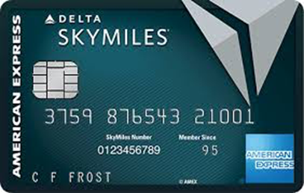
Order of Obtaining Cards
Amex Credit Cards
Hilton Aspire
Month 1-3
Bonvoy Brilliant
Delta Reserve
Hilton Apire
Month 9-12
Month 4-6
Hilton Aspire
Month 7-9
Notes:
Remember, each is spread out so you have plenty of time get the spending bonuses associated with each. You will upgrade the surpass to another reserve after a year. If you do not fly delta, replace with the Hilton honors card

Slide 81
Other Cards

Slide 82
Bilt Rewards Mastercard
(Awesome Card!)
No annual Fee- Sign-Up Bonus is 5X Points for first 5 Days of Receiving Card
  (sign-up bonus is given out randomly, not everyone receives it)
Can use to pay rent (1x points on Rent payments) (Must have if you pay rent!)
3x points on dining
2x points on travel
Rent day every month!
  Doubles points (6x on dining, 4x on travel, 2x on everything else)
Points worth 1.25 cents per point when through Bilt travel
Great travel partners (United, Hyatt, American Airlines, etc…)

Slide 83

Bank of American Premium
Elite Rewards Card
75K points after spending 5K in 3 months
1.5x points on all purchases, 2X on travel and dining
  BOfA Preferred rewards can multiply those points! Must invest with them
    Gold; Invest $20K-50K (25% more on points)
    Platinum: Invest $50K-100K (50% more on points)
    Platinum Honors: Invest over $100K (75% more on points)
$300 incidental travel credit (works for United travel bank and AA gift cards!)
  Also seat upgrades, baggage fees, airline lounge fees and in-flight services
$150 lifestyle credit/year
  good for video streaming services, food delivery, fitness subscriptions and rideshare services
Points can be redeemed for flights through travel portal for 20% extra.

Slide 84
Manufactured Spending
How you get to your bonuses!!!
  Bonuses are most important
Organic Spending #1
Gift Cards
  Great but doesn't’ work for all cards
Direct Spend Techniques
  Pre-paying bills! (cellphone and utilities)
  Fund Bank Accounts (Bank Smartly- US Bank (up to $3000)
Notes:
This is a very important slide! These are the ways to get to your spend bonuses so you get all of the points you can use for so many things. The best way to do it is by organic spend, aka just spending your money. Or getting family members to put expenses on your card and then they venmo you the money so you can pay it off.

Slide 85

Manufactured Spending
Plastiq.com (Great for rent and mortgage, 2.9% fee)
  Only Visa and Mastercard (No Amex)
Pay your friends and family(3% charge)
  Venmo
  Paypal
Kiva microloans (kiva.org)
  Send money to companies in need and get paid back over time.
Ask Friends/Family to put bills on your card and send you money!
Notes:
Plastiq is a great way to get to your spend bonus. It allows you to pay your rent with a check generated for a small fee which is then sent to your landlord. I have used it several times and it works like a charm. Some landlords allow you to pay rent with credit cards but usually not American express. This is where plastiq comes in handy.

Slide 86
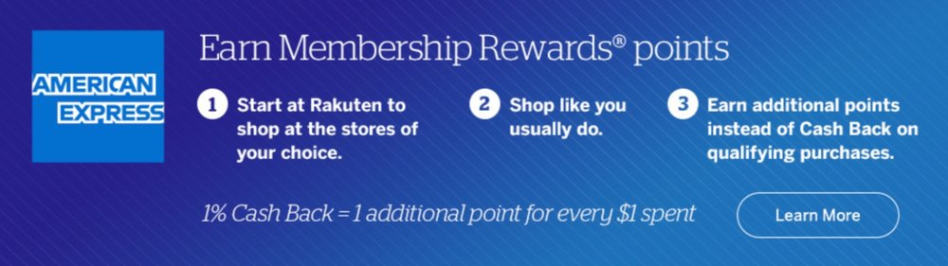
Earning Extra Amex Points w/
Rakuten (Must sign up!!!)
Rakuten is a website, completely free to use, no gimmicks
Gives you cash back for spending money online
  Can get amex points instead of cash back.
  BEST WAY TO EARN AMEX POINTS!!!
Notes:
Upgrading is so important so you can have multiple platinums. This gives you multiple travel credits and money towards uber eats, saks fifth avenue, phone bill costs and streaming costs.

Slide 87
Referrals ( Very Important!)
Utilize these for extra points!
  Each credit card had different referral bonuses for signing people up
  Most people will get better sign up offers through referrals, benefits the person being referred and the person sending the referral.
  Also utilize Incognito Windows on your browser when getting referrals from people. Can cause higher signup bonuses as well!
Chase
  Can only refer for same card (except Southwest branded cards)
Amex
  Can refer from charge Card to any card (Platinum to Gold, Platinum to Delta)
    Only credit card to credit card (Hilton to Hilton, Delta to Delta)
    Max 100k on one card
    *New* If Amex gives Pop-Up that you are not eligible for Bonus, try application without Referral*
Notes:
Referrals are super important for both you and the person you are referring. You get points for referring, but people you refer usually get increased bonus offers through your referral. So everyone wins!

Slide 88
Important
Websites!

Slide 89
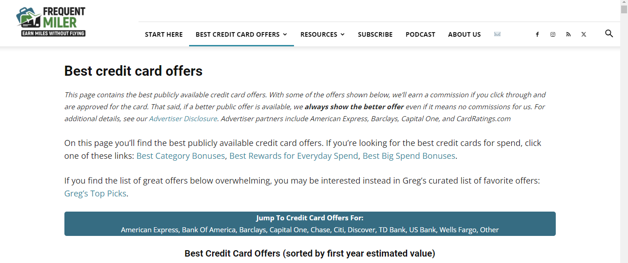
Frequent Miler Best Credit Card Offers Page
(https://frequentmiler.com/best-credit-card-sign-up-offers/)
Always Check here for best credit card offers!
  They will always post the highest offers currently available on every credit card.
  If offer matches a friend’s referral make sure to use that as well!

Slide 90
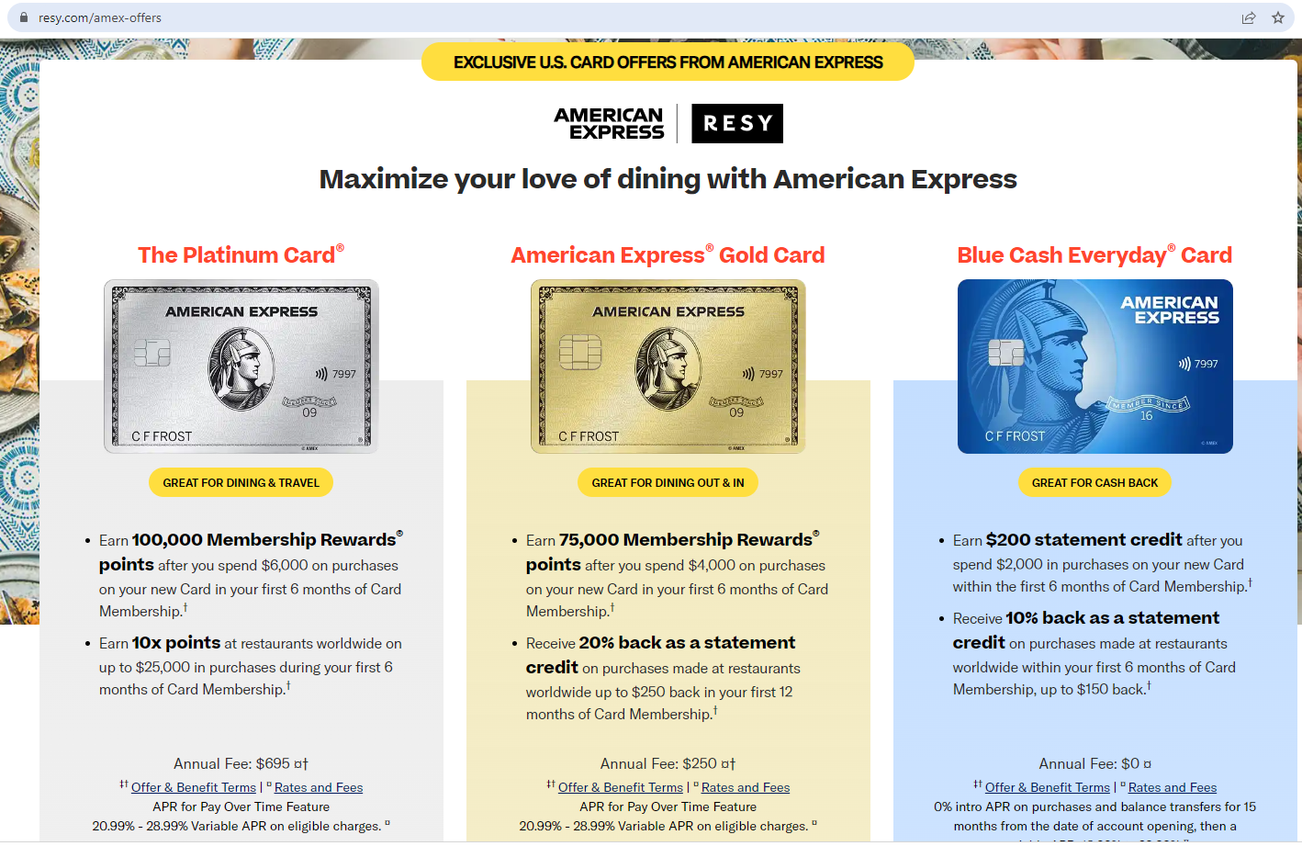
If Referral Offers are Low on Amex (Try resy.com/amex-offers)

Slide 91

Doctor of Credit
(https://www.doctorofcredit.com/)
Daily Information on everything to do with credit (like twitter of credit)

Slide 92
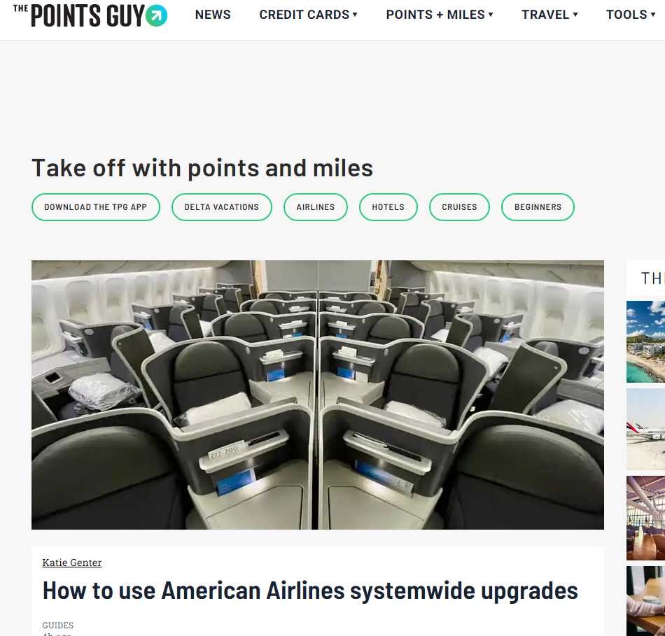
The Points Guy
(http://thepointsguy.com/)
Great website for learning about each credit card and its benefits!

Slide 93
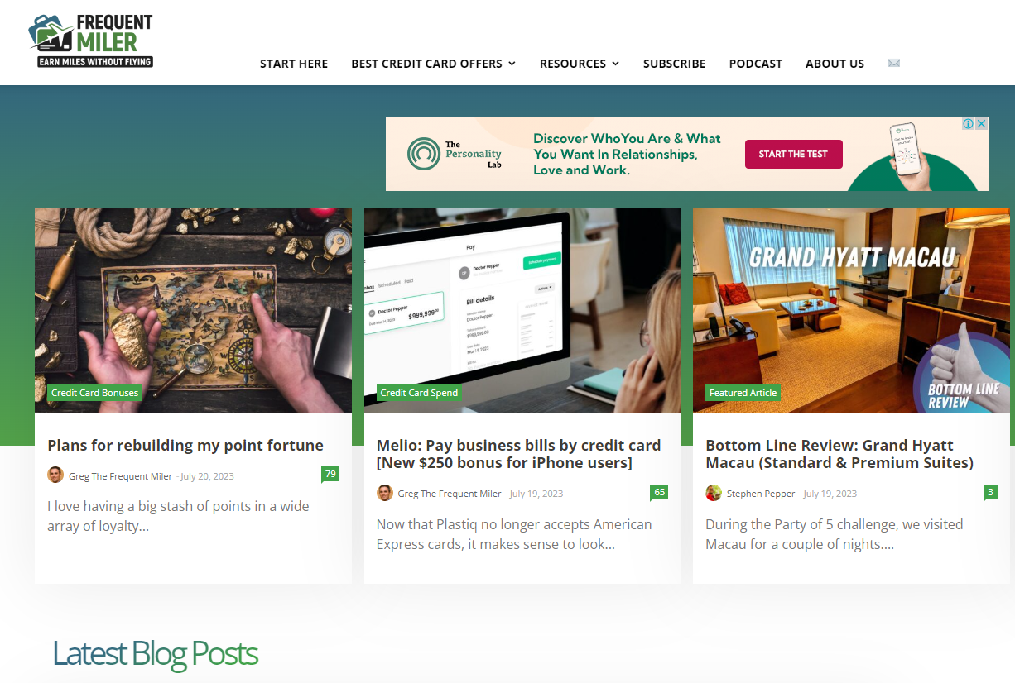
Frequent Miler
(https://frequentmiler.com/)
More in depth- Best Site to learn how to maximize points!
Best Credit Card Offer Page- Will always show best offer available!
  https://frequentmiler.com/best-credit-card-sign-up-offers/

Slide 94
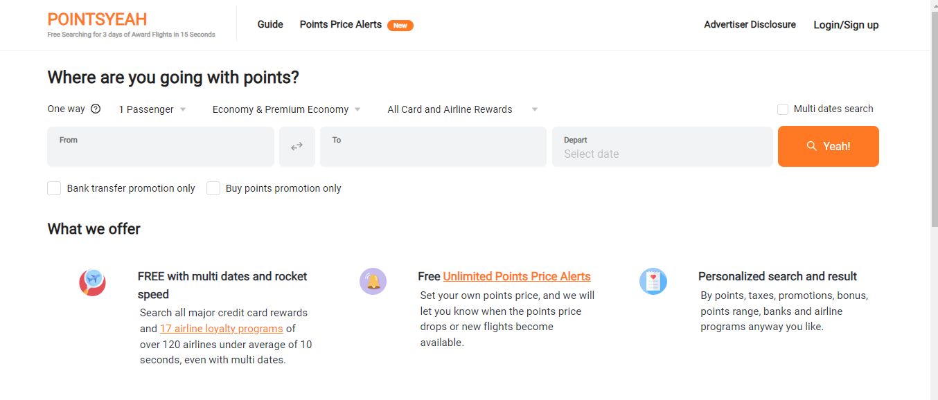
PointsYeah https://www.pointsyeah.com/
Great Site Shows you Awesome Flight Deals and how to Best Use/Transfers your points!!!

Slide 95

Airline Lounges
Download this app!!!
American, United, USO-
  Free to all active duty when flying that specific airline (USO always free)
Centurion and Delta lounge-
  Free when you have any Amex platinum
Priority Pass Lounges
  Free when you have priority pass, which basically comes with any elite credit card (CSR, Amex Plat, Citi Prestige)
    ***NOTE: Amex does not have Priority Pass restaurant benefit, only Chase cards!***
Notes:
American and united lounges are always free to active duty military when you are flying that airline. Centurion lounges are the nicest lounges (can takes showers, get massages, top shelf alcohol and food curated by James Beard Award Winning chefs) followed by Delta lounges.
Priority pass lounges are nice but usually very crowded. Sometimes they do not let you in even if you have a priority pass, because of the crowds. However at some airports priority pass gets you free food at restaurants.
Loungebuddy will tell you all of the lounges at your airport and what is required to get into them. It also will tell you if there are any restaurants where you can get free food at with your priority pass. The food credit is usually $28!

Slide 96
How to Use Card Credits

Slide 97
Travel Credits
Chase, US Bank, and Citi Travel Credits
  Can be used for all types of travel!
    Hotels, airfare, parking, Uber, etc…
    Automatically deducted out of your account when used.
    Renews every card anniversary (Not Jan 1st like Amex)
Amex Plat $200 and Hilton $200 travel credit (Click HERE!!!)
  Have to assign to an airline (American, United, etc.)
  Used for incidentals (upgrades, baggage, food) for airline selected
  Gift cards DO NOT work anymore!!!
  Tip: Southwest and JetBlue flights under $100 still code for the credit!
  **United Travel Bank** BEST WAY (Make United your Airline)
Notes:
Travel credits are easy to use for Chase, citi and US Bank. You just use it on any type of travel and it automatically comes off of your card. Like explained earlier, amex credits must be assigned to an airline.

Slide 98
Travel Credits
Amex Plat $200 and Hilton $200 travel credit (Click HERE!!!)
  Have to assign to an airline (American, United, etc.)
  Used for incidentals (upgrades, baggage, food) for airline selected
  Gift cards DO NOT work anymore!!!
  Tip: Southwest and JetBlue flights under $100 still code for the credit!
  Delta Flights- Split Disbursement
    Pay with $50 gift card then rest on Amex Platinum
    Ex: $230 flight- $50 GC+ $180 on Amex Plat will work!
  United Travel Bank still works as well! (Make United your Airline)
    Go to this site and purchase two $100 credits (must have United MileagePlus account to work)
    https://www.united.com/offers/travelcash
Notes:
Travel credits are easy to use for Chase, citi and US Bank. You just use it on any type of travel and it automatically comes off of your card. Like explained earlier, amex credits must be assigned to an airline.

Slide 99
Other Credits
Amex Uber credit ($15 a month, $35 in December)
  Just add Amex card to Uber account. Uber will add credit to your account by way of UBER CASH. Must be used every month on Uber or Uber Eats
Amex Saks credit
  $50 every 6 months- Can buy gift card in store (not online) and accrue over time
Chase DoorDash Credit
  $5 per month towards DoorDash. Expires after 3 months so can build up to $15 in month 3!
TSA precheck or Global Entry ($100 credit)
  Since you already have TSA, use it for Global Entry. Allows you to bypass customs faster when returning from out of the country.
Notes:
These are all awesome credits you get each year. You must use them before they expire though. The uber credits expire each month and the saks credit expires every six months. The chase doordash credit is good for the whole year though.

Slide 100
Other Credits Cont…
Amex $200 Hotel Credit (CLICK HERE FOR HOW TO USE!)
  Must be used on fine hotels and resorts hotels through Amex website.
  Comes with many extra benefits ($100 food credit, late check out, upgraded room, early check in)
Amex $189 Clear Credit
  Purchase Clear membership with Amex card. Clear allows you to get to front of TSA precheck line at airports
  Amex $240 Entertainment Credit (CLICK HERE FOR HOW TO USE!)
  $20 a month towards Disney Plus, ESPN Plus, Hulu Plus, Sirius XM, The New York Times, Peacock TV, or Audible subscriptions.
Notes:
These are all awesome credits you get each year. You must use them before they expire though. The uber credits expire each month and the saks credit expires every six months. The chase doordash credit is good for the whole year though.

Slide 101
Downgrade Strategy
(Closing Credit Cards)
AmEx Platinum to Green ($150 annual fee) then close after MR Points are exhausted (Dump to Charles Schwab at 1.25 cents per MR point)
Morgan Stanley Platinum to Morgan Stanley Credit (Free) (Rumored)
Schwab Platinum to Schwab credit (Free) (Rumored)
Marriott Bonvoy Brilliant) to Bonvoy Boundless ($95)
Delta Reserve to Delta Blue (Free)
Notes:
Downgrading is very important when you become a civilian again. Hopefully by this time you have reaped years and years of the benefits these cards offer. Then when you leave, you can downgrade the cards so you don’t get charged the annual fees.

Slide 102
Downgrade Strategy
Chase Sapphire Reserve to regular Freedom cards (free)
United Club to United Travel Bank (Free)
Amex Platinum's to Amex Greens ($150 each)
Hilton Aspire to Basic Hilton Honors (Free)
  Slowly close cards over time
  Start with fee cards
  Make sure balance it at 0 when closing the card
  MAKE SURE TO USE ALL POINTS BEFORE CLOSING CARDS!!

Slide 103
Questions?
Feel free to contact me!
Cell Number 671-488-6584
Email: timothy.r.corbin5.mil@health.mil or trcorbin95@gmail.com

Slide 104
References
www.doctorofcredit.com
www.derpreport.com
www.thepointsguy.com
www.frequentmiler.boardingarea.com
www.mlatravelclub.com
www.citi.com
www.upgradedpoints.com

