Slide 1
Society of Air Force Pharmacy
Mid-Year Conference
6 - 8 May 2024
Planet Hollywood Resort & Casino
Las Vegas, NV

Slide 2
Leadership Engagement Panel

Slide 3
Disclosures
The following panel members declare no conflicts of interest, real or apparent, and no financial interests in any company, product, or service mentioned in this program, including grants, employment, gifts, stock holdings, and honoraria.
The views expressed herein are those of the presenters and do not necessarily reflect the official policy of the Department of the Air Force, Defense Health Agency, Department of Defense, nor the US Government.

Slide 4
Learning Objectives
Describe the skills and traits that lead to a successful Air Force Career
Understand advancement opportunities within the Pharmacy Career Field
Review ways to take care of yourself and the people you lead
Identify ways to grow as a leader and why it is important

Slide 5
Col Stephanie Forsythe
Commander, 81st Medical Diagnostics & Therapeutics Squadron
Leadership pearls:
Talent is interesting, character is everything
Care about people and take care of people
Lead with humility, vulnerability, and empathy
Be quick to listen and very slow to judge
Hone your emotional intelligence skills
Have a growth mindset and push yourself outside your comfort zone

Slide 6
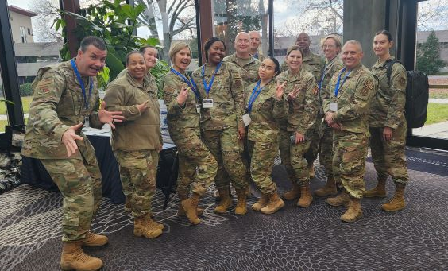
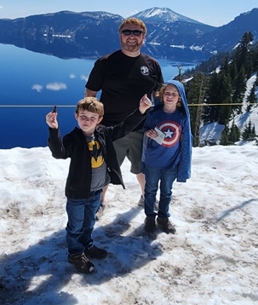
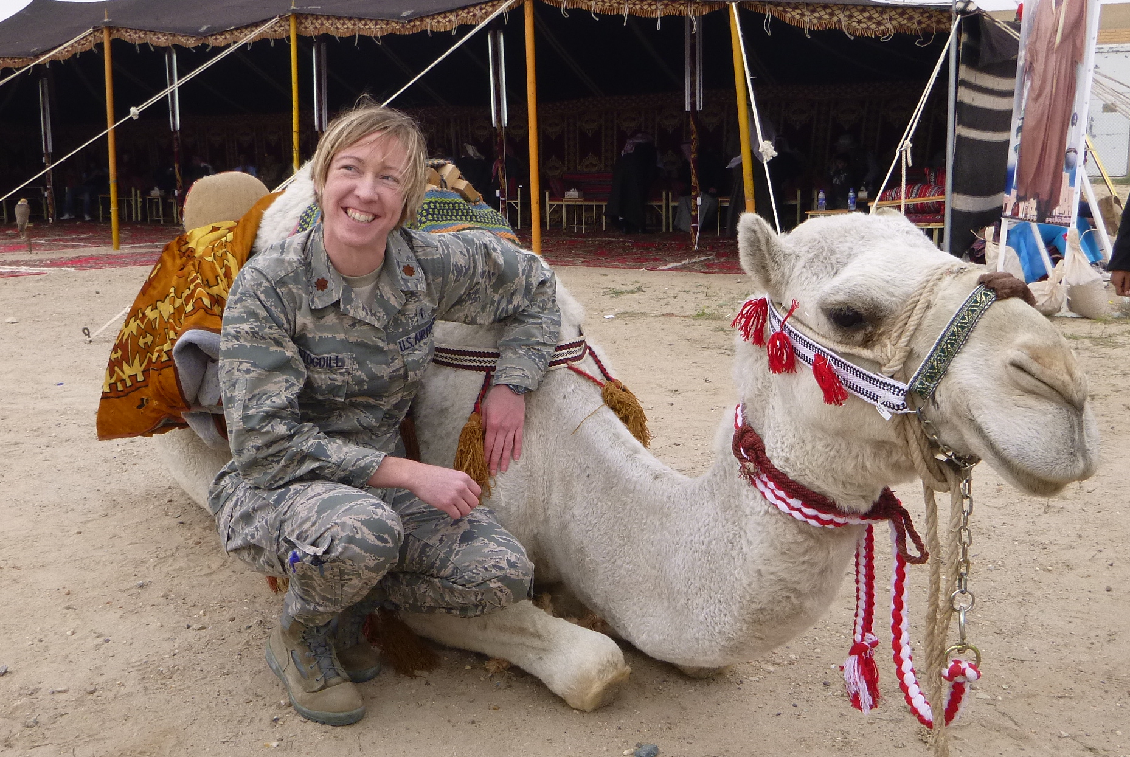
Lt Col Tara Stogdill
Commander, 59th Diagnostics & Therapeutics Squadron
Leadership Pearls:
  Communicate
  Take care of your people
  Know your Why
  Three questions
  Keep Learning, stay curious
  Jump at Opportunities
  Communicate some more!

Slide 7
Lt Col Benjamin Crandall
Commander, 375th Operational Medical Readiness Squadron
What I Have Learned:
Use “Risk” and “Cost” to communicate effectively
Everything can be considered a “graded” event
Build partnerships with everyone!
Do a great job with the job you have
Be Humble – you will falter

Slide 8
Lt Col Emily Dietrich
Commander, 325th Medical Support Squadron
Leadership Pearls:
Being “willing” to learn the art of successful influence by recognizing that constant change is the only thing that is certain.
Commit to & reinforce developing a mindset that focuses on patience.
Recognize and focus on what your sphere of influence is and practice.
  Every action has a positive or a negative incremental impact (friendly actions).
  Proactively and cognitively manage actions, messages, and perceptions.
Understand the greatest needs, interests and desires of the population within your sphere of influence.
The overall theme, tone, culture that you project creates a common purpose to shape or change behaviors and attitudes towards a desired end state.
Be proactive in nature and adapt.
Reference: Scanzillo, Thomas M. and Edward Lopacienski “Influence on Operations & the Human Domain,” Dec 2015.

Slide 9




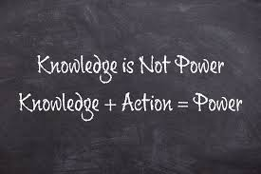

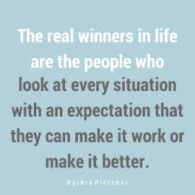



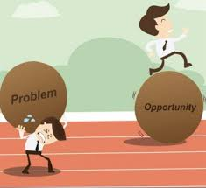

CMSgt Jacey McDuffie
Senior Enlisted Leader, 81st Medical Group
Leadership Pearls:
- FYJ
- Share Knowledge-big and small
- Connections matter
- Do it with pride & take initiative
- Take advantage of opportunities
(Why say no when you can say yes?)
- Set goals…complete…repeat
- Reflect daily- “Was I a great human today?
How can I be better tomorrow?”

Slide 10

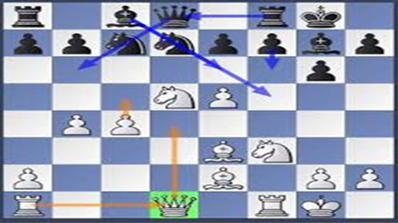
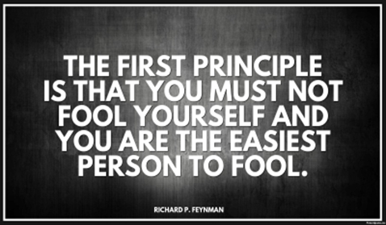


CMSgt Levi Robertson
Senior Enlisted Leader, 45th Medical Group
Lesson’s Learned From Success and Failure
- Yes!!!! starts with A and ends with Z
- Play Chess: think first, act second, speak last
- Self-Deception: you are the great deceiver, don’t crush your relationships and your teams
- Be Yourself: just be a better you
- Have Fun: one person’s prison is another’s paradise

Slide 11
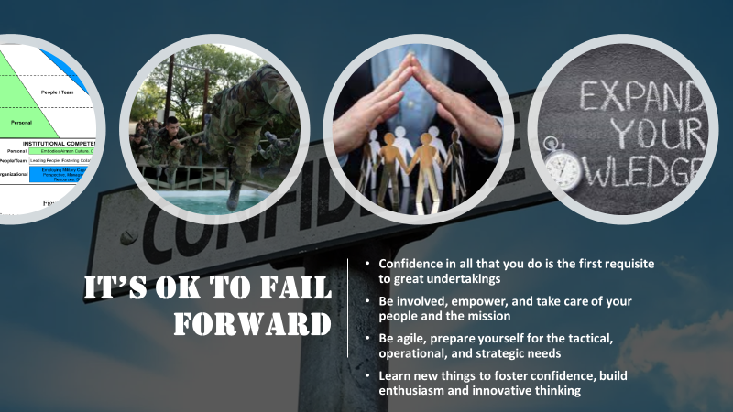
CMSgt Markiesha Crawford
Senior Enlisted Leader, 56th Medical Group

Slide 12
CMSgt Timothy Schnur
Senior Enlisted Leader, 99th Healthcare Operations Squadron
INTEGRITY - Integrity is the cornerstone of trust in leadership. A good leader must possess unwavering integrity to inspire confidence and maintain credibility. When leaders consistently uphold their values and principles, they set a moral compass for their teams, fostering an environment of honesty and dependability.
Vision - A leader’s vision provides direction and purpose for their team. It creates a shared goal that motivates and guides everyone toward a common objective. A leader with a clear vision can inspire and align their team’s efforts toward achieving ambitious goals.
INFLUENCE - Influential leaders inspire others to follow their lead willingly. They lead by example, creating a shared sense of purpose and commitment within the team. Their influence stems from their character, actions, and ability to connect with others.

Slide 13
SMSgt Traci England
Senior Enlisted Leader, 673rd Medial Support Squadron
Leadership Pearls:
Empowerment through Agreement
Taking the Reins of Your Destiny
Igniting Passion in Your Journey
Leading by Example for the Next Generation

Slide 14
Questions?

