Slide 1
Equipment and Technology Update
Lt Col Karl Bituin and Lt Col Justin Lusk

Slide 2
Financial Disclosure
Lt Col Karl Bituin: “Declare(s) no conflicts of interest, real or apparent, and no financial interests in any company, product, or service mentioned in this program, including grants, employment, gifts, stock holdings, and honoraria.”
Lt Col Justin Lusk: “Declare(s) no conflicts of interest, real or apparent, and no financial interests in any company, product, or service mentioned in this program, including grants, employment, gifts, stock holdings, and honoraria.”

Slide 3
Learning Objectives
Explain enterprise level program management for pharmacy automation
Identify the various pharmacy programs and the standardization efforts within them
Discuss the challenges with pharmacy standardization in a resource constrained environment
Dive into future state initiatives

Slide 4
Self Assessment Questions
What is the role and responsibilities of DHA Pharmacy Program Office?
  Develop pharmacy operations policy
  Centrally managing the procurement, maintenance, cybersecurity, and technology refreshes for all automation systems covered under the pharmacy portfolio
  Conduct pharmacy budget analysis and develop formulary policy
  Manage Q-Flow configuration, implementation, and change management requests

Slide 5
Self Assessment Questions
What is the new web-based platform used to request medical equipment?
  DMLSS
  LogiCole
  MHS GENESIS
  Service Helpdesk

Slide 6
Self Assessment Questions
Which of the following programs are centrally managed by DHA POD?
  BD Parata IntelliCab, Q-Flow, MHS-GENESIS, Parata
  Audiocare, BD Parata IntelliCab, Parata, Q-Flow
  ScriptPro, Electronic Clinical Reference, CII-Safe, BD Parata IntelliCab
  ScriptCenter, ScriptPro, NEXiA, Pyxis

Slide 7
DHA Medical Equipment Portfolios
Integrated Clinical Systems PMO (ICS)
J6/CAE (Inventory: 120,519, 6% = $2.5B)
Healthcare Technology Management
MEDLOG/AD-S (Inventory: 1,315,056, 90% = $5B)
TARA Program
All imaging equipment and systems
High dollar surgical equipment
Radiation oncology equipment
Medical Devices & Equipment > $100K <
Cyber Logistics CoE
Property Management Policy & Execution (CPL)
Sustainment Policy & Execution
MTF
Pharmacy Operations Division (POD)
HCO/AD-HCA (Inventory: 11,000, 2% = $450M)
Medical Simulation & Training PMO (MST)
J6/CAE (Inventory: 6,782, 1% = $114M)
Pharmacy equipment
Medical Simulation equipment

Slide 8
Pharmacy is different
CENTRAL MANAGEMENT
“top-down” vice MTF-generated requirements
Our office manages the funding, execution, contracting, sustainment, cyber-security, life cycle management, and new requests of all programs in our portfolio

Slide 9
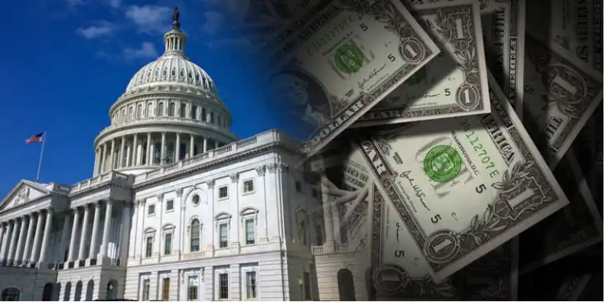
Pharmacy is different
FUNDING (DoD Financial Management Regulation 7000.14-R, Volume 2A, Chapter 1)
“The Procurement appropriation is used to finance investment items and generally includes all costs necessary to deliver a useful end item intended for operational use or inventory. Items classified as investments and financed with Procurement appropriations include those whose system unit cost exceeds $350,000 (the Expense/Investment Threshold) [and] all centrally managed end items”

Slide 10
Pharmacy is different
FUNDING
O&M (Operations and Maintenance) vs. Procurement appropriation
Pharmacy leverages procurement appropriation for equipment purchases of centrally managed programs
In 2023, Component Acquisition Executive (CAE) and J-8 declared offices cannot use O&M appropriation and procurement appropriation on the same equipment

Slide 11
Pharmacy is different
FUNDING
MEDLOG does not identify as centrally managing any portfolio, therefore uses the $350K threshold to use the procurement appropriation
Pros and cons of procurement appropriation
  Availability of procurement appropriation
  End of year purchases

Slide 12
Pharmacy is different
EXECUTION
Our office will centrally execute equipment purchases
Will include DHA project manager and oversight
Will utilize various federal contracting vehicles through Defense Logistics Agency (DLA) or DHA
HOW WE’RE DIFFERENT: HTM and ICS may transfer funds to MTF for execution

Slide 13
Pharmacy Program Office
EXECUTION
Obtaining funding and contracting are independent activities
DLA Electronic Catalog (ECAT) provides a flexible contract, which improves speed from receipt of funding to install of equipment
Without ECAT, we would need a contract…

Slide 14
Pharmacy Program Office
CONTRACTING
A new DHA contract requires 12 months
Leverage Optional Contract Line Item Number (CLINs) into enterprise level contract or contract modifications
Managing 8 Enterprise-level Support Contracts
  >$45M in annual maintenance costs funded
  >$550M in equipment assets
  >11,000 Devices

Slide 15
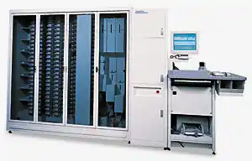
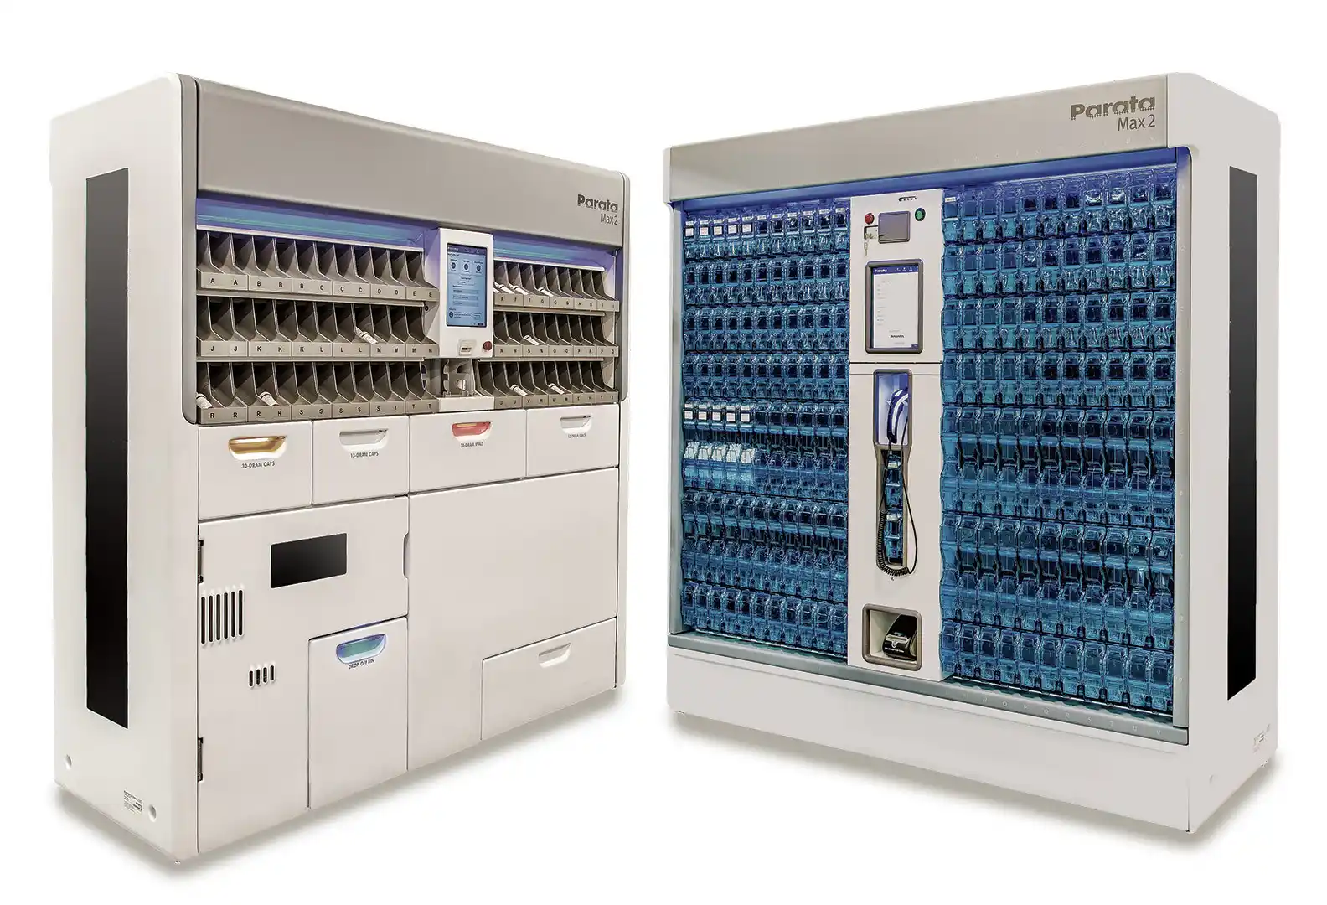
Pharmacy Centralized Programs
POD Managed Programs
  PIAS-E
    Pyxis
  POAS
    ScriptPro
    Parata
    iARx
  RxRefill
    AudioCARE
  Pharmacy Will Call
    Parata Intellicab
    iARx
    ScriptCenter
Non-POD Managed Programs
  PQNS
    Q-Flow
  DHMSM
    MHS GENESIS
  ECR
    Med Library

Slide 16
Pharmacy Program Office
SUSTAINMENT
Maintenance and Support Trends
  e.g. OCONUS vs CONUS
Portfolio Managers and Contracting Officer Representatives (CORs)
Enhancements in conjunction with TechSIG
DHA Escalation Point/Next-Tier resolution
Re-allocation of equipment in enterprise

Slide 17
Pharmacy Program Office
CYBERSECURITY
Information Systems Security Manager (ISSM) and Information Systems Security Officers (ISSO) are embedded in POD
Resource/manpower management
  single program to eight

Slide 18
Pharmacy Program Office
LIFE CYCLE MANAGEMENT
Is a piece of equipment end of life and needing replacement? POD will manage centrally.
Step 1: Evaluate Equipment Age and Maintenance Events
Step 2: Determine site’s Eligibility Criteria
  Number of Prescriptions (Rx’s) processed (identify changes from previous years)
Other considerations
  TARA (Technology Assessment and Requirements Analysis) site visits
  Program Office cost saving opportunities
    Server consolidation
    right-sizing
  % Utilization of equipment
  Contracting Flexibility

Slide 19
Pharmacy Program Office
NEW ITEM REQUESTS
POD leverages LogiCole
Use the Ordering Guides!
  ScriptCenter Ordering Guide
  Tabletop Counting Device Ordering Guide
  More ordering guides to come
    Pyxis ES, CIISafe, Internal Will-Call, Parata, ScriptPro

Slide 20
LogiCole Request Process Flow
Site
Approve
Requestor Submits NER
Coordinator Assigns Reviewers
Reviewers Recommendations
Conduct Equipment Review Board
Coordinator Prioritizes Request
Higher Review?
No
Yes
Send to Higher
Market
Send to Service for Review
Skip SME Reviews
DHA HTM Market Level Review of Request
DHA Service
HTM, POD, DMMSO Portfolio
Coordinator Identifies Portfolio
Service Level?
Yes
Coordinator Assigns SME and Portfolio Manager
SME and Portfolio Manager Recommendation
Agency Coordinator
Approve
No
Agency/DoD
ICS PMO Portfolio
ICS Coordinator Assigns SME
ICS SME Recommendation
ICS Coordinator
Approve

Slide 21
Prioritizing Eligible Requirements
NEW ITEM REQUESTS
Priority 1: No loss of existing capabilities
  End of Life (EOL) notifications
Priority 2: improve patient safety
Priority 3: improve operational efficiency
Priority 4: improve patient satisfaction
Priority 5: enterprise infrastructure enhancements
  Server consolidations
Priority 6: Cost-savings opportunities

Slide 22
Where are we going?
Standardization ➡ Optimization
Pharmacy functional community came to DHA as the most standardized community
AF Pharmacy came to DHA as the most standardized portfolio
DHA has spent years standardizing Army and Navy
  Started with Inpatient Automated Dispensing Cabinets (e.g., Pyxis)
  Followed by Outpatient Workflow Solution (NEXiA)
Notes:
Before you can really optimize any behavior, you have to standardize

Slide 23
Where are we going?
Standardization ➡ Optimization
DPAB Expert Panels guide optimization
Major focuses on regional and enterprise architecture without compromising function
NEXiA rebuilding platform from the ground up for regionalization
  Site hierarchies
  Increased latency tolerance
  Faster upgrade cycles
Notes:
Before you can really optimize any behavior, you have to standardize

Slide 24
Site Hierarchy
2013
2023
2024
NEXiA Server
Bank
NEXiA Server
Bank A
Bank B
Bank C
NEXiA Server
Pharmacy A
Pharmacy B
Pharmacy C
Bank A
Bank B
Bank A
Bank B
Bank A
Bank B

Slide 25
Increased Latency Tolerance
Latency: delay before a transfer of data begins
Latency ➡ lag and system errors
iA latency tolerance is lower than DoD latency tolerance
  i.e., iA has a higher network requirement than DoD
iA changing how NEXiA works to minimize lag experienced
This is critical to enable regional remote verification capabilities
This will also improve overall experience with system performance
Notes:
How will this improve overall experience. Take the fill screen. At a busy site like Lackland it may make sense to refresh the fill screen every 3 seconds; however, at a smaller pharmacy that may be farther away from the server there is little value in that high of a refresh rate. Lowering that refresh rate reduces the work on the workstation and server and can free up bandwidth for other activities resulting in overall faster response rates.

Slide 26
Faster Upgrade Cycles
2013
2019
2025
27 versions of Symphony in the AF
Average upgrade cycle every five years (longer for OCONUS)
6 versions of NEXiA in DHA
Average upgrade cycle less than 12 months
2 versions of NEXiA in DHA
Average upgrade cycle six months
After testing, enterprise deployment within four weeks (all remote)

Slide 27
So what?
Readiness requirements are increasing
Staffing is decreasing and difficult to fill all spaces
Regionalization will allow us to provide remote pharmacist support
With staffing shortages impacting most pharmacies this will alleviate the burden and overall risk to low staffed pharmacies
We shouldn’t have to compromise readiness ↔ healthcare delivery

Slide 28
Pharmacy, Readiness, and Beyond
iA – BD IntelliCab interface
Texting
Verification revamp
Pickup screen revamp
Better Parata and ScriptPro integration
DSCSA enhancements
MHS GENESIS interface enhancements

Slide 29
Tech isn’t everything…
Who controls your pharmacy demand signal?
Who controls your pharmacy response to that demand signal?
What can you do to control your own fate?
Are you prepared to minimize the impact to healthcare delivery while immediately responding to an unplanned exercise?

Slide 30
Self Assessment Questions
What is the role and responsibilities of DHA Pharmacy Program Office?
  Develop pharmacy operations policy
  Centrally managing the procurement, maintenance, cybersecurity, and technology refreshes for all automation systems covered under the pharmacy portfolio
  Conduct pharmacy budget analysis and develop formulary policy
  Manage Q-Flow configuration, implementation, and change management requests

Slide 31
Self Assessment Questions
What is the role and responsibilities of DHA Pharmacy Program Office?
  Develop pharmacy operations policy
  Centrally managing the procurement, maintenance, cybersecurity, and technology refreshes for all automation systems covered under the pharmacy portfolio
  Conduct pharmacy budget analysis and develop formulary policy
  Manage Q-Flow configuration, implementation, and change management requests

Slide 32
Self Assessment Questions
What is the new web-based platform used to request medical equipment?
  DMLSS
  LogiCole
  MHS GENESIS
  Service Helpdesk

Slide 33
Self Assessment Questions
What is the new web-based platform used to request medical equipment?
  DMLSS
  LogiCole
  MHS GENESIS
  Service Helpdesk

Slide 34
Self Assessment Questions
Which of the following programs are centrally managed by DHA POD?
  BD Parata IntelliCab, Q-Flow, MHS-GENESIS, Parata
  Audiocare, BD Parata IntelliCab, Parata, Q-Flow
  ScriptPro, Electronic Clinical Reference, CII-Safe, BD Parata IntelliCab
  ScriptCenter, ScriptPro, NEXiA, Pyxis

Slide 35
Self Assessment Questions
Which of the following programs are centrally managed by DHA POD?
  BD Parata IntelliCab, Q-Flow, MHS-GENESIS, Parata
  Audiocare, BD Parata IntelliCab, Parata, Q-Flow
  ScriptPro, Electronic Clinical Reference, CII-Safe, BD Parata IntelliCab
  ScriptCenter, ScriptPro, NEXiA, Pyxis

Slide 36
Questions?

