Slide 1
Society of Air Force Pharmacy
Mid-Year Conference
6 - 8 May 2024
Planet Hollywood Resort & Casino
Las Vegas, NV

Slide 2
Management, Manpower & Progression
CMSgt LaTonya Reno
Air Force Pharmacy Career Field Manager

Slide 3
Financial Disclosure
CMSgt LaTonya Reno declare(s) no conflicts of interest, real or apparent, and no financial interests in any company, product, or service mentioned in this program, including grants, employment, gifts, stock holdings, and honoraria.

Slide 4
Learning Objectives
Discuss updates & manning for Air Force Pharmacy
Future of Air Force Pharmacy Technician
Strategic development within pharmacy and through DSD
Understanding how resources are determined

Slide 5
Knowledge Test Questions
What is the world-wide average for the AFSC?
In order to further cement advanced accreditation, what changes are being considered for the Phase 2 program?
How many individuals are scheduled for release for FY25 to participate in career broadening opportunities?
The best way to increase the budget at your facility is by entering crazy eights on your DMHRSi timecard.

Slide 6
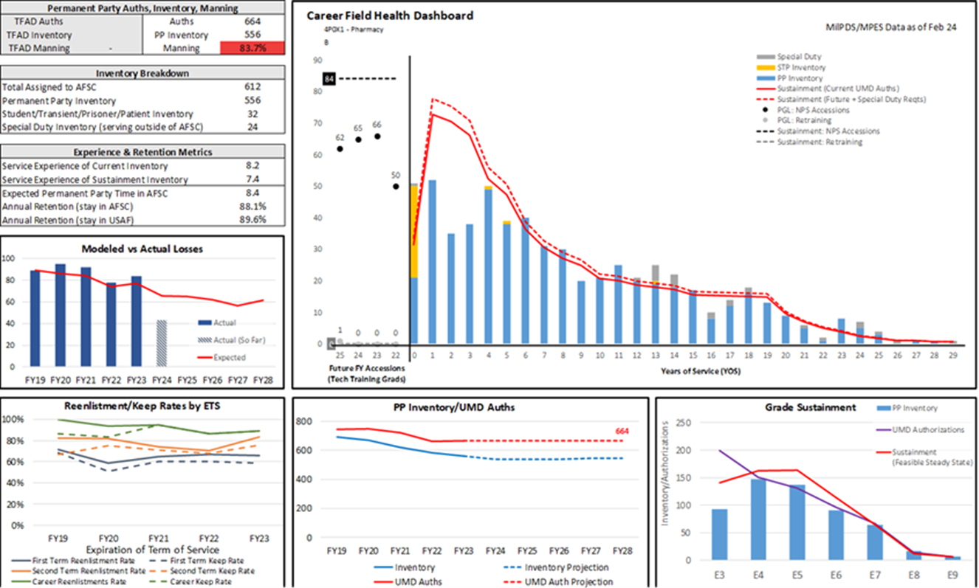

Slide 7
Career Field by the Numbers
 | Auth | Asgn’d | %
AB-A1C | 199 | 92 (*32) | 46.2%
SrA | 151 | 143 | 94.7%
SSgt | 131 | 135 | 103.1%
TSgt | 96 | 91 | 94.8%
MSgt | 67 | 66 | 98.5%
SMSgt | 14 | 17 | 121.4%
WW Total | 658 | 544 | 82.7%
4Ps in DSD | Amt
SSgt | 3
TSgt | 11
MSgt | 7
SMSgt | 2
Total | 23
FY25---14 Projected Releases
2024---23 Currently Filling DSD
*32 Students in Training (STP)
As of 29 Feb 2024

Slide 8
Enlisted Development Team
Board Members – CMSgts & MAJCOM Functional Managers
Keep Talent Marketplace updated/current on future intentions
Upcoming Enlisted Development Team Board
  Convening – TBD (June/July)
  MSgts & SMSgts (DSD returns)
  4P vectored positions
  CMSgt Deployment opportunities
  Future Sq SEL roles
Participation is KEY!!
2022: 72.86% participated in myVector--BETTER
2021: 63.33% participated in myVector--SATISFACTORY

Slide 9
Career Broadening Opportunities
Developmental Special Duties (DSD)
Military Training Instructor (MTI)
Military Training Leader (MTL)
Enlisted Accessions Recruiter
  2nd & 3rd Tier Recruiting
Professional Military Education Instructor (NCOA/SNCOA only)
Developmental Advisor (DA)

Slide 10
Career Broadening Opportunities
Special Duties (Non-DSD & Non-Joint)
Academy Military Trainer (AMT)
Airman & Family Readiness Center Readiness NCOIC/NCO
  Master Resilience Trainer Course Instructor
AFROTC Training Instructor (RTI)
First Sergeant
Basic Military Training First Sergeant
USAF Honor Guard
Base Honor Guard Program Manager
Airman Dorm Leader (ADL)
Superintendent, Inspector General (IG)
Professional Military Education Instructor (ALS)
  PME Academic Development
Missile Facility Manager
Academic Faculty Advisor

Slide 11
Career Broadening Opportunities
Special Duties (Enlisted Joint, Departmental, or Agency)
DoD Courier
Defense Attaché Specialist
https://myfss.us.af.mil/USAFCommunity/s/knowledge-detail?pid=kA08300000001mACAQ

Slide 12
Promotions
8.2. Promotion Quotas The Department of Defense limits the number of Airmen the RegAF may have in the top five enlisted grades. Promotion quotas for Staff Sergeant through Chief Master Sergeant are tied to fiscal year-end strength and are affected by funding limits, regulatory limits, and the number of projected vacancies in specific grades. Public law, as outlined in Title 10, U.S.C., Armed Forces, Chapter 36, Promotion, Separation, and Involuntary Retirement of Officers on the Active Duty List, limits the number of Airmen who may serve in the RegAF in the top two enlisted grades. The authorized average of enlisted members on RegAF status (other than for training) in pay grades E8 and E-9 in a fiscal year may not be more than 2.5 percent and 1.25 percent, respectively.
https://www.studyguides.af.mil/Portals/15/documents/Study_Guides/2024E5-Study-Guide-1-November-2023b.pdf

Slide 13
Managing Promotion Allocations
Air Force Promotion Allocations are based on science & art. Each cycle receives a set number of stripes fair shared across all AFSCs based on current requirements and projected losses
  Maintain promotion rate stability from year to year
  Promote close to requirement when possible while keeping AFSC promotion rates comparable to AF promotion percentage
  A1 approves allocations

Slide 14
Calculating Points & Factors
Specialty Knowledge Test – 100 points
Promotion Fitness Examination – 100 points
Decorations – 25 points
Enlisted Performance Reports – 285 points
https://static.e-publishing.af.mil/production/1/af_a1/publication/dafi36-2502/dafi36-2502.pdf

Slide 15
DAFI 36-2502
Table 2.4, Rule 4
285 points. Assign points to a maximum of three EPRs using the Promotion Recommendation Score (PRS) table below (see Notes 4 and 5). For members with two or more EPRs in the current grade, add all EPR promotion recommendation values to calculate total PRS points.
EPR Recommendation | Most Current EPR | 2nd EPR | 3rd EPR
Promote Now (PN) | 250 | 20 | 15
Must Promote (MP) | 220 | 15 | 10
Promote (P) | 200 | 10 | 5
Not Ready Now (NRN) | 0 | 0 | 0
Example: Scoring under the new Promotion Recommendation Score: First-time eligible, received a MP in 2022, then PRS will be 220. Second-time eligible, received a MP in 2022 and a P in 2021, then PRS will be 220 + 10 = 230. Third-time eligible, received a MP in 2022, a P in 2021, and a P in 2020 then PRS will be 220 + 10 + 5 = 235.

Slide 16
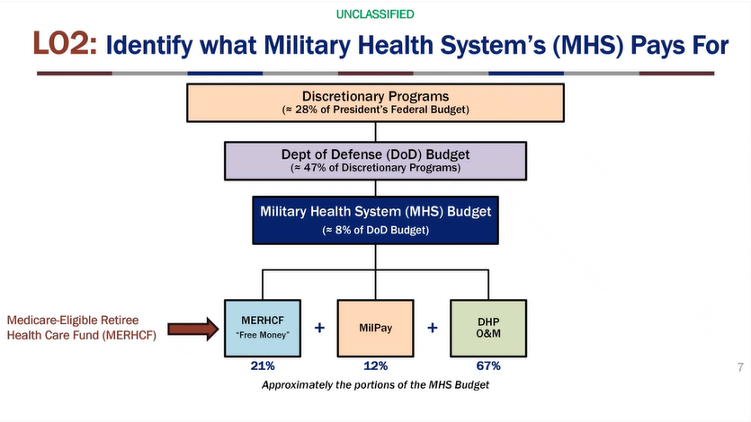
Budget Breakdown

Slide 17
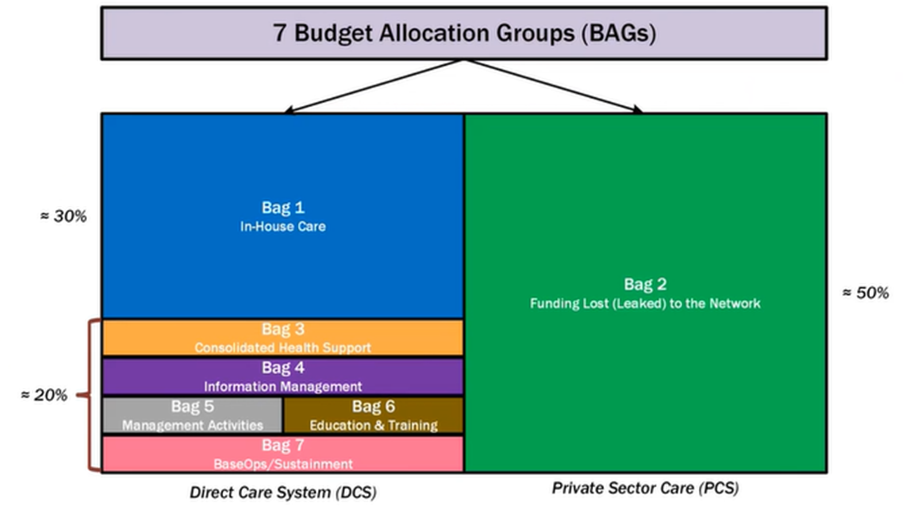

Slide 18
MEPRS Coding Structure
MEPRS codes are identified with a 4-digit code
Categorized in 7 functional accounts
Codes beginning with:
  A – Inpatient Care
  B – Ambulatory Care
  C – Dental Care
  D – Ancillary Services (Lab, Rad, & Pharm)
  E – Support Services (Overhead)
  F – Special Programs (Environmental, Immunizations, Public Health)
  G – Readiness
    A, B, C,F, & G are final operating accounts
    D & E are intermediate operating accounts that are stepped-down into the appropriate final operating accounts

Slide 19
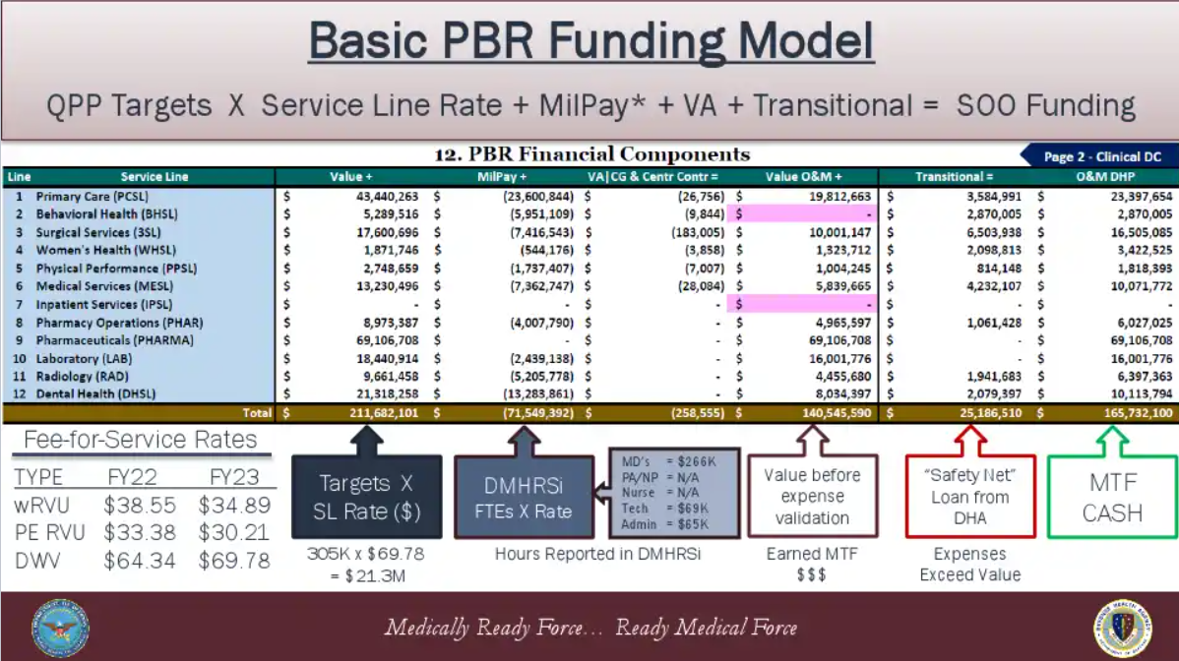
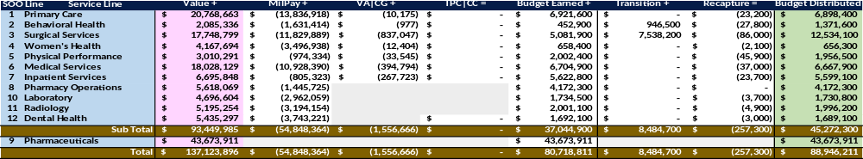
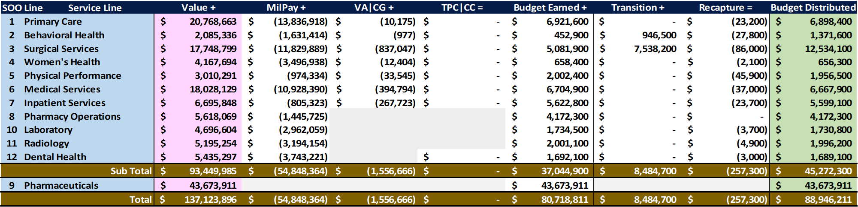
MD’s = $258K
PA/NP = $123K
Nurse = $101K
Tech = $71K
Admin = $65K (O: $119K)

Slide 20

Application #1
Cost Accounting A.K.A, __________
DMHRSi

Slide 21
MD’s = $258K
PA/NP = $123K
Nurse = $101K
Tech = $71K
Admin = $65K (O: $119K)

Slide 22
DMHRSi Impact Example #1
178 AD Nurses -> 178 FTE X $101K = $18M
Crazy 8’s (to A, B, C, D code) -> ($18M)
Admin/Clinic Mix
  80% to A, B, C, D code, -> ($14.4M) from PBR
  20% to Admin (E) -> ($3.6M) from RBR
F & G Target, Admin/Clinic Mix
  12% to F and 22% to G -> No Cost
  53% to A, B, C, D code, -> ($9.5M) from PBR
  13% to Admin (E) -> ($2.4M) from RBR
Difference of $6M!

Slide 23
DMHRSi Impact Example #2
10 4Ps rotate from Clinical to Admin work areas
People group not updated in DMHRSi due to poor communication
11 Holidays, 11 Family Days, 30 Leave days -> 0.2 FTE
10 FTE x 0.2 x $71K = ($142K) from PBR

Slide 24
Future Changes
Add’l School House Instructors
ASVAB Eligibility Score
MCRP Checklist
Enlisted Grade Allocation
Phase 2 Program Extension (5 Days)
CFETP
CDCs

Slide 25
Summary – Key Points
Career Field Health continues to fluctuate between 82-84% which is impacting amount of people allowed to participate in career broadening opportunities
Maintain lines of communication with your MAJCOM Functional Manager
Promotions are steered by authorized vacancies
Use Talent Marketplace/MyVector to make your career intentions known
Accurately code your timecards to garner proper resourcing for your facility
Current priorities focused on ensuring we have adequately trained technicians for GPC

Slide 26
Knowledge Test Answers
What is the world-wide average for the AFSC? 82.7%
To further cement advanced accreditation for the Technician Training Program, what changes are being considered for the Phase 2 portion? Extending 5 training days
How many individuals are scheduled for release for FY25 to participate in career broadening opportunities? 14
The best way to increase the budget at your facility is by entering crazy eights on your DMHRSi timecard. False

Slide 27
Questions?

