Slide 1
Society of Air Force Pharmacy
Mid-Year Conference
Career Field Updates
COREY J. MUNRO, Colonel, USAF, BSC
AF/SG Pharmacy Consultant
BSC Associate Corps Chief, Pharmacy
LATONYA R. RENO, CMSgt, USAF, CPhT
AF Pharmacy Career Field Manager

Slide 2
Financial Disclosure
Col Corey Munro: “Declare(s) no conflicts of interest, real or apparent, and no financial interests in any company, product, or service mentioned in this program, including grants, employment, gifts, stock holdings, and honoraria.”
CMSgt LaTonya Reno: “Declare(s) no conflicts of interest, real or apparent, and no financial interests in any company, product, or service mentioned in this program, including grants, employment, gifts, stock holdings, and honoraria.”

Slide 3
Learning Objectives
Understand how to access and leverage AF pharmacy management support
Understand strategies to communicate your assignment preferences
Gain a better understanding of pharmacy’s role in AF readiness mission

Slide 4
Knowledge Questions
How many AFMED roles of care are currently being developed to combat the Great Power Competition (GPC)?
How can you improve your chances of getting a desired assignment?
What are some things you must do for your deployment readiness?

Slide 5
Pharmacy Management Support
As a pharmacy leader, who can I turn to for support?
  Your consultant triad
    AF consultant
    MAJCOM consultant
    DHA consultant
  Your mentors and resources
    Pharmacy is the most collegial career field in the BSC, IMO
    Pharmacy page on the KX (requires updating, but still usable)
    Make your mentor earn their extra pay ☺

Slide 6
Pharmacy Management Support
Who is my MAJCOM consultant?
  ACC - Lt Col Jeff Andreoli
  AETC - Lt Col Brooke VanEeghen
  AMC - Lt Col Emily Fletcher
  AFMC - Col(s) Tim McDowell
  AFSOC - Lt Col Sang Ngo
  GSC - Maj Patrick Ditullio
  AFDW - Lt Col Rohin Kasudia
  USAFA – Lt Col Michele Serrano
  USSF – Lt Col Lakisha Roe
  USAFE – Lt Col Doug Odegaard

Slide 7
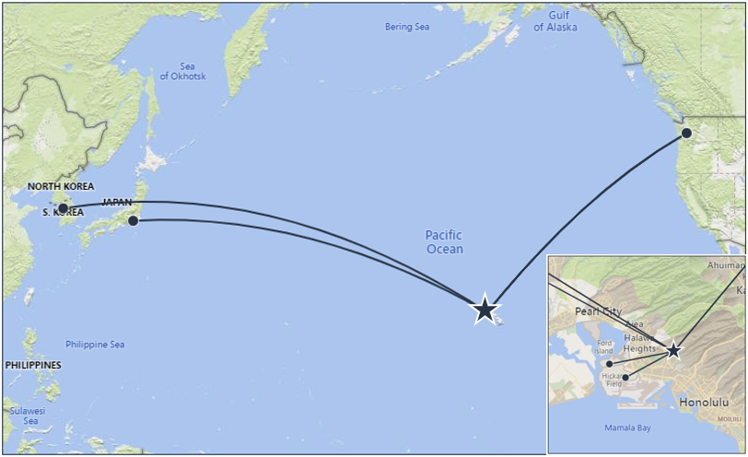
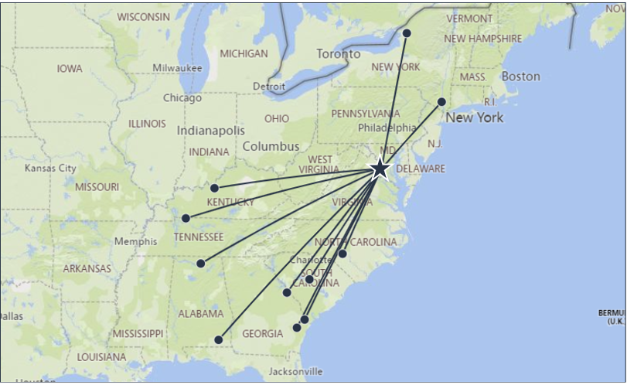
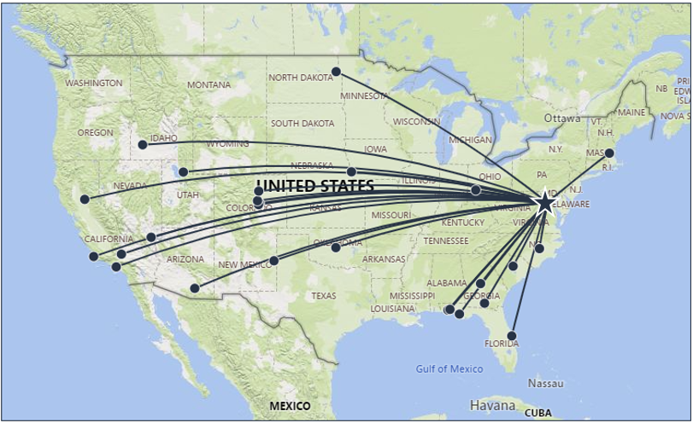
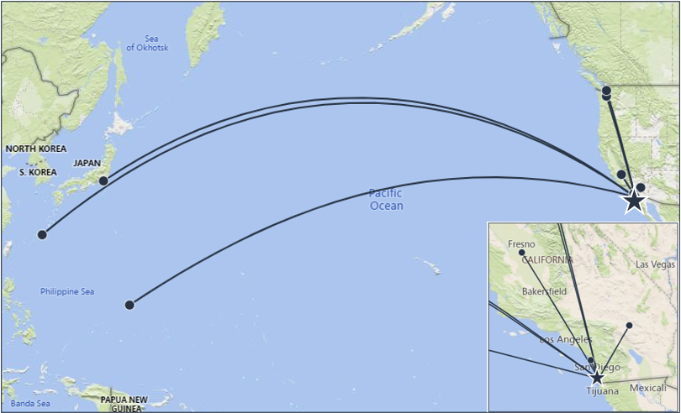
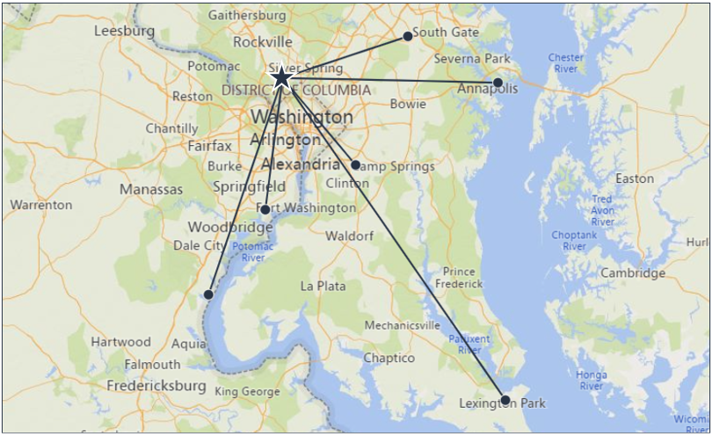
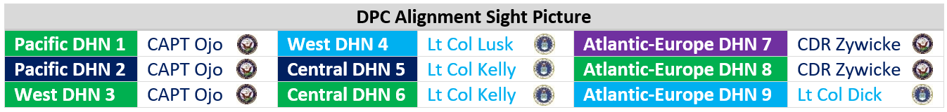
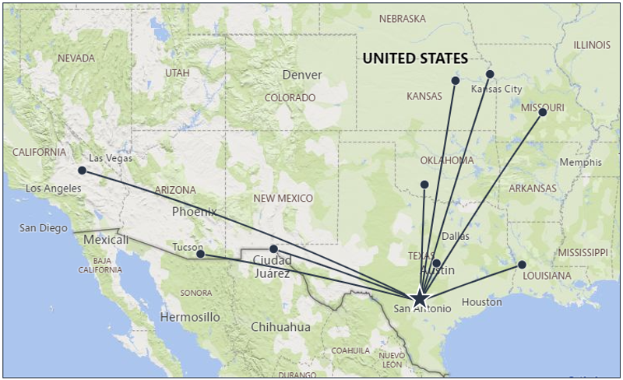
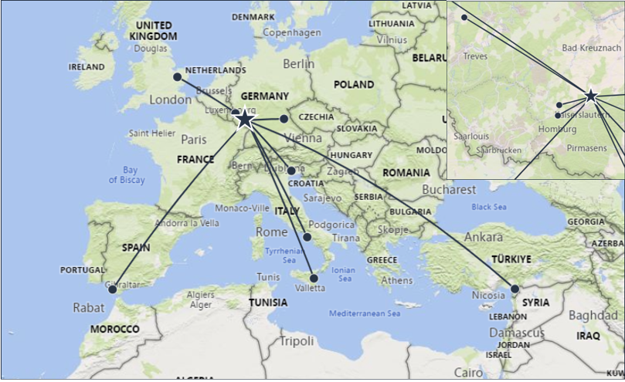
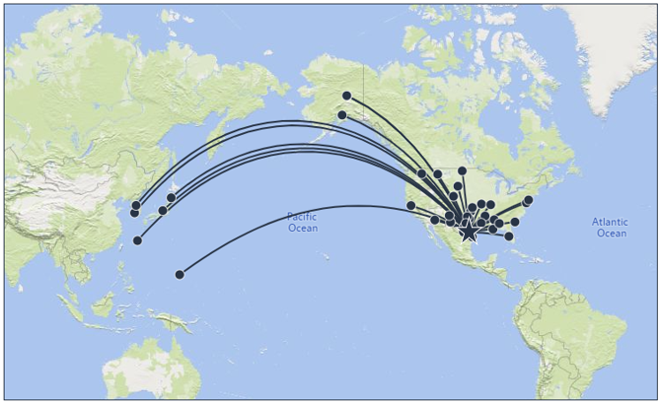
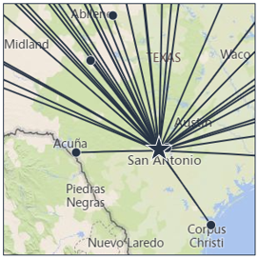
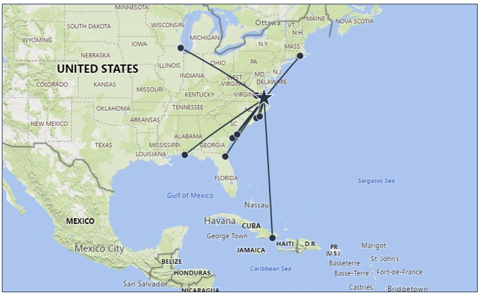
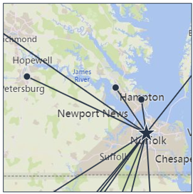

1 Pager
5 DPC Laydown
DHSA Central – DHN 6 (11)
Lt Col Sarah Kelly
sarah.e.kelly32.mil@health.mil
0047 - Dwight D. Eisenhower AMC
0089 - Womack AMC (Ft Liberty)
0001 - Fox AHC (Redstone)
0003 - Lyster AHC (Ft Novosel)
0048 - Martin ACH (Ft Moore)
0049 - Winn ACH (Ft Stewart)
0060 - Blanchfield ACH (Ft Campbell)
0061 - Ireland AHC (Ft Knox)
0086 - Keller ACH (West Point)
0105 - Moncrief AHC (Ft Jackson)
0330 - Guthrie AHC (Ft Drum)
UNCLASSIFIED
DHN 1
9/1/2023
DHSA Pacific – DHN 1 (7)
CAPT Olaitan Ojo
olaitan.f.ojo.mil@health.mil
0052 - Tripler AMC (Hawaii) «
0125 - Madigan AMC (Ft Lewis)
0280 - NHC Hawaii
0287 - 15th MEDGRP Hickam (Hi)
0395 - 62nd MED FLT-JBLM-McChord
0610 - BG Crawford Sams AHC (Japan)
0612 - Brian Allgood ACH (Korea)
DHN 6
DHN 9
DHN 2
DHN 7
DHSA Atlantic-Europe – DHN 9 (26)
Lt Col Ryan Dick
william.r.dick10.mil@health.mil
0032 - Evans ACH (Ft Carson)
0033 - 10th MEDGRP-Academy
0042 - 96th MEDGRP-Eglin
0079 - 99th MEDGRP-Nellis
0095 - 88th MEDGRP-Wright-Patterson
0010 - 355th MEDGRP-Davis Monthan
0015 - 9th MEDGRP-Beale
0018 - 30th MEDGRP-Vandenberg
0019 - 412th MEDGRP-Edwards
0043 - 325th MEDGRP-Tyndall
0046 - 45th MEDGRP-Patrick
0050 - 23rd MEDGRP-Moody
0051 - 78th MEDGRP-Robins
0053 - 366th MED SQ-Mtn Home
0078 - 55th MEDGRP-Offutt
0085 - 27th SPCLOPS MDGRP-Cannon
0090 - 4th MEDGRP-Seymour Johnson
0093 - 319th MEDGRP-Grand Forks
0096 - 72nd MEDGRP-Tinker
0101 - 20th MEDGRP-Shaw
0119 - 75th MEDGRP-Hill
0248 - 61st MED SQ-Los Angeles
0252 - 21st MEDGRP-Peterson
0310 - 66th MEDGRP-Hanscom
7139 - 1st SPCL OPS MED-Hurlburt
7200 - 460th MEDGRP-Buckley
DHN 3
DHSA Pacific – DHN 2 (9)
CAPT Olaitan Ojo
olaitan.f.ojo.mil@health.mil
0029 - NMC San Diego «
0024 - NH Camp Pendleton
0028 - NHC Lemoore
0030 - NH Twentynine Palms
0126 - NH Bremerton
0127 - NHC Oak Harbor
0620 - NH Guam
0621 - NH Okinawa
0622 - NH Yokosuka (Japan)
DHN 8
DHSA Atlantic-Europe – DHN 7 (7)
CDR Emily Zywicke
emily.l.zywicke.mil@health.mil
0067 – WRNMMC «
0123 - AT Augusta MMC (Ft Belvoir)
0066 - 316th MEDGRP (M Grow)
0068 - NHC Patuxent River
0069 - Kimbrough ACC (Ft Meade)
0306 - NHC Annapolis
0385 - NHC Quantico
DHN 4
DHSA West – DHN 4 (39)
Lt Col Justin Lusk
justin.d.lusk.mil@health.mil
0014 - 60th MEDGRP-Travis
0055 - 375th MEDGRP-Scott
0109 - Brooke AMC (Ft Sam Houston)
0117 - 59th MDW-WHASC-Lackland
0118 - NHC Corpus Christi
0004 - 42nd MEDGRP-Maxwell
0005 - Bassett ACH (Ft Wainwright)
0006 -673rd MEDGRP JBER-Elmendorf
0009 - 56th MEDGRP-Luke
0013 - 19th MEDGRP-Little Rock
0036 - 436th MEDGRP-Dover
0045 - 6th MEDGRP-MacDill
0059 - 22nd MEDGRP-McConnell
0062 - 2nd MEDGRP-Barksdale
0073 - 81st MEDGRP-Keesler
0074 - 14th MEDGRP-Columbus
0076 - 509th MEDGRP-Whiteman
0077 - 341st MEDGRP-Malmstrom
0083 - 377th MEDGRP-Kirtland
DHN 5
DHSA West – DHN 4 (con)
0084 - 49th MEDGRP-Holloman
0094 - 5th MEDGRP-Minot
0097 - 97th MEDGRP-Altus
0106 - 28th MEDGRP-Ellsworth
0112 - 7th MEDGRP-Dyess
0113 - 82nd MEDGRP-Sheppard
0114 - 47th MEDGRP-Laughlin
0128 - 92nd MEDGRP-Fairchild
0129 - 90th MEDGRP-FE Warren
0203 - 354th MEDGRP-Eielson
0326 - 87th MEDGRP JBMDL-McGuire
0338 - 71st MEDGRP-Vance
0356 - 628th MEDGRP-Charleston
0364 - 17th MEDGRP-Goodfellow
0637 - 8th MEDGRP-Kunsan (Korea)
0638 - 51st MEDGRP-Osan (Korea)
0639 - 35th MEDGRP-Misawa (Japan)
0640 - 374th MEDGRP-Yokota (Japan)
0802 - 36th MEDGRP-Andersen (Guam)
0804 - 18th MEDGRP-Kadena (Okinawa)
DHSA Central – DHN 5 (13)
Lt Col Sarah Kelly
sarah.e.kelly32.mil@health.mil
0124 - NMC Portsmouth «
0038 - NH Pensacola
0039 - NH Jacksonville
0056 - James Lovell Fed Hlth Care Cntr
0091 - NMC Camp Lejeune
0092 - NHC Cherry Point
0100 - NHC New England
0103 - NHC Charleston
0104 - NH Beaufort
0120 - 633rd MEDGRP JBLE-Langley
0121 - McDonald AHC (Ft Eustis)
0122 - Kenner AHC (Ft Gregg-Adams)
0615 - NH Guantanamo Bay
DHSA Atlantic-Europe – DHN 8 (10)
CDR Emily Zywicke
emily.l.zywicke.mil@health.mil
0607 - Landstuhl Reg MEDCEN «
0609 - Bavaria MEDDACC
0617 - NH Naples
0618 - NH Rota
0624 - NH Sigonella
0633 - 48th MEDGRP-Lakenheath
0635 - 39th MEDGRP-Incirlik
0805 - 52nd MEDGRP-Spangdahlem
0806 - 86th MEDGRP-Ramstein
0808 - 31st MEDGRP-Aviano
DHSA West – DHN 3 (9)
CAPT Olaitan Ojo
olaitan.f.ojo.mil@health.mil
0108 - Wm Beaumont AMC (Ft Bliss)
0110 - Carl R Darnall AMC (Ft Cavazos)
0008 - Bliss AHC (Ft Huachuca)
0057 - Irwin ACH (Ft Riley)
0058 - Munson AHC (Ft. Leavenworth)
0064 - Bayne Jones ACH (Ft Johnson)
0075 - Gen Leonard Wood ACH
0098 - Reynolds AHC (Ft Sill)
0131 - Weed ACH (Ft Irwin)
DHA’s 131 Parent DMIS MTFs
Per DHA Advancement 8/8/23 – While starting w/ 1 DHSA, intent is to eventually stand up 4 geographically defined DHSAs

Slide 8
Officer Assignments
My role as Pharmacy Consultant
  Meet Air Force Mission Requirements
    Mission requirements are of primary importance
    Consultant serves to marry your preferences with AF needs
  Provide career field-level perspective to AFPC
    AFPC is always learning the nuances of each AFSC
    AFPC is more effective if they understand unique 43Pisms
  Synchronize the input of gaining and losing commanders
    Commander involvement is key in assignment process
    CCs can communicate unique mission requirements to myself/AFPC

Slide 9
Officer Assignments
How to improve your chances of getting a desired assignment
  Know what type of job you want
  Know what part of the U.S. (or OCONUS) you would like to be next
  Be realistic and have a backup plan
  Communicate. Communicate. Communicate.
    Talent Marketplace – very valuable
      Provides a quick reference of preferences and bids
      Helps the consultant understand what CCs want
      Helps the consultant search for candidates for specific jobs
    Use the Consultant Communication Tool aka “dream sheet”
    Ensure your commander/consultant/AO are all on same page

Slide 10
Officer Assignments
What I’ve learned after managing 3 assignment cycles:
  If you are offered a flight command, take it!
  Your career progression is first consideration, but not the final one
    AF tries to accommodate your wishes more than you think
    AF requirements reign in complex situations
    Try to put yourself in my shoes when picking your choices
  I am perfectly ok with you doing your own research about openings
  Don’t be afraid to pester me (fire/forget emails are not advised)
  Strongly advise you to tell me and AFPC the same story
  Don’t self-eliminate—if you want an assignment, ask for it!

Slide 11
Pharmacy Readiness
How do I prepare for a deployment?
  Center your pharmacy’s objectives around:
  Patient safety
  Improved therapeutic outcomes
  Customer satisfaction
    Beneficiaries (give them reasons to come back)
    Providers (be a valuable pharmacy resource)
    Nurses (partner with them to improve administration safety)
    Fellow ancillary services (you’re all on the same team)
  Team morale and security
  Medication management (drug security/administration)
  Ensure all your CMRP training is up to date

Slide 12
Pharmacy Readiness
Deployer feedback:
  Know how to leverage resources
  There are a lot of jr personnel--be prepared to mentor and lead
  Know your core competencies
  Be prepared to sit in for your boss
  Many troops arrive in theater without their medications (become familiar with DPP)
  You will gain lifelong relationships and memories

Slide 13
Pharmacy Readiness: On the Horizon…
  Combat Wings
    Medical personnel will be rebalanced to meet requirements
    Address ambiguity between care delivery and ops
    Sync DHA delivery of care with AF readiness mission
    Support currency while providing HC for mission partners and families
  Mission will be prioritized over function
  There will be 15 43P deployments annually until further notice
  Near future deployment locations will remain the same
  Seize or create any opportunity to deploy, but remember that you will still be competitive if you don’t

Slide 14
Pharmacy Readiness: On the Horizon…
Combat Wings Cont’d
Purpose of Change
  2022 National Defense Strategy
  2023 NDAA sect.714
  Great Power Competition
DCW Implementation & Impact on Pharmacy Career Field
  No changes to day-to-day mission
  Normal operations outside of this mission

Slide 15
Pharmacy Readiness: On the Horizon…
Combat Wings Cont’d
Will this generate more mini pharmacies or Doc in a Box?
  Not Occupational Support Teams (OST)
  Does not require establishing more mini pharmacy locations
How would it change prescribing patterns or coordination with other health care providers?
What will Wing composition be?
  ATF Command Echelon
  CSST-L
  CSST
  CSST2

Slide 16
AFMED Medical Roles of Care
Role 1 – First Responder Care
Role 2 – Forward Resuscitative Care
Role 3 – Theater Hospitalization
Role 4 – Definitive Care

Slide 17
CFM Roles & Responsibilities
Training
Implements/Sustains Initiatives pertaining to training, CF development & career progression
Chairs Utilization & Training Workshop (U&TW)
Develops Career Education and Training Plan (CFETP)
Validates Deployment Requirements

Slide 18
CFM Roles & Responsibilities
Resourcing
Monitors career field health & manning
Enlisted Grade Allocation
Program Objective Memorandum
Consultant Collaboration
  Deployment Balancing
  Workforce Availability
  Develop/Revise Manpower Standards

Slide 19
Add’l CFM Roles & Responsibilities
Works with AF/SG & SG CMEF
Works with MAJCOM CMEF to identify MFMs for command oversight
Establish entry requirements
Airman Advancement Division
  SKT Rewrite Project
AFPC Functional Managers
  PCS/PCA
  DSD Releases
  Balancing Staffing Levels

Slide 20
Enlisted MAJCOM Functional Managers
MAJCOM | BASE | RANK/NAME
AETC | KEESLER | SMSgt Jasmin Trumic
ACC | NELLIS | CMSgt Timothy Schnur SMSgt Karen Salenga
AFDW | ANDREWS | SMSgt Kendra Anthony
AFGSC | BARKSDALE | SMSgt (s) Donald Akins
AFMC | WRIGHT PATTERSON | SMSgt Justin Viator
AFSOC | HURLBURT | MSgt Travis Toberman
AMC | TRAVIS | CMSgt Crystal Hollars-Connelly
PACAF | JB ELMENDORF RICHARDSON | SMSgt Traci England
USAFA | AF ACADEMY | SMSgt Leilani Guevarra
USAFE | RAF LAKENHEATH | SMSgt Jason Blas
USSF (Combined w/AFMC) | WRIGHT PATTERSON | SMSgt Justin Viator

Slide 21
MFM Roles & Responsibilities
Serve as liaisons to AF Career Field Manager
SAVs within the command
Monitoring CF Health
Balancing Manning
Elevating Concerns
Evaluating Command Training
Disseminating programs & policies for their designated fields
Coordinating w/AFPC to distribute personnel

Slide 22
Knowledge Questions
How many AFMED roles of care are currently being developed to combat the Great Power Competition (GPC)?
  11
  4
  7
  14
B

Slide 23
Knowledge Questions
How can you improve your chances of getting a desired assignment?
A. Call Col Munro or CMSgt Reno
B. Contact your MAJCOM Commander
C. Use the Consultant Communication Tool aka “dream sheet”
D. Contact the Total Force Center
C

Slide 24
Knowledge Questions
What are some things you must do for your deployment readiness?
  Become very familiar with the Deployer Prescription Program
  Take an extended family vacation
  Get a profile for an ailment that did not exist prior to you being tasked to deploy
  Hand off all your supervisory responsibilities & duties to your civilian counterparts
A

Slide 25
Questions?

