Slide 1

All In: Maximizing Returns in Your Financial Readiness Deck
Major Timothy Corbin, CPFC
Mid-Year Conference
6 - 8 May 2024
Planet Hollywood Resort & Casino
Las Vegas, NV

Slide 2
Disclosure
I have No financial disclosure or conflicts of interest with the presented material in this presentation.

Slide 3
Objectives
Define Financial Readiness
Identify key financial concepts for maximizing returns
Explain the importance of having an emergency savings fund
Identify concepts related to the Thrift Savings Plan
Explain investment opportunities available to you through TSP
Describe key concepts on how to maximize your investment opportunities through the VA loan
Identify ways to increase and build good credit

Slide 4
Financial Readiness
What is it?
  Financial readiness refers to being well-prepared to manage your finances effectively. It involves having the knowledge, skills, and resources to make informed financial decisions.
What does this look like for you?
  Each person’s situation vastly different from the next.
  Do what’s right for you!

Slide 5
Financial Readiness
Why is Financial Readiness Important?
  Being financially ready helps you:
    Avoid debt: Understand budgeting, saving, and spending wisely.
    Plan for emergencies: Build an emergency fund to cover unexpected expenses.
    Invest wisely: Learn about investment options and risk management.
    Prepare for major life events: Such as buying a home, starting a family, or retirement.

Slide 6

Financial Aces in Your Readiness Deck
Emergency Funds
TSP
Real Estate (VA Loan)
Credit and Credit Cards
Notes:
Most financial security for you and your family.

Slide 7

Ace #1: Emergency Funds

Slide 8
Ace #1: Emergency Funds
Why an Emergency Fund?:
  Mission Critical: Emergencies happen – car repairs, medical bills, unexpected PCS orders.
  Peace of Mind: Having a safety net reduces stress and lets you focus on your mission.
  Financial Independence: Be prepared, so you’re not gambling with your future.

Slide 9
Ace #1: Emergency Funds
Get Familiar with LES!
  Have luxury of knowing what our pay is and what it is projected to be.
  Calculate living expenses and any funds left over.
Start Small:
  Minimum Bet: Aim for at least 3 months’ worth of living expenses.
  Maximum Bet: Work up to 6 months’ worth of living expenses
  Monthly Contributions: Set up automatic transfers to your emergency fund.
Stay Disciplined:
  Avoid Temptation: Don’t dip into your fund for non-emergencies.
  Regular Audits: Revisit and adjust as needed.

Slide 10
Ace #1: Emergency Funds
Where to Keep It:
  Safe Bets: A separate savings account – not mixed with regular spending.
    Easiest is having savings account with same bank as checking account
Where to Keep it to Maximize Return
    High-Yield Savings Accounts or Money Market Accounts
      Currently 4-5% yearly return (rate fluctuates)
      Compare to USAA savings (0.01%)
    Can still move money into and out of accounts freely
    Example Return
      USAA: $10,000 x 0.01% over 12 months= $10,001
      High Yield Savings: $10,000 x 5% over 12 months= $10,512
        Compounding interest!

Slide 11
Ace #1: Emergency Funds
Where to Keep It:
  Safe Bets: A separate savings account – not mixed with regular spending.
    Easiest is having savings account with same bank as checking account
Where to Keep it to Maximize Return
    High-Yield Savings Accounts or Money Market Accounts
      Currently 4-5% yearly return (rate fluctuates)
      Compare to USAA savings (0.01%)
    Can still move money into and out of accounts freely
    Example Return
      USAA: $10,000 x 0.01% over 12 months= $10,001
      High Yield Savings: $10,000 x 5% over 12 months= $10,512
        Compounding interest!

Slide 12
Ace #1: Emergency Funds
*Important!*
  High Yield Savings and Money Market Accounts are not the same as CD (Certificate of Deposit Accounts)
    Certificate of Deposit (CD) savings account
      Must keep Money in account for specific amount of time (I.e., 9-12 months)
      Pays higher interest rate, but removing money will cause fee
  Not Best place for emergency fund, but very safe investment with good return
    Rates usually similar to high-yield savings rates, so similar returns.

Slide 13
Ace #2: TSP

Slide 14

TSP Fundamentals
What is the TSP?
  Thrift Savings Plan
  Retirement savings and investment plan for:
    Federal Employees
    Uniformed Service Members
    Ready Reserve
Automatic Contribution:
  Under the Blended Retirement System (BRS), All Air Force members receive an automatic 1% contribution to their TSP account, regardless of whether they personally contribute any money.
    High-3 System needs to manually contribute
Notes:
What is TSP? small, brief explanation

Slide 15
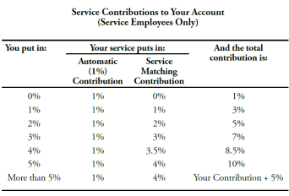
TSP Fundamentals
Maximum Matching: The maximum matching contribution is up to 5% of the member’s pay.
  ***All of match goes into Traditional, even if you put your 5% in Roth***
    Will end up with money in both accounts regardless
  Also: investments go into G fund automatically
    Must make changes in account to diversify to other funds
Maximum Contribution/Year:
  $23K (does not include matching contribution)
10% penalty for borrowing before 59 ½ years old

Slide 16
TSP Investment Funds
G Fund (Guaranteed Bond Fund):
Casino Equivalent: Playing it safe at the roulette table. You place your chips on the green “0” or “00” spots. It’s low-risk, and you’re guaranteed to get your original bet back.
Description: The G Fund invests in special U.S. government treasury securities. It’s the most conservative option, ensuring principal protection. Think of it as the “no-lose” bet.
F Fund (Fixed Income Index Fund):
Casino Equivalent: The F Fund is akin to playing blackjack. You’re not chasing big wins, but you’re steadily accumulating chips. It invests in U.S. bonds.
Description: The F Fund tracks the Bloomberg Barclays U.S. Aggregate Bond Index. It’s stable and provides income, but don’t expect fireworks.

Slide 17
TSP Investment Funds
C Fund (Common Stock Index Fund):
Casino Equivalent: The C Fund is the slot machine. You pull the lever, and sometimes you hit the jackpot! It mirrors the S&P 500.
Description: The C Fund invests in large U.S. company stocks. It’s volatile but potentially rewarding.
S Fund (Small Cap Stock Index Fund):
Casino Equivalent: The S Fund is the craps table. Small bets, but exciting! It tracks the Dow Jones U.S. Completion Total Stock Market Index.
Description: The S Fund focuses on small and mid-sized U.S. company stocks. Higher risk, higher potential returns.

Slide 18
TSP Investment Funds
I Fund (International Stock Index Fund):
Casino Equivalent: The I Fund is like playing baccarat in a European casino. You’re betting on global markets. 🌎
Description: The I Fund invests in international stocks from developed countries. Diversification beyond U.S. borders.
Lifecycle (L) Funds:
Casino Equivalent: The L Funds are the all-you-can-eat buffet. You get a little bit of everything! (G,F, S, C, and I combined)
Description: L Funds automatically adjust their mix based on your target retirement date. They start aggressive and become more conservative as you approach retirement.

Slide 19
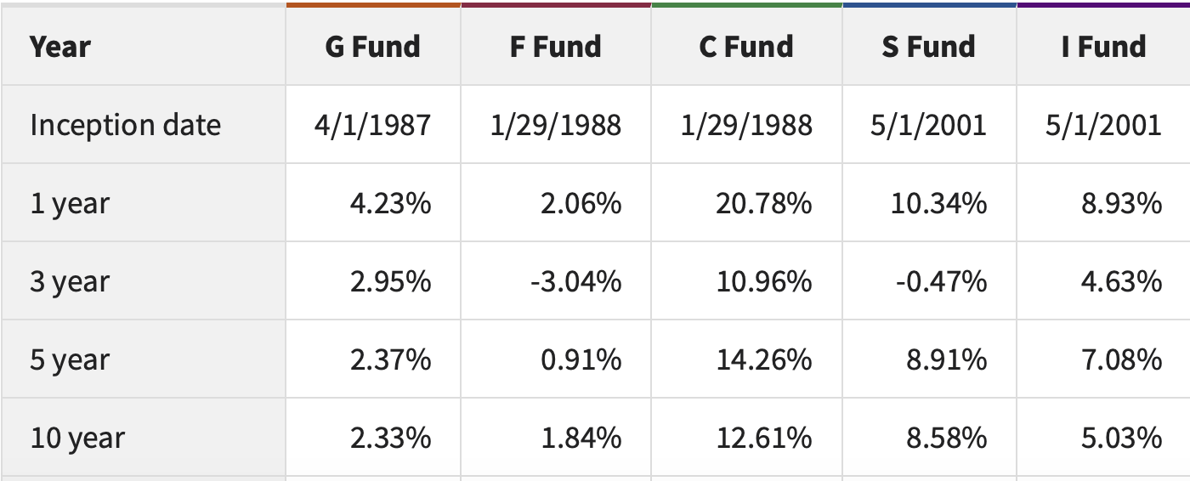
TSP Fund Returns

Slide 20
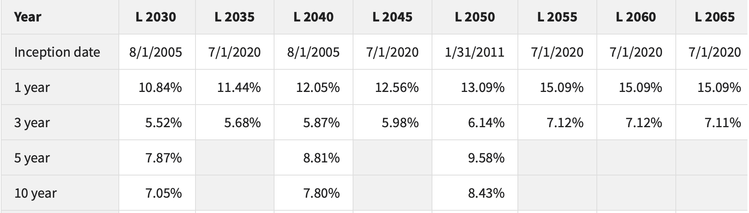
TSP Fund Returns
Notes:
Closer to retirement, less risk, smaller rate of return.

Slide 21
Maximizing Your TSP
Start contributing right away!
  5% base pay at minimum each month
Diversify your Portfolio
  Do not place all in one fund
Identify funds with largest returns over past 5-10 years
  What makes sense with your level of risk?
Do not move funds based on price fluctuation
  Set it and forget it!

Slide 22
Tax Impact on TSP
Consider the impact of taxes
  Roth or Traditional?
    Roth= Tax Now, no tax later (No effect to current income)
      Ex: $50K income with $23K put in Roth= $50K taxable income for that year
    Traditional= Tax later, no tax now (Lowers current income)
      Ex: $50K income with $23K put in Traditional= $27K taxable income for that year
Have student loans? Applying for PSLF? (Public Service Loan Forgiveness)
  Based on income
  Traditional= lower annual income
Minimal taxes during retirement: Roth
Close to moving up to the next tax bracket: Traditional

Slide 23
Ace #3: Real Estate (VA Loan)

Slide 24

VA Loans
What is it?
    Home loan mortgage program available backed by U.S Department of Affairs
Who can get it?
  Served 181 days straight during peacetime
  Served at least 90 days straight during wartime
  Served as a reservist or in the National Guard for at least six years
  The spouse of a service member who died in action or from a service-related disability
Purpose: They are primarily for purchasing a primary residence.
  No down payment is typically required for VA loans.

Slide 25
VA Loan vs. Other Loans
Credit Score:
No specific minimum credit score set by the VA, but lenders often require a FICO score of 580-620.
Conventional loans typically require a minimum FICO score of 620.
Debt-to-Income Ratio (DTI):
VA Loans: Lenders scrutinize DTI if it’s over 41%.
Other Loans: Ideally, DTI should be under 36%, but higher ratios can be accepted.

Slide 26
VA Loan vs. Other Loans
Property Type:
VA Loans: primary residences that meet VA standards.
Other Loans: primary homes, second homes, and investment properties.
Mortgage Insurance:
No private mortgage insurance (PMI) is required.
Instead, there’s a one-time VA funding fee (ranging from 1.25% to 3.3% of the loan amount for purchase mortgages).

Slide 27
Maximizing Your VA Loan
Possible to have more than 1 VA loan at a time
  Ex: Max $750K member can utilize with $0 down Payment
    Buys Home A: $300K (lives in minimum one year)
    Family Grows: Can purchase Home B for up to $450K
    Must move into new home with valid purpose
    Can rent out first home
What if Home B is over 450K? (Ex: $550K)
  Must come up with 25% of overage for down payment
  $550K-$450K=$100K: $100K x 25%= $25K down payment

Slide 28
Maximizing Your VA Loan
What if you want to purchase Home B at $750K after living in Home A ($300K) for at least one year?
  Can refinance Home A ($300K) into conventional loan!
  Must have at least 25% equity in home to do this.
  $300K x 25%= $75K
  Can then use all of $750K in VA home loan to purchase Home B!

Slide 29
Maximizing Your VA Loan
Understanding VA Loan Points:
  VA loan points, also known as discount points, allow borrowers to secure a lower interest rate on their VA loan by paying an upfront fee.
  Each point = typically 1% of the loan amount
    lowers the interest rate by 0.25%.
  For example, paying one discount point upfront (costing $2,000) on a $200,000 VA loan could potentially lower the interest rate from 4% to 3.75% over a 30-year loan.

Slide 30
Maximizing Your VA Loan
How VA Loan Points Work:
  Don’t directly reduce the interest rate.
    lowers the overall cost of borrowing over the loan term.
    Prepaying a portion of the interest that would accrue over time.
  Calculate the break-even point: Consider how long you plan to stay in the home.
    If the savings from the lower interest rate surpass the upfront cost, it’s worth paying for VA loan points.

Slide 31
Maximizing Your VA Loan
  Improve your credit score: A higher credit score may qualify you for a better interest rate and larger loan amount.
  Lower debt-to-income ratio: Reducing existing debts can help you afford a larger loan.
  Larger down payment: If possible, make a substantial down payment to increase your purchasing power.
  Explore VA loan limits: Borrowers with better financial profiles may see larger VA loan limits

Slide 32
Other VA Loan Tips
Takes usually 45-60 days to get approved for VA Loan
Must move in before 60 days after getting approved.
  Spouse can move in if you are unable in 60 days
Consult with Mortgage originator who specializes in VA Home Loans
Can use to buy single home, duplex, triplex, etc…
  As long as your primary residence is in one of the homes.
  Also have to meet additional qualifications, but still possible!

Slide 33
Ace #4: Credit and Credit Cards

Slide 34
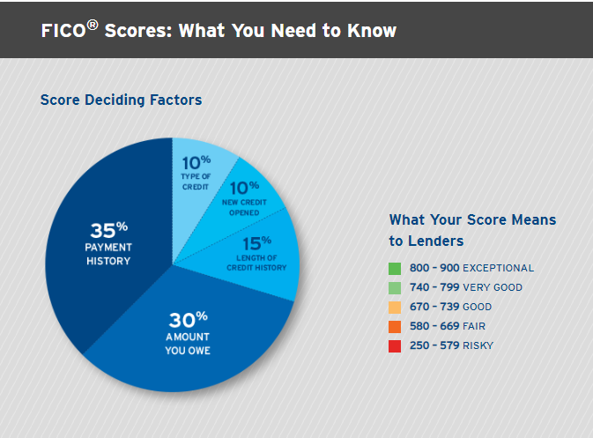
Credit Score Basics
Notes:
Fico Score it what the credit card companies use in order to approve you for a credit card. The higher the score, the better. The breakdown of what goes into your score is above. Creditkarma.com is a good website to get your base score. It is not a fico score but gives you a good idea of what you score is near. Most of the cards discussed in this presentation require at least a credit score of >700

Slide 35
Benefits of Credit Cards
Safety and Convenience
  No need to carry cash—use your credit card instead.
  Fraud protection keeps your money safe.
Cash Back
  Unlimited cash back on dining, grocery shopping, entertainment, etc…
  Imagine winning at the slots every time you dine out or catch a show!
One-Time Bonuses
  Earn a signing bonus when you get a new credit card.
  Spend a certain amount within the first few months to unlock rewards.
  Think of it as hitting the jackpot right from the start! 💰

Slide 36

Benefits of Credit Cards
Special Experience Credits
  Enjoy perks like food and beverage credits.
  Treat yourself to a fancy dinner or a spa day.
  It’s like winning extra chips at the casino! 🍹💆‍♀️
Points and Miles
  Use your credit card for flights and earn points.
  Redeem them for travel, gifts, or statement credits.
  It’s like hitting the travel jackpot! ✈️🌎

Slide 37

Why Do This?
My Mid-Tour Costs
  Flight- ICN to DEN= $831
  Flight- DEN to ASE=$169x2=$338
  Flight- ASE to EWR= $319x2= $638
  Flight- EWR to SAT= $279x2= $558
  Flight- SAT to ICN= $1,393
  Hotel- 3 nights in Denver= $550x 3= $1650
  Hotel- 2 nights in Philadelphia= $345
  TOTAL= $5,753

Slide 38
Why Do This?
Actual Mid Tour Cost
+$580!!!
Notes:
Yes, you read that correctly. I am actually making money from booking all of those flights and hotels. And today I will tell you how. All through holding these credit cards and by earning points through spending money that I was already spending.

Slide 39
My total $$ in Annual Credits
$25,462
Only recurring credits used each year!
  Not including points, lounge access, status, etc…
  Untaxed credits
  This is just the credits the companies give you by having and holding their cards!
Notes:
Amex Cards= $21,402
Chase Cards= $2,385
Citi= $250
US Bank=$525
BOFA= $900

Slide 40
Cost to you
$0
Notes:
There is no cost to you for having these cards. You just have to hold them in your wallet and spend the free money that they already give to you. Business cards used to be free but are unfortunately no longer free but all of the normal charge and credit cards still are.

Slide 41
How To Build Good Credit
Review your credit reports.
Get a handle on bill payments.
Use 30% or less of your available credit.
Treat Credit Cards like a debit card (only spend what you have)
Pad out a thin credit file.
Keep your old accounts open and deal with delinquencies.
Consider consolidating your debt.
Track your progress with credit monitoring.
Notes:
Fico Score it what the credit card companies use in order to approve you for a credit card. The higher the score, the better. The breakdown of what goes into your score is above. Creditkarma.com is a good website to get your base score. It is not a fico score but gives you a good idea of what you score is near. Most of the cards discussed in this presentation require at least a credit score of >700

Slide 42
How to Maximize Card Benefits
***COME TO OTHER BRIEFING!!!!***
Pay off entire balances
Learn all benefits of one card before moving onto next
Make minimum spends for sign up bonuses (staggering)
Keep Cards open while AD (Active Duty)
Keep serving country for at least 2 years
Downgrade to low fee or free products after service

Slide 43
Why Do This?
Think of earning credit cards points and credits as a type of investing
  Instead of earning money from saving, you are earning from spending!
  Similar to rolling the dice at the casino, but you are guaranteed a return with every purchase.
Credits and Benefits earned are tax-free
  Many credits renew each year just by holding card.
Will save your family on travel, dining, lifestyle costs, etc.…
  Allow to spend hard-earned money on experiences, and not the travel costs to get there.

Slide 44
Objectives Learned
Define Financial Readiness
Identify key financial concepts for maximizing returns
Explain the importance of having an emergency savings fund
Identify concepts related to the Thrift Savings Plan
Explain investment opportunities available to you through TSP
Describe key concepts on how to maximize your investment opportunities through the VA loan
Identify ways to increase and build good credit

Slide 45
Questions?

Slide 46
References
https://www.Tsp.gov
https://www.Veteransunited.com
https://www.Bankrate.com
https://www.Nerdwallet.com
https://www.frequentmiler.com
https://mla.dmdc.osd.mil/mla/#/home
https://www.investopedia.com
www.doctorofcredit.com
www.derpreport.com
www.discover.com
www.thepointsguy.com
www.frequentmiler.boardingarea.com
www.mlatravelclub.com
www.citi.com
www.upgradedpoints.com
https://www.kiplinger.com/retirement/retirement-planning/602593/what-not-to-do-with-your-tsp-8-thrift-savings-plan-mistakes

Slide 47
Q&A
Which of the following accounts are you not able to withdraw from at any time without incurring an early withdrawal fee?
Money-Market Account
High-Yield Savings Account
Checking Account
Certificate of Deposit (CD) account

Slide 48
Q&A
Which of the following accounts are you not able to withdraw from at any time without incurring an early withdrawal fee?
Money-Market Account
High-Yield Savings Account
Checking Account
Certificate of Deposit (CD) account

Slide 49
Q&A
The “C” TSP investment fund mirrors what stock index?
S&P 500
Dow Jones Industrial
U.S. government treasury securities
Global Market Stock Index

Slide 50
Q&A
The “C” TSP investment fund mirrors what stock index?
S&P 500
Dow Jones Industrial
U.S. government treasury securities
Global Market Stock Index

Slide 51
Q&A
VA Loans can initially be used for what type of residence?
Secondary
Primary
Vacation Home
Investment Property

Slide 52
Q&A
VA Loans can initially be used for what type of residence?
Secondary
Primary
Vacation Home
Investment Property

Slide 53
Q&A
A FICO credit score of 760 would be considered to a lender as:
Good
Exceptional
Very Good
Risky

Slide 54
Q&A
A FICO credit score of 760 would be considered to a lender as:
Good
Exceptional
Very Good
Risky

